Slide 1
Spring 2018
SC READY / SCPASS
STC and TA Training

Slide 2
Table of Contents
TOPIC | SLIDE NUMBER
What’s New | Slides 3-8
Updates | Slide 9
Grade 3 Reading Rosters | Slide 10
Key Dates | Slide 11
Resources | Slide 12
Calculators | Slide 13
Seating Charts | Slide 14
Test Security | Slide 15
Test Security Cases | Slides 16-35
Online Testing | Slides 36-51
Paper/Pencil Testing | Slides 52-86

Slide 3
What’s New
Testing Window
  The SC READY and SCPASS test administration window is April 16-June 8. The assessments must be administered during the last twenty school days as determined by each district’s instructional calendar.
  For grade 3 students, ELA must be administered in the first week of the 20-day window.
SCPASS Reduction in Testing
  Science grades 4, 6, and 8
  Social studies grades 5 and 7
Test Materials
  Online graphing tool available for mathematics grades 7 and 8
  No longer alternating ABCD/FGHI for SCPASS response options in answer document.

Slide 4
What’s New (cont.)
EL Policy Change
  All EL students must take the SC READY ELA test in their first year of U.S. enrollment.
  There will be no more exemption from the SC READY ELA test for EL students.
  Report Cards (accountability) will show a growth component for EL students.
  The first year scores will be used as a baseline or “pretest” to show growth for subsequent years.

Slide 5
What’s New (cont.)
Oral Administration
  For ELs, Session 1 of ELA test is a standard accommodation for grades 4-8.
  Options to ensure that students receive oral administration for Session 1 only include:
    For paper testing: Use Audio CD-ROMs or scripts for Session 1 only.
    For online testing: TAs should not allow students to wear headphones for ELA Session 2.
    For individual online administration: TAs should mute testing device for ELA Session 2.
    The Test ticket will now inform the TA which test session the student has the oral accommodation for.

Slide 6
What’s New (cont.)
Customized Materials
  SL DVDs are no longer produced
  Braille OAS no longer produced; special notes included in OAS.
  Large-Print test booklet will be enlarged 13 x18
  Loose-Leaf online accommodation no longer available
    All items are presented one at a time in the online test
  Secure, Large-Print Supplements for Online & Paper/Pencil Testers (ELA grades 3 and 8; social studies grades 5 and 7)
    Contain item descriptions for some graphics
    Formerly called “TA Notes for Online Testers”

Slide 7
What’s New (cont.)
ELA Passage Booklets for Online Testers
  Secure documents; sign out and in on security checklist
  Provide to students who take the ELA test online
  Passage Booklets are produced by grade level.
  Booklet will include the reading passage for the TDA item, as well as all reading passages for ELA Session 2.
  Students may highlight or mark the texts on the paper copy but will type their reading answers and TDA responses online.
  Large-print versions of the passage booklets will not be provided; students will receive the LP packet of materials.

Slide 8
What’s New (cont.)
Precode Changes
  Districts will receive New Student Precode Labels for students who were changed from online to paper testing between the January and March precode files.
  Schools must use overage materials or place an additional material order for the test booklets needed for these students.
eDIRECT
  DTCs may Force Submit tests within eDIRECT
  Multiple Student Upload functionality is available.

Slide 9
Updates
Return Grade 3 ELA Answer Documents for Accelerated Reporting: Deadline extended to May 22.
A new version of the Test Administration Manual was posted to eDIRECT with updated Index pages.
In the print version of the ADM, the last “SAY” instruction on page 15 should be ignored, and not read to the students. Instead, the first instruction on page 16 should be read to all students (not just the students in grades 5, 6, 7, and 8). The ADM on eDIRECT has been updated to reflect these updated instructions.
Score ranges for Lexiles and Quantiles will continue to be provided.

Slide 10
Grade 3 Reading Rosters
Grade 3 Reading – Accelerated Reporting
  Two separate answer documents: ELA and Math
  ELA Session 1 and Session 2 must be completed in the same test mode to receive results
  Results are preliminary and could change based on post-testing psychometric review
  Rosters will be posted to eDIRECT at 5:00pm EST:
    For online testing: within 3 business days of submitting ELA Session 1 and Session 2 online tests
    For paper/pencil testing: within 6 business days of DRC receiving answer documents
      Use fluorescent orange return shipping label
      Deadline for returning for accelerated reporting: May 22 via UPS Next Day Air

Slide 11
Key Dates
Deliverable | SC READY/SCPASS
OTTs & Tutorial Available Accommodated version available by Feb. 13 | Available
TAMs, ADMs, & Brochures Delivered | February 27
eDIRECT Test Setup Available | March 26
Secure Materials Delivered | By April 16
Testing Window (online and paper/pencil) | April 16-June 8*
Return Grade 3 ELA Answer Documents for Accelerated Reporting | April 18-May 22
Return all other material | June 12
* The testing window is determined by the last twenty days of a district’s instructional calendar.
Notes:
These are important dates to keep in mind for the SC READY/SCPASS administrations.
Test setup will be available for both SC READY and SCPASS on March 26.
Grade 3 ELA answer documents must be returned by May 22 via UPS Next Day Air to be accepted for accelerated reporting.
All other material can be returned as soon as testing is complete, but the deadline is June 12.

Slide 12
Resources
Resource | For online testing? | For P/P testing? | Posted to eDIRECT | Delivered
Test Administration Manual (TAM) | Yes | Yes | Now | Feb 27
Administration Directions Manual (ADM) | Yes | Yes | Now | Feb 27
STC/TA Training Tool | Yes | Yes | Mar 2 | N/A
eDIRECT User Guide | Yes | Yes | Yes | N/A
DRC INSIGHT Tech User Guide | Yes | No | Yes | N/A
Online Testing Tech Training Presentation | Yes | No | Yes | N/A
Materials Receipt & Return Supplement* | Yes** | Yes | Mar 5 | N/A
Security Checklists | Yes** | Yes | Yes | N/A
Packing Lists | Yes** | Yes | Yes | N/A
Each of the above resources will be available on eDIRECT on the date shown.
*For ship-to sites only; formerly known as the DTC Supplement
**Due to ELA Passage Booklets for Online Testers
Notes:
This slide lists the various resources you may have available to you for testing.

Slide 13
Calculators
Mathematics grades 6–8
  Calculator and No-Calculator sections
  Graphing Tool available for Grades 7 & 8
Science grades 6 & 8 – Students may use calculators
  Online – built in four function
  School- or student-owned calculators may be used
Calculator policy is located in the TAM beginning on p. 31
Notes:
For math grades 6-8 there is a calculator section and a no calculator section. There is also a graphing tool available for grades 7 and 8 mathematics.
Calculators will be available for students to use in science grades 6 and 8.
The updated calculator policy is located in the TAM.

Slide 14
Seating Charts
Seating Charts
  Required for each paper/pencil and online test session
  Include district, school, test date, subject, grade level,
  TA name, all student first initials and last names, and
  seating locations
  PowerPoint seating chart templates available on eDIRECT
  Can be created using graph paper or other paper
  Options for returning after testing:
    Via hard copy (in school boxes of nonscorable materials)
    Electronically via email (from STCs to DTCs, and from DTC to SC Project Team)
    Electronically posted to SFTP site (instructions on eDIRECT)
Notes:
Seating chart templates are located on eDIRECT or you can provide your own. They can be returned either electronically or via hard copy in the non scorable boxes.

Slide 15
Test Security
All personnel involved in paper and online testing must be familiar with South Carolina test security legislation and State Board test security regulations.
All district and school personnel who will have access to secure test materials (including online tests) are required to sign a new Agreement to Maintain Test Security and Confidentiality form. These forms have been updated for 2018.
The 2018 TAM provides updated guidance on test security. Be sure to review this information including the sections on Student and School Responsibilities for Maintaining Test Security (p. 29) and Student Cheating (p. 30).
Schools and districts are required to use security checklists to track the distribution and return of all secure test materials.
For online testing: schools and districts are required to use the online testing rosters to track the distribution and return of all secure online test tickets.
DTCs, STCs, TAs, and monitors are responsible for ensuring that all test materials and student responses for online tests are handled in accordance with security procedures outlined in the TAM.
Notes:
All personnel who have access to secure materials must sign a new Agreement to Maintain Test Security and Confidentiality form for SC READY and SCPASS. These forms have been updated for 2018. Three types of test security agreement forms are available for district and school use. One form is for DTCs and STCs; the second form is for TAs; and the third form is for all monitors who may be assisting with testing. The test security agreement forms for DTCs and STCs and for TAs are provided in the TAM; the form for monitors is provided in Appendix E in the TAM. These forms are perforated for easy removal and may be copied. Personnel must read the Test Administration Manuals and receive training before signing the test security agreement forms.
All signed test security agreement forms are returned to the DTC. The forms should be retained by the DTC for five years.

Slide 16

Test Security$—$Case 1
  Teachers at Lucky Star Elementary School were concerned about the storage of test materials. After an investigation, Ms. Moon, the DTC, concluded that the test materials were stored in an unsecured room. She reported that Lucky Star’s surveillance footage showed over 20 people had entered and exited the room in one day to obtain instructional supplies.

Slide 17
Case 1 Explanation
  Secure materials must be kept in locked storage when not in use. The secure location should not have outside or inside windows. Test materials should not be stored in the same room as a copy or fax machine or any other frequently accessed equipment or supplies.

Slide 18
Test Security—Case 2
  Mrs. Simon’s students were having difficulty answering several items on the fourth grade SCPASS science test. She noticed they were marking incorrect answers.
  Mrs. Simon knew her students could answer items like these. On the blackboard, she wrote an example of a question like one in the test booklet. She asked the students if they remembered working on this question during class.

Slide 19
Case 2 Explanation
  Mrs. Simon violated multiple test security regulations as defined in 2 S.C. Code Ann. Regs. 43–100 (2011).
  First, unless this was an oral administration, Mrs. Simon should not have read the test items and should not have inspected the test booklets and answer documents closely enough to know that her students were missing the items. Additionally, she attempted to coach examinees during testing and she interfered with her student’s responses to the items. In doing so, she failed to follow all directions pertaining to the administration of a test as specified in the TAM.

Slide 20
Test Security—Case 3
  The Golden Pond STC, an efficient gray-haired lady named Ms. Dorothy, gave Ms. Fondo her ELA test materials. After counting the test booklets, they noticed that there were more booklets than the number of students being tested. Ms. Dorothy kept the extra materials, and Ms. Fondo returned to her classroom to administer the test. Soon afterwards, the STC realized that directions were highlighted in one of the test booklets she kept and that this was an accommodation for one of Ms. Fondo’s students.

Slide 21
Case 3 Explanation
  STCs must use the electronic Security Checklist to track the distribution and receipt of test materials. The STC and the TA must sign out and sign in each document on the electronic School Security Checklist.
  It is a necessary, but insufficient, practice to count the test booklets and answer documents during this process. The STC and TA are responsible for making sure that the appropriate test materials are signed out for each student.
  Ms. Dorothy’s error is compounded in this case because one of Ms. Fondo’s students did not receive an accommodation specified in her IEP. To address this test security violation, an IEP team meeting must be convened as described in the TAM.

Slide 22
Test Security—Case 4
  After the SC READY administration, Mr. Phish turned in his test materials to the STC, Ms. Bass. A few minutes later he returned with another student’s test booklet. To be sure that all of the test materials for Mr. Phish’s students had been returned, Ms. Bass compared Mr. Phish’s stack of test booklets and answer documents with the numbers and names on the security checklist. She found that the answer document for Charlie Tripp was missing. When Mr. Phish returned to his classroom and asked Charlie about the answer document, the student pulled the document from his desk.

Slide 23
Case 4 Explanation
  TAs must be sure to return all secure test materials for all students. Mr. Phish should have used a checklist or other method to help him account for the secure test materials in his classroom. TAs are expected to actively proctor students during each test session and to collect all test materials from each student when the student finishes the test. When test materials are returned to the STC, the TA and STC should use the electronic School Security Checklist to “sign in” each test booklet and answer document that was signed out to the TA.

Slide 24
Test Security—Case 5
  All classrooms at High-Tec Middle School have computers. Ms. Twitter, a frequent user of her computer, e-mailed her colleagues after testing to ask if they noticed the question in the social studies test about the Museum of Ancient History.

Slide 25
Case 5 Explanation
  Ms. Twitter is guilty of several test security violations. TAs and other personnel are not permitted to read test items before, during, or after testing. Based on her e-mail message, it appears that Ms. Twitter read a question in one of her student’s test booklets. She should not have done this unless she was conducting an oral or signed administration using a secure script. In addition, TAs are not permitted to disclose or discuss the contents of any test with students, teachers, or other personnel. Here again, Ms. Twitter committed a test security violation by e-mailing her colleagues with a reference to secure test content.

Slide 26
Test Security—Case 6
  Mrs. Hansel, the Special Education Coordinator, developed a plan for ordering customized materials and arranging for SCPASS testing accommodations. In December, she asked all teachers at Stonehouse Middle School to provide her with a list of the testing accommodations specified in each student’s IEP and/or 504 Plan. Teachers sent this information to Mrs. Hansel.
  After testing was completed, however, it was discovered that one of Mr. Gredler’s students had not received an accommodation for science as specified in his IEP. A review of the situation revealed that Mr. Gredler had provided Mrs. Hansel with the student’s IEP accommodations for social studies, but not for science.

Slide 27
Case 6 Explanation
  Not providing accommodations as appropriate for students with IEPs or 504 Plans is a test security violation. Because the student in Mr. Gredler’s class did not receive the accommodation specified in his IEP, an IEP team meeting must be convened as specified in the TAM to determine whether or not the science test administration should be considered valid.

Slide 28
Test Security—Case 7
  After testing, Ms. Bell, a teacher at Symphony Elementary School, returned a stack of test materials to Mr. Trombone, the STC. She then took her students outside for recess, leaving her door unlocked.
  Meanwhile, Mr. Trombone was re-checking the test materials that had been returned. He discovered that the answer documents for Ms. Bell’s students were missing. In an effort to locate the documents, Mr. Trombone checked Ms. Bell’s classroom. He found the answer documents on Ms. Bell’s desk, buried under a pile of homework papers.

Slide 29
Case 7 Explanation
  Ms. Bell violated at least three test security regulations:
  she failed to return test materials for all examinees;
  she failed to follow instructions specified in the test manuals for the distribution, storage, or return of test materials; and,
  because she left the answer documents on her desk in an unlocked room, she also allowed unauthorized access to test materials after testing.
  Mr. Trombone appears to share responsibility in this situation as well. During the check-in process, he and Ms. Bell should have accounted for all secure materials (test booklets and answer documents) that had been checked out to Ms. Bell.

Slide 30
Test Security—Case 8
  At the conclusion of SC READY testing, Ms. Diego received an e-mail from her STC documenting where her ESOL students had been tested and the accommodations they had received.
  Ms. Diego realized immediately that one of her Spanish-speaking students was not on the list and had not received the appropriate accommodation.

Slide 31
Case 8 Explanation
  Without more information, we don’t know who was at fault in this situation. An ESOL student should have received an accommodation but did not, and this is a test security violation. This case illustrates the need for all teachers and administrators to work together and demonstrates that each school should develop a plan for providing the appropriate accommodations for each ESOL student.
  Allowable accommodations for ESOL students are discussed in Appendix D of the TAM. Appropriate accommodations should be based on the student’s English language proficiency assessment scores, teacher judgments, and other evidence. Testing accommodations should be recorded on the student’s accommodation form and kept with the student’s ESOL folder.

Slide 32
Test Security—Case 9
  Mr. Edwards, a teacher at Springfield Middle School, is very thorough. His students are taking the SCPASS test online this year, and Mr. Edwards wants to make sure that his students get as many points as possible on the test.
  During testing, as each student finishes, Mr. Edwards asks them to go to the Review/End Test screen. If he sees a blank response, he instructs the student to return to the item and answer it.

Slide 33
Case 9 Explanation
  This is a test security violation. TAs should not examine an online test or a paper answer document to make sure all of the questions were answered.
  While moving around the classroom, it is permissible for TAs to check that students are following the directions for marking their responses on the computer screen or in the answer document. It is not permissible to stop and read test items or check students’ responses on the computer screen or in their answer documents. The TA may make general announcements to the class such as reminding students to check their answers before exiting the test or to do a good job of erasing on the paper answer documents.

Slide 34
Test Security—Case 10
  In order to save time, Mr. Fatica decided to have his students practice the Online Tools Training (OTT) immediately before the actual test administration
  To be efficient, he handed out the Student Test Tickets as soon as the students were seated. The class then began to work on the OTT as a group, openly discussing the practice items. Four students mistakenly used their test tickets to login to their actual tests during the OTT session. By the end of the OTT session, they had nearly completed the entire test.

Slide 35
Case 10 Explanation
  This is a test security violation for several reasons. As indicated in Appendix B of the TAM, the OTT should be used prior to the online testing window, not immediately prior to an actual test session. The TA failed to follow directions as specified in the test manual, but the TA also violated S.C. Code Annotated Section 59-1-445 (2004) by giving examinees access to the test questions prior to testing.

Slide 36
Online Testing

Slide 37
Security for Online Testing
Test tickets are secure.
Use testing roster, in lieu of security checklist, to account for tickets.
Online tests may not be viewed by anyone prior to the
test session.
TAs are expected to ensure that visible online tests are not left unattended.
  TAs should set up seating for online testing to provide maximum privacy for each student.
  It is the responsibility of the STC and TA to ensure partitions/folders, privacy filters, spacing, and other measures are implemented as needed.
  Student use of computers must be monitored to ensure students do not activate software or other resources that could interfere with the integrity of the test.
Notes:
Test tickets are secure. You will utilize the testing roster, in lieu of the security checklist, to account for test tickets.
Online tests may not be viewed by anyone prior to the test session.
TAs are expected to ensure that visible online tests are not left unattended.

Slide 38
Online Testing
Training and Support
Review the following materials:
  DRC INSIGHT Technology User Guide
  Presentation for Online Training Technical workshop from October, 2017
  eDIRECT User Guide
If automatic updates were enabled, no action is needed for the 2017-18 school year testing.
  As of Fall 2017: New version of Test Engine (INSIGHT). Version 8.0.x
  As of Fall 2017: New version of the Testing Site Manager (TSM). Version 9.2.x
A TSM is only mandatory for HVA and/or VSL accommodated tests.
Notes:
The DRC INSIGHT Technology User Guide is available on eDIRECT. It is recommended that all DTCs, STCs, and Technology Coordinators read and become familiar with this manual.

Slide 39
Online Testing
Training and Support
Tutorial
  Guides TAs and students through testing experience,
  including testing tools and navigation
  Review prior to Online Tools Training (OTT)
  Access Tutorial via:
    eDIRECT under General Information (no login required)
    Link on DRC INSIGHT homepage
  Includes audio narration
  May be used in a large-group setting
Notes:
The online testing tutorial is a video presentation that guides test administrators and students through the testing experience. The tutorial is set up in sections and includes information on test navigation and the functionality of each testing tool. The tutorial can be accessed via eDIRECT without a login. A link to the tutorial also appears on the INSIGHT homepage. The tutorial may be used in a large-group session and should be presented to students prior to the Online Tools Training.

Slide 40
Online Testing
Training and Support
Online Tools Training (OTT)
  Simulates the student testing experience and allows students to become familiar with online testing tools and functionality; correct answers and scores not provided
  Items in the OTT are not representative of the actual test content. The purpose of the OTT is for students to learn how to use the tests and navigate the online testing engine.
  Highly recommended that students use the OTTs as much as needed prior to testing
  Access via:
    Link on eDIRECT home page (accommodated versions not available)
    Link on DRC INSIGHT homepage
  Accommodated versions include oral administration (HVA) and video sign language (VSL)
    Available now
    Access via link on DRC INSIGHT homepage
    Use of TSM Required
Notes:
The Online Tools Training (OTT) is an opportunity for students to become familiar with the tools in the online testing engine. Students should be allowed to review the OTT as many times as desired prior to testing. However, OTT sessions should not be scheduled immediately prior to a regular testing session.
Standard, oral administration (HVA), and Video Sign Language (VSL, SCPASS Only) versions of the OTTs are available for each subject. Access to the standard, HVA, and VSL OTTs is available via the online testing software. Access to a public URL, which can be used without installing the software, is available for the standard version only. For all versions, usernames and passwords are provided on the sign-in screen.
It is important to note that the items in the OTT are not representative of an actual test. Correct answers are not provided for any OTT questions, and scores are not given. The purpose of the OTT is for students to learn how to use the tools and navigate the online testing engine.

Slide 41
Online Testing
Preparation
Testing Software
  Review technical documentation
  Install the software
  Prepare TSM (if TSM is needed)
    Select checkboxes for oral administrations (HVA and TTS), if needed
    Select checkbox for video sign language administrations (VSL), if needed
    Update Content when notified by DRC (week of April 2)
Precode
  Information from the March Update Precode File will be used
  to populate test setup
  All students will be loaded into test setup, regardless of online testing designation flag
Notes:
It is important to be fully prepared for online testing. School personnel, including the STC and technology coordinator, should meet to discuss an online testing plan. It is also important for the STC and technology coordinator to read the INSIGHT Technology User Guide, which contains installation instructions, hardware and system requirements, and troubleshooting tips. All personnel involved with testing should read the SC READY and SCPASS TAM.
Sessions should be scheduled for students and test administrators to view the Tutorial and to practice using the Online Tools Training (OTT).
All student records in the precode update file will be loaded into eDIRECT – Test Setup and placed into test sessions.
Demographic information for students testing online can be modified.
No action is necessary for students testing paper/pencil. Demographic information should not be modified in eDIRECT. Students do not need to be removed from the test sessions.
If your school was planning to test students via paper/pencil, but wishes to test online instead, please make sure student accommodations and demographic information are updated.
Any new students that will test online can be added to Test Setup and placed into a test session as needed.

Slide 42
Online Testing
Preparation
Reference eDIRECT User Guide to:
  Provide permissions to STCs and TAs (chart on following page)
  Ensure all students are included in a test session
    Add students as needed
    Update demographics and accommodations as applicable
  Print testing rosters and student test tickets
    Use roster to create seating charts
    Two separate test tickets are used for ELA Session 1/Session 2 and Grades 6‒8 Math Calculator/No-Calculator
    Do not distribute test tickets to students until indicated to do so in the administration directions.

Slide 43
Online Testing
Test Setup Permissions
Permission | Allows Users To:
Online Testing – Secured Resources | View secured online testing downloads
Test Setup – Device Toolkit | Set up organizational units for testing devices (all Tech Coordinators)
Test Setup – Primary Window | Access test setup
Students – Add/Edit | Add/edit students and student data for online testing
Students – Download Students | Download list of student information for all students in a school
Students – Search/View | Search/view student data and download search results
Teachers – Add/Edit | Add/edit teachers who have students testing online
Teachers – Search/View | Search/view teacher data and download search results
Test Session – Add/Edit | Add, edit, and delete test sessions
Test Session – Search/View | Search/view test session data and download search results
Test Session – Status Summary | View testing status summary information
Test Setup – View Student Status | View status of Not Started, In Progress, or Complete
Test Tickets – View/Print | Print student test ticket and view individual ticket status
Test Tickets – View Questions Attempted | See questions attempted by students against total number of test questions
SC Project assigns permissions to DTCs. DTCs assign to STCs, TAs, and Tech Coordinators as needed.
Notes:
These are the test setup permissions available in eDIRECT.

Slide 44
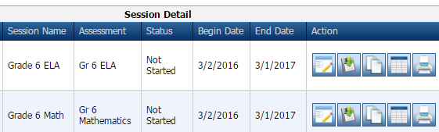
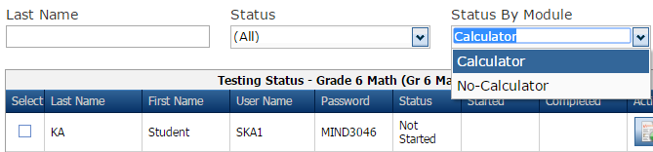
Online Testing
Preparation – SC READY
Printing rosters and test tickets for sections
(ELA Session 1/ ELA Session 2 and Calculator / No-Calculator)
Search for the session. You may print rosters and tickets for both ELA Session 1 and ELA Session 2 (and the Calculator and No-Calculator Sections for mathematics) by clicking on the print icon.
If you want to print rosters and test tickets for only one section, search for the session. Then, select the Edit/Print Ticket Status icon.
Then, search/filter by Module as shown here.
Notes:
You can search and print the separate test tickets for ELA Session 1 and Session 2, as well as for grades 6-8 math Calculator and No Calculator sections.

Slide 45
Online Testing
Accommodations
Online Accommodation
Oral Administration* Human Voice Audio (HVA) for directions and items (same as audio CD-ROM) Text-to-Speech (TTS) for tools and Help content Schools must provide headphones
Oral Administration + Large-Print
Large-Print Fully scalable; students can view items in larger format by testing at workstation with larger monitor Text and graphics approximately 30% larger, depending on monitor size and screen resolution
If ESOL – Oral Administration is checked for a student, the Online – Oral Administration accommodation must also be checked to turn on the audio/HVA feature in DRC INSIGHT.
Oral Administration is not available for students testing ELA grade 3.
*Oral Administration for ELA Session 1 or Session 2 can be indicated in Test Setup.
This does not change the functionality of DRC INSIGHT, but helps the TA know which ELA session the student should have the accommodation.

Slide 46
Online Testing
Accommodations
Online Accommodation
Sign Language
Sign Language + Signed Administration Sign language form with Video Sign Language (VSL) for directions and items
Oral/Signed Administration is not available for students testing ELA grade 3.

Slide 47
Online Testing
Rosters
Testing Rosters:
  Contain form number, username/password, and accommodations assigned to each student
  Are used for signing out/in secure test tickets and creating seating charts
  Should not be transmitted via email or non-secure fax
  Should be treated as a secure material; they must be accounted for at all times and securely destroyed after testing
Notes:
Student Test Rosters contain the form number and username/password assigned to each student. These rosters can be exported to Excel and can be used to create seating charts and/or custom-sized test tickets. Test rosters can also be used as security checklists to sign in/sign out student test tickets.
Student Test Rosters are secure materials. They should be distributed, collected, accounted for, and securely destroyed following testing.

Slide 48
Online Testing
Test Tickets
Student Test Tickets
  Contain username and password needed for students to login to an online test
  Contain the Form Number for students utilizing ELA Passage Booklets
  TAs should verify that each student has the correct ticket by carefully following the administration directions
  Should not be transmitted via email or non-secure fax
  Should be treated as a secure material; they must be accounted for at all times and securely destroyed after testing
  Separate test tickets are provided for:
    ELA Field Test
    ELA Session 1
    ELA Session 2
    Mathematics (separate tickets provided for grades 6-8 calculator and no-calculator sections)
    Science
    Social Studies
Notes:
Student Test Tickets are automatically generated for students in test sessions. The tickets will contain all of the login information needed to begin the test.
Test tickets also contain the Form Number for students utilizing ELA Passage Booklets.
STCs or TAs will print the tickets and roster prior to the testing session. TAs should hand out test tickets to students immediately before testing begins, and should verify each student has their correct ticket. Students will have one ticket per subject they are testing.
There is one test ticket per session for ELA (Session 1 and Session 2) and 1 per section for grades 6-8 math (calculator/no calculator).
Tests are activated once a student logs in with the username and password provided on their ticket.
Student Test Tickets are secure. They must be distributed, collected and accounted for each day of testing, and securely destroyed following testing.

Slide 49
Online Testing
Regenerating a Test
Automated Process
  If a student’s accommodations are updated, the test ticket will be updated automatically, if needed.
  eDIRECT message will notify user if a new test ticket needs to be printed.
  If accommodations are updated for a student who has started testing,
  the ticket will not automatically regenerate. Refer to the information found on pages 19 and B-3 of the TAM for instructions on how to proceed.
Notes:
If a student’s accommodations are updated, the test ticket will now be automatically updated, if needed. An eDIRECT message will display to tell the user if a new ticket needs to be printed.
If accommodations are updated for a student who has started testing the ticket will not automatically regenerate. STCs should contact the DTC for any students who start testing without the appropriate accommodations.

Slide 50
Online Testing
Restarting a Test
Students can “Pause” their own test; they have 20 minutes to resume testing. A test can also automatically end due to inactivity (fire drill, etc.)
  If student does not return within 20 minutes, they can log in later that same day using the same test ticket.
  Student responses, sticky notes, highlighters, and flags, will be saved.
Notes:
Students can “Pause” their tests and then have 20 minutes to resume testing. If a student does not return within 20 minutes, the student can log in later the same day using the same test ticket.
If a test is exited due to inactivity, the student can log in later the same day using the same test ticket.
It is critical for the TA to know of the student’s whereabouts during the period when he or she was not testing and know if the student had access to resources such as the Internet, books, or if they had an opportunity to talk to others. The TA, perhaps with STC, DTC, and even SCDE involvement, will need to determine whether the student should be allowed to continue testing, or if allowing the student to continue constitutes a security violation.
If a student is allowed to return to testing, all of their answers, sticky notes, highlighters, and flags will be saved for the next time they log in.

Slide 51
Online Testing
Restarting a Test, cont.
Follow the instructions included in the chart on page B-3 of the TAM for handling the following testing scenarios:
  A student does not have enough time to complete testing.
  A student does not finish testing because of illness or internet/power outage.
  A student “Submits” a test by accident.
  A student begins testing, but is missing accommodations.
Notes:
If the student does not resume testing the same day, or if the student submits a test by mistake, contact the DTC.

Slide 52
Paper/Pencil Testing

Slide 53
Security Checklists
Security Checklists
  Electronic format only; available on eDIRECT
  Posted by April 9
  Used to track and monitor receipt and distribution of
  secure paper/pencil test materials & ELA Passage Booklets for Online Testers, and Large Print Supplements for Online and Paper Testers
    STCs and TAs sign out and sign in all secure test materials
    Record notes, as needed
    Record any additional material orders
    Indicate date materials were packaged to return
  Options for returning after testing:
    Via hard copy (in school boxes of nonscorable materials)
    Electronically via email (from STCs to DTCs, and from DTC to SC Project Team)
    Electronically posted to SFTP site (instructions on eDIRECT)
Notes:
District and school security checklists will be available in electronic format only. The STC will send the completed security checklist (in Excel format) to the DTC via email attachment. The electronic checklists can also be sorted, printed, and returned in the nonscorable boxes.
The electronic files will be posted to eDIRECT by April 9.
Additional instructions for use and return of the electronic security checklists can be found in the TAM and also on eDIRECT.

Slide 54
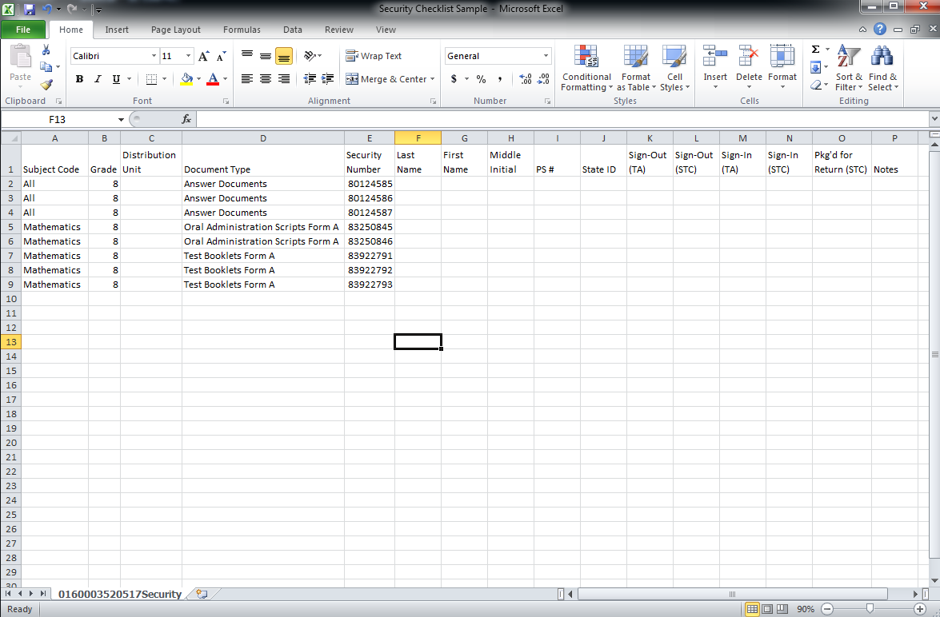
Security Checklists
There is additional information regarding the security checklists available on eDIRECT under Documents.
Notes:
Here is an example of a security checklist that has been saved as an Excel spreadsheet. The electronic checklists may be sorted or printed as needed by each school.

Slide 55
Paper/Pencil
Inventory Materials
Retain original shipping boxes
District Boxes: White
School Boxes: Brown
Verify materials received
Refer to packing lists
Compare security numbers on range sheets to security checklists
Record any missing material
Use “Notes” column on electronic security checklists
Email discrepancies to DRC
Notes:
The STC is responsible for the security of all test materials. Schools and districts will be held responsible for missing materials so it is important that inventory control measures are implemented to keep track of materials received, returned, and those signed out to TAs. It is a violation of S.C. Code Annotated Section 59-1-445 (2004) to “(e) Fail to follow security regulations for distribution and return of secure test [materials] as directed, or fail to account for all secure test materials before, during, and after testing.”
STCs must inventory the school’s test materials to ensure that all materials listed on the packing lists are present. Also, the STC should compare the security numbers on the range sheets with the numbers listed on the School Security Checklists. Make a note on the security checklist of any missing materials. Inform the DTC of any missing or damaged materials.

Slide 56
Paper/Pencil Additional Materials
Consider whether any materials can be reused before ordering additional materials.
  Oral administration scripts and audio CD-ROMs may be reused.
Use the Intra-district Transfer Form to transfer materials between schools in your district.
  Use this form before placing an additional materials order.
  Note the transfer on electronic security checklist.
  Form is available on eDIRECT under General Information—Documents.
If additional materials are required, submit orders via eDIRECT
  All Applications—Materials—Additional Materials
  Orders received before 4:00 pm Eastern time will be processed on the same day and shipped via overnight delivery.
Notes:
The STC should check the quantities of materials received to ensure there are sufficient materials for students scheduled to take the tests. Contact the DTC to place orders for additional materials. When additional materials are received, they must be recorded on the Security Checklist.

Slide 57
Paper/Pencil Answer Documents
Answer Documents
  SC READY (combined) document for both ELA & Mathematics, except for grade 3 (separate for ELA and Mathematics)
  SCPASS separate documents for Science and Social Studies
  Preprinted with student name, based on January precode file
  Packaged by grade and distribution unit
  Used for all test booklets
Notes:
Answer Documents for both SC READY and SCPASS are preprinted with student name, based on January precode file, and packaged by grade and precode sort information (home room or materials sort field).

Slide 58
Paper/Pencil Materials
Test booklet
  All subjects have one form per grade level
  All items have been reviewed for use by students who are blind or visually impaired and students who are deaf or hearing impaired (no separate Form A & C)
Notes:
You may notice a graphic (or icon) next to the name of the test booklet. This icon (e.g., a book for ELA) is used to help the students match the test booklets to the corresponding section in their answer document.

Slide 59
Paper/Pencil Materials
Loose-Leaf (LL)
  Single-sided pages bound in a 3-ring binder for each subject
  One item per page
  Preprinted answer documents are provided separately
Large-Print (LP)
  Digitally enlarged to a finish size of 13 x 18 with approximately
  19-point font
  TA Notes
  LP Supplement
  ELA – TDA response pages for final drafts
  Preprinted answer documents are provided separately
  Student marks or writes all answers in large-print booklet;
  the TA must transcribe responses (including the TDA) into the answer document
  The new, larger booklet size should be considered when planning, e.g., for larger desks, room setup, and seating arrangements.
Notes:
Loose-leaf test booklets are printed single-sided, one item per page, and placed in 3-ring binders.
Everything a student needs for using a loose-leaf test booklet is packaged together except the answer document.
For all subjects, students record their responses in their scannable answer documents.
Large-print test booklets are enlarged versions of the test booklet. Large-print test booklets are spiral bound.
Everything a student needs for using a large-print test booklet is packaged together except the answer document. For all subjects, the large-print package includes test administrator (TA) notes and the large-print test booklet.
Students mark or write all answers in the large-print test booklet. A TA must transcribe the student’s responses into the student’s answer document.
See Appendix C in the TAM for more information.

Slide 60
Paper/Pencil Oral Administration
Oral Administration Script (OAS)
  Produced for all grades in math, science, and social studies and grades 4-8 for ELA
Audio CD-ROMs
  Produced for all grades in math, science, and social studies and grades 4-8 for ELA
  For use with a computer (paper/pencil test booklet needed)
  Can be used for make-up testing
  Expires the day after the last day of make-up testing, June 9 Note: All oral administrations must begin with the Paper/Pencil Administration Directions in the ADM.
Notes:
Audio CD-ROMs are produced for all grades in math, science, and social studies and grade 4-8 for ELA. These CD-ROMs will expire on the day after the last day of testing. The CD-ROMs can be used for make-up testing.
Oral Administration Scripts (OASs) are produced for all grades in math, science, social studies, and grades 4-8 for ELA.
CD-ROMs and Form A OASs can be used with all test booklets, including form types LL and LP.

Slide 61
Paper/Pencil Materials—BR and SL
Braille (BR)
  Test booklet
  Print version of test booklet
  TA Notes
  Preprinted answer documents are provided separately
  TA must transcribe all responses into the answer document
    Brailled TDA response may be returned and transcribed by vendor
Sign Language
  No separate sign language test booklet; all items in regular test booklet have been reviewed.
Signed Administration Script (SAS)
  Produced for all grades in math, science, and social studies and grades 4-8 for ELA for use a test booklet
  Used for Pidgin Signed English (PSE), Signed Exact English (SEE), and American Sign Language (ASL) administrations
  Note: All oral and signed administrations must begin with the Paper/Pencil Administration Directions in the ADM.
Notes:
The Braille package will include a Braille test booklet, a print version of the test booklet, and TA Notes indicating changes between the Braille and print versions and the use of tactile graphics.
Scannable answer documents are provided separately.
Braille OASs are no longer produced. A student who needs an oral accommodation with a braille accommodation can utilize the regular Oral Administration Script.
Students will answer items in the Braille test using a Braillewriter or other method. TAs must transcribe all multiple-choice responses into a scannable answer document. Brailled TDA responses for SC READY may be returned and transcribed by the vendor.
Signed Administration Scripts are produced for all grades in math, science, and social studies, and grades 4-8 ELA. These scripts can be used for Pidgin Signed English, Signed Exact English, and American Sign Language (ASL) administrations.
SL DVDs are no longer produced.
Please note that all oral and signed administrations must begin with the administration directions in the ADM. The ADM directions will instruct the TA when to begin using the script.
See Appendix C in the TAM for more information.

Slide 62
Paper/Pencil Testing –
Answer Document Labels
  Answer documents must have pre-printed information or a label applied in order to be scored.
  The various types of labels available will be reviewed on the following slides.

Slide 63
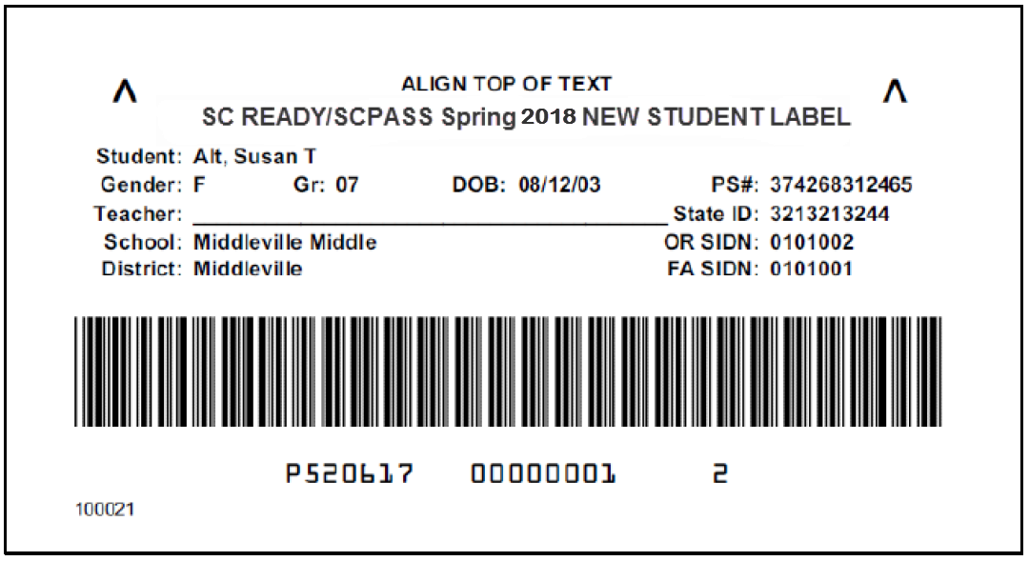
Paper/Pencil New Student Labels
  Contain preprinted information for new students from the March Precode Update file and for students whose online testing designation has changed to paper/pencil
  Contain student identification information
  Printed 10 pink-striped labels per sheet
Notes:
New student labels are produced for students who were not included in the January precode file, but appeared on the March update precode file and for students whose online testing designation has changed to paper/pencil. Student information is preprinted on the labels.
Each sheet contains pink-striped labels with preprinted information for up to ten students.
The labels for SC READY and SCPASS will appear the same, so any label can be used on any answer document.

Slide 64
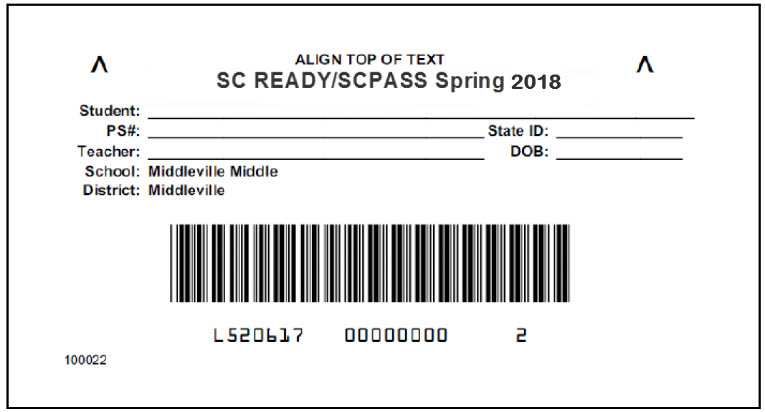
Paper/Pencil Override Labels
  For any student without a preprinted answer document or
  new student precode label
  For answer documents with incorrect information
  Student information must be written on spaces provided
    Coding student name and applicable demographic information is mandatory on the answer document
  Printed 10 white labels per sheet
Notes:
If you do not have a preprinted answer document or new student label for a student, or if a student’s information is no longer accurate or applicable, then an override label should be used to identify the student’s answer document. Each override label sheet contains labels for ten answer documents.
Before applying an override label, clearly print the student’s name, student PowerSchool number, student state ID, date of birth (DOB), and the teacher’s name on the label.
If you use an override label, the answer document is not considered precoded, and therefore, some handcoding will be required on the front cover and on pages 2 or 3 of the answer document.

Slide 65
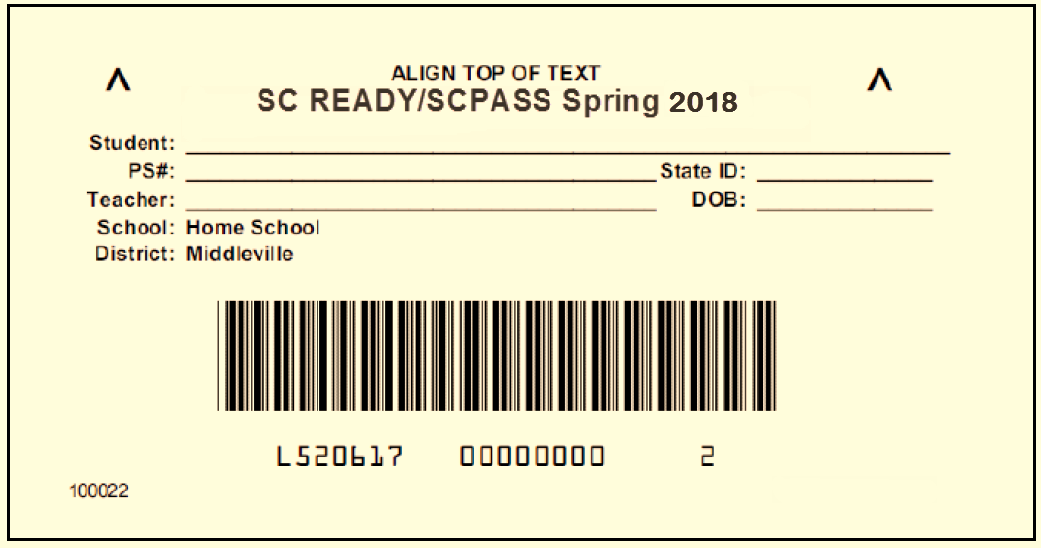
Paper/Pencil Home School Override Labels
  Function similar to override labels
  Packaged in district boxes
  Printed 10 ivory labels per sheet
Notes:
This is a sample of the home school override label.

Slide 66
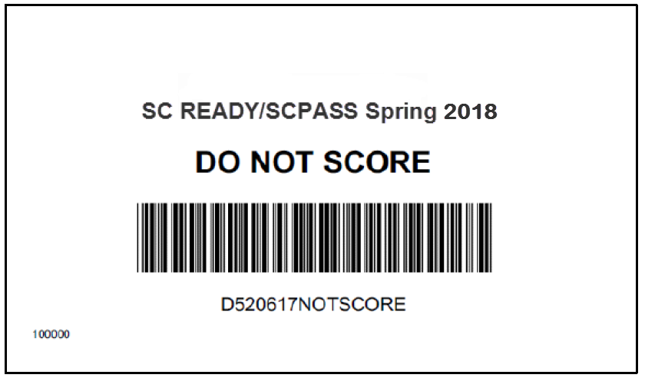
Paper/Pencil Do Not Score Labels
  Apply to preprinted, used, or mislabeled answer documents that DRC should not score
  Printed 10 tan labels per sheet
  Do not place labels on any answer documents with
  the IEP Invalidation bubble marked
  Not needed on unused overage answer documents
Notes:
A Do Not Score label must be applied to any preprinted, used, or mislabeled answer document that should not be scored.
Do not hand-write “Do Not Score” on answer documents. Use a label to indicate that an answer document should not be scored.
Remember that unused, overage answer documents do not need to have a Do Not Score label applied to them. Also, do not put a Do Not Score label on an answer document that has the IEP invalidation bubble marked for any test.
Shrinkwrapped packages do not need to be opened if they are not needed. Send shrinkwrapped packages back to the contractor as is.

Slide 67
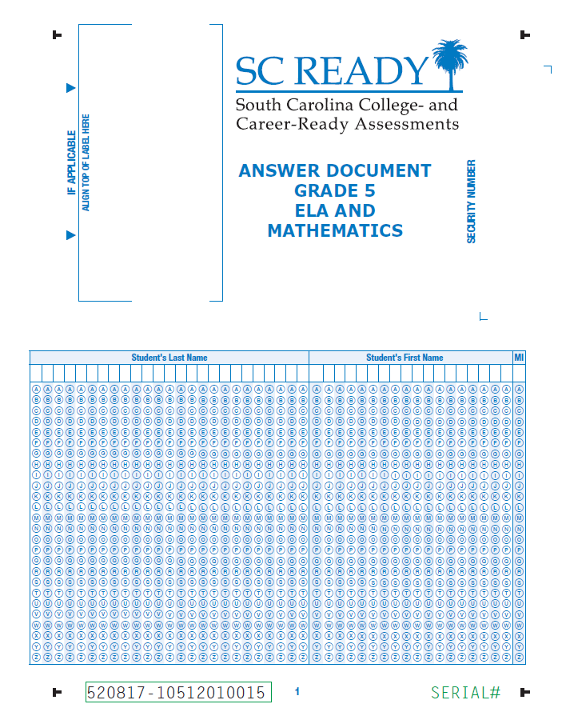
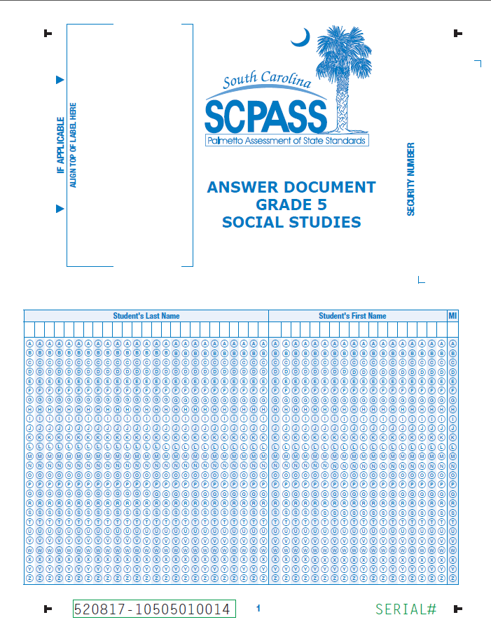
Paper/Pencil
Answer Documents
Notes:
On the left is an example of the front cover of the SC READY answer document and on the right is the front cover of the SCPASS answer document.

Slide 68
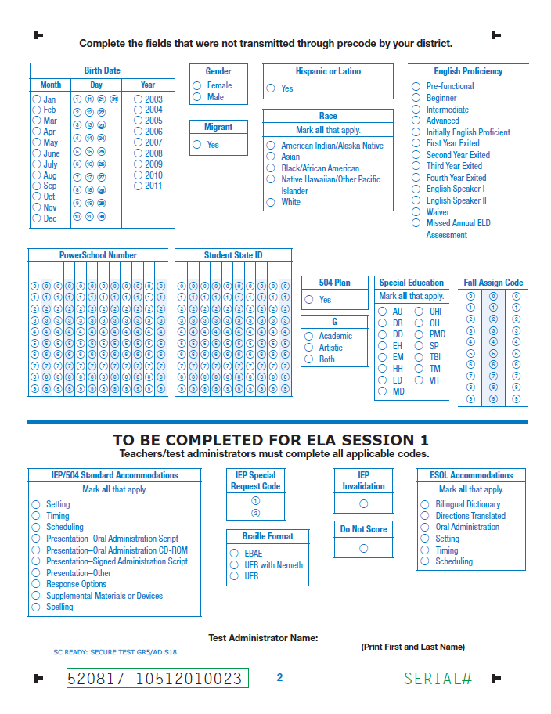
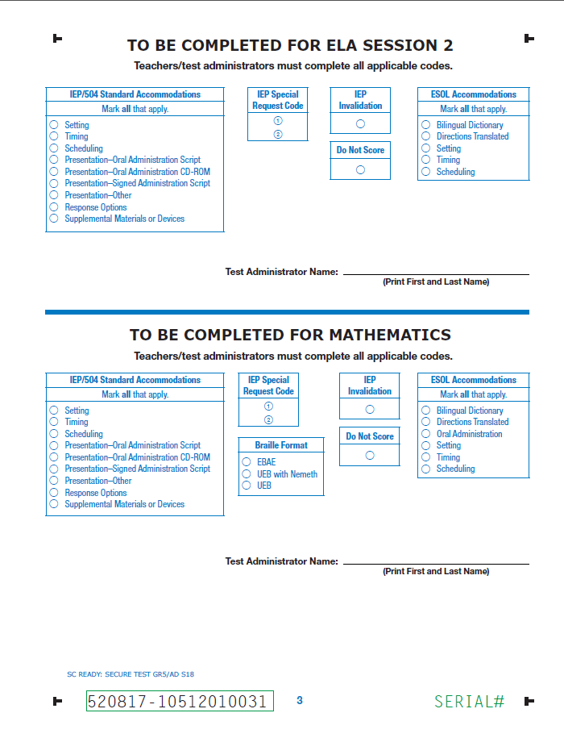
Paper/Pencil
Answer Documents – Samples in TAM
Notes:
This shows pages 2 & 3 of the SC READY answer document.

Slide 69
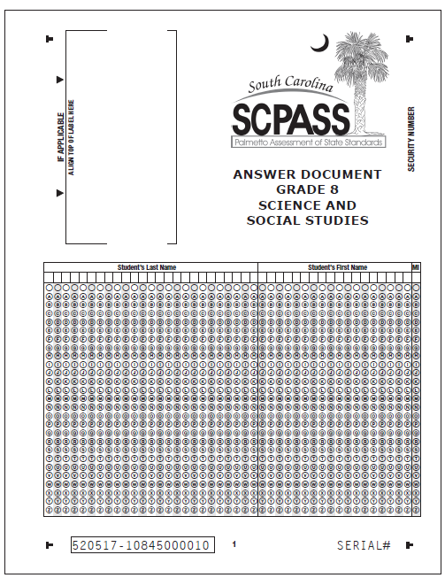
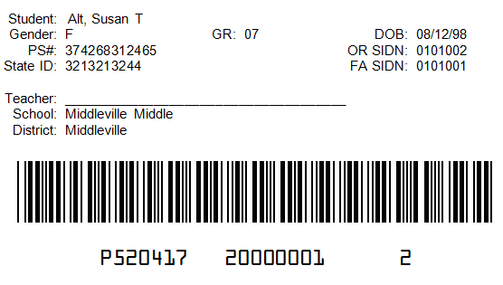
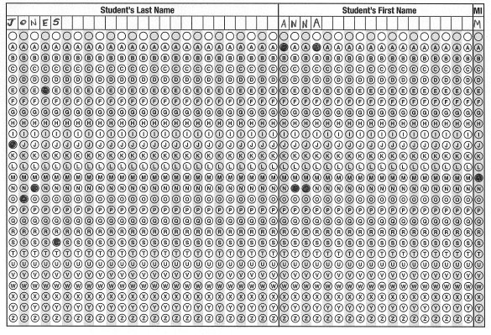
Paper/Pencil
Coding Answer Documents—Precoded*
Sample of preprinted data
Handcoding student name
is optional for precoded answer documents, but is recommended.
*Precoded documents are preprinted or have a new student precode label applied.
Notes:
Precoded means that student information is preprinted on the answer document, or a new student label has been used.
This is a sample of a preprinted label applied to an answer document.
Handcoding the student name is optional, but recommended. Handcoding the student name serves as a secondary method for ensuring that the student whose name is pre-printed on the answer document is the person who actually took the test.

Slide 70
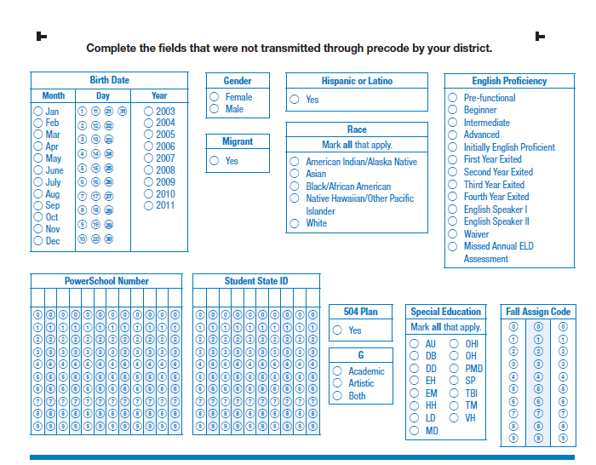
Paper/Pencil
Coding Answer Documents—Precoded
Code any fields not submitted via precode.
Notes:
These fields appear on page 2 of the answer document. The information for these fields could have been submitted through precode. Any information not submitted via precode by your district should be handcoded in this section of the answer document.

Slide 71
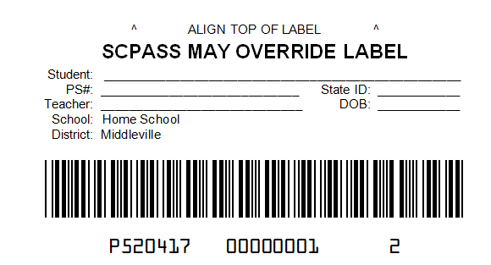
Paper/Pencil
Coding Answer Documents—Non-Precoded
Write information on override label and apply to designated area.
Anna Jones
Jason Smith
9/20/99
Handcoding student name is mandatory for non-precoded answer documents.
Notes:
A document is considered non-precoded if override labels are used.
This is an example of an answer document with an override label.
Make sure to write the applicable information on the label in the blank spaces provided.
Handcoding the student name is mandatory on answer documents that use override labels.

Slide 72
Paper/Pencil
Coding Answer Documents—Non-Precoded
Code all applicable fields.
Notes:
All applicable fields in this section of page 2 of the answer document must be hand-coded if an override label is used.

Slide 73
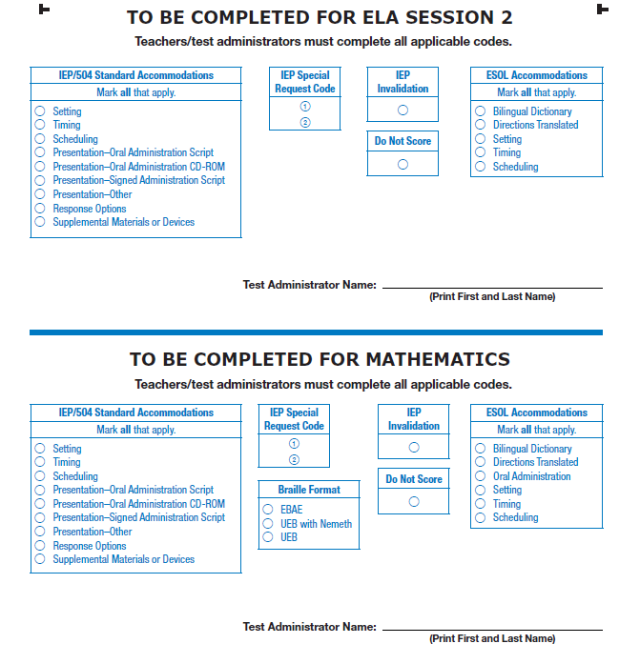
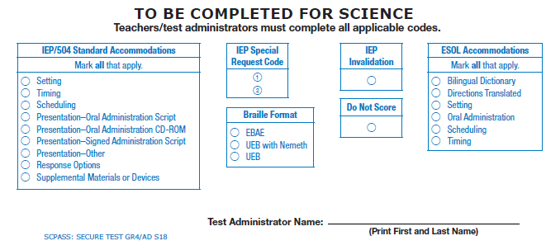
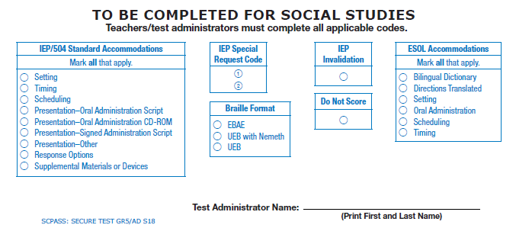
Paper/Pencil
Coding Answer Documents
Code all applicable fields, per subject.
Test Administrator name must be printed on line for each subject.
Notes:
Applicable fields must be hand-coded.
Please note that the Test Administrator name must be printed on the line for each subject.

Slide 74
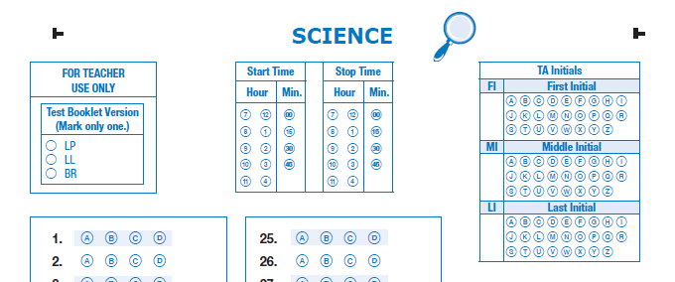
Paper/Pencil
Coding Answer Documents
NEW: Test Booklet Version should be coded correctly for reporting purposes.
Students bubble the first, middle, and last initial of the test administrator (TA) for each subject.
Notes:
The student’s test booklet version must be coded on the student’s answer document.
Instructions for coding the test booklet version are included in the administration directions found in the ADM.
The TA’s initials should also be coded for each subject in the answer document.

Slide 75
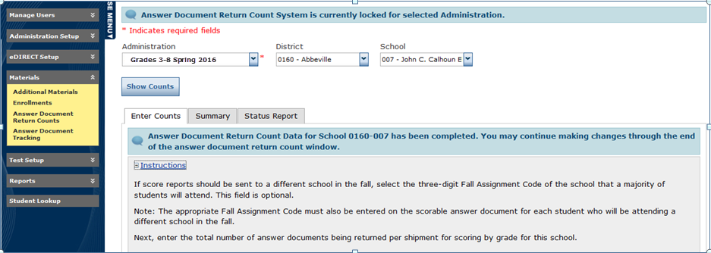
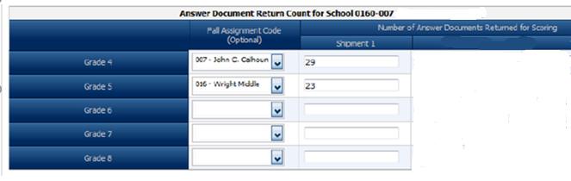
Paper/Pencil
Answer Document Return Form (ADRF)
The ADRF is used to indicate the number of answer documents being returned.
Enter the quantity of answer documents for return.
Complete Fall Assignment info,
if necessary.
There will be also be a separate row for grade 3 math.
Notes:
The Answer Document Return Form (ADRF) is used to indicate the number of answer documents being returned. The ADRF is used to compare the number of scorable materials that were indicated as returned by your school against the number of scorable materials actually received by the contractor.
In addition, the ADRF includes fall assignment information. Fall assignment information on the electronic ADRF allows schools to designate that they would like score reports for a grade of students to be sent to the school students will be attending in the fall, if different from where the students tested.
Fall assignment can be designated via precode, test setup, the electronic ADRF, or on an individual student answer document.

Slide 76
Paper/Pencil
Fall Assignment
VALUE If coded as this, then…. |  |  |  |  | FINAL VALUE reported as this
Precode | ADRF | Student’s Answer Doc | Online |  | Test School’s ID | Precode | ADRF | Student’s Answer Doc | Online
 |  |  |  |  | 
 |  |  |  |  |  |  |  | 
 |  |  |  |  |  |  | 
 |  |  |  |  |  |  |  | 
 |  |  |  |  |  | 
 |  |  |  |  |  |  |  | 
 |  |  |  |  |  |  | 
 |  |  |  |  |  |  |  | 
 |  |  |  |  |  |  |  |  | 
Notes:
Since fall assignment information can come from 4 sources, a set of override rules has been established to determine the “final value” used for reporting. Fall assignment on the electronic ADRF overrides precode information. Fall assignment coded on the answer document overrides information on the electronic ADRF. And fall assignment coded in test setup overrides all other sources.
This Fall Assignment Data Grid displays how the override rules work. In the top example, fall assignment was not provided via precode, the electronic ADRF, or the student’s answer document. In this case, student scores would be reported to/for the tested school.
In the final example, fall assignment was provided via precode, the electronic ADRF, the student’s answer document and populated in test setup. The fall assignment information in test setup would be used for as the final value for reporting purposes.

Slide 77
Paper/Pencil
STC Return Procedures
  Read and follow return procedures in TAM.
  Confirm all scorable answer documents have preprinted information or a label applied.
  Confirm that student name is bubbled on all non-precoded answer documents.
  For SC READY: Ensure that accommodations on pages 2 and 3, as well as Test Booklet Version and TA Initials on subsequent pages, have been accurately bubbled.
  For SCPASS: Ensure that accommodations on page 2—as well as Test Booklet Version and TA Initials on page 3 have been accurately bubbled.
Notes:
Return procedures are provided in the TAM and Materials Receipt and Return Supplement for ship-to sites.
Verify that all answer documents to be scored have either preprinted information or an appropriate (new student or override) label applied.
Make sure that accommodation codes have been completed for students with IEPs or 504 Plans and for ESOL/LEP students.
Also make sure that the test booklet version and TA initials were accurately bubbled on the answer document.

Slide 78
Paper/Pencil
STC Return Procedures
Do Not Score Labels
Place on any unused preprinted answer documents or used answer documents that should not be scored.
Security Checklists
Use security checklists located on eDIRECT and return via email or SFTP site to DTC.
(If security checklists were printed and used, return in nonscorable
boxes.)
Seating Chart
Return seating charts via paper (in nonscorable boxes) or send via email/SFTP site to DTC.
ADRF
Complete ADRF on eDIRECT.
Notes:
Place Do Not Score labels on any unused preprinted answer documents or used answer documents that are not to be scored.
Complete the electronic Answer Document Return Form on eDIRECT.
TAs will create a seating chart for each test session.
It is essential that you use the electronic security checklists to verify the change of custody for all secure test materials.

Slide 79
Paper/Pencil
Materials Return—Braille
Return answer documents for Braille with scorable materials (except as noted for ELA below).
Return all other Braille materials in the plastic bag
and place with nonscorable materials.
If transcription is needed for TDA response, return all ELA Braille materials for student together in plastic bag in the scorable box.
Notes:
Answer documents for students using Braille materials should be returned with scorable materials (except as noted for ELA). The remaining Braille materials (including Braille test booklets, TA Notes, and ancillary materials) should be sealed in the original plastic bag and returned in a nonscorable box.
If transcription is needed for the TDA response, return all ELA Braille materials for the student together in the plastic bag in the scorable box.

Slide 80
Paper/Pencil
Materials Return
Materials will be returned via UPS.
  For Grade 3 reading accelerated reporting: Return deadline is Tuesday, May 22; call UPS to arrange pickup (if not already scheduled) by Friday, May 18.
  SC READY and SCPASS Material: As testing is complete; return deadline is June 12.
Notes:
SC READY Grade 3 ELA answer documents will be picked up no later than May 22.
Scorable materials include all scorable answer documents, including answer documents for students testing with Braille materials. Grades and subjects may be mixed within the boxes.
Nonscorable materials include all used test booklets and customized materials that are no longer needed for testing. Check these test booklets to ensure that scorable answer documents have not been placed inside of these booklets.
Place all scorable materials in separate boxes from nonscorable materials.

Slide 81
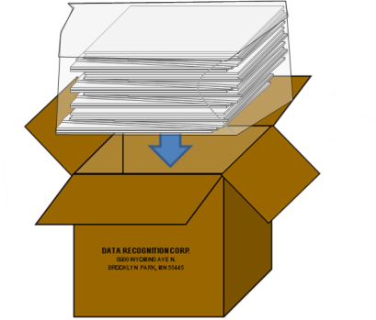
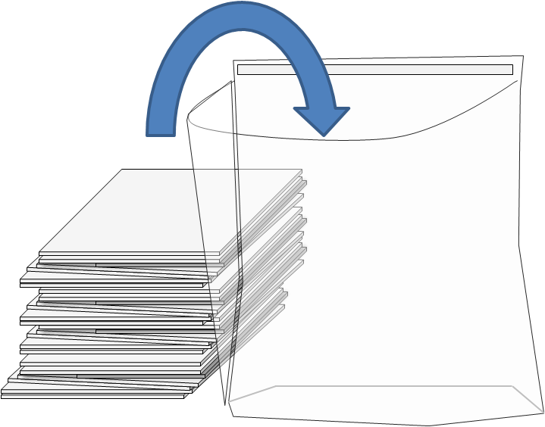
Paper/Pencil
Packaging Procedures
Place all scorable
test materials in
plastic return bags provided by DRC.
Seal the bags tightly and place in scorable boxes.
Notes:
Place all SCORABLE test materials in the plastic return bags. Seal the bags tightly, and place them in the SCORABLE boxes.

Slide 82
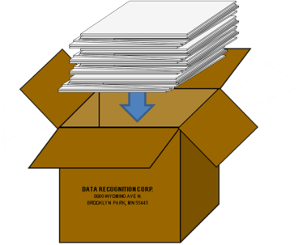
Paper/Pencil
Packaging Procedures
Place all nonscorable test materials in nonscorable boxes (plastic bags are not needed for nonscorable materials).
Notes:
Place all nonscorable test materials in the nonscorable boxes. No plastic bags are provided for nonscorable materials.

Slide 83
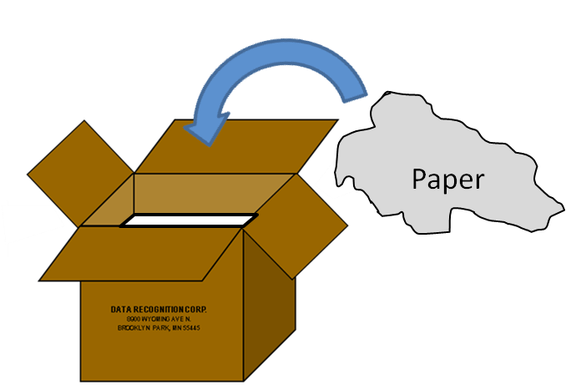
Paper/Pencil
Packaging Procedures
Fill any empty space in each box with crumpled paper or bubble wrap
to ensure that testing materials do not shift during transit.
Fill any voids to the top of the box.
Notes:
Fill any empty space in the box(es)with crumpled paper or bubble wrap to ensure that testing material does not shift during transit. Make sure you fill voids to the top of the box.

Slide 84
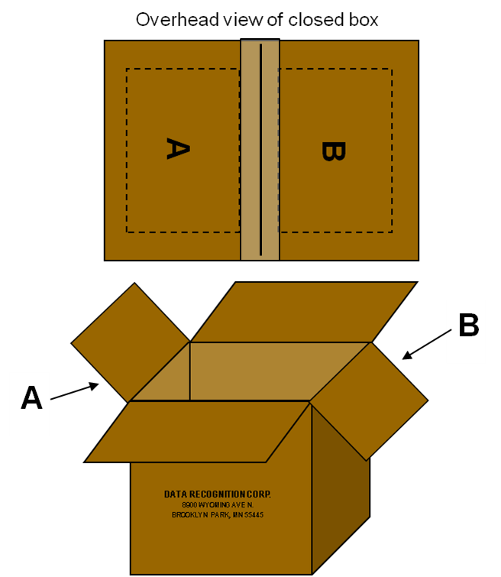

Paper/Pencil
Packaging Procedures
Fold in the outer flaps (with old shipping labels), exposing the A & B flaps.
Notes:
Fold in the outer flaps (with the old shipping labels), exposing the A & B flaps.

Slide 85


Paper/Pencil
Packaging Procedures
Tape boxes securely
using three pieces of packaging tape on
BOTH the top and the bottom.
Overlap the tape, and
make sure it wraps around
the sides at least two inches.
Notes:
Tape boxes securely using three pieces of packaging tape on both the top and bottom of the boxes. Overlap the tape, and make sure it wraps around the sides at least two inches.

Slide 86
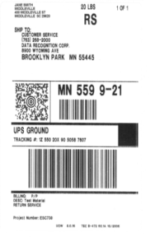
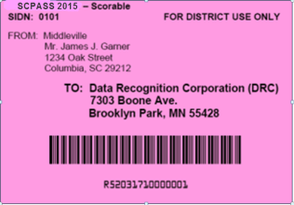

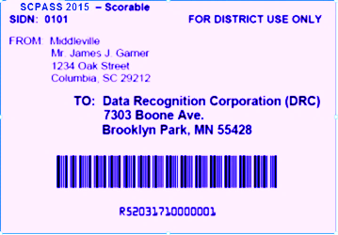
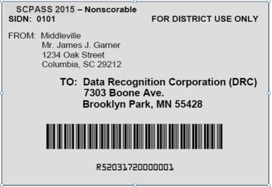

Paper/Pencil
Packaging Procedures
Place appropriate colored DRC label on Flap A (orange for grade 3 ELA, pink for scorable, and white for nonscorable.)
Overhead view of closed box
Place the UPS-RS label on Flap B (NDA for scorable, Ground for nonscorable.)
Notes:
Place the appropriate colored DRC label on Flap A.
Place the UPS-RS label on Flab B. Be sure to retain the tear-off portion of the UPS-RS label for your records.

