Slide 1

The Evaluator's Role in the SLO Process
Presented in cooperation with the SCDE Offices of Teacher Evaluation, Office of School Leadership and TAP
Day 2

Slide 2
Think of a time that you tried something new….
Was it a successful experience? Or was it a frustrating experience?
What contributed to the success or failure of the experience?

Slide 3

Group Norms
Be present (physically and mentally)
Please use electronic devices responsibly
Ask questions when in doubt
Honor the time schedule
Participate actively

Slide 4
Overarching Objectives
Develop an understanding of SLOs and their role in the Expanded ADEPT Support and Evaluation System
Become proficient in evaluating SLO components to ensure successful implementation
Identify methods to support teachers in the development and monitoring of SLOs
Identify resources to facilitate the evaluation of SLOs at the school level

Slide 5
Agenda Overview
Evaluating the SLO
Assessment, Content, and Rigor Review
SLO Readiness Tool
Managing SLO Data (Enrich VC3)
Coaching Conversations
Case Study: Beginning of the Year Mid Course Conference End of Year
Next Steps

Slide 6

The Quality Review Tool
Evaluating a SLO for quality

Slide 7
The Quality Review Tool
The Learning Goal
Assessment and Scoring
Targets

Slide 8
Ratings
Acceptable Quality
Appropriately identifies and thoroughly describes/explains
Quality Needs Improvement
Generally or broadly identifies
Insufficient Quality
Vague, unessential, confusing, insufficient

Slide 9
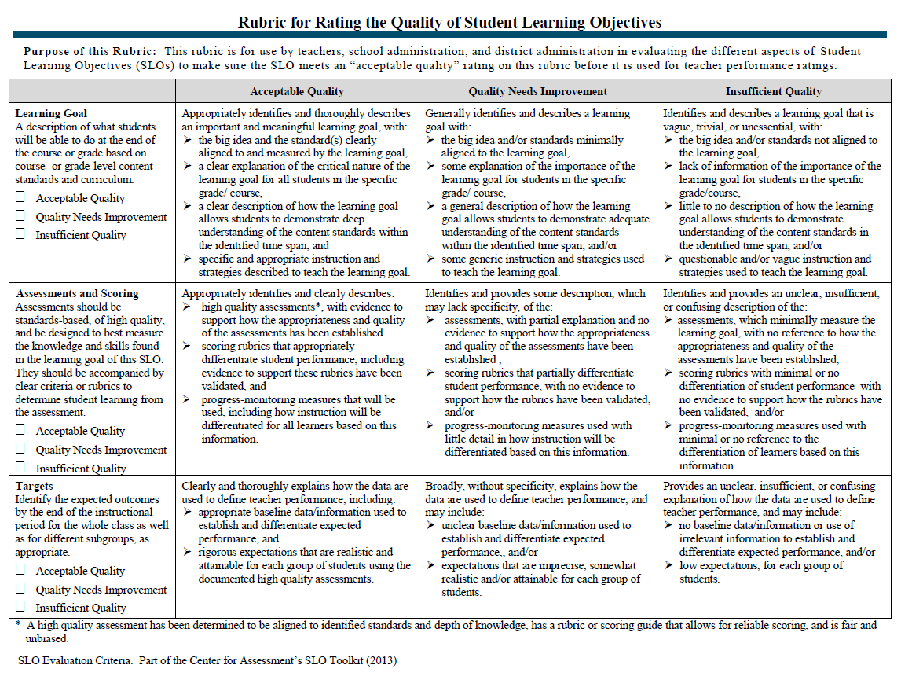
The Quality Review Tool

Slide 10
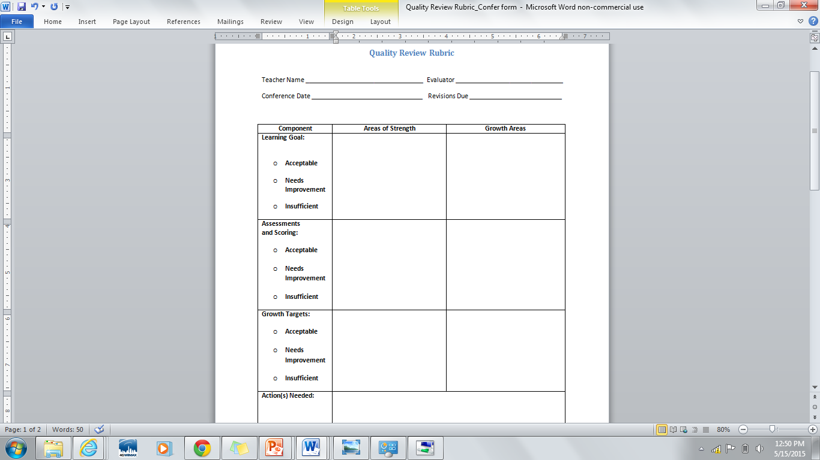
Quality Review Conference Form

Slide 11
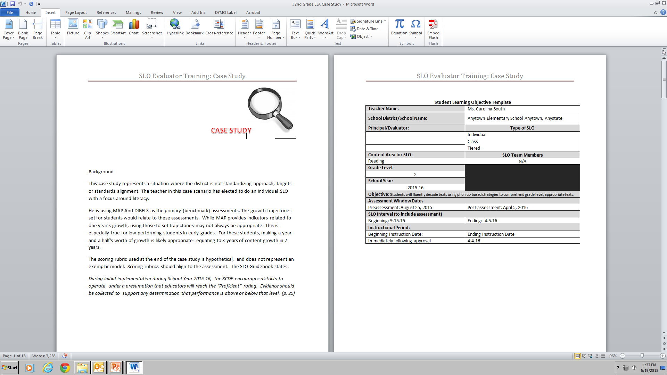
Grade 2 SLO Case Study

Slide 12
Case Study Activity
Task:
Use the Quality Review Rubric to evaluate the quality of the 2nd Grade SLO example. Be sure to rate the SLO in all three categories.
Identify areas of strength and areas of potential growth in the SLO. Use the Quality Review Conference Form to record your findings.

Slide 13
Assessment and Rigor Review

Slide 14
Assessments
Measure what students are expected to learn in a course over time
Indicate the degree to which a teacher has impacted his or her students’ learning
Must be pre-approved through preliminary conference

Slide 15
Best Practice: Use 2 – 3 assessment sources
One assessment is unlikely to paint an adequate picture of student learning
Yield more meaningful, valid, and reliable information

Slide 16
State Standardized Assessments
Common Assessments
Teacher-Created Assessments
District Standardized Assessments

Slide 17
Determining
Assessment
Strength
Valid
Timely
Stretch
Reliable
Comparable
Rigorous

Slide 18
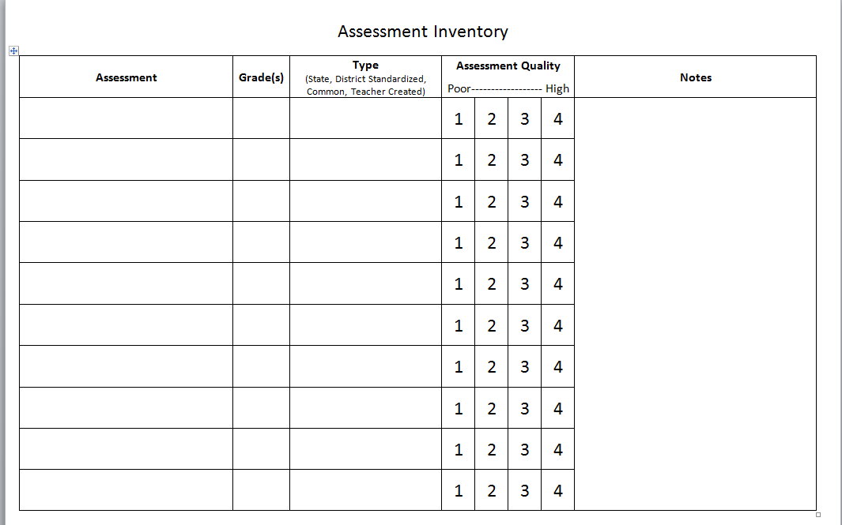
Assessment Inventory Activity
Work with your table group to complete the assessment inventory chart.
Discuss the following questions with your teams:
What content area(s) and/or grade(s) need improvement in assessment quality?
Which teacher leaders can assist with the development of common assessments, if needed, for your district?
What are your district’s next steps with assessments?

Slide 19
Rigor
Setting Appropriate Growth Targets

Slide 20
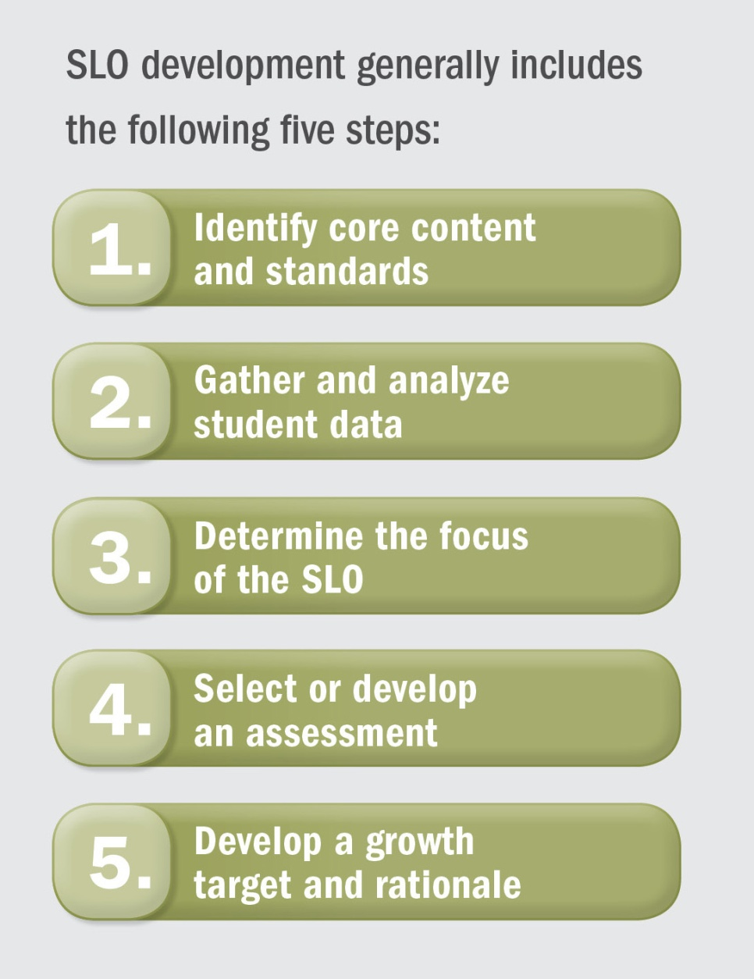
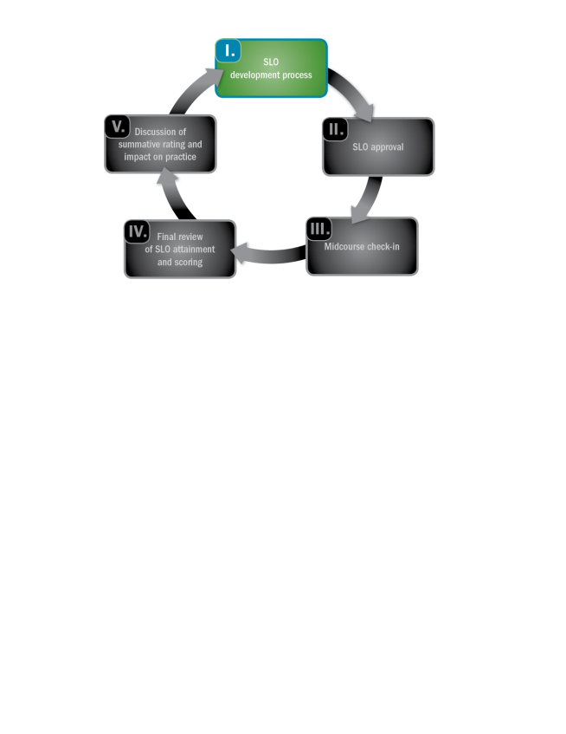
SLO Development Process
Notes:
.

Slide 21
Qualities of Growth Targets
Set to measure an increase between two points in time
Are rigorous and attainable
Informed by baseline and trend data
Stretches ALL students

Slide 22
Examine the Data
Pretests (course content)
Scores from previous similar content
Data collected over time
Additional historical data

Slide 23
Types of Growth Targets
Tiered Growth Targets | Targeted Growth Targets | Individual Growth Targets
Appropriate for the class approach to SLOs, tiered growth targets include all students but at varying degrees of expected growth. | Sub population(s) of students are the focus of the SLO goal. Appropriate for course approach as a second SLO when the first includes all students. | Appropriate for use in class or course SLOs. All students have individualized growth targets based on previous performance and expectations.

Slide 24
Possible Contextual Factors
Learning disabilities or conditions
Behavioral conditions
Student health and home conditions (i.e. transient or managing long-term health challenges)
Note: It is important to consider
Students’ past performance data
The extent to which these factors may impact student growth
What types of interventions or supports are in place and their effectiveness

Slide 25
Process for Setting Growth Targets
Set Initial Growth Targets
What growth have students made in previous years?
Adjust Growth Targets
Are there contextual factors that are likely to affect students’ growth in positive or negative ways?
Review Targets
Are these targets rigorous and attainable?
What is the minimum score at which students can be “proficient”? Does the initial growth target allow students to make meaningful progress towards proficiency?
Are these factors reflected in students’ previous growth or are they new?
What growth have students with similar factors made in the past?

Slide 26
Teacher Considerations for Setting Growth Targets
How will teachers connect growth targets to instructional strategies?
What instructional strategies will be used to ensure that lower-performing students do not fall further behind?
What instructional strategies will be used to ensure that lower-performing students can make progress towards closing their achievement gap?
What instructional strategies will be used to ensure that students consistently demonstrating proficiency continue to grow and develop advanced skills?
What instructional strategies will be used to engage and challenge higher-performing students?

Slide 27
Teacher Considerations for Setting Growth Targets
How will teachers monitor student progress?
What kinds of formative assessments and informal formative data collection will teachers use?
What kind of interim goals or benchmarks will teachers set (formally or informally) to ensure students are on-track?

Slide 28
Growth Target Example
Pre-assessment Baseline Score | Target Score on Post-assessment
41-60 | 70 or increase by 15 points, whichever is greater
61-70 | 80 or increase score by 15 points, whichever is greater
71-80 | 88 or increase score by 12 points, whichever is greater
81-90 | 95 or increase score by 8 points, whichever is greater, plus 85 or higher on final project
91-100 | 95 or increase score by 3 points (if possible), whichever is greater, plus 90 or higher on final project

Slide 29
How Could This Growth Target Be Improved?
During the fall semester, 50 percent of the students will earn a National Physical Fitness award for their performance on the Physical Fitness test.
This target is focused on proficiency, not growth. It also only requires 50 percent of students to meet the specified goal.
Use baseline data to inform the target(s).
Focus on growth, not proficiency.

Slide 30
How Could This Growth Target Be Improved?
Students scoring 80 or lower on the science pre-assessment will increase their scores on the post-assessment by at least 10 points. Any students scoring 81 or higher on the science pre-assessment will maintain their scores.
This target could be stronger. It does not sufficiently aim to bring students up to proficiency. Not all students are required to show growth.
Consider revising targets if students are very low performing so that all low-performing students are growing towards proficiency.
Revise targets for students scoring 81 or higher so that they must demonstrate growth

Slide 31

Please be ready to begin the next session in 15 minutes.
Thank you!

Slide 32
enrich vc3
Managing SLO Data
http://www.screencast.com/t/rhkNK3pCJkME

Slide 33
SLO Readiness tool
Next Steps

Slide 34
SLO Readiness Tool: Category Overview
Educator Knowledge of the SLO Process
Capacity and Infrastructure
Communication and Stakeholder Engagement
Resources
Data Access and Technology
Goal Setting
Student Assessments
Scoring

Slide 35
SLO Readiness Tool: Levels of Engagement
Not in Place (NP) | Purpose Building (PB) | Action Planning (A) | Implementing (I) | Refining (R)
No activity occurring in this area | Identifying needs Exploring options Building background knowledge Answering why Increasing awareness Learning about | Articulating and defining new skills Training Answering what, where, who, when & how | Putting plans into action Doing the work Monitoring for fidelity Providing resources Changes in staff practice Providing clarity | Adapting practice to local context while maintaining fidelity Building habits and routines

Slide 36
SLO Readiness Tool: Strategy Chart
Action Step | Timeline | Evidence of Implementation | Assigned

Slide 37
SLO Readiness Rubric Activity
Take out the Goal Setting and Student Assessments pages of the tool
Individually rate your district’s current state in the two categories
Talk with your district team about each of your ratings. Come to a consensus for an overall rating for the category
List 2 action steps on the strategy charts for each category

Slide 38

Please be ready to begin the next session at time reported by your trainer.
Thank you!

Slide 39
coaching conversations
Supporting Development of High Quality SLOs

Slide 40


Slide 41
Coaching Protocol
Validate
Clarify
Stretch &Apply

Slide 42
SLO Approval Conference Video
Count off 1-3. During the video capture language stems that demonstrate your assigned area of the protocol.
#1) Validate: Affirms strength, or rationale
#2) Clarify: Asks for greater detail, probes deeper
#3) Stretch: Pushes the educator to think about next steps growth and development
Video Link: Approval Conference

Slide 43
Supporting and Evaluating the SLO
A Case Study

Slide 44

Reviewing Case Study SLO Plan

Slide 45

SLO Approval: Preliminary Conference
Coaching Conversation Video Recap

Slide 46

SLO Approval: Preliminary Conference
SLO Development
Mid-Course Conference
Final Review and Score
Preliminary Conference- SLO Approval
Summative Conference and Reflection
When? Prior to start of SLO interval.
Who? Final approval is issued by the building principal.
Notes:
Add directions for activity to this slide

Slide 47
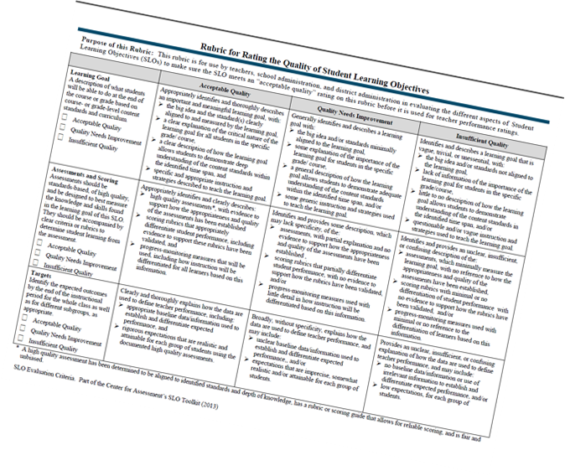
SLO Review
Note other areas you would include in the coaching conversation if you were conducting the preliminary conference
Remember to use coaching stems when providing feedback
10 Minute Activity

Slide 48
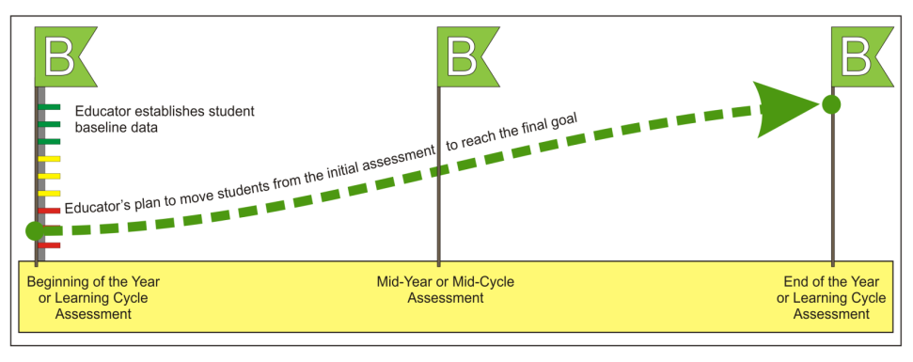
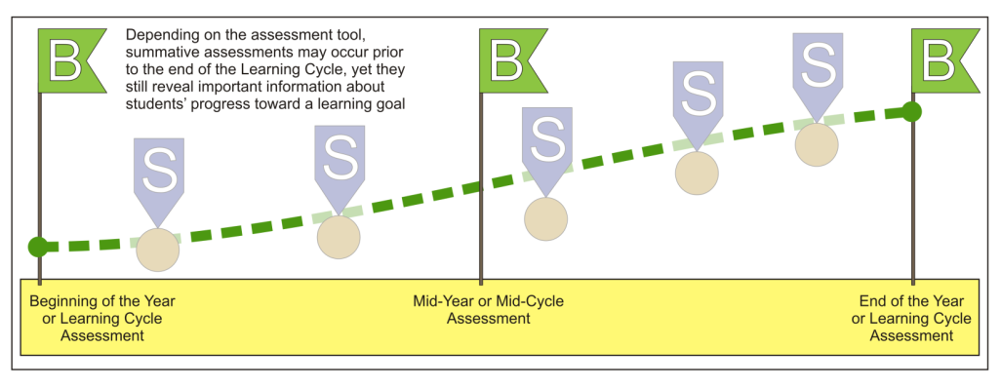
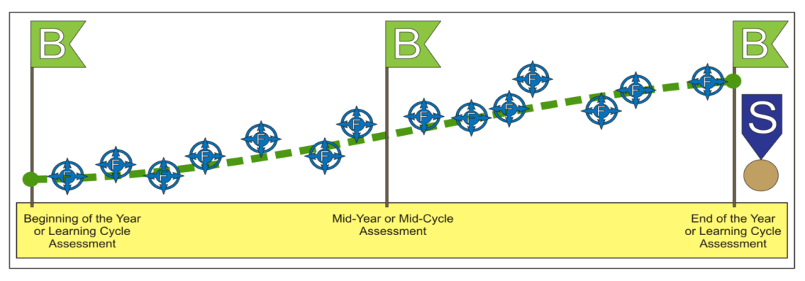
Assessment Framework
MAP/Dibels/F&P
Unit tests
Spelling Tests
Running Records
Oral recordings
Graphics courtesy of WI Department of Public Instruction

Slide 49
Please be ready to begin the next session in 15 minutes.
Thank you!

Slide 50
Mid Course Conference
Find the mid-course data
Review the data
pose 2 validating statements
Pose 2 clarifying questions and
Pose 1 statement what will stretch or encourage application of new learning
After 15 minutes, compare findings with an elbow partner
SLO Development
Mid-Course Conference
Final Review and Score
Preliminary Conference- SLO Approval
Summative Conference and Reflection

Slide 51
Mid-Course Conference
Adjustments to growth targets are allowable at mid-course conference should data support an adjustment.
Be careful to determine whether the data includes appropriate alignment and responsiveness to instructional strategies.
Teachers are to come to the conference with reflections on
how they have identified root causes for off-track
performance.
Adjustments are likely.
Chronic absence students are not removed at this time.

Slide 52
End of Year
Each Student Learning Objective, upon review of the evaluator(s), will be given a rating. The ratings are based on the percentage of students that have met their growth goals based upon the rubric agreed upon at the beginning conference and any mid-course conference adjustments.
Teachers self-score the SLO prior to review with the evaluator.
SLO Development
Mid-Course Conference
Final Review and Score
Preliminary Conference- SLO Approval
Summative Conference and Reflection

Slide 53
Preparing for the Summative Conference
• Review all available evidence submitted by the teacher, including the summary of results and any supporting documentation.
• Compare results to original targets set for students.
• Determine whether or not the data supports the teacher’s SLO rating.
• Take into account the requirements for rigor and comparability within the district.
• Review the PG&D plan results and results of action research.

Slide 54
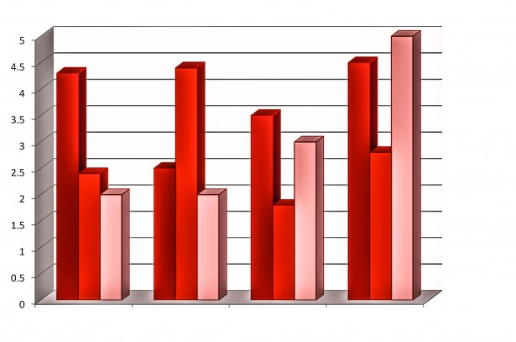

SLO Scoring: Questions to Consider
Was the target for this SLO reached?
If not, was it close?
If so, was the target greatly surpassed? Why or why not?

Slide 55
Early Implementation Considerations:
Operate under the presumption that educators will reach a “proficient” rating.
Evidence should be collected to support and determination if performance is above or below that level.

Slide 56
Scoring Rubric Example
SLO Rating | Percentage of Attainment
Unsatisfactory | 50% or fewer students met growth goal.
Needs Improvement | 51 -99% of students met growth goal.
Proficient | All students met growth goal.
Exemplary | All students met growth goal; 25% of students exceeded goal.

Slide 57
Case Study Scoring Rubric
Exemplary In addition to meeting the standard… | Proficient | Needs Improvement | Unsatisfactory
The teacher attains a high level of student achievement with all populations of learners. | The work of the teacher results in acceptable, measurable progress based on established standards for a significant number of students. | The work of the teacher results in student growth but does not meet the established standard and/or is not achieved with all populations taught by the teacher. | The work of the teacher does not achieve acceptable student growth.
Almost all students 90-100% meet their targeted growth, and many exceed their targets | A significant number of students 70%-89% meet or exceed their targets. | A less than significant number 69-50%of students meet or exceed their targets. | Fewer than 50%of students meet or exceed their targets.

Slide 58
Coaching Protocol
Validate
Clarify
Stretch &Apply

Slide 59

Key Takeaways
Student growth is collected and scored annually.
SLO Scoring rubrics are submitted annually with ADEPT plans.
For 15-16, assume “proficiency” unless significant data to suggest otherwise.
Those that engage in the process (as outlined) report that the scoring of an SLO is not surprising.

Slide 60
Overarching Objectives
Develop an understanding of SLOs and their role in the Expanded ADEPT Support and Evaluation System
Become proficient in evaluating SLO components to ensure successful implementation
Identify methods to support teachers in the development and monitoring of SLOs
Identify resources to facilitate the evaluation of SLOs at the school level

Slide 61
Next Steps
SLO Evaluator Training (for appropriate staff)
Materials available on SCDE Website http://ed.sc.gov/slo
SLO Teacher Training
SLO Toolkit http://ed.sc.gov/plod
SLO Online Module
District SLO Trainings

Slide 62
Office of Teacher Evaluation Team
Kris Joannes Director | kjoannes@ed.sc.gov 803-734-0443
Joseph Tadlock Team Leader | jatadlock@ed.sc.gov 803-734-8368
Rinice Sauls Education Associate | rsauls@ed.sc.gov 803-734-0663
Tria Grant Education Associate | tgrant@ed.sc.gov 803-734-9642
Libby Ortmann Education Associate | oortmann@ed.sc.gov 803-734-4424
Dr. Angela Bain Deputy Superintendent, Division of Educator Effectiveness abain@ed.sc.gov 803-734-8105

Slide 63

Don't judge each day by the harvest you reap, but by the seeds you plant.
Robert Louis Stevenson

