Slide 1



Introduction to Student Learning Objectives (SLOs)
Teacher Training Module
Notes:
Welcome to the South Carolina Department of Education’s overview of Student Learning Objectives. The purpose of this training is to provide you with an overview of the SLO process implemented in our state as part of the South Carolina State Board of Education Expanded ADEPT Support and Evaluation System.
The ppt. is designed so participants will only have click the next arrow to advance each slide. The voice over and animation will begin automatically.
When you see the next arrow, click it to advance to the next slide.

Slide 2

Required Materials
HS Physical Science SLO Example
Assessment Checklist
Baseline and Trend Activity Packet
SLO Before and After Activity
Rubric for Rating Quality SLOs
SLO Rubric Companion Guide
Notes:
This training includes activities to better prepare you to engage in the SLO process. If you haven’t done so already, please take a moment to download the following resources as you will need them during the training to complete the activities:
The HS Physical Science SLO Example
The Assessment Checklist
The Baseline and Trend Activity Packet
The SLO Before and After Activity
The Rubric for Rating Quality SLOs, and
The SLO Rubric Companion Guide
These resources can be found on the Professional Learning on Demand page where this training ppt. is located.

Slide 3




Student Learning
Objectives
SLOs
Planning
Delivering
Assessing
Notes:
Student Learning Objectives, commonly referred to as SLOs, will serve as one approach to gathering evidence for the student growth measure within the Expanded ADEPT Support and Evaluation System. The process for creating quality Student Learning Objectives is appropriate for classroom teachers responsible for planning, delivering and assessing instruction to students over time.

Slide 4
Outcomes
Explain how SLOs support your students’ growth and your own professional development
Identify key tasks associated with the development and implementation of SLOs
Identify the components of a high quality SLO
Begin planning for the development and implementation of SLOs
Notes:
This training focuses on the following topics in order to provide you with a clear understanding of how a high quality SLO is developed and monitored. This training will highlight: The use of SLOs as a vehicle for collecting evidence of student growth Key tasks associated in the development and implementation of SLOs within your classroom, and The components of a high quality SLO The information provided in this training will also support you in the development and implementation of a high quality SLO for use in your evaluation.

Slide 5

Notes:
This graphic represents the agency’s vision of the Profile of the SC Graduate. In order fulfill the vision, every student in the state of SC deserves an effective teacher. Many recent education studies attribute teacher effectiveness as the most influential school based factor related to student achievement. It is no longer enough to be highly qualified. Being highly qualified is important, and ensures that all teachers have the appropriate background and training to teach particular grades and subjects. What highly qualified teachers do with that knowledge in order to impact student achievement is a measure of effectiveness.

Slide 6
Expanded ADEPT System Purpose
Inform Professional Growth and Development
Provide ongoing feedback
Notes:
The intent of the Expanded ADEPT Support and Evaluation System is to provide all teachers with ongoing feedback related to practice in order to inform professional growth and development – ultimately raising student achievement in every classroom in South Carolina.

Slide 7

Evaluated with Expanded ADEPT Support and Evaluation System
Evaluated with 2006 ADEPT Guidelines
Educator
(Certified classroom-based teachers who plans, delivers, and assesses instruction)
School Counselors
Speech and Language Therapists
Library Media Specialists
Notes:
For purposes of this system, educator is defined as a certified classroom-based teacher who plans, delivers, and assesses instruction over time. School counselors, speech and language therapists, and library media specialists will continue to be evaluated under the existing 2006 ADEPT guidelines

Slide 8
Major Shifts
Isolation to collaboration
Management to Instructional Leadership
Highly Qualified to Highly Effective
Practice to Outcomes
Notes:
The Expanded ADEPT Support and Evaluation System presents major shifts in the way we do business in our schools.
The system promotes collaboration between teachers and between teachers and their school leaders.
It encourages principals to move from a management mindset to one of instructional and distributed leadership.
Teachers are expected to not only be highly qualified, but also highly effective.
The system pushes educators to focus on intended student outcomes, and then work to align instructional practices and school leadership in ways that support those intended outcomes.

Slide 9

Benefits of using
student growth measures within teacher evaluation
Notes:
To gain a sense of context, let’s first explore the benefits of using student growth measures with teacher evaluation.

Slide 10



Growth vs. Proficiency
Student growth models are DIFFERENT from proficiency models
Advantage to growth models
allow the educator to determine precisely the amount of growth seen in each student related to his/her instruction
Notes:
Student growth models are different from proficiency models. We have operated in a proficiency model for quite some time as districts have worked to achieve specific proficiency levels related to state assessments. However, there are advantages to growth models. Not all students within a class or subset of students will have the same beginning of the year skills and abilities. Student growth measures allow the educator to determine precisely the amount of growth seen in each student related to his/her instruction. Keep in mind that one year’s growth is not the same for all students.

Slide 11
Growth vs. Proficiency
Notes:
The blue bars represent student scores on the baseline assessment, given at the beginning of the year. In this hypothetical scenario, the baseline assessment and the final assessment are aligned versions of the same district test, in which there are the same number and types of questions, but each question is slightly different. Students can score up to 100 points on the district test, the minimum proficiency score being 80 or higher. Only student A reached proficiency; however student A also showed the least amount of growth. Student D showed the most growth with a 35 point jump, followed by students B and C with a jump of 10 points and 15 points, respectively. If we used a proficiency model – say 80% is the marker for proficiency, student A would be the only student meeting the goal. The teacher would NOT be “credited” for all the growth seen in the other students.

Slide 12
Student Growth Measures
Based on and determined by student academic growth during an interval of instruction
Two collection methods
Statewide Test-Score-Based Measures
Student Learning Objectives
Notes:
Growth measures are based on, and determined by, the academic growth students make during an interval of instruction.
Two methods of collecting student growth are:
Statewide Test-Score-Based Measures
Student Learning Objectives as a vehicle for organizing data on assessment measures (could include statewide test-score-based measures within the SLO).

Slide 13
Measuring Student Growth
All educators should calculate student growth in 2016-17 as good teaching practice and as required by ESEA waiver
2016-2017, SC Board of Education approved:
Test-score based measures (EVAAS value added measures) are no longer a required part of educator evaluation
Student growth will continue to be collected through the SLO process
Notes:
All educators should calculate student growth.
For the 2016-2017 school year, the SC Board of Education does not require test score based measures to be calculated as part of educator evaluation. Rather, student growth will be calculated through the SLO process.

Slide 14
Definition of SLO
A vehicle for collecting and analyzing student growth
Academic growth goals a teacher sets for students
Data based, Standards based
Collaborative development and monitoring
Notes:
An SLO is used in teacher evaluation systems as a vehicle for collecting evidence of student growth. Student growth measures look at the level of impact a particular teacher has on student academic growth over the course of the time they are leading student instruction.
SLOS are incorporated into evaluation systems in multiple states as the basis of measuring student growth. SLOs are written, monitored and scored annually. The SLO process involves pre-assessing students, providing instruction, and post assessing students to measure their growth.

Slide 15



SLOs = Product + Process
SLO should reflect the duration of time
Year-long, Semester, Quarter
Course interval should be adjusted accordingly
SLOs are appropriate within a classroom setting where teachers are responsible for planning, delivering, and assessing students over time
Notes:
The SLO is both a product (the goal and supporting documentation) and a process (the ongoing progress monitoring that occurs over the course of the SLO cycle.)
An SLO should reflect the duration of time the teacher is leading students in instruction. Typically this is a year-long goal but can also be a semester or a quarter. The SLO interval should be adjusted accordingly. SLOs are appropriate for use in measuring student academic growth within the classroom setting, where teachers are responsible for planning, delivering, and assessing students over time.

Slide 16
Types of SLOs
Individually developed SLOs
are formed by one teacher and
are unique to their context.
The teacher, is responsible
for his/her own outcomes.
Team developed SLOs
are formed by a group of teachers with the same SLO objectives. They are each responsible for their own outcomes. Student data is unique to the individual teacher.
Notes:
Teachers can develop SLOs individually or as a team.
Individually developed SLOs are formed by one teacher and are unique to their context. Here, the teacher, is responsible for their own outcomes. While team based SLOs focus on similar content and have similar expectations of growth, each individual teacher within the team will develop an SLO that is particular to his/her students. Each teacher’s SLO will need to be monitored, and scored individually as it is unique to his/her student population.
Check with your district related to the approach of SLOs.

Slide 17
Approaches to SLOs
HS: (2) sections of Art History and (2) Pottery classes
Student population comes from one section of one subject.
All students are included in the student population.
Class
Course
Student population comes from both sections of Art History.
Notes:
Teachers writing SLOs are required by the State of SC to complete one SLO annually. SC only requires ONE SLO for teachers teaching multiple courses or sections. Districts may have other rules.
There are a number of approaches to writing SLOs. Districts decide whether the class vs. course approach is determined at the building level or left to the individual teacher or team of teachers to determine.
Students from one subject or class can be included in the SLOs student population using the class approach. If multiple sections are offered for the same course the teacher can include students from all sections.
A teacher is not required by the state to write an SLO for each subject taught. Districts have discretion as to whether or not teachers will write more than one SLO. The SCDE recommends teachers write no more than two SLOs annually.

Slide 18

Approaches to Growth Targets
Targeted Approach
Sub population(s) of students are the focus of the SLO Goal.
Appropriate for course approach as a second SLO when the first includes all students.
Notes:
In a targeted approach to setting growth targets, sub population(s) of students are the focus of the SLO goal. This approach is appropriate for course approach as a second SLO when the first includes all students.

Slide 19
Approaches to Growth Targets
Tiered Approach
A teacher writes a single class SLO
All students are included in the SLO, BUT have varying degrees of expected growth
Tier 1:
5 Advanced Students
Goal is final assessment score of 90 or above, plus in-depth project.
Tier 2:
15 Basic Students
Goal is final assessment score of 80 or above.
Tier 3:
4 Below Basic Students
Goal is final assessment score of 70 or above.
Notes:
In the event a teacher writes a single class SLO, a tiered approach is recommended. Here, all students within the class are included in the SLO but have varying degrees of expected growth depending on their baseline assessment and historical data.
For example:
Tier 1 could represent 5 advanced students with the goal of the final assessment to score 90% or better.
Tier 2 could represent 15 basic students with the goal of the final assessment to score 80% or better.
Tier 3 represent 4 below basic students with the goal of the final assessment to score 70% or better.

Slide 20

Approaches to Growth Targets
Individualized Growth Targets
Should reflect students’ various starting points and previous performance and expectations.
Appropriate for class or course-based SLOs
Student A
will show a 27+ point growth
Student B
will show a 38+ point growth
Student C
will show a 22+ point growth
Notes:
Teachers may also choose to create individualized growth targets for students. The individual growth targets should reflect students’ various starting points and previous performance and expectations. Historical data is valuable in this instance. It provides the teacher with a picture of the students’ typical performance. The use of individualized growth targets is appropriate for class or course level SLOs.

Slide 21
SLO Business Rules for SC
District Business Rules Will Vary
Notes:
In this section, we will review the SLO process and the “business rules” associated with the SLO process. SC Districts are afforded a great deal of flexibility within the SLO process. It is important that you are aware of (your district’s) decisions around several SLO process pieces.

Slide 22
SLOs Promote
Collaboration (among teachers and teacher/administration/support staff).
Teachers’ enhanced capacity for data driven instruction.
Clear connection between curriculum, assessment, and student data.
A process of measuring student growth outcomes.
Teacher input and ownership in his/her evaluation.
Notes:
SAY: Before we jump into the rules for how SLO’s are implemented, let’s remember some of the ways SLOs can promote the strength of instruction and collaboration in a school.
Engaging in the three required conferences is one example of the collaborative nature of SLOs.
SAY: In many instances, SLO development allows educators the opportunity to collaborate with their colleagues on their grade level or content area. There are also opportunities to collaborate with educators across content areas and grade levels. The administrators and support staff are also available to collaborate with during the SLO development stage. SLO development and implementation enhances a teacher’s capacity for implementing a data-driven culture in his or her classroom. Using data to make instructional decisions is very important to providing quality instruction. SLOs also help make the connection between what is being taught, what’s being assessed, and student outcomes, again helping to inform the teacher’s instruction. They serve as a method for measuring student academic growth and can assist teachers in embedding this process into their practice.
SAY: Finally, SLOs give teachers input into their own evaluations. The educator can identify an area of focus for the evaluation and draw support from colleagues, support staff, and administrators in an effort to meet the goals that have been set. In shore, the SLO process formalizes many of the best practices you are already doing.

Slide 23
Teachers must be present for 85% of the teaching interval.
Focus of the goal must be academic in nature NOT behavioral.
Suggested Parameters
IEP goals can inform BUT should not be used as SLO goals.
Students must be present for 75% of the teaching interval.
Notes:
In order to have a more accurate measure of a teacher’s impact on student growth, the teacher must be present for 85% of the SLO interval. There are instances where a prolonged absence will prevent a teacher from influencing student growth. If this is the case, the measure is reflected as incomplete.
Student absence is a concern for many teachers. It’s difficult to influence a student’s academic growth if they are not in school. Students who are not in attendance 75% of the SLO interval are removed from the student population prior to scoring the SLO*.
*This does not need to be continuous attendance. However, if a prolonged absence influences their anticipated growth gains, an adjustment at the mid-course conference is appropriate.
SLOs should reflect academic and not behavior goals. In rare instances (teachers of students with severe disabilities) the goal may reflect access to academic growth. In no instance should IEP goals be used as SLO goals. IEP goals are specific to the student, whereas SLO goals are for groups of students.

Slide 24
Required Conferences
The
Preliminary
Conference
The
Mid-course
Conference
The
Summative
Conference
Notes:
In order to appropriately monitor the progress of the SLO, three (3) required conferences are expected as part of the process:
The Preliminary Conference
The Mid-course Conference
The Summative Conference
We will discuss the timing of these conference later in the training.

Slide 25
Minimum of 6 students
RECOMMENDED
Some service delivery models make it challenging to write SLOs
6 students must be included in student population
Less than 6 students, contact your building principal
Select the class/course with the greatest number of students
Elementary teachers should select reading/literacy or math as the focus
Notes:
Some teachers support students in service delivery models that will make it challenging to write SLOs. For this purpose, six (6) students must be included in the student population of the SLO. If a teacher is responsible for less than six students, he/she should contact the building principal for guidance on whether or not they will be expected to write an SLO.
Teachers teaching multiple sections of the same course, but are electing to focus the SLO on one section, should select the class with the greatest number of students, when possible. This diminishes the possibility of any one student influencing the overall outcomes of the SLO.
Additionally, if a teacher is an elementary generalist, it is recommended that they focus on either math or reading.

Slide 26

What Makes a High Quality SLO
Product and Process
Notes:
In this portion of the training, we will review the components of the SLO and the process of developing and monitoring high- quality SLOs.

Slide 27
Product The Anatomy of a SLO
Objective- The goal statement. Identifies content; focused enough that it is measurable.
Student Population- Specific population targeted by the SLO; includes information about student learning.
Standards-Identifies the content standard(s) and indicators that align to the SLO objective.
Post Assessment- Indicate what assessment will be used as a post assessment and how it is aligned to the baseline assessment.
Progress Monitoring- Describes type and frequency of interim assessments to measure student progress.
Baseline Data- Describes students’ baseline knowledge for learning and patterns in data.
Instructional Strategies- Describes research-based instructional strategies that will be used during interval.
Growth Targets- Describes teacher’s expectations for student growth at end of interval; tiered for all students. Gives a rationale for the growth targets
Historical and Trend Data- Describes applicable past data for the students.
Notes:
SLOs can be thought of as both a product and a process. The SLO template used in this section of the module represents a plan, or “blueprint” for the work ahead, while the work is supported in an ongoing collaborative process throughout the interval of the SLO. The components of an SLO are similar across states using SLOs within their evaluation systems.

Slide 28
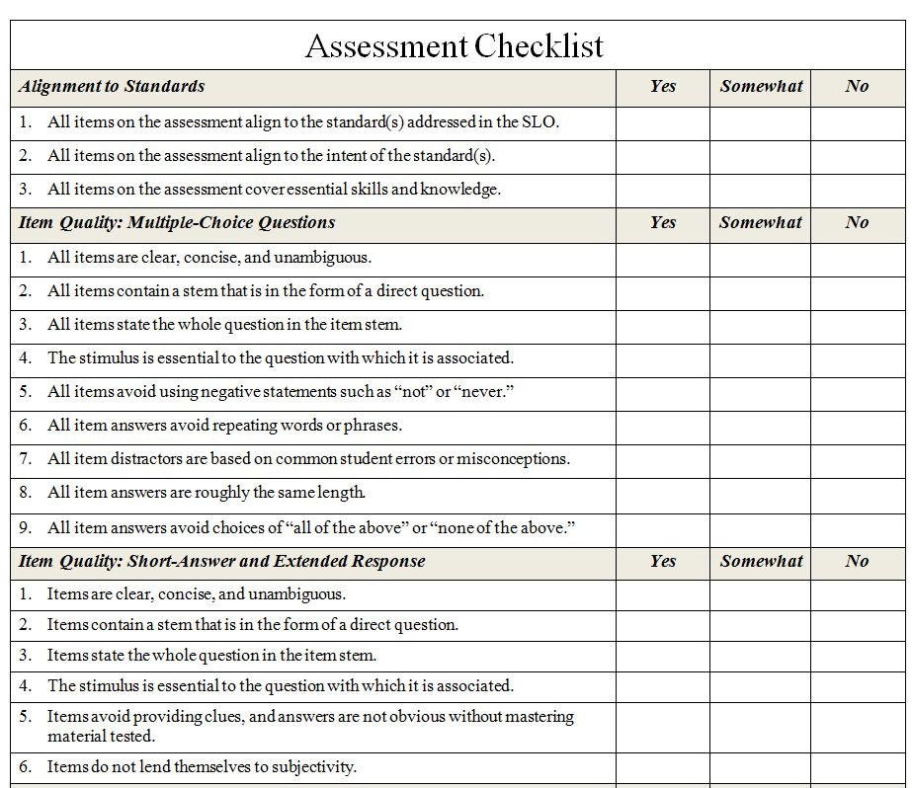
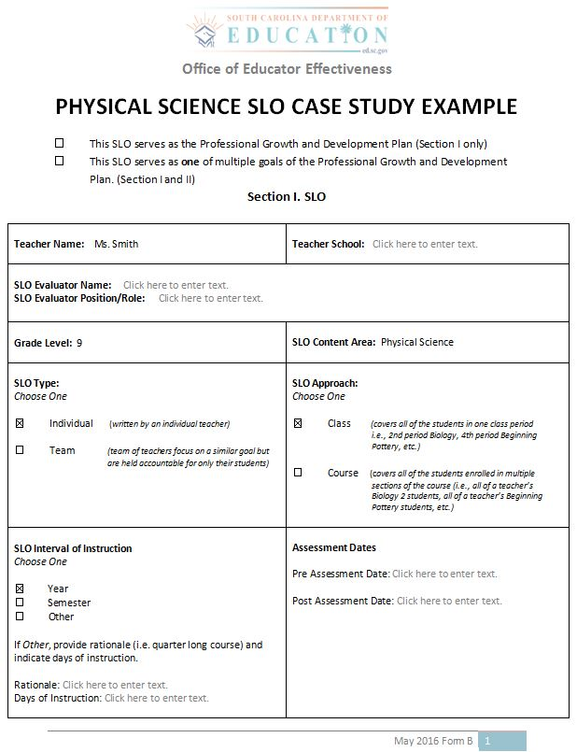
A Case Study: Reviewing the Anatomy of the SLO
Assessment Checklist
Ms. Smith
Grade 9
Physical Science
Notes:
Let’s get a sense of what the SLO plan looks like. Take a moment to retrieve your copy of the SLO example for a HS Physical Science course and the Assessment Checklist.
When you have those two resources, advance to the next slide to begin the case study.

Slide 29
Notes:
The example you see here is created on the SLO planning template. It represents the standard template the state is using in their training and related resources. Local districts might have their own planning template that represents additional information, and a different order. Nonetheless, you will see the same common components.
The SCDE does not collect SLO templates. Districts maintain the SLO planning template and related documentation.
The first page of the template is the dashboard. Here you will see information related to the teacher including the teacher’s name, content and grade level, as well as the type and approach the teacher selected, assessment dates, and the interval of instruction Our sample teacher – Ms. Smith – has 3 sections of 9th grade General Science.
She has chosen to focus on ONE of the classes, which means all students from that class will be included. The SLO interval of instruction, in this case, is one full academic year. The interval of the SLO lasts for the duration of time the teacher is responsible for planning, delivering and assessing instruction.
The teacher’s SLO must be approved in a timely fashion according to district timelines.

Slide 30


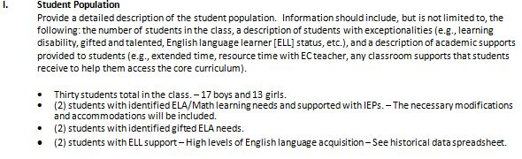

Student Population
Describes what students are included in the SLO goal
Drills deeper into student population
Includes information that may impact growth goals
Notes:
The student population section describes what students are included in the SLO goal and how that was determined. It also includes what might impact students’ growth goals.
Take a moment and review the student population sample.
You will note there is information related to IEPs, gifted and talented students, and English Learning Acquisition

Slide 31
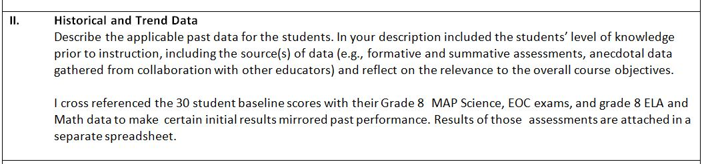

Historical & Trend Data
Review performance and historical data
Examples of Historical Data
Past performance on similar assessments
Attendance records
Student specific learning needs (IEP)
Conferences with student’s previous teachers
Notes:
Let’s move on to the next component – Historical and Trend Data.
Ms. Smith references data gathered from her students’ previous assessments.
Teachers are encouraged to review any historical assessment and performance data that are available as the data will suggest typical performance and any other issues that might impact a student’s growth gains within the interval. Historical data may include but is not limited to:
Past performance on similar assessments
Attendance records
Whether or not the student has any specific learning needs addressed through an IEP, and
Conferences with the student’s previous teachers.
Take a few moments to read and review the historical and trend data description. As you are doing so, think about sources of evidence that you have available that might lend itself to this portion of the SLO.

Slide 32
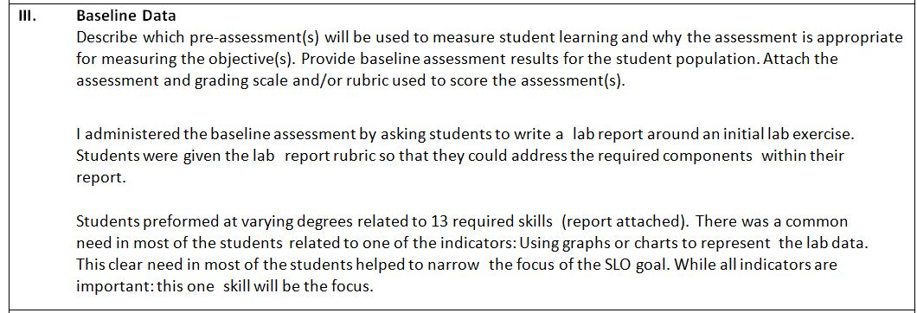
Baseline Data
Make sure Pre and post – assessments are aligned
If possible, use 2-3 assessment measures
Approved in Preliminary Conference
Refer to SCDE Assessment Checklist
State Standardized Assessments
Common Assessments
District Standardized Assessments
Teacher Created Assessments
Notes:
Here you can see that Ms. Smith has described the assessment she is using as a baseline assessment. The baseline assessment should align to the post assessment used at the end of the SLO interval.
Whenever possible, it is suggested teachers use 2-3 measures as benchmark assessments. This allows for multiple avenues for students to demonstrate growth. In early implementation, 2-3 assessments may be difficult. It’s OK. Down the road, as you develop more assessments you will have more resources.
The assessment used within the SLO process will need to be approved for use in the Preliminary Conference. To assist teachers in this area, SCDE has created an Assessment Checklist. Take out your copy of the Assessment Checklist and take a few moment to review it.
Check with your district regarding their assessment policy and procedure.

Slide 33
Baseline Data
State Standardized Assessments
Common Assessments
District Standardized Assessments
Teacher Created Assessments
Integration of standardized test scores
Example: MAP
Teachers without Standardized Tests
Consider available resources for assessment
Develop baseline and post assessment
Work with teacher teams to create common assessments
Notes:
When possible, standardized tests should be integrated into the SLO process. The standardized assessments may need to be utilized a bit differently that in the past, and administration of the tests will need to fit within district timelines.
For example, teachers who have access to standardized assessment such as MAP may consider using MAP as a benchmark assessment. In the past, MAP may have been used as a formative assessment, and administered four times over the course of the year. To use it within the SLO process, a teacher would need to administer the assessment (at the very least) at the beginning and end of the SLO interval. Additional assessments could be administered within the cycle for additional evidence.
Not all teachers will have access to standardized assessments, and may need to consider available resources of assessment data they have in place or will need to develop an assessment for use as a baseline and post assessment. An example might be a teacher created performance assessment using a rubric as the assessment instrument.
Whenever possible, teacher teams should use a common assessment as the basis for SLO progress monitoring to ensure comparability between teacher teams.

Slide 34
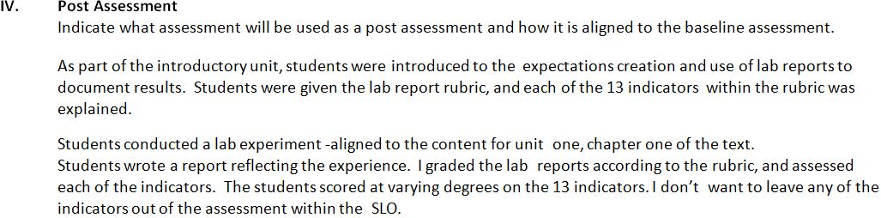

Post Assessment
Describe how pre- and post assessment are aligned
Alignment is Important
Notes:
In this section teachers should describe how the post assessment is aligned to the pre assessment. To gain an accurate measure of the amount of growth achieved by each student, alignment is important. Take a moment to read Ms. Smith’s description of her post assessment.

Slide 35
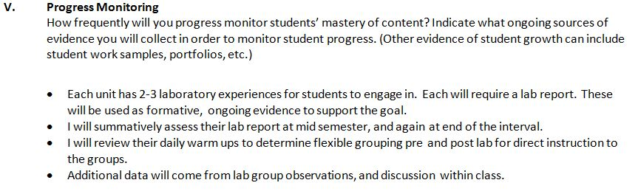

Progress Monitoring
SLO is a living, breathing document
SLO is continually monitored
Periodic assessments informing instructional strategies and adjustments to strategies
Notes:
The progress monitoring section of the SLO template is what makes the SLO process different than past goal-setting practices. The SLO is a living, breathing document. It does not get “set on a shelf” only to be revisited at the end of the year. The SLO will be continually monitored throughout the interval, with periodic formative and summative assessments informing the instructional strategies and any adjustments to the strategies along the way.
This sample SLO describes the other sources of evidence that will be used to gauge student growth: lab reports and daily warm ups are identified. It’s likely that by mid-course check in, there will be additional resources of evidence included.
Read over this section. As you do so, think about ways that evidence is presented in their contexts.

Slide 36
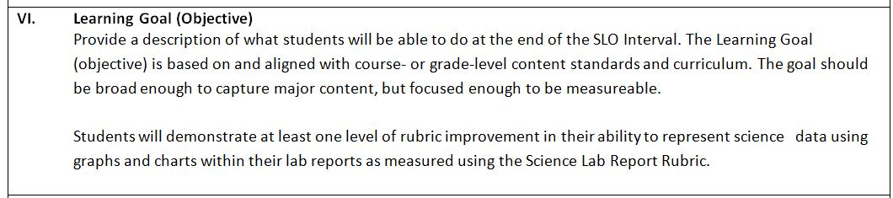

Learning Goal
Based on content standards
Identifies and describes an important and meaningful learning goal
Captures major content
Focused enough to be measureable
Notes:
The learning goal is a description of what students will be able to do at the end of the SLO interval. The learning goal should appropriately identify and describe an important and meaningful learning goal, capture the major content, and be measurable.

Slide 37
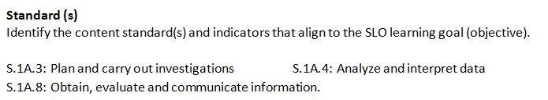

Standards
Enduring content and skills
Focus represents the time of instruction
Avoid unit specific content
Focus on a few standards with relevant meaning to the SLO
Notes:
There is no doubt that teachers work with multiple concepts, enduring understandings, and standards within their classes or courses. The Standards section of the SLO represents enduring content and skills around which teachers develop the skills and abilities of their student population. The focus of the SLO represents something that spans the duration of time the teacher is leading instruction. Avoid unit specific content, and focus only on a few standards with relevant meaning to the SLO.
In this case study, three standards represent the heart of the work within the SLO. Some districts will identify the focal standards for the SLO, while others will allow the teacher to identify the content through their own analysis of student data.
Check with your district about their decisions related to standards used for SLOs.

Slide 38
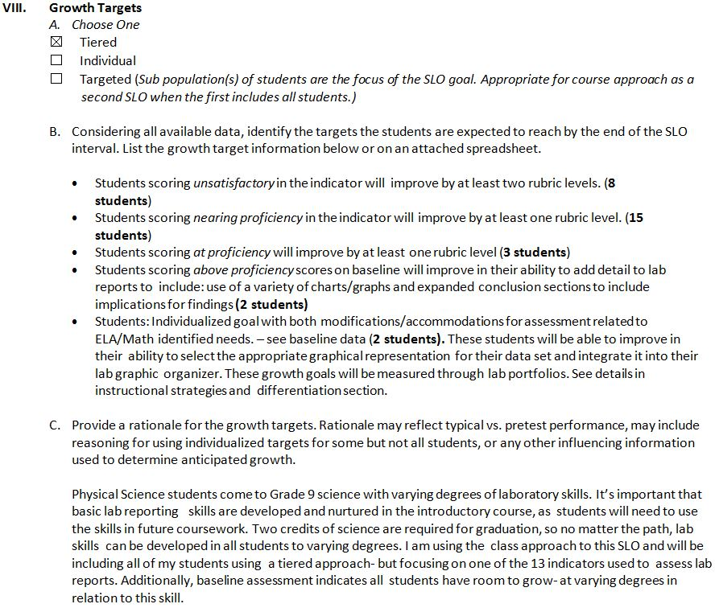

Growth Targets
Teacher selects approach to growth targets
Growth targets should be rigorous and appropriate
Notes:
Now let’s take a look at the growth target section of the SLO. This section identifies the specific growth targets for the student population included in the SLO goal.
This case study is a class-based SLO in which the teacher selected the tiered approach to setting growth targets. It is important that teachers set rigorous, yet appropriate growth targets for the students.

Slide 39
Growth Targets
Identifies specific growth targets
Setting growth targets may be challenging in the beginning
Goals should not be set arbitrarily
Notes:
In early implementation, setting growth targets will be challenging. Teachers can anticipate that initial growth targets will be off, and that mid-course adjustments will need to be made. This is typical in early implementation of SLOs. Teachers will become more sophisticated in their ability to set appropriate goals in subsequent years. Be patient!
That being said, adjustments to goals should not be made arbitrarily. All changes must be approved by the evaluator. Adjustments would need to take place during the mid-course conference, and supported with appropriate data.
Notice that the goals of this case study are growth oriented, and not about proficiency levels. This represents the beauty of SLOs. Teachers are not held accountable for bringing students to a predetermined proficiency level; they are expected to grow students regardless of beginning skills and abilities! We will engage in an activity around setting appropriate growth targets later in this training.

Slide 40

Growth Targets
Provide rationale
Include data:
Historical
Trend
Baseline
Notes:
In this portion of the growth section of the SLO, the teacher provides the rationale for the growth targets set for each student. Notice the teacher incorporates historical, trend, and baseline data in her rationale and additional important course information.

Slide 41

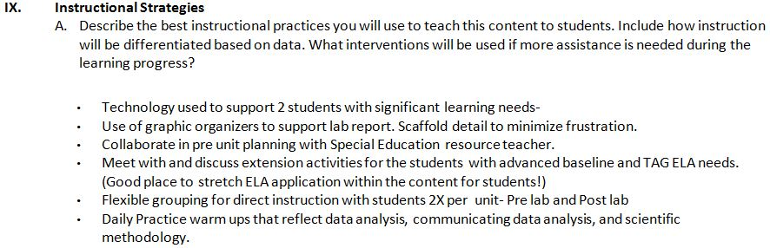
Instructional Strategies
HEART of the work related to SLOs
Should be revisited throughout instruction
Outlines plans to move students forward
Should engage in reflection
Consider PD needed to effectively implement strategies
Notes:
The Instructional Strategies section of the SLO template is important. Some would call this the heart of the work related to SLOs. The SLO is unlike goals in the past. It is meant to revisit throughout the course of the time teachers are leading their students in instruction. In this section of the SLO, the teacher articulates how she plans to move students forward in their learning.
It is important that teachers engage in reflection when completing this portion of the SLO. Take a look at the example in this section.
Notice that Ms. Smith has identified flexible grouping as a strategy. This instructional strategy involves a proficient use of formative assessment and differentiation. It’s important that Ms. Smith consider the skills necessary in using flexible grouping, and determine what supports and professional development may be needed to effectively implement that particular strategy well. At a minimum, she will need to be ready to speak to how the use of flexible grouping may look like in action.
This section of the SLO lends itself to coaching opportunities and collaborative work between teachers and instructional coaches.

Slide 42
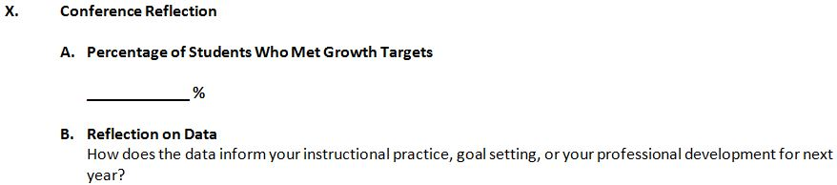

Conference Reflection
Growth target calculations
SLO reflection
Notes:
At the end of the cycle Ms. Smith will calculate the percentage of students who met their growth targets. In the reflection portion, Ms. Smith will use the data to determine next steps.

Slide 43
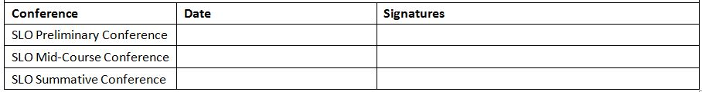
Required Conferences
Collaborative process
Provides documentation of required meetings
Preliminary Conference
Mid Course Conference
Summative Conference
Notes:
The template provides documentation related to the required meetings between the teacher and the SLO evaluator. Three meetings are expected as part of the SLO process: The Preliminary Conference, the Mid-Course Conference and the Summative Conference.
We will discuss these conferences later in the training.

Slide 44
Process: The SLO Cycle
SLO
Development
Summative Conference and Reflection
Preliminary Conference – SLO Approval
Final Review and Score
Mid-Course
Conference
Notes:
Now that you have examined the common components within the SLO “plan” or “product”, let’s switch over to the process around creating, monitoring, and scoring SLOs.
The “product” is the result of careful construction at the beginning of a rich, collaborative SLO “process”. Let’s take a closer look at what goes in to the development of a high quality SLO.
The bulk of the work lies in the first step of the SLO cycle – SLO Development. The SLO cycle represents the duration of the SLO interval, to include assessing students and scoring the SLO. Once the SLO is developed, teachers and evaluators will participate in a:
Preliminary Conference where the SLO is approved,
the Mid-Course Conference (the half way point for the SLO interval)
the Final Review and Score,
and the Summative Conference and Reflection.
The SLO template we just examined represents the beginning of the cycle and includes five sub tasks.

Slide 45
Process: The SLO Cycle
SLO Development generally includes the following steps:
SLO Development
Final Review and Score
Summative Conference and Reflection
Mid-Course Conference
Preliminary Conference-SLO Approval
1
Identify core content and standards
2
Gather and analyze student data
3
Determine the focus of the SLO
4
Select or develop an assessment
5
Develop a growth target and rationale
Notes:
You just examined an example SLO. What did it take to get there?
In order to develop the SLO the teacher should consider the following:
1. Identify core content and standards
2. Gather and analyze student data
3. Determine the focus of the SLO
4. Select or develop an assessment
5. Develop a growth target and rationale

Slide 46
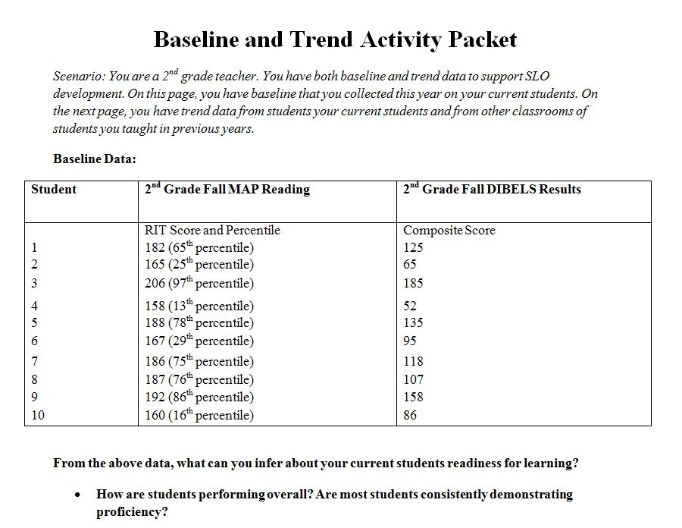
Baseline Assessment
& Trend Data Activity
Notes:
In this portion of the training, we will discuss baseline assessment and participate in a trend data activity to help familiarize you with using baseline data.
Let’s begin by analyzing some student data in order to get a sense of what data is telling us about students’ baseline skills and abilities and how we might use the data to set appropriate but rigorous academic growth goals.
For this activity we will use MAP data as the basis. We recognize that MAP is not an assessment that is available to all teachers. That’s OK. This activity is not about the assessment, but rather how to use assessment data to inform growth goals. For our purposes it’s about the process, not the assessment.
This activity has three parts:
A baseline, Trend Data and Growth targets steps.
Take out your “Baseline and Activity Trend Packet”.

Slide 47
Activity Part I:
Analyzing Baseline Data
Are there clear groups of students? If so, what are they?
What students are included in each grouping?
How would you describe the performance of each grouping?
Are there any students that are not easily assigned to a group?
Notes:
For this activity you are a second grade teacher. You have administered the Fall MAP assessment as well as the Fall DIBELS assessment. Your SLO focus is in the area of reading, so you are using the reading MAP scores.
Take a few moments to review the baseline data found on page one and the trend data from your students and other classroom students found on page two of the activity handout.
Before you advance to the next slide, take some time to place the students into groups based on the available data. Are there clear groups of students? If so, what are they? How many groups did you identify? How might you describe those groups?
Typically groups start with three – Below proficiency, at or nearing proficiency, and above proficiency. Were there any students that did not fall easily into a grouping?

Slide 48
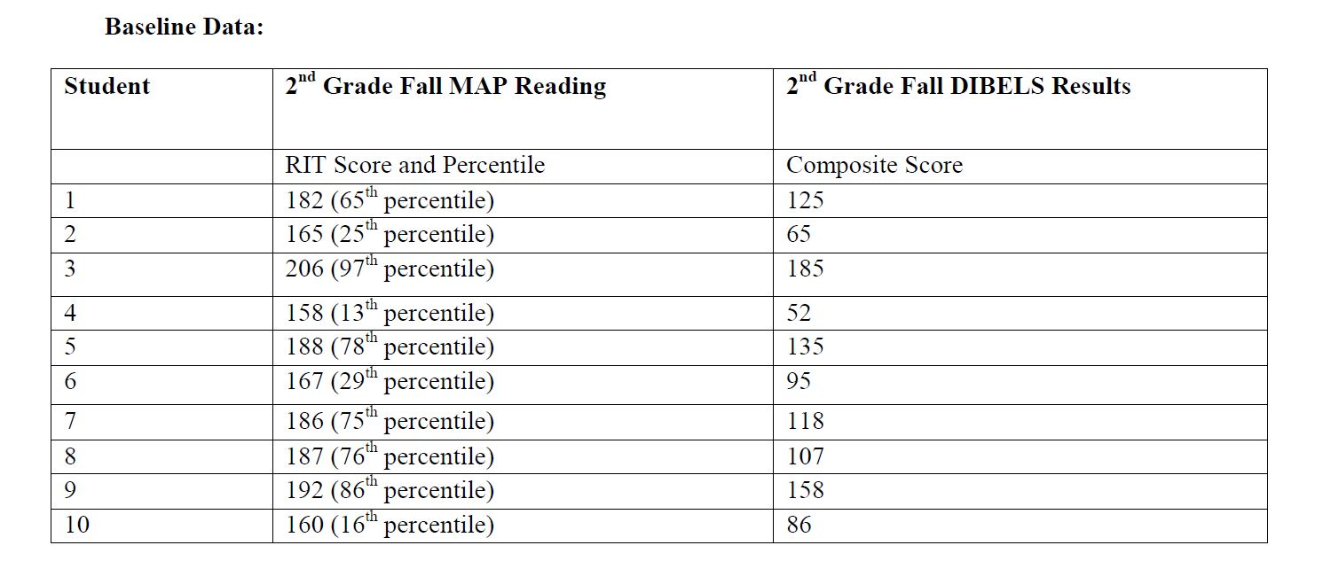
Below Proficiency
Below Proficiency
Notes:
Let’s investigate one approach to the analysis of this data. Please note, that this is not the only approach to the data, nor is there concrete evidence for placement of all the students within this data set. However upon initial review, groupings of students might look like this.
These students have a MAP range of 158-167 RIT score and 13-29 percentile range. Their DIBELS assessment fell in the range of 52-95. We might refer to these students as below proficiency levels.

Slide 49
Above Proficiency
Above Proficiency
Notes:
There also appears to be an above proficiency tier as well.
These students have a map rage of 192-206 RIT score and 86-97% percentile range. Their DIBELS assessment fell in the range of 158-185.

Slide 50
At Proficiency
At Proficiency
Notes:
Lastly, a tier of students that we might describe as nearing or at proficiency.
These students have MAP range of 182-187 RIT score and 65-78 percentile range. Their DIBELS assessment fell in the range of 107-135.
This is the grouping that might have made you a bit uncomfortable. That’s because there is a bigger spread in scores, and some inconsistences in the MAP and DIBELS data. In fact, you may have struggled with placing some of the students in the middle category.
Notice the discrepant data points of student 8. The student is high achieving on MAP and “Well Below Benchmark” on DIBELS. How might you think about situations such as this?
Students like number 8 are representative of what will happen when setting initial growth targets. This feeling of unease should push you to look carefully at the historical data or trend data in order to find a confident starting point for that student.

Slide 51
Baseline Assessment
Administered at the beginning of the SLO interval
Aligned to the content standards in the SLO and to post assessment
Can be a performance assessment using a teacher-created rubric
Notes:
Before we move to the next step of the activity, let’s pause and consider potential assessments for baseline assessments. Whether standardized or teacher-created, in order to write and implement SLOs, a quality assessment is needed to determine the baseline skills and abilities of students and be able to appropriately measure growth over time.
Baseline Assessments should be:
Administered at the beginning of the SLO interval
Aligned to the content standards in the SLO and to the post assessment, and
Can be a performance assessment using a teacher-created rubric.

Slide 52
Baseline Assessment Data
Describe students in terms of groups.
Describe student performance over time.
Inform
growth
targets.
Inform
instructional
strategies.
Notes:
Ultimately your baseline assessment data should:
Describe students in terms of groups.
Describe student performance over time.
Inform growth targets.
Inform instructional strategies.

Slide 53
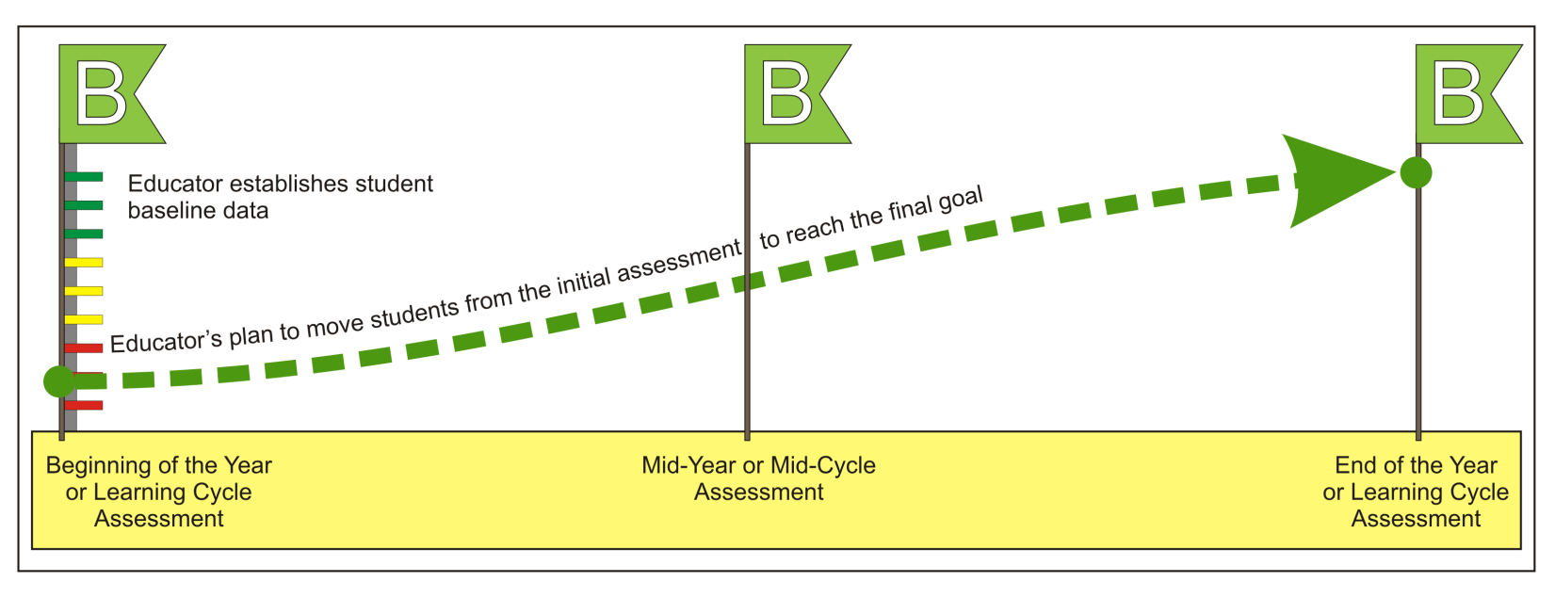
Benchmark Assessments
Graphic courtesy of WI Department of Public Instruction.
Notes:
As mentioned earlier, the baseline assessment is referred to as a benchmark assessment. Training thus far has emphasized the need for a baseline assessment. We have also discussed the importance of having an aligned (or even the same when appropriate) assessment at the end of the interval to measure the growth of students. A teacher may want to consider a mid-cycle assessment in order to gauge how students are progressing – Especially if there is not enough evidence to support changes.
Graphic courtesy of WI Department of Public Instruction.

Slide 54

Activity Part II:
Historical/Trend Data
Trend and other student data help educators determine how much growth each student is likely to make.
Identify and gather trend data
Examples of trend data include:
Test scores from prior years
Current and past grades
Formative assessment data past & present
Reading and math conferences
Data about student population
Attendance records or 504 plans
Results from diagnostic assessments
Notes:
Let’s move on to the second part of the activity.
Although administering a baseline assessment will give the teacher information related to his or her students’ beginning skills and abilities, it’s challenging to know for certain whether the data reflects student’s typical performance. Because it is our goal to set appropriate growth targets, we want to dig a little deeper into data to gain a sense of typical performance, as well as anything else that might suggest a different grouping.
For many teachers, there will not be historical assessment data to draw from. Here are some other sources of historical data to draw from.
Trend data and other student data helps educators determine how much growth each student is likely to make. You should identify and gather trend data.
Some examples of trend data include:
Test scores from prior years
Current and past grades
Formative assessment data both current and past
Reading and math conferences
Student population data such as attendance records or 504 plans
Results from diagnostic assessments.
In a few years you will have your own historical data to draw from. Remember we are in the early stages of SLO implementation. Be patient and do the best you can. Also mid-course conferences are appropriate for making adjustment to SLO goals. Don’t be frustrated or paralyzed by the process, do the best you can with the information available.

Slide 55
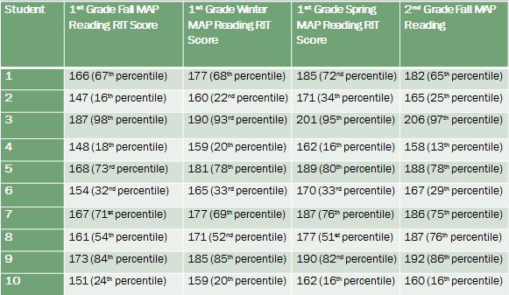
Historical MAP Data
Notes:
On the second page of the activity packet is additional data related to ten students: in this case the students’ first grade MAP scores from fall through spring.
Does this information provide any more details about those students that were hard to place into original groupings?
Look at the data for student 8. This shows a more consistent pattern for MAP assessment. Likely this data will influence your original grouping for student 8.

Slide 56
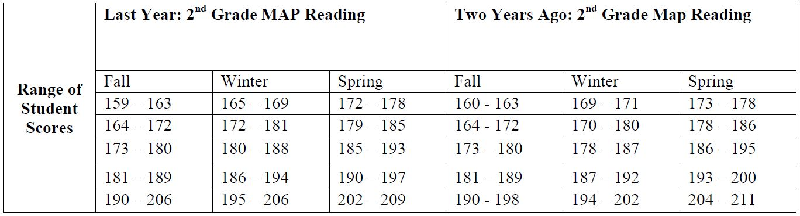
Historical/Trend Data
Notes:
Additionally the teacher has reviewed the scores from her last year’s class and the year before that to gain a sense of the degree to which her teaching impacted student growth.
Take a look at this historical data and determine whether or not your original groupings are solidified. If needed, adjust your groupings.
Think about the changes, did this data assist you in placing difficult to place students?
Typically those students that were hard to place are easier to place once the teacher looks at the trend data, or typical performance.
Note that this is a “best guess” at the time with the data you have. The SLO process has assurances in place that allow for adjustments should the students be demonstrating a much different growth trajectory than anticipated.

Slide 57
Activity Part III:
Setting Growth Targets
Baseline Performance Level | Growth Target
Before you advance to the next slide, take some time to set growth targets for the students.
Remember to use the available data.
Notes:
Let’s focus on Part III of the activity, setting growth targets. Setting growth targets is the most challenging part of this process and will take the longest. At the end of this step it’s important that you have declared an appropriate (yet rigorous) growth target for each of the groupings. There is no right answer here. Depending on the analysis of the data, growth targets might be approached differently.
Before you advance to the next slide, take some time to set growth targets for each of your groups.
Remember to consider all of the data you have available to make those growth targets.

Slide 58
Activity Part III:
Setting Growth Targets
Baseline Performance Level | Growth Target
Below Proficiency
+ 15 points or more
At Proficiency
+ 7 points or more
+ 2 points or more
Demonstrates ability to transfer skills to authentic situations
Above Proficiency
Notes:
The growth targets you see here are examples of the targets that could be set. Are your growth targets similar to those shown here? Remember, when setting growth targets, it’s important to use the data you have for students to ensure growth targets are appropriate and rigorous.

Slide 59

Think about…
Was there a wide variance of skills and abilities of students within each grouping?
What did you do with students that are nearing or at the top of the MAP chart?
Notes:
Think about the growth targets you set. Was there a wide variance of skills and abilities of students within each grouping (tier)? What did you do with students that were nearing or at the top of the MAP chart? Remember, there is no right answer here. Depending on the analysis of the data, growth goals might be approached differently.

Slide 60

Refining Growth Targets
Growth goals are not set arbitrarily!
Engage in a rich analysis of student data
Set appropriate yet rigorous growth goals
This activity
Gives insight into the process
Occurs in the development of the SLO
Prepare SLO to submit for approval
Begin implementation
Notes:
Growth targets are not set arbitrarily.
As a teacher, you will engage in a rich analysis of available student data to set appropriate yet rigorous growth targets.
To review, this activity gives insight into the process that occurs in the development of the SLO as you, the teacher, prepare to submit the SLO for approval and begin implementation in the classroom.
In the next few slides we will review the steps of setting growth targets.

Slide 61

Set Initial Growth Targets
What growth have students made in previous years?
Does the initial growth target allow students to make progress toward proficiency?
What is the minimum score at which students can be proficient?
Notes:
First you should, set initial growth targets.
Ask yourself:
What growth have students made in previous years?
What is the minimum score at which students can be “proficient”?
Does the initial growth target allow students to make meaningful progress toward proficiency?

Slide 62

Adjust Growth Targets
Are there contextual factors that are likely to affect students’ growth in positive and negative ways?
Are these factors reflected in students’ previous growth or are they new?
What growth have students with similar factors made in the past?
Notes:
The next step is to adjust growth targets.
Ask yourself:
Are there contextual factors that are likely to affect students’ growth in positive and negative ways?
Are these factors reflected in students’ previous growth or are they new?
What growth have students with similar factors made in the past?

Slide 63

Review Targets
Are these targets rigorous and attainable?
Notes:
Next you should review targets that you have set.
Ask yourself:
Are these targets rigorous and attainable?

Slide 64

Record Results
Record these results to utilize as future trend data!
Notes:
And finally record results.
Recall that earlier we noted that in a few years you would have your own historical and trend data.
You should record these results to utilize as future trend data.

Slide 65

SLO Approval, Review, Implementation and Scoring
Notes:
This module discusses the approval, review, implementation and scoring of SLOs.

Slide 66
SLO Approval:
Preliminary Conference
SLO
Development
Who?
Final approval is issued by the building principal.
Summative Conference & Reflection
Preliminary Conference – SLO Approval
When?
Prior to the start of the SLO Interval.
Final Review and Score
Mid-Course Conference
Notes:
It is important that a building principal be involved in some capacity in the approval of the SLO, and ultimately be the one to approve the SLO.
This does not mean the principal must be responsible for coaching teachers in the development of their SLOs. It is appropriate to have the preparation of the SLO goals supported with building teams, PLCs, or in collegial conversations with an instructional coach. Any of these support personnel may review, coach, and present SLOs to the principal as “ready for approval”.

Slide 67
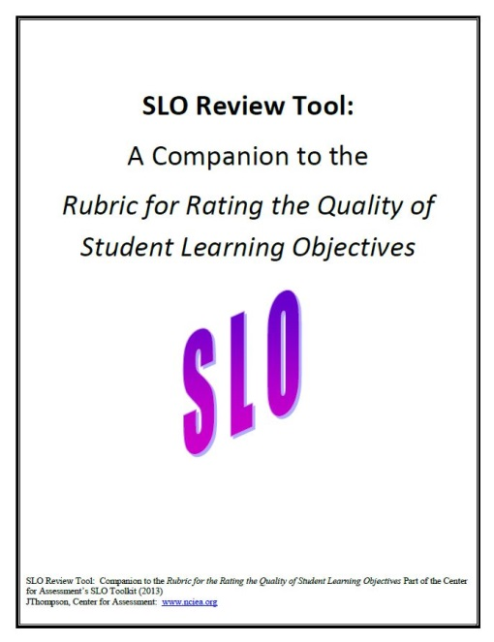
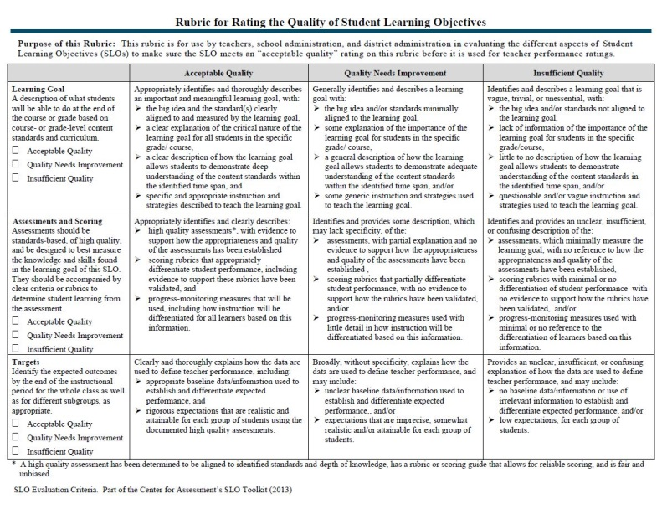
SLO Quality Review
Three critical areas:
The Content
The Assessment
The Rigor
The Center for Assessment
Rubric for Rating SLO Quality Tool
is designed to:
Provide teachers, principals, evaluators and district administration guidance for evaluating SLOs
Ensures SLO meets “acceptable quality”
Notes:
You will recall that we reviewed the components of the SLO earlier in the training. All components are important, and work to tell the “complete story” around the plan to move students forward in their learning. However, there are three critical areas that provide insight into the quality of the SLO goal: Content Assessment, and Rigor. To assist with this process the Center for Assessment has developed a rubric for rating the quality of SLOs. Whether you are a teacher working to develop a quality SLO, an instructional coach or colleague that is reviewing another’s SLO, or a principal – recognizing quality can be challenging. This rubric helps to ensure that SLOs meet “acceptable quality”. We will spend time reviewing this tool in just a moment.

Slide 68
Content, Assessment,
& Rigor
Alignment of district/building initiatives
Whether or not the content reflects enduring understandings over time
Content
Quality of Assessment
It cannot be stressed enough!
The SLO is only as good as the assessment used to track student growth
Rigor of Target
Reflects analysis and reflection in prep
Tied directly to the data analysis and rationale presented in the SLO
Notes:
What makes these three focus area important?
Content: Allows a quick glance into the alignment of district/building initiatives and whether or not the content reflects enduring understandings that can be developed over time.
Quality of Assessment: It cannot be stressed enough. The SLO is only as good as the assessment used to track student growth.
Rigor of Target: Reflects the analysis and reflection involved in preparation. It is tied directly to the data analysis and rationale presented in the SLO.

Slide 69
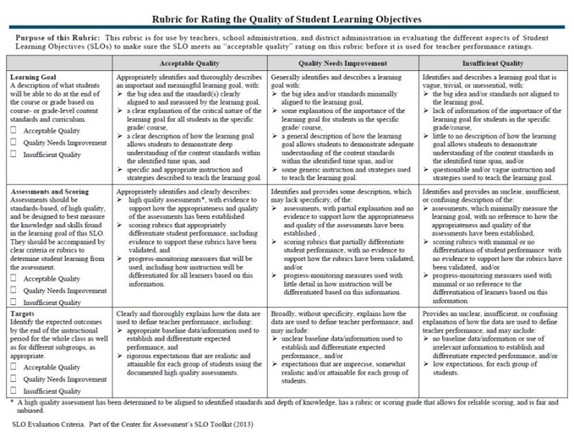
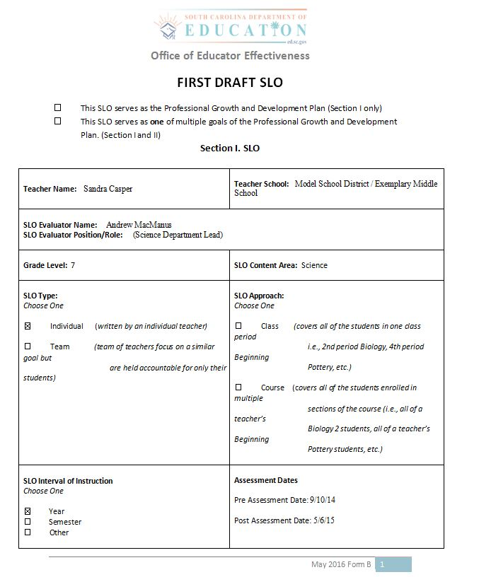

SLO Review Activity
Before and After Review Packet
SLO Rating Rubric
SLO Rubric Companion Guide
Notes:
Let’s begin this modules activity by obtaining key materials. For this activity you will need:
The Before/After Review Packet
Center for Assessment Rubric for Rating the Quality of SLOs, and the
Companion Guide.
This tool and its companion guide were developed by the Center of Assessment and is included in the SCDE toolkit with permission for use in training and within districts. It’s important that teachers have access to the tool and understand the criteria principals will be using in the approval conference. You will notice that it is in a rubric format, and allows for specific feedback related to areas of strength and those areas of the SLO that need work.
Before you advance to the next slide, take a moment and locate these resources. We are going to engage in an activity using this tool and its companion guide in order to familiarize ourselves with the tool, and to spend some time reviewing an SLO example.

Slide 70


SLO Review Activity
STEP ONE
Review the First Draft SLO and make notes of:
areas of strengths
questions you have
noticeable areas for improvement
Complete Step One before you advance to the next slide.
Notes:
With your resources in front of you, pretend you are a principal, and are about to engage in an approval conference with a teacher. In preparation, you are using the review tools to review the teacher’s SLO template.
First, you will review the First Draft SLO. Make notes of areas of strength, questions you have, and any noticeable areas for improvement. Remember, the SLO plan must tell the complete story.
We want this activity to be as authentic as possible. So, don’t review the second or third versions of the SLO before reading the first draft to make your initial remarks. That’s like reading the last chapter of a book and knowing the ending.
Before you advance to the next slide, take a few minutes to review the “First Draft SLO” section.
Using the review tools, make notes related to the quality of the SLO.

Slide 71

SLO Review Activity
STEP TWO
Read the Draft SLO with Reviewer Comments
Determine if you were on the same track as the reviewer
Read the Final SLO
Notes:
Now take a look at the reviewers notes titled “Reviewers Comments”. Take a moment and review the comments, and determine if you were on the same track.
Then review the revised copy of the SLO.

Slide 72
SLO Implementation
Begins after SLO approval and lasts the duration of time the teacher is leading instruction
Includes regular review of data to determine progress and adjust instruction accordingly
Evidence is collected throughout the interval to include assessment results and other evidence of student learning
Notes:
Now that you’ve had a chance to use the rubric to review an SLO, let’s talk more about SLO implementation.
Once the SLO has been approved for implementation, the teacher begins to employ the instructional strategies identified within the SLO plan.
The difference from past goal setting practices is that the teacher is engaging in ongoing review of assessment data and other evidence of student learning to adjust strategies and supports accordingly.
Take a few moments to think about other sources of evidence of student learning you have access to on a daily basis other than assessing students.

Slide 73
Other Student Growth Evidence
Discussion
records
Running
records
Interviews with students
Small group instruction
data
Student work samples
Notes:
Here are a few examples of non-assessment related evidence that you have access to daily to assist in gauging student growth:
Discussion records
Running records
Interview with students
Small group instruction data, and
Student work samples.

Slide 74
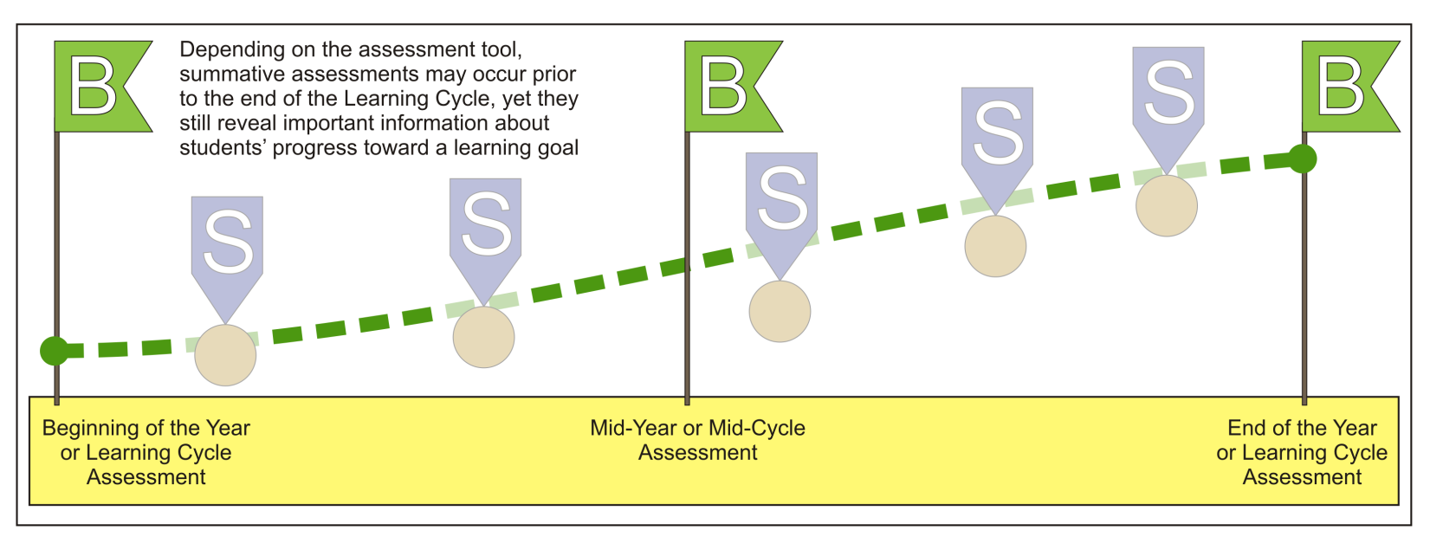
Assessment & Evidence:
Monitoring Progress
Graphics courtesy of WI Department of Public Instruction
Notes:
We have spent time discussing the use of pre/post assessments and have referred to them as the benchmark assessments. It’s likely that there are other, periodic assessments, such as unit and chapter tests. These are summative snapshots related to their understanding of the content presented in each chapter or unit. They likely encompass far more than what’s reflected in the SLO goal. However, they may yield some specific evidence to support the SLO goal.

Slide 75
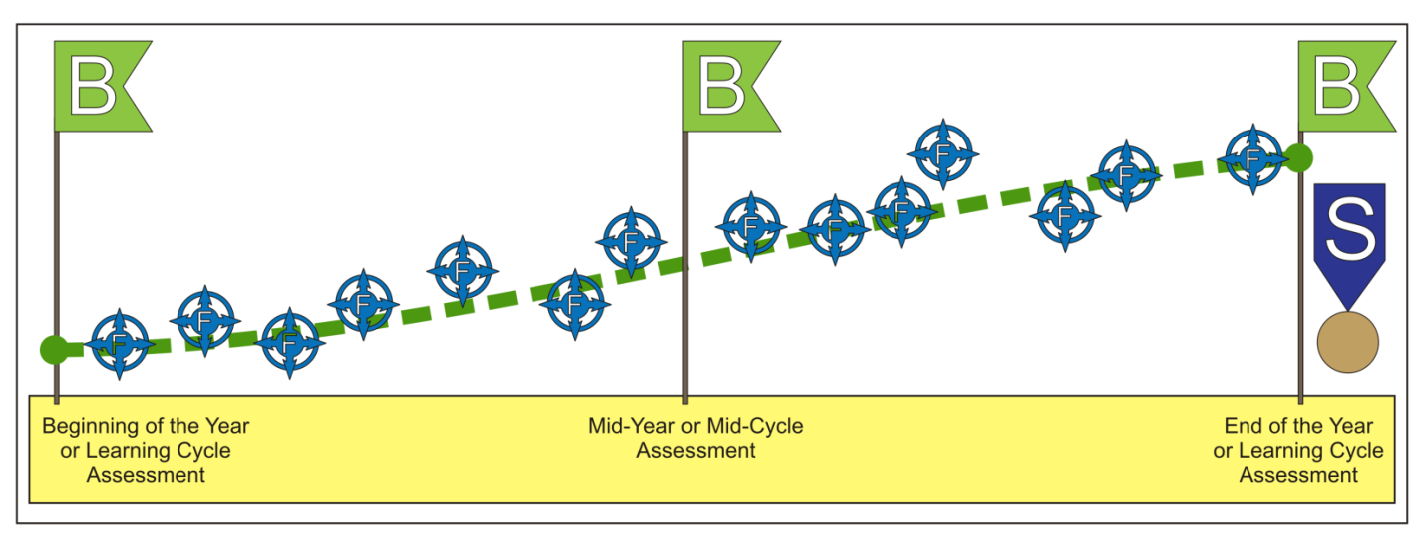
Assessment & Evidence:
Monitoring Progress
Graphics courtesy of WI Department of Public Instruction
Notes:
Another source of evidence is the formative evidence a teacher receives about student progress. Many of those formative evidence sources were identified a couple of slides back. Together – The benchmark, summative, and formative assessment data present a balanced assessment framework for use in the SLO process.
Take a moment to think about formative evidence you may collect to support growth gains in students.

Slide 76
Mid-Course Conference
Takes places mid-way through the SLO interval
Teacher reviews data to date
Goals may be adjusted
Adjustments are not made arbitrarily
Must be approved
SLO
Development
Summative Conference & Reflection
Preliminary Conference – SLO Approval
Final Review
and Score
Mid-Course Conference
Notes:
We’ve discussed the three required conferences involved in the process when we looked at the example template. These conferences provide assurances within the SLO process.
Let’s dig deeply into the Mid-Course Conference. A mid-course conference between the teacher and building principal should take place approximately mid-way through the SLO interval. This is a critical piece of the SLO process. It is at this time, that the teacher reviews the data to date, and determines whether the students are making appropriate progress toward their goal.
This conference allows for timely response to needed supports, and possibly adjustment of goals. Goals can be adjusted at the mid-course conference provided assessment data and evidence support the need for adjustment. In early implementation, it is anticipated that SLO goals will likely be adjusted. This required meeting is critical to the success of the process.
Remember, adjustments to SLOs are not to be made arbitrarily. These adjustments are done within the mid-course conference and not throughout the interval and must be approved. In early implementation, these adjustments are to be expected as it will take some time to get used to setting growth targets.

Slide 77
SLO Scoring
Teacher
gathers
evidence of student growth
Teacher
administers
post assessment at end of interval
Teacher
implements
strategies
Teacher
self-scores the
SLO
Mid-Course Conference
Notes:
After the Mid-Course Conference, the teacher continues to implement the strategies and gather evidence of student growth. At the end of the SLO interval a post assessment is administered.
Once the results of the post assessment are analyzed, the teacher will use all evidence collected to self-score their SLO. Districts are allowed flexibility to develop their own feedback rubric.

Slide 78
Final Review and Score
SLO
Development
Teacher uses the district’s scoring rubric
Reflects the percentage of students meeting their goal
Student Attendance
Students not in attendance 75% of interval are removed
Teachers need to provide supporting documentation
Summative Conference & Reflection
Preliminary Conference – SLO Approval
Final Review
and Score
Mid-Course Conference
Notes:
When applying a score to the SLO, the teacher will use the district created scoring rubric.
Remember the SC business rule that addresses student attendance: Any student that has not met the attendance requirement stipulated in the South Carolina parameters, 75% attendance within the interval, is removed from the calculations. Teachers will need to provide supporting documentation of this in the Summative Conference.

Slide 79
SLO Feedback Rubric
Score | Criteria
4 | 90% - 100% of students have met their growth target.
 | Educator set up rigorous, superior goals(s); skillfully used appropriate assessments, continuously monitored progress; and strategically revised instruction in response to ongoing progress monitoring.
3 | 75% - 89% of students have met their growth targets.
 | Educator set up attainable goals(s); used appropriate assessments, consistently monitored progress; adjusted instruction in response to progress monitoring.
2 | 51% - 74% of students have met their growth targets.
 | Educator set up goals(s); used assessments that were not appropriate for the goal, inconsistently monitored progress; inconsistently or inappropriately adjusted instruction
1 | 0% - 50% of students have met their growth targets.
 | Educator Inconsistently used assessments, failed to monitor progress; failed to adjust instruction based on progress monitoring data.
Notes:
This is the SC Feedback rubric.
This rubric addresses both the SLO process and results of the goal. Note that teachers receive feedback related to the percentage of students meeting growth targets, and on the how the teacher implemented the process.
Districts have flexibility to create their own rubrics. Check with your district to determine how SLOs will be scored.

Slide 80
Summative Conference
& Reflection
SLO
Development
Teacher and principal meet to review results of SLO goal
Discuss
What Worked
Next Steps
Summative Conference & Reflection
Preliminary Conference – SLO Approval
Final Review
and Score
Mid-Course Conference
Notes:
After the SLO is self-scored, the teacher will prepare all documentation and engage in a Summative Conference with the principal or evaluator designee. In this conference, the teacher and principal or evaluator designee meet and review the results of the SLO goal and the teacher’s self-selected SLO score to determine the final rating.
This conference allows the teacher and principal or evaluator designee to consider
what worked, and what will need to be considered for the next cycle of SLO implementation.

Slide 81
Teacher Next Steps:
Consider sources for assessment and evidence
Develop assessments for use with SLOs
Consider your context and any unique challenges
Support your district in SLO process decisions
Notes:
This training serves as an introduction to the SLO process for measuring student growth. There are several readiness activities in which teachers can engage.
Assessments may need to be created prior to SLO implementation. Developing assessments is a good place to focus early energies.
Consider your teaching context. Anticipate unique considerations, and work to arrive at solutions to any challenges.
Finally, support your district in SLO process decisions.

Slide 82
Continued development of teacher SLO resources
SLO Evaluator
training
resources
SCDE
Next Steps
Expansion of SLO Repository
Monitor feedback and adjust process accordingly
Notes:
The South Carolina Department of Education has a role in the support of the SLO process. This training represents the beginning of a series of SLO related trainings. SLO Evaluator training resources have also been developed.
The SLO example repository will continue to be expanded upon. The SCDE invites you to submit sample SLO plans for inclusion into the repository. All identifying information will be removed, and they will be modified slightly to represent consistency. At this time, any samples can be submitted by emailing then directly to the Office of Educator Effectiveness associates.
The SCDE will continue to monitor your feedback and adjust the process accordingly when appropriate.

Slide 83
SLO Support
SLO@ed.sc.gov
Questions and SLO examples
http://ed.sc.gov/educators/educator-effectiveness/measuring-student-growth/slo/
Notes:
To assist educators in the support of SLO implementation, an SLO specific email has been created. This email address will allow districts to submit SLO examples to SCDE for inclusion in the sample repository. Please only submit examples that have been approved for use, and reviewed and/or edited locally. Again all identifying information will be removed, and could be edited or formatted for continuity purposes.
All questions related to SLOs and the SLO process are most welcome. WE are here to support you.

Slide 84


Notes:
Outstanding! You have completed the SLO Online training.
We wish you well as you embark on the journey to create meaningful and effective Student Learning Objectives.

