Slide 1


The Evaluator's Role in the SLO Process Module One-Approval Conference
Presented by the SCDE Office of Educator Effectiveness

Slide 2
Connector
How does supporting the SLO process with teachers benefit a principal?
Take one minute to process independently
Turn and talk to your neighbor to discuss your thoughts
Be prepared to share out with the group

Slide 3
Welcome
and
Introductions

Slide 4
Group Norms
Be present (physically and mentally)
Please use electronic devices responsibly
Ask questions when in doubt
Honor the time schedule
Participate actively

Slide 5
Key Topics
Welcome and Introductions
SLOs and Teacher Evaluation
Assessment and Rigor
Quality Review Tool
Coaching Conversations & the Approval Conference
Next Steps: Districts, Evaluators, Teachers

Slide 6
Overarching Objectives
Develop an understanding of SLOs and their role in the Expanded ADEPT Support and Evaluation System
Become proficient in evaluating SLO components to ensure successful implementation
Identify methods to support teachers in the development and monitoring of SLOs
Identify resources to facilitate the evaluation of SLOs at the school level

Slide 7
SLOs and Teacher Evaluation

Slide 8
Expanded ADEPT
ADEPT (2006) | Expanded ADEPT (2015)
Professional Practice-100% Observation and Artifacts | Professional Practice Student Growth Measure District Choice (optional)
Districts have flexibility to determine composition; however, to satisfy ESEA requirements:
Multiple Measures- no one factor be more than 80%
Student Growth Measures- significant portion- at least 20%

Slide 9
SLOs and Teacher Evaluation
Student growth must be a significant portion of an educator’s evaluation
SLOs are a vehicle for collecting evidence of student growth
Designed for use by teachers in grades and subjects that do not have a state-mandated, ESEA required assessment. (2015-2016 SLOs for all)
SLOs can be combined with a teacher’s VAM score to yield a student growth score

Slide 10
SLO Resources
SLO Toolkit- http://ed.sc.gov/slo
District Decision Checklist
SLO Guidebook
Notes:
These resources are in Word form so they can be manipulated.

Slide 11

Tic-Tac-Toe GOGO Activity
Directions:
Find the SLO Tic-Tac-Toe sheet in your participant packet.
2. Select a row, column, or
diagonal of questions/tasks to
answer/respond.
3. Use the SLO Guidebook to locate the
responses to the tasks in the boxes.
When you’ve completed your three, get up and visit with others to share and find answers to all the questions on the grid.

Slide 12
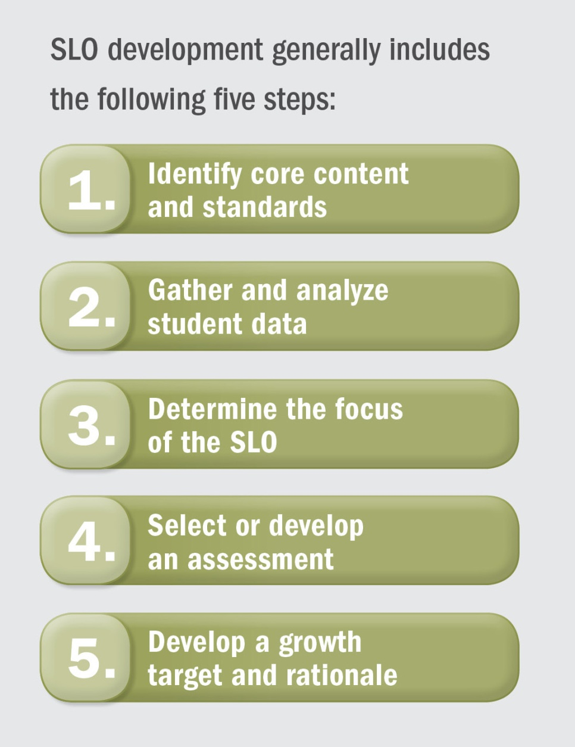
The SLO Process
SLO Development
Mid-Course Conference
Final Review and Score
Preliminary Conference- SLO Approval
Summative Conference and Reflection

Slide 13
Product The Anatomy of a SLO
Objective- The goal statement. Identifies content; focused enough that it is measurable.
Rationale- Explains how growth targets and student population were determined.
Student Population- Specific population targeted by the SLO; includes information about student learning.
Content/Standards/Interval of Instruction- Specifies time period of instruction, and demonstrates content standard alignment.
Assessment- Describes which assessment(s) and grading procedures will be used and why they are appropriate.
Progress Monitoring- Describes type and frequency of interim assessments to measure student progress.
Baseline and Trend Data- Describes students’ baseline knowledge for learning and patterns in data.
Instructional Strategies- Describes research-based instructional strategies that will be used during interval.
Growth Targets- Describes teacher’s expectations for student growth at end of interval; tiered for all students.
Teacher Professional Growth and Development (and Action Research): SC specific component.

Slide 14
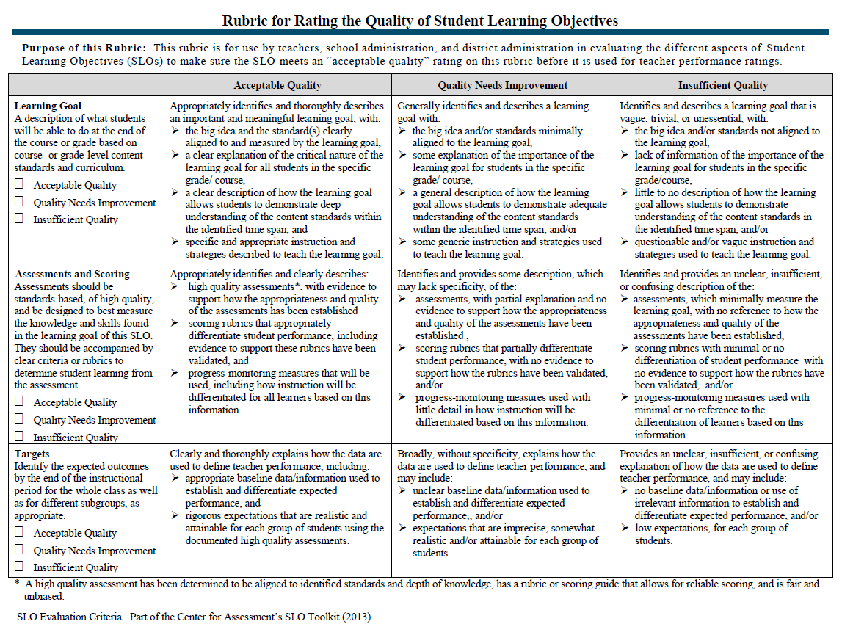
The Quality Review Tool

Slide 15
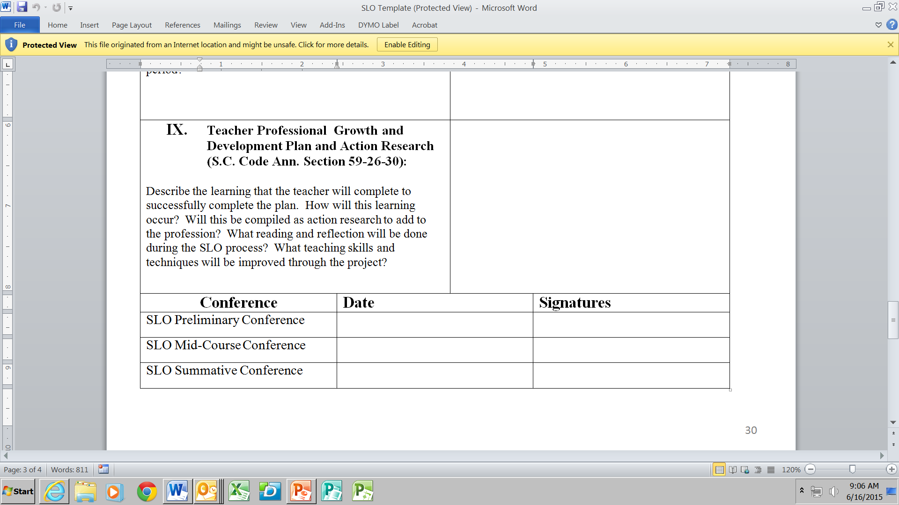

Slide 16
Summative Scoring Table
Exemplary In addition to meeting the standard… | Proficient | Needs Improvement | Unsatisfactory
The teacher attains a high level of student achievement with all populations of learners. | The work of the teacher results in acceptable, measurable progress based on established standards for a significant number of students. | The work of the teacher results in student growth but does not meet the established standard and/or is not achieved with all populations taught by the teacher. | The work of the teacher does not achieve acceptable student growth.
Almost all students meet their targeted growth, and many exceed their targets | A significant number of students meet or exceed their targets. | A less than significant number of students meet or exceed their targets. | Fewer than of students meet or exceed their targets.
Beginning of the Year Targets:
Performance Level: | Performance Level: | Performance Level: | Performance Level:
of Meet/Exceed of Exceed | of Meet/Exceed | of Meet/Exceed | < of Meet/Exceed
End of Year Performance:
of Meet/Exceed of Exceed | of Meet/Exceed | of Meet/Exceed | < of Meet/Exceed

Slide 17
Assessment and Rigor Review

Slide 18
Assessments
Measure what students are expected to learn in a course over time
Indicate the degree to which a teacher has impacted his or her students’ learning
Must be pre-approved through preliminary conference

Slide 19
Best Practice: Use 2 – 3 assessment sources
One assessment is unlikely to paint an adequate picture of student learning
Yield more meaningful, valid, and reliable information

Slide 20
State Standardized Assessments
Common Assessments
Teacher-Created Assessments
District Standardized Assessments

Slide 21
Determining
Assessment
Strength
Valid
Timely
Stretch
Reliable
Comparable
Rigorous

Slide 22
Rigor
Setting Appropriate Growth Targets

Slide 23
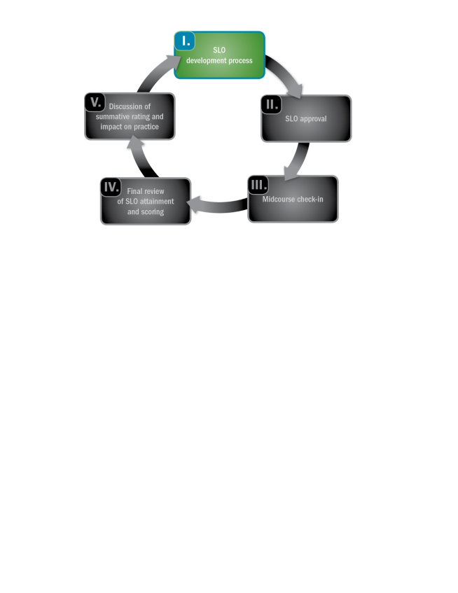
SLO Development Process
Notes:
.

Slide 24
Qualities of Growth Targets
Set to measure an increase between two points in time
Are rigorous and attainable
Informed by baseline and trend data
Stretches ALL students

Slide 25
Examine the Data
Pretests (course content)
Scores from previous similar content
Data collected over time
Additional historical data

Slide 26
Types of Growth Targets
Tiered Growth Targets | Targeted Growth Targets | Individual Growth Targets
Appropriate for the class approach to SLOs, tiered growth targets include all students but at varying degrees of expected growth. | Sub population(s) of students are the focus of the SLO goal. Appropriate for course approach as a second SLO when the first includes all students. | Appropriate for use in class or course SLOs. All students have individualized growth targets based on previous performance and expectations.

Slide 27
Possible Contextual Factors
Learning disabilities or conditions
Behavioral conditions
Student health and home conditions (i.e. transient or managing long-term health challenges)
Note: It is important to consider
Students’ past performance data
The extent to which these factors may impact student growth
What types of interventions or supports are in place and their effectiveness

Slide 28
Process for Setting Growth Targets
Set Initial Growth Targets
What growth have students made in previous years?
Adjust Growth Targets
Are there contextual factors that are likely to affect students’ growth in positive or negative ways?
Review Targets
Are these targets rigorous and attainable?
What is the minimum score at which students can be “proficient”? Does the initial growth target allow students to make meaningful progress towards proficiency?
Are these factors reflected in students’ previous growth or are they new?
What growth have students with similar factors made in the past?

Slide 29
Teacher Considerations for Setting Growth Targets
How will teachers connect growth targets to instructional strategies?
What instructional strategies will be used to ensure that lower-performing students do not fall further behind?
What instructional strategies will be used to ensure that lower-performing students can make progress towards closing their achievement gap?
What instructional strategies will be used to ensure that students consistently demonstrating proficiency continue to grow and develop advanced skills?
What instructional strategies will be used to engage and challenge higher-performing students?

Slide 30
Teacher Considerations for Setting Growth Targets
How will teachers monitor student progress?
What kinds of formative assessments and informal formative data collection will teachers use?
What kind of interim goals or benchmarks will teachers set (formally or informally) to ensure students are on-track?

Slide 31
Growth Target Example
Pre-assessment Baseline Score | Target Score on Post-assessment
41-60 | 70 or increase by 15 points, whichever is greater
61-70 | 80 or increase score by 15 points, whichever is greater
71-80 | 88 or increase score by 12 points, whichever is greater
81-90 | 95 or increase score by 8 points, whichever is greater, plus 85 or higher on final project
91-100 | 95 or increase score by 3 points (if possible), whichever is greater, plus 90 or higher on final project

Slide 32
How Could This Growth Target Be Improved?
During the fall semester, 50 percent of the students will earn a National Physical Fitness award for their performance on the Physical Fitness test.
This target is focused on proficiency, not growth. It also only requires 50 percent of students to meet the specified goal.
Use baseline data to inform the target(s).
Focus on growth, not proficiency.

Slide 33
How Could This Growth Target Be Improved?
Students scoring 80 or lower on the science pre-assessment will increase their scores on the post-assessment by at least 10 points. Any students scoring 81 or higher on the science pre-assessment will maintain their scores.
This target could be stronger. It does not sufficiently aim to bring students up to proficiency. Not all students are required to show growth.
Consider revising targets if students are very low performing so that all low-performing students are growing towards proficiency.
Revise targets for students scoring 81 or higher so that they must demonstrate growth

Slide 34

Please be ready to begin the next session in 10 minutes.
Thank you!

Slide 35
The Quality Review Tool
Evaluating a SLO for quality

Slide 36
The Quality Review Tool
The Learning Goal
Assessment and Scoring
Targets

Slide 37
Ratings
Acceptable Quality
Appropriately identifies and thoroughly describes/explains
Quality Needs Improvement
Generally or broadly identifies
Insufficient Quality
Vague, unessential, confusing, insufficient

Slide 38
The Quality Review Tool

Slide 39
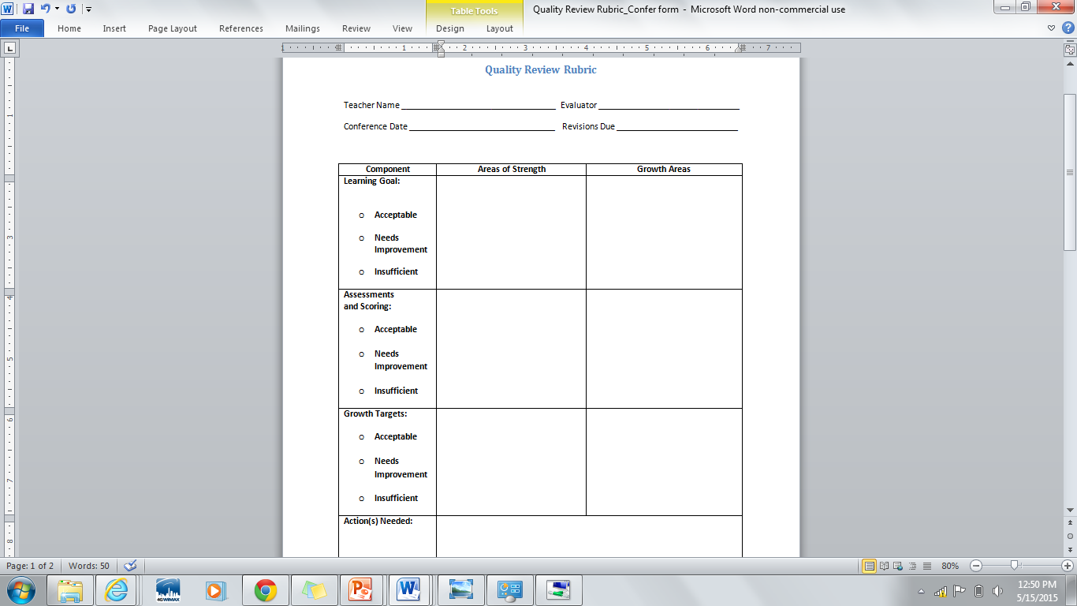
Quality Review Conference Form

Slide 40
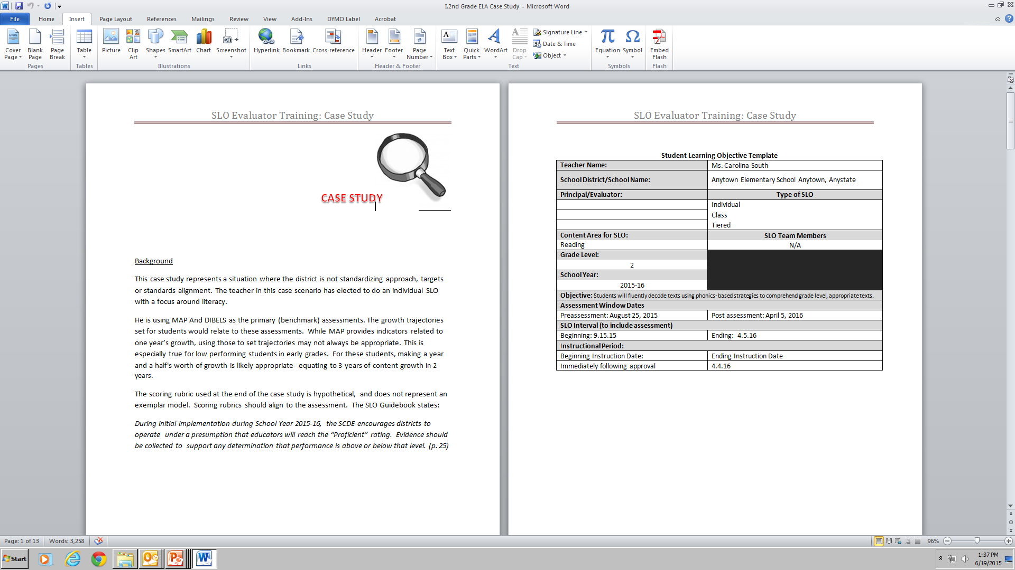
Grade 2 SLO Case Study

Slide 41
Case Study Activity
Task:
Use the Quality Review Rubric to evaluate the quality of the 2nd Grade SLO example. Be sure to rate the SLO in all three categories.
Identify areas of strength and areas of potential growth in the SLO. Use the Quality Review Conference Form to record your findings.

Slide 42
coaching conversations
Supporting Development of High Quality SLOs

Slide 43


Slide 44
Coaching Protocol
Validate
Clarify
Stretch &Apply

Slide 45
SLO Approval Conference Video
Count off 1-3. During the video capture language stems that demonstrate your assigned area of the protocol.
#1) Validate: Affirms strength, or rationale
#2) Clarify: Asks for greater detail, probes deeper
#3) Stretch: Pushes the educator to think about next steps growth and development
http://www.kaltura.com/index.php/extwidget/preview/partner_id/1675021/uiconf_id/28500151/entry_id/1_yqivbn6m/embed/auto?&flashvars[streamerType]=auto

Slide 46
Supporting and Evaluating the SLO
A Case Study

Slide 47

Reviewing Case Study SLO Plan

Slide 48

SLO Approval: Preliminary Conference
Coaching Conversation Video Recap

Slide 49
SLO Approval: Preliminary Conference
SLO Development
Mid-Course Conference
Final Review and Score
Preliminary Conference- SLO Approval
Summative Conference and Reflection
When? Prior to start of SLO interval.
Who? Final approval is issued by the building principal.
Notes:
Add directions for activity to this slide

Slide 50
Coaching Conversations Practice
Using your Quality Review Rubric Conference Sheet, engage in a coaching conversations with a table partner
Remember to use your coaching stems
Reverse Roles
Validate
Clarify
Stretch &Apply

Slide 51
SLO Development Process
Notes:
.

Slide 52
Office of Educator Effectiveness Team
Kris Joannes Director | kjoannes@ed.sc.gov 803-734-0443
Joseph Tadlock Team Leader | jatadlock@ed.sc.gov 803-734-8368
Rinice Sauls Education Associate | rsauls@ed.sc.gov 803-734-0663
Tria Grant Education Associate | tgrant@ed.sc.gov 803-734-9642
Libby Ortmann Education Associate | oortmann@ed.sc.gov 803-734-4424
David Damm Education Associate | ddamm@ed.sc.gov 803-734-8046
Dr. Sheila Quinn Deputy Superintendent, Division of Innovation & Effectiveness squinn@ed.sc.gov 803 734 7897

Slide 53

Don't judge each day by the harvest you reap, but by the seeds you plant.
Robert Louis Stevenson

