Slide 1


The Evaluator's Role in the SLO Process Module Three
Summative Conference
Presented by the SCDE Office of Educator Effectiveness

Slide 2

Connector
Think about this year. How has supporting the SLO process benefitted the principal? The teachers?
Take one minute to process independently
Turn and talk to your neighbor to discuss your thoughts
Be prepared to share out with the group

Slide 3
Welcome
and
Introductions

Slide 4
Group Norms
Be present (physically and mentally)
Please use electronic devices responsibly
Ask questions when in doubt
Honor the time schedule
Participate actively

Slide 5
Key Topics
Welcome and Introductions
SLO Module Review
SLO Conference Cycle
Coaching Conversations & the Mid-Course Conference
Case Study: End of the Year
Next Steps: Districts, Evaluators, Teachers

Slide 6
Overarching Objectives
Develop an understanding of SLOs and their role in the Expanded ADEPT Support and Evaluation System
Become proficient in evaluating SLO components to ensure successful implementation
Identify methods to support teachers in the development and monitoring of SLOs
Identify resources to facilitate the evaluation of SLOs at the school level

Slide 7
SLO Module Review

Slide 8
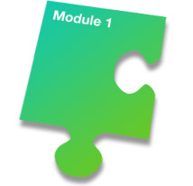

SLO Evaluator Modules
Approval Conference
Mid-Course Conference
End of the Year
Conference

Slide 9
End of Year
Each Student Learning Objective, upon review of the evaluator(s), will be given a rating. The ratings are based on the percentage of students that have met their growth goals based upon the rubric agreed upon at the beginning conference and any mid-course conference adjustments.
Teachers self-score the SLO prior to review with the evaluator.
SLO Development
Mid-Course Conference
Final Review and Score
Preliminary Conference- SLO Approval
Summative Conference and Reflection

Slide 10
Preparing for the Summative Conference
Review all available evidence submitted by the teacher, including the summary of results and any supporting documentation.
Compare results to original targets set for students.
Determine whether or not the data supports the teacher’s SLO rating.
Take into account the requirements for rigor and comparability within the district.
Review the PG&D plan results and results of action research.

Slide 11
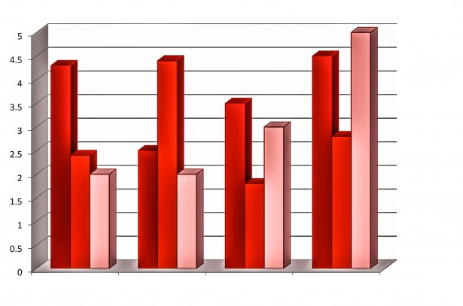

SLO Scoring:
Questions to Consider
Was the target for this SLO reached?
If not, was it close?
If so, was the target greatly surpassed? Why or why not?

Slide 12
Early Implementation Considerations:
Operate under the presumption that educators will reach a “proficient” rating.
Evidence should be collected to support and determination if performance is above or below that level.

Slide 13
Scoring Rubric Example
SLO Rating | Percentage of Attainment
Unsatisfactory | 50% or fewer students met growth goal.
Needs Improvement | 51 -99% of students met growth goal.
Proficient | All students met growth goal.
Exemplary | All students met growth goal; 25% of students exceeded goal.

Slide 14
Case Study Scoring Rubric
Exemplary In addition to meeting the standard… | Proficient | Needs Improvement | Unsatisfactory
The teacher attains a high level of student achievement with all populations of learners. | The work of the teacher results in acceptable, measurable progress based on established standards for a significant number of students. | The work of the teacher results in student growth but does not meet the established standard and/or is not achieved with all populations taught by the teacher. | The work of the teacher does not achieve acceptable student growth.
Almost all students 90-100% meet their targeted growth, and many exceed their targets | A significant number of students 70%-89% meet or exceed their targets. | A less than significant number 69-50%of students meet or exceed their targets. | Fewer than 50%of students meet or exceed their targets.

Slide 15
Coaching Protocol
Validate
Clarify
Stretch &Apply

Slide 16
coaching conversations
Supporting Development of High Quality SLOs

Slide 17
SLO Summative Conference Video
Count off 1-3. During the video capture language stems that demonstrate your assigned area of the protocol.
#1) Validate: Affirms strength, or rationale
#2) Clarify: Asks for greater detail, probes deeper
#3) Stretch: Pushes the educator to think about next steps growth and development
Video Link: http://www.kaltura.com/tiny/kru5u

Slide 18

SLO Summative Conference
Coaching Conversation Video Recap

Slide 19

Key Takeaways
Student growth is collected and scored annually.
SLO Scoring rubrics are submitted annually with ADEPT plans.
For 15-16, assume “proficiency” unless significant data to suggest otherwise.
Those that engage in the process (as outlined) report that the scoring of an SLO is not surprising.

Slide 20
Overarching Objectives
Develop an understanding of SLOs and their role in the Expanded ADEPT Support and Evaluation System
Become proficient in evaluating SLO components to ensure successful implementation
Identify methods to support teachers in the development and monitoring of SLOs
Identify resources to facilitate the evaluation of SLOs at the school level

Slide 21
Next Steps
SLO Evaluator Training (for appropriate staff)
  Materials available on SCDE Website http://ed.sc.gov/slo
SLO Teacher Training
  SLO Toolkit http://ed.sc.gov/plod
  SLO Online Module
  District SLO Trainings

Slide 22
Office of Educator Effectiveness Team
Kris Joannes Director | kjoannes@ed.sc.gov 803-734-0443
Joseph Tadlock Team Leader | jatadlock@ed.sc.gov 803-734-8368
Rinice Sauls Education Associate | rsauls@ed.sc.gov 803-734-0663
Tria Grant Education Associate | tgrant@ed.sc.gov 803-734-9642
Libby Ortmann Education Associate | oortmann@ed.sc.gov 803-734-4424
Dr. Sheila Quinn Deputy Superintendent, Division of Innovation & Effectiveness squinn@ed.sc.gov 803 734 7897

Slide 23

Simple Truths

