Slide 1
American Rescue Plan Emergency Assistance to Nonpublic Schools
(ARP EANS)
Technical Assistance Session

Slide 2
Purpose and Goals
The purpose of this Technical Assistance Session is to provide an overview of recent revisions to eligibility criteria under the SC ARP EANS program, as well as a change to some processes previously outlined during the Technical Assistance Session dated 10/27/2021, which can be found on the SC ARP EANS website.
The Goal of this session is to provide interested parties with an understanding of the SC ARP EANS revised eligibility and the processes that the SCDE will use to administer these funds.

Slide 3
OVERVIEW OF CHANGES
SC ARP EANS Program

Slide 4
Background
In review of the initial applications received, it was determined that the original low-income enrollment requirement of 40 percent would not aid a fair representation of low-income students enrolled in South Carolina non-public schools.
Governor Henry McMaster submitted an amended application on January 14, 2022, indicating a revised low-income enrollment threshold of 20 percent.
The U.S. Department of Education reviewed this request and approved the amendment on February 10th, 2022.

Slide 5
Revised Timeline
1/14/2022
South Carolina Governor’s Office submits revised application for ARP EANS grant
2/10/2022
US Dept. of Education approves the revised application
2/18/2022
SCDE provides Technical Assistance session to widely disseminate information

Slide 6
Revised Timeline (continued)
2/18/2022
Applications are made available to non-public schools
3/6/2022
Applications close at 11:59 p.m.; any application received after the deadline will not be considered.
3/18/2022
SCDE will approve or deny completed applications, with final amounts approved as soon as possible after applications close.

Slide 7
Private School Eligibility
In the revised application for ARP EANS, the significant poverty percentage is now defined as 20 percent or higher
All other eligibility criteria remain the same:
  Must be established as a not-for-profit entity, licensed, accredited, or otherwise approved to operate in accordance with State law, and in existence prior to March 13, 2020
  Did not and will not apply for and receive a PPP loan made on or after December 27, 2020
  Must be most impacted by the COVID-19 pandemic. The factor utilized in determining COVID-19 impact is the number of infections per capita in the community(ies) served by the non-public school
Notes:
Note:
Most requirements are the same as EANS I under CRRSA and have not changed under the revision:
Must be established as a not-for-profit entity; for-profit private schools are ineligible
Must have been in existence prior to March 13, 2020
Must be licensed, accredited, or otherwise approved to operate in accordance with State law
Did not and will not apply for and receive a loan under the Small Business Administration’s Paycheck Protection Program (PPP) (15 U.S.C. 636(a)(37)) that is made on or after December 27, 2020
Special condition: If a private school received PPP from an application made before Dec. 27, 2020, it must assure that no EANS funds may be used to pay for the same service or items (reimbursable or otherwise) as the PPP funds were or will be used.

Slide 8
Low-Income Enrollment
Private school must provide the number of low-income students enrolled in its school for the 2020-21 school year
  Must be aged 5 – 17 years old and enrolled at the non-public school
  Must be from a family at or below 185 percent of the 2020 poverty level
Private school must use one or more of the following data sources as the basis for determining its poverty level:
  Personal tax documents, W-2s, pay stubs, or other similar documents which indicate a household’s annual income
  Free or reduced-price lunch data,
  Scholarship or financial assistance data,
  E-Rate data, and/or
  Other relevant data that identifies students whose family income does not exceed 185 percent of the 2020 Federal poverty guidelines
Notes:
Associations mentioned FACTS as a possible source of information for schools

Slide 9
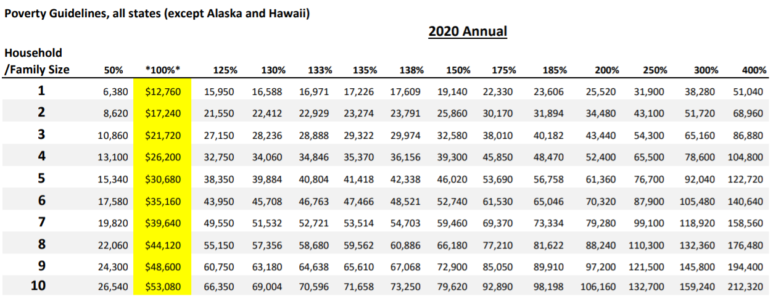
Low-Income Enrollment Table
2020 Poverty Guidelines can be found here and is also available on the SC ARP EANS website and in the ARP EANS application
Department of Health and Human Services

Slide 10
Impact of COVID-19
Private schools must list the county(ies) they serve, indicate the proportion of enrollment for each county, and provide the COVID infection rate for each county
  To ensure all schools are reporting for the same time period, we will be looking at infections rates as of October 15, 2021
  Schools whose proportionate infection rates exceed the U.S. infection rate as of October 15, 2021, will be considered “most impacted”
The SCDE will be utilizing the South Carolina Department of Health and Environmental Control (SCDHEC) to verify community infection rates

Slide 11
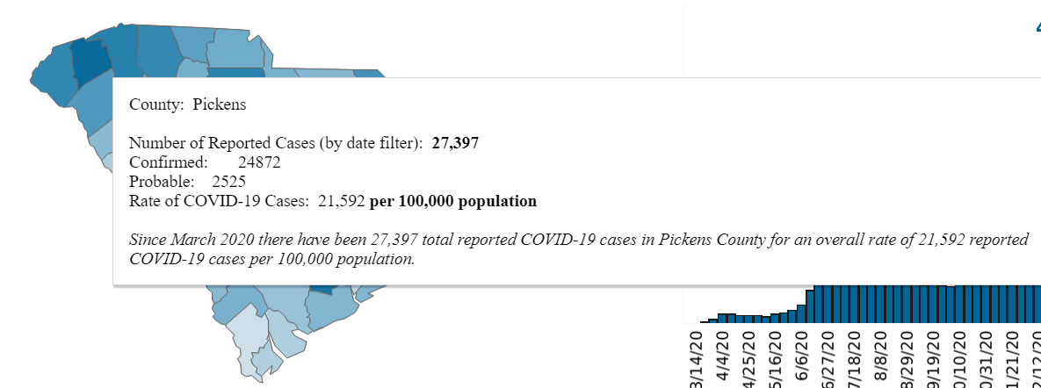
COVID-19 Dashboard
The SCDHEC COVID-19 dashboard can be found here and is also available on the SC ARP EANS website and in our application
  Once in the dashboard, click on the “Cases” tab for county-wide infection rates
  Ensure the date range shows an end date of 10/15/2021
  Based on the below, schools who serve Pickens county would report an infection rate of 21.59%
SCDHEC COVID-19 Dashboard

Slide 12
PROCUREMENT PROCESS
SC ARP EANS Program

Slide 13
Vendor Management
Vendors are no longer limited to those who are contracted with the SCDE
A third-party vendor will be utilized in a similar manner as with EANS I
  Reimbursements are not permitted.
  Because the program is no longer limited to state-contracted vendors, schools must follow the SCDE procurement process
  More information will be provided to approved applicants once finalized
Notes:
Originally, all assistance under SC ARP EANS was to be provided by state-approved contractors
Under the revised criteria, the number of eligible schools and claims for assistance are expected to increase significantly
Due to this, it would no longer be feasible for the SCDE to house the claims process internally

Slide 14
Procurement Thresholds
Costs must be allowable, reasonable, and necessary, and be included in the school’s final approval for assistance
Quotes must be obtained prior to request
  Up to $10,000 – One Quote
  Over $10,000 – Three (3) Bona Fide Quotes from qualified sources of supply
If you cannot obtain three quotes, entity must:
  provide proof that request was advertised on school website, or
  provide proof that three quotes were attempted
We will allow funding for the request of the lowest bid
* Applies to all purchases other than Catapult Learning services

Slide 15
Equipment
Equipment is defined as:
  Any single item whose market price or purchased cost is $2,500 or more; or
  Any technology device (such as a laptop, projector, interactive monitor, camera, or other device) regardless of cost
Prior to submitting a claim for equipment, the school must:
  Download and complete the Equipment Tracker found on the SC ARP EANS website
  Download and complete the Transfer of Ownership form found on the SC ARP EANS website, using the Equipment Tracker as an addendum
  Email the Equipment Tracker in Excel format and a scanned copy of the signed Transfer of Ownership form to sceans@ed.sc.gov
The SCDE understands that serial numbers may not be available until devices are received.
  We ask that you initially submit the tracker completed to the best of your ability.
  Once the devices are received, update the tracker and send to sceans@ed.sc.gov for us to complete the process

Slide 16
Equipment – Annual Inventory
All tagged equipment must also be annually inventoried by the school
Around June 1st of each year, non-public schools who received assistance for equipment will be provided with an inventory list and instructions on completing the annual inventory process
  These steps include verifying physical condition of devices, confirming the correct asset tags are still affixed to the appropriate device, etc.
  Affirmation that the inventory has been complete and any items needing addressed must then be sent back to the SCDE
  This process must be complete prior to June 30th

Slide 17
APPLICATION PROCESS
EANS Program

Slide 18
Application Process
Non-public schools must complete the online application found on the SC ARP EANS website by 11:59 p.m. on March 6, 2022
In addition to the previously-described eligibility data, non-public schools must provide a detailed description of products and/or services being requested
  This includes the product and/or service, number of units, years applicable, purpose, cost for such assistance, and relation to the pandemic should be provided for us to appropriately determine allowability
  If a school is initiating or continuing services with Catapult for Categories 4, 7, 9 or 12, please work with them to generate a proposal and upload this document in your application

Slide 19
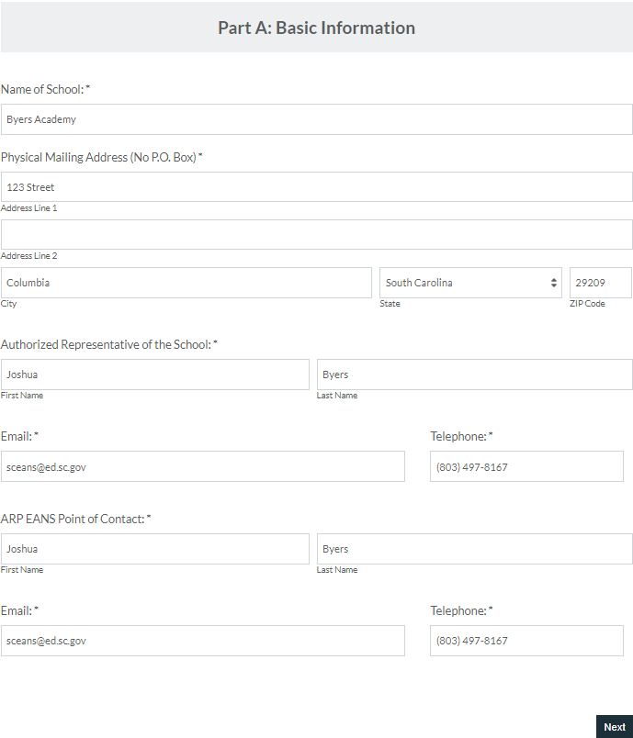
Online Application
Part A: Basic Information
School Name
Physical Address (P.O. Box not permitted)
Authorized Representative
  Individual with the authority to submit the application
EANS Point of Contact
  Who we will reach out to if we have any questions or need additional information

Slide 20
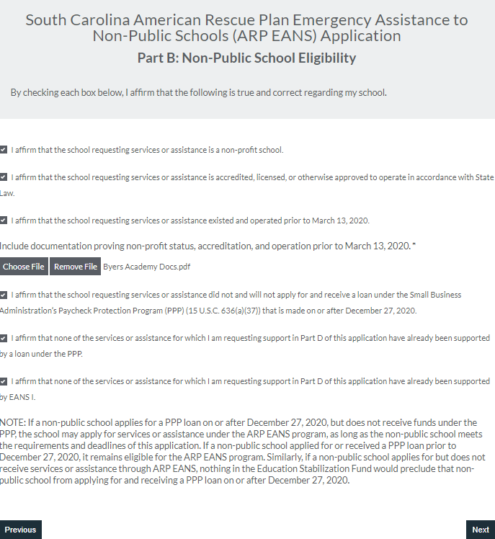
Online Application
Part B: Eligibility
Affirm and upload documentation supplying proof:
  Non-profit
  Accredited, licensed, or approved to operate
  In operation prior to March 13, 2020
Affirm PPP was not applied for on or after December 27, 2020
Affirm any PPP funds prior to Dec. 27, 2020, were not and will not be used for services being applied for
Affirm any EANS I funds will not be used for services being applied for

Slide 21
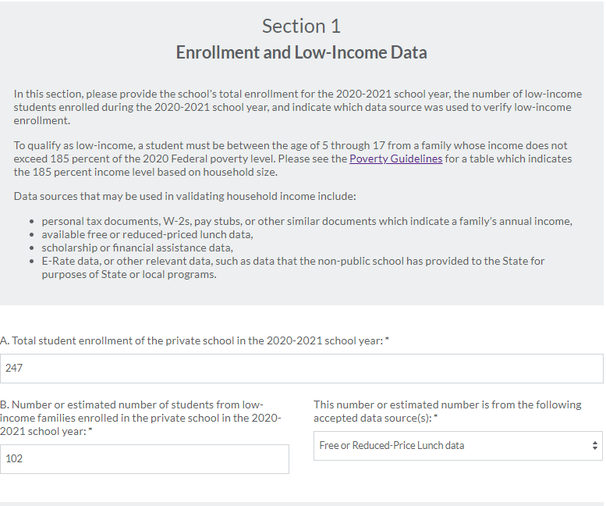
Online Application
Part C: School Data
Section 1: Enrollment & Low-Income Data
School must provide:
  2020-2021 total enrollment
  Number of students from low-income households
  Data source used to provide the number of low-income students
To qualify as low-income
  Student must be aged 5-17 years old
  Student must be from family or household whose income falls within 185% of the poverty level

Slide 22
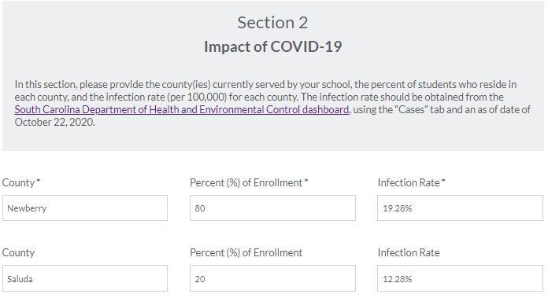
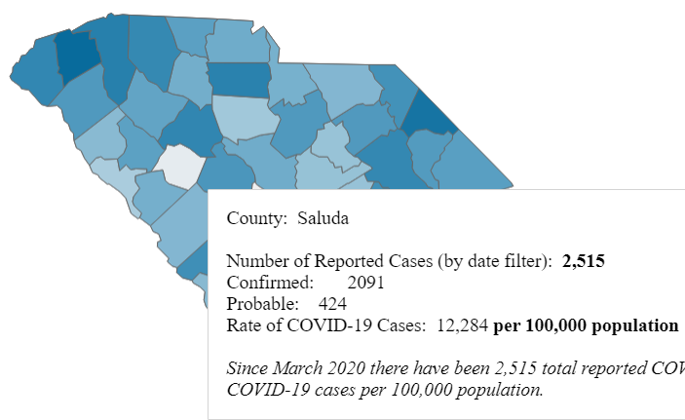
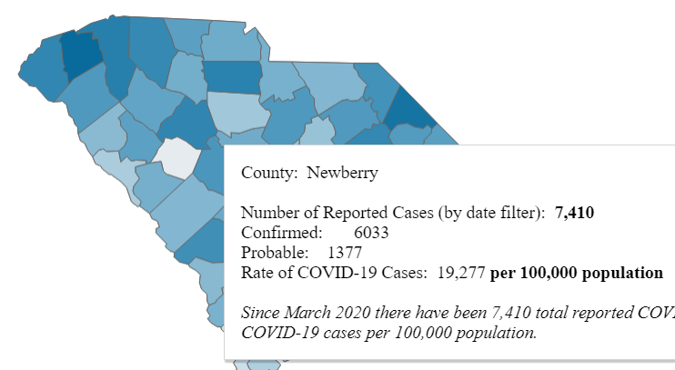
Online Application
Part C: School Data
Section 2: Impact of COVID-19
School must provide:
  County(ies) in which they serve
  Percent of enrollment from each county
  Infection rate for each county as of 10/15/2021

Slide 23
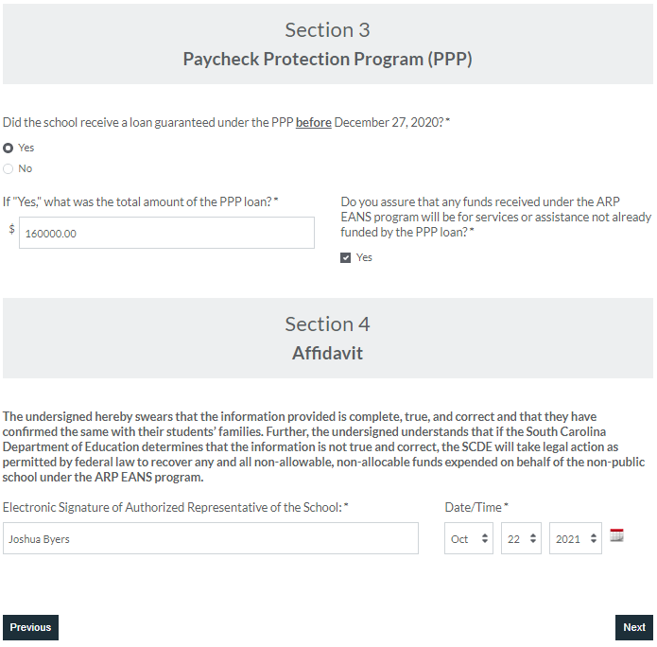
Online Application
Part C: School Data
Section 3: Paycheck Protection Program
School must certify that, if a PPP loan was received prior to 12/27/2020, the funds were not used for any services or assistance being requested
Section 4: Affidavit
School must affirm that all data provided in Part C is accurate and that if it is found not to be correct, the SCDE has the right to recover funds
The SCDE also has the right to ask for supporting documentation and will perform a random audit of applications received

Slide 24
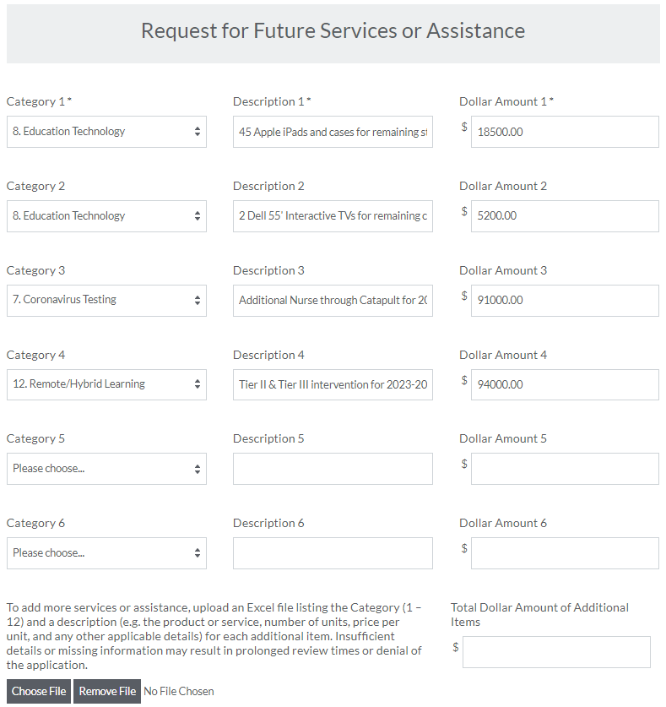
Online Application
Part D: Assistance Requested
School must provide the category and a description of the assistance being requested
The description of the request must include pertinent information which allows the SCDE to validate that requests are allowable, reasonable, and necessary
If the boxes provided are insufficient, an excel document may be uploaded to include additional services
Any reference to specific products or services is not an endorsement by the SCDE for a particular vendor and is solely used as an example for application purposes.

Slide 25
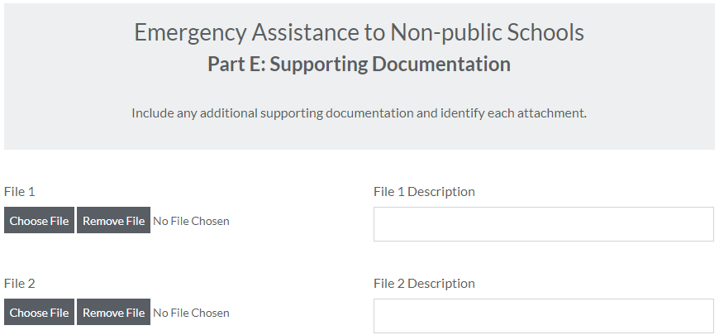
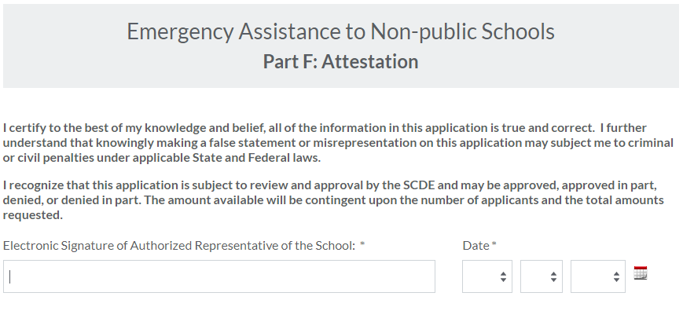
Online Application
Part E: Supporting Docs
Include any additional documentation believed to be relevant to the application
Part F: Attestation
Sign and submit for SCDE review

Slide 26
Next Steps
Applications are available as of February 18, 2022, on the SC ARP EANS website and will close at 11:59 p.m. on March 6, 2022
Conditional Approval will be provided initially to those who are eligible
The SCDE will review all applications to ensure all requested assistance appears reasonable, allowable, and necessary, and to ensure the total amount requested from non-public schools does not exceed the amount available under SC ARP EANS
Final Approval will be provided shortly after

Slide 27
SC ARP EANS Resources
SC EANS I Website
SC ARP EANS Website
Allowable Uses for EANS Funds
U.S. Department of Education ARP EANS Website
U.S. Department of Education EANS FAQs

Slide 28
Questions
Please email SCEANS@ed.sc.gov with any questions or issues
regarding the EANS Program
Please email SCEANS@catapultlearning.com with any questions regarding the services Catapult Learning provides, or to schedule a planning meeting with them

