Slide 1



EDUCATORS: THE OVERLOOKED WORKFORCE
SREB Presentation to the
South Carolina Teacher Recruitment and Retention Taskforce
February 10, 2023
Dr. Stephen Pruitt and Megan Boren
Notes:
STEPHEN
Improving our education systems are key to the economy. Educators are integral to our economy but have been overlooked.

Slide 2
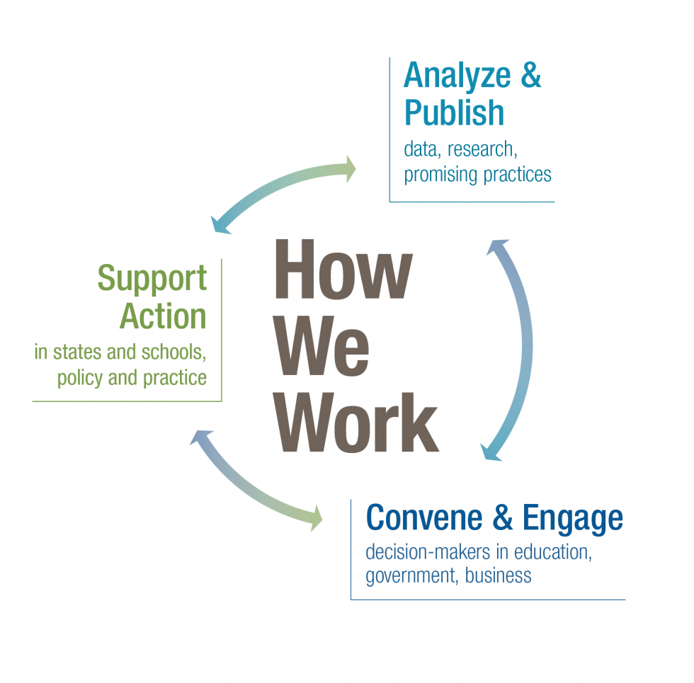
Notes:
STEPHEN
A bit about SREB.....

Slide 3

Every child deserves a great teacher — but teacher shortages hurt education and the economy
Notes:
Teacher shortages affect students. Teacher shortages affect student learning and the experiences students have in school. For example, teacher shortages can lead to increased class sizes and can increase a student’s likelihood of having a less experienced or out-of-field teacher.
Teacher shortages are a drain on the economy. A strong teacher workforce is crucial to fueling the current economy and preparing students for fulfilling careers of their own in the future. Businesses are reliant on the education system to produce a strong workforce and often choose to locate in places with high-quality educational experiences — so when students don’t have strong, well-trained teachers, these workforce needs are less likely to be met.
What is our response to others that say teacher shortages aren’t really an issue, are overstated, or haven’t been affected by COVID? This narrative may not fully account for regional differences or may be only looking at the overall quantity of teachers, but not the quality or demographic of those teachers. It also may not weigh the equitable distribution of strong teachers — for example, shortages in rural communities and/or low-income schools.

Slide 4

A SNAPSHOT OF
TEACHER WORKFORCE DATA
Notes:
MEGAN
What kinds of educator shortages are we having with the teacher workforce and why?

Slide 5

Unpacking Teacher Shortages: Overview
We can break this challenge down into four key areas:
Quantity
What proportion of teachers are entering and exiting the profession?
Is it enough to meet needs?
How well-prepared are novice teachers?
How effective is the teaching that is taking place?
What levels of experience and certification do teachers have?
How well-supported are teachers at various stages of their careers?
Quality
Demographics
What are the demographics of the teacher workforce?
Does the teacher workforce reflect student demographics?
Distribution of Talent
In the SREB region, students of color and students from low-income backgrounds are disproportionately taught by teachers who are:
Less experienced
Less effective
Out-of-field

Slide 6

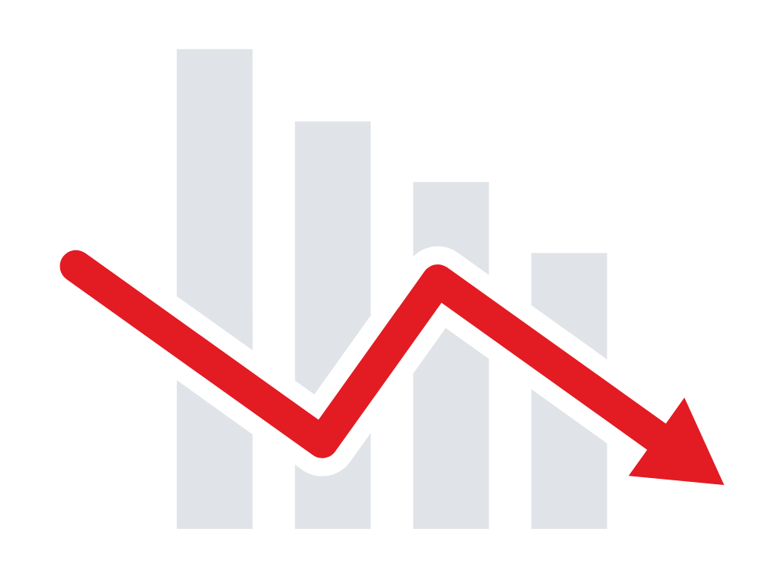




Teacher Shortages:
Quantity (Entering)
of parents say they would not like their child to become a teacher
In a 2022 survey of Chief Talent Officers, 86% said they were currently finding it more difficult to hire new teachers
54%
One study found that 50% of high school students said they would be “somewhat,” “moderately,” or “definitely” interested in becoming a teacher — but the top reasons they cited for why they ultimately decided not to include:
Completion in teacher preparation programs is trending downward:
SREB states are preparing over 15,700 fewer teachers than a decade ago, despite recent rising enrollments.
low pay
lack of career advancement
lack of flexibility
lack of prestige & respect
Sources: Title II Reports, 2019-20 | PDK Poll, 2018 | ACT Research & Policy, 2018 | TNTP, 2022
Notes:
Notes:
To understand the teacher quantity/supply issue, we need to understand why people aren’t entering the profession in the first place.
PDK’s 2018 poll was the first time since polling began in 1969 where a majority of parents said they would not want their child to become a teacher (46% said they’d support their child going into teaching; 54% said they would not want their child to become a teacher)
SREB states prepared over 15k fewer teachers in 2021 than in 2013.
In 2019-20, total enrollment in prep programs in the region was 247,891. 54,143 completed in 2020. This includes traditionally prepared teachers and both IHE-based and non-IHE based alternative programs.

Slide 7
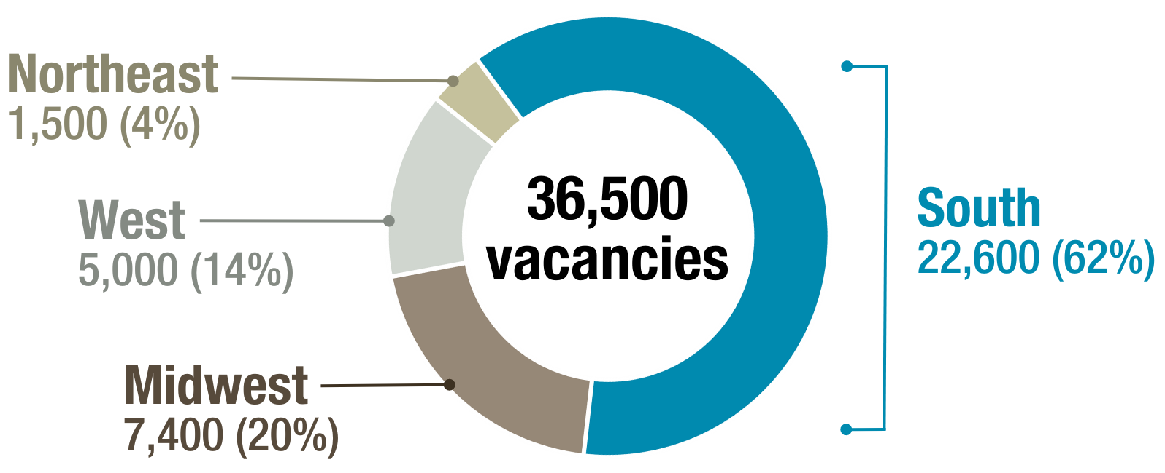
Teacher Shortages:
Quantity
The South makes up a majority of known U.S. teacher vacancies.
An estimated number of teacher vacancies by region shows shortages are felt everywhere, but especially in the South.
Source: K-12Dive / Annenberg Institute at Brown University 2022
Notes:
LPI found that the investments districts make in new hires (turnover, recruitment, hiring, training) don’t pay their full dividend when teachers leave within their first 1 or 2 years after being hired — and given that the average turnover rate in SREB states among teachers in their first 5 years is 45%, there’s a lot of monetary inefficiencies and challenges that come with teacher turnover and shortages. It costs on average $21,000 to replace each teacher.
Notes:
More specific state-by-state data can be found on page 4 of the teacher blueprint report (or at the USDOE teacher shortage areas website).
In this data, middle school grades are typically lumped in with secondary.

Slide 8
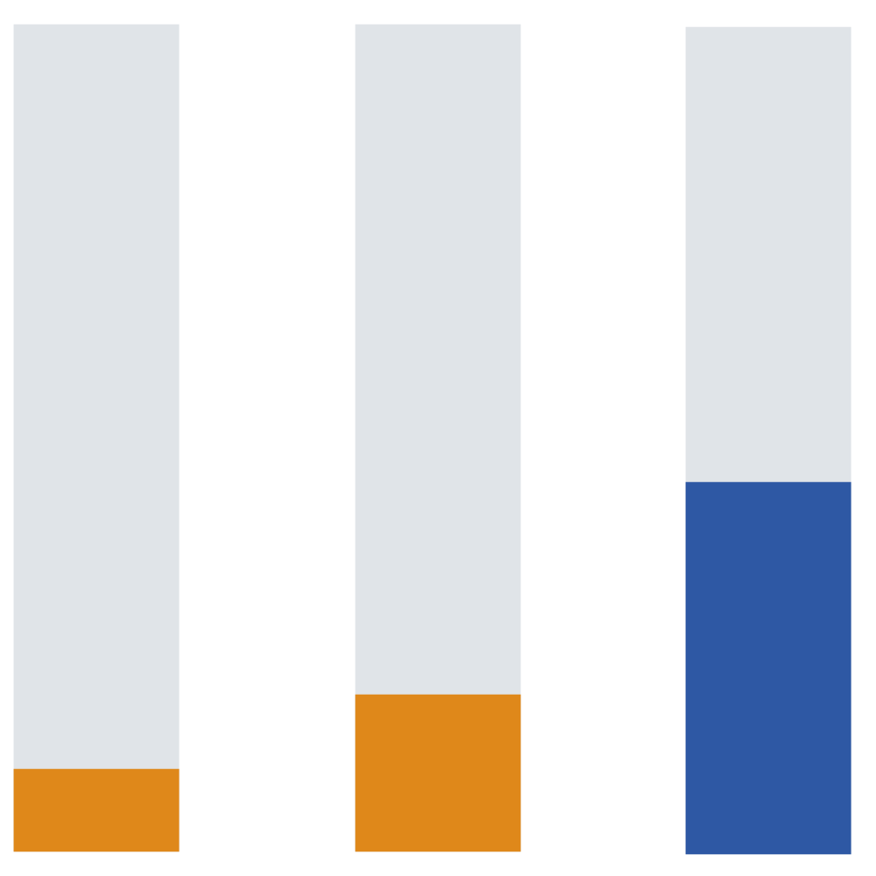
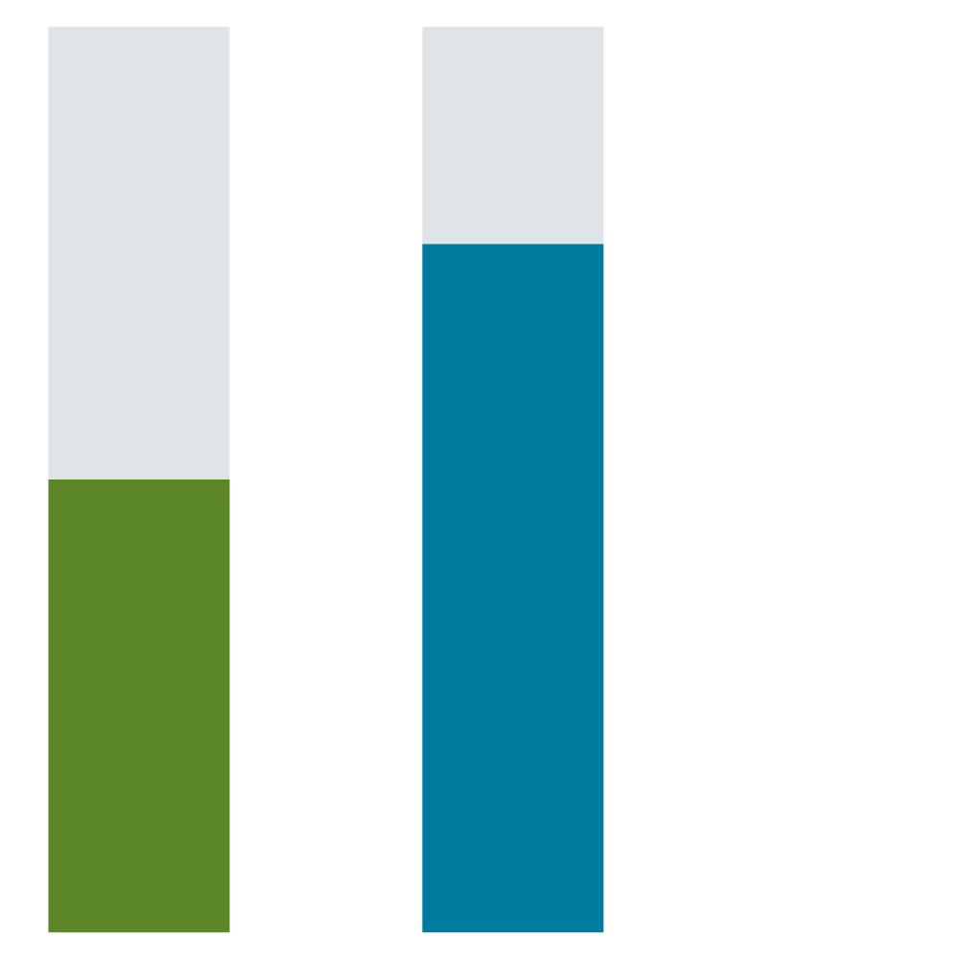
Teacher Shortages:
Quantity (Exiting)
Working conditions are at the heart of why many states have trouble attracting and retaining a strong teacher workforce.
Teachers who leave cite:
Inadequate pay
School climate
Stress and burnout
School leadership
Lack of autonomy and value
2019-20
2021-22
76%
50%
45%
10%
Average turnover rate in SREB states
Average turnover rate in SREB states among teachers with ≤ 5 years of experience
Teachers who say they plan to leave their jobs
Chief Talent Officers who say resignations are higher now than in previous years
Sources: IES/NCES, 2019-20 | TNTP, 2022 | NEA, 2022 | RAND, 2021
Notes:
Notes:
To understand the teacher quantity/supply issue, we need to understand why people are choosing to leave the profession.
In 2019-20, turnover averaged 10.2% in the region, yet some states in the SREB region had an average turnover rate as high as nearly 19%.
The survey data included here is national, but likely indicative of similar trends in the SREB region.
Federal data shows that between January-November 2020, 800k resignations were handed in by employees who work in education at the state and local level — a 40% rise. For comparison, retail resignations rose 27% in that same timeframe.

Slide 9
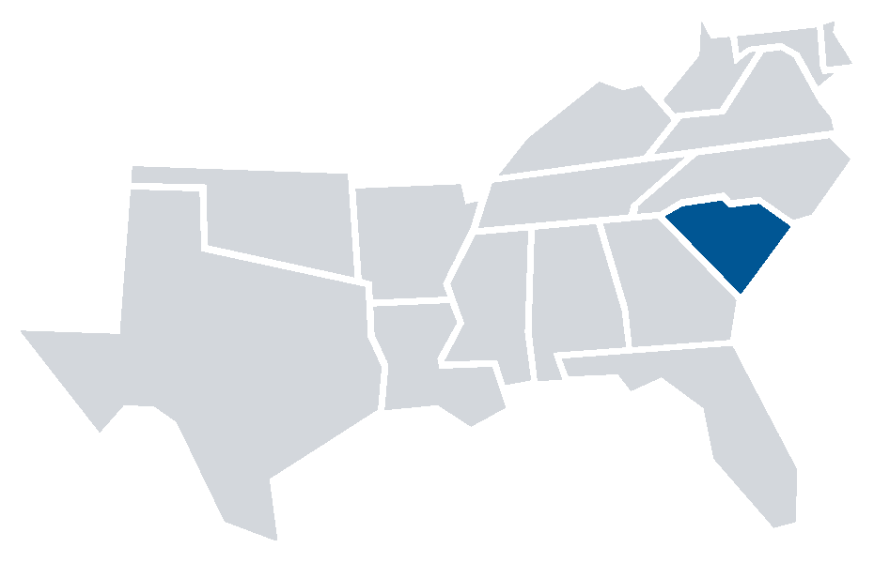
Teacher Shortages:
Quantity
South Carolina
English Language Arts
5-12
Math
5-12
Science
5-12
Social Studies
5-12
Special Education
P-12
English as a Second Language
P-12
Career/Tech Education
P-12
Teacher Shortages by Subject and Grade
53,306
Total Number of Teachers
24.1:1
Pupil to Teacher Ratio in Core Subjects
Declining Completion Rates in Teacher Preparation
South Carolina prepared nearly 400 fewer teachers as compared to 2013.
12.1%
Teacher Turnover Rate
2,089 completers
2,168
2,447
Sources: Title II Reports, 2019-20 | U.S. Department of Education, Teacher Shortage Area report, SC State Report Card 21-22 Classroom Environment report
Notes:
Notes:
To understand the teacher quantity/supply issue, we need to understand why people aren’t entering the profession in the first place.
PDK’s 2018 poll was the first time since polling began in 1969 where a majority of parents said they would not want their child to become a teacher (46% said they’d support their child going into teaching; 54% said they would not want their child to become a teacher)
SREB states prepared over 15k fewer teachers in 2021 than in 2013.
In 2019-20, total enrollment in prep programs in the region was 247,891. 54,143 completed in 2020. This includes traditionally prepared teachers and both IHE-based and non-IHE based alternative programs.

Slide 10
Teacher Shortages:
Quality
On average, in the SREB region…
15.7% of teachers are inexperienced (≤ 3 years)
4.2% are uncertified or emergency certified
11.1% are teaching out-of-field
South Carolina, 2021-22
19% of teachers are inexperienced
Not reported - uncertified or emergency certified
2.4% are teaching out-of-field
Sources: IES/NCES, 2019-20 | Title II Reports, 2019-20 | Learning Policy Institute, 2017, SC State Report Card 21-22 Classroom Environment report
Notes:
Notes:
Data such as teacher experience level and certification/credentials are not a perfect proxy for teacher quality, but they are one valuable input/indicator.
“Teaching Out-of-Field” refers to teachers who spend more than a certain percentage of their time teaching in grade levels, subject areas, or specialized areas (such as ELL or special education) that they are not certified in.
In one SREB state, over 35% of teachers are inexperienced, uncertified or teaching a majority of classes out of their trained field, affecting up to $165k students in the state.

Slide 11

National Ranking | State | % of Teacher Workforce
#1 | NC | 23.2%
#3 | SC | 17.4%
#4 | MS | 14.5%
#6 | KY | 9.9%
#7 | AR | 9%
#8 | FL | 8.2%
#9 | AL | 7.8%
#10 | OK | 7.2%
#13 | WV | 6.1%
#14 | MD | 5.6%
#17 | LA | 4.9%
#19 | DE | 4.8%
#20 | VA | 4.5%
National Average = 3%
#29 | GA | 2.2%
#37 (tied) | TN | 1.2%
#49 | TX | 0.3%
The SREB region leads the nation in the percent of teachers who are
National Board Certified
Source: NBPTS, 2022
Notes:
Note: TN is tied at #37 with PA.
National avg is 3%, SREB avg is 7.9%

Slide 12
Teacher Shortages:
Demographics
South Carolina
Teacher Gender Teacher Race/Ethnicity
19% Male
… and 77% of teachers are female, with the remaining unspecified
… and 75% of teachers are white, with the remaining not reported
Sources: IES/NCES, 2019-20 | Title II Reports, 2019-20 | Alliance For Resource Equity, 2021 | The Education Trust, 2019

Slide 13
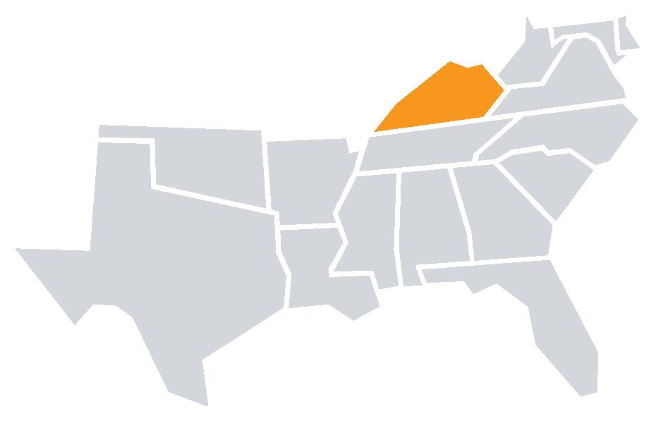
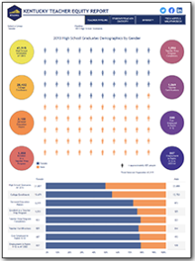
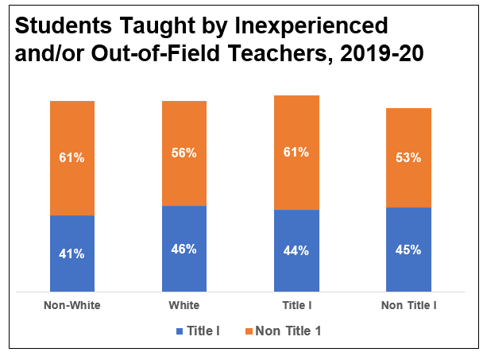
Teacher Shortages:
Distribution of Talent
KENTUCKY DATA:
Reporting on Distribution of Teacher Talent
Kentucky Teacher Talent Spotlight
Only a few states collect data on what many call “teacher equity,” yet all states should. Kentucky publicly reports on the percent of students from different demographics that are taught by less experienced, ineffective, or out-of-field teachers. The chart below highlights their data.
Kentucky’s Teacher Equity Report:
An interactive dashboard that presents two perspectives on the educational workforce.
Published July 2021
Sources: Kentucky School Report Cards; KYSTATS
Notes:
South Carolina does not currently report on this type of talent distribution data. SREB encourages doing so for a clearer picture of the teacher supply and demand needs of districts across the state. This way the state can make more targeted improvements in these areas as needed.

Slide 14
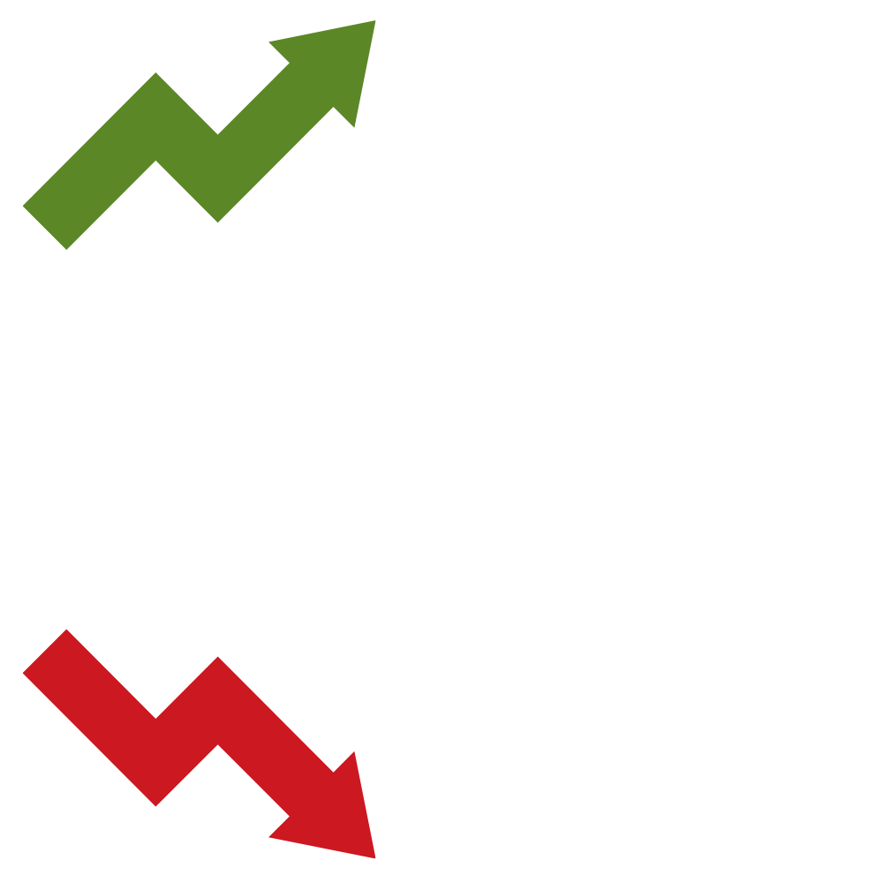
The Impact of COVID-19:
Early indicators point to a mounting teacher shortage problem.
What’s increasing?
What’s decreasing?
Workloads
44% of teachers report working more hours during the pandemic.
Morale
84% of teachers and admins say morale is lower than prior to COVID.
2. The percent of teachers who say they plan to leave
2. The percent of teachers who are ‘very satisfied’
Sources: Educators for Excellence, 2021 | NEA, 2022 | RAND, 2021 | Horace Mann, 2020 | Mission Square Research Institute, 2020 | EdWeek Research Center, 2020 | EdWeek Research Center, 2022
Notes:
Teacher shortages are affected by many things – teacher compensation packages and out of pocket classroom expenses, stress levels, workloads, administrative and peer leader support, school culture, supports and planning time, and of course the level of respect and listening to teacher voice. The pandemic exacerbated many of these issues.
Note: This data is national, but likely indicative of similar trends in the SREB region.

Slide 15
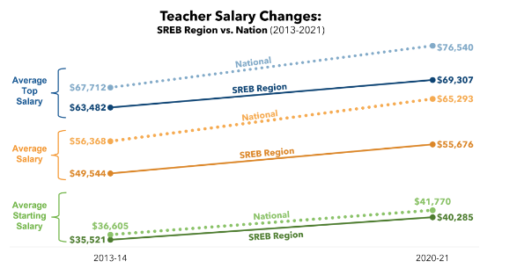
SREB Region-At-A-Glance:
Teacher Compensation
South Carolina
Average Teacher Salaries, 2020-21
$76,568 - Avg Top
$53,188 - Avg Overall
$37,704 - Avg Starting
Source: SREB Teacher Compensation Dashboard – SREB’s Updated Teacher Compensation Board to be released mid-February 2023
Notes:
South Carolina’s top salary exceeds the region and nation, but the overall average and starting average is below the national and regional averages.
Note: Although the cost of living index for the region is 95.2% (slightly lower than national), these discrepancies in compensation outweigh that.

Slide 16
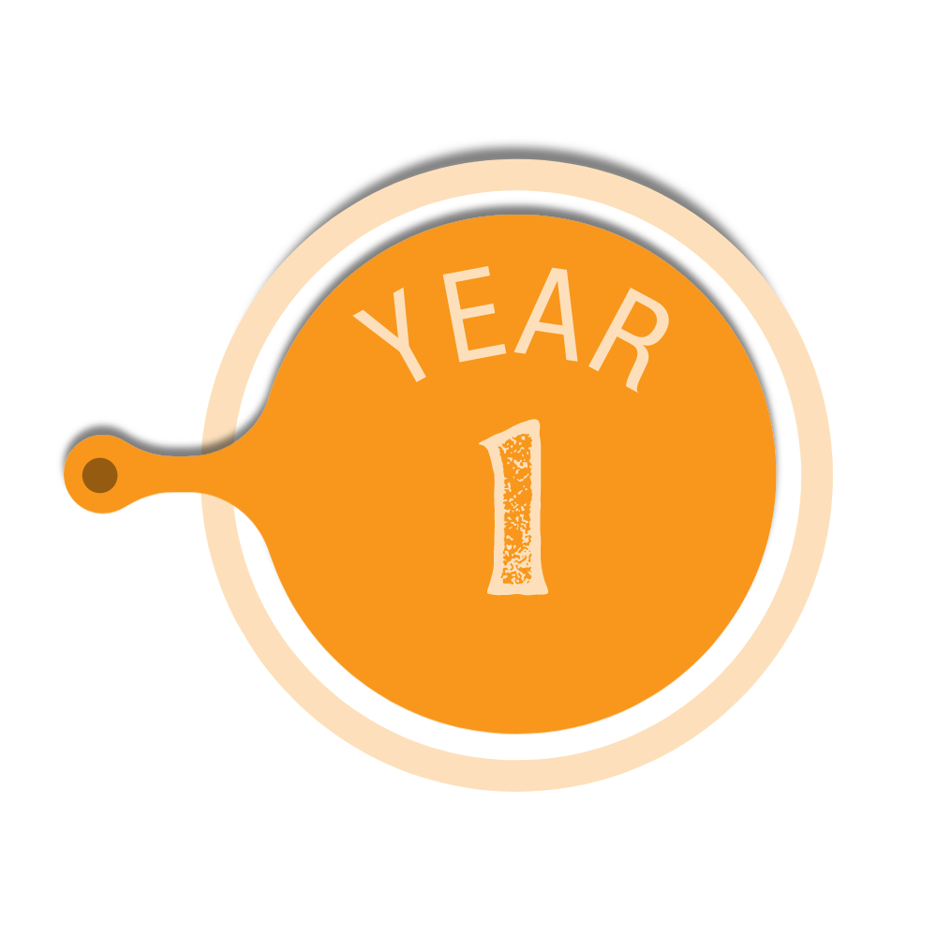



SREB Region-At-A-Glance:
Teacher Compensation
Average Annual Net Salary in Region, 2021
Average Annual Net Salary in South Carolina, 2021
TAKE HOME PAY
$29,420
$27,159
$36,663
$36,125
$46,296
$51,731
Source: SREB Teacher Compensation Dashboard – SREB’s Updated Teacher Compensation Board to be released mid-February 2023
Notes:
Based on state data, SC should consider increasing the starting pay for teachers, as they lag the regional average in gross and net pay for early career teachers. See our dashboard for more details, plus data on teacher health benefits and retirement benefits.
Note: Cost of living index in SC is 95.9%.
The teacher wage penalty from EPI, is -8.3%, the lowest in the region! Regional average wage penalty is -23.5%.

Slide 17
PROJECTIONS
THE FUTURE EDUCATOR WORKFORCE
Notes:
STEPHEN
If no changes are made and current trends continue, here is a peak into what the educator workforce could look like in the next decade.

Slide 18


Projections in SREB States
2019-20 DATA
2029-30 PROJECTIONS
1.3 million teachers serving
19.4 million students
across 16 states
1.8 million teachers serving
27.3 million students
across 16 states
Source: SREB projected data calculations using Census data

Slide 19
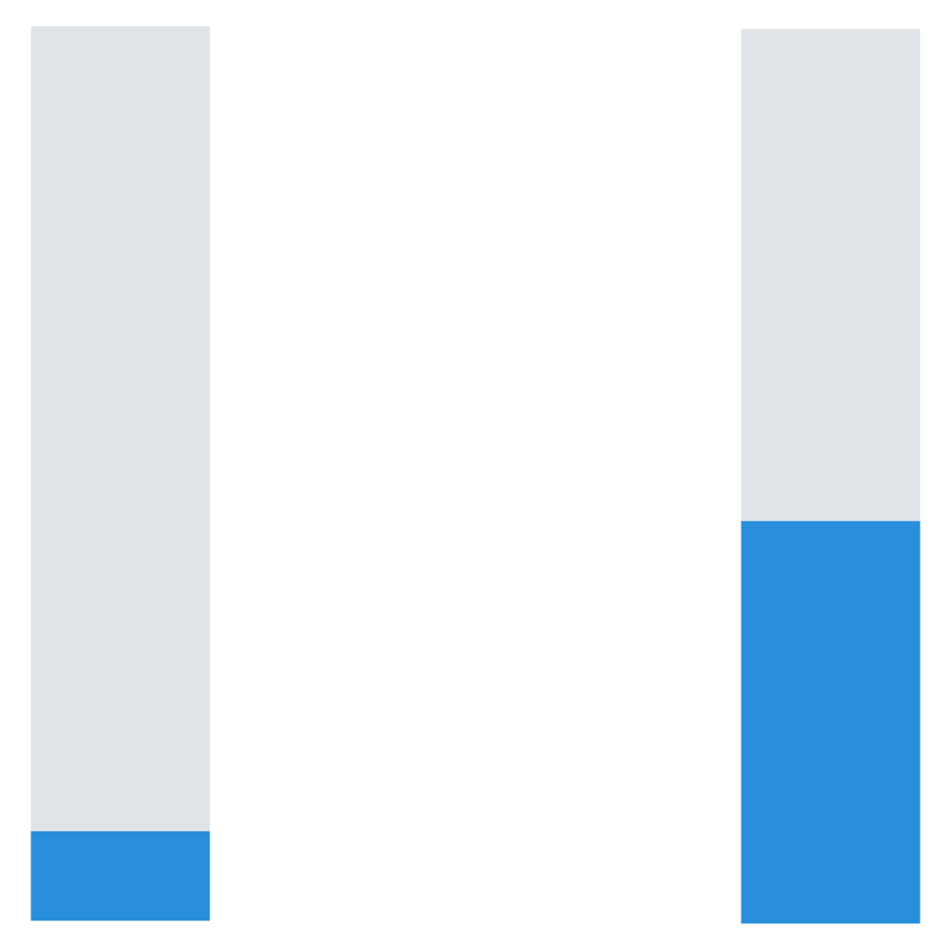
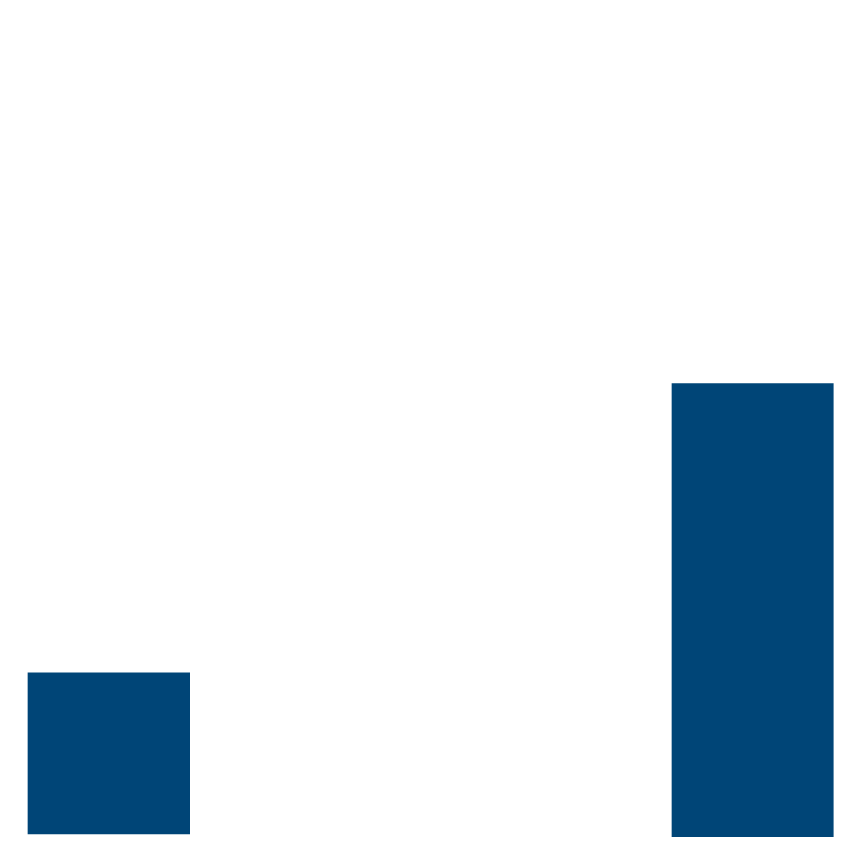
Projections in SREB States
2019-20 DATA
2029-30 PROJECTIONS
56%
45%
20%
10%
Average teacher turnover rate
Average new teacher turnover rate among teachers with ≤ 5 years of experience
Projected average teacher turnover rate
Projected average new teacher turnover rate among teachers with ≤ 5 years of experience
Source: SREB projected data calculations
Notes:
Turnover will double – and new teacher turnover will reach over 50%, costing school districts enormous amounts in turnover costs to hire, train and retain more new teachers – or rely further on underprepared staff.

Slide 20
Projections in SREB States
2019-20 DATA
2029-30 PROJECTIONS
4.2% Uncertified or Emergency
5.4% Uncertified or Emergency
By 2030,
16.1 million
K-12 students may be taught by an unprepared or inexperienced teacher
11.1% Teaching Out-of-Field
12.7% Teaching Out-of-Field
15.7% Inexperienced
40.9% Inexperienced
Source: SREB projected data calculations
Notes:
The inexperience and ill-prepared levels will rise significantly – putting more than half of all students in the SREB region at risk of having a teacher who is not qualified or ready to teach the courses they are teaching.

Slide 21
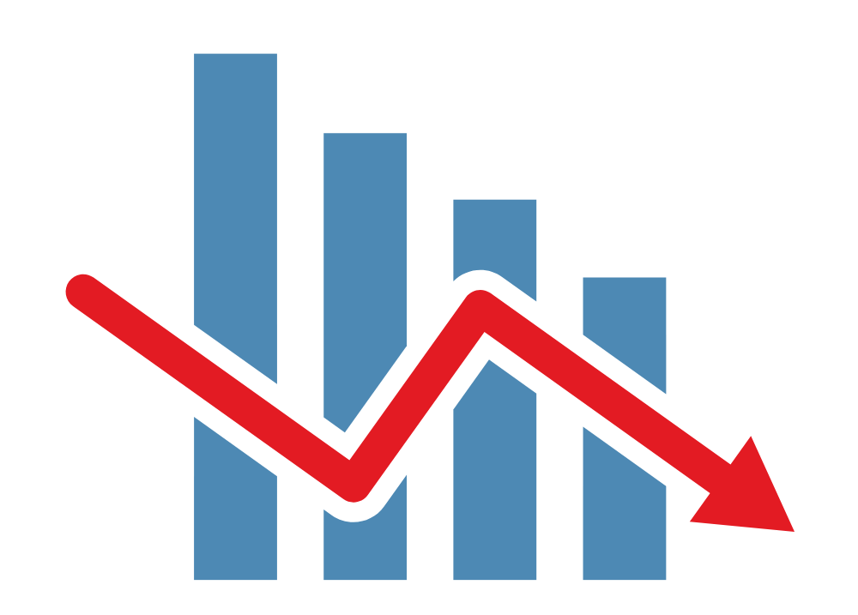
Projections in SREB States
2019-20 DATA
2029-30 PROJECTIONS
54,143
people completed teacher preparation programs in 2020 — a decline of 23% in the region since 2013
31,470
predicted completers in the SREB region in 2030, despite projected rising enrollment rates for most SREB states
That’s
42% fewer
Source: SREB projected data calculations
Notes:
Teacher preparation COMPLETION rates will continue to decline, despite more enrolling. Some states will only be producing a couple hundred new teacher grads each year, if current trends continue.

Slide 22

How do we recruit, develop, and retain enough strong, diverse educators — especially in the places they’re needed most?
Notes:
So how do we fix the issues we face now to ensure our kids and grandkids will have quality, fully prepared and supported teachers?

Slide 23

TO SOLVE TEACHER SHORTAGES, STATES NEED
A RENOVATION BLUEPRINT
Notes:
Let’s make teaching an attractive career. Elevate the teaching profession — make it a rewarding, valued, appreciated position in our communities. Patchwork repairs are not solving our leaky pipeline problem, nor are they attracting new talent. What do we do? Renovate our teacher workforce policies from the foundation up. S

Slide 24
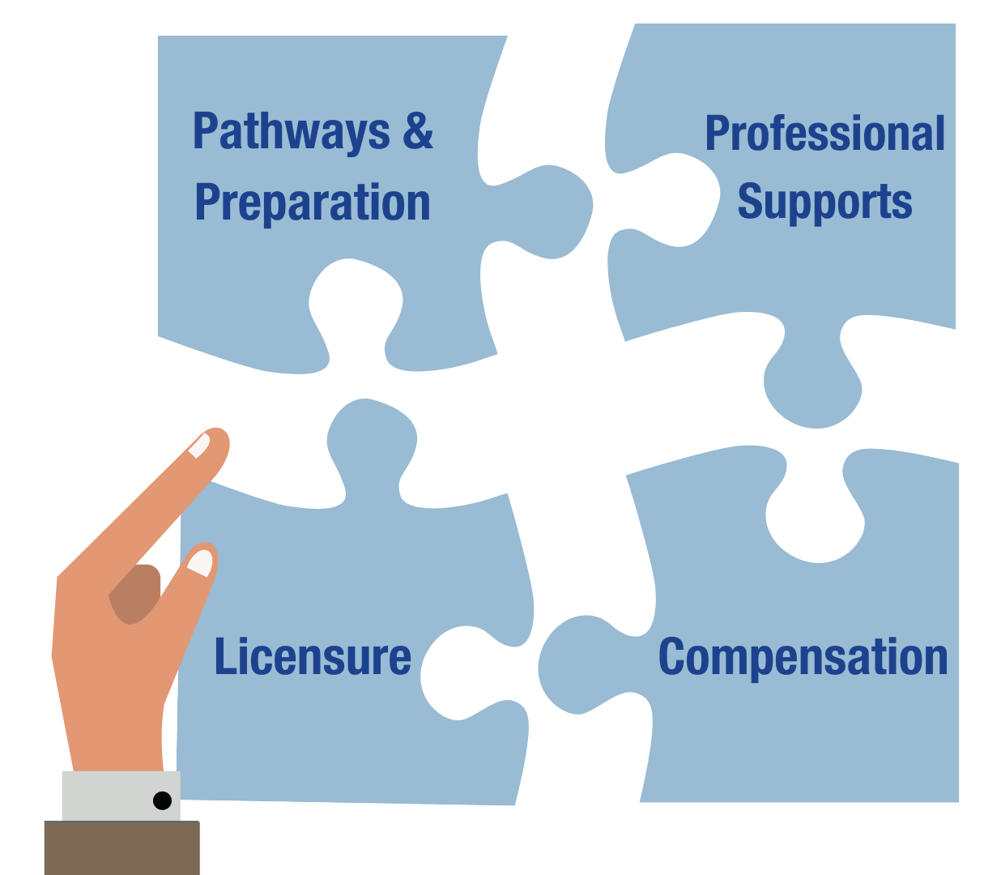
Elements of a Strong Blueprint
Improving teacher workforce policy and practice requires a comprehensive approach.
These four elements work together as an interlocking system.
Source: ????, ???
Notes:
The elements should not be studied in a vacuum but researched, debated and redesigned as one seamless, interdependent whole. Changing teacher licensure policies alone will not affect great change, for instance, nor will simply increasing compensation. It takes all four elements together, and all stakeholders working together, to elevate and support teachers.

Slide 25
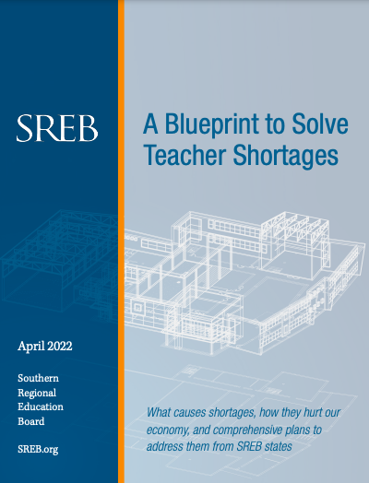




Elements of a Strong Blueprint
Pathways & Preparation
A variety of entry points into teaching that share common high standards
Preparation programs attuned to teachers’ real-life needs, such as classroom management and the science of reading
Professional Supports
Opportunities for strong teachers to maximize and share their talents via well-supported teacher-leadership roles
The flexibility, class sizes, and support staff needed for teachers and their students to succeed
SREB’s new blueprint report includes:
A closer look at the teacher shortage challenge
A framework for renovating teacher workforce policy
Recommended action steps for states
Licensure
Licensure systems that scaffold up based on teachers’ skills, competencies, and impact — and align with the pay and ongoing support
they receive
Compensation
Salary structures that avoid stagnation and reward teachers’ skills, knowledge, impact, and leadership
Health and retirement benefits that are high-quality and affordable
Notes:
Blueprint action plan
Must tackle the core root-causes of the issue: improve prep and make more pathways to recruit into the profession.... more accessible but still high bar; create career advancement in licensure; embed teacher supports in policy and incentivize positive culture/staff changes; restructure teacher compensation for new pathways and provide better full package of benefits.

Slide 26



Across the Career Continuum
Advancement Options
Mentor-Teacher
Master Teacher
Flexible career mobility to achieve professional licensure
Professional Teacher
Beginning Teacher: Skills Advancement
Route into teaching
Beginning Teacher: Partial Skills
Beginning Teacher: Skills Acquisition
College & University
Industry Experience
Resident or Apprentice
PATHWAYS & PREP
LICENSURE
PROFESSIONAL SUPPORTS
COMPENSATION
Notes:
Create a career continuum with more accessible paths into the profession – like paid apprenticeship and residency, traditional and alternative – all with the same standards of rigor once a teacher reaches the professional level. Tie in key supports throughout the continuum to support growth – like access to quality PD, financial support for PD, mentors for all new teachers with scaled coaching hours depending on the level of instructional skills acquisition. Create advanced levels for teachers to build a qualified and trained cadre of mentors and peer leaders who are exceptional in content, coaching or other leadership needs for schools.

Slide 27
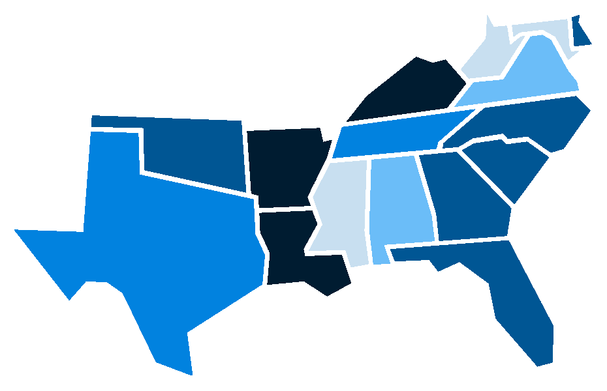
Robust, quality data can help states effectively address teacher shortages.
6 Best Data Practices
Does your state produce new teacher supply data?
Does your state produce new teacher demand data?
Does your state disaggregate supply and demand data to the institution, district, and certification level?
Does your state report on teacher shortages?
Does your state publish teacher mobility data?
Does your state make school-level aggregates of teacher performance data publicly available?
On average, SREB states employ less than half of these 6 practices
0
3
0
1.5
4
2.5
3
3.5
4
3.5
0
1.5
3
2.5
4
3
Source: NCTQ, 2021
Notes:
To do build the elements and a strong career continuum, states need to carry out 4 action steps:
Collect and analyze data to know your state shortage issues and why (immediate need!) – SC does not collect enough data yet to fully understand the teacher shortage issues around the state in Quantity, Quality, Demographics and Talent Distribution!!!!
bring key leaders and educators together to collaborate on a comprehensive solution blueprint (3-5 years)- which SC is doing now with this Taskforce!!
Commit to long-term systemic change and implement the blueprint changes (10+ years)
Make a continuous investment in your state’s future (10+ years) – for both K-12 and higher ed to bolster the talent pipeline, support students and grow the workforce/economy

Slide 28

The American Rescue Plan/ESSER
States can support districts and schools with planning and implementation around how to use federal stimulus money for COVID recovery — while also addressing teacher shortage issues.
For Example: Many districts are looking to address learning disruptions via tutoring initiatives.
What guidance could states provide to support districts and schools with connecting these tutoring initiatives to teacher pipelines and career progression?
What shining examples can states point to and share?
States can also use their portion of ARP funding to support the educator workforce directly.
Spotlight On South Carolina
SC is using ESSER funds to collaborate with institutions of higher education to employ college students as summer teaching interns.
They are also looking to address teacher shortages by developing pipelines of new talent, attracting diverse candidates, and launching a communications platform to promote new pathways into the profession.
Notes:
South Carolina has made strides to use funding for the teacher pipeline effort.

Slide 29

Main Sources:
Elementary/Secondary Information System — Institute of Education Sciences/National Center for Education Statistics
State Dashboards — Institute of Education Sciences/National Center for Education Statistics
Title II Reports — US DOE
A Blueprint to Solve Teacher Shortages — SREB
Teacher Compensation Dashboard — SREB
State Rankings by Percentage of National Board Certified Teachers — National Board for Professional Teaching Standards
Frustration In The Schools / 2019 Poll — Phi Delta Kappan
TALIS / 2018 Survey — Institute of Education Sciences/National Center for Education Statistics
Voices from the Classroom 2021 and Voices from the Classroom 2022 — Educators For Excellence
Job-Related Stress Threatens Teacher Supply: Key Findings from the 2021 State of the U.S. Teacher Survey — RAND
2022 Poll Results / Stress and Burnout Pose Threat of Educator Shortages — National Education Association
What We’ve Been Hearing About Teacher Shortages / 2022 Survey Data — TNTP
Encouraging More High School Students to Consider Teaching — ACT Research & Policy
Teaching Quality & Diversity Guidebook — Alliance for Resource Equity
If You Listen, We Will Stay: Why Teachers of Color Leave and How to Disrupt Teacher Turnover — The Education Trust
State of the States 2021 / State Reporting of Teacher Supply and Demand Data — NCTQ
*Other sources where otherwise noted.

Slide 30

SREB works with states to improve education.
Support Action
We help policymakers and state agencies navigate policy and practice.
Convene & Engage
We help states collaborate and share resources.
Analyze & Publish
We share promising practices, and we provide states with reliable data and research to inform strategy.
To explore teacher workforce data, learn about our Human Capital Roundtables, or get support, visit: sreb.org/topic-teacher-workforce-policy
Notes:
Closing:
There are a lot of great ideas and changes happening to support our educators and build up the pipeline. Look to each other for help and collaborate to solve this huge problem and SREB is willing to help if you need us and will take any questions you for us.
This work is monumental, but....We owe it to our students. We owe it to our educators. We owe it to our businesses. We owe to ourselves and our families.

