Slide 1
Going Deeper:
Tier 2 and Tier 3
Southeast Comprehensive Center (SECC)
    Ramona Chauvin, Ph.D.
    Ursula Hill, Ed.D.
    Kathleen Theodore, Ph.D.
Copyright © 2019 American Institutes for Research. All rights reserved.

Slide 2


Staff: Senior Technical Assistance Providers
Dr. Ursula Hill
Dr. Kathleen
Theodore
Dr. Ramona
Chauvin
Notes:
I would like to introduce our facilitators. Discuss SECC/AIR in relationship to national expertise.

Slide 3
Agenda
Multi-Tiered System of Support (MTSS)
Evidence-Based Tier 2 Intervention
Tier 3: Intensive Intervention
Progress Monitoring
National Center on Intensive Intervention
Case Example

Slide 4
Session Objectives
Understand the essential elements of secondary and tertiary interventions.
Understand how secondary and tertiary interventions are implemented within a multi-tiered system of supports.

Slide 5
High-Quality Tier 1 Instruction
Students With Disabilities
Receive services
at all levels, depending on need
3% to 5% of students
Tier 3: Intensive Level
of Prevention
Tier 2: Targeted Level
of Prevention
15% of students
Tier 1: Universal Level
of Prevention
80% of students
Notes:
This slide has animations.
Many educators associate MTSS with the following triangle. It is intended to represent the three levels of prevention and the percentage of students who would be expected to benefit from these levels of prevention in an effective system. Click for animation. The first level, or Tier 1, is indicated in green. It is expected that most students, at least 80%, benefit from core curriculum delivered through differentiated.
Click for animation. The next level, or Tier 2, is supplemental to Tier 1. Even with good instruction, it is estimated that approximately 15% of students will need supplemental, small group instruction to benefit from the core instruction and curriculum.
The top level, or intensive instruction or Tier 3, includes specialized, individualized systems for students with intensive needs. It typically involves small group instruction of one to three students who are significantly behind their peers. It is estimated that approximately 3 to 5% of students will need intensive support.
If fewer than 80% of students are benefiting from the current primary prevention system, schools should consider focusing school improvement efforts on improving the core instruction and curriculum. If there is a large percentage of students in the Tier 2 or Tier 3, consider implementing large group instructional activities and system changes within Tier 1 to reduce the number of students requiring additional support.
Click for animation. Students with disabilities may receive supports throughout levels of the system, depending on their individual needs.

Slide 6
Evidence-Based Tier 2 Intervention

Slide 7
Tier 2 Within MTSS
 | Tier 1 | Tier 2 | Tier 3
Instruction or Intervention Approach | Comprehensive, research-based curriculum | Standardized, targeted small-group instruction | Individualized, based on student data
Group Size | Classwide (with some small-group instruction) | 3–7 students | No more than 3 students
Assessment | Screening, 3 times yearly | At least biweekly or monthly | Weekly
Population Served | All students | Students identified as at risk (~15%–20%) | Significant and persistent learning needs, nonresponders (3%–5%)
Notes:
Evidence-based practices are an important part of effective Tier 2 intervention.
Instruction at Tier 2 is standardized and targeted for a small group of 3-7 students. Students who receive Tier 2 intervention have been identified as at risk on a universal screening measure, and are typically 15-20% of a school population. Students receiving this level of support should receive progress monitoring assessments on a monthly (feasible) to biweekly (recommended) basis.

Slide 8
Distinction Between Tier 1 and Tier 2
 | Tier 1 | Tier 2 (Supplemental)
Instruction | District core curriculum and instructional practices that are research based, aligned with state or district standards, and incorporate differentiated instruction | Follow standardized evidence-based programs as designed
Duration and Time Frame | Occurs during uninterrupted instructional block (at least 90–120 minutes in reading) | Use duration and time frame defined by developer
Group Size | Typically 20–30 students (with small-group instruction occurring daily) | Three to seven students (as defined by developer)
Progress Monitoring | Recommended to occur monthly for “on-watch” students | Biweekly
Population Served | All students, including students with disabilities (SWDs) and English language learners (ELLs) | At-risk students (typically 15%–20% of student population)
Notes:
So, what is the difference between Tier 1 and Tier 2 interventions?
Tier 2 interventions typically follow standardized, evidence-based programs rather than whole class curriculum. Instruction occurs in smaller groups of 3-7 students (ideally), following the duration and timeframe defined by the intervention program, rather than an uninterrupted whole class instructional period each day. It is recommended that progress monitoring occurs biweekly, though some schools may find that monthly progress monitoring is more feasible. Finally, while Tier 1 instruction serves all students, including students with disabilities, Tier 2 intervention occurs with those students who are identified as at-risk in 1 or more content areas, which may or may not include students with disabilities as well as students who have not been identified as having a learning disability.

Slide 9

Four Critical Features of Tier 2
Uses evidence-based interventions that support academic and behavior needs
Complements core academic and behavior instruction/program
Uses standardized interventions with appropriate dosage and grouping size delivered by trained personnel with fidelity
Scheduled in addition to Tier 1
Notes:
There are 4 critical features of an evidence-based Tier 2 intervention system:
1) First, all Tier II interventions should be evidence-based in content areas and grade levels where they are available and they support academic and behavior needs. Tools for identifying evidence-based interventions will be discussed later in the presentation.
2) Second, Tier 2 must complement core instruction; specifically, it is well aligned with core instruction and incorporates foundational skills that support the learning objectives of core academic instruction and supports behavior programs.
3) Third, in addition to being evidence-based, Tier 2 interventions should be standardized and delivered at an appropriate frequency (ideally 3 times a week) by a trained educator, with a small group of students. Discuss role of the teacher.
4) Lastly, Tier 2 intervention should be scheduled in addition to Tier 1 – it should not replace core reading or math instruction.

Slide 10
Tier 3: Intensive Intervention

Slide 11
Thinking About Intervention Tiers
 | Tier 1 | Tier 2 | Tier 3
Instruction/ Intervention Approach | Comprehensive research-based curriculum | Standardized, targeted small-group instruction | Individualized, based on student data
Group Size | Class-wide (with some small group instruction) | 3–7 students | No more than 3 students
Monitor Progress | Screening, 3 times a year | At least 1 time per month | Weekly
Population Served | All students | At-risk students | Significant and persistent learning needs
Notes:
In this module, we will be focusing on the most intensive tier in an MTSS model. In other contexts, Tier 3 may be referred to as intensive interventions or tertiary supports. Regardless of the name used, these supports are those that reserved for students who need:
Click for animation and review contents of the table for Tier 3.
Increasingly focused/tailored approach
Decreasing group size
Increasing frequency of progress monitoring
Increasing student need

Slide 12
Tier 3 Intensive Intervention
Focus | Instruction | Setting | Assessment
Students who have not responded to core- and supplemental intervention (Tier 2) | Intensive intervention (Tier 3) delivered to small groups (two or three students) or individually | Intervention classroom, other general education location within the school | Progress monitoring and diagnostic
Notes:
The focus of Tier 3 intervention is on students who have not responded in Tier II. The instruction is evidence-based intensive instruction and is continuously adjusted and individualized to address the needs of each student. Decisions regarding student participation in both primary and intensive levels of prevention are made on a case-by-case basis, according to student need. It is typically delivered within the intervention classroom to a small groups of students or individually. Procedures are in place to monitor the fidelity of implementation. The assessments administered within the Tier 3 are progress monitoring and diagnostic measures.

Slide 13
What is Intensive Intervention?
Intensive intervention is designed to address severe and persistent learning or behavior difficulties. Intensive interventions should be:
Driven by data
Characterized by increased intensity (e.g., smaller group, expanded time) and individualization of academic instruction and/or behavioral supports
Notes:
Read slide to highlight distinguishing characteristics of intensive intervention.

Slide 14
Tier 3 Intensive Intervention
Includes evidence-based methods for individualizing instruction
Is more intense than Tier 2 (longer and more frequent)
Requires implementation fidelity
Is delivered by well-trained or specialized staff in optimal group sizes
Includes decisions based on valid and reliable data and criteria implemented accurately
Addresses general education curriculum in an appropriate manner for students
Notes:
The following are true in an effective intensive level of prevention:
Intensive-level interventions are evidence-based standard protocols or are based on validated methods for individualizing instruction.
Interventions are more intensive than Tier 2 interventions. In other words, a standard protocol intervention may be individualized using ongoing progress monitoring data to make adjustments in instruction.
Intensive-level interventions are led by well-trained staff and the group size is optimal for the age and the needs of students.
Decisions about responsiveness to intervention are based on reliable and valid progress monitoring data that reflect the slope of improvement..
Decisions regarding student participation in both primary and intensive levels of prevention are made on a case-by-case basis, according to student need and interventions address the general education curriculum in an appropriate manner for students.
Note: Learn more about intensive or intensive interventions by contacting the National Center on Intensive Interventions (http://www.intensiveintervention.org/).

Slide 15
Who Needs Tier 3: Intensive Intervention?
Students with disabilities who are not making adequate progress in their current instructional program
Students who present with very low academic achievement and/or high-intensity or high-frequency behavior problems (typically those with disabilities)
Students in a tiered intervention program who have not responded to Tier 2 intervention programs delivered with fidelity
Notes:
Read slide.
Note for second item:
The decision to move a student directly to an intensive intervention should be made on an individual and case-by-case basis. In most cases, data should be collected over time to help demonstrate that the student’s low achievement/behavior challenges are both significant AND persistent.

Slide 16
Tier 3 and Special Education
Tier 3 is the most intense level of prevention.
The structure of Tier 3 is based on your schools’ decision rules.
A bit of guidance…
  Decision rules should be in place prior to intervention implementation.
  Schools should use decision rules to determine when students are responding to intervention or needing more intense intervention (Tier 3).
  When a disability is suspected, student should be referred for special education services.
Notes:
(Adapted from NYSED Guidance) DECISION RULES Decision rules or criteria for decision making need to be created prior to implementation of the intervention to determine when:
students are not responding adequately to instruction and need supplemental intervention;
students are responding adequately to instruction and no longer need supplemental intervention;
an intervention may need to be changed; and/or
a student may need a referral for special education services to determine if a student‘s learning difficulty is the result of a disability.
If a student has not made adequate progress in attaining grade-level standards after an appropriate period of time when provided with instruction utilized in an MTSS framework, the school district must make a referral and promptly request parental consent to evaluate the student to determine if the student needs special
Additional optional resource: In sum, there is not consensus in the field about the relationship between Tier 3 in MTSS and special education. It is recommended that special education teachers work with those students needing the most intense level of academic need. http://www.rti4success.org/video/what-relationship-between-rti-and-special-education Doug Fuchs, Ph.D., Vanderbilt University

Slide 17

Discussion

Slide 18
Progress Monitoring
Essential Component
Notes:
Key ideas:
Explaining progress monitoring as essential component

Slide 19
Progress Monitoring
Purpose | Monitor students’ response to Tier 1, Tier 2, or Tier 3 instruction to estimate rates of improvement, identify students who are not demonstrating adequate progress, and compare the efficacy of different forms of instruction
Focus | Students identified through screening as at risk of not meeting learning outcomes.
Tools | Brief assessments that are valid, reliable, and evidence-based
Time Frame | Students are assessed at regular intervals (e.g., weekly, biweekly, or monthly).
Notes:
Now we will discuss progress monitoring. The purpose of progress monitoring is to monitor students’ response to primary, secondary, and tertiary instruction. Progress monitoring data can be used to estimate the rates of improvement, which allows for comparison to peers; to identify students who are not demonstrating or making adequate progress so that instructional changes can be made; and to compare the efficiency of different forms of instruction—in other words, to identify the instructional approach or the intervention that leads to the greatest growth among students.
Progress monitoring is not just for those students identified for supplemental instruction. The focus is on students who have been identified through screening as at risk for poor learning outcomes. This could include students just above the cut score as well as those scoring below the cutoff score.
Progress monitoring tools, just like screening tools, should be brief, valid, reliable, and evidence based. Common progress monitoring tools include general outcome measurements, including curriculum-based measures and mastery measures.
The time frame for progress monitoring assessment depends on the intensity of student needs, the tools being used, and the typical rate of growth for a student.
Progress monitoring can be used any time throughout the school year. With progress monitoring, students are assessed at regular intervals (e.g., weekly, biweekly, monthly) to produce accurate and meaningful results that teachers can use to quantify short- and long-term student gains toward end-of-year goals. At a minimum, progress monitoring tools should be administered at least monthly. However, more frequent data collection is recommended given the amount of data needed for making decisions with confidence (six to nine data points for most tools). With progress monitoring, teachers establish long-term (i.e., end-of-year) goals that indicate the level of proficiency students should demonstrate by the end of the school year.

Slide 20
Why Progress Monitor?
Comment: The Essential Components of RTI is dated April 2010. Is this the same source?
Data allow us to…
Estimate the rates of improvement (ROI) across time.
Compare the efficacy of different forms of instruction.
Identify students who are not demonstrating adequate progress.
Determine when an instructional change
is needed.
Source: Center on Response to Intervention at American Institutes for Research, 2010
Notes:
Progress monitoring data is used to place students in intervention groups or decide which interventions work best for your groups. Monitor the progress of students receiving supplemental instruction at least once a month. Use these data to determine whether students still require intervention.
Progress monitoring assessments allow us to gauge students’ progress. For example, within MTSS models, progress monitoring assessment results are used to make a series of decisions that move students between more and less intensive levels of intervention.
Research has demonstrated that when teachers use progress monitoring for instructional decision making, students learn more, teacher decision making improves, and students are more aware of their own performance (e.g., Fuchs, Deno, & Mirkin, 1984).
Tier 2, or supplementary instruction, is expected to benefit a large majority of students who do not respond to effective primary prevention. Most students receiving supplemental interventions should benefit from this instruction. A small percentage of students, however, will demonstrate inadequate response, providing evidence that they require more intense, individualized (intensive) instruction. Progress monitoring data will allow us to make sound decisions about the level of instruction and intervention needed for students.
Data should indicate that interventions and data-based decision rules were implemented with fidelity.
National Center on Response to Intervention (2010). Implementer Series Module 2: Progress Monitoring Washington, DC: U.S. Department of Education, Office of Special Education Programs, National Center on Response to Intervention. Retrieved from: http://www.rti4success.org/resource/essential-components-rti-closer-look-response-intervention

Slide 21
Progress Monitoring
Are students meeting short-term goals that will help them reach their long-term goals?
Are students making progress at acceptable rates?
Should instruction be adjusted or changed?
Notes:
In summary, progress-monitoring data can help answer these questions:
Are students meeting short-term goals that will help them reach their long-term goals?
Are students making progress at an acceptable rate? It is not enough just to make progress. The progress must be meaningful and must close the gap between the student’s progress and that of his or her peers.
Does the instruction need to be adjusted or changed? Using preestablished data decision rules, progress monitoring allows you to determine whether the instruction is working for the student and evaluate the effectiveness of changes.
Let’s take a moment to reflect on your current progress-monitoring practices. On your note-taking template on Handout 2, write down insights gleaned about progress monitoring and any ideas you would like to clarify with your school’s RTI leadership team. As you write, think about the following:
How is progress monitoring used in your school?
Is the screening versus progress-monitoring process clear?

Slide 22
Fidelity at Tier 2 Versus Tier 3
Tier 2: Degree to which the program is implemented the way intended by program developer.
Tier 3: Degree to which the program is implemented the way it was designed or adapted based on data and fidelity to the Tier 3 data decision-making process.
Comment: Please add three reference entries for the sources below on the References slides.
Sources: Gersten et al., 2005; Mellard & Johnson, 2007; Sanetti & Kratochwill, 2009
Notes:
As you learned in the Tier 2 module, fidelity refers to how closely prescribed procedures are followed, and in the context of schools, the degree to which teachers implement programs the way they were intended by the program developers. It also relates to the quality of the implementation. Tier 3 starts with the delivery of a Tier 2 intervention with fidelity. However, when students do not respond as expected, a change is needed. With Tier 3, educators will use data to make changes to the implementation of the intervention to increase the impact on student performance. Educators will need to maintain fidelity to the adaptation to assess the impact of the change and determine if the adaptation was effective.
Note: Throughout discussions of fidelity it is important to ensure that teachers believe that they work in an open, non-threatening environment that values their skills and expertise and where they can learn from their colleagues. With a system of open communication and productive feedback, fidelity checks of classroom techniques and the essential components of multi-tiered systems of support can be a useful and supportive way for teachers to collaborate and become a stronger teaching network. This may be a useful discussion point for some groups.

Slide 23
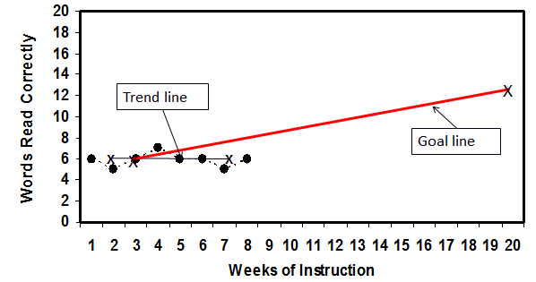
Progress Monitoring:
What This Looks Like
Collect and graph data to support decisions about a student’s responsiveness to intervention
Comment: Please add a reference entry for this source.
Source: Center on Response to Intervention at American Institutes for Research, 2012
Notes:
The graph on this slide provides an example of what progress monitoring data looks like. When a student is regularly progress monitored during an intervention, their progress can be depicted by a trend line, which demonstrates their rate of growth and progress towards a pre-established long or short term goal, as demonstrated by the goal line.
Goal setting is important at all levels.

Slide 24

Taxonomy of Intervention Intensity
Dimensions to consider:
Strength
Dosage
Alignment
Attention to transfer
Comprehensiveness
Behavioral or academic support
Individualization*
Comment: We can’t use image on right unless we have copyright permission from author or this is an AIR publication.
Notes:
You may be wondering by now how to go about selecting an evidence-based intervention.
The Taxonomy of Intervention Intensity was developed based on existing research to support educators in evaluating and building intervention intensity.
We will focus today’s presentation on the first 6 dimensions – the 7th dimension is important for Tier 3 but is not necessary for Tier 2 intervention.

Slide 25
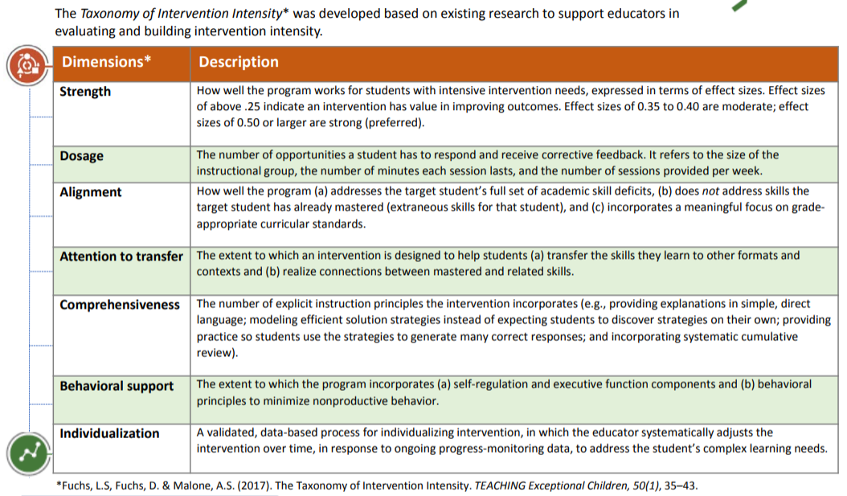
Taxonomy of Intervention Intensity
Comment: We can’t use image below unless we have copyright permission from author or this is an AIR publication.
Notes:
This slide provides a more detailed description of each of the dimensions, and is also found on Handout 1 in your packet.

Slide 26
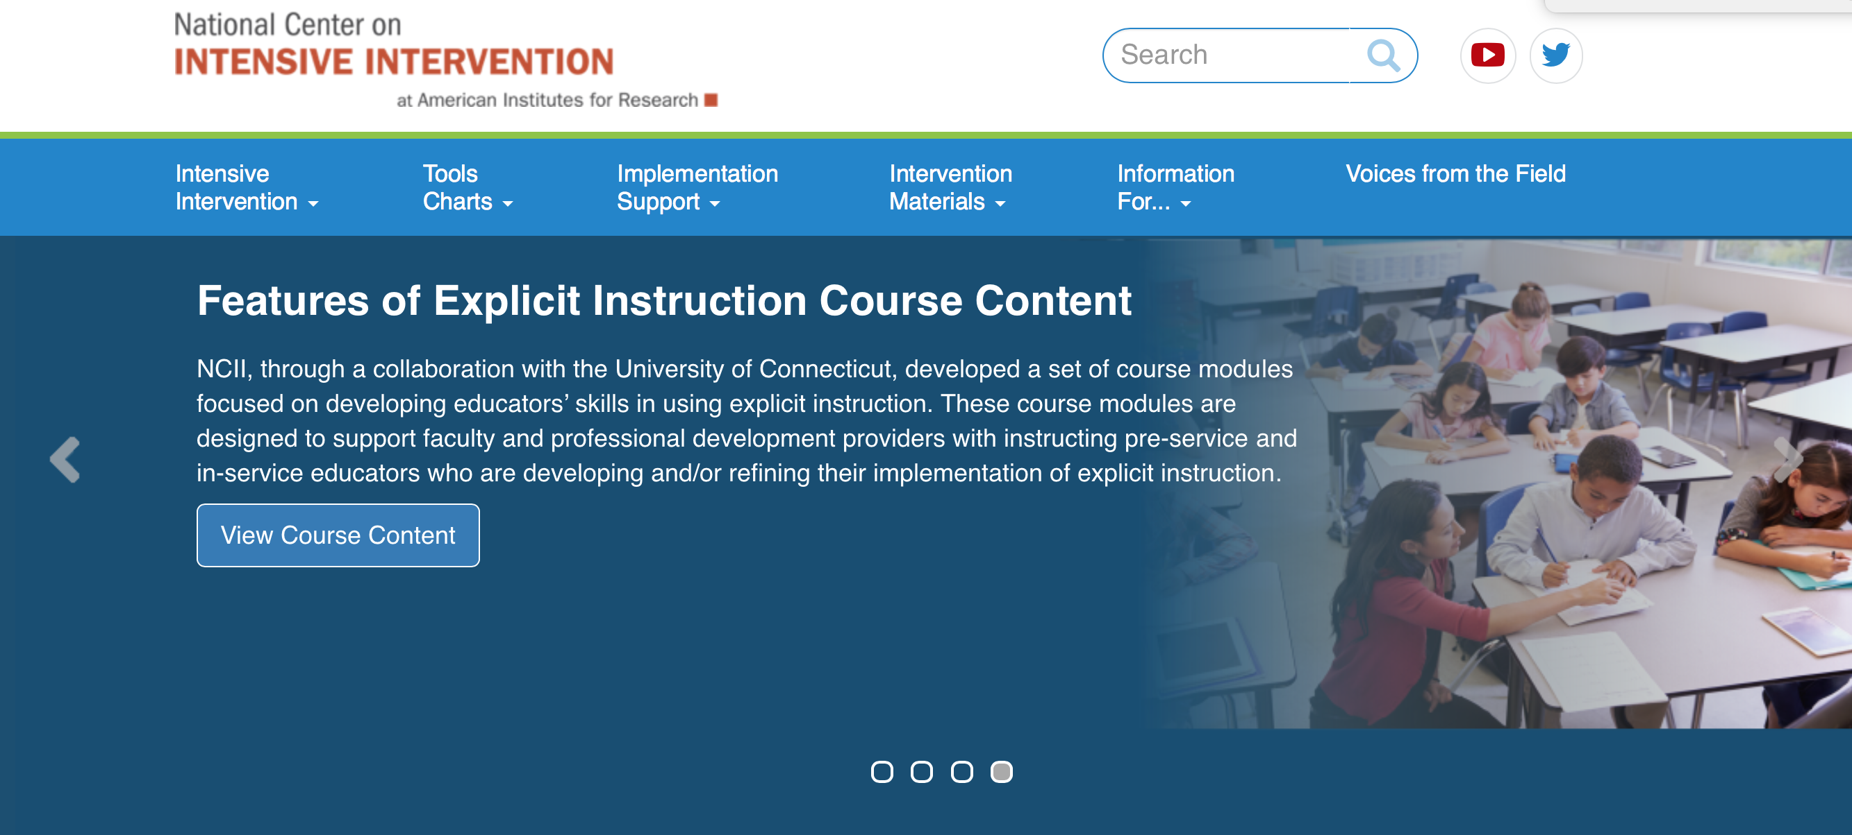
Need More Information?
National Center on Intensive Intervention

Slide 27
Case Example

Slide 28
Case Example: Lindsay
Lindsay is a sixth-grade student with an individual education program (IEP) for a specific learning disability.
Lindsay struggles with mathematics and has recently begun struggling with fluency, performing on timed tests, and consistency on mastery assessments.

Slide 29
Intervention History: Lindsay
Lindsay receives Corrective Mathematics in a
small-group setting with three other students,
five times a week, 50 minutes each session.
On her current IEP, there are no behavioral goals.

Slide 30
Lindsay’s Current Performance
Initial data collection and analysis revealed the following:
  An error analysis revealed errors on mathematics concepts she had previously demonstrated mastery, including long division skills.
  Teachers predict Lindsay is struggling with the increased length and intensity of mathematics assessments in sixth grade.
Lindsay has started to demonstrate off-task behaviors and high levels of distractibility:
  In the late afternoon, final periods of the day, during unstructured time

Slide 31
Intervention Adaptation 1
The intervention team met and made the following
decisions about Lindsay’s intervention:
  Decrease the number of students in intervention.
  Break lengthy mathematics assignments and assessments into smaller chunks to avoid issues with stamina and distractibility.
  Move Lindsay into a mathematics intervention period earlier in the school day to help with distractibility.
  Provide increased feedback and opportunities to practice, especially with long division problems.

Slide 32
Intervention Adaptation 2
Lindsay’s teachers met and decide to:
  Continue her intensified math intervention.
  Make the following adaptations to include a behavioral component:
  Add a self-regulation component to the intervention
  to be tracked by Lindsay.
  Add weekly check-ins with Lindsay and her intervention teacher to assess behavior progress monitoring data.

Slide 33
Discussion

Slide 34
Need More Information?
CEEDAR Center
https://ceedar.education.ufl.edu
High-Leverage Practices in Special Education https://highleveragepractices.org
IDEA Partnership
www.ideapartnership.org
National Center on Intensive Intervention at American Institutes for Research
https://intensiveintervention.org
National Center for Systemic Improvement (NCSI)
https://ncsi.wested.org

Slide 35
References
Aceves, T. C., & Orosco, M. J. (2014). Culturally responsive teaching (Document No. IC-2). Gainesville, FL: University of Florida, Collaboration for Effective Educator, Development, Accountability, and Reform Center. Retrieved from http://ceedar.education.ufl.edu/wp-content/uploads/2014/08/culturally-responsive.pdf
Burns, M. K., Appleton, J. J., & Stehouwer, & J. D. (2005). Meta-analytic review of responsiveness-to-intervention research: Examining field-based and research-implemented models. Journal of Psychoeducational Assessment, 23(4), 381–394.
Center on Response to Intervention at American Institutes for Research. (2010, October 29). Universal Screening [Video file]. Retrieved from https://www.youtube.com/watch?v=HaHWoN-LVFc&t=5s
Center on Response to Intervention at American Institutes for Research. (2010). The essential components of RTI: A closer look at response to intervention. Retrieved from https://rti4success.org/resource/essential-components-rti-closer-look-response-intervention

Slide 36
References
Center on Response to Intervention at American Institutes for Research. (2012). RTI implementer series, module 2: Progress Monitoring Training Manual. Retrieved from https://rti4success.org/sites/default/files/RTI%20PM%20Manual_web_w_handouts.pdf
Dexter, D. D., Hughes, C. A., & Farmer, T. W. (2008). Responsiveness to intervention: A review of field studies and implications for rural special education. Rural Special Education Quarterly, 27(4), 3–9.
Gertsen, R., Jordan, N. & Flojo, J. (2004). Early identification and interventions for students with mathematics difficulties. The Journal of Learning Disabilities, 38, 4, 293–304.
McLeskey, J., & Brownell, M. (2015). Practice Review: High-leverage practices and teacher preparation in special education. CEEDAR Document No. PR-1. Retrieved from http://ceedar.education.ufl.edu/wp-content/uploads/2016/05/High-Leverage-Practices-and-Teacher-Preparation-in-Special-Education.pdf
Mellard, D., & Johnson, E. (2007). RTI: A practitioner’s guide to implementing response to intervention. Thousand Oaks, CA: Corwin Press.

Slide 37
References
National Center on Intensive Intervention at American Institutes for Research. (2018, June). Academic screening tools chart. Retrieved from https://charts.intensiveintervention.org/chart/academic-screening
Sanetti, L. & Kratochwill, T. (2009). Treatment integrity assessment in the schools: An evaluation of the Treatment Integrity Planning Protocol. School Psychology Quarterly, 24(1), 24–35.
Simmons, D. C., Coyne, M. D., Kwok, O. M., McDonagh, S., Harn, B. A., & Kame'enui, E. J. (2008). Indexing response to intervention: A longitudinal study of reading risk from kindergarten through third grade. Journal of Learning Disabilities, 41(2), 158–173.
Vaughn, S., Wexler, J., Roberts, G., Barth, A. A., Cirino, P. T., Romain, M. A., Francis, D., Fletcher, J., & Denton, C. A. (2012). Effects of individualized and standardized interventions on middle school students with reading disabilities. Exceptional Children. 77(4). 391–407.
Windschitl, M., Thompson, J., Braaten, M., & Stroupe, D. (2012). Proposing a core set of instructional practices and tools for teachers of science. Science Education, 96(5),
878–903.

Slide 38
SECC at AIR
Ursula Hill, SECC State Liaison
uhill@air.org
Kathleen Theodore, SECC Early Childhood Project Lead
ktheodore@air.org
Ramona Chauvin, SECC Senior Technical Assistance Consultant
rchauvin@air.org

