Slide 1
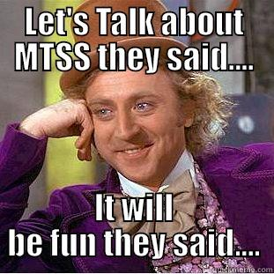
MTSS:
The Golden Ticket
SCASA i3 Conference
David Mathis, Ed.D.
Quincie Moore, Ph.D.
Taylor Seale, MPP

Slide 2
What is MTSS in South Carolina?
SCMTSS is a systemic, continuous-improvement framework in which data-based problem solving and decision-making is practiced across all levels of the educational system for supporting students.

Slide 3
MTSS Vision
SCMTSS will be used to improve Tier 1 instruction for all students and to problem-solve for students who need additional support academically, socially, and or emotionally.

Slide 4
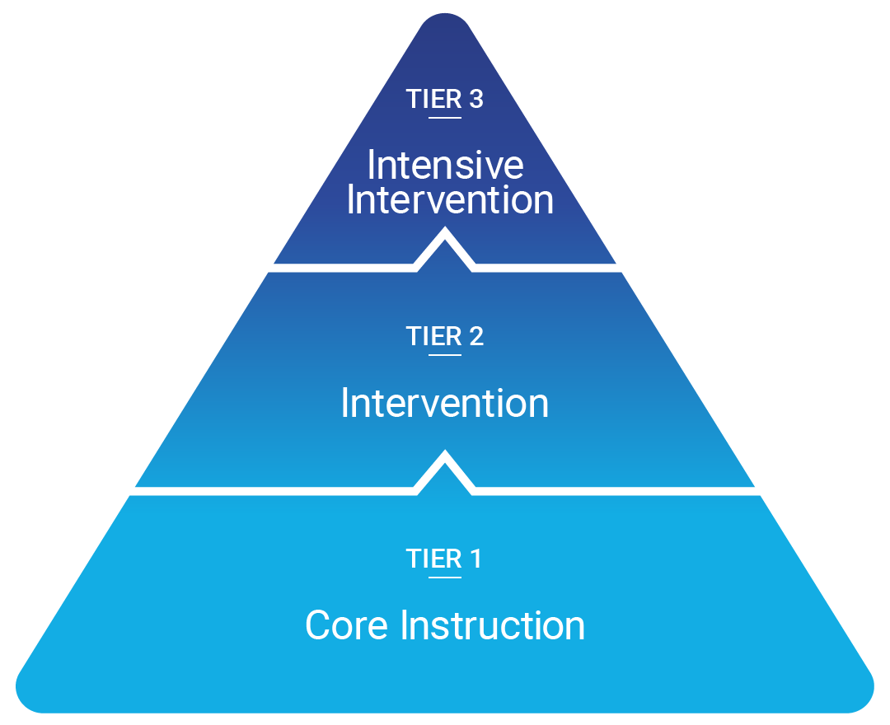
SCMTSS Tiers

Slide 5
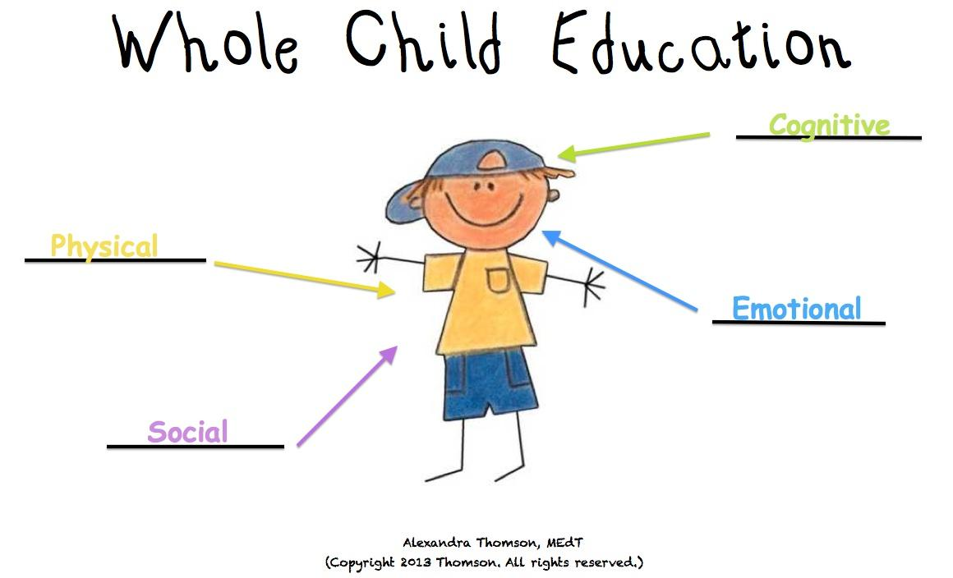
Whole Child Education

Slide 6
SCMTSS Mission
Use the SCMTSS framework to improve instruction so all students graduate college and career ready.

Slide 7
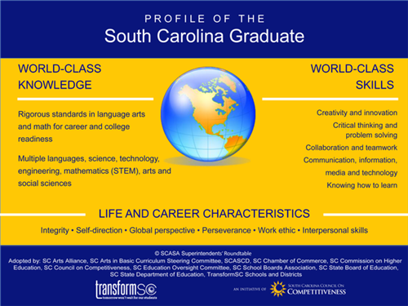
Profile of the Graduate

Slide 8

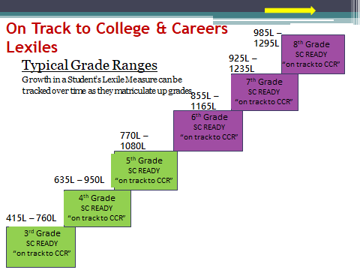
Lexile Ranges

Slide 9
College and Career Ready Indicators
College Ready
ACT: Score of 20
SAT: Composite Score of 1020
AP Exam: Score of 3 or higher
IB Exam: Score of 4 or higher
Cambridge Exam: C or higher (identified courses)
Career Ready
Career Readiness Assessment: Silver or higher
CTE Completer and Certification
ASVAB: Score of 31 or higher
Work-based Learning

Slide 10
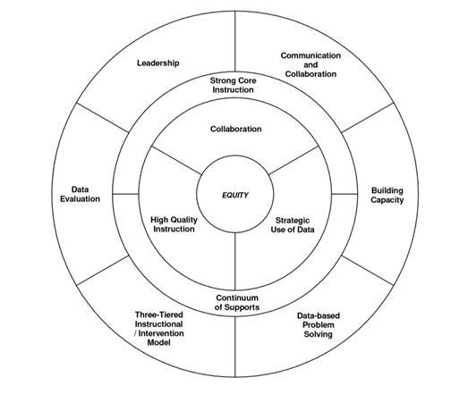
SCMTSS Wheel

Slide 11
What MTSS is…
A prevention framework for school improvement made up of core components and features
Supports all students, including those students in need of enrichment
Flexible for schools and districts to customize to meet their unique circumstances
Collaborative and incorporates a team-based approach of representative stakeholders

Slide 12
What MTSS is…
Data driven, using multiple valid and reliable data sources
Framework that can be used to assist with special education decisions
Good teaching!

Slide 13
What MTSS is not…
A program or curriculum
Just for struggling students or students with disabilities
A one-size-fits-all prescriptive model
The responsibility of one teacher or one specialist
Based on assumptions or unreliable data
Prereferral process for special education
Not something else to do!

Slide 14
MTSS Legislation: SCDE Requirements
MTSS Legislation: Act 213
SCDE must provide training and support for a statewide MTSS framework that must include:
  Common data-based problem-solving model
  Ongoing student assessment
  Layered continuum of supports using evidence-based practices

Slide 15
MTSS Legislation: SCDE Requirements
What does this support look like?
South Carolina Multi-Tiered System of Supports (SCMTSS) Framework and Guidance Document
Professional Development Opportunities

Slide 16
MTSS Fall 2019 Professional Development Opportunities
MTSS Overview
6 Components of MTSS
Using Universal Screeners and Additional Data to Inform Tier 1 Core Instruction
Effective Phonics Instruction

Slide 17
MTSS Legislation: SCDE Requirements
The SCDE will assist in identifying universal screeners and developing the screening process

Slide 18
Task Force Criteria for Screeners
Screener must be under 10 minutes;
Screener must contain normative data for cut points;
Screener must screen for dyslexia and have the ability to progress monitor the abilities/skills mentioned below; and
Screener must measure all of the following abilities/skills (see next slide)

Slide 19
Task Force Criteria for Screeners
Kindergarten Skills | First Grade Skills | Second Grade Skills
Phonological Awareness: Word Awareness Rhyming and Alliteration Syllables Phonemic Awareness Alphabetic Principle (letters represent sounds which form words) Letter Sounds Alphabet Knowledge Listening Comprehension Vocabulary Development | Phonological Awareness: Word Awareness Rhyming and Alliteration Syllables Phonemic Awareness Alphabetic Principle (letters represent sounds which form words) Letter Sounds Alphabet Knowledge Phonics Fluency (high frequency words) Fluency (with connected texts) Vocabulary Comprehension | Phonics Fluency with connected text Vocabulary Comprehension

Slide 20
Universal Screeners Identified by Learning Disorders Task Force
DIBELS 6th Edition and DIEBELS 8th Edition
easyCBM
STEEP Oral Reading Fluency
FAST: earlyReading Composite
mCLASS Reading 3D
Acadience Reading (previously called DIBELS Next)
AIMSweb
Notes:
The department is developing an appeals process for districts that want to use other screeners

Slide 21
MTSS Legislation: District Requirements
Beginning in 2019–20, to the extent funding is provided or that screening tools are available at no cost, a local school district shall:
Use the universal screening process to screen each student in Kindergarten through Grade One three times
Shall convene a school-based team to analyze screening data

Slide 22
MTSS Legislation: District Requirements
If the process conducted indicates that a student is at risk for experiencing academic difficulties, the District shall:
Notify the parent or legal guardian
Provide the parent or legal guardian with information and resource material so that they may assist the student
Provide the student with tiered, evidence-based instruction
Monitor and evaluate the student’s progress

Slide 23
MTSS Legislation: SCDE Requirements
The SCDE shall create a template for Districts to report annually.

Slide 24
MTSS Legislation: District Requirements
Districts will submit the following data, as requested by the SCDE, at the end of the 2019–20 school year:
Identification of screening tool used
Professional development provided that is specifically applicable to reading difficulties
Number of students screened and the number identified
Types of interventions offered to students identified as having a reading difficulty
Longitudinal data demonstrating academic growth

Slide 25
SCDE/OELL Reminders
Waiting lists for CERDEP
  August 1st deadline to send list to SCDE
Submitting data for SRC

Slide 26
Contact Info
David Mathis: dmathis@ed.sc.gov
Quincie Moore: qmoore@ed.sc.gov
Taylor Seale: tseale@ed.sc.gov
Weblinks:
https://ed.sc.gov/instruction/early-learning-and-literacy/multi-tiered-system-of-supports-mtss/; OR
Search for “MTSS” on www.ed.sc.gov

