Slide 1
Office of Career and Technology Education
Three Credit Completer programs

Slide 2
FEEDBACK
Recorder Reporter
1. Questions
2. Recommendations to
Move Forward

Slide 3
CATE Mission
The CATE mission is to develop our most valuable resource - our students; helping them gain the skills, technical knowledge, academic foundation, and real-world experience, they need to become college and career ready in every sense of the word.

Slide 4
OCTE Objectives
Establish a system of statewide consistency.
Provide a system of support for teachers/administrators that lead to college and career readiness skills for all CATE students.
Align practices and policies with SCDE and OCTE initiatives.
Provide a foundation for rigorous academic coursework and relevant learning experiences.

Slide 5
Vision of CATE in SC
College and Career Ready CATE Students:
            CATE Completer
            Dual Credit Courses
            Honors Credit Courses
            WorkKeys© (Silver or Higher)
            Work Based Learning Credit Bearing Course
            Career and Technology Ed. Student Organizations
            Career Focused Certification
            Technical Skills Assessments/Certifications
            Industry Recognized Credential/Certification

Slide 6
WHY A THREE UNIT COMPLETER?
Increase the number of completers
Increase the number of placements
Increase the number of apprenticeships/work-based
experiences/work-based credit bearing courses
Provide opportunities for students to experience
different programs
Provide opportunities for students to enroll in and
complete work-based learning credit bearing
course
Provide more focused programs so that students can
specialize and excel in their chosen field of study

Slide 7
Definitions
&
Regulations

Slide 8
Concentrator Definition
A CATE Concentrator is a secondary student with an assigned CIP code who has earned three Carnegie units of credit in a state-recognized CATE program. A state-recognized program must be composed of an approved sequence of career and technology education courses leading to a career goal and must include the minimum number of Carnegie units of credit required for the program.

Slide 9
Completer Definition
Completer is a CATE concentrator who has earned all of the required units in a state recognized CATE program identified by the assigned CIP code.

Slide 10

Regulation 43-234
***43-234. Defined Program, Grades 9-12 and Graduation Requirements
B. Career and Technology Education Completers
Each district must survey all its high school graduates who are identified as career and technology education completers to determine their placement status with regard to employment, postsecondary education, and military service. A career and technology education completer is a student with an assigned Classification of Instructional Programs (CIP) code who has
earned at least three units of credit in CATE courses leading to a career goal.
***House K-12 Regulation Committee approved - 4/20/2017
***Effective Date 05/26/2017

Slide 11
Regulation 43-234
***43-234. Defined Program, Grades 9-12 and Graduation Requirements
Follow-up Placements
The district must conduct the survey ten months after graduation each year and must submit the results annually to the SCDE for the purpose of federal and state accountability requirements.
***House K-12 Regulation Committee approved - 4/20/2017
***Effective Date 05/26/2017

Slide 12

Regulation 43-236
***43-236. Career or Technology Centers/Comprehensive High Schools
School districts will offer in high schools and/or career or technology centers a full complement of courses within a minimum of two career clusters to enable students to complete an approved sequence of Career and Technology Education coursework leading to a career goal.
      A student will have “completer” status upon meeting the requirements of the approved sequence, which must require at least three Carnegie Units.
      ***House K-12 Regulation Committee approved - 4/20/2017
      ***Effective Date: 05/26/17

Slide 13
Three Unit Minimum
Students:
who have taken CATE courses and completed three units as part of a state recognized program prior to 2017-18 will be required to meet the four (4) unit minimum requirement to be a completer.
Regulation 43-234 & Regulation 43-236
Effective May 26, 2017

Slide 14
Three Unit Minimum
Students:
who have taken CATE courses and earned 1-2 units in an approved 3-unit program prior to the 2017-18 school year have the option of meeting the three (3) unit minimum requirement to be a completer;
OR
who are beginning an approved 3-unit program for the 2017-18 school year will be required to meet the minimum requirements to be a completer.

Slide 15
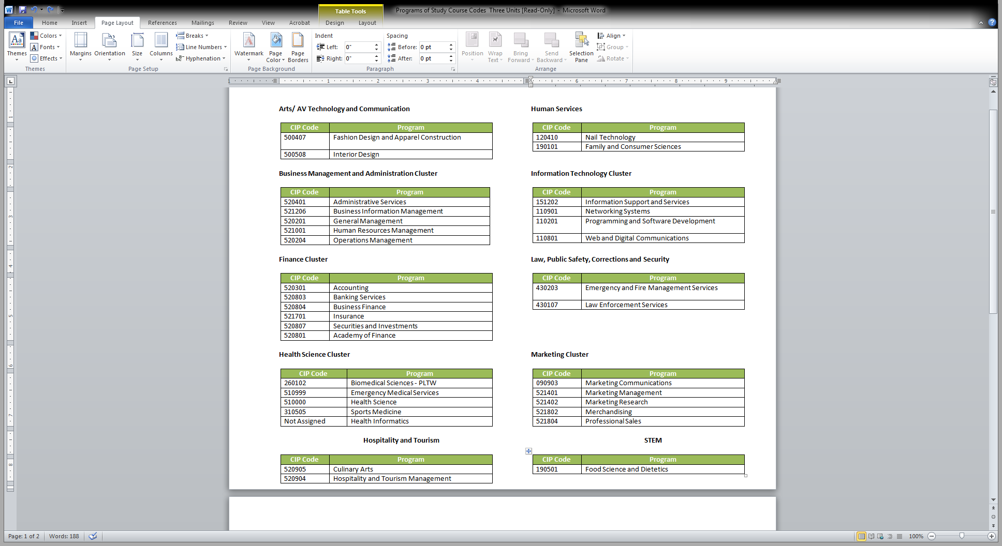
Approved Programs

Slide 16
responsibilities - OCTE
Statewide Perspectives
Data Collection - Baseline
PowerSchool
Provide framework for programs
Student Preparation for Credentials
Approve teacher qualifications
Determine students who qualify for the 3-unit minimum

Slide 17
Responsibilities - LEA
Determine course offerings
Developing state recognized programs of study
Identifying qualified teachers
Identifying concentrators
Identifying completers
Creating baseline data
Reporting accurate, timely, relevant data

Slide 18
LEA Responsibilities
Providing focused programs that adequately prepare students to be successful on end of course and end of program assessments that lead to certifications.
Providing opportunities for students to complete a work-based learning credit bearing course.

Slide 19
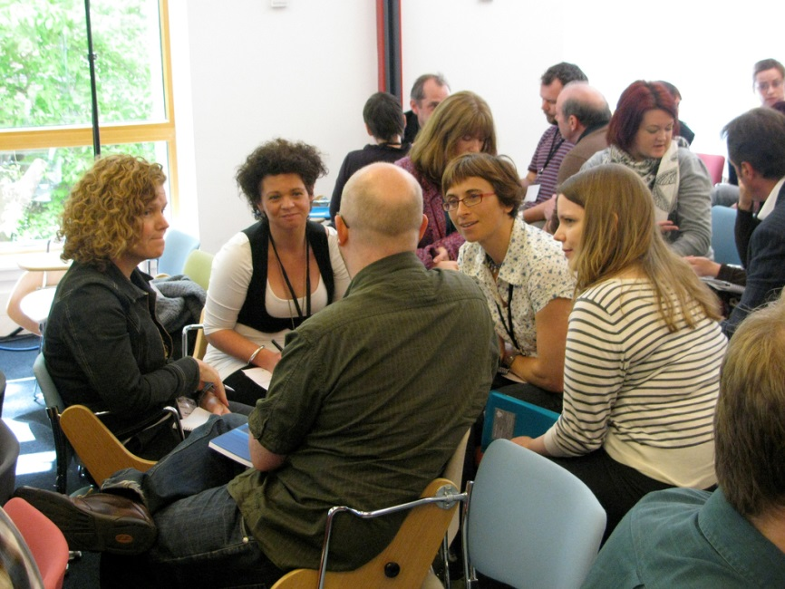
Time for Group Conversations

Slide 20
Group Reports

Slide 21
Contact
Dr. Eleanor R. Glover Gladney
Program Team Lead
Phone: 803-734-3826
E-Mail: eglover@ed.sc.gov

