Slide 1

CTEA / CATE Spring Meeting Career Ready Accountability Update David M. Mathis, Ed.D. Deputy Superintendent, Division of College and Career Readiness

Slide 2
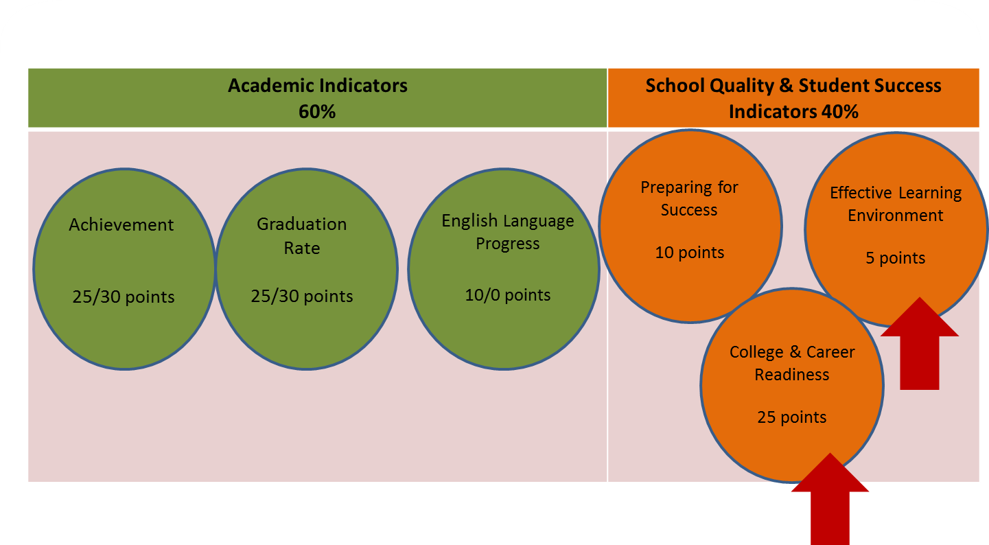
High Schools

Slide 3


College & Career Readiness
High School
25 Points
Percentage of students College or Career Ready

Slide 4
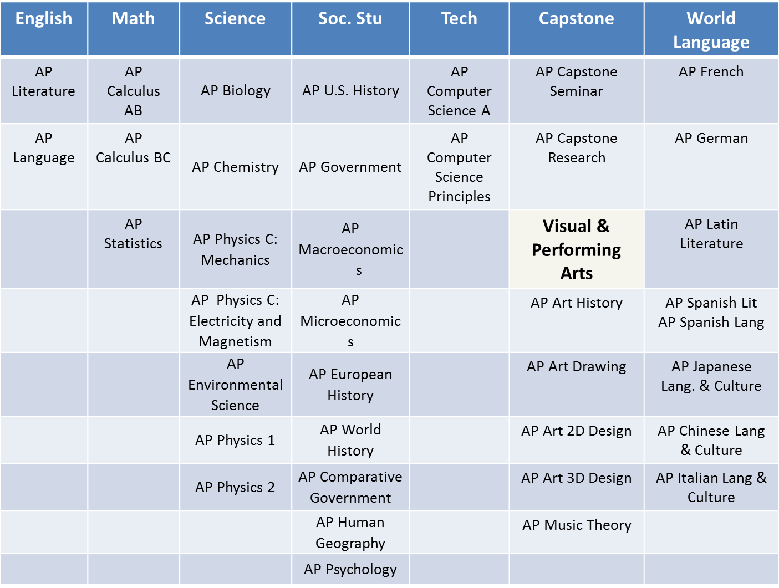
Courses

Slide 5
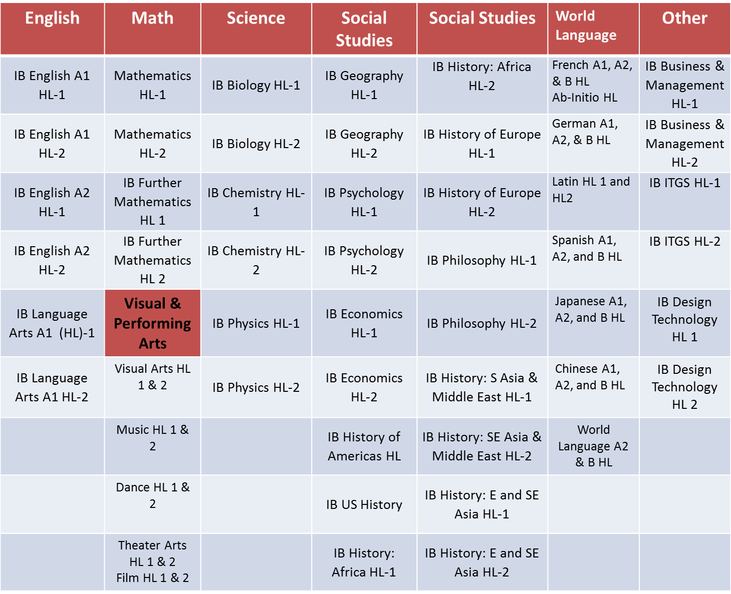
AP Courses

Slide 6
Dual Credit Courses College & Career Readiness
English, Science, Technology, Engineering, and Math two-year/four-year transfer courses
6 hours (2 courses) “C” or higher
Subject Area | Examples *see full list of courses
English | English 101, 102, 111, 150, etc.
Science | Biology 101, 102, Chemistry 110, 111, etc.
Technology | CPT 101, CSCE 145, 146, etc.
Engineering | Phy 201, 202
Mathematics | Math 110, 111, 120, 140, 141, etc.
Social Studies | HIS, 201, 202, POL 101, PSY 101, ECON 210
*Note: CATE Report Cards may include CTE Dual Credit Courses (TBD)

Slide 7
College & Career Readiness
High School
25 Points
Percentage of students College or Career Ready

Slide 8
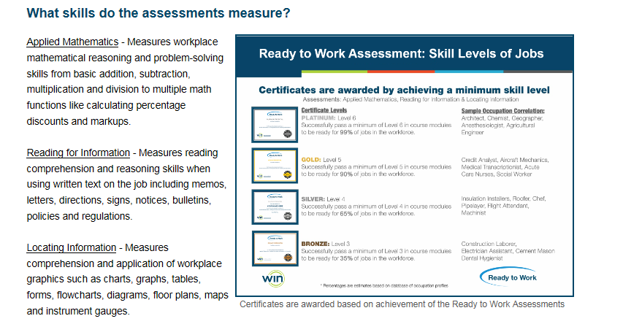
Worldwide Interactive Network Career Readiness Assessment
55 Minutes
55 Minutes
55 Minutes

Slide 9
Essential Soft Skills Assessment (55 minutes)
Entry level work tasks and behaviors
Cooperating with others
Negotiating and resolving conflict
Solving problems and making decisions
Observing critically
Taking responsibility for learning
The assessment requires participants to choose two answers for each scenario – the BEST and WORST
answers for handling a situation

Slide 10
Test Dates
Paper administrations
One-day testing April 17 or 18
make-up tests April 24 or 25
Two-day testing April 17 and 18
make-up tests April 24 and 25
Online and Accommodations testing window
April 17-25

Slide 11
Scoring
Scale score range for Math and Reading
200-270
Scale score range for Locating Information
200-240
Essential Soft Skills – pass/fail

Slide 12
Credentials
Four credential levels based on Math, Reading & Locating Information
Bronze = level 3 on all three assessments
Silver = level 4 on all three assessments
Gold = level 5 on all three assessments
Platinum = level 6 on all three assessments

Slide 13
College & Career Readiness
High School
25 Points
Percentage of students College or Career Ready

Slide 14
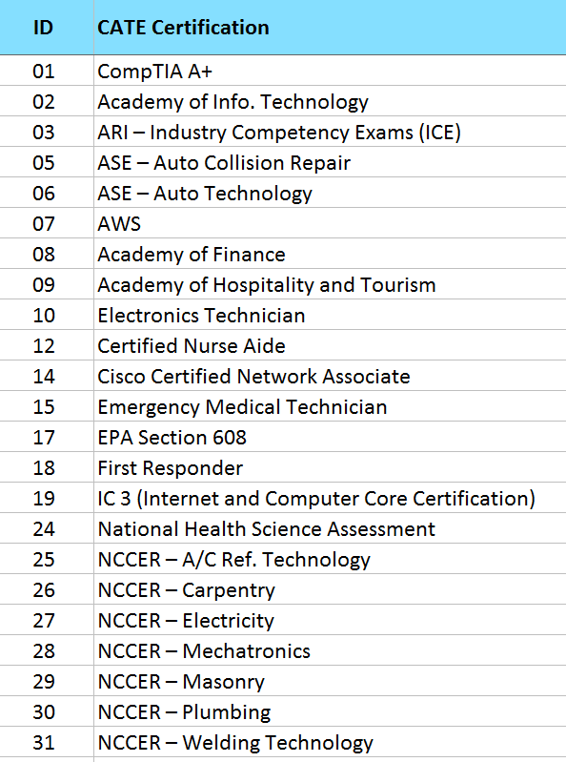
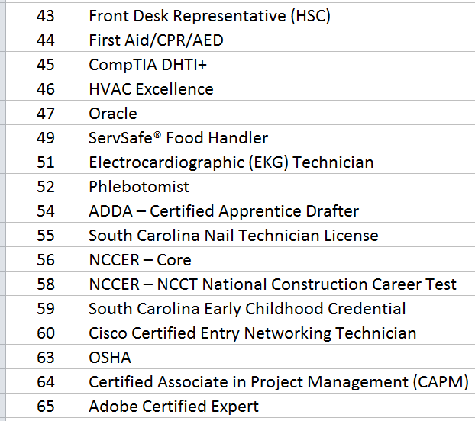
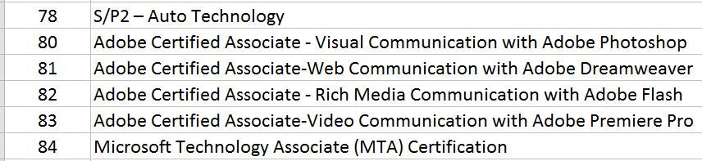
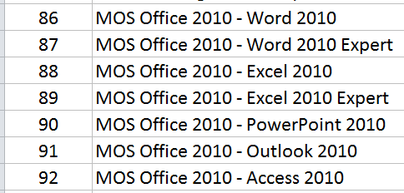
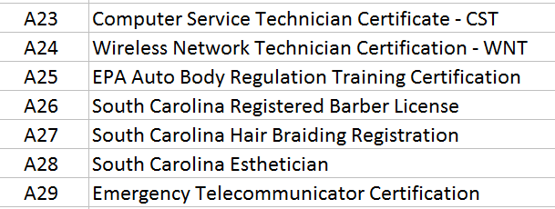
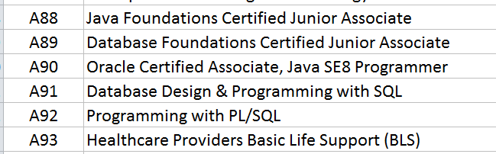
State and National Industry Credentials (samples from prior list)

Slide 15
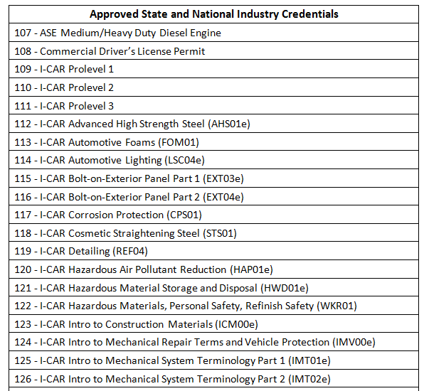
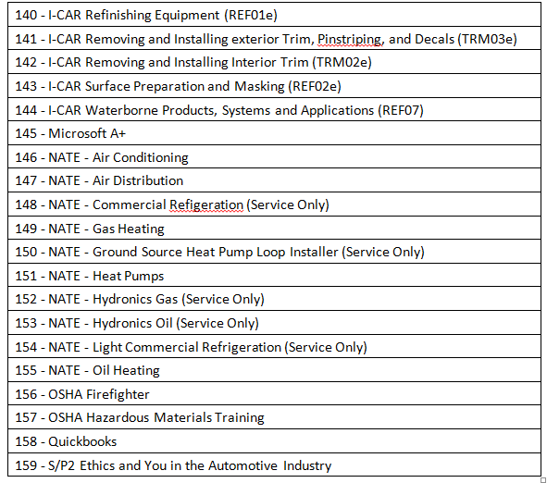
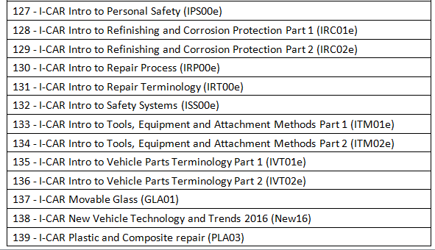
NEW Industry Certifications Recommended from Business/Industry

Slide 16
College & Career Readiness
High School
25 Points
Percentage of students College or Career Ready

Slide 17
SC Approved Work-based Learning Experience
A minimum of 40 hours of on-the-job work experience
Mutually developed Training Agreement outlining skills and objectives students will master through work experience
A placement that is aligned to student’s career pathway in the Individual Graduation Plan
Mutually developed Industry Evaluation aligned to skills in the job and characteristics of Profile of SC Graduate
One unit of credit reported on the high school transcript

Slide 18
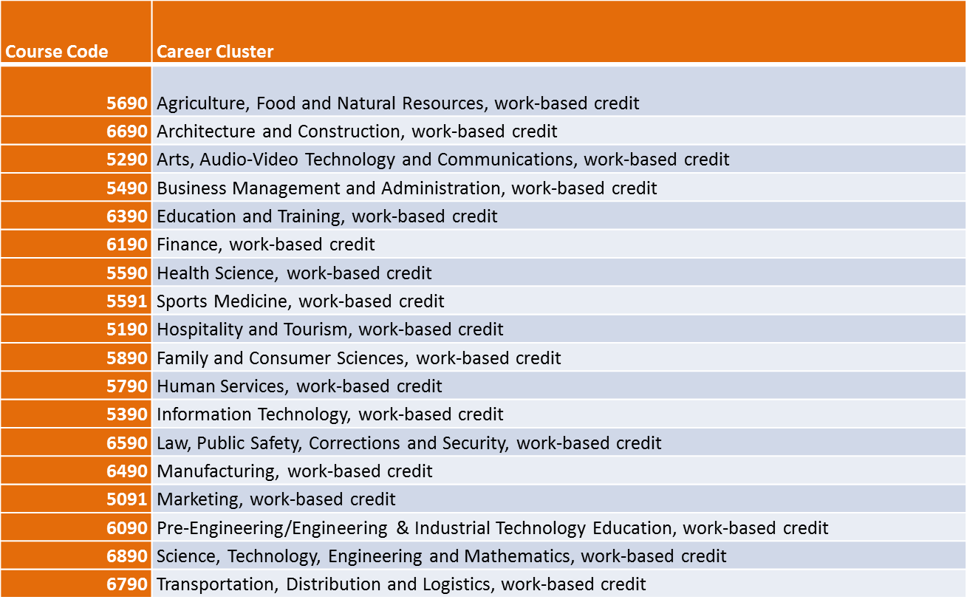
Work-based Learning Course Codes by Pathway

Slide 19
Work-based Learning embedded in other courses
Health Science 3
Automotive Technology 3
Finance & Accounting
Certified Nursing Assistant rotation
Working in a local body shop repair internship
Running a school-based credit union

Slide 20
WBL Data Collection and Validation for 2017-18
Requirement | PowerSchool WBL
40 Hours | Y/N (desk audit)
Type of WBL | Internship, Apprenticeship, Co-Op
Related Course Credit | Y/N type in related course
Training Agreement | Y/N (desk audit)
Evaluation Score of 3 or better | Dropdown 1-5
Alignment to Career Cluster | Y/N and selection of Cluster

