Slide 1

Office of Career and Technical Education Program Team
Fall Update
October 5, 2021

Slide 2

OCTE Program Team
Dr. Eleanor Glover Gladney
Troy Helms
Andrew Cook
Dominick Sanders
Angel Clark
Steven Watterson
Dana Depew
B. T. Martin
Kama Staton
Jacqueline Wiseman

Slide 3
Arts, AV Technology Education and Training Hospitality and Tourism Human Services/Family and Consumer Sciences Science, Technology, Engineering and Mathematics Dr. Eleanor Glover Gladney

Slide 4
Agenda
Human Services/Family and Consumer Sciences Booklet
What’s very important to remember?
What’s revised or changed?
What’s new?
Leadership: CTE Student Organizations
Professional Learning Opportunities
Statewide Networking
Questions

Slide 5
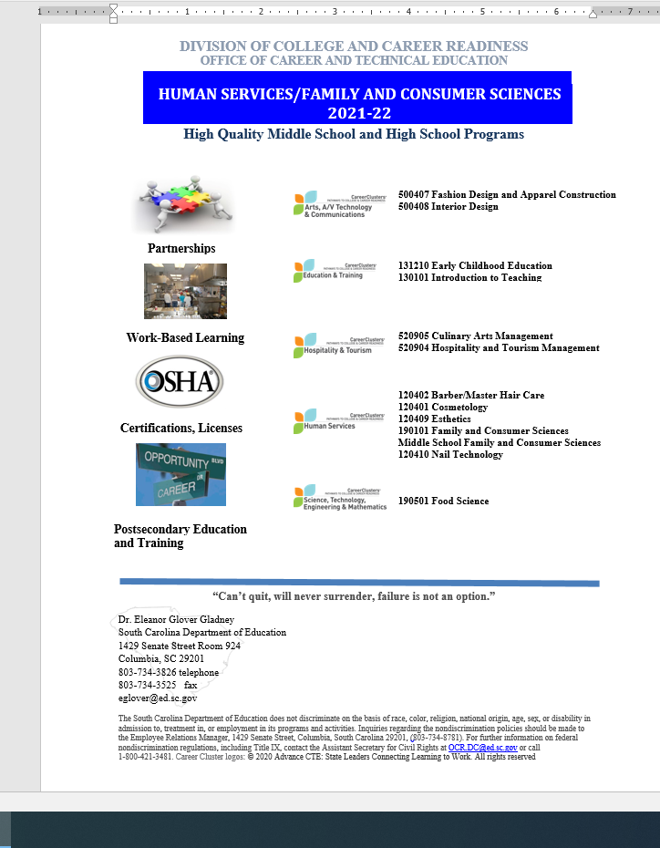
Human Services/Family and Consumer Sciences Booklet
High Quality Elements - Partnerships, Work-based Learning, Certifications, Postsecondary
Clusters - Arts/AV Technology, Education and Training, Hospitality and Tourism, Human Services/Family and Consumer Sciences, STEM
Program Requirements - CIP Codes, Course Codes, Concentrator, Completer, Hyperlinks - Standards, Work-based Learning, Equipment Lists, Certifications, CCR designations, Career Options sampling,
Occupational Outlook Handbook – High Wage, In Demand, High Skill employment information
Career and Technical Student Organization (CTSO)
Teacher Certification Requirements

Slide 6

Important
https://cdn.pixabay.com/photo/2016/09/29/13/51/important-1702878_1280.png
What’s Very Important to Remember?

Slide 7
What’s Very Important to Remember?
South Carolina Labor, Licensing, and Regulations
Barber/Master Hair Care
Cosmetology
Esthetics
Nail Technology

Slide 8
South Carolina Labor, Licensing, and Regulations
Governed by Barber Board or Cosmetology Board
Statutes and Regulations
Schools
Teachers/Substitutes on File
Standards
Equipment Lists
Hourly Requirements
Reporting
Distance Learning Requirements

Slide 9

Change
https://docs.google.com/presentation/d/1ytvB-Jl-ZIBrMUF9CjtI6cluHyJ65DUR/edit#slide=id.gb8262f2a22_0_34
What’s Revised/Changed?

Slide 10
Revisions and Changes
Standards Revisions Features
Revised Standards
Proposed Courses to Phase Out
Proposed Course Title Changes

Slide 11

New
https://docs.google.com/presentation/d/1ytvB-Jl-ZIBrMUF9CjtI6cluHyJ65DUR/edit#slide=id.gb8262f2a22_0_38
What’s New?
Notes:
Project Based Learning
Artificial Intelligence
Information Technology
Field Review
Posted 2021-22 for Transitions
Released for Implementation 2022-23

Slide 12

Barbershop Computing

Slide 13
2022-23 New Courses
Standards Development
6108 Mental Health Fitness October 5-7, 2021
5460 Safety and Sanitation TBD
Natural Hair Braiding (pending approval) TBD

Slide 14
Virtual Courses – VirtualSC
Child Development 1
Family Life Education 1
Parenting Education 1
Future additions:
Mental Health Fitness
Sanitation and Safety

Slide 15
New CIP Coded Programs 2022-23
Human Services/Family and Consumer Sciences
190704 Family Systems and Mental Health 4 credits
Hospitality and Tourism Cluster
120501 Baking and Pastry 4 credits

Slide 16
Dual Credit for CTE Completer Status Courses 2022-23
Dual Enrollment Course Names and Postsecondary Codes | SCDE Assigned Dual Enrollment Course Codes | Equivalent CTE Secondary Course Name | Equivalent CTE Secondary Course Code
Dual Enrollment Introduction to Pastries (BKP 102) AND Dual Enrollment Introduction to Baking (BKP 101) | 8716 8701 | Baking and Pastry | 5723
Dual Enrollment Introduction to Baking and Pastry (BKP 119) AND Dual Enrollment Bakeshop Production (BKP 120) | 8707 8717 | Advanced Baking and Pastry | 5724

Slide 17
Dual Credit for CTE Completer Status Courses 2022-23
Dual Enrollment Course Names and Postsecondary Codes | SCDE Assigned Dual Enrollment Course Codes | Equivalent CTE Secondary Course Name | Equivalent CTE Secondary Course Code
Dual Enrollment Nutrition (CUL 103) | 5727 | Nutrition and Wellness (formerly Sports Nutrition 1) | 5759
Dual Enrollment Food and Safety (CUL 109) | 5810 | Safety Sanitation | 5460
Dual Enrollment Sanitation (CUL 155) | 5732 | Safety Sanitation | 5460

Slide 18

American Culinary Federation (ACF) Accreditation
ACF Virtual Self-Study Course
Signed Letter Required from Administrators
Secondary Baking and Pastry and Culinary Arts Programs
9 weeks (October 4, 2021 – December 16, 2021)
Additional opportunity for students to earn national certifications
60 Continuing Education Units earned for completing the course
Hours earned through the self-study course can be used toward hours for teacher certifications – Certified Culinary Educator® (CCE®)
Support provided for accreditation site visit

Slide 19
American Culinary Federation (ACF) Earn Accreditation
Benefits of Postsecondary and Secondary Accreditation
Want to learn more? (Accreditation Information Inquiry)
See What Programs Have Been Accredited
ACFEF Accrediting Commission actions and schools responses
Site Visits
Annual Reports

Slide 20

Leadership
https://docs.google.com/presentation/d/1ytvB-Jl-ZIBrMUF9CjtI6cluHyJ65DUR/edit#slide=id.gb8262f2a22_0_42
CTE Student Organizations
“Intracurricular”

Slide 21
Human Services/Family and Consumer Sciences
DECA
Educators Rising – “Our Community”
Family, Career and Community Leaders of America (FCCLA)
SkillsUSA

Slide 22

PLO
https://docs.google.com/presentation/d/1ytvB-Jl-ZIBrMUF9CjtI6cluHyJ65DUR/edit#slide=id.gb8262f2a22_0_38
Professional Learning Opportunities

Slide 23
Professional Learning Opportunities
PSI Testing Services and SCLLR Programs – Monthly
1st Monday beginning November 1:00 – 2:00
South Carolina Association of Family and Consumer Sciences
Thursday & Friday, February 17-18, 2022 Embassy Suites Columbia on Greystone, Columbia, SC
Virtual Preconference – Coding and Computing FaCtS
Wednesday, February 16, 2022

Slide 24
Professional Learning Opportunities
Mental Health Training for School Staff - TBD
Site Visit Support January 1, 2022 – June 30, 2022

Slide 25

Networking
https://docs.google.com/presentation/d/1ytvB-Jl-ZIBrMUF9CjtI6cluHyJ65DUR/edit#slide=id.gb8262f2a22_1_40
Statewide Networking

Slide 26
Join the PLC Via Listserv
Family and Consumer Sciences Listserv
Hospitality and Tourism Listserv
Personal Services Listserv
1. Put the name of the Listserv in the subject line
2. Ask to be added to one or more of the Listservs listed above
3. Send the e-mail to eglover@ed.sc.gov

Slide 27

Questions
Dr. Eleanor R. Glover Gladney
E-mail: eglover@ed.sc.gov
Phone: 803-734-3826
Fax: 803-734-3525

Slide 28
Agriculture, Food, and Natural Resources Troy Helms

Slide 29
NEW CERTIFICATIONS
Landscape Professional Certification – Clemson University
Boater Education – DNR
Hunter Education – DNR
Working towards a Soils Certification for 2022-23- DHEC

Slide 30
12-Month Funding
Assurance forms have been mailed out
Please make sure the assurance forms are signed and returned
Teachers are expected to meet their obligations as agreed upon in their extended contract.
Teachers are completing surveys about district travel restrictions that assist our team with planning events
There will be ample virtual events available for them to participate in if the teachers are restricted due to COVID Protocol

Slide 31
Key Upcoming Dates
Oct. 19 FFA Day at the State Fair
Oct. 27 – 30 National FFA Convention
Nov. 10 Fall Agriculture Assessment
Nov. 17 Fall Agriculture Assessment Make-up
Dec. 1 – 4 NAAE Convention
Dec. 8 – 11 National Young Farmer Education Association Convention
Notes:
Follow this example for Professional Development

Slide 32
Program Growth
Continued to see a tremendous growth of programs even during the pandemic
Middle School Growth
Additional Teacher growth
Please reach out to Troy Helms or Frank Saldana if you are interested in opening a program in your district or adding another teacher

Slide 33
Questions
Regions 1 and 2 Coordinator
Troy Helms
E-mail: rthelms@Clemson.edu
Phone: 803-320-1064
Fax: 803-286-6650
Regions 3 and 4 Coordinator
Frank Saldana
E-mail: jsaldan@Clemson.edu
Phone: 765-336-4300
Fax: 843-249-4033

Slide 34
Information Technology Andrew Cook

Slide 35
Agenda
Program Highlights
Course Standards
Instructional Materials
Computer Science Graduation Requirement
Program Data
Educator Certification
External Engagements
CTSOs

Slide 36
IT Program Highlights
Added AP and IGCSE Computer Science Courses to the IT Pathways
Added the Game and Interactive Media Design Pathway
Esports Gaming Competition via SkillsUSA
Added Python and Swift Programming Courses
New and Revised Course Standards
Artificial Intelligence Standards Draft (October 2021)
Instructional Materials Reviews (Summer and Fall 2021)
Business Data Applications (5021)
Added to the CS Graduation Requirement Fulfillment List

Slide 37
IT Course Standards Update
Computer Programming 1 (New Name Introduction to Computer Programming)
Computer Programming 2 (New Name Intermediate Computer Programming)
Advanced Computer Programming (In Progress)
Game Design and Development (Revised)
Information Systems (New)
Mobile Applications Development (New)
Physical Computing and Control Systems (New)

Slide 38
Instructional Materials Reviewed
Advanced Computer Repair and Service
Animation and Game Design and Development
Computer Forensics and Cybersecurity
Discovering Computer Science

Slide 39
Game and Interactive Media Design Pathway
Required Courses
Foundations of Animation**
Game Design and Development**
Choose any two of the courses below for completion:
Accounting I
Advanced Animation
AP Computer Science A #
AP Computer Science Principles #
Computer Programming 1
Computer Programming 1 with C++
Computer Programming 1 with Java
Computer Programming 1 with Python #
Computer Programming 1 with Swift #
Computer Programming 1 with Visual Basic
Computer Repair and Service
Cyber Security Fundamentals
Digital Art and Design 1
Entrepreneurship
Fundamentals of Computing
Fundamentals of Computing I and Fundamentals of Computing II
Fundamentals of Web Page & Design and Development
IGCSE Computer Science (0478) #
Media Technology 1
Networking Fundamentals
PLTW – Computer Science A
PLTW – Computer Science Essentials
PLTW – Computer Science Principles
PLTW – Cybersecurity
Information Technology Internship, work-based credit

Slide 40
SCDE Regulation 43.234 (Defined High School Program)
Computer Science Graduation Requirement
One unit of Computer Science is required
Keyboarding was deleted as an option beginning with the 2018-19 school year
Certifications
Students shall have the opportunity to earn industry credentials or certifications
Proficiency-based instruction/grade based on District plan

Slide 41
Computer Science Redefined
Before 2019: 90% time on the computer
9-12 Computer Science Standards Key Concepts
Computing Systems
Networks/Internet
Data and Analysis
Algorithms and Programming
Impact of Computing
Notes:
Old definition vs. New definition
K-12 CS Framework

Slide 42
CS Standards Example
Key Concept | Level 1 | Level 2 | Level 3 | Level 4
Algorithms and Programming | Standard 1: Design algorithms that can be adapted to express an idea or solve a problem.
 | HS1.AP.1.1 Create flowcharts and/or pseudocode to express a problem or idea as an algorithm. | HS2.AP.1.1 Create algorithms to solve computational problems that have an application in the real world (e.g., local community, church, civic organization, school, home life). | HS3.AP.1.1 Adapt predefined algorithms to solve computational problems. | HS4.AP.1.1 Evaluate algorithms in terms of efficiency, correctness, and clarity (CSTA, 2017).

Slide 43
SCDE Regulation 43.232 (Defined Programs 6 - 8)
Occupational or Exploratory Programs:
At least one elective which should include key concepts such as digital literacy; computing systems; networks and the internet; and data and analysis.
High School Credit:
Courses offered must be limited to courses that are currently in the 9–12 section of the Activity Coding System for the Student Information System with the exception of physical education and health education courses. It is expected that students taking courses for high school credit have been taught and mastered the middle school level standards prior to taking the courses for high school credit.
High School Courses with ½ Credit Options:
Discovering Computer Science, Fundamentals of Computing

Slide 44
2021-22 Courses To Fulfill Computer Science Graduation Requirement
Computer Science HL 471D IB
Computer Science HL-1 471B IB
Computer Science HL-2 471C IB
AP Computer Science A 4771
AP Computer Science Principles 4775
Fundamentals of Computing 5023, 502800CH, 502900CH
IT Fundamentals 5025
Webpage Design / Advanced 5031, 5033
All Computer Programming Courses 5050, 5051, 5053, 5054, 5055, 5056, 5057, 5058, 5064, 5065, 5066, 5067
Networking Fundamentals / Advanced 5310, 5311
Server Administration / Advanced 5312, 5313
Computer Repair / Advanced 5320, 5321
Operating Systems / Advanced 5322, 5323
Database Design / Programming 5324, 5326
SAS Programming 1 & 2 5327, 5328
Animation / Advanced 5350, 5351
Game Design and Development 5352
GIS Technology 1 & 2 5361, 5362
Cyber Security / Advanced 5370, 5372
Computer Forensics 5374
Discovering Computer Science 5061, 506200CH, 506300CH
IGCSE Computer Science 9706
PLTW Principles of Engineering 6050
PLTW Computer Science Essentials 6372
PLTW Computer Science A 6373
PLTW Computer Science Principles 6377
PLTW Cybersecurity 6378
Business Data Applications 5021
Notes:
502800CH, 506200CH – grade 7 for ½ credit
502900CH, 506300CH – grade 8 for ½ credit
Appendix Q of the Activity Coding System

Slide 45
2021-22 Dual Enrollment Courses to Fulfill CS Graduation Requirement
Notes:
502800CH, 506200CH – grade 7 for ½ credit
502900CH, 506300CH – grade 8 for ½ credit
Appendix Q of the Activity Coding System

Slide 46
2021-22 Dual Enrollment Courses to Fulfill CS Graduation Requirement (cont’d)
Notes:
502800CH, 506200CH – grade 7 for ½ credit
502900CH, 506300CH – grade 8 for ½ credit
Appendix Q of the Activity Coding System

Slide 47
VirtualSC IT Course Offerings
Fundamentals of Computing
Fundamentals of Webpage Design and Development
IT Fundamentals

Slide 48
Bureau of Labor Statistics National Trends (Occupations)
Occupations | 2019 | 2029 | Percent Change | Annual Average Openings (2019-29) | Median Annual Wage (2020)
Computer and Information Systems Managers* | 461.0 | 509.2 | 10.4 | 36.8 | $151,150
Computer and Information Analysts* | 763.4 | 850.8 | 11.5 | 60 | $95,490
Computer Programmers | 213.9 | 193.8 | -9.4 | 10.4 | $89,190
Web Developers and Digital Interface Designers | 174.3 | 188.3 | 8.0 | 13.4 | $77,200
Information Security Analysts* | 131.0 | 171.9 | 31.2 | 13.9 | $103,590
Computer Network Support Specialists | 195.1 | 207.7 | 6.4 | 14.8 | $65,450
Notes:
Employment by detailed occupation 2019 and projected 2029 (Numbers in thousands)
https://www.bls.gov/emp/tables/occupational-projections-and-characteristics.htm
Operations specialties managers
Computer and Information Systems Managers
Computer and mathematical occupations
Computer occupations
Computer and information research scientists
Computer and information analysts
Computer systems analysts
Information security analysts
Software developers and programmers
Computer programmers
Software developers, applications
Software developers, systems software
Web developers
Database and systems administrators and network architects
Database administrators
Network and computer systems administrators
Computer network architects
Computer support specialists
Computer user support specialists
Computer network support specialists
Computer occupations, all other

Slide 49
Enrollment/Concentrator/Completer Data
CTE Program | Enrollment 2017-18 | Concentrators/ Completers 2017-18 | Enrollment 2018-19 | Concentrators/ Completers 2018-19 | Enrollment 2019-20 | Concentrators/ Completers 2019-20
Information Support and Services |  | 188/126 |  | 255/165 |  | 302/166
Networking Systems |  | 157/117 |  | 147/119 |  | 193/151
Programming and Software Development | 15694 | 354/282 | 19840 | 390/276 | 44651 | 674/341
Web and Digital Communications |  | 284/174 |  | 277/167 |  | 699/255
Computer Science (PLTW) |  | 92/39 |  | 101/62 |  | 64/33
Computer and Information Security/Information Assurance |  | 20/19 |  | 17/17 |  | 15/12

Slide 50
Information Technology Certifications 2020-21
Certification | Passed | Administered
ACE-Web Communications with Animate CC [160] | 3 | 4
Cisco Certified Entry Networking Technician [60] | 17 | 17
Cisco Certified Network Associate [14] | 1 | 1
CIW Site Development Associate [300] | 10 | 14
CIW Web Foundations Associate [298] | 8 | 8
CIW Web Security Associate [167] | 2 | 5
CompTIA A+ [01] | 1 | 1
CompTIA Cloud Essentials [275] | 2 | 14
CompTIA IT Fundamentals [A7] | 6 | 19
CompTIA Network+ [32] | 1 | 1
CompTIA Security+ Certification [A52] | 1 | 1
CTECS: Computer Programming with Visual Basic [341] | 2 | 2
CTECS: Information Support and Services [342] | 5 | 7
CTECS: Web and Digital Communications [344] | 2 | 2
IC 3 (Internet and Computer Core Certification) [19] (Business) | 24 | 35
Microsoft Certified Solutions Associate (MCSA) [A56] | 1 | 1
PCAP Certified Associate in Python Program [257] | 3 | 10
Precision Exams: Computer Programming II Python [413] | 7 | 16
TestOut IT Fundamentals Pro [321] | 15 | 15
TestOut Network Pro Certification [A19] | 7 | 8
TestOut PC Pro Certification [A18] | 31 | 36
Information Technology Total | 149 | 217

Slide 51
Computer Science Praxis Test 5652
SCDE Certification Code - 79
Content Categories
Impacts of Computing (15%)
Algorithms and Computational Thinking (25%)
Programming (30%)
Data (15%)
Computing Systems and Networks (15%)
Cut Score – 149
100 questions (3 hours)
Notes:
Time: 3 hours
Number of Questions: 100
Question Types: clicking ovals, typing in entry boxes, clicking parts of a graph, dragging and dropping answers, drop down menu.
Use the Praxis Study Guide as a reference: https://www.ets.org/s/praxis/pdf/5652.pdf

Slide 52
Computer Science Educator Certification Add-on
By Coursework
Bachelor’s degree or higher
Initial or Professional certificate at the early childhood, elementary, middle, secondary, or PK–12 level
Minimum qualifying score(s) on the content area examination(s) required by the SBE for the content area; and
Completion of all required coursework with an equivalent of a grade of “C” or better.
Required Courses
Computing Systems 3 semester hours
Network and the Internet 3 semester hours
Data and Analysis 3 semester hours
Algorithms and Programming 3 semester hours
Impact of Computing 3 semester hours

Slide 53
Computer Science Educator Certification Add-on (cont’d)
By Exam
Bachelor’s degree or higher
Initial or Professional certificate at the early childhood, elementary, middle, secondary, or PK–12 level
Minimum qualifying score(s) on the content area examination(s) required by the SBE for the content area; and

Slide 54
CTE Teacher PD Update
30 hour PD to teach the introductory Computer Science courses.
Discovering Computer Science, Fundamentals of Computing, and Fundamentals of Web Page Design and Development
Reference the Required Credentials for Professional Staff Members Manual for more course by course information.
Computer Science Praxis Prep Course
Micro Credential Pilot (Bloomboard)
Notes:
Code.org training, IT credential, Computer Science Praxis, demonstrated prior experience
Case by Case basis

Slide 55
SCDE External Engagements
Code.org
The Stem Center at the Citadel
State of CS Report
CSTA/CSTA South Carolina
SC ECEP (Landscape Report)
Learning Blade
Middle School Stem Resources
AI4K12/AI4All – 5 Big Ideas
CSforALL
Script Facilitators (Aiken, Spartanburg 1)
NSF Includes Planning Grant Proposal
South Carolina Coalition for Math and Science (SCCMS)
Microsoft TEALS
USC School of Engineering and Computing
Engineering, Computer Science and STEM Camp
IT-oLogy
Tech-in-a-Box Summer Enrichment Program
Girls Who Code
Hour of Code

Slide 56




CAREER AND TECHNICAL STUDENT ORGANIZATIONS (CTSO’S)
Joseph Chapman, Interim Executive Director
jchapman@skillsusasc.org
Tammy Vault, State Advisor
​sctsastateadviser@gmail.com
Ross Jones, State Adviser ​rjones@scfbla.org
Dawn Coker
DCoker@chesterfieldschools.org

Slide 57
Questions
Andrew Cook
E-mail: acook@ed.sc.gov
Phone: 803-734-0372
Fax: 803-734-3525

Slide 58
K-12 Computer Science Dominick Sanders

Slide 59

2021-2022 CS PLO Dates
Free & Virtual
Fall 2021 - HS - CS Career Connections | September 18, 2021
Fall 2021 - K-8 - CS Across the Curriculum | September 18, 2021
Fall 2021 - HS - Tales from the CS Workforce | October 16, 2021
Fall 2021 - K-8 - Hands-on CS/CT | October 16, 2021
Spring 2022 - HS - Building a Robust CS Program | January 22, 2022
Spring 2022 - K-8 - CS & Literacy | January 22, 2022
Spring 2022 - HS - Advanced Topics in CS | March 26, 2022
Spring 2022 - K-8 - CS & Numeracy | March 26, 2022
Click Here to Register for PLOs
Notes:
https://forms.gle/gvqAgCvd3vZEeX2a9

Slide 60
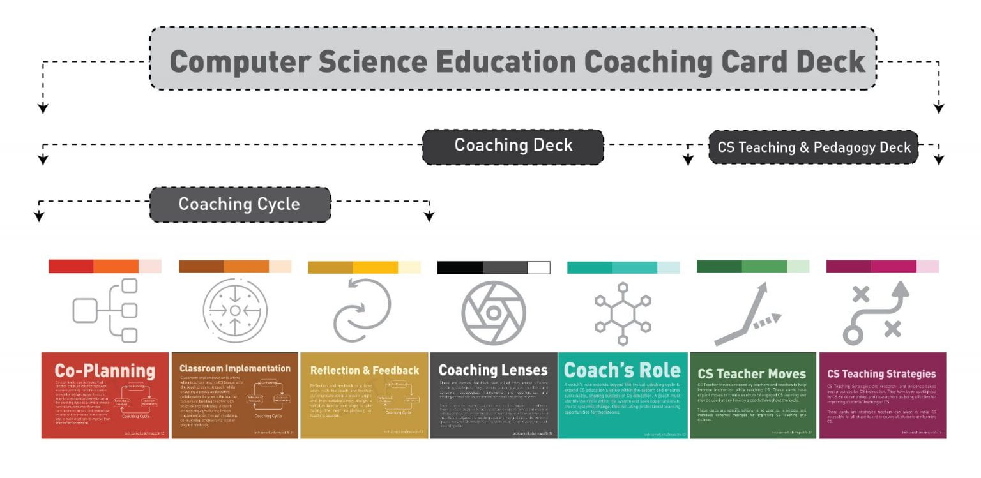
CS Coaching Toolkit
Provision of Instructional look-fors to support in assessing CS education at all levels
This deck may be utilized in flexible ways:
Inform: It can be used to develop learning activities for individuals, professional learning communities, or coach development programs.
Plan: It can provide guidance to practicing coaches as a tool for brainstorming and planning.
Organize: Coaches can utilize cards as in-the-moment cues and tools for teacher collaboration to stay on track during coaching sessions.
Disbursement will began at the Instructional Leaders Roundtable
If your school or district would like a toolkit please fill out the form – Click here to access the form
Notes:
https://forms.office.com/r/7pZrp0YUYy

Slide 61

Upcoming
CS Bytes (Quarterly Newsletter)
Week of October 4, 2021
Computer Science Ed Week
December 6- 12, 2021

Slide 62
Questions
Dominick Sanders
E-mail: dsanders@ed.sc.gov
Phone: 803-734-2862
Fax: 803-734-3525

Slide 63

Health Science Angel Clark

Slide 64
What’s New in Health Science?
Review of what changes took place beginning 2020-21
Health Science 1- 5550 – Foundations of Healthcare Professionals
Health Science 2- 5551- Advanced Healthcare Applications
Health Science 3- 5552- Human Structure, Function, and Disease.

Slide 65
What’s New in Health Science?
Standards reviewed and updated by committees this past summer
Sports Medicine 1,2,3
Pharmacy for Medical Careers
Medical Billing and Coding
Medical Terminology
Middle School Standards
All will be posted before the end of the 2021 year and take effect in Fall 2022

Slide 66
What’s New in Health Science?
New Courses coming in 21-22 school year
Public Health Pathway
1. Foundations of Public Health – 5586
2. Advanced Principles of Public Health -5587
Middle School Course
Fundamentals of Healthcare – 2791 (8th grade only)
Notes:
Fundamentals of Healthcare 2791
Course Description: This course provides students with a foundation of healthcare applications used in a variety of healthcare careers. While further exploring the five career pathways developed by NCHSE (the National Consortium on Health Science Education), students will be exposed to basic healthcare industry practices.
Course Objectives: Upon completion of this course students will have a good understanding of what it takes to be a healthcare professional. This course will assist students in making informed decisions regarding academic and occupational goals.
Grades: Recommended for grade 8
This course is recommended for: Students with a desire learn more about Healthcare.
Pre-requisites: Introduction to Healthcare Professions
Stackable Credentials: NFHS Learn (concussion, heat related illness), First Aid, Heartsaver CPR/AED, Stop the Bleed

Slide 67
What’s New in Health Science?
Other CTE courses being added as part of the completer path
Sports Nutrition (5760) Included in the Human Services Career Cluster – under the Family and Consumer Science Standards
Introduction to Veterinary Science (5613) Included in the Agriculture Career Cluster- under the Plant and Animal Standards

Slide 68
Popular Topics for Questions
Dual Enrollment
Plan is to add more statewide approved DE courses for completer credit.
Credentials
Many that can be taken within the course code 5560
Completer Paths
Three-Unit, Four-Unit, Dual Pathway Completers

Slide 69
National Health Science Certificate Exam
National Health Science Certificate (NHSC)
Changed names
Remote proctoring
Testing spreadsheet to Dana Depew
Proctor ID’s
Cost covered by grant for one test per completer.
When do students take the test?

Slide 70
Professional Development
SC ACTE Health Science Educators Division
In-person, November 14-16, 2021, Embassy Suites, Myrtle Beach, SC
Webinars
Health Science Back to School Webinar
HOSA informational webinars
_ National Consortium for Health Science Education (NCHSE)

Slide 71
Upcoming SC HOSA Conferences
October 30, 2021 – Virtual Fall Leadership Conference
Free to all who want to attend
Advisor training 10:00 AM – 12:00 Noon
Opening session starts at 1:00 PM
Most sessions will take place via Zoom so that students may interact and ask questions
Sessions will include information on competitive events and leadership
Local Officer training session is at 4:00 PM
March 16-18, 2021 – State Leadership Conference

Slide 72
Health Science and HOSA Professional Partners or Donors
College of Charleston
Prisma Health
Newberry College
SC Hospital Association
Nephron Pharmaceuticals
MUSC School of Pharmacy
USC College of Pharmacy
Kershaw Health
Starla’s Teaching Tips
University of SC
Clemson University
AHEC
Blue Cross Blue Shield
PassAssured
Cherokee Trail Veterinary
St. Andrews University
Citizens
Coastal Carolina Veterinary
Humana Healthy Horizons
SC HS Educators
Midlands Technical College
Lexington Medical Center
Aiken Regional Medical Center

Slide 73
Questions
Angel Clark, MSN, RN
Email: aclark@ed.sc.gov
Phone: (803) 734-0372 Fax: 803-734-3525

Slide 74
Architecture and Construction Government and Public Administration Law, Public Safety, Corrections, and Security Manufacturing STEM Steven Watterson

Slide 75
Architecture/Construction/Manufacturing
Tooling-uSME software purchase.
Tooling-uSME Catalog
Industry 4.0 / Smart Manufacturing * Introduction to Additive Manufacturing 111 * Additive Manufacturing Methods and Materials 141 * Cybersecurity for Manufacturing Basics 101 * Introduction to the Industrial Internet of Things 111 * Introduction to Digital Twin 241 | Machining * Introduction to CNC Machines 201 * Basics of the CNC Lathe 211 * Basics of the CNC Mill 212 * Basic Cutting Theory 201 * Basics of G Code Programming 231 | Maintenance * Electrical Units 101 * Introduction to Circuits 201 * Introduction to Fluid Systems 101 * Introduction to Electric Motors 301 * Introduction to Mechanical Systems 101

Slide 76
Architecture/Construction/Manufacturing
Tooling-uSME software purchase.
Tooling-uSME Catalog
Welding * Welding Safety Essentials 101 * Introduction to Welding Processes 151 * Introduction to Welding 141 * Introduction to GMAW 251 * Introduction to FCAW 261 | Foundational * Intro to OSHA 101 * Math: Fractions and Decimals 111 * Basic Measurement 101 * Quality Overview 111 * Blueprint Reading 131

Slide 77
Professional Learning Opportunity
Any Teacher completing a Tooling-uSME course module will receive CEU’s towards license renewal
Welding PD is scheduled for November 19, 2021, location TBD
As a reminder August 1, 2021, all NCCER written tests must be done electronically. This a link to help you with the etesting
etesting hyperlink
Instructor Certified Training Program will be scheduled
October 13-15, 2021, location TBD

Slide 78
Questions
Steven Watterson M.Ed.
Email: swatterson@ed.sc.gov
Phone: (803) 734-8267 Fax: 803-734-3525

Slide 79
Course Standards Technical Skills Assessments Business Management and Administration Finance Law, Public Safety and Security Marketing Dana Depew

Slide 80
Business Program Summary Changes
CIP Code | Name | Concentrator Courses | Changes for 2021-22
520401 | Administrative Services | IBA 1 / Administrative Technology | IBA 2 new name: Business Data Applications (BDA) and added throughout all programs
521206 | Business Information Management | Image Editing / Digital Publication Design
520201 | General Management | Accounting 1 / Entrepreneurship
521001 | Human Resource Management | Fundamentals of Human Resource Management / Business Law
520204 | Operations Management | Virtual Enterprise 1 / Virtual Enterprise 2

Slide 81
Program Summary-Finance
CIP Code | Name | Concentrator Courses | Changes for 2020-21
520301 | Accounting | Accounting 1 Accounting 2 | IBA 2 new name: Business Data Applications (BDA)
520803 | Banking Services | Banking Services Business Finance | Added: Marketing / Non-Traditional for Males
520201 | Business Finance | Business Finance Accounting 1
521701 | Insurance Services | Business Finance Insurance and Risk Management
520807 | Securities and Investments | Business Finance Securities and Investments

Slide 82
Program Summary-Marketing
CIP Code | Name | Concentrator Courses | Changes for 2020-21
090903 | Marketing Communications | Marketing / Advertising or Digital Media Marketing | IBA 2 new name: Business Data Applications (BDA)
521401 | Marketing Management | Marketing / Marketing Management
521402 | Marketing Analytics | Marketing / Marketing Analytics
521802 | Merchandising | Marketing / Merchandising

Slide 83
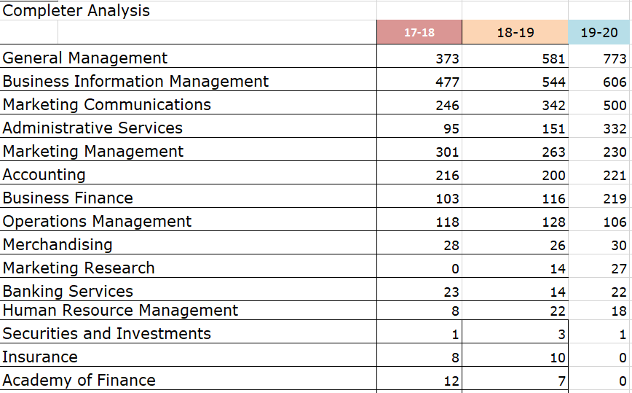
Program Analysis

Slide 84
Business and Marketing Course Name Changes 2022-23
Global Business renamed International Business
Digital Literacy add course code
IBA 1 renamed Digital Workplace Applications

Slide 85
2019-20 Concentrator/Completer
Program | Concentrators | Completers
Administrative Services | 743 | 332
Business Information Management | 1,636 | 606
General Management | 1,713 | 773
Human Resources | 71 | 18
Operations Management | 198 | 106
Total | 4,361 | 1,835
Enrollment by BUSINESS Cluster: 28,984 (not including 7-8 gr.)
Notes:
2018-19 2,546 1,426

Slide 86
2019-20 Concentrators/Completers Data
Program | Concentrators | Completers
Academy of Finance | 2 | 0
Accounting | 427 | 221
Banking Services | 61 | 22
Business Finance | 372 | 219
Insurance | 0 | 0
Securities and Investments | 5 | 1
Total | 867 | 463
Enrollment by FINANCE Cluster: 13,447
28
Notes:
2018-19 467 350

Slide 87
2019-20 Concentrator/Completer Data
Program | Concentrators | Completers
Marketing Communications | 1,360 | 500
Marketing Management | 597 | 230
Marketing Research (Marketing Analytics) | 30 | 27
Merchandising | 188 | 30
Total | 2,175 | 787
Enrollment by MARKETING Cluster: 7,736
Notes:
2018-19 838 645

Slide 88
Middle School Course Update and Corresponding Certifications/Preparation
New Course Code | Old Course Code | Course Title | Certification/ Preparation | PowerSchool Code
2702 | 5008 | Computer Applications | IC3: Key Applications MOS EverFi Digital Literacy | 19 100, 102, 104 A31
1853 2853 | 5181 | Digital Literacy | IC3: Living Online MS Digital Literacy | 19 85
2704 2706 2703 | 5011 5100 5010 | Google Basics Keyboarding Multimedia Basics | Career Preparedness IC3: Cloud Computing/ Collaboration | A78 19
2705 | 5282 | Financial Literacy | EverFi Financial Literacy | A30

Slide 89
Business Administration and Supervision Certification Update
Course(s) Alignment | Certification | CCR (Y/N) | Description
Business Information Management | TOSA® DigiComp 442 DigiComp 443 InDesign 443 Photospho4 445 Illustrator | N | Isograd TOSA® Digital certifications are designed for employees, students, and job seekers to validate their skills.
All programs | MS Office 2019 Associate and Expert 439-445 |  | MOS certifications help validate proficiency in using Microsoft Office 2019 and Office 365 and meet the demand for the most up-to-date skills on the latest Microsoft technologies
Administrative Services | Microsoft 365 Certified TEAMS Administrator Associate 440 |  | Microsoft Teams Administrators configure, deploy, and manage Office 365 workloads for Microsoft Teams that focus on efficient and effective collaboration and communication in an enterprise environment.

Slide 90
Business Management and Administration Certification Update 2022-23
Course(s) Alignment | Certification | CCR (Y/N) | Description
Fundamentals of Project Management | PMI Project Ready 434 | N | The PMI Project Management Ready certification presents the tools needed to apply the project management skillset to all workplace and day-to-day activities. Students prepared for this certification know project management fundamentals and core concepts, traditional plan-based methodologies, Agile frameworks/methodologies, as well as Business Analyst frameworks.
Notes:
Deleted:
MS Office 2010

Slide 91
Dual Credit for Completer Status
Dual Enrollment Course Names and Postsecondary Codes | SCDE Assigned Dual Enrollment Course Codes | Equivalent CTE Secondary Course Code and Name
Principles of Management (MGT 101) | 6740 | 5092 Business Principles and Management
Business Law (BUS 121 / TSTM 240) | 5045 | 5044 Business Law
Introduction to Marketing (MKT 101) | 6710 | 5421 Marketing
Microcomputer Applications, Introduction to Computer Technology (CPT 170, CSCI 105 CSCI 105) | 5026 | 5020 Integrated Business Applications 1
Notes:
– Carefully analyze post-secondary courses to match secondary CTE standards

Slide 92
CTE Course Standards Rigor and Relevance
Aligned to:
ELA
Math
Science
Social Studies
ISTE
CS
Safety
CTSO Integration
Technology Knowledge
Employability Skills
Professional Knowledge
Core Content
Notes:
Part C (Technology Knowledge) #4 includes cyberbullying and Creative Commons.

Slide 93
2020-21 Updated Course Standards
Business | Marketing
Digital Literacy | Sports and Entertainment Management
Digital Publication Design | Marketing Management
Global Business
Integrated Business Applications 1
32
Notes:
Standards documents include links to the materials/resource document as well as academic alignment. Use the Student Profile!

Slide 94
2021-22 Planned Course Standards Revisions
Business | Marketing
Fundamentals of Business, Marketing, and Finance | Advertising
 | Fashion Marketing
 | Merchandising

Slide 95
SC Virtual School
Accounting 1 CP – not currently available
Entrepreneurship CP
Integrated Business Applications 1 CP
Personal Finance CP
30

Slide 96



Career and Technical Student Organizations (CTSOs)
Future Business Leaders of America | Business Professionals of America | DECA
CONTACT: Ross Jones, State Director rjones@scfbla.org | CONTACT: Dawn Coker, State Advisor dcoker@chesterfieldschools.org | CONTACT: Ginger Hill, State Advisor (803) 984-2579 scdeca.hill@yahoo.com

Slide 97
Professional Development
SCBEA / SBEA / NBEA
FBLA, DECA, BPA
Finance Forum, Oct. 27, Columbia
Various workshops: credentials, software, YESCarolina, IT summer training (CSPD Week)
New: SCVirtual (40 hours CEUs)
MS Access (self-paced, online)
MS Excel Advanced (coming soon)

Slide 98
Questions
Dana Depew, M.Ed.
E-mail: ddepew@ed.sc.gov
Phone: 803-734-2828
Fax: 803-734-3525

Slide 99
Arts, Audio-Video Technology and Communication Science Technology Engineering and Mathematics (STEM) Transportation, Distribution and Logistics B. T. Martin

Slide 100
Arts, AV Technology, and Communications
Graphic Communications Standards have been revised
Core Engineering standards are completed
Need more Industry Certifications for
Architectural and Mechanical Design
Digital Arts & Design Technology
Media Technology

Slide 101
Science, Technology, Engineering, and Mathematics
SREB Middle Grades STEM Courses – 20 Schools received grants to implement the first course “Fundamentals of Science and Technology” in the spring or the fall of this year.
Will seek new funding for the 2021-2122 school year
SREB STEM Teacher Training was held – June 21-25, 2021 @ UofSC
Project Lead the Way – Engineering Essentials – New foundation course – There are 3 foundation courses EES, IED, POE. Note, POE counts for Computer Science credit
SREB Aerospace Engineering – 4 Courses

Slide 102
Transportation, Distribution, and Logistics
ASE Student Testing – SC TEBA is paying for Completers only
ASE Program Accreditation – We encourage all of the Automotive programs to become ASE Accredited -Technical Assistance is Available
ASE All Star Student Competition – February 2022
Fall Automotive Instructors Conference – September 19-20, 2021
Automotive Collision Repair Technology – ASE and I-CAR Standards
Automotive Technology – ASE Standards
CDL Program – Committee to develop curriculum standards
Diesel Technology – Inspection, Maintenance, & Minor Repair
Global Logistics & Supply Chain Management – SREB Curriculum

Slide 103
Questions
B. T. Martin
E-mail: BTMartin@ed.sc.gov
Phone: 803-734-3398
Fax: 803-734-3525

Slide 104
Work-Based Learning Kama Staton

Slide 105
SC Accountability System- Career Ready Qualifiers
Tips
Senior Cohort is measured, qualifier follows until graduation
Only need to meet one qualifier for college or career ready indicator
Qualifier counts 25 of the 100 points
SC High School Credential qualifiers are counted in the formula
Score Silver, Gold or Platinum on WIN Learning or WorkKeys
ASVAB Score of 31 or higher
CTE Completer with industry recognized credential
Career Ready Work-Based Learning placement
Source: 2020-21 EOC Accountability Manual

Slide 106
SC Accountability System-Career Ready Qualifier Work-based Learning Placement Qualifiers
Registered Apprenticeship
Youth Apprenticeship
Cooperative Education (Co-Op)
Internship
*Refer to SC Dept. of Education Work-Based Learning Implementation Guide for established criteria and guidelines

Slide 107
WBL Career Ready Qualifier Requirements
Student must successfully complete the state-approved work-based learning exit evaluation from an employer . The WBL program must include all of the following:
A training agreement which defines a combination of objectives and a minimum of 40 practical experience hours or the highest number of hours required by industry defined competencies in a career pathway.
and
Be aligned with the student’s IGP Career Program Pathway
and
Include an industry evaluation that is created from the training agreement, which is mutually developed and includes the world-class skills from the Profile of the SC Graduate with a positive employer evaluation score, 3 or higher on a scale of 1-5. SC Work-Based Learning Training Agreement and Evaluation Plan Template
and
The student must have earned a minimum of one unit in the pathway related to the work-based placement or completed a personal pathway of study.

Slide 108
WBL Career Ready Qualifier (cont.) Requirements
All documentation is maintained at the school level for two years after the student graduates from high school. Documentation includes IGP at time of placement, training agreement, evaluation plan.
Academic credit, compensation, liability, and activities are district specific and may vary with course of study.
CTE WBL Credit- Bearing Course Codes are for CTE students taking the course in a CTE CIP-coded program.
SC Work Based Learning Implementation Guide, pgs.8-10
Academic Credit for non-CTE could include local board approved course or embed WBL placement as requirement of a course ( ex. Social studies, electives).

Slide 109
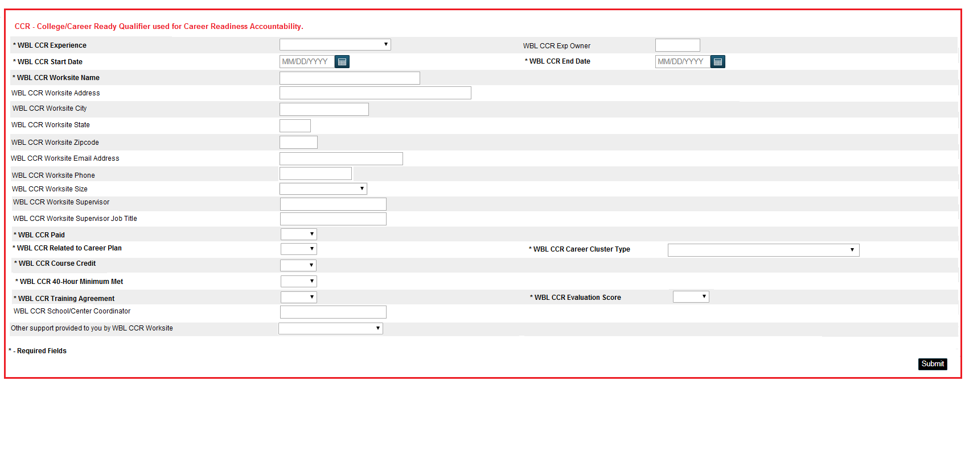
Powerschool Reporting
This field is at the first field of entry at the top of the WBL page in PowerSchool.
THIS IS FOR REPORTING CAREER READY QUALIFIER ONLY!
The only reporting experiences for this field is Registered Apprenticeship, Youth Apprenticeship, Internship, or Co-Op for accountability purposes only! Need to only report one! Additional experiences can be reported in the WBL Experiences fields below the red box. Data is captured for senior cohort for report card rating.

Slide 110
2020-2021 Waiver Granted
SC Report Cards
On March 26, 2021, the U.S. Department of Education waived federal accountability requirements and granted flexibility in administering assessments due to COVID-19.

Slide 111

Partnership
Be a Bridge Builder

Slide 112
Professional Development 2021 Fall Regional School Counseling and Career Guidance Personnel Workshops
October 14
Columbia International University
REGISTRATION LINK
Registration Deadline: October 11
October 15
Spartanburg Community College
REGISTRATION LINK
Registration Deadline: October 11
November 17
Colleton County High School
REGISTRATION LINK
Registration Deadline: November 12

Slide 113

Resources
SC Work Based Learning Summit (scwblsummit.blogspot.com)
All presentations and session recordings now available on the blogspot!

Slide 114
Resources (cont.)
Career and Technical Education
SC Career Guidance/WBL Virtual Toolkit
SC School Counseling and Career Guidance Model
SC Work-Based Learning Resource Page
SC Career Education Career Aisle
SC Discus Job Career Resources
Microburst Learning
SCOIS
NCAA Eligibility Center
SC Works Labor Market Data

Slide 115
Deadline to enter all WBL experiences into PowerSchool
Friday, May 27, 2022

Slide 116
Questions
Kama Staton
E-mail: kstaton@ed.sc.gov
Phone: 803-734-8415
Fax: 803-734-3525

Slide 117
Professional Development Jacqueline Wiseman

Slide 118

Where to Find PLOS
Where to find Professional Learning Opportunities
CTE Support Website
Agency Events and PLO Calendar
SCDE CTE Website

Slide 119
New CTE Administrators
New CTE Administrator Institute
Not just for New CTE Administrators
Aspiring Leaders
Need a refresher
Dates and syllabus

Slide 120

CTE Videos
CTE Videos
Link to all videos

Slide 121
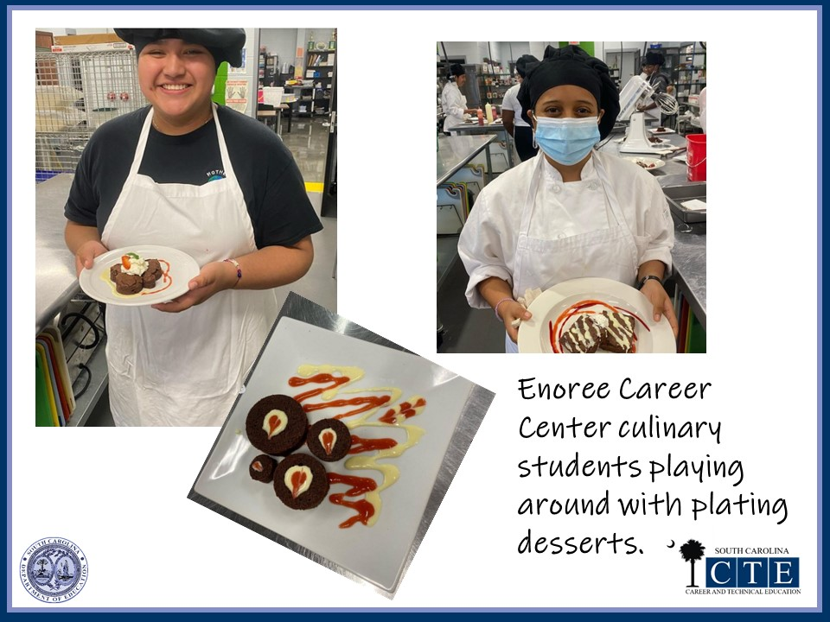

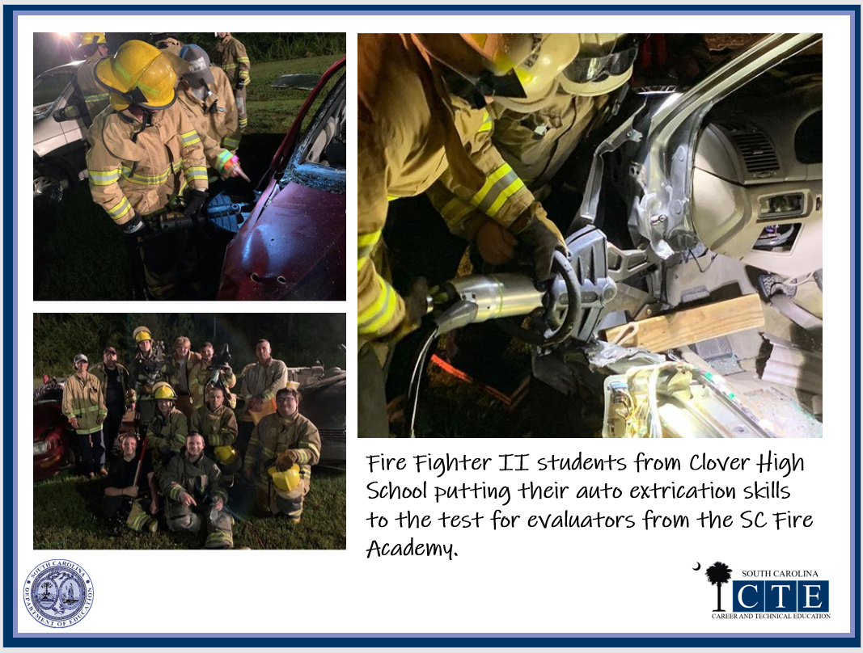
This Week In CTE
This Week In CTE

Slide 122

Are We Friends
Are We Friends?

Slide 123
Questions
Jacqueline Wiseman E-mail: jwiseman@ed.sc.gov
Phone: 803-734-8455
Fax: 803-734-3525

Slide 124

Thank you
Contact Info

