Slide 1

SCDE Presents:
Louise Amos
Office of Research and Data Analysis (ORDA)
lamos@ed.sc.gov
Laura McNair
Office of Federal and State Accountability (OFSA)
lmcnair@ed.sc.gov

Slide 2
Topics
Regulations
Uniform Grading Policy
Dual Enrollment
Transfer Grades
Early Graduates
Credit Recovery
Transcript Template and Proper Procedures
Proper Coding
Finalizing/Archiving Transcripts
Questions and Answers

Slide 3
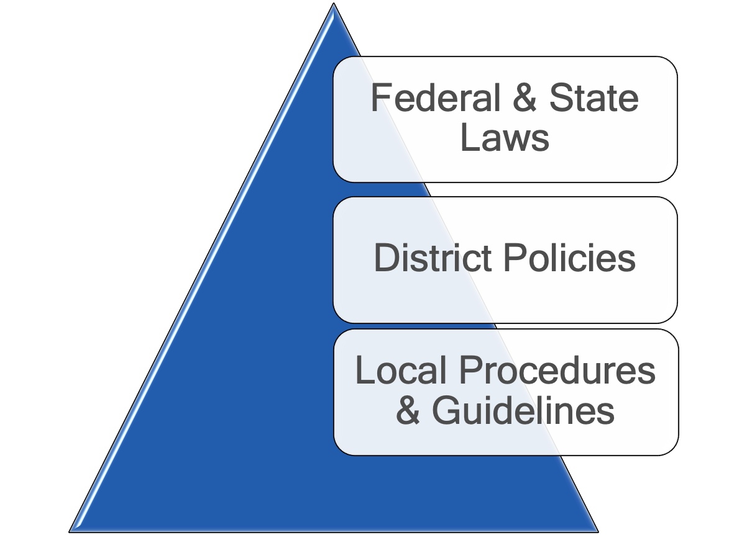
Follow the Rules

Slide 4
SBE Regulation 43-234 - Defined Program, Grades 9-12
Districts must maintain accurate student data and each district superintendent must verify the accuracy of course records for students. (SBE 43-234(VII)(D), 43-172).
Approved computer science courses are in Appendix Q of the Activity Coding Manual (ACM). Check the ACM for the listing of dual enrollment courses that meet the computer science credit. The list of courses usually changes year to year. If students are assigned any other course than what is in that appendix, they have not met graduation requirements.
Students may take either Foreign Language OR a Career and Technology course (refer to college admission requirements).
Courses offered in nontraditional settings such as online courses, dual enrollment courses, and courses offered by the school through the district, state, or another type of provider must be included in the active master scheduler.

Slide 5
SBE Regulation 43-238 - Comprehensive Health Education
A half credit course for 36 weeks of which 750 minutes is focused on reproductive health.
The course may be a series of mini courses, or units of instruction integrated into existing required courses. One of these requires a plan to be submitted to the Division of Curriculum for written approval at least six weeks prior to implementation.
Students in middle or junior high school are NOT permitted to take P.E. I for high school credit. If an 8th grader has finished the year and has rolled over to 9th grade status, that student may take P.E. I during the summer (UGP).
Virtual SC’s P.E. I course does NOT include Comprehensive Health Education. A separate course must be taken.

Slide 6
SBE Regulation 43-172 - Accounting and Reporting
A pupil shall be dropped from membership on the day when the number of unlawful days absent exceeds 10 consecutive days or when the pupil leaves school because of transfer, death, expulsion, graduation, legal withdrawal, or for any other reason.
A pupil shall maintain membership in a minimum of 200 minutes of daily instruction or its equivalency annually.
It is illegal to count early graduates as active students in PowerSchool. They must be transferred out of PowerSchool and placed in Graduated Students.

Slide 7
SBE Regulation 43-273 - Transfers and Withdrawals
Units earned by a student in an accredited high school of this state or in a school of another state which is accredited under the regulations of the board of education of that state, or the appropriate regional accrediting agency, will be accepted under the same value which would apply to students in the school to which they transferred.
If a student transfers from a school, which is not accredited, he or she shall be given tests to evaluate prior academic work and/or be given a tentative assignment in class for a probationary period. Districts are encouraged to establish local board policy to address a non-accredited school’s transfer grades and credits.
Dual credit courses earned out of state may or may not carry quality point weightings. When a student transfers, the weight applied at the sending institution according to that state’s regulations will be applied on the transcript in the receiving South Carolina high school. A high school should NOT change the weight of a dual credit course to match South Carolina’s process when they transcribe the course.

Slide 8
SBE Regulation 43-273 - Transfers and Withdrawals
Data shall be furnished by the sending school when requested in writing no later than 10 business days. Schools may not withhold the transfer of records for fees owed by the student. Ensure you have a request from the school to which the student is transferring prior to sending any data.
Transfer historical grades, current grades and progress in courses if before the end of the term, attendance, incident management records, health records, and official identification documents. (FERPA/HIPPA)

Slide 9
Withdrawing from Courses
Students who withdraw from a course within the timeframe will do so without penalty.
Students who withdraw after 3 days for a 45-day course, 5 days for a 90-day course, or 10 days for a 180-day course, without administrator approval, will receive a WF/50 and the 50 will be calculated into the overall GPA. Timeframes for distance learning, dual enrollment, and virtual courses are established by local board policy, IHL’s and Virtual SC deadlines.
Drops outs and expulsions after the allowed time frame will receive:
WP if passing course - no earned credits and no quality points
WF if failing course – no earned credits but a 50 will be factored into GPA
Students with excessive absences may make up work or demonstrate proficiency as determined by local board policy (R. 274 VII (B)). If a grade of FA is assigned, it will carry no earned credits but a 50 will be factored into the student’s GPA.

Slide 10
SBE Regulation 43-232 - Defined Program, Grades 6-8
Middle Level and Junior High Schools S.C. Regulation 43-232.I.B permits high school credit for middle school students as follows:
Courses must be limited to ones that are currently in the 9th – 12th grade section of the ACM for the Student Information System, with the exception of Physical Education I and Comprehensive Health Education courses.
It is expected that students taking courses for high school credit have been taught and mastered the middle school level standards prior to taking the courses for high school credit.
The number of high school credits permitted at the middle school or junior high school level must be determined by the local school district.
The uniform grading scale and the system for calculating GPAs and class rank will apply to all courses carrying high school units of credit; including units earned at the middle or junior high school levels.
Notes:
To further clarify courses taken by students attending middle and junior level schools, the course database at the middle school must have the active high school courses listed with appropriate codes (HS, and subject, grade scale for the honors, CP, etc. levels, etc.).
Note that PE and Health courses ARE NOT to be offered for high school credit in the 6-8 grade levels.

Slide 11
Uniform Grading Policy
S.C. Code Ann. § 59-5-68 (2004)
The State Board of Education (SBE) adopted a Uniform Grading Policy (UGP) for South Carolina’s public schools in December 1999. That policy, which applied to all students who first enrolled in the ninth grade in the 2000–01 school year, was revised in 2007, 2016 (ten- point scale), 2017, and 2019.
Notes:
The UGP comes directly from the SC Code annotated regulation, 59-5-68. The SC State School Board adopted the UGP first in December 1999 and that policy applied to all students who first enrolled int 9th grades for the 2000 school year. It was revised in 2007 with the conversion from SASI to PS as our SIS. Then in 2016 the move from the 7-point to a 10-point grade scale required an update.

Slide 12
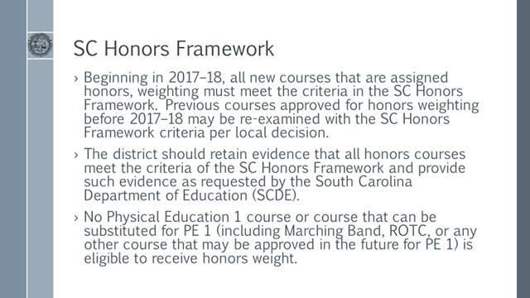
SC Honors Framework

Slide 13
Honors Courses
To receive honors credit, Local Board Approved (LBA) courses must be developed and evaluated using the SC Honors Framework and submitted to Standards and Learning for approval.
One half a quality point (.5) is added to the CP weighting. The field is automatically populated in PowerSchool.
All courses receiving honors weight from in-state and out-of-state accredited schools must be transcribed as honors weight.
Districts shall have the right to evaluate evidence before transcribing the courses at honors weight for students who transfer from non-accredited schools.
Districts should adopt a policy for accepting units of credit from home schools, private schools, or out-of-state, non-public charter schools for consistency. (R. 43-273).

Slide 14
Advanced Learning Opportunities
These courses include Advanced Placement, International Baccalaureate Courses, and Advanced International Certificate of Education Courses.
120 hours is 1 quality point, 240 hours is 2 quality points
Quality points cannot be changed based on participation or non-participation in ALO standardized final examination (AP exams)
Includes courses offered online, nontraditional settings, and transfers from out-of-state accredited under the SBE of that state. (R. 43-273)

Slide 15
10-Point Grade Scale
*After 2016, the SC Grading Scale is as follows:
A= 90-100
B= 80-89
C= 70-79
D= 60-69
F= 0-59
WF= 50
FA= 50
P= no value
WP= no value
AU= no value
NP= no value

Slide 16
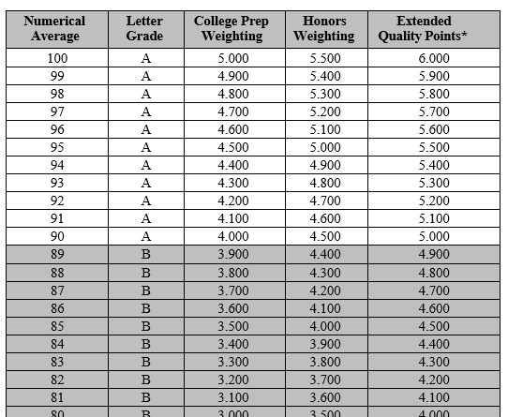
10-Point Grade Scale – 2016 -17 and Afterwards

Slide 17
Dual Enrollment vs. Dual Credit
Students taking Dual Enrollment (DE) courses are building two transcripts: the Institutions of Higher Learning (IHL) transcript and the High School transcript.
Dual Enrollment courses only receiving College Preparatory Credit include:
Diploma
Certificate
Remedial
Orientation
Dual credit refers to the extra academic weighting. One quality point is added to CP weighting for dual enrollment credit courses leading to:
Bachelor’s Degree (BA, BS)
Associate’s Degree (AA, AS)
Associate of Applied Science Degree (AAS)
Industry Credentials (license, certification that verifies individual’s competence issued by a third party) (Dept. of Labor)
The ACM specifies which DE courses receive only CP weighting. It is the school’s responsibility to know how to treat each course/program of study.

Slide 18
Dual Enrollment
Districts must develop detailed agreements with their partner IHL, whether two-year or four-year colleges or technical colleges, that clearly outline the specific courses and detailed procedures including grade scale differences. (R. 43-234, 43-259).
Students may not take dual enrollment courses on their own time without first consulting the district to determine if the course is a part of the agreement between the high school and IHL.
All Dual Enrollment courses are in the ACM. If a new dual enrollment course code is needed, request a new course code very early using the Request for Addition Form found at https://ed.sc.gov/districts-schools/state-accountability/high-school-courses-and-requirements/

Slide 19
Dual Enrollment
Check for equivalents before requesting a new course code – Public Speaking (SPC 205, COMM 140, 160, SPE 110)
Use the course code, course name, and abbreviation of the IHL in which the student will attend. Assign the appropriate academic weight and unit. Use the school principal in the teacher section for all dual enrollment classes.
All courses must be entered into the student data collection system active master scheduler at the time the student takes the course. (R. 43-234 VII-D2)
Courses may not be added to the student’s course history (transcript) after the student takes the class. Write procedures for exceptions.
No course codes are to be used by a school or district unless they are in the Activity Coding Manual or given by the Office of Federal and State Accountability.

Slide 20
Articulation Agreement/Memorandum of Agreement (MOA)/ Memoranda of Understanding (MOU)
Separate contract for each institution
Specific college courses that will be offered/programs of study
Specify course time period (2022/23 Fall and Spring Semesters)
Length of contract (one or two years)
Course location (HS or IHL)
Transportation
Costs (course, textbook, transportation, etc)
Discipline/rules
Withdrawal procedures – Follow UGP
Grading policy – report final grades based on UGP
Signed and dated by both parties
Contact persons
Student eligibility
*Have the district attorney review the contract.*

Slide 21
Converting Grades on Transcripts
Transfer grades consist of current grades from a teacher’s gradebook prior to the end of the term. Districts must have a policy for entering transfer grades into a new teacher’s gradebook.
If numerical grades are provided, those averages must be used.
The following conversions will apply: A = 95, B = 85, C = 75, D = 65, F = 50. Follow guidelines for entering P and NP on transcripts.
If the passing grade has a numerical score equal to or more than a 60, the grade will be a P. If the transcript indicates a failing grade with a numerical score equal to or less than a 59, the grade will be a NP.
Align the transfer course, if out of state, as closely as possible to a course in the ACM. If no course aligns, construct a transfer course code using the directions in Appendix M of the ACM. Maintain a database of transfer course codes, so all counselors and administrators can refer to it and avoid duplication.

Slide 22
Pass (P)/ Fail (F) Grades (UGP)/Transfer Grades
If the transcript shows “P” or “F,” that grade will be converted to a number (UGP scale) based on information from the receiving school.
If no numerical average can be obtained for “P” as the letter grade, an earned credit will be awarded, the grade will be exempted from the GPA calculation, and the letter grade of “P” will display on the transcript.
If a numerical average cannot be obtained for “F”, no earned credit will be awarded for the course, the grade will be exempted from the GPA calculation, and the letter grade of “NP” will display on the transcript.

Slide 23
Local Board Policy
Local boards should establish policy to allow a student to audit a course and receive a grade of AU that will have no impact on GPA. Follow ACM for coding.
Establish a policy to address a non-accredited school and homeschool transfer grades and credits.
Establish a policy for accepting international transcripts.

Slide 24
Content Recovery
Districts shall establish criteria to determine eligibility.
Districts shall determine number of content recovery opportunities.
Districts shall determine length of time a student has to complete work. The student is still enrolled in a class; therefore, upon satisfactory completion of all teacher assigned work, the certified teacher shall include the recovered work into the final grade to arrive at a new grade for the course based on the district’s policy.
Virtual SC classes are for initial or credit recovery only. Never use Virtual SC for content recovery.
Notes:
Follow your districts’ policies for content recovery; note the timeline for completing courses within the same term.

Slide 25
Retaking a Course
Students may retake a course at the same level of difficulty if he/she earned a D, P, NP, WP, FA, WF, or an F in that course.
Local boards may extend the policy to allow students making any grade to retake any course.
For all grade levels, all course attempts will remain on the transcript. However, only the highest grade will be factored into the student’s GPA. The lower grade will have a “0” for credit earned and a “1” for potential credit, but the grade will be excluded from GPA, Class Rank, Honor Roll, and Graduation Calculations. Refer to PowerSchool Notes.
If a student’s final grade on the retake is lower, both courses will appear on the transcript.
Students in grades 9-12 must retake a course before the end of the next school year or before the next sequential course. For example, a student may not re-take English I after English III.
A student who retakes a high school credit course from middle school must complete it before the beginning of the second year of high school or before the next sequential course (whichever comes first).

Slide 26
Retaking a Course Coding Procedures
Old course is marked as:
Earned Credit Hours = 0
Potential Credit Hours remains as originally stored
Exclude from GPA Calculation
Exclude from Class Rank Calculation
Exclude from Honor Roll
Exclude from Graduation Calculation
Display on Transcript = Yes
New course is stored as normal at the end of the term.
Earned Credit Hours per Activity Coding System Guidelines
Potential Credit Hours per Activity Coding System Guidelines
Include in GPA Calculation
Include in Class Rank Calculation
Include in Honor Roll
Include in Graduation Calculation
Display on Transcript = Yes
Notes:
When a student retakes a course, the school counselor/registrar must verify the grade data on the Historical Grades Page for accuracy. Based on the final grade (score) for the retaken course, follow the settings as indicated on this slide.
What happens if the student’s final grade on the retake is lower? Must both courses appear on the transcript? YES!

Slide 27
Credit Recovery Policy
Districts must have a Proficiency-Based System Education Application and Credit Recovery Policy on file with the Office of Federal and State Accountability. Policies must address the following areas:
1. Eligibility
2. Vendors used for instruction
3. Instructional methodology
4. Number of courses per semester/length of time
5. Content and Curriculum - aligned to South Carolina Standards and aligned across courses within a district.
6. Specific procedures for evaluation of student progress and determining grades.
7. Subject area certified teacher
8. Counselor, guardian, student, and principal sign and date a contract.
9. Grading is aligned to the UGP.
10. Email the Office of Federal and State Accountability for a sample policy and agreement.
Notes:
The UGP provides this information for Grades:
Districts are responsible for

Slide 28
Credit Recovery
Credit recovery is defined as a course-specific, skills-based learning opportunity for students who have previously failed to master content or skills required to receive credit. It is a block of instruction less than the entirety of the course that addresses deficiencies for proficiency.
Courses requiring the EOCEP test will be allowed to take the examination only once, at the end of the regular course. EOCEP courses: English II, Algebra I, Intermediate Algebra, U.S. History and Constitution, and Biology I.
Districts determine length of time, but courses taken during semester one or two must be completed within one academic school year.
Note: A student wishing to modify his or her GPA shall repeat the full course for credit and not seek a credit recovery solution.

Slide 29
Credit Recovery Grading (UGP)
A new course starting with the appropriate activity code, grade scale designation, and unit marker will be entered on the student record. (Algebra I-CR; 4114CRCW)
Course code must include CR in 5th and 6th characters and include “CR” in the course title
60 or higher = passing grade is entered as a “P” for the final grade
Numerical grade value of “0”
60 or below = failing grade is entered as an “NP” for the final grade
Numerical grade value of “0”
The credit recovery course grade does not impact the student’s GPA.
The original failing grade will remain on the transcript and is factored into the student’s GPA.
Notes:
The credit recovery program (CR) involves completing make up work that will allow a student to recover a credit for the failed course. CR within itself is not a stand-alone course but for student accountability purposes (transcripts), CR will be recorded as a course when a student elects to recover rather than retake a course to earn the “lost” credit. The course will have its unique course name and course number; for example, Algebra 1 – CR as name and 4114CRCW as number or activity code.
All course attempts (failed course, CR course, or audited course) will be recorded on the student’s transcript, and the total credits attempted (potential credits) will indicate the number of all courses that a student has taken, including CR and AU courses.
Credit will be earned when the student passes the CR course; that is, the Earned and Potential Credit values will display with the number of credits for the specific course. In this way all coursework for high school will be listed on a student’s transcript and will provide a picture of the student’s course history.
NOTE: Credit Recovery Courses with EOCEPs
Students who are enrolled in courses requiring state end-of-course examinations must take the examinations and fulfill all requirements outlined in Regulation 43-262. Students will be allowed to take the examination only once, at the end of the regular course duration and not at the end of an extended period granted through the credit recovery option.

Slide 30
Credit Recovery Time Frame
Student takes a course in Semester 1 of 2020-21
Student can take CR in Semester 2 of 20-21 school year
OR
Can take CR in the summer session 2021 and complete by Aug. 15 OR
Take and complete CR no later than the end of semester 1 of 2021-22. This would be the final semester to complete CR since one academic year from the initial credit would end.
If student failed a course in semester 2 of 20-21, window is open until the end of semester 2 of 21-22.

Slide 31
Credit Recovery vs. Retakes
Follow the SC UGP guidelines for retakes and credit recovery
Credit Recovery
“P” or “NP” on transcript; no numerical grade
If student passes, 1 earned credit; 2 potential credits; Failing grade is included in GPA
Must complete within 1 academic year (or summer deadline if taken in summer)
Retakes
Only one earned credit, but multiple potential credits (depends on the # of retake attempts)
All course attempts and grades remain on the transcript
ONLY the highest grade point value is included in the GPA calculation
Exclude from GPA all retake grades that have lower point values
Retakes are the same course, at the same level of difficulty (exceptions apply)

Slide 32
Potential and Earned Credits
All courses that a student enrolls in are a “POTENTIAL” credit (Audits are the exception)
This includes: Initial credit courses, Retakes and CR attempts
All courses/grades remain on the transcript
Earned credits - may need to be manually added or removed depending on the situation
Errors on any year-end stored transcript - requires SCDE and/or District assistance to correct
When the grade is stored, it is a potential credit.

Slide 33
Conversion Chart* for Non-Percentage Grades
Grade | WP | AU | P | NP | WF | FA
GPA Points | 0 | 0 | 0 | 0 | 0 | 0
Added Value | 0 | 0 | 0 | 0 | 0 | 0
Percent | 0 | 0 | 0 | 0 | 50 | 50
Earned Credit Hours | 0 | 0 | 1 or 0.5 (based on course) | 0 | 0 | 0
Potential Credit Hours | 1 or 0.5 (based on course) | 0 | 1 or 0.5 (based on course) | 1 or 0.5 (based on course) | 1 or 0.5 (based on course) | 1 or 0.5 (based on course)
GPA Calculation | Exclude | Exclude | Exclude | Exclude | Include | Include
Class Rank Calculation | Exclude | Exclude | Exclude | Exclude | Include | Include
Honor Roll Calculation | Exclude | Exclude | Exclude | Exclude | Include | Include
Graduation Calculation | Exclude | Exclude | Include | Exclude | Include | Include
Display on Transcript | Yes | Yes | Yes | Yes | Yes | Yes
*Important Note: Edited/Updated December 9, 2020
Notes:
We created this conversion chart to reference when you need to determine how the various letter grades are included in GPA calculations, displayed on transcripts, etc.
This chart was updated based on careful review of the UGP after the initial training in September 2020. These changes are as follows:
P grade – select the “INCLUDE” radio button for Graduation Calculation
Both WF and FA grades – select the “INCLUDE’ radio button for GPA, Class rank, Honor Roll and Graduation Calculations since these scores are to be included when averaging grade points, calculating class rank, etc., and will display on transcripts.
Students who drop out of school or are expelled after the allowed period for withdrawal but before the end of the grading period will be assigned grades in accordance with the following policies:
1. WP Grades: The student will receive a WP if he or she was passing the course. The grade of WP will carry no earned units of credit and no quality points to be factored into the student’s GPA.
2. AU Grades: The student who contracts with the school to audit a course will receive no credits for taking the course and this grade will be excluded from any calculations.
3. WF Grades: The student will receive a WF if he or she was failing and chose to withdraw from the course outside the timeframe for course withdrawals. The grade of WF will have 0 GPA Points, will carry no earned units of credit but will be factored into the student’s GPA as the numerical percent of 50.
4. FA Grades (Excessive Absences (Failure due to Absences): As noted in Regulation 43-274 VII(B), students with absences may make up work or demonstrate proficiency as determined by the local school district. The local school board shall develop policy on the body of evidence that is acceptable to demonstrate proficiency. If a grade of FA is assigned, it will have 0 GPA points, will carry no earned credit hours (units for credit toward graduation) but will be factored into the student’s GPA as the numerical percent of 50.
5. P – Pass (P)/Fail (F) Grades: If the transcript shows that the student has earned a grade of P (passing) or F (failing), that grade will be converted to a numerical designation on the basis of information secured from the sending institution as to the appropriate numerical value of the “P” or the “F.” If no numerical average can be obtained for the “P,” an earned credit will be awarded and follow UGP Administrative Procedures for entering a “P” on the transcript. If no numerical average can be obtained from the sending institution on the “F,” an “NP” will be entered on the transcript. (See UGP Administrative Procedures for other transfer grade issues.)
Percent indicates the numerical score for the letter grade.
Potential Credit Hours indicate a student attempted a course. Whether he/she passed or failed to meet course completion requirements, this field will indicate the credits the student would have received for taking the course. If the GPA calculation radio button is marked as exclude, the course grade does not impact the student’s GPA calculation and vice-versa.
The Graduation Calculation is set when grades are permanently stored when Repeated Course Grade Suppression is being used. When not using the Repeated Course Grade Suppression component, grades are stored with the default value to be included. When grades are manually entered the value for Graduation Calculation should also be set to included Otherwise the grades credit will not print on the transcript.
Finally note that everything displays on the student’s transcript.

Slide 34
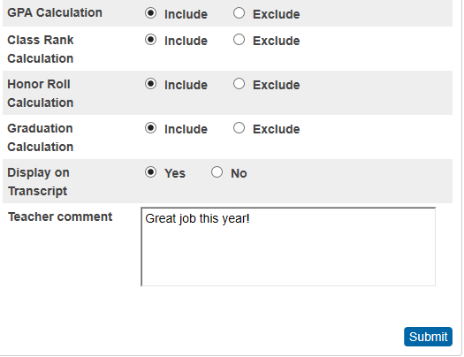
Grade Calculations and Transcript options
Select each option whether to include or exclude the grade from various calculations and display on the transcript.

Slide 35
Early Graduates
Students who complete requirements for graduation (R. 43-234) mid-year (Fall/Winter) and Summer (Late)
Students will be excluded in the class count for class rank calculations for SC scholarship purposes. Therefore, PS administrators need to ensure the “Exclude from Class Ranking” checkbox is selected for early graduates.
A student who completes graduation requirements early and wants to be ranked with the senior class for scholarship eligibility determination purposes can remain an active senior through the end of the senior year by enrolling in courses provided by the high school, a CATE center, or a college/university for dual credit.
Districts should ensure that parents and students are aware of the implications of Fall/Winter graduation (excluded from class rank and thus scholarship eligibility based on rank). The parents, student, and school counselor should sign and date a district-designed policy. (Contact OFSA for a sample policy.)
Notes:
Office of Research and Data Analysis
Office of Federal and State Accountability
Office of Student Intervention/School Counselors
2018-2019, Version 1.0

Slide 36
Early Graduates
District policy may allow early (Fall/Winter) graduates to participate in graduation ceremonies at the end of the school year (Spring); however, the student must not be enrolled as an active student at any time after officially graduating.
Some SC schools/districts keep early graduates as actively enrolled students and counted in membership. These students are not enrolled in classes and are not receiving services. Per Regulation 43-172, this practice is unlawful since schools/districts are receiving funds through false membership counts.

Slide 37
Summer Graduates
If a student does not complete graduation requirements for a HS diploma, he/she remains in the 12th grade and his record at the 180th day shows retained.
When student meets requirements, Graduation Date is updated in PS. Double check all fields in PS.
The transcript at the end of the year will show the failing grade for the initial course. If the student retakes the course during the summer or opts for credit recovery, the new information will be entered into the Historical Grades page as a summer term.
All summer work must be completed by August 15 or the student becomes a Fall graduate. Summer graduates are excluded from class rank.
PS admins need to ensure the “Exclude from Class Ranking” checkbox is selected.

Slide 38
Early Graduate and Summer Graduate Process in PowerSchool
State reporting release 21.6.1 explains two automatic processes.
Group Function Page allows the selection of a single or group of students to be updated to a graduated status and records archived.
Will help make sure necessary fields for graduation are coded for accurate data reporting and collection.
Try it on test server and share with school staff to improve data and reporting.

Slide 39
Graduating Early
3rd year students who graduate a whole year early. They are included in their “new” senior cohort’s class rank.
Sals/Vals/Honor Grads – Ensure a district policy is in place whether or not to include 3rd year graduates in these rankings.

Slide 40
PE through Marching Band/JROTC
Students are permitted to earn the Physical Education I graduation credit through Marching Band; however, a district must first submit an Innovative Course Application to the Office of Standards and Learning. The application must document the marching band course includes all appropriate South Carolina Academic Standards for Visual and Performing Arts and for Physical Education. Students will need a separate .5 credit of Comprehensive Health Education.
A student may earn Physical Education I credit through JROTC, but will need a separate .5 credit of Comprehensive Health Education.

Slide 41
Transcripts
Top – State of South Carolina/Standard High School Transcript – Final
Graduation Date – 180th day of the school year for Spring graduates.
Class Of: Correct year is displayed (20xx)
Diploma Type: State of SC Diploma
School Name and Address (Should not have Graduated Students) on top, right-hand side
Student’s Information on top, left-hand side
GPA Summary/SC UGP and 4.0 UGP
Credits Earned – Students must meet all requirements of Reg. 43-234
Class Rank for Spring graduates
No class rank for winter or summer graduates
Date Calculated
Principal’s Signature and date
Principal’s Printed Name underneath signature

Slide 42
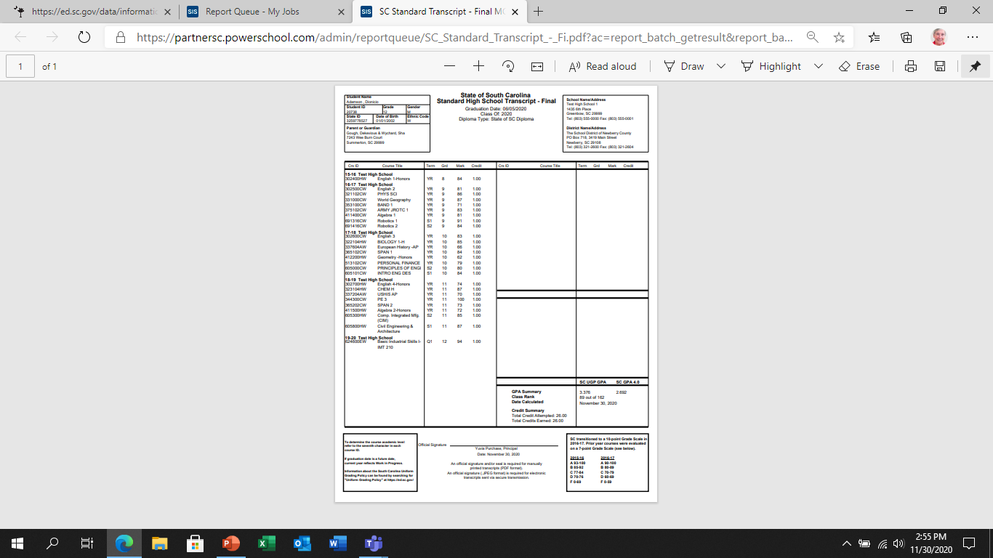
SC Transcripts
Top section has many fields that need verification that data are accurate for each student.
Notes:
Overview: lots of parts to a report that provides coursework completed for each student. Note the title for this report, the student demographics and the school/district information alone.

Slide 43
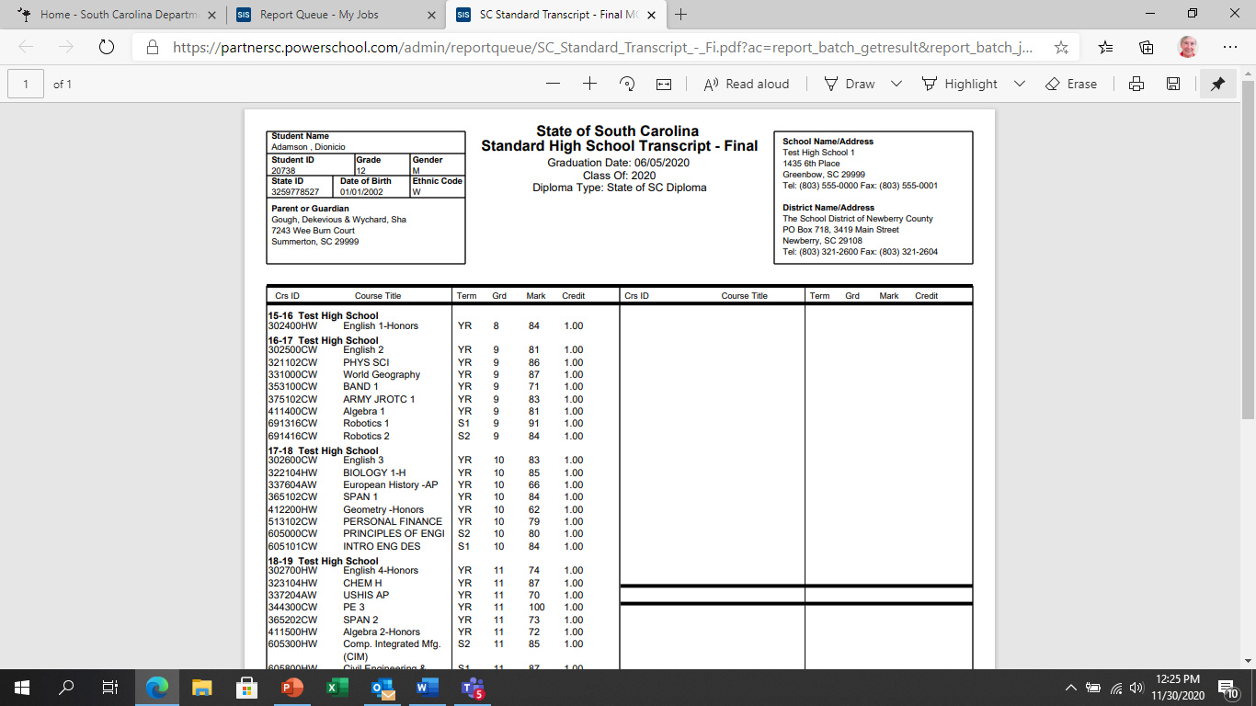
Final Transcript Heading
SC CHE, SC Colleges and Universities, and other entities look closely at transcript headings and fields; missing values are indicators that the student record may be incomplete or inaccurate.
Notes:
FINAL in the title --- Graduation Date --- Class of --- Diploma Type

Slide 44
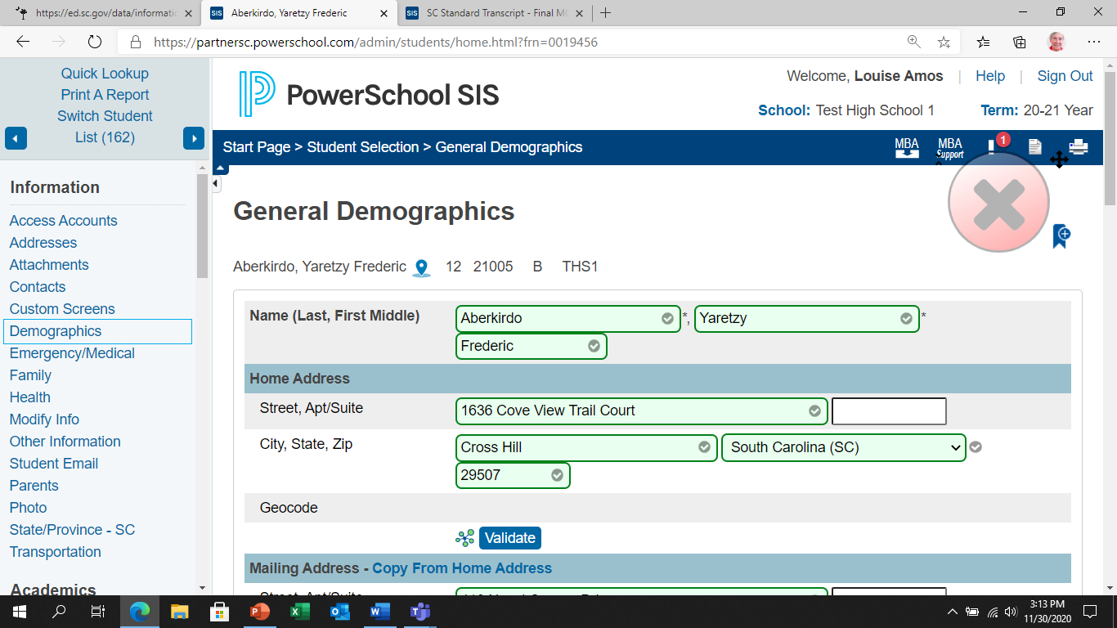
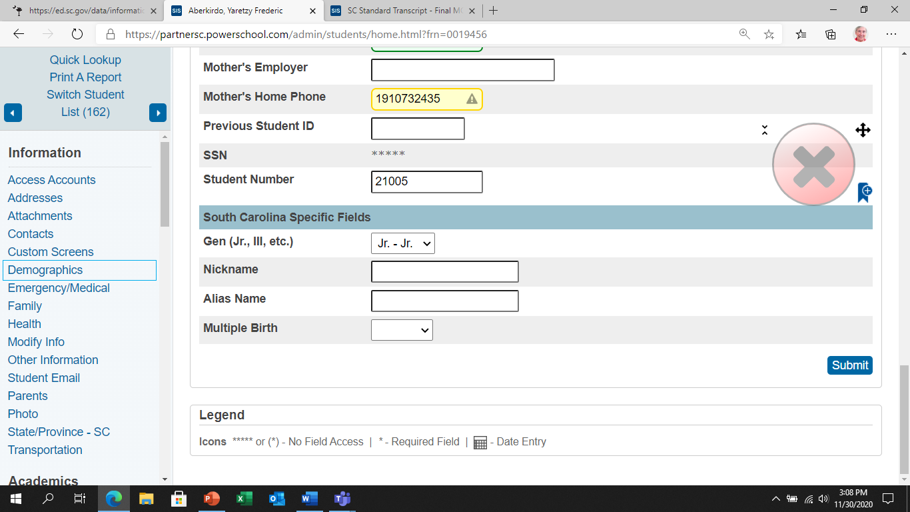
Parts of the Student’s Name
Student Name
fields:
Last First Middle
Student Generation:
Gen (Jr., III, etc.)
To select from drop-down values
Notes:
Data elements that must display on a student’s transcript come from many pages within the PS application. All of these fields of the student’s name reside on the Demographics page; part core and part custom. We realize the fields are important to many different reports so we usually depend on many eyes to help us discover accurate values in core fields.

Slide 45
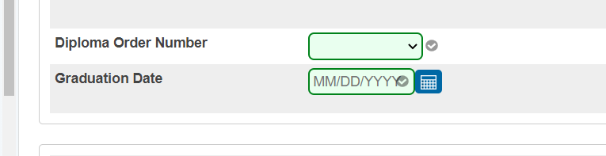
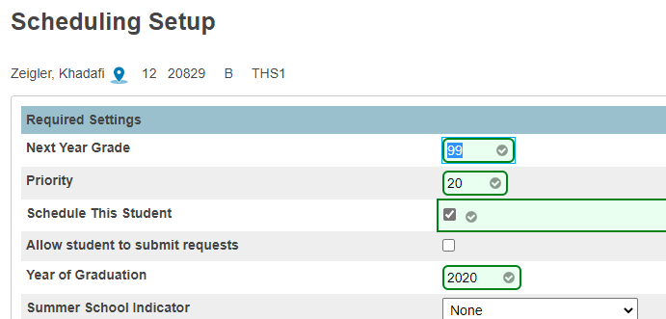
Graduation Date vs. Class of (Year)
Populate the Graduation Date field MM/DD/YYYY on the SC Student Information Page.
Populate Year of Graduation field YYYY on the Scheduling Setup Page.
Notes:
The fields Graduation Date and Class of (Year) are located on entirely different PS pages.
Jason will share with us best practices for reporting of data and procedures.

Slide 46
Important Transcript Data Elements
Display Name | PowerSchool Page | Internal Field Name | Description
Graduation Date | SC Student Information Page | GradDate | Date student is expected to complete all high school coursework; current term of completed requirements
Class of (Year of Graduation) | Select Student > Scheduling > Scheduling Setup | Sched_Yearof Graduation | Enter the year that the student is expected to graduate from the currently selected school. The data value in this field populates the “Class of” on the transcripts provided through SCDE.
Diploma Type | SC Student Information Page | Diploma_type | Values: F;State of SC Diploma N;District Non-Diploma Document
GPA Summary SC UGP GPA SC GPA 4.0 |  | gpa method="SC_GPA_UGP_Round gpa method="SC_GPA_4.0_Round"
Notes:
However, there are many data elements that are used specifically for providing transcript data. We have pulled together several of the SC customized fields using a chart that lists the label or field name, page, internal field name and description for important data elements to verify. We built two slides so that you could read the information…

Slide 47
Important Transcript Data (cont.)
Display Name | PowerSchool Page | Internal Field Name | Description
Class Rank | School > Class Rank > Class Rank Settings | Calculation that is displayed “on the fly” upon submitting or printing a transcript. | Must be updated with any grade (score) change Recalculate current class ranks: Manually Click Recalculate Now
Date Calculated |  | Letter.date | System Date
Official Signature Principal |  | Principal | Filename for xx_transcript.jpg where xx = FN LN of current Principal
Date |  | Letter.date | System Date
Notes:
And since we wanted you to actually see them, we enlarged the fonts. Though this chart does not list the common demographic data such as last name, first name, etc., we felt it necessary to remind you of a few very important values people want to know…
On the fly means you get to view the calculation only when you print the report. It is not stored; therefore any slight change in one student’s grades can impact the ranking of all other student within the same class (senior, junior, etc.)

Slide 48
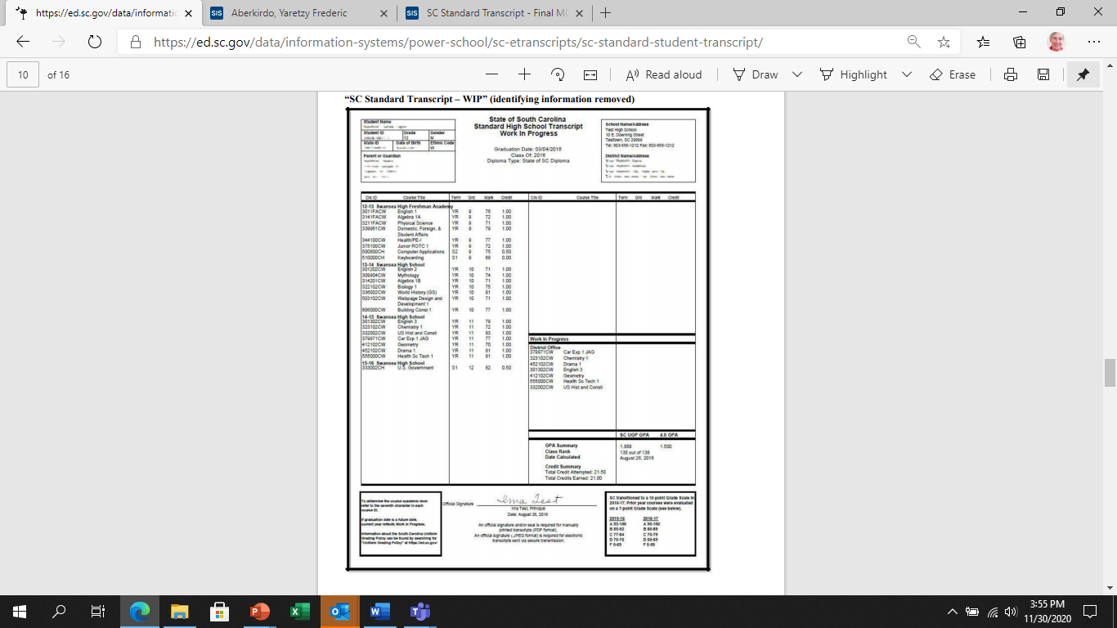
Final vs. WIP Transcripts: Title
Notes:
Final vs. WIP TITLE

Slide 49
Final vs. WIP Transcripts: Current Courses
Notes:
The WIP transcript has the current year’s listing of courses student is taking – until final grades are stored.

Slide 50
Process for Archiving and Timelines for Transcripts
Process FINAL transcripts after grades are stored at the end of each school year.
Run transcript and class ranking reports for ALL students in each class, 9-12.
Palmetto Fellows Scholarship determination can use class rank beginning with 10th grade .
Work with your PS District and School Admins to learn specific procedures you are expected to follow consistently (file naming conventions, file locations, etc.).

Slide 51
Archiving Transcripts
Store an electronic version (PDF) of transcripts in multiple places (counselor’s computer, registrar/secretary’s computer, central network storage, etc.); BUT ensure these are truly FINAL. Do this on or before June 15th for a valid “Date Calculated.”
Suggestion: print and save a paper copy of final transcripts in folders, by class, by year, for easier access.
DO NOT run new transcripts using PowerSchool after archiving - print the stored/archived versions
Grade changes can present GPA and class rank errors that will potentially disqualify your students from scholarship eligibility.

Slide 52
Transcript and Reporting Procedures
Transcript Object Reports
Developed by ORDA
Imported into PowerSchool by district PowerSchool Administrator
Required for SC Commission on Higher Education’s (CHE) State Scholarship for eligibility purposes
Must have a valid Principal’s signature (Superintendent if Principal unavailable)
Must have “Date Calculated” populated by deadline date
Notes:
The Office of Research and Data Analysis/PS provides both the SC Final and SC Work in Progress standard transcript templates. These templates are imported into each instance of PS at the district level and set up for each school in that district with its own school and principal information. When selecting a student, a group of students, or an entire class of students, you can “submit” this report and view the pdf versions of these student reports. The difference between these two transcripts is the WIP lists courses the student is currently taking in a special box object on the right side of the report. The final transcript lists all completed coursework at the end of each year by class: freshman, sophomore, junior, senior. The final report for each year is the transcript used by CHE to determine certain eligibility for SC Scholarships.
These standard reports become very special documents when submitted to colleges, universities, scholarship-proving entities, workplaces, etc. to indicate the high school coursework completed by each student. The data are reviewed and evaluated to determine if the student meets requirements for earning a job, winning a scholarship, being admitted to higher learning institutions, etc.
Over the years we at the state, district or school levels are asked to provide transcripts from previous years to prove authenticity of a SC High School Diploma. When these reports are missing an important Graduation Date, a principal’s signature, the total number of units with appropriate required courses, validity of all the data are questioned. School counselors, teachers, principals, PS data clerks, and even students should be verifying the information reported on transcripts each year to ensure the all data values are accurate

Slide 53
Transcript Requirements for State Scholarship Eligibility
Official transcripts and a final rank report for the top 30% must be sent to the colleges and universities to which the students are applying.
The Graduation Date is the last date of the school term in which the student completes coursework.
GPA & Class Rank cannot include grades earned after the official senior class graduation date.
Students completing requirements for graduation during the summer are considered summer graduates; as such, transcripts for these students are stored/archived based on the summer dates set by the school/district policy.

Slide 54
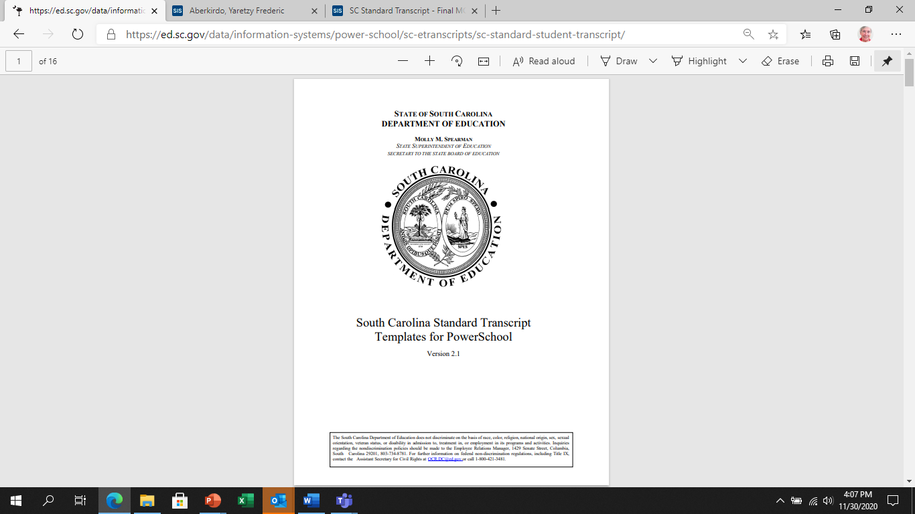
Transcript Templates
https://ed.sc.gov/data/information-systems/power-school/sc-etranscripts/sc-standard-student-transcript/
SC specific Transcript Templates are provided to PS Administrators upon request only – powerschool@ed.sc.gov.
Notes:
Review this document on our website..

Slide 55
What Are Historical Grades?
Historical grades are final grades, or grades that are permanently stored in the student's record.
At the end of each grading term, PowerSchool administrators copy and store the students' current grades from the teacher’s gradebook to the student’s historical grades.
Historical grades appear on report cards and transcripts and should also be passed along to a receiving school whenever a student transfers to another school.

Slide 56
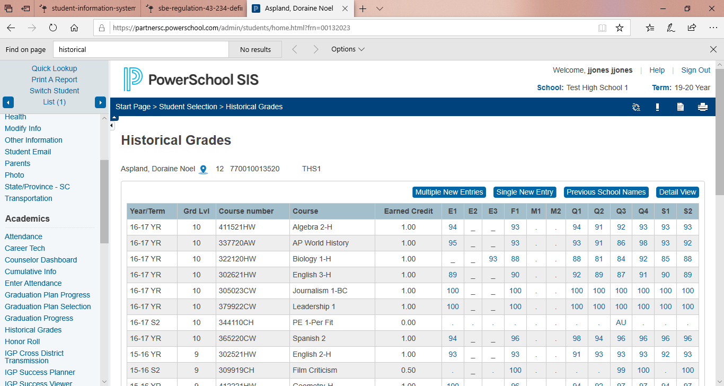
Historical Grades Page

Slide 57
Store Terms
Store Terms are the bins or column names seen on the historical grades page
F1 – Final stored grade for all courses
S1 or S2 – Semester 1 or 2 grade at the end of each term
Q1, Q2, Q3, Q4 – Final grade at the end of each quarter
E1, E2, E3 – Commonly used as an Exam grade for EOC courses during year or semester terms

Slide 58
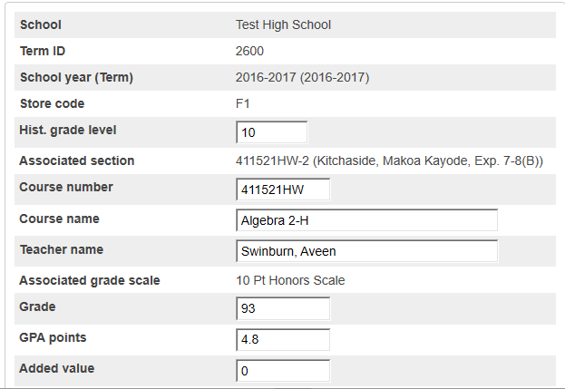
Parts of the Historical Grade Page
School Name
Year of course
Student Grade Level
Course information
Course Grade
GPA Points
Carnegie Credits
Credit Type

Slide 59
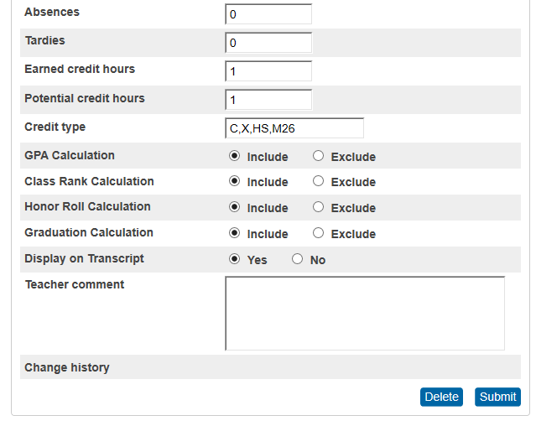
Parts of the Historical Grade Page, continued
Absences
Carnegie Credits
Credit Type
GPA, Class Rank, Honor Roll calculations
Teacher Comments

Slide 60
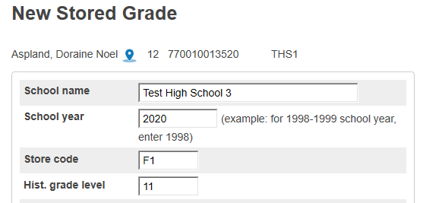
Create A New Historical Grade
School name – if out of state, enter the school name, city, and state abbreviation.
School Year of the course grade
Store Code – should be F1 for all manual entries.
Hist. grade level – the student’s grade level when earning the course grade.

Slide 61
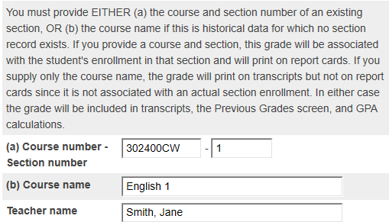
Course Information for Stored Grade
For historical grades from other schools, section number should be blank.
Teacher name will most likely be blank.

Slide 62
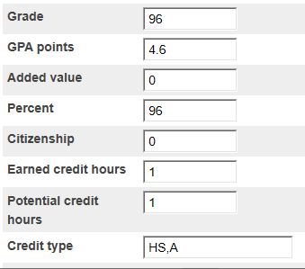
Grade Specifics
Refer to Uniform Grade Policy for GPA points
Reference Activity Coding Manual for Credit Types

Slide 63
Credit Types
Grade Bands:
ES – Elementary School
MS – Middle School
HS – High School
Subject / Content
A – English/Language Arts
C – Mathematics
E – Science
H – US History and Constitution
J – Economics
K – US Government
L – Other Social Studies
P – Physical Ed or Jr ROTC
R – Computer Science/Keyboard
T – Foreign Language or CTE
X – Electives
Credit types allow courses to be grouped together and each course can be associated with one or more credit types.
Credit types are specific to South Carolina schools (primarily for high school courses) for both subject and grade levels.
The “HS” credit type is very important for Individualized Graduation Plan (IGP) display/reports and Graduation Planner/Sets, and the order and format for entering the credit type list impacts how courses display or do not display on reports.

Slide 64
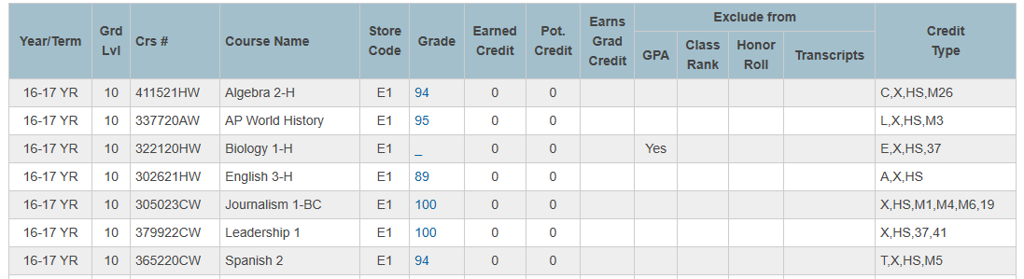
Detailed View Useful for troubleshooting calculations on transcripts or class rankings or honor roll.

Slide 65
Process for Grade Level Changes
Transfer the student out with exit code “GC” at the end of the term.
Re-enroll the student on the next day with the corrected grade level.
Verify EFA coding if a change is necessary.
Notes:
Louise: The early graduate may currently have the grade level of 10 or 11. To ensure the student is a senior for the year he/she completes all high school requirements to graduate, change the grade level to 12. Best practice is to change the grade level at beginning of the final term during which the early grad will finish.
Note that in the “Early Graduate Guide” the changing of the grade level differs… USE THIS SET OF INSTRUCTIONS. We are in the process of updating the EGG.

Slide 66
Non-Diploma Students
Consult with your SPED department
SC High School Credential
https://thesccredential.org/
District certificate of attendance
Exclude from Class Rank when running class rank for semester/year-end storing
Activity Codes for SPED courses in the SC Activity Coding Manual
Jostens does not print certificates of attendance

Slide 67

Questions?
Office of Data and Research Analysis:
Louise Amos- lamos@ed.sc.gov
Office of State Accountability:
Laura McNair- lmcnair@ed.sc.gov

