Slide 1
SC Work-Based Learning:
Overview and Work Experiences Crosswalk
Kama J. Staton
Division of College and Career Readiness
Office of Career and Technical Education

Slide 2

The Why: Purpose of WBL
SC Perkins V/EEDA Act of 2005
SC Perkins/EIA/WBL Funding Streams
Economic Development/Business/Industry Demand
Profile of the SC Graduate
Seals of Distinction
Career Ready Accountability System
Student Self-Worth/SEL/Citizenship

Slide 3
What is WBL in SC?
Work-based learning is sustained interactions with industry or community professionals in a real worksite environment. Per the WIOA, Work-Based Learning (WBL) is defined as a structured learning experience at the worksite for a specific timeframe that leads to a career path. WBL is a school-coordinated, sponsored, coherent sequence of workplace experiences that are related to each students’ career goals and interests, while based on instructional preparation, and are performed in partnership with local businesses, industries, or other organizations in the community. WBL enables students to apply classroom instruction in a real-world business or service-oriented work environment.

Slide 4

SC State Approved WBL Experiences
Apprenticeship
Co-Op
Internship
Job Shadowing (On-site, at the worksite)
Job Shadowing (Virtual)
Mentoring
School-Based Enterprise
Service Learning
Structured Field Study
CTE Internship- Work-Based Credit-Bearing Course

Slide 5
SC Accountability System-
Career Ready Qualifier
WORK-BASED LEARNING QUALIFIERS
Registered Apprenticeship
Youth Apprenticeship
Cooperative Education (Co-Op)
Internship
*Refer to SC Dept. of Education Work-Based Learning Implementation Guide for established criteria and guidelines

Slide 6
WBL Career Ready Qualifier
Requirements
A training agreement which defines a combination of objectives and a minimum of 40 practical experience hours or the highest number of hours required by industry defined competencies in a career pathway.
and
Be aligned with the student’s IGP Career Program Pathway
and
Include an industry evaluation that is created from the training agreement, which is mutually developed and includes the world-class skills from the Profile of the SC Graduate with a positive employer evaluation score, 3 or higher on a scale of 1-5. SC Work-Based Learning Training Agreement and Evaluation Plan Template
and
The student must have earned a minimum of one unit in the pathway related to the work-based placement or completed a personal pathway of study.
**All of the above are required in order to count**

Slide 7
A Guide to Work Experience
Alignment and crosswalk with
SC High School Credential: A Guide to Work Experiences
Work Experiences | Types | Example Hours
Intro: Career Awareness Activities | Relevant transition assessments (e.g., interest or preference inventories, strengths-based assessments, etc.) Reflective activities Individual career planning Career Research Activities (ex. SCOIS, DISCUS, O-NET Career Fairs Classroom Speakers Classroom Career Activities (ex. self-reflection, soft skills training, etc.) | 25% (or less) of 360 Hours = 90 Hours
Career Exploration Activities (Typically 9th and 10th grade) | Structured Field Study (WBL) Mentoring (WBL) Service Learning (WBL) Job Shadowing (WBL) | 25% (or less) of 360 Hours = 90 hours
Work-Based Learning Placement (Typically 11th and 12th grade) Note: Work experiences that consist of competitive employment opportunities are optimal. Competitive employment is defined as a paid, community-based (i.e. a setting in the community where people with and without disabilities work) work experience that provides hands-on experience with the functions of a particular job. | School-based enterprise (WBL) Cooperative Education-Co-op (WBL) Internships (WBL) Apprenticeships (WBL) | 50% (or more) of 360 Hours = 180 hours
Completion | All | Total = 360 hours (or more)

Slide 8
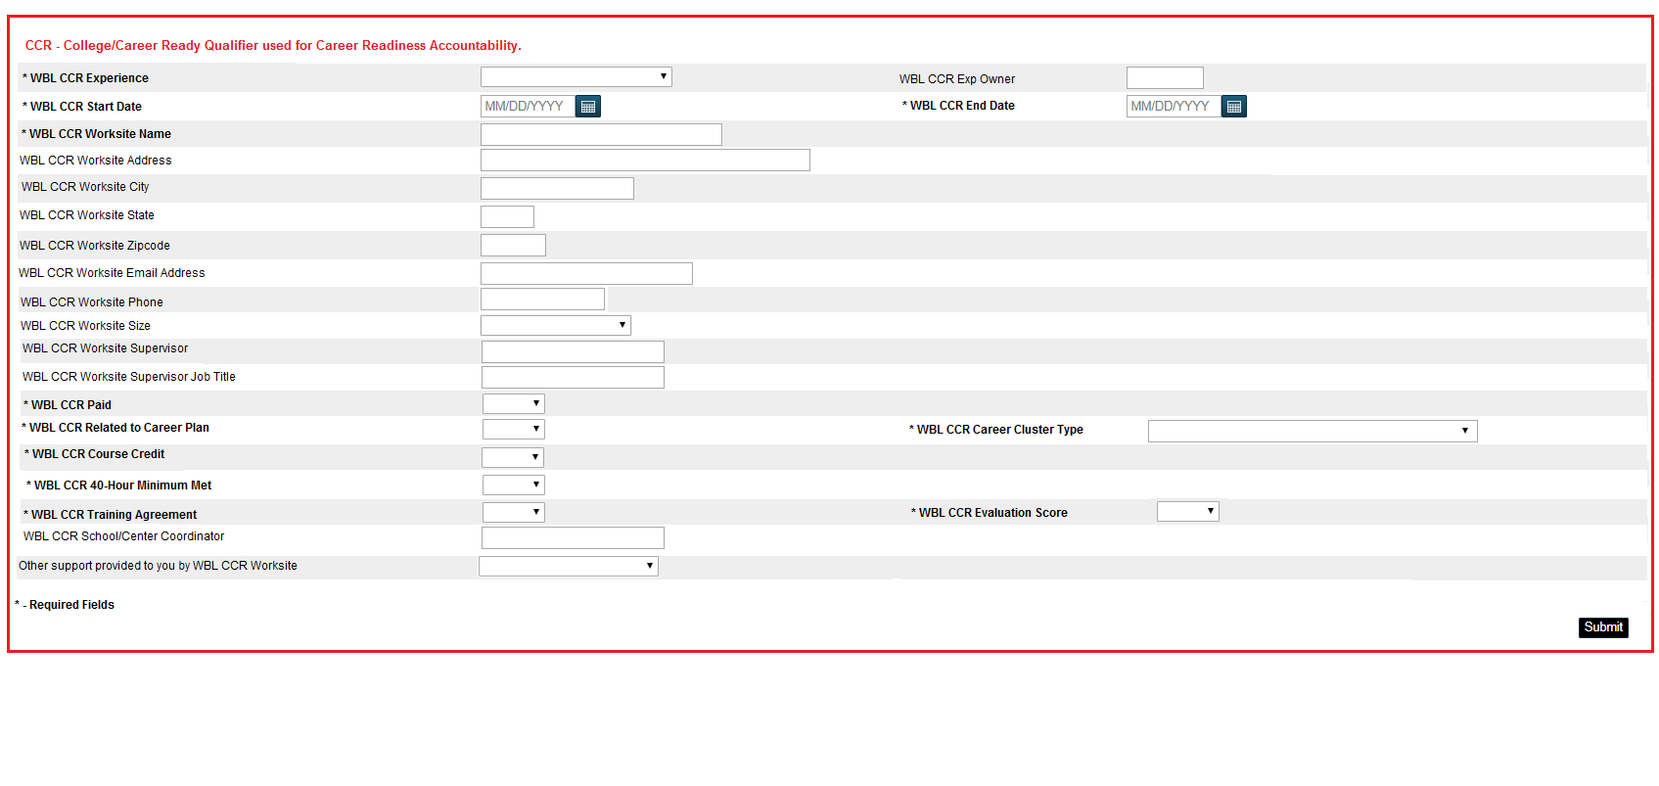
POWERSCHOOL REPORTING
This field is at the first field of entry at the top of the WBL page in PowerSchool. THIS IS FOR REPORTING CAREER READY QUALIFIER ONLY!
The only reporting experiences for this field is Registered Apprenticeship, Youth Apprenticeship, Internship, or Co-Op for accountability purposes only! Need to only report one! Additional experiences can be reported in the WBL Experiences fields below the red box. Data is captured for senior cohort for report card rating.

Slide 9
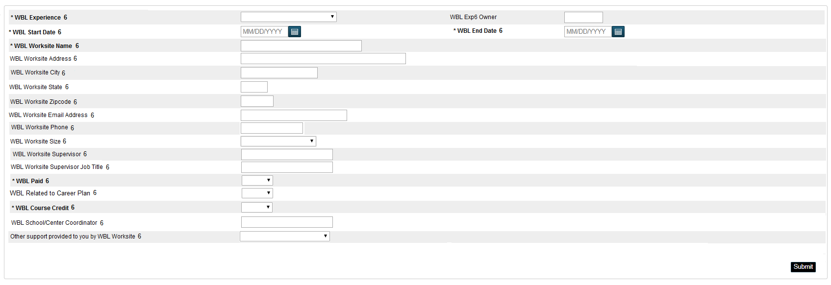
POWERSCHOOL REPORTING
Same required fields with a total of 10 experience fields for entry

Slide 10
Deadline to enter all experiences into PowerSchool
Friday, May 27, 2022

Slide 11
RESOURCES
SC Work-Based Learning Implementation Guide
SC School Counseling and Career Guidance Model
SC Career Guidance/WBL Virtual Toolkit
SC Work-Based Learning Resource Page
SC Career Education Career Aisle
SC Discus Job Career Resources
Microburst Learning
SCOIS
Career and Technical Education
SC Works Labor Market Data

Slide 12
Contact Information
Kama Staton, Education Associate
Work-Based Learning
1429 Senate Street Rm. 915-A
Columbia, SC 29201
Phone: (803) 734-8415
Email:kstaton@ed.sc.gov
Fax: 803-734-3525
Notes:
Follow this format for the contact information

