Slide 1
GAPS
SCASBO Fall 2016

Slide 2
            Grants Accounting and GAPS
Grant Coordinators Need Grant Coordinator Role for GAPS
- Regardless of whether they are the individual entering budget or not
  Quarterly Expenditure Reporting Required
  - Due by end of month following end of quarter once budget has been approved
  - If these aren’t submitted timely, risk assessment score will go up
Budget amendments must be submitted prior to expenditures being obligated – federal regulations state that expenditures
must be approved prior to obligation. If not, you’re out of federal compliance.
  - Please Note. General deadline for budget amendments is three weeks prior to
  end of expenditure period unless noted differently in GAN.

Slide 3
Nurse Grants/Allocations
FY 17 – Paid out monthly as part of EFA/EIA Allocations
CATE EIA/Local Expenditures
CATE EIA (EIA Equipment and WBL)
Paid out monthly with regular EIA/EFA Allocation
once CATE Local Plan has been approved
CATE GAPS – EIA and Local Expenditures reported in GAPS
Report of Expenditures ONLY – payment isn’t based on Expenditures Reported

Slide 4
Budgets/GAPS
Budget Amendments –
Budget Amendments Must Be Approved Prior to the Expenditures being obligated
Approved by the SCDE Program Office not SCDE Finance
Budget Decrease Functionality
Rolled out in February 2016
Only Available when an allocation is decreased.
Examples; De-obligation of previously awarded grant funds
Title I amount carried forward to next year
Instructions shown at http://www.ed.sc.gov/finance/grants-accounting/
You will be notified when this becomes a requirement on a particular grant

Slide 5
Reimbursement of Expenditures
Weekly payments processed on Wednesday – cutoff for expenditure entry/approval for inclusion in weekly payments is Friday at 5pm most weeks
Tuesday morning – reports are run and figures prepared for Weekly Cash Draw
Wednesday – Checks cut/direct deposits/LGIP transfers made
Please reconcile your books – If you have entered an expenditure and it was approved by your Finance Approver before COB on Friday at 5pm, the payment should be in your Treasurer’s Office by the end of the next week.

Slide 6
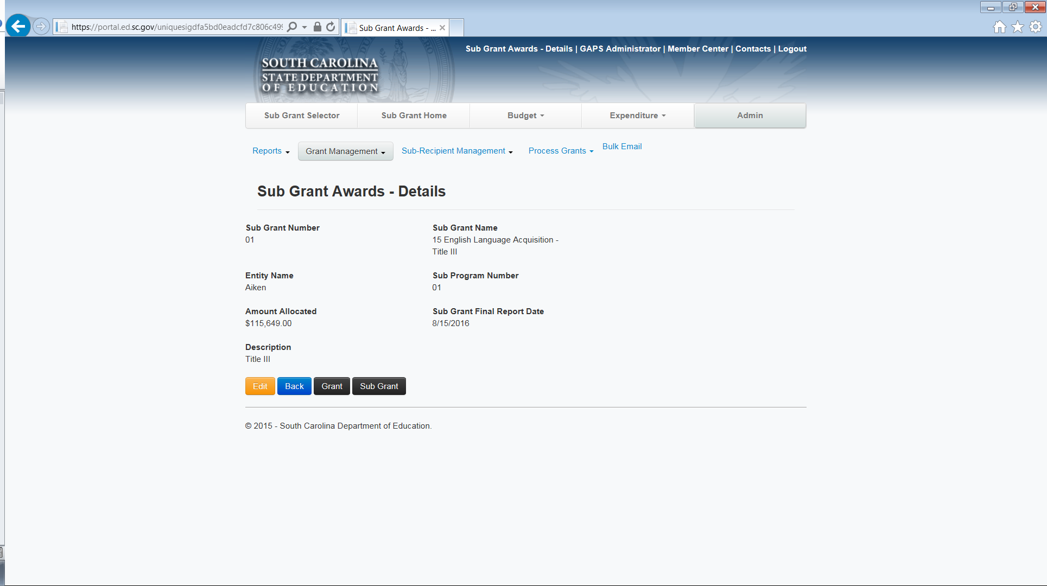
Deadlines
8/15/17 – Deadline for Entry/Submission of June 30, 2017 Expenditures
Note - If a grant ends September 30, 2017, the final due date for the report may be November 15, 2017. However, the final due date for June 30th expenditures is still August 15, 2017.
The August 15th due date will not change from one year to the next regardless of which day of the week this falls on.
Final report date shown in GAPS – Last Day for that sub grant to have expenditure reports submitted

Slide 7
  Prior to Expenditure Report Deadline
  Please Review Expenditure Details report to verify that all line items have been submitted to SCDE Finance – items can’t be in Presubmittal or Submitted to Finance Approver Status. If they are, they haven’t been submitted to the SCDE for payment and will not be paid.
  This report can be run for your Entity as a whole.
  Tip … Report will run faster, if you choose the quarter that you’re trying to verify

Slide 8
GAPS Reports Available
Two Types of Reports Available
Budget
Budget Summary – High level report to show budget balance
* Budget Details – Budget Balance by line item and Approval Status
Budget Status – Summary report – probably not useful for you
* Budget Actuals Summary – Budget balance/pending items
Expenditures
Expenditure Summary – High level report to show net funds remaining
*Expenditure Details – Line item expenditures report and Approval Status
Expenditure Status – Summary report – probably not useful for you
Expenditure Refund Details – To view status of Expenditure Refunds
Additional Tips.
Reports can be sorted by clicking on column headings if needed
Most reports can be exported to EXCEL for further sorting and/or filtering
NOTE – After Final Report Date, Reports Menu is the only way to view grant details

Slide 9
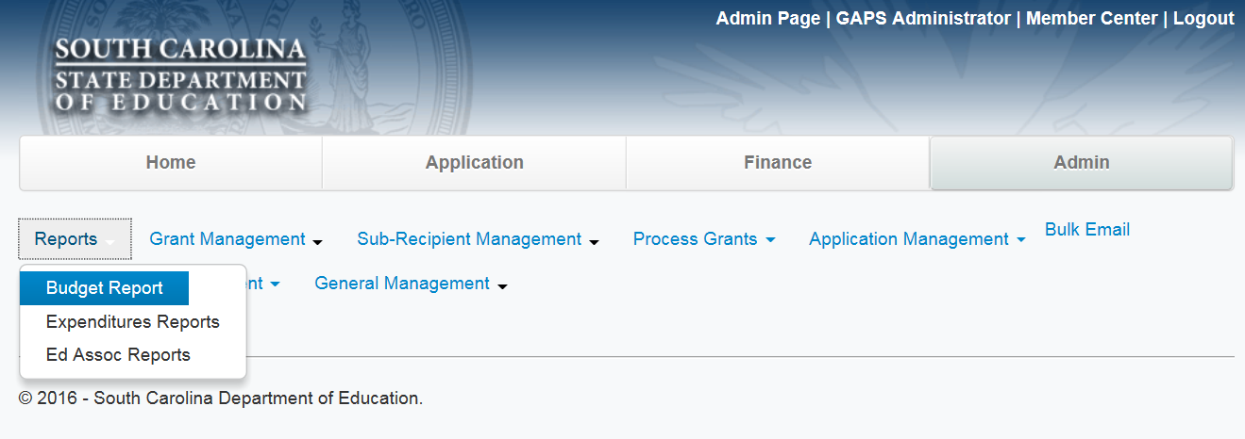
Accessing Reports in GAPS
3) Select Budget Report
Your screen will look a little
different. However, you will
choose the
Admin Tab and then Go To
Reports Tab

Slide 10
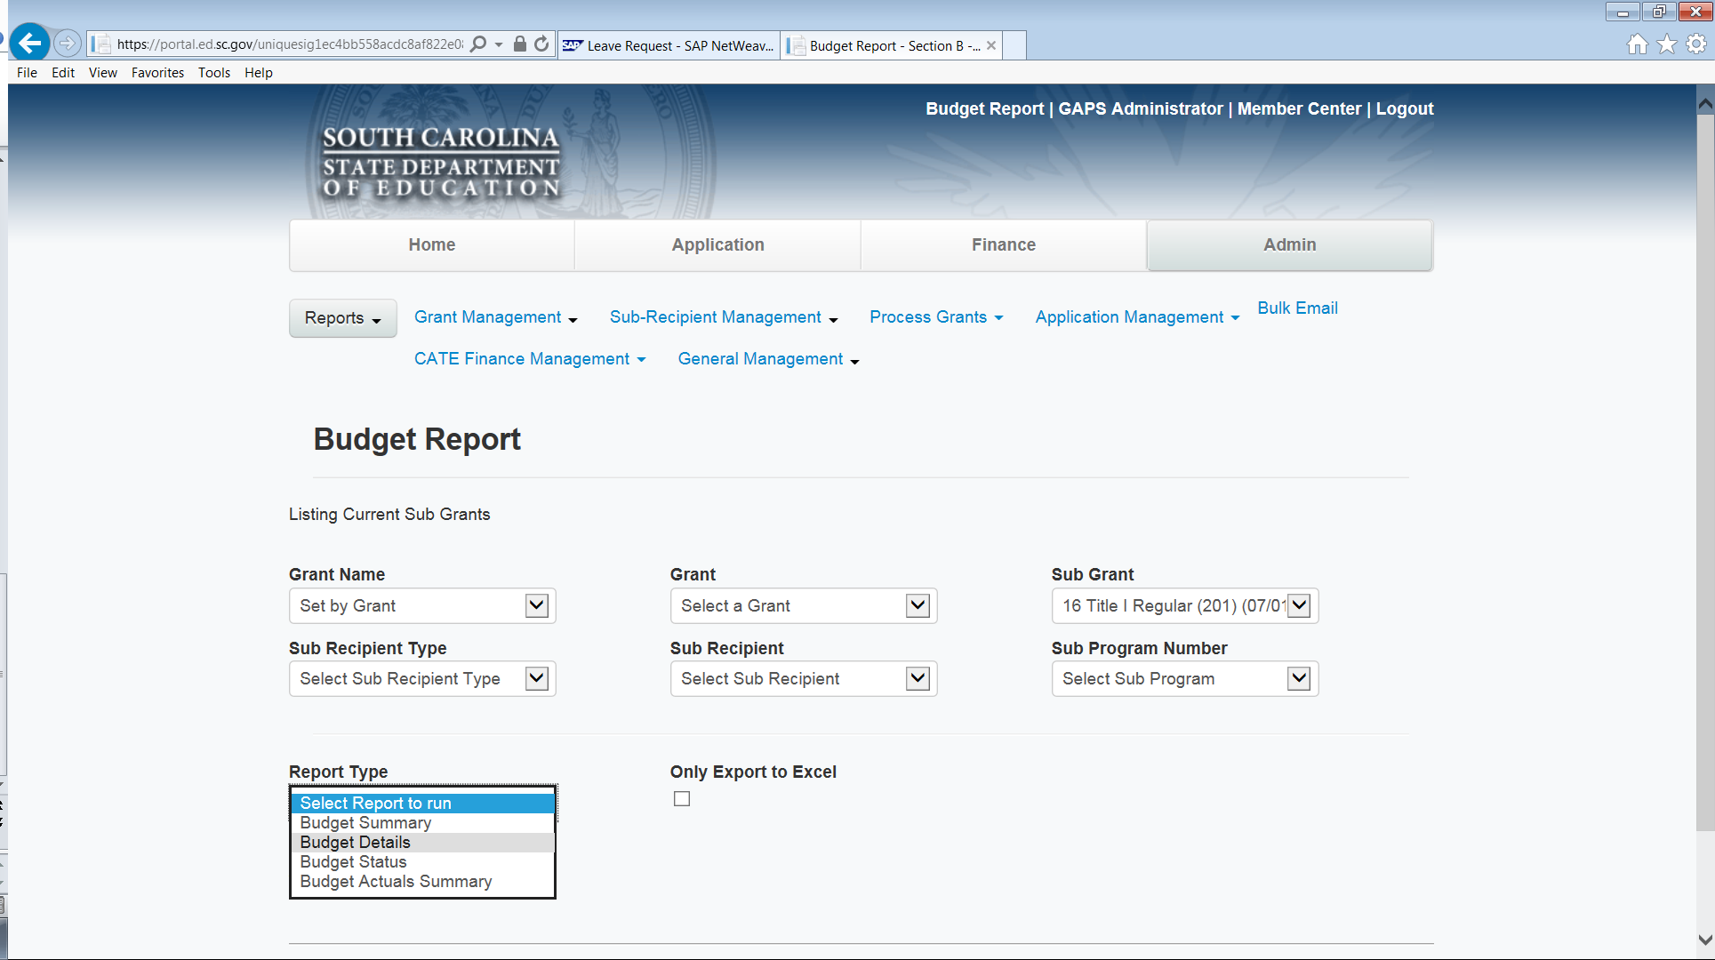
Accessing Reports in GAPS (cont’d)
To check status of a budget

Slide 11
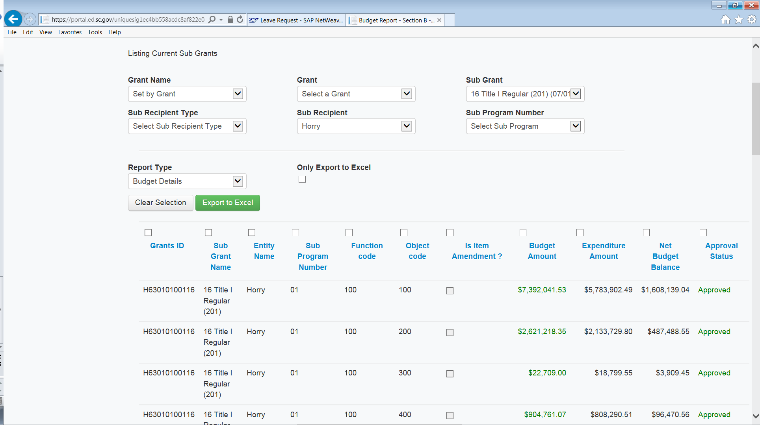
Accessing Reports in GAPS (cont’d)
Select Sub
Grant Title
Select Budget Details to see approval status by line

Slide 12
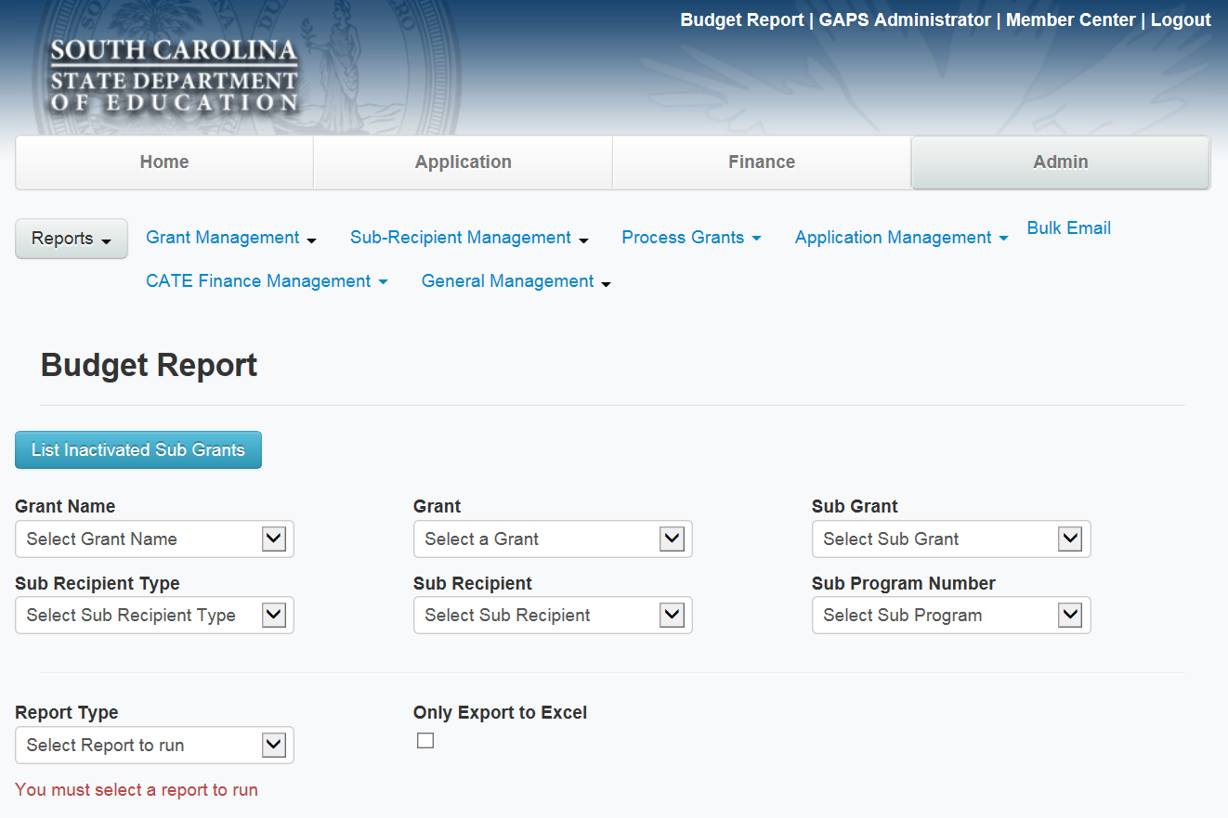
Accessing Reports in GAPS (cont’d)
For Budget Reports, you’ll have to click on the
Button for Inactivated Sub grants if the grant is no longer in an active award status

Slide 13
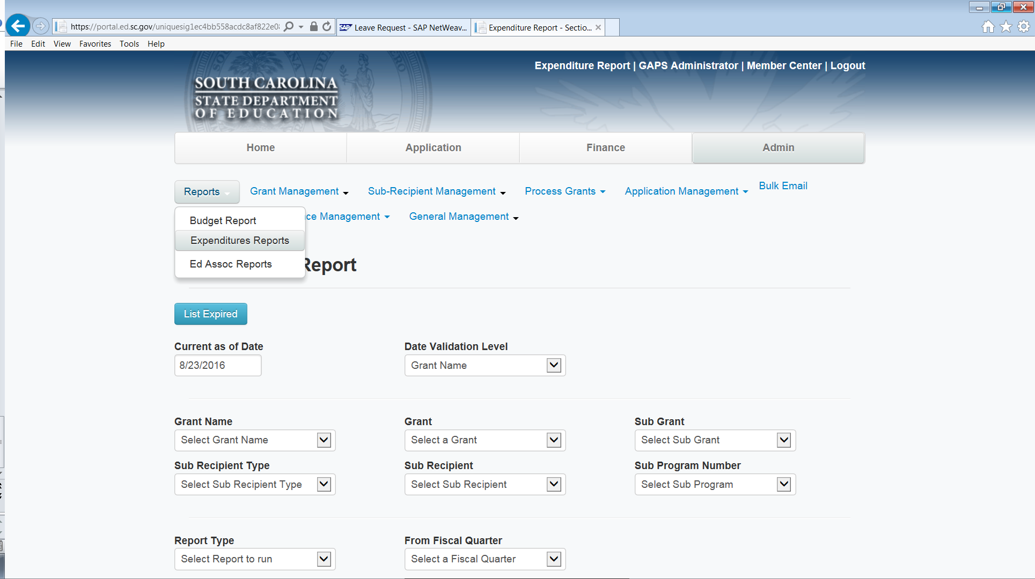
Accessing Reports in GAPS (cont’d)
Expenditure reports are accessed by going back to Reports Tab
To review reports by quarter

Slide 14
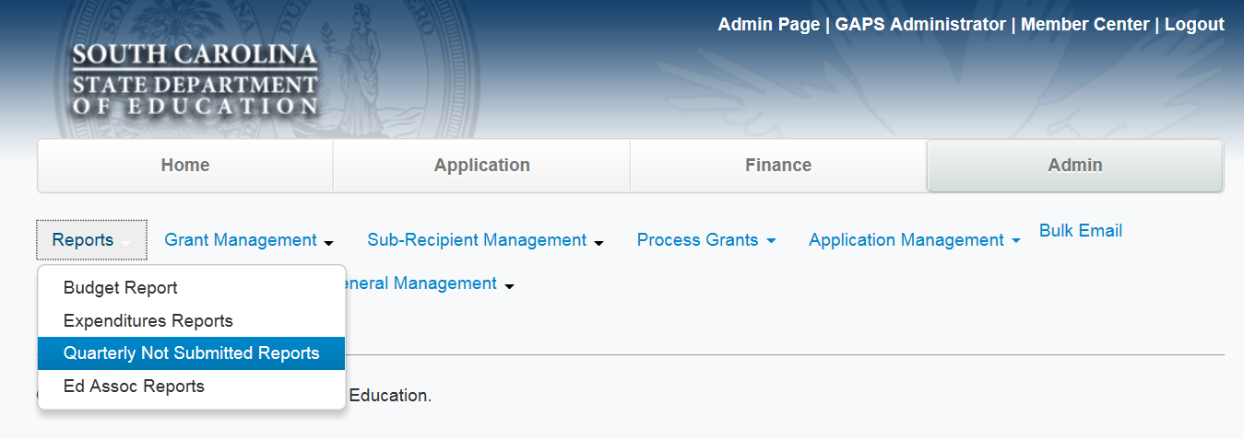
New Report
Qtrly Not Submitted Reports – To show Quarterly Expenditure Reports Not Submitted

Slide 15
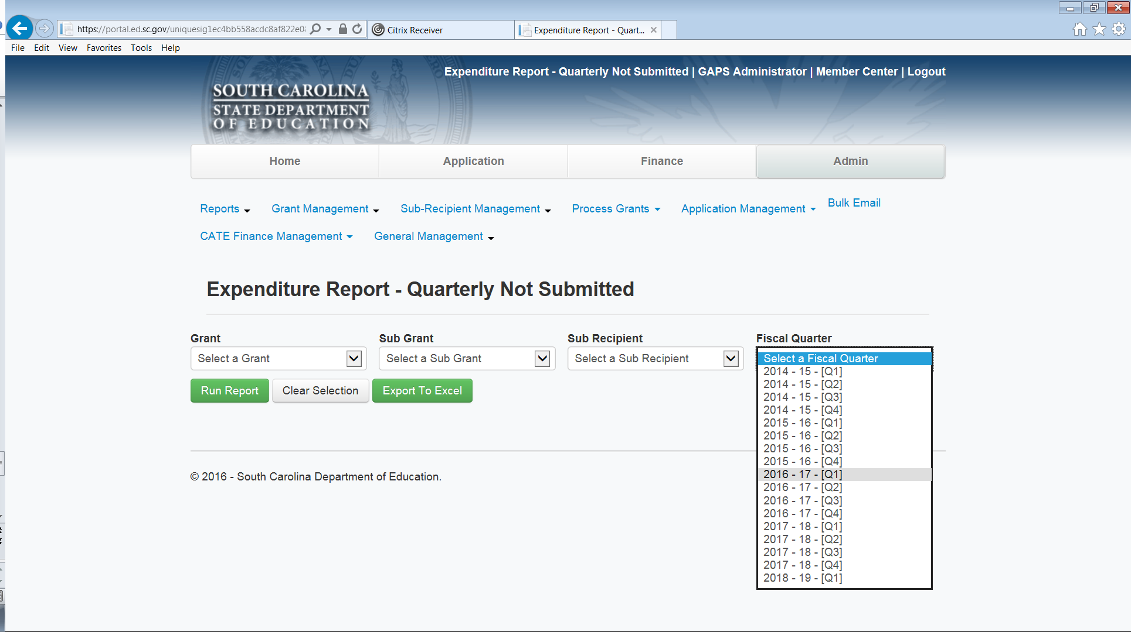
Cont’d - Qtrly Not Submitted Reports – To show Quarterly Expenditure Reports Not Submitted
Report can be run wide open by quarter or can be narrowed down by the other fields shown here
Note: Report doesn’t currently bring in items with anything in progress – this will be changed in the near future

Slide 16
FUTURE QUESTIONS/ISSUES
Questions related to Budget/Budget Amendment Status need to go to the specific SCDE Program Office – Grants Accounting Staff can’t approve or return these items
Questions related to Expenditures/Expenditures Refunds Status need to be sent to the SCDE Grants Accounting Office at grantsaccounting@ed.sc.gov.
GAPS issues should be explained and screenshots taken of each step being taken and sent to the Grants Accounting Office at grantsaccounting@ed.sc.gov
Assistance with running reports. Please send your question to grantsaccounting@ed.sc.gov and one of the Grants Accounting Section Team Members will give either give you a call back or send instructions via email to get you to the information that you need.
You’re always welcome to copy the assigned Grants Accountant on these email submissions. However, the grants email box is monitored all day and chances are you’ll hear back from someone more quickly when your question is submitted through this box. Also, this allows us to maintain a tracking system so we can watch for potential issues affecting multiple users so we can begin trouble shooting the issue.

