Slide 1
SCDE Office of Finance Boot Camp
Office of Special Education Programs
August 21, 2026
Presenters: Lagenia (Genie) McEachin Session & Emmett Eddy
Fiscal and Grants Management
Office of Special Education Services
Notes:
Just type in the content placeholder to add your title.

Slide 2
Agenda
FGM Overview
IDEA Part B
IDEA Grants
Grants Accounting Processing System (GAPS)
PPPSC
MOE
Excess Cost
Fiscal Monitoring
Questions
Notes:
Left aligned
Title font is 88pt
Numbered line item 66 pt
Detail/slide item 36 pt

Slide 3
OSES Fiscal and Grants Management (FGM)
The OSES Fiscal and Grants Management (FGM) Team provides resources and technical assistance to all LEAs in the areas of fiscal accountability, fiscal compliance and fiscal data collection.

Slide 4
Individuals with Disabilities Education Act Part B

Slide 5
History of Individuals with Disabilities Education Improvement Act (IDEA)
IDEA provides federal funds to assist states in assuring that each child with a disability receives a free appropriate public education (FAPE).
The first law was passed in 1975 and was called the Education for All Handicapped Children Act or Public Law 94-142.
The Act has been reauthorized several times—one of the most significant reauthorizations in 1986 added provisions relating to the education of preschoolers (3-5) and early intervention for infants and toddlers. This reauthorization is often referred to as Public Law 99-457.

Slide 6
What is the purpose of IDEA?
(a)To ensure that all children with disabilities have available to them a free appropriate public education that emphasizes special education and related services designed to meet their unique needs and prepare them for further education, employment, and independent living;
(b) To ensure that the rights of children with disabilities and their parents are protected;
(c) To assist States, localities, educational service agencies, and Federal agencies to provide for the education of all children with disabilities; and
(d) To assess and ensure the effectiveness of efforts to educate children with disabilities.

Slide 7
Who receives benefits under IDEA?
  Children with disabilities under the IDEA.
  Must have been evaluated and determined eligible in accordance with state and federal regulations
  Must require special education and related services

Slide 8
IDEA Part B Allowable Costs
Staff salaries and benefits
Supplies and materials
*Equipment (prior approval from SCDE)
Purchased Services
*Transportation (when required as a related service)
Other items necessary to special education program or pursuant to an IEP

Slide 9
IDEA Grant

Slide 10
IDEA Funding
IDEA Funds are awarded annually
IDEA is “forward funded”-meaning it is available to LEAs on July 1, even though the federal fiscal year begins on October 1
A 12-month carryover period is allowed for unspent funds, meaning each award has a 27-month grant cycle
IDEA funds can only be spent on allowable activities and only if the LEA meets Maintenance of Effort and Excess Cost requirements
Unspent funds are reallocated among LEAs

Slide 11
Three-part formula
Base amount—The base was established in 1999 for the IDEA 611 award and in 1997 for Preschool (IDEA 619). The state base amount for 611 is $51,358,930 and 619 is $5,094,371. The base does not change except under 4 conditions identified in IDEA or the Significant Expansion of Charter Schools.
Population—this calculation is the combination of the 45 Day Average Daily Membership (ADM) and the number of students enrolled in private schools within the LEA. This reflects total population—not just students with disabilities. It is the largest of the three amounts—$120,334,488 in SFY26.
Poverty-the smallest part of the flowthrough to districts is based on poverty of the LEA using Pupils in Poverty from the LEA “Headcount”. This is based on all students—not only students with disabilities. The SFY26 amount was $21,235,498.

Slide 12
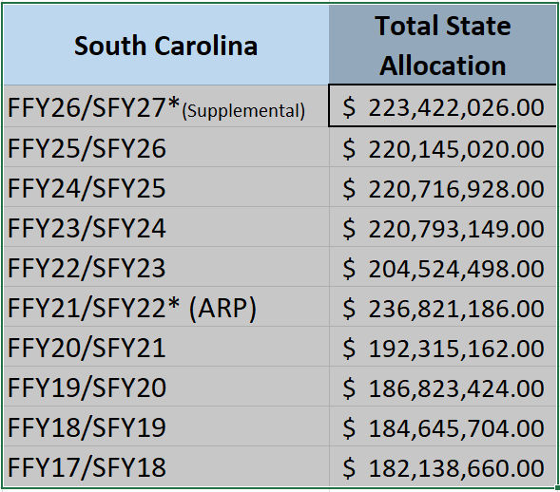
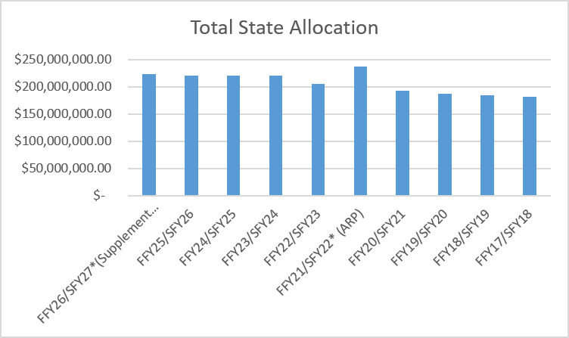
South Carolina IDEA Allocations
Notes:
Shown in the charts are the State of South Carolina IDEA 611 Allocations for the last 9 years. Up until FFY21/SFY22 Allocation amounts increased annually. Of course, the allocation went down in FFY 22/23 due to the one time allocation of ARP funds in 21/ 22. It then increased in 23/24
However, in 24/25 we saw a decrease of about $76,000 and this year in 25/26 we saw an additional decrease of over $570,000.

Slide 13
FFY26/SFY 27 Supplemental Funding
LEAs are receiving separate GANs for supplemental funding
Supplemental funding amounts are small
Districts should expend all IDEA supplemental funding before expending regular IDEA.

Slide 14
FIFO
First In First Out
SFY25
SFY26
(FFY23)
July 1, 2024 – Sept 30, 2026
(FFY24)
(FFY25)
July 1, 2026 – Sept 30, 2028
July 1, 2025 – Sept 30, 2027
SFY27

Slide 15
IDEA Open Grants
925 IDEA 611 (203) Grant
825 IDEA Preschool 619 (205) Grant
926 IDEA 611 (203) Grant
826 IDEA Preschool 619 (205) Grant
927 IDEA 611 (203) Grant
827 IDEA Preschool 619 (205) Grant

Slide 16
LEA Fiscal Requirements
Submit signed IDEA Terms and Assurances
Meet Maintenance of Effort (MOE) Requirement
Meet Excess Cost Requirement
Submit IDEA Application
Parentally Placed Private School Children (PPPSC)-calculation of proportionate share
Maintain Fiscal and Programmatic Compliance
Data Reporting

Slide 17
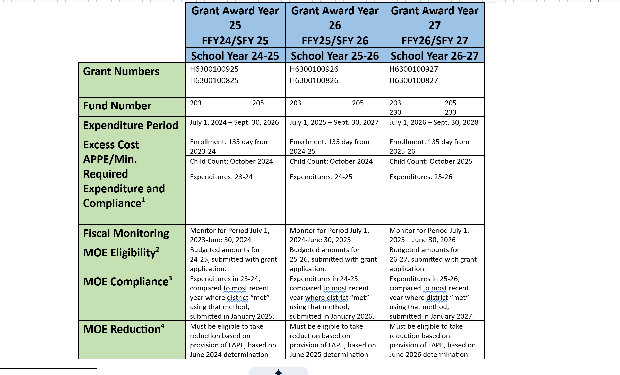
Grant Cycle Chart

Slide 18
GRANTS ACCOUNTING PROCESSING SYSTEM (GAPS)

Slide 19
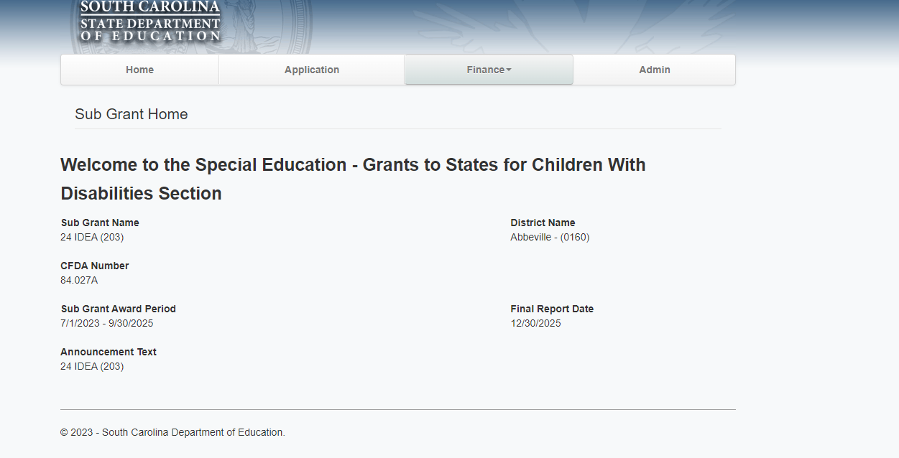
Master Data for Sub Grant
Important Dates Displayed:
1) Award Period – From and To Dates for Grant Award
2) Final Report Date – Final Date for Expenditure Report to be submitted

Slide 20
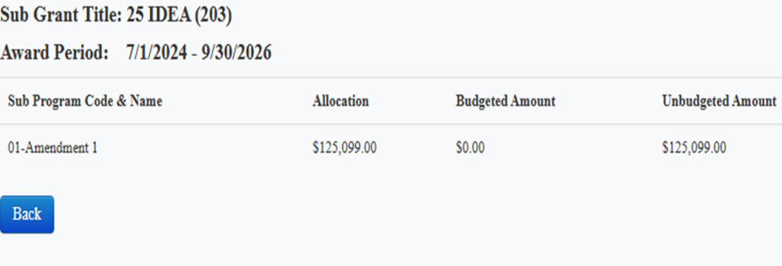
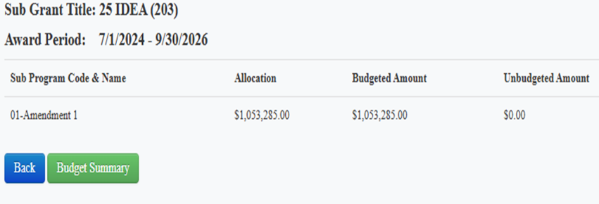
Unbudgeted V.S. Fully Budgeted Example
Make sure the full award amount is loaded, verify that all funds are loaded in the correct function and object codes field, and verify the indirect cost amount is correct function and object code.
Unbudgeted Fully Budgeted

Slide 21
Budget Narrative/ Budget Amendments
Budget Narrative should be detailed and describe expenditures so that we know they are for Special Education and Related Services.
This gives the Program Office the opportunity to review all anticipated expenditures to ensure that they are allowable.
Budget Amendments
Budget Amendments Must be Approved Prior to the Expenditures being obligated. If not, you are out of federal compliance.
The deadline for Budget amendments is three weeks prior to end of expenditures period unless noted differently in GAN.

Slide 22
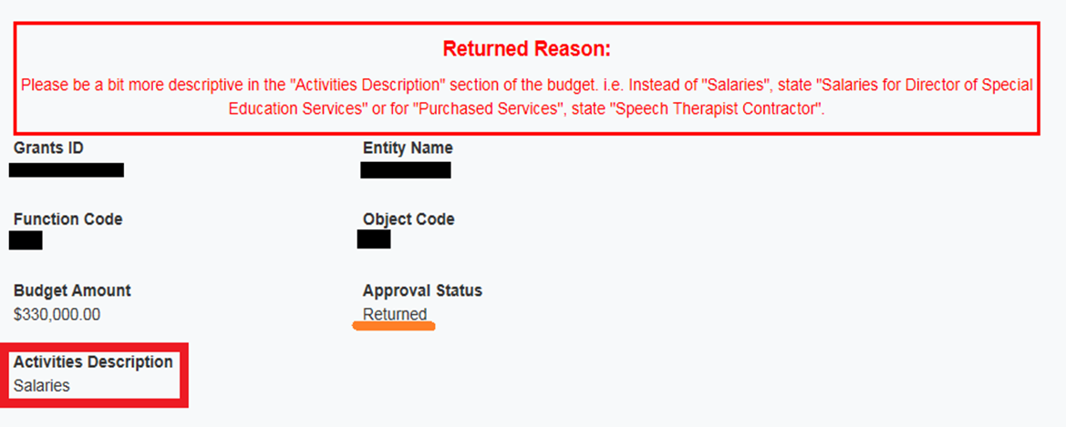
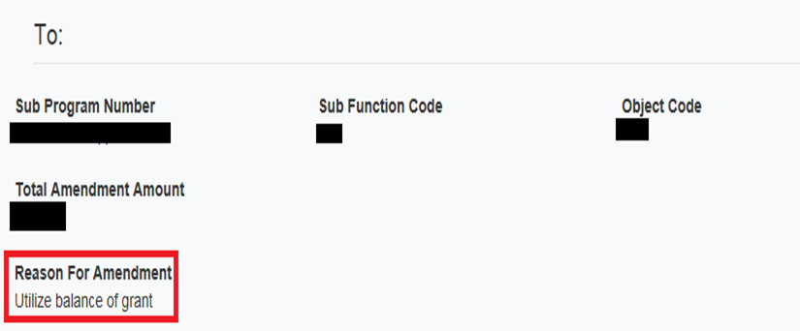
Amendment Example

Slide 23
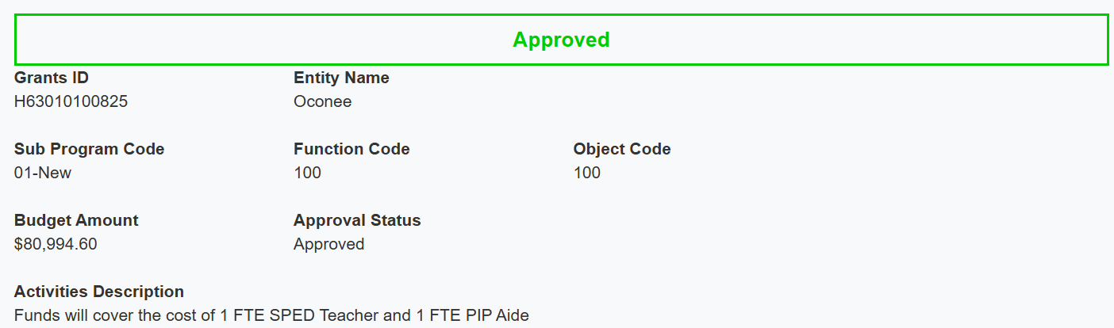

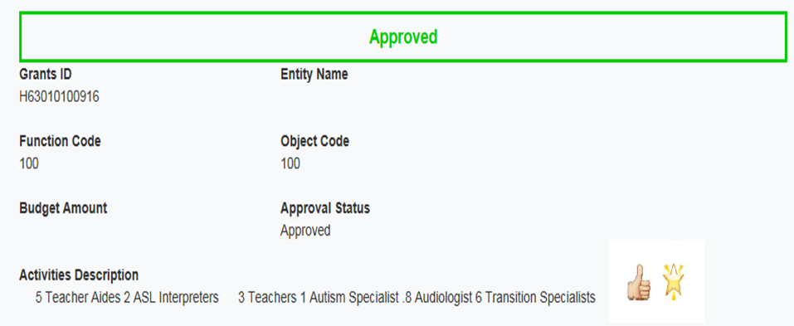

Budget Amendment

Slide 24
Making Changes and or Delete a Budget or Amendment
Changes:
Contact the Grants Administrator and ask to RETURN the budget/amendment to the Grant Sub Recipient Finance.
The Sub-Recipient of Finance will have to option to RETURN to the Grant Coordinator to make changes and submit again for approval.
Delete:
Contact the Grants Administrator and ask to RETURN the budget/amendment to the Grant Sub Recipient Finance.
The Grant Sub Recipient Finance will have to option to DENY. Denying the items helps when the item or transaction is no longer needed.
* Please note is only subject to budgets and amendments that does not have a final approval.

Slide 25
Assistance with GAPS
Questions related to Budget/Budget Amendment Status need to go to the specific SCDE Program Office – fwilson@ed.sc.gov (Grants Accounting Staff can’t approve or return these) items
Questions related to Expenditures/Expenditures Refunds Status need to be sent to the SCDE Grants Accounting Office at grantsaccounting@ed.sc.gov.
GAPS issues should be explained, and screenshots of each step being taken and emailed to the Grants Accounting Office at grantsaccounting@ed.sc.gov
Assistance with running reports. Please send your question to grantsaccounting@ed.sc.gov and one of the Grants Accounting Section Team Members will give either give you a call back or send instructions via email to get you to the information that you need.
For any additional information regarding our new system please send an e-mail to grantsaccounting@ed.sc.gov.

Slide 26
Parentally Placed Private School Children (PPPSC)

Slide 27
PPPSC
Parentally Placed Private School Children (PPPSC) refers to students with disabilities who were placed by their parents in a private elementary or secondary school when there is no dispute with the school district—this is simply parent choice.
Proportionate share is the IDEA requirement that LEAs calculate an amount of their IDEA 611 and 619 awards that must be expended to provide equitable services for eligible private school students with disabilities.

Slide 28
PPPSC-Reminders
Elementary and Secondary (by state definition)-Elementary is no lower than Kindergarten
Preschool children with disabilities less than Kindergarten age are NOT PPPSC
PPPSC include homeschooled children
Meaningful consultation must occur before determining how proportionate share will be expended
LEAs must track proportionate share expenditures using function 149
State/local funds cannot be used in lieu of IDEA funds
LEAs may spend more than the required amount from IDEA only if they have a "Meets" determination
Unexpended funds in year 1 must be carried over to year 2 of the award
Unexpended funds cannot be moved to another line item (through an amendment) before an OSES review of the LEA's compliance with 300.130-300.144

Slide 29
MOE

Slide 30
Non-supplanting (Use of Amounts 300.202)
(a) General. Amounts provided to the LEA under Part B of the Act—
(1) Must be expended in accordance with the applicable provisions of this part;
(2) Must be used only to pay the excess costs of providing special education and related services to children with disabilities, consistent with paragraph (b) of this section; and
(3) Must be used to supplement State, local, and other Federal funds and not to supplant* those funds.
*OSEP has clarified that if an LEA has met MOE and Excess Cost, they have met the non-supplanting requirement.

Slide 31
LEA Maintenance of Effort (MOE)
MOE is the IDEA fiscal requirement based on the total state and local expenditures for special education and related services. IDEA funds not be used to reduce expenditures on special education and related services from state and local funds.
The LEA must budget/expend at least as much as was expended in the most recent prior year where they met the MOE standard (“threshold”).
There is an MOE eligibility requirement that must be met to receive funds. This is collected with the LEA’s assurances.
There is also an MOE Compliance requirement. Failing to meet the compliance requirement can result in repayment of the shortfall

Slide 32
LEA/MOE Reminders, Continued
There are some exceptions that can be used to reduce the MOE threshold.
There is also an MOE adjustment/reduction that may be available to some LEAs.
There is NO WAIVER of the MOE requirement for LEAs-even when supplemental federal funds (such as ESSER…) are provided.

Slide 33
What fiscal information is required?
LEAs demonstrate compliance with MOE by budgeting/expending the required funds for special education and related services.
Special education means specially designed instruction, at no cost to the parents, to meet the unique needs of a child with a disability. This is described in the child’s IEP.
Related services means transportation…other supportive services as are required to assist a child with a disability to benefit from special education. Other common examples include speech therapy, occupational therapy, physical therapy, and psychological services.
Notes:
We have many functions that represent special education instruction, but few that are specific to related services—have to be able to identify those through location or modifier…
(210)
typically use 213 for OT/PT—caution, this also includes school nurses
214 school psychologists—who may not be 100% special education
215 specific special ed support
Among the 220 functions, none are specific to special education.

Slide 34
Calculation of “Local Only”
Most expenditures for special education and related services come from the General Fund, which is a combination of state support provided through State Aid to Classrooms as well as local funds.
Expenditures are not distinguished by the source; however, our guidance from OSEP is that if you cannot separate state from local funds, they must be counted under “Total State and Local”.
This reduces the LEA’s ability to use all four calculation methods.
We encourage LEAs to use all available methods for these reasons:
More opportunity to meet the standard
When an LEA does not meet MOE, the State Agency uses the smallest shortfall to determine the amount to be repaid. That is usually the local amount.
Notes:
Under the prior system, state funds under EFA went into the general fund along with your local funds. However, since we knew how much went to each LEA by categorical weighting, we could subtract that from the total expenditures and assume that the balance was “local”. Expenditures from 300 funds were pure “state” funds.
The new system has caused us to look at that differently. Although the weighting for students with disabilities now is 2.6 for all, that is an index used to determine the total level of funding for each LEA.
We have moved to a new version of the MOE/LEA Calculator—this one gives us more flexibility. What are prepopulating all the functions that would be expected in MOE calculation.
They are also color –coded to show which ones would be included in Excess Cost.
Although the top says “general fund” –since much of EIA has been rolled up, there will be rows at the bottom to add other state or local sources that you might have used.

Slide 35
The Power of Exceptions
Can help the district “Meet with Exceptions”
“Meets with Exceptions”=“Meets”
May help district “Meet with Exceptions” by more than one method
Lowers the threshold for future years
If a district fails MOE by all 4 methods, the lowest shortfall is used to calculate the amount to be remitted through non-federal funds
Notes:
There are 5 exceptions to MOE—only 4 apply in SC.
Enrollment
Voluntary Departure of Special Ed/RS personnel
Termination of a long term expenditure
Termination of a “costly” program
Really only 2 commonly used:
Enrollment—based on Child Count; calculated automatically.
Example; a 5% reduction in child count, will be a 5% reduction in the amount necessary to meet state/local and local only—also applies to the per capita amounts.
However, the voluntary departure of personnel applies equally to local and State/Local

Slide 36
MOE Adjustment or Reduction
The MOE Adjustment is available to eligible districts when the current year’s allocation exceeds the allocation of the prior year.
Eligible districts are those that can establish and maintain FAPE, meaning,
  meet the criteria to receive a grant award
  they have a “Meets” determination and
  have not been identified as having significant disproportionality
The MOE reduction allows districts to reduce their state and local support by up to 50% of the increase.
Notes:
MOE adjustments/reductions are available to certain districts when there is an increase in IDEA awards over the prior year.
The district must have a “Meets” determination.
This flexibility in IDEA can be use along with the exceptions. Districts can “free up” a calculated amount of state/local budgets for Special Education and related services to be used for other initiatives.

Slide 37
Excess Cost

Slide 38
Excess Cost – IDEA Grant
IDEA is an “Excess Cost” entitlement grant
One of the first assurances an LEA must make to be eligible to receive funds--
300.202 Use of amounts.
(a) General. Amounts provided to the LEA under Part B of the Act—
(1) Must be expended in accordance with the applicable provisions of this part;
(2) Must be used only to pay the excess costs of providing special education and related services to children with disabilities, consistent with paragraph (b) of this section; and
(3) Must be used to supplement State, local, and other Federal funds and not to supplant
those funds.
Notes:
IDEA is an “Excess Cost” allocation
Excess Cost is discussed in two ways:
Individual/specific costs (is this allowable?)
Excess Cost as a fiscal compliance “test” --
It is to be used for expenditures beyond the average expenditure for all students. That calculation is referred to the Annual Per Pupil Expenditure (APPE).
For example, if the APPE is $10,000, IDEA can be used for allowable expenditures above that amount. The Office of Special Education Programs (OSEP) has clarified that the LEA does not have to expend an amount equivalent to the APPE before using IDEA, but would have to meet that threshold before the end of the fiscal year.

Slide 39
Excess Cost - continued
Individual-specific expenditures must be an "excess cost" to be allowable.
Excess Cost is the IDEA requirement that LEAs must expend as much on students with disabilities as the Average Annual Per Pupil Expenditure (APPE) of all students.
All expenditures of the LEA must be included—with the exception of capital outlay and debt service.
Expenditures must be calculated by Elementary and Secondary—consistent with each State’s definition.

Slide 40
IDEA FISCAL MONITORING

Slide 41
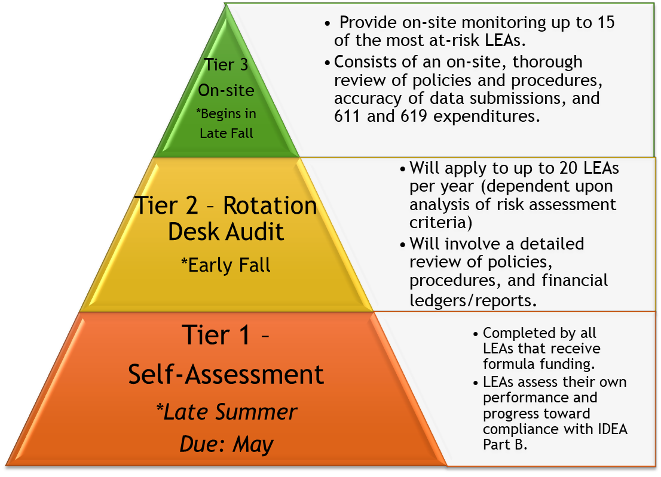
Tiered Risk-Based Monitoring

Slide 42
IDEA RISK ASSSEMENT
IDEA Balances Remaining
LEA Turnover (Special Education Director, Superintendent)
Monitoring History
Review of Self-Assessment
SCDE Risk Rating
Single Audit Management Decisions
Size of IDEA Award
Timely and Accurate Submission of IDEA Application
Timely and Accurate Submission of Excess Cost Calculator
Timely and Accurate Submission of Maintenace of Effort Calculator
Timely and Accurate Submission of Table 8 & ESY Data

Slide 43
TIER II MONITORING
Tier 2 monitoring will apply to up to 20 LEAs per year (dependent upon analysis of risk assessment criteria) and will involve a more detailed review of policies, procedures, financial ledgers, and timeliness and accuracy of data submissions. Fiscal Monitors work with districts during the desk audit to ensure that district policies and procedures comply with Uniform Grant Guidance, IDEA, and state regulations.

Slide 44
TIER III MONITORING
Tier 3 monitoring will apply to up to 15 LEAs (dependent upon analysis of risk assessment criteria) and will involve an on-site or virtual, review of policies and procedures, financial ledgers, and timeliness and accuracy of data submissions. An inventory of IDEA purchased equipment will also be performed at a selected district site. Upon completion of the on-site (virtual) monitoring, an official Letter of Findings will be issued to the LEA for any deficiencies noted with a specific timeline established for correction. Tier 3 monitoring will be completed by May of each year.

Slide 45
FGM Due Dates and Deadlines
IDEA SFY27 Application Due August 26
Financial Aid Reimbursement Request September 26
IDEA 611 & 619 GANS Due to FGM October 2026
MOE/Excess Cost Compliance Calculators November 2026
MOE Compliance Calculators January 2027
Excess Cost Compliance Calculators February 2027

Slide 46
FGM Team
Jessica Bodger
Fiscal Monitoring/Excess Cost/
Contracts
jrbodger@ed.sc.gov
Lisa Cooper
Procurement
lcooper@ed.sc.gov
Emmett Eddy
Fiscal Monitoring/MOE/Inventory
eeddy@ed.sc.gov
Genie McEachin-Session
OSES Budgets/Special Projects
lmceachinsession@ed.sc.gov
Tiffany Pearson
OSES Budgets
tvpearson@ed.sc.gov
Artena Starks
Financial Aid/Grants Administration
aastarks@ed.sc.gov
Feonia Wilson
Grants Administration
flwilson@ed.sc.gov
Michelle Williams Young
TEAM Lead
smwilliamsyoung@ed.sc.gov

Slide 47

QUESTIONS

Slide 48
ed.sc.gov
Notes:
Slide title is hidden from display

