Slide 1

Understanding Medicaid
Finance Boot Camp
District Finance Coordinators
Presented By: Marquita Taylor, Ophelia McClary
August 22, 2025

Slide 2
Agenda
What is Medicaid?
Why Medicaid in Education?
Medicaid Funding
Billable Medicaid Services
School-Based Medicaid Programs/Services
  School-Based Rehabilitative Therapy Services (SBRS)
  Rehabilitative Behavioral Health Services (RBHS)
  School District Administrative Claiming (SDAC)
  Special Needs Transportation (SNT)
Reimbursement
Contracts
District Review of Medicaid Reimbursement Data

Slide 3
What is Medicaid?
Medicaid is a joint federal and state program that provides health coverage to millions of Americans, including
eligible low-income adults,
children,
pregnant women,
elderly adults, and
people with disabilities.
Notes:
Header font 50pt
Content/body text font 28pt

Slide 4
What is Medicaid? -continued
Medicaid is a state administered health insurance program that is guided by federal requirements.
Centers for Medicare and Medicaid (CMS)
Department of Health and Human Services (DHHS)
Notes:
Header font 50pt
Content/body text font 28pt

Slide 5
What is Medicaid? (continued)
• Medicaid is different in each state.
• Within federal guidelines, the state decides
  eligibility requirements,
  service array,
  rates, and
  policy and procedures.
Notes:
Header font 50pt
Content/body text font 28pt

Slide 6
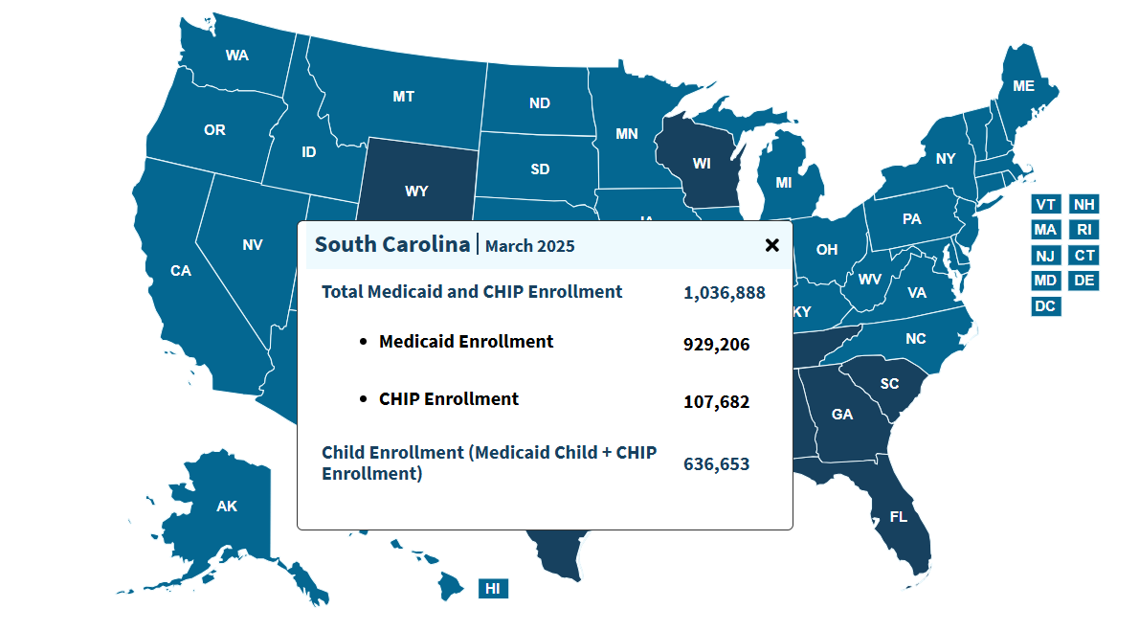
SC Medicaid/CHIP Enrollment
Source: https://www.medicaid.gov/state-overviews/scorecard/measure

Slide 7
Percentage of Students Enrolled in Medicaid Statewide
Source: SC Revenue and Fiscal Affairs

Slide 8
Why Medicaid in Education?
Congress changed the Medicaid rules to permit school districts to seek Medicaid reimbursement for medical services in an Individualized Education Program (IEP).
Additionally, the South Carolina Legislature mandated that school districts maximize Medicaid reimbursement.
Source: South Carolina Proviso 1.2

Slide 9
Medicaid Funding
Medicaid is a jointly funded program (state and federal).
National Expenditures – $908.8 billion*
SC Expenditures - $8.87 billion*
School Districts - $33.4 million*
*Amounts as of FY 2024
Source: NHE Fact Sheet | https://www.cms.gov/data-research/statistics-trends-and-reports/national-health-expenditure-data/nhe-fact-sheetCMS

Slide 10
School-Based Medicaid Programs & Services
School-Based Rehabilitative Therapy Services (SBRS)
Rehabilitative Behavioral Health Services (RBHS)
School District Administrative Claiming (SDAC)
Special Needs Transportation (SNT)
Telehealth (facility fee)
Medicaid Adolescent Pregnancy Prevention Services (MAPPS)
COVID - 19 Testing
Autism Spectrum Disorder (ASD)

Slide 11
School-Based Rehabilitative Services (SBRS)

Slide 12
Medicaid Reimbursement is available for the following School-Based Rehabilitative Services:
Speech Language Therapy (SLP)
Physical Therapy (PT)
Occupational Therapy (OT)
Audiology (AUD)
Nursing Services for Children Under 21
Orientation & Mobility (O&M)
Medicaid Adolescent Pregnancy Prevention Services (MAPPS)
Special Needs Transportation (SNT)
School District Administration Claiming (SDAC)
Telemedicine (Facility Fee)
Autism Spectrum Disorder (ASD)

Slide 13
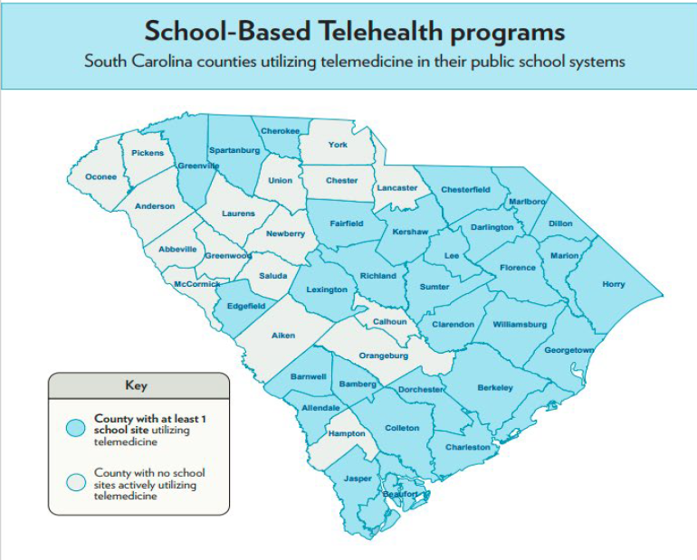
SCDE Telemedicine
Medical facilities throughout the state have existing programs to provide telehealth in the school districts and have established the SC Telehealth Alliance.
The program treats common childhood illnesses including sore throat, rashes, and chronic diseases such as asthma.
If the student’s condition cannot be diagnosed via telehealth, the provider will work with the family to connect them to an in-person provider.

Slide 14
Rehabilitative Behavioral Health Services (RBHS)

Slide 15
Rehabilitative Behavioral Health Services
Diagnostic Assessment (DA)
Psychological Testing and Evaluation (PTE)
Individual Psychotherapy (IP)
Group Psychotherapy (GP)
Family Psychotherapy (FP)
Multiple Family Group Psychotherapy (MFGP)
Behavioral Health Screening (BHS)
Service Plan Development (SPD)
Crisis Management (CM)
Psychosocial Rehabilitation Services (PRS)
Behavior Modification (B-Mod)
Family Support (FS)

Slide 16
School District Administrative Claiming (SDAC)

Slide 17
SDAC
Federal reimbursement for activities that support the Medicaid program.
Reimbursement is determined using random moment surveys (RMS) to access what activities participants perform.
Surveys are assigned proportionally to each participating district.
Results of the surveys determine the percentage of reimbursable activities.

Slide 18
SDAC - continued
The school year is divided into four quarters based on the SFY beginning with JAS (i.e., July, August, September).
After the quarter ends, each district enters their cost information for the quarter (salaries, purchased services, other non-federal costs, etc.)
An invoice is generated for each school district, electronically signed by the district’s finance coordinator, and submitted to the SCDHHS for payment.

Slide 19
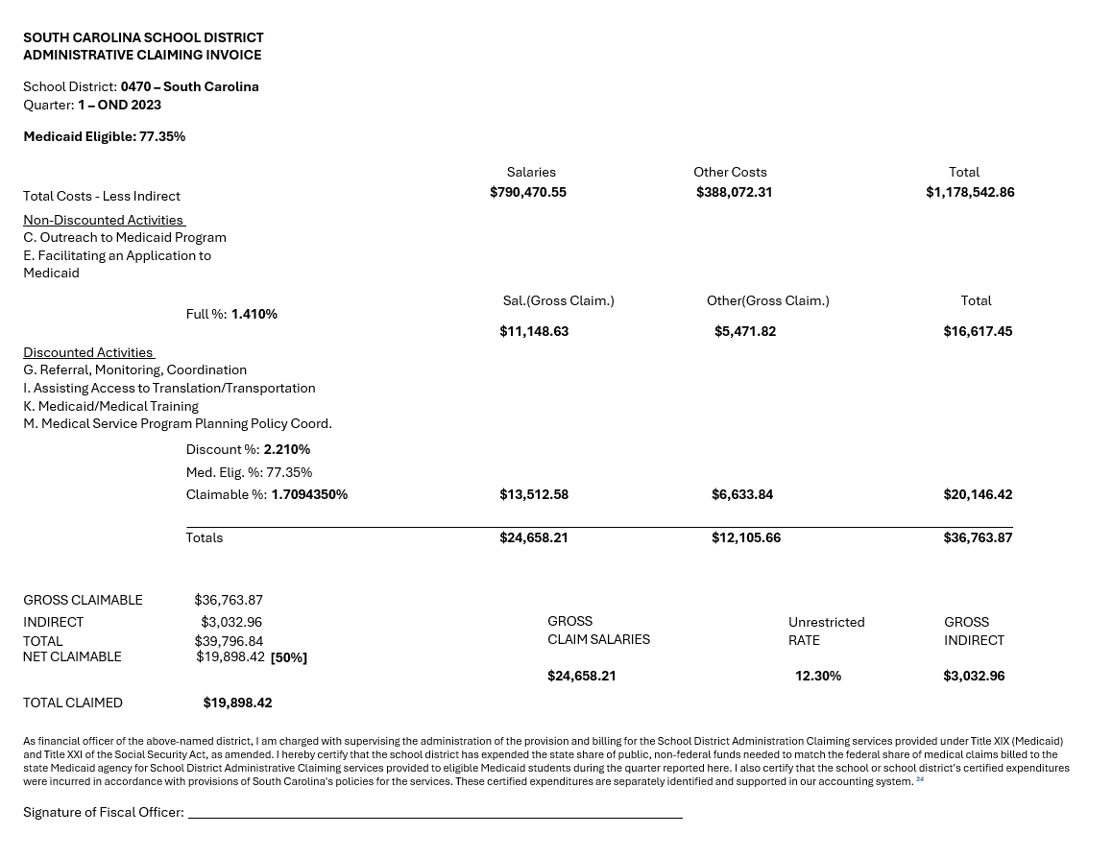
SDAC – (continued)
The school year is divided into four quarters based on the SFY beginning with JAS (i.e., July, August, September).
After the quarter ends, each district enters their cost information for the quarter (salaries, purchased services, other non-federal costs, etc.)
An invoice is generated for each school district, electronically signed by the district’s finance coordinator, and submitted to the SCDHHS for payment.

Slide 20
District Responsibilities for SDAC
Participants
  Complete Surveys
District Coordinator
  Develop Personnel Roster
  Train Participants
  Review Surveys for Accuracy
  Ensure Participants have access to the SDAC application
Finance Coordinator
  Enter Cost Information
  Review Invoice for Accuracy
  Sign and Return Invoice

Slide 21
Special Needs Transportation (SNT)

Slide 22
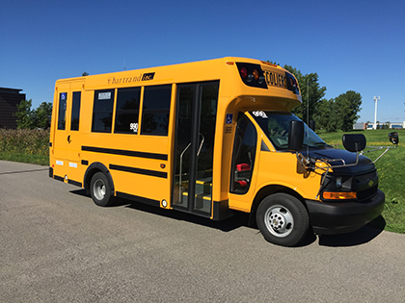
SNT
SNT is reimbursable when a student is transported on a specially adapted school bus to or from a location where a Medicaid reimbursable service is received (i.e., ST, OT, PT)
Services can be provided at a school or other facility.
SNT must also be identified in the Individualized Education Program (IEP) of the student.

Slide 23
SNT - continued
The South Carolina Department of Education (SCDE) pays school districts a portion of its Medicaid SNT revenues. SCDE owns the buses and is the Medicaid claimant.
Some district expenses are included in the annual SNT cost report that is submitted to the SCDHHS.
SCDHHS sets the maximum reimbursement allowed for each trip.
The maximum daily reimbursement for the SY 2025 – 2026 is $87.18.
  $29.06 per trip
  Up to 3 trips per day

Slide 24
SNT Claims Process
Districts enter student ridership data into the SNT application on the SCDE website
SCDE utilizes EdPlan to retrieve students IEP data.
SCDE receives SPON file from SCDHHS that contains student info (i.e., Medicaid numbers, dates of health services, etc.)
SPON file is uploaded into the SNT claims application
SNT Claims application prepares an electronic claim file with transportation claims and submits to the SCDHHS
SCDHHS processes the claim file and returns an electronic remittance with the paid dollar amounts.
The monetary amounts are stored into the SNT claims application awaiting distribution to districts.
Once the state match is paid, SCDE keeps 50% and distributes 50% of the federal share to districts.

Slide 25
Reimbursement

Slide 26
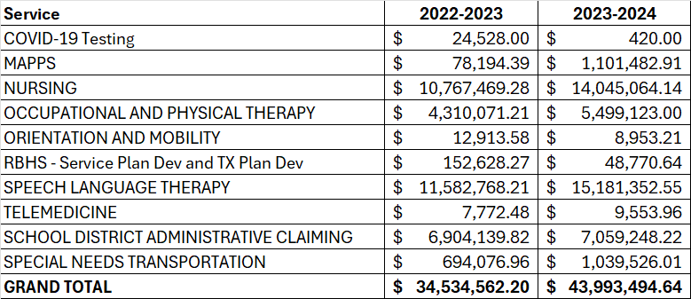
Reimbursement FY23 and FY24

Slide 27
Fluctuations in Medicaid Reimbursement
Factors that influence Medicaid reimbursement are:
Districts decision to bill for a service
Staffing
Incorrect billing
Third Party Liability (TPL)
Managed Care Organization (MCO) involvement
Student Enrollment

Slide 28
RBHS Claim Submission
FFS
  Submit claims directly to SCDHHS via SCDHHS Web Tool
MCO (for RBHS)
  Healthy Blue by BlueChoice of SC
  Absolute Total Care (ATC)
  Molina Healthcare
  First Choice by Select Health
  Humana (effective July 1, 2021)

Slide 29
Ways to Maximize Reimbursement
Provide IEP services as required
Provide non-IEP services, as necessary
Capture all services provided in billing application/medical records
For students with Medicaid insurance, be sure to receive Medicaid numbers from parents/guardians
In a timely manner, accurately capture billing information and submit to Medicaid

Slide 30
District Reimbursement Data

Slide 31
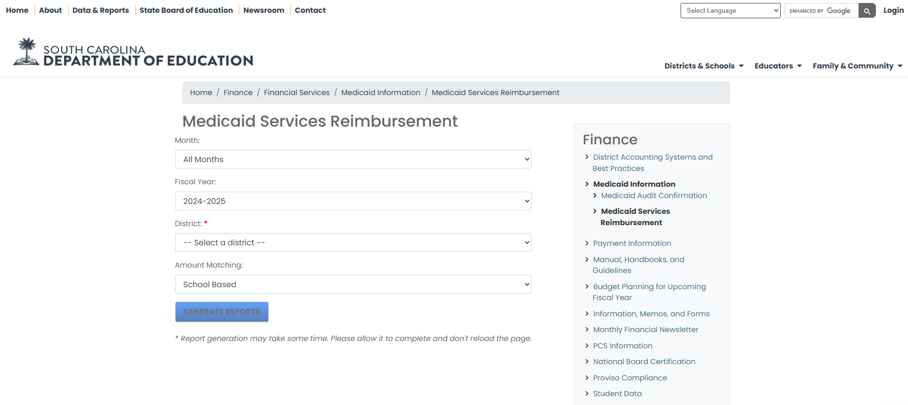
View District Reimbursement
Districts’ Medicaid reimbursement data is readily available via the Finance section of the SCDE website.

Slide 32
ed.sc.gov
Notes:
Slide title is hidden from display

