Slide 1



Grants Management Overview
Finance Bootcamp
Audrey H. Shifflett, Office of Grant Services
August 21, 2026
Notes:
OK – as you’re ready to get on with your life after the past two and a half days…

Slide 2
Agenda
1 Expectations for Grants Management
2 Policies and Procedures
3 Assurances and Terms and Conditions
4 Waste, Fraud, and Abuse
Notes:
I’m going to quickly take you through these agenda items

Slide 3

Disclaimer
This presentation shares subgrant requirements and federal regulations, including portions of 2 CFR Part 200 Uniform Administrative Requirements, Cost Principles, and Audit Requirements for Federal Awards (a.k.a. Uniform Grant Guidance or UGG).
Notes:
I like to start with this disclaimer – because the information I’m going to share today about grants management and requirements includes federal regulations and our agency’s requirements, but …

Slide 4

Disclaimer, continued
This presentation is not a substitute for reading
subgrant award
program-specific assurances
SCDE’s Assurances and Terms & Conditions
applicable regulations and laws.
Notes:
It’s important that you understand that what I’m presenting today is not a substitute for you reading the grant awards issued to your district and all the related documents – the assurances and terms and conditions, and the federal regulations or state laws that apply to the contractual agreements your district has entered into. And that’s what a grant or subgrant is – it is a contractual agreement between our SCDE and your school district.

Slide 5

The only constant is…
Change!
Office of Management and Budget (OMB) proposed updates to Title 2 of Code of Federal Regulations in May 2026
45-day window for public comment resulted in almost 500,000 responses
Waiting to hear what proposed changes will become effective October 2026
Stay tuned!

Slide 6
Agenda 1
Expectations for Grants Management

Slide 7

As a State Educational Agency (SEA) the SCDE
Supports SC public school districts:
  Students
  Teachers
  Administrators and staff
Supports State Board of Education
Administers state and federal funds for education.

Slide 8

The SCDE expects
School Districts* to
Adhere to all funding requirements
Have adequate internal control systems
Comply with state laws, federal laws, and regulations
Meet performance expectations
Meet all reporting requirements (i.e., reports are accurate, complete, and submitted on time).
*Also known as local education agencies or LEAs.
Notes:
Here are the grant management expectations that the state has for school districts. This may not be the first time you’ve seen these during this boot camp and it probably is not the last time you’ll see them – They’re the five expectations of school districts [slide contents]. All of these expectations are grounded in law, regulations, or terms of a contract.

Slide 9
Grant Manager’s Role
Manage administration of a specific grant/subgrant program:
Programmatic activities to achieve proposed goals and objectives
Financial activities to achieve prudent fiscal management of funds
Record keeping activities to ensure accurate documentation
Compliance activities to fulfill all program requirements, including accurate reporting and close out.
Notes:
It’s important for you to understand the grant manager’s role.

Slide 10
Finance Officer’s Role
Oversee financial management of district’s grants and subgrants
Compliance activities that meet award terms and standards in 2 CFR Part 200, especially §§200.302–330, including accurate reporting and close out
Financial activities to achieve prudent fiscal management
Record keeping activities to ensure accurate documentation.
Notes:
It’s also important for you to understand the financial officer’s role in grants management. Your overall role is to support your grant managers so that the district succeeds overall.

Slide 11

Who Complies with What?
“…all recipients that work with federal funding must comply with the laws, authorities, regulations and policies that govern those funds.”
—Thompson Federal Grants Development Module, Tab 100

Slide 12

Federal Laws, Regulations, and Guidance
Congress creates and President signs laws
Federal Agency issues program regulations to implement and enforce laws
Office of Management and Budget (OMB) issues regulations (cross-cutting)
Federal Agency creates guidance to clarify regulations and issues letter & memos for more info
  Public inspection required for regulations; see Federal Register www.federalregister.gov

Slide 13
Example: Hierarchy of Requirements
84.010 Title I Part A Basic Grants to LEAs
Law: Elementary and Secondary Education Act
Regulations:
34 CFR 200 — program-specific regulations
EDGAR (agency-specific: Education Department General Administrative Regulations )
2 CFR Parts 25, 170, 180, 200 — cross-cutting regulations (across multiple agencies)
US Department of Education:
Non-regulatory Guidance
Dear Colleague Letter on Waivers and Flexibility
Title I, Part A: Improving Basic Programs Operated by Local Educational Agencies | U.S. Department of Education

Slide 14
Questions and Tips
Questions
How many grant managers in your district?
What specific projects are the district’s grant managers administering?
What other staff (Finance, Administration, etc.) assist with grants management?
Tips
Know your grant managers; build a relationship
Meet with grant managers at least annually
  Ensure they understand internal controls
  Ensure you understand their concerns about their programs
Read the monthly SCDE Finance Newsletter (email) and share it with grant managers

Slide 15
Agenda 2
Policies and Procedures
of a Pass-through Entity

Slide 16

Pass-through Entity: SC Department of Education (SCDE)
Primary Grantee
  Receives grant from federal agency
  Must comply with authorizing law, applicable regulations, guidance, etc.
  Makes subgrants to eligible entities (subgrantees) in compliance with laws and regulations
  See 2 CFR Part 200.332 Requirements for pass-through entities for more information.
Notes:
If you are new to grants management, or even if you are not, understanding the policies and procedures of a pass-through entity can be challenging. The South Carolina Department of Education is the state’s education agency for pre-K through 12th grade. As such, we receive grants directly from federal agencies, in this case the US Department of Education and the US Department of Agriculture. With the grants we receive, we have a direct contractual relationship with these agencies and for some of these grants, we are a pass-through entity. That means we are a primary grantee and we pass-through federal funds to other entities through subgrants. We have to follow federal law in how to pass through the funds and the laws authorizing the grants we get determine how we get those funds to you – whether we can give you a formula subaward or whether we must conduct a subgrant competition for the funds.

Slide 17

SCDE: Pass-through Entity Issues Subawards
  Complies with laws & regulations
  Adds limits compliant with
    State laws
    State-level program requirements
    Must oversee and account for subgrants
    Risk assessment
    Monitoring
    Audits
SUBGRANTEE
SCDE
Notes:
If you are new to grants management, or even if you are not, understanding the policies and procedures of a pass-through entity can be challenging

Slide 18
SCDE passes through to Subgrantee
State Laws, Provisos, Regulations
    Per diem
    Procurement
Assurances and Terms and Conditions for Federal Subawards
    Audit
    Recordkeeping
    Time and Effort
  Federal requirements
SUBGRANTEE
SCDE

Slide 19
Subgrantee
Local Education Agency (LEA)/ School District
Secondary grantee
  Receives subgrant award
  Must comply with subaward terms (including pass-through entity’s applied limits)
  Must comply with Assurances and Terms and Conditions
SUBGRANTEE
SCDE

Slide 20
Must Comply with
“It is therefore incumbent upon grant applicants, turned grant recipients, not only to meet the terms and conditions of the award agreement, but also to meet the requirements of law, statutes, policies, procedures and all pertinent regulations.”
—Thompson Federal Grants Development Module, Tab 400
Program requirements
Assurances and Terms and Conditions
Regulations
Laws

Slide 21
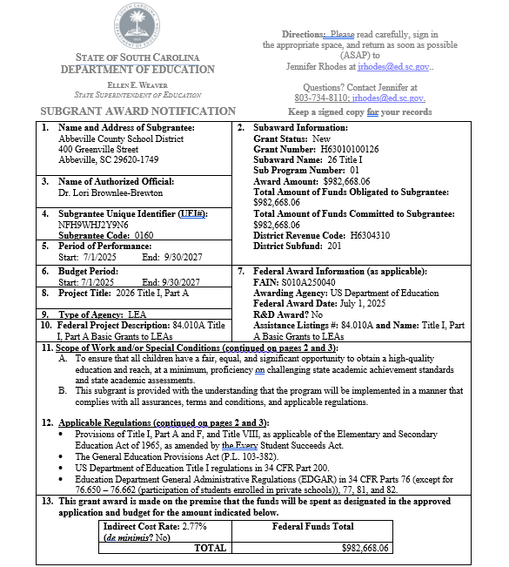
Have you seen this?
Scope of Work and/or Special Conditions
Applicable Regulations
Award amount section
Notes:
Subgrant award notification. The scope of work sets the plan; all of the regulations and laws referenced in the applicable regulations apply to your subaward, as do the agency’s terms and conditions for federal subawards. It’s important to understand how they apply. And it is very important that you review these and ensure that your Finance Department can comply with the terms in this agreement because it is…

Slide 22
Subgrant Award
Legally binding contract in which subgrantee agrees to
  Act with integrity:
    using funds as outlined in award
    reporting actual use of funds
  Properly track use of funds.
Notes:
…essentially a legally binding contract. Your district – as the subgrantee – is obligated to use the subgrant funds as outlined in the agreement and to act with integrity when making decisions about using the funds and reporting on how your actual use of the funds. As a subgrantee, you are also obligated to properly track the use of funds and maintain adequate supporting documentation. This is your primary resource; it will guide you to what you need to know, but understand that a lot of information is there by reference – which means you have to go to another source for the details.

Slide 23
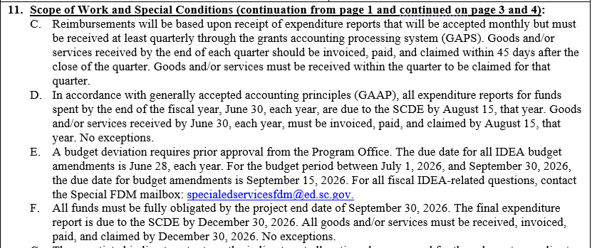
11. Scope of Work/Special Conditions

Slide 24
Subgrant Award Binds Subgrantee to
Maintain adequate supporting documentation
  All expenditures (POs, proof of purchase, journal entries)
  All procurements (procurement history, contractor monitoring)
  Inventory control
Follow SCDE’s Guidelines for Retaining Documentation to Support Expenditures
Notes:
…essentially a legally binding contract. Your district – as the subgrantee – is obligated to use the subgrant funds as outlined in the agreement and to act with integrity when making decisions about using the funds and reporting on how your actual use of the funds. As a subgrantee, you are also obligated to properly track the use of funds and maintain adequate supporting documentation. This is your primary resource; it will guide you to what you need to know, but understand that a lot of information is there by reference – which means you have to go to another source for the details.

Slide 25
Agenda 3
SCDE’s Assurances and Terms and Conditions

Slide 26
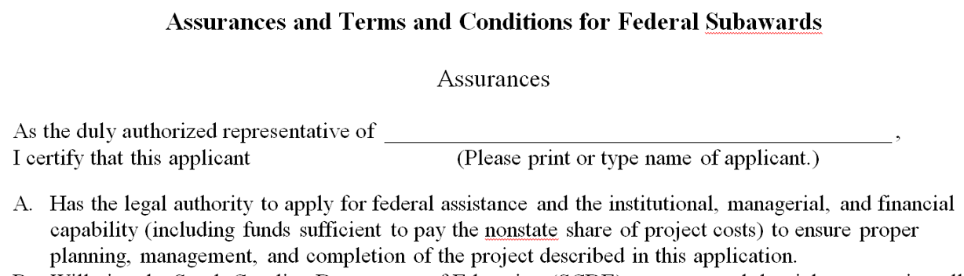
SCDE’s Assurances and Terms and Conditions for Federal Subawards/State Awards
Legally binding
“Promises” school district (LEA) makes
Updated at least annually.

Slide 27
Assurance C: School District has
Accounting system with
  Sufficient internal controls
  Clear audit trail
  Written cost-allocation procedures
Financial management system that
  Distinguishes expenditures
  Identifies costs by programmatic year/budget line item
  Differentiates direct, indirect, administrative costs.
Notes:
Assurance C is about your district’s accounting system and financial management system – these are the basics that both your accounting system and your financial management system must have to manage government grant funds.

Slide 28
Assurance C, continued: School District will
Maintain adequate supporting documents
  expenditures
  in-kind contributions
Show and support a cost
  in books or records (disbursement ledger, journal, payroll register)
  by source documents (receipt, travel voucher, invoice, bill, in-kind voucher).

Slide 29
Selected Terms and Conditions
F. Submit expenditure claims at least quarterly (also an award Scope of Work item)
I. Provide for accurate and timely recording of receipts and expenditures
J. Do not exceed state limits on lodging, per diem, and mileage
L. Submit all reports (programmatic, financial, evaluation) by deadline and in prescribed format.

Slide 30
More Terms and Conditions
O. Single audit required for entities expending $1,000,000 or more in federal funds
P. Retain all records for minimum of six (6) years after closeout (after final reports submitted and SCDE closes account; not project end date).

Slide 31
Remember: Retain Records for Six Years after Close-out
Example: Subaward ends September 30, 2026
LEA’s full closeout documentation to SCDE – 90 days later (by December 30, 2026)
  LEA’s retention “clock” starts December 30, 2026
  Add six years: retention period ends December 30, 2032

Slide 32

Assurances and Terms and Conditions
READ IT!
Program manager
ALL signatories
Finance staff
“Can I use grant funds for…?”
Notes:
So, why am I pointing out all of this – to reinforce the need for more people in your district to read this document and understand it. Not only should the program manager read and understand it, but all the signatories and your finance staff who is working with the subgrant funds. The assurances and terms and conditions are designed to support your compliance with federal regulations and will be one of the tools in your tool box to address questions like (on slide) when someone comes to you wanting to use Title I funds for unallowable expenses (i.e., things not in your approved plan).

Slide 33
Agenda 4
Waste, Fraud, and Abuse

Slide 34

Federal Reliance on State and Local Governments
In federal fiscal year 2025,
an estimated $1.2 trillion
went to state and local governments for
federal benefit programs and grant programs.
Notes:
Estimate from the federal government accountability office (GAO). “The federal government provided an estimated $1.2 trillion in assistance to state and local governments in fiscal year 2025. Each year, this funding helps support services, including transportation, education, and community development. There are many reasons for, and benefits to, administering federal programs at the state level. However, the reliance on nonfederal agencies to distribute payments, make eligibility decisions, and conduct oversight can heighten fraud risks.” It also increases the risks of waste and abuse as well. So let’s look at these separately, starting with waste (next slide).

Slide 35
Waste
Squandering money or resources, even if not explicitly illegal.
For example:
Buying overpriced equipment from a favored vendor
Buying unnecessary equipment
Notes:
The US Government Accountability Office – the GAO – defines waste…

Slide 36
Example of District Waste
Desk audit found unaccountable Title I inventory totaling $20,000
Resulting site visit: 3 schools
Accounted for all but approximately $900
District inventory clerk and some principals failed to follow written procedures for inventory control
District had to return approximately $900.
Notes:
A desk audit prompted a site visit to three schools because the district couldn’t account for $20,000 worth of inventory.
The visit uncovered two things: all but $900 of the inventory and that the district’s internal control for inventory was flawed. Staff were not following written procedures, including the district’s inventory clerk and new principles were not being trained in the correct procedures for inventory control. As a result, the district has to return the unaccounted for funds ($900) and they’re on the program office’s radar regarding all their internal control processes. So this is both an example of waste and what happens when internal controls are not working properly.

Slide 37
Fraud
The intentional, unlawful acquisition of benefits (funding, property and/or services) by committing wrongful acts adversely affecting government programs and operations.
Only the judicial system can determine whether an act is indeed fraud.
Notes:
Definition from the US Government Accountability Office
Important to keep in mind that only the judicial system can determine whether something is fraud. (Presumption of innocence is a critical factor of our judicial system.)

Slide 38
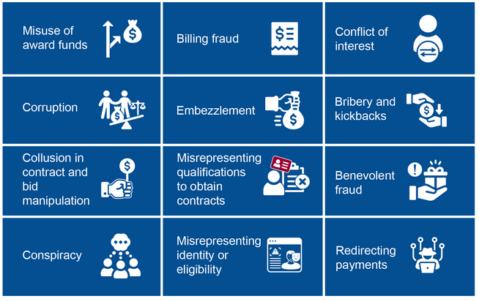
Examples of General Fraud Risks in Federally Funded, State-Administered Programs
Combating Fraud: Managing Risks in Federally Funded, State-Administered Programs | U.S. GAO
Notes:
From the US Government Accountability Office from a study published in July titled Combating Fraud: Managing Risks in Federally Funded, State-Administered Programs

Slide 39
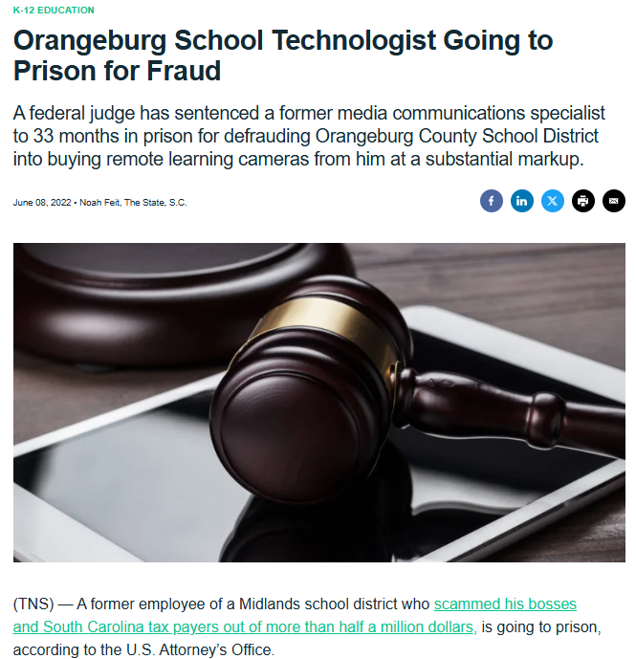
Fraud Example: District
Media Communications Specialist
Used shell companies, fabricated documents, forged signatures and false identity
Stole $550,000
Other school district employees discovered scheme, confronted him, and reported it to the FBI
Judicial system
33 months imprisonment followed by 3-years of court-ordered supervision
Ordered to pay approximately $600,000 in restitution

Slide 40
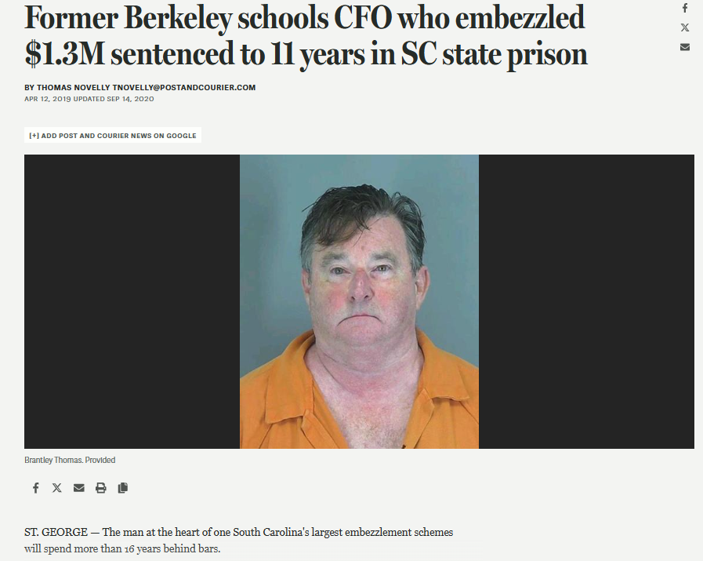
Fraud Example: District Chief Financial Officer
Rebate scheme: overpaid entities and diverted rebate checks to his personal account
Stole $1.3M
While out on bond, stole $36,000 from jewelry business that hired him as a bookkeeper
Judicial system
State (11 years) and federal sentences (63 months) to be served consecutively
Ordered to pay restitution
  $939,654.94 to school district
  $36,657.23 to jewelry business
Judge signed Notice of Lien requiring any benefit payable to him from state retirement account to be paid to school district until state restitution amount is satisfied

Slide 41
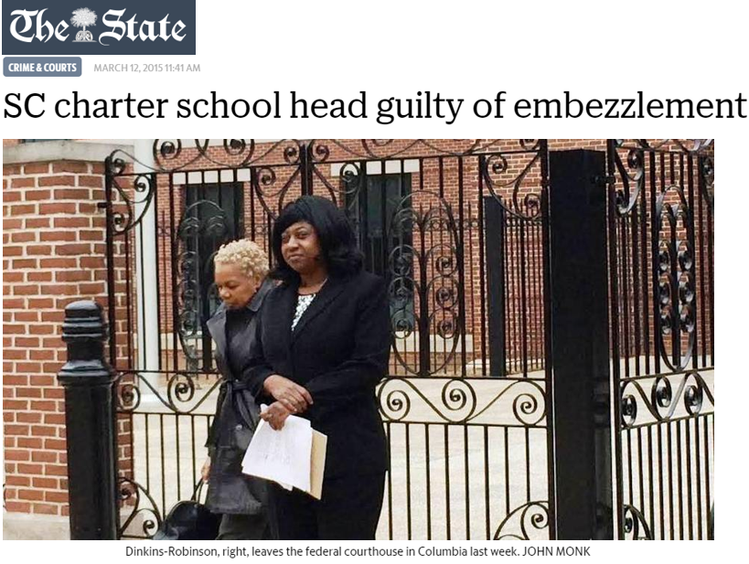
Fraud Example: Director of M.L. Dinkins Charter School
Created 4 shell companies & paid them USED Title I, Title II, and USDA child nutrition funds for services never rendered and goods never received
Stole $1.5 million
Judicial system
Convicted in federal court (jury trial)
Served 3.5 years in federal penitentiary
Ordered to pay restitution to USED and USDA
Forfeiture of house and five annuity accounts established with stolen funds

Slide 42
Abuse
Behaving improperly or unreasonably or misusing one’s position or authority.
Notes:
Another definition from the US Government Accountability Office; this definition can help you if you suspect something fishy is going on. Investigate abuse, use the word abuse, and if you uncover fraud, then you were correct in your suspicions.

Slide 43

Examples: Abuse of Title I Funds
Districts had to reimburse Title I funds:
$38,000 expended for a “team building” event at Kiawah Island
Salary and benefits for Title I coordinator who, in district’s Title I plan, spent 85% of time on Title I, but really spent < 15%.
Notes:
Here are two instances of “abuse” of federal Title I funds: one district had to reimburse title I funds that were used to take the team to a Kiawah Island spa. Another district was misrepresenting how much time the Title I coordinator was spending on Title I activities and had to reimburse funds for the difference, which was 70%. I encourage you -- get to know section 303 of the Uniform Grant Guidance regulations, which begins with “The non-federal entity must (a) Establish and maintain effective internal control over the federal award that provides reasonable assurance that the non-federal entity is managing the federal award in compliance with federal statutes, regulations, and the terms and conditions of the federal award.” It goes on from there and states that you must “take prompt action” – their words – “take prompt action when instances of noncompliance are identified including noncompliance identified in audit findings.”

Slide 44
Possible Abuse Indicators
Unilaterally redirecting use of funds in a manner different than outlined in subaward or approved plan
Failing to adequately account for, track, or support transactions.
See 2 CFR Part 200.303 Internal Controls.
Notes:
The items in your approved plan for a subgrant are what is allowable. If you misrepresent those items, that’s abuse. I shouldn’t have to tell you that appearances are everything, and if you’re doing things like using funds for purposes outside of your approved plan and the terms of your subaward, it can appear to be abuse of fund (if not fraud). Likewise, if you do not keep adequate records to support how you’re spending the subgrant funds, it will look like you’re hiding something that could be abuse (or worse: fraud).

Slide 45

How to Mitigate Risks
What do you do?
Notes:
Theft is the most common issue in almost all organizations, including those managing federal grant funding. People who embezzle funds can be extremely creative and appear very trustworthy – precisely why they can do so much damage to an organization and remain undetected for extended periods of time. (Handout with more details)

Slide 46
Mitigate Risks through Internal Controls
Maintain a well designed and tested system of internal controls.
Internal controls are policies, procedures, and processes that help organizations operate effectively and responsibly.
These controls promote compliance, safeguard assets, support accurate financial reporting, and align day-to-day operations with organizational goals.

Slide 47
Identify Weaknesses
Examine operations to determine vulnerabilities
  Finance (payroll, time & effort recordkeeping)
  Procurement
  P-Card policy and procedures
  Gift card policy and procedures
Notes:
These are some ways to mitigate the risk of waste, fraud, and abuse of federal funds and the first is a strong system of internal controls. Checks routinely written to employees as “reimbursement” of expenses and the use of ATM/Debit/Credit Cards (even gift cards) must be carefully controlled and require robust oversight.

Slide 48

Questions?

Slide 49
Contact Us
SCDE Office of Grant Services
Grants@ed.sc.gov (803) 734-5810
Audrey Shifflett, Director
Lashaundra Dubose, Program Manager
Tina Thomas, Program Coordinator

Slide 50
ed.sc.gov
Notes:
Slide title is hidden from display

