Slide 1


Grants Management Overview
Finance Bootcamp
Audrey H. Shifflett, Office of Grant Services
August 22, 2025
Notes:
Slide title should be Aptos Bold font, left-aligned, not smaller than 44pt
Audience – To whom/group you are presenting to
Speaker – Who is giving the presentation (may be by name or by department)
Date – Date of presentation

Slide 2
Agenda
1 Expectations for Grants Management
2 Policies and Procedures
3 SCDE’s Assurances and Terms and Conditions
4 Waste, Fraud, and Abuse
Notes:
Left aligned
Title font is 88pt
Numbered line item 66 pt
Detail/slide item 36 pt

Slide 3

Disclaimer
This presentation is to help you understand subgrant requirements and federal regulations, including portions of 2 CFR Part 200 Uniform Administrative Requirements, Cost Principles, and Audit Requirements for Federal Awards (a.k.a. Uniform Grant Guidance or UGG).
Notes:
I like to start with this disclaimer – because the information I’m going to share today about grants management and requirements includes federal regulations and our agency’s requirements, but …

Slide 4

Disclaimer, continued
This presentation is not a substitute for reading
subgrant award
program-specific assurances
SCDE’s Assurances and Terms & Conditions for Federal Subawards
applicable federal regulations.
Notes:
It’s important that you understand that what I’m presenting today is not a substitute for you reading the grant awards issued to your district and all the related documents – the assurances and terms and conditions, and the federal regulations or state laws that apply to the contractual agreements your district has entered into. And that’s what a grant or subgrant is – it is a concstractual agreement between our SCDE and your school district. Quickly, just a show or hands –how many of you have had experience with grants?

Slide 5
Agenda 1
Expectations for Grants Management

Slide 6
School Districts (a.k.a. LEAs) are Expected to
Adhere to all funding requirements
Have adequate internal control systems
Comply with state laws, federal laws, and regulations
Meet performance expectations
Meet all reporting requirements (i.e., reports are accurate, complete, and submitted on time).
Notes:
Here are the grant management expectations that the state has for school districts. This may not be the first time you’ve seen these during this boot camp and it probably is not the last time you’ll see them – They’re the five expectations of school districts [slide contents]. All of these expectations are grounded in law, regulations, or terms of a contract.

Slide 7
Grant Manager’s Role
Manage administration of a specific grant/subgrant program:
Programmatic activities to achieve proposed goals and objectives
Financial activities to achieve prudent fiscal management of funds
Record keeping activities to ensure accurate documentation
Compliance activities to fulfill all program requirements, including accurate reporting and close out.
Notes:
It’s important for you to understand the grant manager’s role.

Slide 8
Finance Officer’s Role
Oversee financial management of district’s grants and subgrants
Compliance activities that meet award terms and standards in 2 CFR Part 200, especially §§200.302–330, including accurate reporting and close out
Financial activities to achieve prudent fiscal management
Record keeping activities to ensure accurate documentation.
Notes:
It’s also important for you to understand the financial officer’s role in grants management. Your overall role is to support your grant managers so that the district succeeds overall.

Slide 9

Who complies with what?
“…all nonfederal entities that work with federal funding must comply with the laws, authorities, regulations and policies that govern those funds.”
—Thompson Federal Grants Development Module, Tab 100

Slide 10

Federal Laws, Regulations, and Guidance
Congress creates and President signs laws
Federal Agency issues program regulations to implement and enforce laws
Office of Management and Budget (OMB) issues regulations (cross-cutting)
Federal Agency creates guidance to clarify regulations and issues letter & memos for more info
Public inspection required for regulations; see Federal Register www.federalregister.gov

Slide 11
Example: Title I Hierarchy of Requirements
84.010 Title I Part A Basic Grants to LEAs
Law: Elementary and Secondary Education Act
Regulations: 34 CFR 200 (program-specific) EDGAR (agency-specific), 2 CFR Parts 25, 170, 180 (cross-cutting)
US Department of Education (USED) Non-regulatory Guidance on Title I
USED Dear Colleague Letter on Title I Resource Equity

Slide 12
Agenda 2
Policies and Procedures of a Pass-through Entity (like the SCDE)

Slide 13

Pass-through Entity: SC Department of Education (SCDE)
Primary Grantee
Receives grant from federal agency
Must comply with authorizing law, applicable regulations, guidance, etc.
Makes subgrants to eligible entities (subgrantees) in compliance with laws and regulations
See 2 CFR Part 200.332 Requirements for pass-through entities for more information.
Notes:
If you are new to grants management, or even if you are not, understanding the policies and procedures of a pass-through entity can be challenging

Slide 14

SCDE: Pass-through Entity Issues Subawards
Complies with laws & regulations
Adds limits compliant with
State laws
State-level program requirements
Must oversee and account for subgrants
Risk assessment
Monitoring
Audits
SUBGRANTEE
SCDE
Notes:
If you are new to grants management, or even if you are not, understanding the policies and procedures of a pass-through entity can be challenging

Slide 15
SCDE passes through to Subgrantee
State Laws, Provisos, Regulations
Per diem
Procurement
Assurances and Terms and Conditions for Federal Subawards
Audit
Recordkeeping
Time and Effort
Federal requirements
SUBGRANTEE
SCDE

Slide 16
Subgrantee
Local Education Agency (LEA) i.e., school district
Secondary grantee
Receives subgrant award
Must comply with subaward terms (including pass-through entity’s applied limits)
Must comply with Assurances and Terms and Conditions
SUBGRANTEE
SCDE

Slide 17
Must Comply with
“It is therefore incumbent upon grant applicants, turned grant recipients, not only to meet the terms and conditions of the award agreement, but also to meet the requirements of law, statutes, policies, procedures and all pertinent regulations.”
—Thompson Federal Grants Development Module, Tab 400
Program requirements
Assurances and Terms and Conditions
Regulations
Laws

Slide 18
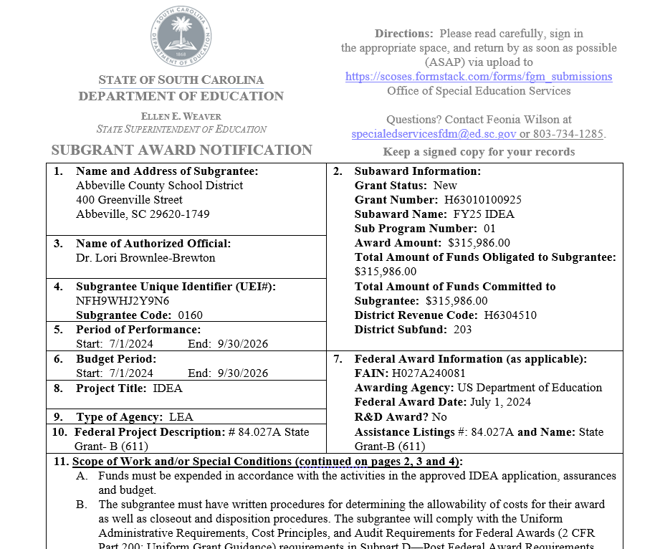
Have you seen this?
11 - Scope of Work and/or Special Conditions
12 - Applicable Regulations
13 – Award amount section
Notes:
Subgrant award notification. The scope of work sets the plan; all of the regulations and laws referenced in the applicable regulations apply to your subaward, as do the agency’s terms and conditions for federal subawards. It’s important to understand how they apply. And it is very important that you review these and ensure that your Finance Department can comply with the terms in this agreement because it is…

Slide 19
Subgrant Award
Legally binding contract in which subgrantee agrees to
Act with integrity when
using funds as outlined in award
reporting actual use of funds
Properly track use of funds.
Notes:
…essentially a legally binding contract. Your district – as the subgrantee – is obligated to use the subgrant funds as outlined in the agreement and to act with integrity when making decisions about using the funds and reporting on how your actual use of the funds. As a subgrantee, you are also obligated to properly track the use of funds and maintain adequate supporting documentation. This is your primary resource; it will guide you to what you need to know, but understand that a lot of information is there by reference – which means you have to go to another source for the details.

Slide 20
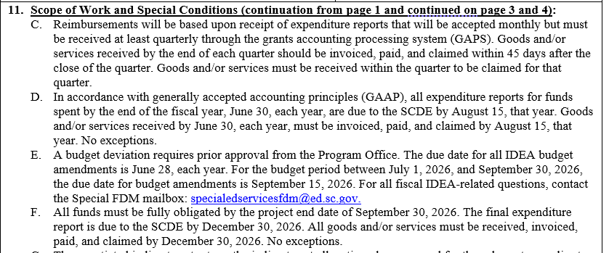
11 – Scope of Work/Special Conditions

Slide 21
Subgrant Award Binds Subgrantee to
Maintain adequate supporting documentation
All expenditures (POs, proof of purchase, journal entries)
All procurements (procurement history, contractor monitoring)
Inventory control
Follow SCDE’s Guidelines for Retaining Documentation to Support Expenditures
Notes:
…essentially a legally binding contract. Your district – as the subgrantee – is obligated to use the subgrant funds as outlined in the agreement and to act with integrity when making decisions about using the funds and reporting on how your actual use of the funds. As a subgrantee, you are also obligated to properly track the use of funds and maintain adequate supporting documentation. This is your primary resource; it will guide you to what you need to know, but understand that a lot of information is there by reference – which means you have to go to another source for the details.

Slide 22
Agenda 3
SCDE’s Assurances and Terms and Conditions

Slide 23
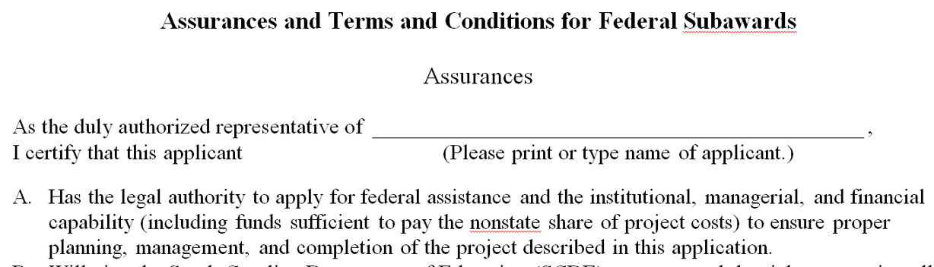
SCDE’s Assurances and Terms and Conditions for Federal Subawards/State Awards
Legally binding
“Promises” school district (LEA) makes
Updated at least annually.

Slide 24
Assurance C: School District has
Accounting system with
Sufficient internal controls
Clear audit trail
Written cost-allocation procedures
Financial management system that
Distinguishes expenditures
Identifies costs by programmatic year/budget line item
Differentiates direct, indirect, administrative costs.
Notes:
Assurance C is about your district’s accounting system and financial management system.

Slide 25
Assurance C, continued: School District will
Maintain adequate supporting documents
expenditures
in-kind contributions
Show and support a cost
in books or records (disbursement ledger, journal, payroll register)
by source documents (receipt, travel voucher, invoice, bill, in-kind voucher).

Slide 26
Assurance P: School District will comply
Executive Order 13513 “Federal Leadership on Reducing Text Messaging While Driving”
Do not text message while driving during official (sub)grant-related business.
Subaward scope of work restricts emailing while driving during official (sub)grant-related business.

Slide 27
Selected Terms and Conditions
F. Submit expenditure claims at least quarterly (also a subaward Scope of Work item)
I. Provide for accurate and timely recording of receipts and expenditures
J. Do not exceed state limits on lodging, per diem, and mileage
L. Submit all reports (programmatic, financial, evaluation) by deadline and in prescribed format.

Slide 28
More Terms and Conditions
O. Single audit required for entities expending $750,000 (updated 2024: $1,000,000) or more in federal funds
P. Retain all records for minimum of six (6) years after closeout (after final reports submitted and SCDE closes account; not project end date).

Slide 29

Assurances and Terms and Conditions for Federal Subawards
READ IT!
Program manager
ALL signatories
Finance staff
“Can I use grant funds for…?”
Notes:
So, why am I pointing out all of this – to reinforce the need for more people in your district to read this document and understand it. Not only should the program manager read and understand it, but all the signatories and your finance staff who is working with the subgrant funds. The assurances and terms and conditions are designed to support your compliance with federal regulations and will be one of the tools in your tool box to address questions like (on slide) when someone comes to you wanting to use Title I funds for unallowable expenses (i.e., things not in your approved plan).

Slide 30
Agenda 4
Waste, Fraud, and Abuse

Slide 31
Waste
Squandering money or resources, even if not explicitly illegal.
For example:
Buying overpriced equipment from a favored vendor
Buying unnecessary equipment for personal use or gain.
Notes:
The US Government Accountability Office – the GAO – defines waste…

Slide 32
Example of District Waste
Desk audit found unaccountable Title I inventory totaling $20,000
Resulting site visit: 3 schools
Accounted for all but approximately $900
District inventory clerk and some principals failed to follow written procedures for inventory control
District had to return approximately $900.
Notes:
A desk audit prompted a site visit to three schools because the district couldn’t account for $20,000 worth of inventory.
The visit uncovered two things: all but $900 of the inventory and that the district’s internal control for inventory was flawed. Staff were not following written procedures, including the district’s inventory clerk and new principles were not being trained in the correct procedures for inventory control. As a result, the district has to return the unaccounted for funds ($900) and they’re on the program office’s radar regarding all their internal control processes. So this is both an example of waste and what happens when internal controls are not working properly.

Slide 33
Fraud
Attempting to obtain something of value through willful misrepresentation.
Only the judicial system can determine whether an act is indeed fraud.
Notes:
Definition from the US Government Accountability Office
Important to keep in mind that only the judicial system can determine whether something is fraud. (Presumption of innocence is a critical factor of our judicial system.)

Slide 34
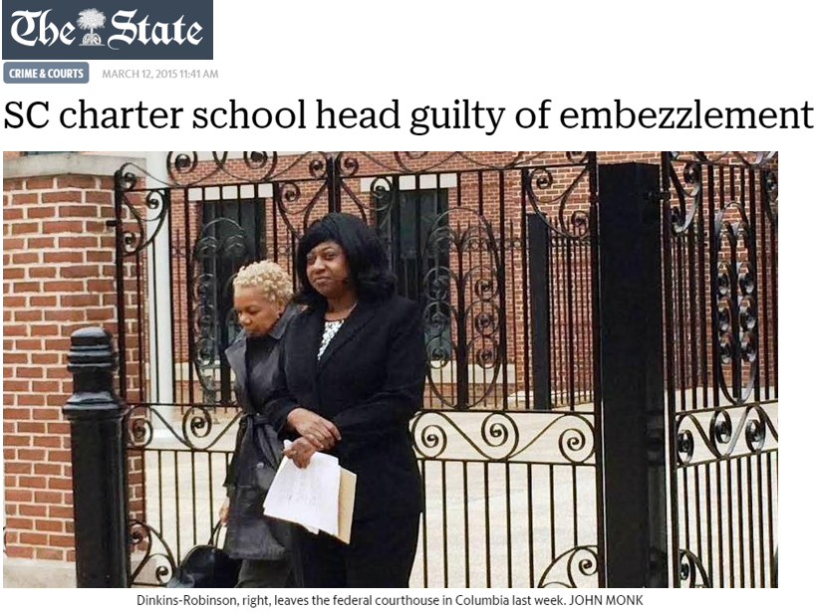
Example of Fraud
Director of M.L. Dinkins Charter School
Created 4 shell companies & paid them USED Title I and USDA child nutrition funds
$1.5 million
Judicial system
Convicted in federal court (jury trial)
Served 3.5 years in federal penitentiary

Slide 35
Abuse
Behaving improperly or unreasonably or misusing one’s position or authority.
Notes:
Another definition from the US Government Accountability Office; this definition can help you if you suspect something fishy is going on. Investigate abuse, use the word abuse, and if you uncover fraud, then you were correct in your suspicions.

Slide 36

Examples: Abuse of Title I Funds
Districts had to reimburse Title I funds
$38,000 expended for a “team building” event at Kiawah Island
Salary and benefits for Title I coordinator who, in district’s Title I plan, spent 85% of time on Title I, but really spent < 15%.
Notes:
Here are two instances of “abuse” of federal Title I funds: one district had to reimburse title I funds that were used to take the team to a Kiawah Island spa. Another district was misrepresenting how much time the Title I coordinator was spending on Title I activities and had to reimburse funds for the difference, which was 70%. I encourage you -- get to know section 303 of the Uniform Grant Guidance regulations, which begins with “The non-federal entity must (a) Establish and maintain effective internal control over the federal award that provides reasonable assurance that the non-federal entity is managing the federal award in compliance with federal statutes, regulations, and the terms and conditions of the federal award.” It goes on from there and states that you must “take prompt action” – their words – “take prompt action when instances of noncompliance are identified including noncompliance identified in audit findings.”

Slide 37
Possible Abuse Indicators
Unilaterally redirecting use of funds in a manner different than outlined in subaward or approved plan
Failing to adequately account for, track, or support transactions.
See 2 CFR Part 200.303 Internal Controls.
Notes:
The items in your approved plan for a subgrant are what is allowable. If you misrepresent those items, that’s abuse. I shouldn’t have to tell you that appearances are everything, and if you’re doing things like using funds for purposes outside of your approved plan and the terms of your subaward, it can appear to be abuse of fund (if not fraud). Likewise, if you do not keep adequate records to support how you’re spending the subgrant funds, it will look like you’re hiding something that could be abuse (or worse: fraud).

Slide 38

How to Mitigate Risks
What do you do?
Notes:
Theft is the most common issue in almost all organizations, including those managing federal grant funding. People who embezzle funds can be extremely creative and appear very trustworthy – precisely why they can do so much damage to an organization and remain undetected for extended periods of time. (Handout with more details)

Slide 39
Mitigate Risks through Internal Controls
Maintain a well designed and tested system of internal controls
Notes:
These are some ways to mitigate the risk of waste, fraud, and abuse of federal funds and the first is a strong system of internal controls. Checks routinely written to employees as “reimbursement” of expenses and the use of ATM/Debit/Credit Cards (even gift cards) must be carefully controlled and require robust oversight.

Slide 40
Identify Weaknesses
Examine operations to determine vulnerabilities
Finance (payroll, time & effort recordkeeping)
Procurement
P-Card policy and procedures
Gift card policy and procedures
Notes:
These are some ways to mitigate the risk of waste, fraud, and abuse of federal funds and the first is a strong system of internal controls. Checks routinely written to employees as “reimbursement” of expenses and the use of ATM/Debit/Credit Cards (even gift cards) must be carefully controlled and require robust oversight.

Slide 41

Questions?

Slide 42
Contact Us
SCDE Office of Grant Services
Grants@ed.sc.gov (803) 734-5810
Audrey Shifflett, Director
Lashaundra Dubose, Program Manager
Tina Thomas, Program Coordinator

Slide 43
ed.sc.gov
Notes:
Slide title is hidden from display

