Slide 1

Subrecipient Risk Assessment
Finance Boot Camp
Hershula Davis
Director, Office of Auditing Services
August 20, 2026
Notes:
Slide title should be Aptos Bold font, left-aligned, not smaller than 44pt
Audience – To whom/group you are presenting to
Speaker – Who is giving the presentation (may be by name or by department)
Date – Date of presentation

Slide 2
Subrecipient Risk Assessment Regulation
2 CFR Part 200.332(b) requires evaluation of a subrecipient’s risk of noncompliance with federal statutes, regulations, and terms and conditions of a subaward
LEAs are rated on 10 criteria
Federal program officers rate subrecipients on criteria 1-6
  Annually, an interrater reliability meeting is held to ensure program offices are rating subrecipients consistently
The Office of Finance rates subrecipients on criteria 1,2,4, and 6
The Office of Auditing Services rates subrecipients on criteria 7-10

Slide 3
SCDE’s Subrecipient Risk Assessment Process
Ratings from each of the first six criteria are averaged to get an overall risk rating for each criteria
The average ratings from the six criteria are then totaled with the ratings from criteria 7-10 to get a total risk score
Based on the total risk score, subrecipients are designated as overall low, medium, or high risk
Overall risk scores are communicated with the SCDE’s UGG administrative workgroup, comprised of members from the Offices of Finance, Auditing Services, General Counsel, and Grants
Risk scores are then communicated with the federal program officers and senior staff
Overall risk scores can be used to:
  Assist with making decisions on awarding federal subgrants
  Place specific conditions on federal awards

Slide 4
Ten Risk Criteria

Slide 5
Ten Risk Criteria – Part 1
Criteria 1 – Key Personnel Turnover
  Experience of key personnel
  Stability of key personnel
  Turnover in key personnel
Criteria 2 – Required Reporting
  Required program reporting submitted and timeliness of submission
Criteria 3 – Programmatic Compliance
  Instances of programmatic noncompliance
  Minimal or significant deficiencies noted
Criteria 4 – Fiscal Compliance
  Level of fiscal deficiencies noted during monitoring visits
Criteria 5 – Performance
  Were performance requirements, expectations, and outcomes met?
Criteria 6 – Technical Assistance
  Frequency and need for technical support and assistance

Slide 6
Ten Risk Criteria – Part 2
Criteria 7 – Financial Stability
  The percentage of general fund unrestricted fund balance to general fund total expenditures
Criteria 8 – Quality of Management Systems
  Internal control findings or federal award noncompliance findings noted in the annual audit report
Criteria 9 – Audit Report Submission
  Submission of annual audit in the LEA Audit Reporting System (LARS) by December 1st
Criteria 10 – Other Material Factors
  Accreditation
  Cheating/Test security violations
  Other know issues (state program violations, etc.)
**All criteria do not carry the same weight**
  Fiscal Compliance, Financial Stability, and Quality of Management Systems carry the greatest weight
  Timeliness of the annual audit submission carries the lowest weight

Slide 7
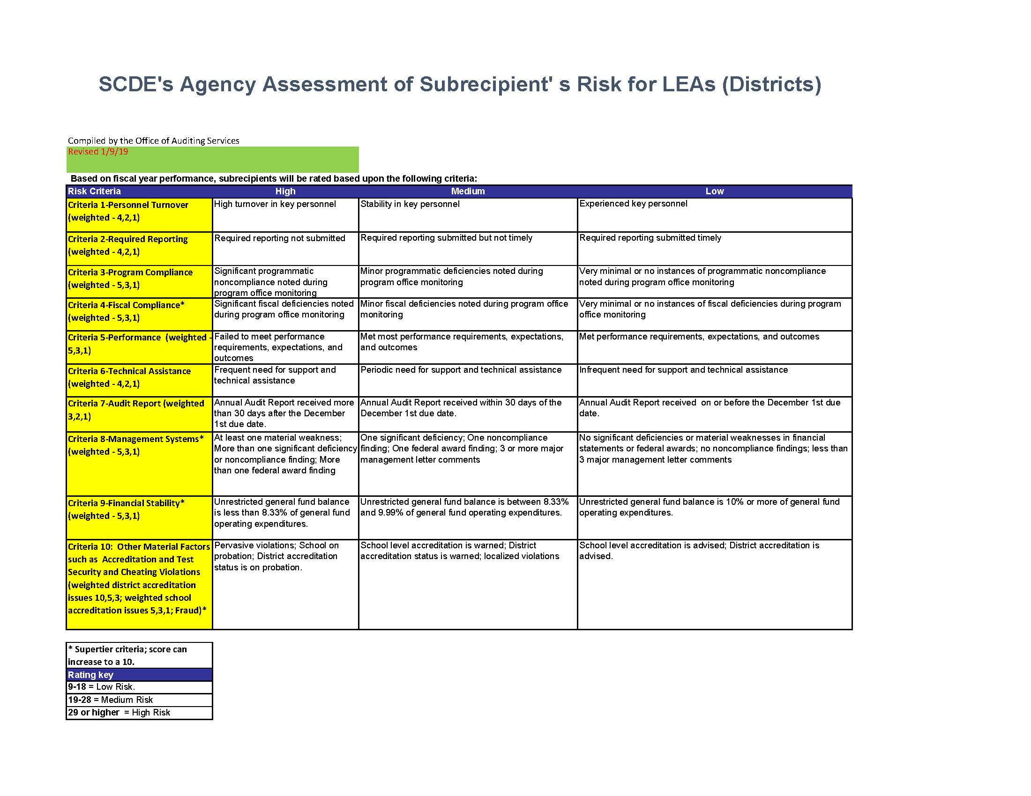
Ten Risk Criteria

Slide 8
Notification of Risk Scores

Slide 9
Notification of Risk Scores By Scale
Risk score scale:
  Overall risk score 9 – 18 Low risk
  Overall risk score 19 – 28 Medium risk
  Overall risk score 29+ High risk
If your entity has an overall risk score of low or medium, Office of Auditing Services will distribute correspondence communicating the district’s risk score to the district’s superintendent, chief finance officer, federal program director, and school board chair
If your district is determined to be at risk of noncompliance (high risk), notification of the district’s status will be communicated directly by the Office of the State Superintendent. The district’s superintendent, chief finance officer, federal program director, and school board members will be notified.

Slide 10
How Can I Lower My Score?
Submit all required reports, both financial and programmatic, on time
Ensure all new personnel are high quality and are properly trained
Understand all programmatic regulations, requirements, performance measures, and expected outcomes, and comply
Ensure all costs charged to federal programs are allowable
Submit at least quarterly expenditure reports in GAPS
Document all policies and procedures related to financial management
Ensure proper segregation of duties
Maintain sufficient operating funds
Correct all accreditation deficiencies
Ensure test security procedures are followed
Strengthen internal controls to reduce audit findings

Slide 11
SCDE Subrecipient Risk Assessment Procedures
Link to procedures:
Subrecipient Risk Assessments - South Carolina Department of Education

Slide 12
Questions

Slide 13
Contact
Hershula Davis
Director, Office of Auditing Services
(803) 734-6022
hdavis@ed.sc.gov
auditingservices@ed.sc.gov

