Slide 1
Procurement 101: South Carolina Department of Education Edition

Slide 2
What Is Procurement?
Procurement is the process by which state agencies acquire goods, services, construction, and IT using public funds (taxpayer dollars).
Procurement is governed by the South Carolina Consolidated Procurement Code and supporting regulations. Furthermore, procurement is also governed by Comptroller Generals Office policies, SC State Law, Federal regulatory rules and procedures like the Federal Acquisitions Regulation (FAR). Additionally, procurement is guided and uses as a benchmark the American Bar Association (ABA) Model Procurement Code and the Uniform Commercial Code (UCC).

Slide 3
Why Do We Have a Procurement Department?
Ensure fairness, transparency, and efficiency in public contracting.
Maximize the value of taxpayer dollars.
Promote broad-based competition.
Prevent fraud, waste, and abuse.

Slide 4

When Should Program Areas Involve Procurement?
You should involve the procurement department as early as possible; ideally at the concept stage, before any specifications are drafted

Slide 5
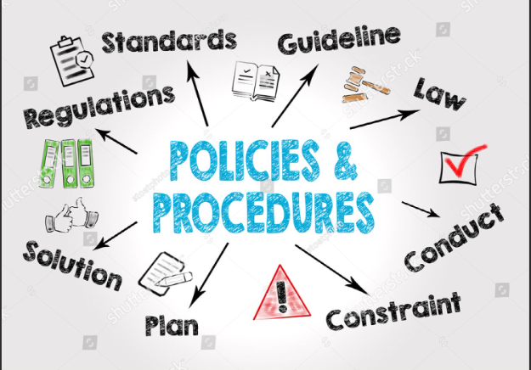
Who Has Regulatory Oversight?
State Fiscal Accountability Authority (SFAA)
  Oversees procurement policy and compliance.
  Implements rules and conducts oversight of agency operations.
Department of Procurement Services (DPS)
  Administers statewide term contracts and monitors procurement activity.

Slide 6
South Carolina Procurement Thresholds and Source Selection Methods
Title 11, Chapter 35 – SC Consolidated Procurement Code and Applicable Regulations
Thresholds are based on the total anticipated cost to the state – this means you must consider base price, shipping and handling, all applicable taxes and any other fees.
Purchases must not be divided to circumvent thresholds.
Even if a purchase qualifies as a small purchase under South Carolina’s Procurement Code, agencies can, and at times should, use more formal methods like Requests for Proposals (RFPs) or Invitation for Bids (IFBs).

Slide 7
Small Purchases
Purchases up to $100,000 may be considered a small purchase (11-35-1550). However, just because the Code permits small purchases up to $100,000 does not mean an agency may exceed its certification level.
Current SCDE certified procurement authority:
Supplies and Services $150,000
School Bus Supplies & Maintenance $400,000
Information Technology $100,000
Construction $50,000

Slide 8
Small Purchase Thresholds and Requirements
Purchases up to $10,000
Price must be fair and reasonable (just because it’s under 10K doesn’t mean price is fair and reasonable – you must make sure price is indeed fair and reasonable).
At least one quote is required.
Annotate “Price is fair and reasonable” on the PO.
Distribute repeat purchases among qualified suppliers.

Slide 9
Small Purchase Thresholds and Requirements – Part 2
Purchases between $10,000.01 – $25,000 OR for a small purchase of commercially available off-the-shelf products (COTS)* not in excess of one hundred thousand dollars, OR for a small purchase of construction not in excess of one hundred thousand dollars.
Three written quotes must be obtained from bona fide, responsive, and responsible vendors (you must send the request for quote in writing, and you must receive the responses in writing – so nothing verbal will count).
The request for quotes must include:
A clear and complete purchase description
Quotes must be retained in the procurement file for audit purposes.
Quotes may be requested and received via email, fax, mail, or secure electronic systems (e.g., SCEIS or agency-approved platforms).
Any applicable specifications, delivery requirements, or terms
*Commercially available off-the-shelf product" means supplies, other than printing, or information resources: that is a commercial product, as defined herein, that is sold in substantial quantities in the commercial marketplace; and is offered to the State, without modification, in the same form in which it is sold in the commercial marketplace. It does not include agricultural products, petroleum products, and other items customarily sold in bulk.

Slide 10
Small Purchase Thresholds and Requirements – Part 3
  The method of communication should ensure:
    Traceability (e.g., timestamped email)
    Confidentiality until award
    Equitable distribution among qualified suppliers
  When practical, solicit quotes from vendors other than the previous supplier to promote competition.
  SCBO is not required for purchases under $25,000. However, agencies may voluntarily advertise solicitations in SCBO to broaden vendor outreach or increase transparency. Also, if you advertise in SCBO and receive only one quote in response, you’re still able to proceed with that one quote
  SCBO becomes above $25,000, where public advertisement is required by law.

Slide 11
Small Purchase Thresholds and Requirements – Part 4
Purchases Between $25,000.01 – $100,000 (typically does not apply to construction as it is already covered in previous level above and if processed as above, SCBO ad isn’t necessarily needed)
Must be publicly advertised in SCBO.
Minimum 7 calendar day notice before due date.
Advertisement must include:
Description of the goods/services
How to obtain the solicitation/quote request
Response deadline
Delivery location (email, mail, SCEIS, etc.)
Award to lowest responsive and responsible source.

Slide 12
Small Purchase Thresholds and Requirements – Part 5
Over $100,000
Requires formal solicitation using an approved source selection method.

Slide 13

Source Selection Methods
Invitation for Bids (IFB) is the preferred procurement method. All procurement methods, other than an IFB require written a justification (you have to explain why an IFB won’t work to procure what you are trying to procure)
Market Research is required for ALL procurement methods (yes, including emergencies – to the extent possible) and documentation of the research must be kept in the file for auditing purposes.

Slide 14
Invitation for Bid (IFB) –
§11-35-1520
We know and will tell you exactly what we want and when and how to get there; just give us your best price!
  All specifications and requirements are fully known and defined - you know exactly what you’re buying, how much, and under what conditions.
  Vendors compete solely on price.
  Award goes to the lowest responsive and responsible bidder.

Slide 15
Competitive Sealed Proposals (RFP) –
§11-35-1530
We know what we want and when, but we need your help figuring out how to get there! Give us your solution and the price for the solution you are offering!
  Use this method when the desired outcome is clear, but the path to achieving it is not.
  You know what you want to accomplish, but need vendors to propose solutions, methods, or innovations to get there.
  Evaluation includes technical approach, experience, and other qualitative factors—not just price.

Slide 16
Competitive Fixed Price Bidding (FPB)– §11-35-1525
We know and will tell you exactly what we want and when and how to get there as well as how much/the max we’re willing to pay for it. If you agree with it all, simply complete page 1 and 2 of the solicitation document and return to us.
  Price is pre-established.
  Multiple vendors may be added post-award.

Slide 17
Sole Source Procurement – §11-35-1560
  Only one vendor available who can meet the specific needs of the agency.
  Market research demonstrates that potential alternatives were explored and evaluated as the current requirements and goals for a project were developed.
  Requires written justification explaining why no other vendor or contractor can adequately meet the specific needs.
  Requires public notice posted in the South Carolina Business Opportunities (SCBO) system.

Slide 18
Emergency Procurement – §11-35-1570 & Reg. 19-445.2110
Purchasing method used when an urgent situation makes it impractical to follow standard procurement procedures. Approval should be obtained from the Chief Procurement Officer or agency head/designee, when practical, prior to procurement
Emergency condition means an immediate threat to:
  The functioning of state government
  The preservation or protection of property
  The health or safety of any person
b) Emergencies may arise from:
  Natural disasters (e.g., floods, pandemics, hurricanes)
  Equipment or system failures
  Fire or loss of critical infrastructure
  Riots or other public safety threats
  Fiscal takeover of a school district
  Any other condition formally declared by the Chief Procurement Officer or agency head

Slide 19
(continued)
Emergency Procurement – §11-35-1570 & Reg. 19-445.2110
  c) The need cannot be met through normal procurement methods due to time constraints.
  d) Procurement must be limited to only those supplies, services, IT, or construction necessary to address the emergency.
  e) Market research must be conducted
  f) Competition must be sought to the extent practicable.
  g) Written determination is required, documenting:
    The nature of the emergency
    Why standard methods were impracticable
    The basis for selecting the contractor
  h) Notice requirements under §11-35-1570(B) must be followed and documented in the procurement file.

Slide 20
Other Ways to Procure
Statewide term contracts
Exemptions
NASPO (cooperative purchasing).
MMCAP (cooperative purchasing – medical)

Slide 21
Scope of Work & Solicitation Content - include the following components
a. Scope of Work - a detailed description of the tasks, deliverables, and responsibilities the vendor must complete if awarded the contract. It outlines what needs to be done, how it should be done, and when it must be completed
b. Information for Offerors to Submit
defines how vendors must structure their proposals to meet procurement requirements. It covers formatting rules (e.g., page limits, submission method), required documents, and content expectations for both technical and cost proposals.
The technical proposal directly addresses Section III – Scope of Work by explaining how the offeror will accomplish each required task/need/requirement listed in Section III, including their methodology, timeline, and resources. It should also detail the qualifications of key personnel and provide relevant experience that supports their ability to perform
c. Section VIII – Pricing - pricing must reflect the total cost of delivering the Scope of Work; not just unit rates or short-term estimates. Offerors should calculate costs based on actual needs, such as 1,000 licenses over 60 months, not one license or one month. Unit pricing may be included for clarity, but proposals must show the full cost of all required quantities and contract duration
d. Any other relevant solicitation sections (like if there are demonstrations, you’d need a demonstration script)

Slide 22
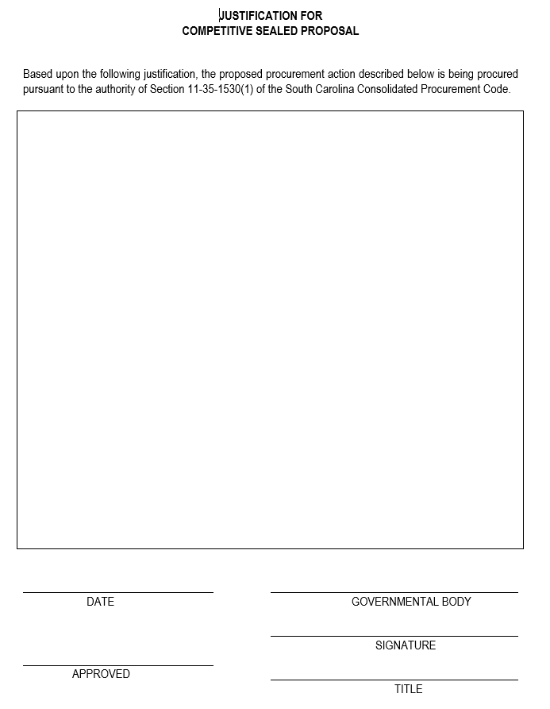
Justification for RFP
Complete form MMO#104 - access the form here https://procurement.sc.gov/osp/forms.

Slide 23
Multi-Year Justification
Required if the initial term of the contract exceeds one year
  Example: If your initial term is 2 years with 3 optional 1-year renewals, this form is required
Form asks that and explanation be provided of why the first term exceeds one year
Access the form here https://procurement.sc.gov/osp/forms.

Slide 24

Market Research
Before writing a scope of work agencies are required by code to perform market research. That means looking into what vendors offer, how much things cost, and how long they take to deliver. This helps you pick the right type of solicitation and write clear, realistic requirements that vendors can actually meet. It also helps avoid confusion, bad contracts, and wasted time. Good research leads to better results, fewer problems, and a smoother process from start to finish.
Label all documents clearly as “Market Research”
Include all research conducted in preparation for the procurement

Slide 25
Solicitation Request Form
Must be fully completed—every item is required – it is simple, and nothing should be left blank.
Access the form here https://procurement.sc.gov/osp/forms.
If it is not completed, we cannot process your request.

Slide 26
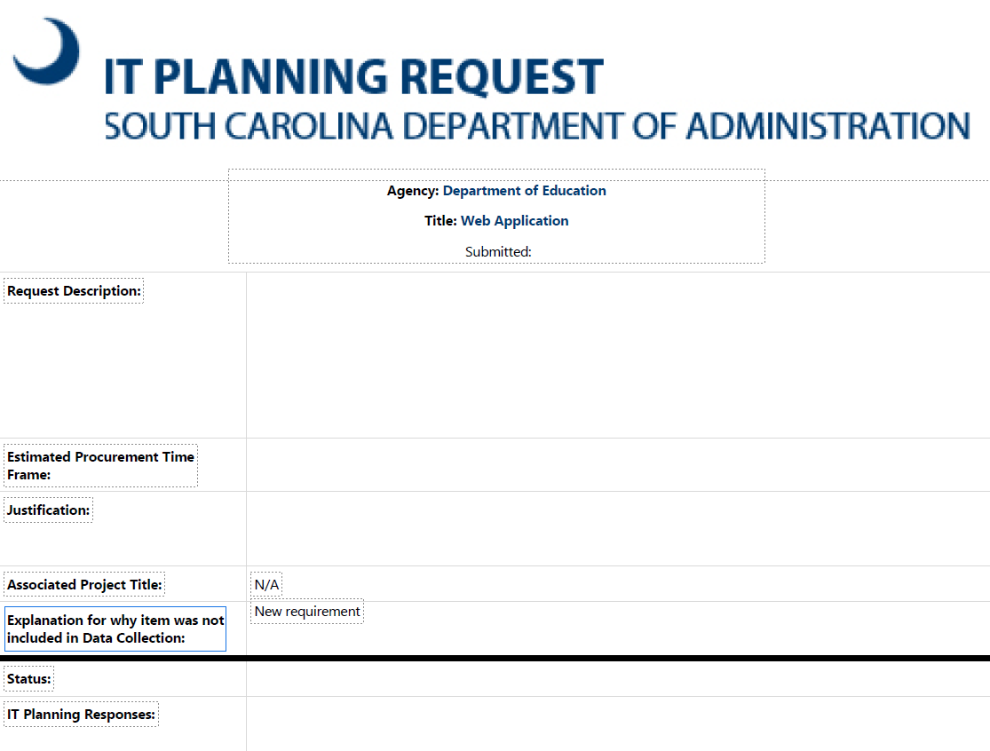
IT Plan (if applicable)
Required if the procurement is for IT or includes significant IT components
Required if over $50,000
Contact Jeff Henry for assistance
Must be the approved IT plan

Slide 27

Shopping Cart
Create a shopping cart with a $0.01 placeholder
Attach all completed documents to the cart
Label each file clearly so reviewers can identify contents WITHOUT opening them

Slide 28
P-Card Program – SC Department of Education
The SC Department of Education uses Purchasing Cards (P-Cards) to streamline small-dollar purchases for official business. These VISA cards, issued through Bank of America, are governed by statewide procurement rules and agency-specific controls as well as SC State Fiscal Accountability Authority (SFAA).
To receive a P-Card, an employee must be approved by their supervisor, complete required training (Level I, and Level II if applicable), and sign a Cardholder Agreement. The card is issued in the employee’s name and must be used only for official purchases. Cardholders are enrolled in the WORKS system for transaction tracking and reconciliation.

Slide 29

Spending Limits
Single transaction limit: $2,500
Superintendent must approve over $2,500 single transaction limit and purchases
Over $10,000 must be approved by SC Office Of State Procurement’s Chief Procurement Officer.
Cannot split transactions to bypass set limits

Slide 30

Example of Allowable Purchases
Office supplies, instructional materials, and small equipment
Professional services under the threshold
Travel expenses (only as permitted by agency policy)
Software, subscriptions, and licenses (with approval)
Hotel (only as permitted by agency policy)

Slide 31

Example of Prohibited Purchases
Employee meals (there are only a couple of exceptions, like employee appreciation meal)
Cash advances
Personal items or services
Gift cards, cash advances, alcohol, tobacco, or controlled substances

Slide 32

Oversight and Compliance
Merchant Category Codes (MCCs) restrict vendor types
Each transaction must be documented with receipts and business purpose
Monthly reconciliation and supervisor review are required
Cards must be surrendered upon termination, reassignment, or request
No sharing of cards between employees

Slide 33

Questions?

