Slide 1

Indirect Costs
Finance Boot Camp
Hershula D. Davis
Director, Office of Audit Services
August 21, 2025
Notes:
Slide title should be Aptos Bold font, left-aligned, not smaller than 44pt
Audience – To whom/group you are presenting to
Speaker – Who is giving the presentation (may be by name or by department)
Date – Date of presentation

Slide 2
What You’ll Learn
What indirect costs are
How indirect cost rates are computed
The indirect cost rate verification process
What’s new
Reminders

Slide 3
Indirect Costs: Definition and Guidelines
What Are They?

Slide 4
What Are They?
Real expenses of doing business
Not readily identifiable with the activities of a grant
Benefit a grant and other activities and programs of an organization
Accounting
Auditing
Budgeting
Payroll
Personnel
Purchasing

Slide 5


How Do I Claim Indirect Costs?

Slide 6
Indirect Cost Rate Computation
Crash Course

Slide 7
Your Rate Types
Indirect cost rates are calculated annually for LEAs by the SCDE
Predetermined rate type used by LEAs
Two rates calculated
Unrestricted
Restricted

Slide 8
Computation of Indirect Cost Rate
Audited financials for the second preceding fiscal year used in rate calculation
Example: Indirect Cost Rates for Fiscal Year 2025-26 are based on 2023-24 audited financials
Costs are classified into categories
Indirect Costs
Direct Costs
Excluded Costs

Slide 9
Classification of Costs - Indirect Costs
Restricted Rate
Board of Education (only account 231-318 audit services)
Fiscal Services (Function 252)
Internal Services (Function 257)
Internal Auditing Services (Function 259)
Central Support Services (Function 260 series, except 261)
Unrestricted Rate
Board of Education (only account 231-318 audit services)
Fiscal Services (Function 252)
Operation and Maintenance of Plant (Function 254)
Internal Services (Function 257)
Internal Auditing Services (Function 259)
Central Support Services (Function 260 series)
Depreciation on Buildings and Equipment (Data Supplied by LEAs)

Slide 10
Classification of Costs - Direct Costs (Restricted)
Instruction (Function 100 series)
Pupil Services (Function 210 Series)
Instructional Staff Services (Function 220 series)
Board of Education (Function 231, except Object 318, Audit Services)
Office of Superintendent (Function 232)
School Administration (Function 233)
Operation and Maintenance of Plant (Function 254)
Pupil Transportation (Function 255)
Food Services (Function 256, except food, supplies, purchased services directly charged, equipment)
Heads of Component (Organizational) Units (Objects 180, 281-289, 380, 480, 580, 680)
Supporting Services Pupil Activity (Function 271)
Community Services (Function 300 series)
Summer School (Function 170 series)

Slide 11
Classification of Costs - Direct Costs (Unrestricted)
Instruction (Function 100 series)
Pupil Services (Function 210 Series)
Instructional Staff Services (Function 220 series)
Board of Education (Function 231, except Object 318, Audit Services)
Office of Superintendent (Function 232)
School Administration (Function 233)
Pupil Transportation (Function 255)
Food Services (Function 256, except food, supplies, purchased services directly charged, equipment)
Heads of Component (Organizational) Units (Objects 180, 281-289, 380, 480, 580, 680)
Supporting Services Pupil Activity (Function 271)
Community Services (Function 300 series)
Summer School (Function 170 series)
**Operation and Maintenance of Plant not included in Unrestricted direct costs**

Slide 12
Indirect Cost Rate Formula
Pool – (Indirect Costs)
Base – (Direct Costs)
Indirect Cost Rate Formula
Indirect Cost Rate = Indirect Costs/Direct Costs
Predetermined Rate Calculation
Average of most recent 5 year’s rates, discounted by 5 percent

Slide 13
Predetermined Rate -What It Looks Like

Slide 14
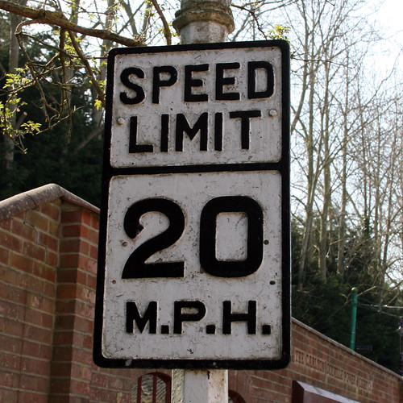
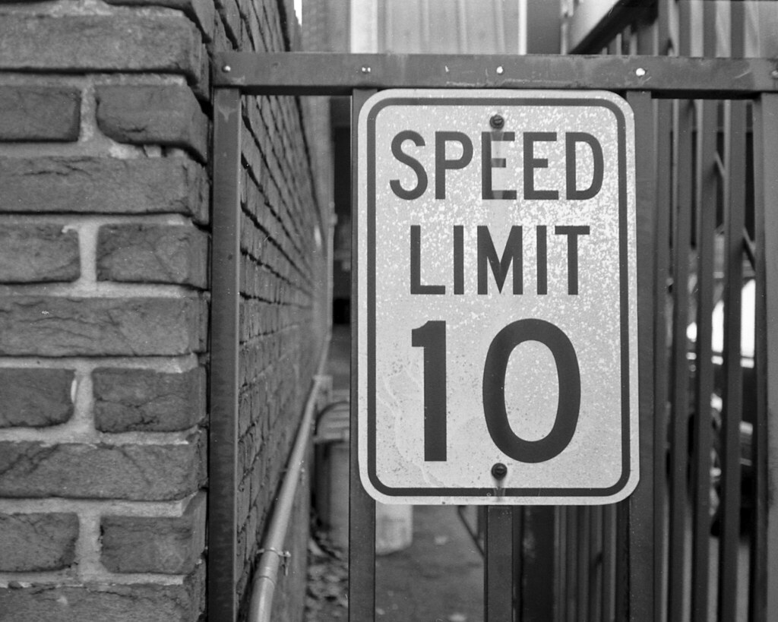
Rate Caps
Unrestricted Rate – 20%
Restricted Rate – 10%

Slide 15
Indirect Cost Rate Verification Process
What You Need to do in the Process

Slide 16

What is My Role in the Verification Process?

Slide 17

Verify Your Financial Data!

Slide 18
The Indirect Cost Rate Verification Process
Rates are generated in LARS (LEA Audit Reporting System) from audited financial data
Email sent to districts
Indirect Cost Rate Calculation Spreadsheet
Signature pages (restricted and unrestricted)
Memorandum with Instructions and Deadline
Indirect Cost – General Information
Districts verify financial data
Any corrections to data should be made in red on the calculation spreadsheet and totals should be re-calculated
Signature pages emailed to the Office of Audit Services
Indirect Cost Agreement emailed to district

Slide 19
Understanding the Indirect Cost Rate Verification Process
Signature Pages
Should be signed by the Superintendent or an authorized signer for your district
“Name of Official” should match the signature of the Superintendent or the person who signed as authorized signer
“Title” should match the title of the Superintendent or the person who signed as the authorized signer
If signature information does not match, document will be emailed back to the district for correction

Slide 20
Capitalization Thresholds
Capitalization thresholds now required by the United States Department of Education (USED) to be posted on the SCDE’s website
School district capitalization thresholds are also included on school district indirect cost rate agreements
“Items of equipment are capitalized and depreciated if the initial acquisition cost is equal to or greater than $5,000.”
State’s capitalization threshold is $5,000
If district threshold is higher than state’s, the district must adhere to the state’s capitalization threshold
If district threshold is lower than the state’s, the district must adhere to its capitalization threshold
Capitalization thresholds reported on Supportive Information Form in LARS

Slide 21
What’s New
What’s Coming Down the Pipeline…

Slide 22
Indirect Cost Rate Proposal
SCDE’s delegation agreement with USED for calculating school district indirect cost rates expired June 30, 2025
New proposal submitted to USED in December 2024
USED granted an extension until June 30, 2026 of current delegation agreement
Review of proposal pending

Slide 23
Reminders
Don’t Forget!

Slide 24
Excluded Costs
REMEMBER! Excluded costs must be excluded when applying the indirect cost rate to grant awards when recouping indirect costs.

Slide 25
What are the Excluded Costs?
Subawards in excess of $25,000 (Function 265)
Capital Outlay – Facility Acquisition and Construction (Function 253 and Object 500 series) and Equipment (Object 540 series)
Other Charges (Function 400 series)
Food Services expenditures for food, supplies, purchased services directly charged, and equipment charged to Function 256 including Object 393
Debt Service (Function 500 series)
Unused Leave Payments (Object Code 140)
Participant Support Cost (Function 267)

Slide 26

Subawards/Subcontracts NOT Contracts
We exclude the excess of $25,000 for subawards/subcontracts not contracts for goods and services!

Slide 27
Subaward/Subcontract vs Contract
A subaward/subcontract is issued for the purpose of carrying out a portion of a federal award.
Example: A school district receives a federal grant award, and the school district enters into an agreement with another entity to perform a portion of the programmatic responsibilities for the federal grant award.
A contract is entered into for the purpose of obtaining (purchasing) goods or services for the school district’s own use. It creates a procurement relationship with a contractor or vendor.

Slide 28
“0%” Indirect Cost Rates Issued When…
We have not received your school district’s audited financial data
There are uncorrected errors in audited financial data or if your annual audit submission is missing information
Supportive Information Form must be submitted and include depreciation information
Depreciation is used to calculate the unrestricted indirect cost rate
If signature pages are not returned signed

Slide 29
Ensure your Financial Data is Correct!

Slide 30
Resources
Link to Indirect Cost Rates and Resources - Indirect Cost Rates - South Carolina Department of Education - 08/18/2025 10:06 PM

Slide 31

Questions

Slide 32
Contact Us!
Hershula Davis, Audits Director
hdavis@ed.sc.gov; 803-734-6022
Richelle Melvin, Audits Manager
ramelvin@ed.sc.gov; 803-734-8453

