Slide 1


Financial Services
Finance Boot Camp
August 21, 2025

Slide 2
Agenda
01
Introduction
02
Funding Sources
03
Processes
04
Resources

Slide 3
Agenda #01
Introduction

Slide 4
Primary Duties
Allocate State funds to school districts and other entities
Keep school district business officials informed of changes in state education programs and related funding issues and requirements
Manage the 45th- and 135th-Day Pupil Accounting processes
Process monthly Medicaid match payments
Compile required annual reporting (ESSA, In$ite, etc.)
Manage SC Educator - Compensation
Notes:
Primary district-facing duties

Slide 5
Agenda #02
Funding Sources

Slide 6
Sources of Funding
Local
Property Taxes
State
State Aid to Classrooms
Retiree Insurance
Federal
Title I
IDEA
CERDEP
ESSER
Child Nutrition
Investment Earnings
Notes:
Charter districts have access to other local funds such as gifts and donations, but not property taxes

Slide 7
State Aid to Classrooms
Revenues 3103 & 3503
“New” State funding formula, initially rolled out FY23
Funding appropriated by General Assembly (Proviso 1.3)
Targeted student/teacher ratio; average teacher salary for 12-years with Masters
Includes weightings and add-ons for certain pupil classifications
State share 75%, Local share 25% for traditional districts
State share 100%, Local Share 0% for Charter districts
Student Classification | Weight
Base (K, P, E, HS, HB) | 1.00
Students with Disabilities (EM H, LD, TM H, EH, OH, VH, AUT, HH, SP H) | 2.60
Precareer & Career Technology (CTE) | 1.20
Add-On Classification | Weight
Pupils in Poverty (PIP) | 0.50
Gifted & Talented | 0.15
Academic Assistance | 0.15
Limited English Proficiency | 0.20
Enrolled – Brick & Mortar (Charter Authorizers Only) | 1.25
Enrolled – Virtual (Charter Authorizers only) | 0.50

Slide 8
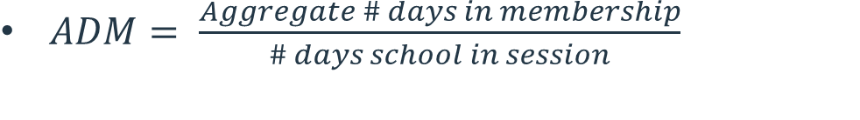

Membership Counts
Average Daily Membership (ADM)
Weighted Pupil Units (WPU)
$ADM= \frac{Aggregate \# days in membership}{\# days school in session}$
$WPU=ADM ∗Classification Weighting$
Classification | Total Days Enrolled | # Days in Session | ADM
Kindergarten | 10,000 | 45 | 222.22
Elementary | 25,000 | 45 | 555.56
Learning Disabled | 12,500 | 45 | 277.78
Classification | ADM | Weight | WPU
Kindergarten | 222.22 | 1.00 | 222.22
Elementary | 555.56 | 1.00 | 555.56
Learning Disabled | 277.78 | 2.60 | 722.22
SCDE Membership Counts
Notes:
Link to membership counts, move to website and play around with the fields. Touch on Student Accountability report as well

Slide 9
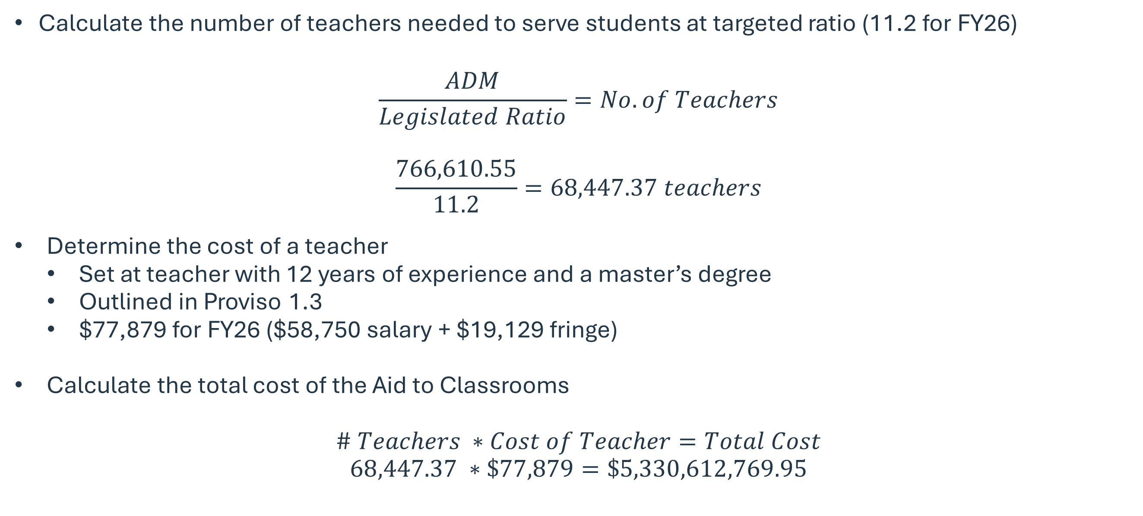
Determining Funding Statewide
Calculate the number of teachers needed to serve students at targeted ratio (11.2 for FY26)
$$\frac{ADM}{Legislated Ratio}=No. of Teachers$$
$$\frac{766,610.55}{11.2}=68,447.37 teachers$$
Determine the cost of a teacher
  Set at teacher with 12 years of experience and a master’s degree
  Outlined in Proviso 1.3
  $77,879 for FY26 ($58,750 salary + $19,129 fringe)
Calculate the total cost of the Aid to Classrooms
$$\# Teachers ∗Cost of Teacher=Total Cost$$
$$68,447.37 ∗\$77,879=\$5,330,612,769.95$$

Slide 10
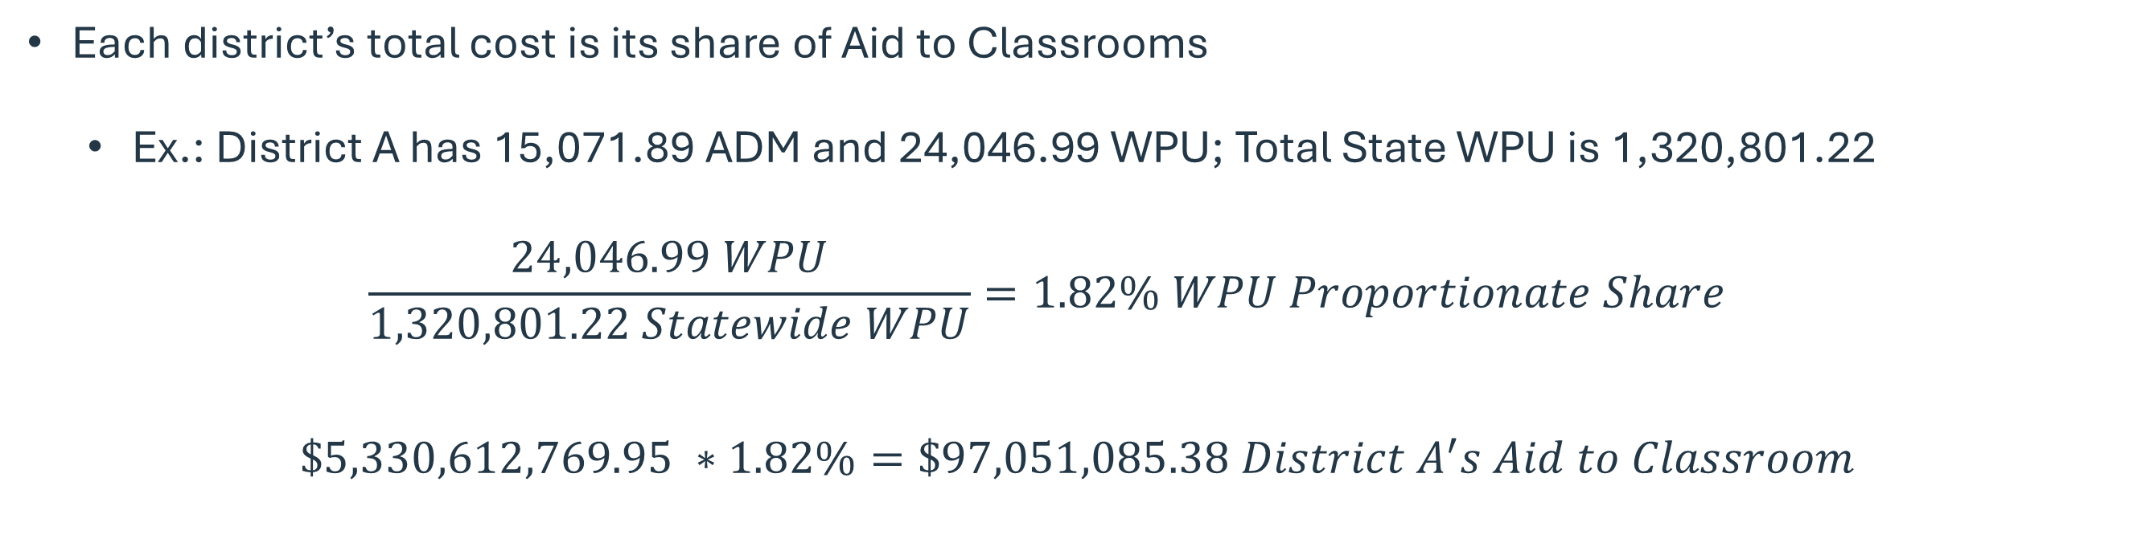
Determining Funding to Districts
Each district’s total cost is its share of Aid to Classrooms
  Ex.: District A has 15,071.89 ADM and 24,046.99 WPU; Total State WPU is 1,320,801.22
  $$\frac{24,046.99 WPU}{1,320,801.22 Statewide WPU}=1.82\% WPU Proportionate Share$$
$$\$5,330,612,769.95 ∗1.82\%=\$97,051,085.38 District A^{′}s Aid to Classroom$$

Slide 11
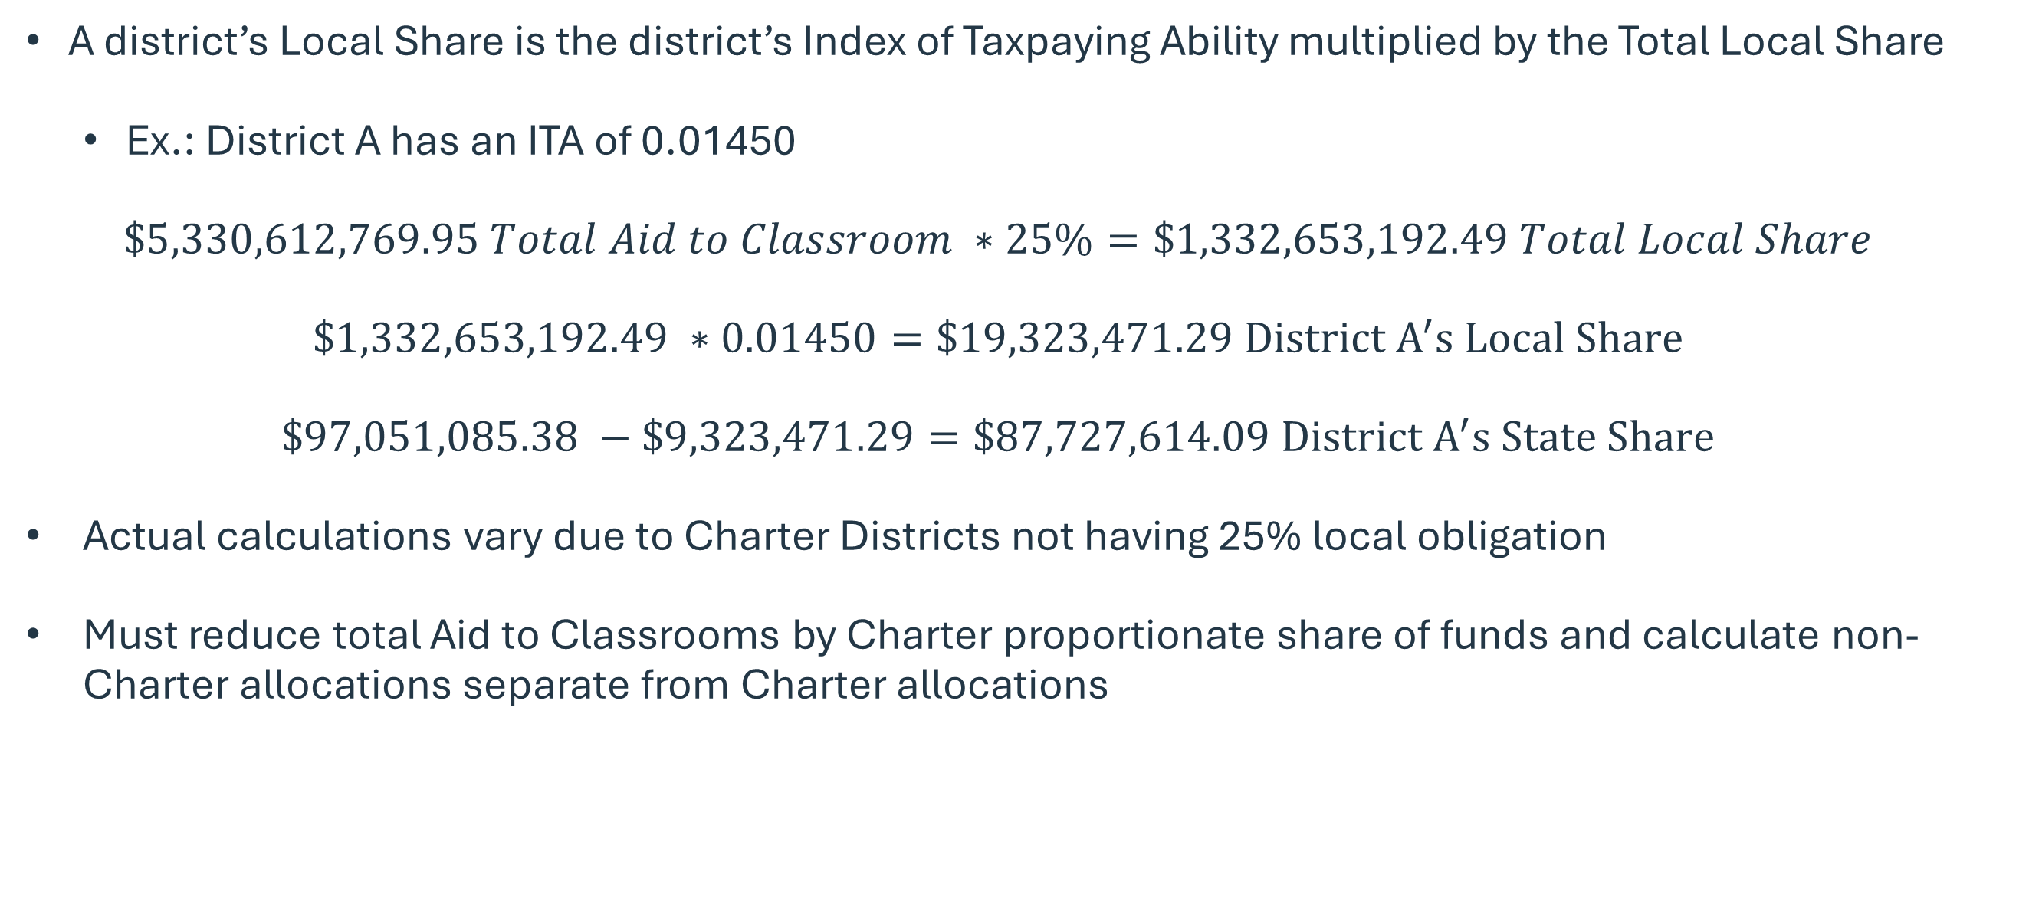
Determining Local Share
A district’s Local Share is the district’s Index of Taxpaying Ability multiplied by the Total Local Share
  Ex.: District A has an ITA of 0.01450
  $$\$5,330,612,769.95 Total Aid to Classroom ∗25\%=\$1,332,653,192.49 Total Local Share$$
  $$\$1,332,653,192.49 ∗0.01450=\$19,323,471.29 District A^{′}s Local Share$$
  $$\$97,051,085.38 −\$9,323,471.29=\$87,727,614.09 District A^{′}s State Share$$
Actual calculations vary due to Charter Districts not having 25% local obligation
Must reduce total Aid to Classrooms by Charter proportionate share of funds and calculate non-Charter allocations separate from Charter allocations
Notes:
Hand out copies of exercise

Slide 12
Flexibility and Transparency
Although the number of teachers is calculated in the State Aid to Classrooms formula, districts have the flexibility to spend these funds as they determine best.
Pursuant to Section 59-20-80, each school board of trustees must make available by September first of each fiscal year its annual budget that includes state, local, and federal investments in education. The budget must be available on the district’s website. The department, in collaboration with local school districts, will provide a template that each district must use in reporting its budget.

Slide 13
Other State Funding
Teacher Supply - Revenue 3187 & 3577
  Proviso 1A.9
  $400 for FY26 for eligible positions
  Offset expenses for educational supplies
  Separate from regular payroll
Reading Coach – Revenue 3135 & 3535
  Proviso 1.50
  Offset cost of reading/literacy coach
  Up to $62,730 for salary and benefits
  Listing provided to LEAs by SCDE
National Board Certification – Revenue 3532
  Proviso 1A.64
  $7,500 or $5,000 stipend depending on certification dates
  Listing provided to LEAs by SCDE
Retiree Insurance – Revenue 3181
  Proviso 1.5
  Premium costs for medical benefits
  Total payroll reported by SCRS
  Retiree insurance managed by SFAA
Funding allocations may be Proviso-directed, based on specific data, or some other criteria
Notes:
31XX indicates GF source, 35XX indicates EIA source
Teacher Supply – Initial allocation in July based on prior year SC Educator reports (excluding those showing a termination date). Adjustments made in January based on November 30th reports. Any teacher who worked one day is eligible.
Reading Coach – Based on instructors reported by district and total appropriation. In FY25, about 730 eligible schools received up to $57,536 per coach (but no more than the coach’s total compensation)
National Board Certification – 10-year certifications ($7,500 stipend) are phasing out. NB only utilizing 5-year certifications now, which Proviso directs us to pay $5,000 annually. Touch more on next slide.
SCRS = South Carolina Retirement System
SFAA = State Fiscal Accountability Authority

Slide 14
National Board Timing
Stipends are based on the fiscal year:
NB certified teachers may complete their MOC in one of the two years prior to expiration
  Please encourage teachers to complete early to ensure no pause in stipends
 | 2021-22 | 2022-23 | 2023-24 | 2024-25 | 2025-26
Certification Period | 12/1/21-11/30/22 | 12/1/22-11/30/23 | 12/1/23-11/30/24 | 12/1/24-11/30/25 | 12/1/25-11/30/26
Fiscal Year | 7/1/21-6/30/22 | 7/1/22-6/30/23 | 7/1/23-6/30/24 | 7/1/24-6/30/25 | 7/1/25-6/30/26
 | Aug 2026 | Sep 2026 | Oct 2026 | Nov 2026 | Dec 2026 | Jan 2027 | Feb 2027 | Mar 2027 | Apr 2027 | May 2027 | Jun 2027
MOC in 2025 |  | $500 | $500 | $500 | $500 | $500 | $500 | $500 | $500 | $500 | $500
MOC in 2026 |  | $0 | $0 | $0 | $0 | $0 | $1,000 | $1,000 | $1,000 | $1,000 | $1,000
 | SCDE sends NBC listing for verification |  |  |  |  | SCDE sends NBC listing for verification
Notes:
Suppose Michael obtained his National Board certification on December 1st. We would have been notified of his new certification and would have paid the district his $5,000 stipend for the remainder of the fiscal year.
If Michael completes MOC in 2025, SCDE would be notified in December 2025 and would know to include his stipend in the district’s allocations for the 2026 fiscal year
If Michael waits to complete his MOC until 2026, the SCDE would be notified in December 2026. Since our records show his stipend ends in June 2026, we would not include any stipend for him in the district’s allocations until after December when we’ve been notified that he completed his MOC and is verified by the district.

Slide 15
Agenda #03
Processes

Slide 16
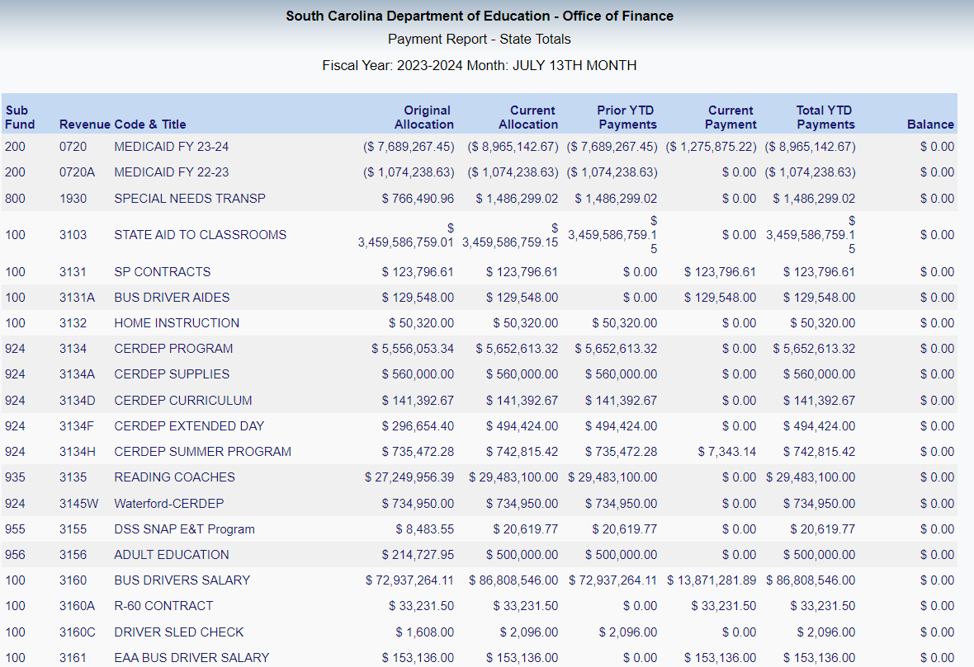
Monthly Payment Schedule
For State EIA and General Fund payments
Generally, the 22nd of each month, or the Friday leading up. FY26 schedule is:
Funds delivered through the monthly payment process can be found on our Monthly Payments to Districts report
July 22nd
August 22nd
September 22nd
October 22nd
November TBD
December TBD
January 20th
February 20th
March 20th
April 22nd
May 22nd
June 22nd
July 13th
Notes:
Walk through monthly payments report; discuss what each column represents

Slide 17
District Reporting
45th-, and 135th-Day Pupil Accounting Collection Period
  Membership and attendance data captured through PowerSchool
  Used to calculate State Aid to Classroom and other various revenue allocations
  5th-Day Collection for Charter districts to make necessary initial adjustments
SC Educator (PCS)
  Staff information system; Compensation and Certification sides
  Compensation data used for NBC and Teacher Supply allocations
  Professional Certified Staff Listing & User Access Form
In$ite
  Financial analysis by specified categories (Instruction, Support, Operations, etc.)
  Provides comparison at district- and school-level
ESSA
  Per-pupil expenditure data at school-level
Notes:
SC Educator – DOH, DOT, certification dates, salary information, position codes, school, etc.
Quickly walk through the code listing (NBC and Teacher Supply eligible positions) and user access forms

Slide 18
Reporting Deadlines
Some key deadlines this fiscal year:
Financial Services will provide updates throughout the year
Due Date | Report/Activity
August 15 | Final day for expenditure claims for Federal grants
October 21 – November 7 | 45th–Day Pupil Accounting
November 30 | SC Educator staff updates for Teacher Supply
December 1 | In$ite and ESSA Financial Transparency Annual Audit due
March 30 – April 21 | 135th–Day Pupil Accounting
June 30 | Funding Flexibility SC Educator staff updates

Slide 19
Agenda #04
Resources
Notes:
Membership/Student Accountability
SC Educator (manual, PCS code listing, request form)

Slide 20
Online Resources
Financial Services website
General information on funding provided to districts
Financial Newsletters
Monthly updates from Chief Finance Office
Budget Planning
House and Senate budget projections, Minimum Teacher Salary requirements, etc.
Funding Manuals
Financial and programmatic requirements for different revenue sources
Financial Accounting Handbooks
Auditing standards, Chart of Accounts, etc.
Other Manuals & Guidance
SC Educator User Manual, Fiscal Practices, 45- and 135-Day Reporting Manual
Notes:
If time permits, run through Medicaid Audit page as well

Slide 21
Contact Information
Melanie Cooper
Finance Director
Phone: 803.734.8135
Joshua Byers
Financial Services Manager
Phone: 803.734.8885
Michael Scheele
Fiscal Analyst III
Phone: 803.734.8145
Email: mcooper@ed.sc.gov
Email: jrbyers@ed.sc.gov
Email: mscheele@ed.sc.gov

