Slide 1

District Website Financial Transparency Requirements 2026-27
2026 Finance Bootcamp
Valarie Byrd, MA, CETL®, CCRE
Senior District Technology Consultant
Information Technology Office

Slide 2
Financial Transparency Requirements
Districts must post budgets, expenditures, audits, and related reports on their websites.
Information must be:
  Clear
  Accurate
  Accessible

Slide 3
Data Privacy & Security
The district’s credit card numbers must be REDACTED prior to posting anything to the website
Personal Identifiable Information (PII) of staff, students, parents, and community members should always be redacted!

Slide 4
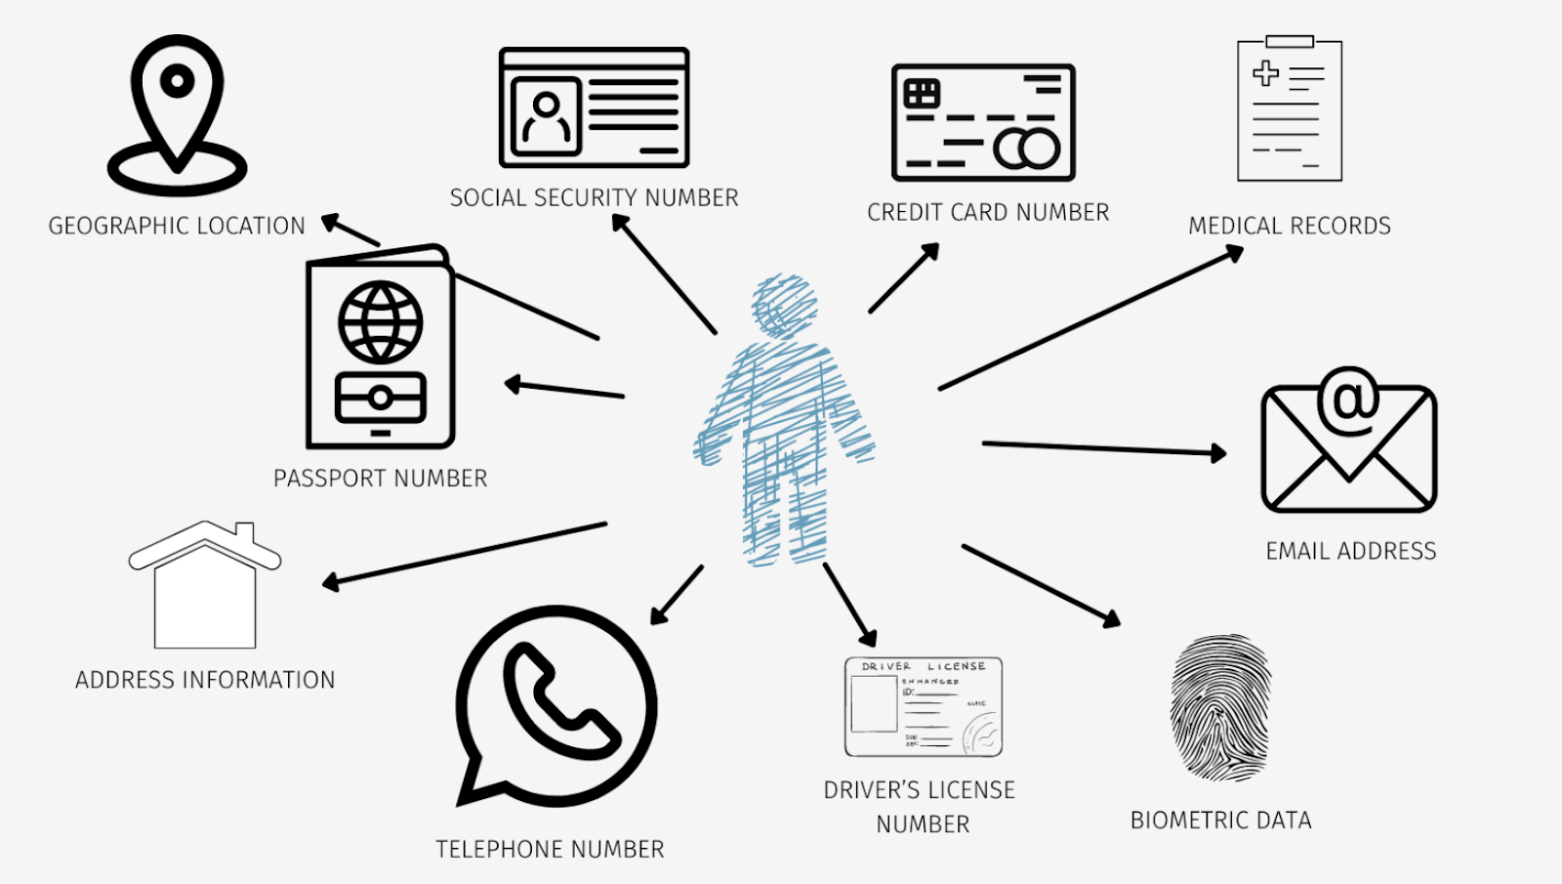
Personal Identifiable Information (PII)
Notes:
Information that can be used to distinguish or trace an individual’s identity, either alone or when combined with other personal or identifying information that is linked or linkable to a specific individual. The definition of PII is not anchored to any single category of information or technology. Rather, it requires a case-by-case assessment of the specific risk that an individual can be identified.

Slide 5
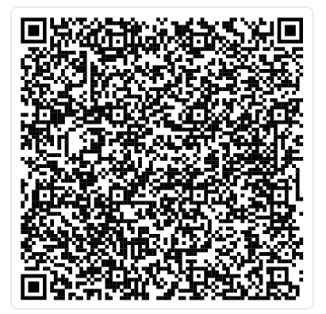
Financial Transparency Legislation
Annual budget
Annual audit
Flex spending
Transaction register for $100+
Monthly credit card statements
Administrative costs report
https://www.scstatehouse.gov
ed.sc.gov/edtech/district-websites/content-requirements/

Slide 6
Annual Budget
General Appropriations Bill for
2026-27 (H630-1.3)
Plain Language
(G) … each school board of trustees must make available by September first of each fiscal year its annual budget… The budget must be available on the district’s website. The department… will provide a template that each district must use in reporting its budget.
Each year, the district board must propose a budget.
A copy of the approved budget proposal must be posted the website.
The budget proposal must follow the SCDE-provided template.

Slide 7
Annual Audit
General Appropriations Bill for
2026-27 (H630-1.3)
Plain Language
J) Each district’s annual audit must be available on the district’s website.
Each year, the district’s finances are audited.
A copy of those audit results must be posted on the district’s website annually.

Slide 8
Flex Spending
General Appropriations Bill for
2026-27 (H630-1.20)
Plain Language
Quarterly…each school district must certify where non-instructional or nonessential programs have been suspended and the specific flexibility actions taken…and the certification must be conspicuously posted on the internet website maintained by the school district.
Each quarter, if applicable, the district must provide a certified copy of the SCDE Funding Flexibility Form to SCDE Finance.
A copy of the form must be posted on the district’s website quarterly.
Notes:
Procedures: https://ed.sc.gov/finance/financial-services/information-memos-and-forms/fiscal-year-2026-2027/funding-flexibility-procedures-for-fiscal-year-2026-27/

Slide 9
Transaction Register for Expenditures of $100+
General Appropriations Bill for
2026-27 (H630-1.20)
Plain Language
School districts must maintain a transaction register that includes a complete record of all funds expended over one hundred dollars, ... The register must be prominently posted on the district's internet website and made available for public viewing and downloading.
Districts must maintain an active, monthly record of transactions.
A copy of the register must be posted on the district’s website.

Slide 10
Transaction Register Requirements
Information on each transaction must include:
  the transaction amount;
  the name of the payee; and
  a statement providing a detailed description of the expenditure.
The register must:
  NOT include an entry for salary, wages, or other compensation paid to individual employees.
  NOT include any information that can be used to identify an individual employee.
  Be accompanied by a complete explanation of any codes or acronyms used to identify a payee or an expenditure.
  Be searchable and updated at least once a month.

Slide 11
Monthly Credit Card Statements
General Appropriations Bill for
2026-27 (H630-1.20)
Plain Language
…must also maintain on its internet website a copy of each monthly statement for all of the credit cards… The credit card number on each statement must be redacted prior to posting… must be posted not later than the thirtieth day…
Districts must maintain a monthly record of credit card statements.
Statements must be posted to the district website monthly.
Credit card (and account) numbers must be redacted prior to posting.

Slide 12
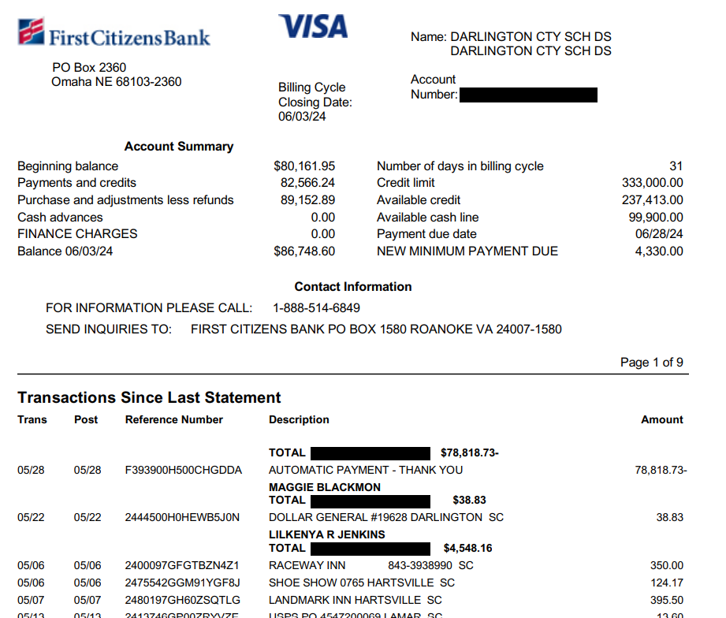
Monthly Credit Card Statement, Example

Slide 13
Administrative Cost Report
General Appropriations Bill for
2026-27 (H630-1.35)
Plain Language
School districts must report the amount of funds spent on administrative costs, as defined by In$ight in the prior fiscal year and post the report on the districts website…provide electronic copy of this report …in conjunction with the financial audit report required by Section 59-17-100 of the 1976 Code
Annually, a copy of the district administrative cost report must be posted to the district website.
The report should be included in the district financial audit report.

Slide 14
ed.sc.gov

