Slide 1

District Website Financial Transparency Requirements 2025-26
2025 Finance Bootcamp
Sean Osborne
Website Accessibility Specialist
SCDE Chief Information Office

Slide 2

Financial Transparency Requirements
Districts must post budgets, expenditures, audits, and related reports on their websites.
Information must be:
Clear
Accurate
Accessible

Slide 3
Data Privacy & Security
The district’s credit card numbers must be REDACTED prior to posting anything to the website
Personal Identifiable Information (PII) of staff, students, parents, and community members should always be redacted!

Slide 4
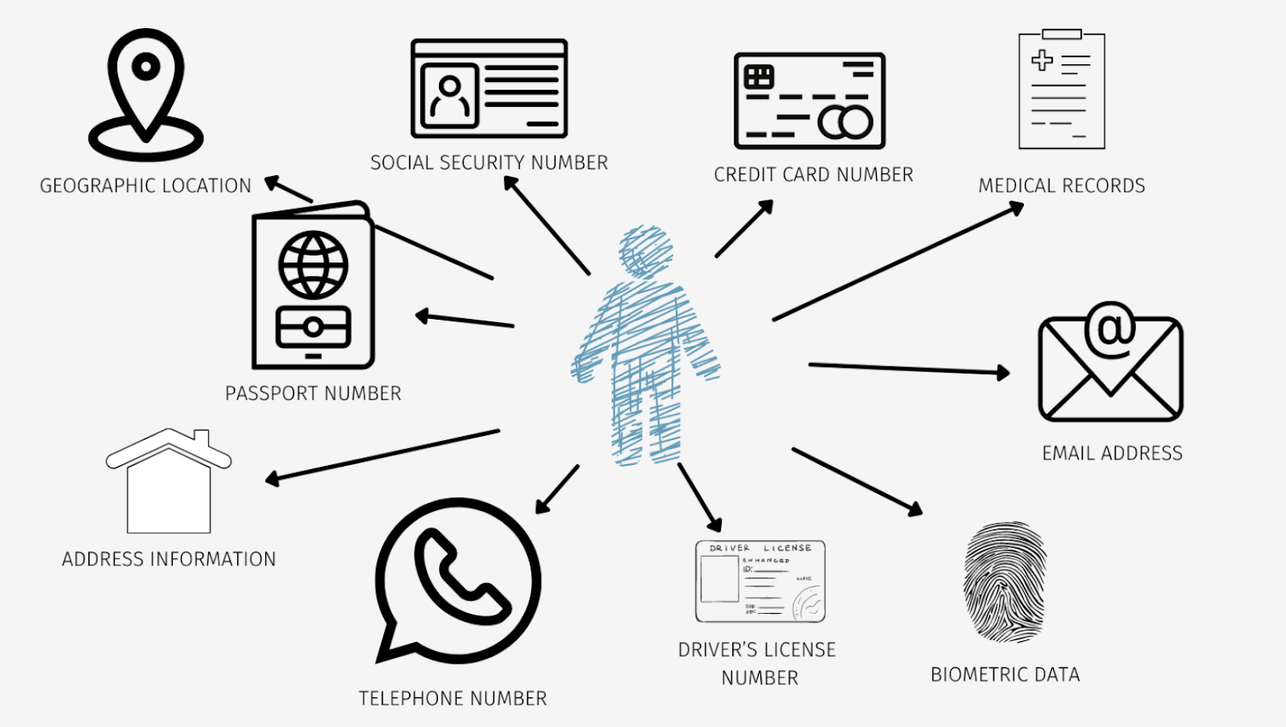
Personal Identifiable Information (PII)
Notes:
Information that can be used to distinguish or trace an individual’s identity, either alone or when combined with other personal or identifying information that is linked or linkable to a specific individual. The definition of PII is not anchored to any single category of information or technology. Rather, it requires a case-by-case assessment of the specific risk that an individual can be identified.

Slide 5

Financial Transparency Legislation Checklist
Annual budget
Annual audit
Transaction register for $100+
Monthly credit card statements
Administrative costs report
ed.sc.gov/edtech/district-websites/content-requirements/

Slide 6
Annual Budget
General Appropriations Bill for 2025-26 (H630-1.3)
Plain Language
(F) … each school board of trustees must make available by September first of each fiscal year its annual budget… The budget must be available on the district’s website. The department… will provide a template that each district must use in reporting its budget.
Each year, the district board must propose a budget.
A copy of the approved budget proposal must be posted the website.
The budget proposal must follow the SCDE-provided template.

Slide 7
Annual Audit
General Appropriations Bill for 2025-26 (H630-1.3)
Plain Language
I) Each district’s annual audit must be available on the district’s website.
Each year, the district’s finances are audited.
A copy of those audit results must be posted on the district’s website annually.

Slide 8
Transaction Register for Expenditures of $100+
General Appropriations Bill for 2025-26 (H630-1.21)
Plain Language
School districts must maintain a transaction register that includes a complete record of all funds expended over one hundred dollars, ... The register must be prominently posted on the district's internet website and made available for public viewing and downloading.
Districts must maintain an active, monthly record of transactions.
A copy of the register must be posted on the district’s website.

Slide 9
Transaction Register Requirements
Information on each transaction must include:
the transaction amount;
the name of the payee; and
a statement providing a detailed description of the expenditure.
The register must:
NOT include an entry for salary, wages, or other compensation paid to individual employees.
NOT include any information that can be used to identify an individual employee.
Be accompanied by a complete explanation of any codes or acronyms used to identify a payee or an expenditure.
Be searchable and updated at least once a month.

Slide 10
Monthly Credit Card Statements
General Appropriations Bill for 2025-26 (H630-1.21)
Plain Language
…must also maintain on its internet website a copy of each monthly statement for all of the credit cards… The credit card number on each statement must be redacted prior to posting… must be posted not later than the thirtieth day…
Districts must maintain a monthly record of credit card statements.
Statements must be posted to the district website monthly.
Credit card (and account) numbers must be redacted prior to posting.

Slide 11
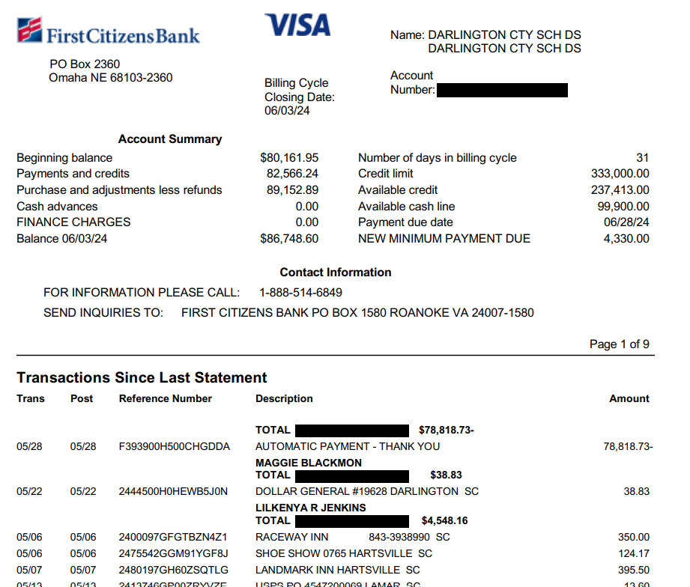
Monthly Credit Card Statement, Example

Slide 12
Administrative Cost Report for Prior Year
General Appropriations Bill for 2025-26 (H630-1.36)
Plain Language
School districts must report the amount of funds spent on administrative costs, as defined by In$ight in the prior fiscal year and post the report on the districts website…
Districts must annually post information on funds spent on administrative costs.
Report is for the prior fiscal year.
Report should include a summary of annual salary information defined by In$ite.

Slide 13
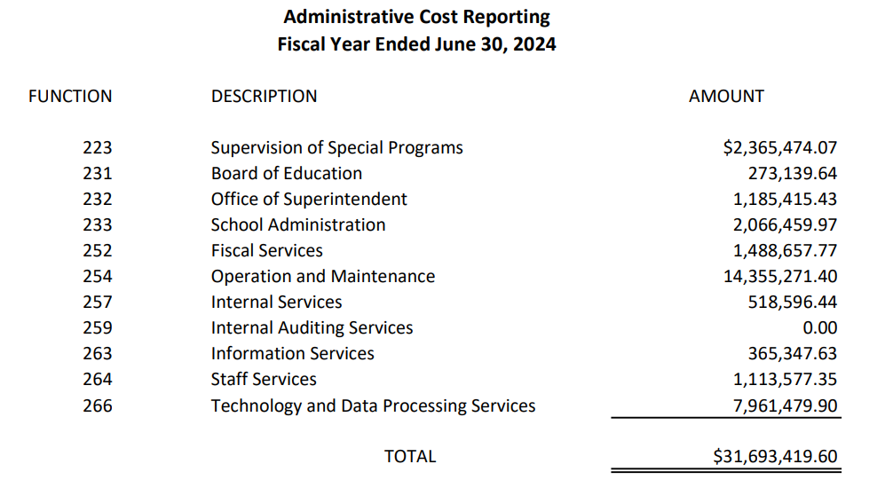
Administrative Costs Report, Example

Slide 14
Related Requirements
Surplus Property
Funding Flexibility
Funding Balance
Comptroller General Website
Governor’s Schools Fees

Slide 15
Surplus Property List
General Appropriations Bill for 2025-26 (H630-1.87)
Plain Language
…All school districts must publish on their website by September 15, 2025, a list of properties that qualify under this provision.
Districts must maintain a list of vacant or unused property.
List must be posted each year by September 15th.
If nothing qualifies, post something like: “[District] has no district property that qualifies for transfer, sale, or lease to governmental subdivisions or state agencies.”

Slide 16
Surplus Property, Explained
A school district must transfer, or offer for sale or lease, any surplus real property or property which has been vacant, unused, or unused for direct student instruction for the previous four school years and is not currently included in any district capital improvement plan for future use on or before July 1, 2025.

Slide 17
Funding Flexibility Certification
Quarterly… the chairman of each school district's board and the superintendent of each school district must certify where non-instructional or nonessential programs have been suspended and the specific flexibility actions taken…
The certification must be presented publicly at a regularly called school board meeting, and the certification must be conspicuously posted on the internet website maintained by the school district.
Certification is a combination of multiple documents, one of which is a Funding Flexibility Form

Slide 18
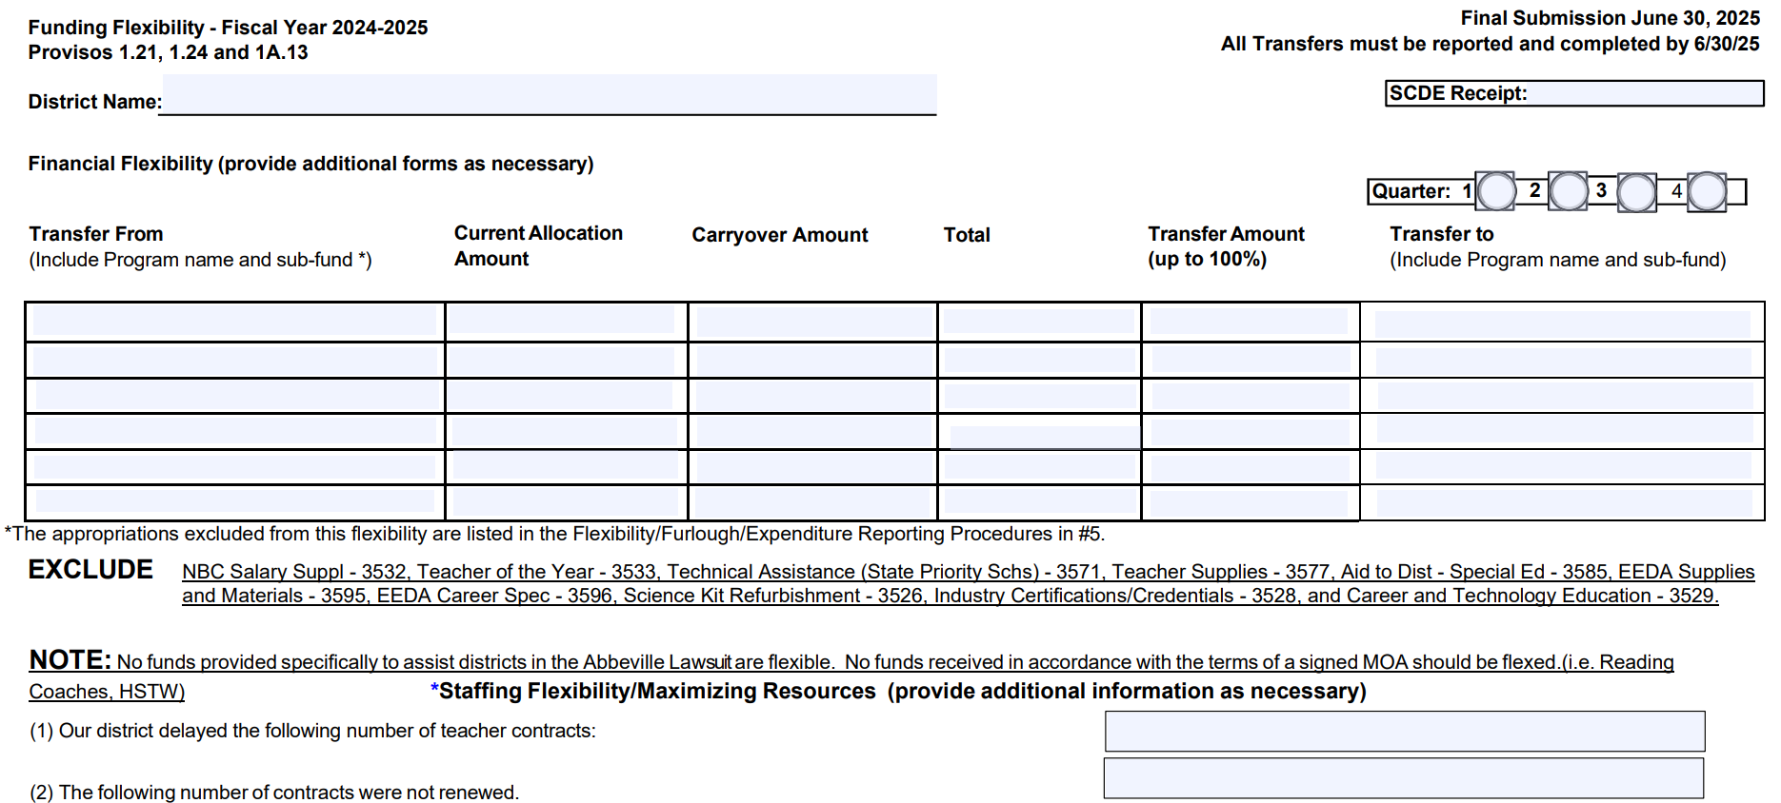
Funding Flexibility Certification, Example
https://ed.sc.gov/finance/financial-services/information-memos-and-forms/

Slide 19
Monthly Reporting of Fund Balance
To provide transparency, Revenue and Fiscal Affairs will document annually, through an online financial dashboard, the expenditure of all state, local, and federal funds by each district and by each charter school authorizer and other relevant data to include its fund balance and average fund balance for the reporting year. The districts shall report monthly, to the Department of Education, their monthly fund… District expenditures for the prior fiscal year must be published on the department's website for public disclosure by January 1.

Slide 20
Comptroller General Website
School districts that do not maintain an internet website must transmit all information required by this provision to the Comptroller General in a manner and at a time determined by the Comptroller General to be included on the internet website.

Slide 21
Fee Schedules for Governor’s Schools
The Governor's School for the Arts and Humanities shall be authorized to charge, collect, expend, and carry forward student fees as approved by their Board of Directors. The purpose and amount of any such fees shall be to maintain program quality in both academics and residential support.
The Governor's School for Science and Mathematics shall be authorized to charge, collect, expend, and carry forward student fees as approved by their Board of Directors. The purpose and amount of any such fees shall be to maintain program quality in both academics and residential support.

Slide 22
Other Considerations
Record-Keeping
Timeline of Posts
Website Organization
SCDE Support

Slide 23

Record-Keeping
The Comptroller General advises that transparency documents be on the district website for three years

Slide 24
Timeline of Specific Posting Requirements
Annually
Monthly
September 1: Budget
September 15: Surplus
February: Admin Costs
February: Audit Results
June 30: Funding Flex Form (May Need Quarterly)
Transaction Register
Credit Card Statements
Fund Balance (Dashboard)

Slide 25
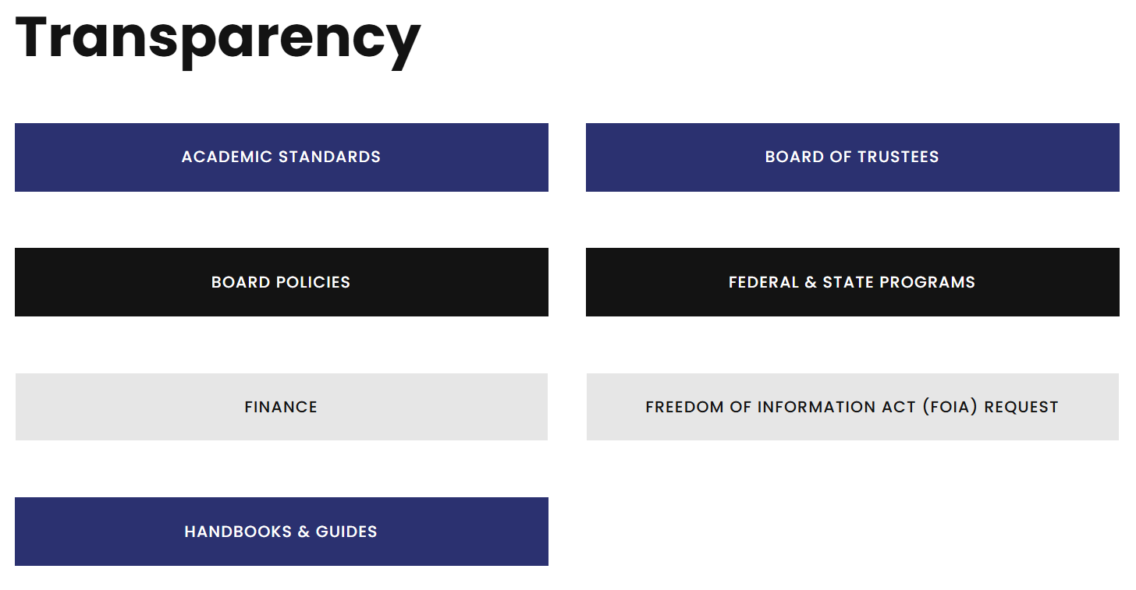
Website Organization, Example 1

Slide 26
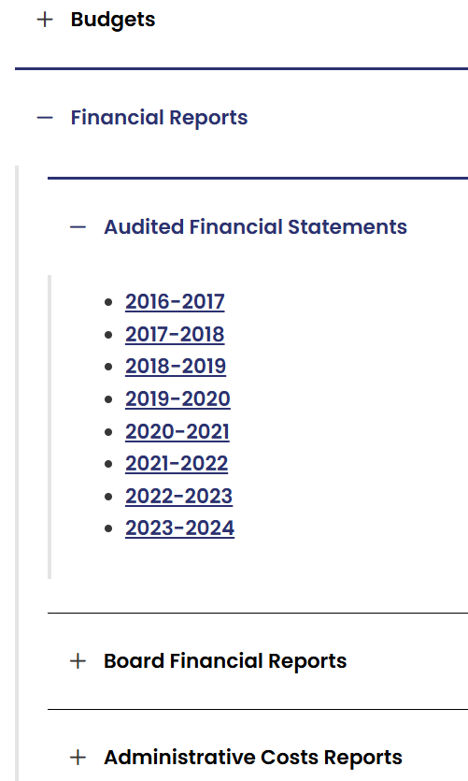
Website Organization, Example 2

Slide 27
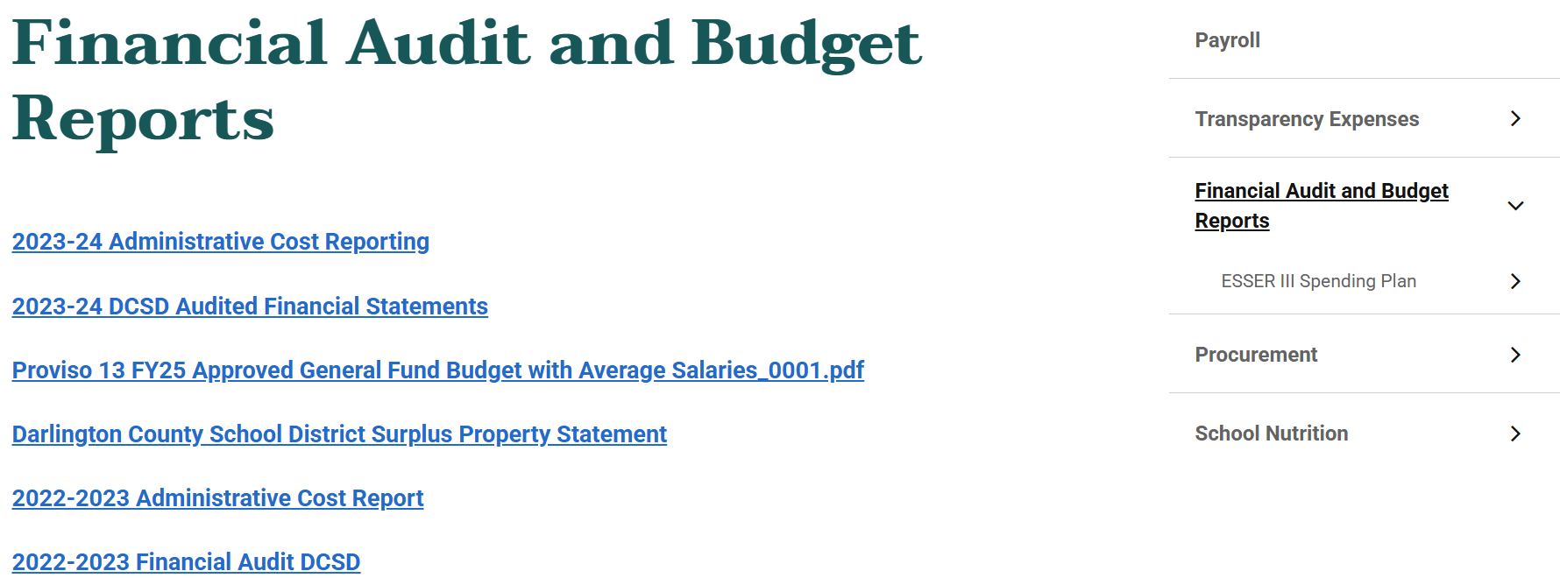
Website Organization, Example 3

Slide 28
SCDE Support
District Website Requirement Resources:
Webpage
Checklist
Rubric
Contact Sean Osborne (sosborne@ed.sc.gov)
ed.sc.gov/edtech/district-websites/content-requirements/

Slide 29
ed.sc.gov

