Slide 1

OMB Updated the Uniform Grant Guidance. Now What Do I Do?
SCASBO Spring 2025 Conference
Audrey H. Shifflett, SCDE Office of Grant Services
March 6, 2025

Slide 2

Disclaimer
This presentation is to help increase your understanding of updates to federal regulations, specifically parts of
2 CFR Part 200 Uniform Administrative Requirements, Cost Principles, and Audit Requirements for Federal Awards.
This presentation is not a substitute for reading 2 CFR Part 200 and other parts of Title 2 of the Code of Federal Regulations (CFR) or any of the following:
subaward
SCDE’s Assurances and Terms & Conditions for Federal Subawards
any applicable program-specific assurances.

Slide 3

Most Stringent Rule/Threshold Applies
Reminder
When a rule or threshold in regulation differs from state requirement/local policy, typically
MOST Stringent or
MOST Restrictive applies
Notes:
When things like thresholds or rules seem to differ or conflict, typically the most stringent limit or rule applies.

Slide 4
Example: travel threshold
Federal Regulation 2 CFR Part 200.475 says:
Travel costs are allowable “…consistent with those normally allowed in like circumstances in the non-federal entity’srecipient’s or subrecipient’s other non-federally-funded activities and in accordance with non-federal entity’sthe recipient’s or subrecipient’s established written travel reimbursement policies.”
(italics mine)
Notes:
For example – with travel, the federal regulation basically says that travel costs that are normally allowed and reasonable and in accordance with the NFE’s written travel policies are allowable. [However…]

Slide 5
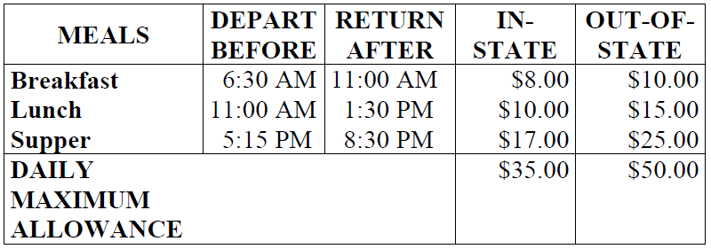
Subaward and Assurances and Terms and Conditions sets most stringent
State of South Carolina’s Proviso 117.20 of Annual Appropriations Act:
“The employee shall also be reimbursed for the actual expenses incurred in the obtaining of meals except that such costs shall not exceed $35 per day within the State of South Carolina. For travel outside of South Carolina the maximum daily reimbursement for meals shall not exceed $50.”
Terms and Conditions
Travel Costs
“Meals and incidentals are limited by the state budget proviso.”
Notes:
However…because you receive a subaward that has passed through the state, the state’s law that limits per diems applies and restricts the use of subgrant funds.

Slide 6

How a District Complies
Example (hypothetical in broad terms):
District per diem is $50/day in-state
Subaward funds limited to $35/day in-state
Remaining $15/day must be non-federal/non-state funds
Notes:
Don’t start giving me whiny babyface – this doesn’t mean that a district employee traveling for a subgrant cannot get their full district-allowed perdiem. It just means that the state grant funds or federal subgrant funds cannot be used for more than the state’s limit of $35 per day in state and $50 per day for out of state for travel perdiem.

Slide 7
Agenda
1 Updates & New Regulations
2 Policies & Procedures
3 Effective Date
4 Tips and Resources
Notes:
Left aligned
Title font is 88pt
Numbered line item 66 pt
Detail/slide item 36 pt

Slide 8
Updates & New Regulations
Note: Not Comprehensive
Notes:
Agenda is 88 pt
Line item is 66 pt

Slide 9
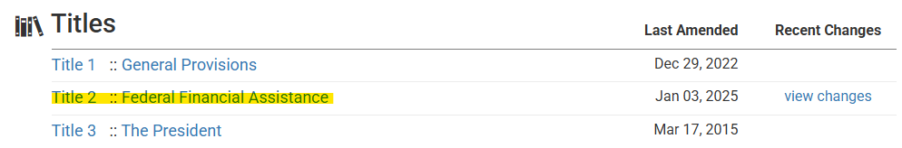
Updates Announced in Federal Register April 22, 2024
Title 2 of the Code of Federal Regulations (CFR) is now OMB Guidance for Federal Financial Assistance (previous title: OMB Guidance for Grants and Agreements)
Updated 2 CFR Parts 1, 25, 170, 175, 180, 182, 183, 184, and 200
2 CFR Part 200, Uniform Administrative Requirements, Cost Principles, and Audit Requirements for Federal Awards is still Uniform Guidance (a.k.a. Super Circular, Uniform Grant Guidance or UGG).

Slide 10
2 CFR Part 200.302 Financial Management
Edited language; same 7 “musts” for LEAs:
Identification of all Federal awards received and expended….
Accurate, current, and complete disclosure of financial results…. (reporting)
Maintain records that sufficiently identify amount, source, and expenditure…(accounting records/financial obligations)
Effective internal control and accountability….
Comparison of expenditures with budget amounts for each Federal award.
Written procedures to implement requirements of §200.303.
Written procedures for determining the allowability of costs….
And see §§200.334, 200.335, 200.336, 200.337.

Slide 11
2 CFR Part 200.303 Internal Controls
Establish, document, and maintain effective internal control over the Federal award…. These internal controls should align with (Green Book or COSO’s Internal Control-Integrated Framework)...
Comply with the U.S. Constitution, Federal statutes, regulations, and the terms and conditions of the Federal award.
Evaluate and monitor…compliance with statutes, regulations, and the terms and conditions of Federal awards.
Take prompt action when instances of noncompliance are identified.
Take reasonable cybersecurity and other measures to safeguard information including protected personally identifiable information (PII) and other types of information. This also includes information the Federal agency or pass-through entity designates as sensitive or other information the recipient or subrecipient considers sensitive and is consistent with applicable Federal, State, local, and tribal laws regarding privacy and responsibility over confidentiality.

Slide 12
2 CFR 200.318 General procurement standards
“Recipient” and “Subrecipient”
Documented procurement procedures —“…must maintain and use documented procedures for procurement transactions under a Federal award or subaward, including for acquisition of property or services…..must be consistent with State, local, and tribal laws and regulation and the standards identified in §§ 200.317 through 200.327.”
Oversight of contractors —“…must maintain oversight to ensure that contractors perform in accordance with the terms, conditions, and specifications of their contracts or purchase orders. See also §200.501(h).”
Conflicts of interest —“…must maintain written standards of conduct covering conflicts of interest….” (1 & 2)
Avoidance of unnecessary or duplicative items
Procurement arrangements using strategic sourcing
Use of excess and surplus Federal property
Use of value engineering clauses
Responsible contractors —“…must award contracts only to responsible contractors…. See also §200.214.”
Procurement records
Time-and-materials type contracts
Settlement of contractual and administrative issues

Slide 13
§200.318 (h) Responsible contractors
Recipient/Subrecipient
must award contracts only to responsible contractors that possess the ability to perform successfully under the terms and conditions of the proposed contract.
must consider contractor integrity, public policy compliance, proper classification of employees (see the Fair Labor Standards Act, 29 U.S.C. 201, chapter 8) past performance record, and financial and technical resources when conducting a procurement transaction.
See also §200.214 Suspensions and debarment
Recipient/Subrecipient
Are subject to the nonprocurement debarment and suspension regulations implementing Executive Orders 12549 and 12689, as well as 2 CFR Part 180.
The regulations in 2 CFR Part 180 restrict making Federal awards, subawards, and contracts with certain parties that are debarred, suspended, or otherwise excluded from receiving or participating in Federal awards.
Key takeaway: Procurement RFPs should include accounting for contractor integrity and past performance.

Slide 14
Other Procurement Updates
2 CFR Part 200.319 Competition –
“All procurement transactions under the Federal award must be conducted in a manner that provides full and open competition and is consistent with the standards of this section and §200.320.
Removes prohibition on geographic preference.
§200.320 Procurement methods –
Term change: “simplified acquisitions” (no more “small purchases”)
Clarifies “micro-purchases” and “simplified acquisitions” are types of “informal procurement methods for small purchases.”
Removed requirements that local governments must open sealed bids in public.
§200.321 Contracting with small businesses, minority businesses, women’s business enterprises, veteran-owned business, and labor surplus area firms

Slide 15

New: Subgrantees can subgrant funds, but…
…that makes the district a pass-through entity (PTE)
District must comply fully with
2 CFR Part 200.332 Requirements for pass-through entities and other regulations for PTEs (“recipients”).

Slide 16
2 CFR Part 200.332 Requirements for pass-through entities
Verify that the subrecipient is not excluded or disqualified in accordance with § 180.300…. (NEW)
Ensure every subaward is clearly identified to subrecipient as a subaward & includes information provided below…. (19 items)
Evaluate each subrecipient’s fraud risk & risk of noncompliance with a subaward….
If appropriate, consider implementing specific conditions in a subaward as described in § 200.208 and notify Federal agency (i.e. SCDE) of specific conditions….
Monitor activities of subrecipient as necessary to ensure subrecipient complies with Federal statutes, regulations, and the terms and conditions of subaward….
Depending upon PTE’s assessment of risk posed by subrecipient…, the following monitoring tools may be useful….
Verify that a subrecipient is audited as required by subpart F of this part….
Consider whether results of subrecipient’s audit, site visits, or other monitoring necessitate adjustments to PTE’s records….
Consider taking enforcement action against noncompliant subrecipients as described in § 200.339 and in program regulations….

Slide 17
If District Wants to Subgrant, must notify SCDE
SCDE will require district send notice of intention to subgrant prior to district issuing subgrant (details to come).
SCDE must
Monitor district as a pass-through entity (PTE) for compliance with §200.332 and other applicable regulations (“recipient”)
Incorporate pass-through activity as part of annual risk assessment of district
Possibly others…SCDE still working on this one! More information to come.

Slide 18
Policies and Procedures
Check/Create New by July 1, 2025

Slide 19
Required Written Policies and Suggested
Policies define standards.
Accounting Policies — §200.306 (h) (2) (i); §200.400; §200.430(i)
Conflicts of Interest Policy — §200.318(c)
Time and Effort Policies — §200.430(a)
Fringe Benefits Policies — §200.431
Employee Health and Welfare Policies — §200.437
Travel Reimbursement Policy — §200.475(a)
^{NEW} Participant Support Cost Classification — §200.456; §200.1 (define in written policies/procedures)
Suggested ^{NEW} Whistleblower Protections — §200.217 because “…The recipient and subrecipient must inform their employees in writing of employee whistleblower rights and protections under 41 U.S. C. 4712.”

Slide 20
Required Written Procedures
Procedures tell what you’re doing.
Real property sales procedures — §200.311(c)(2)
Time and Effort Procedures — §200.430
Allowability Procedures — §200.302(b)(7); §200.403(c)
Cash Management Procedures — §200.302(b)(6); §200.305
Procedures for Managing Equipment — §200.313(d)
Record Conversion Quality Control — §200.336
^{NEW} Participant Support Cost Classification — §200.456; §200.1 (define in written policies/procedures)

Slide 21
Effective Date
October 1, 2024
for New and Amended Awards

Slide 22
Effective Dates: Updated Uniform Grant Guidance (UGG)
Updates to Title 2 announced in Federal Register on April 22, 2024
2 CFR Part 200.110(a) – “…become effective once implemented by Federal Agencies of when any future amendment to this part becomes final.”
OMB Memo M-24-11: “Consistent with 2 CFR 200.106 and applicable law, Federal agencies must take appropriate steps to ensure the 2024 Revisions are effective for all Federal awards issued on or after October 1, 2024. Agencies should ensure that Federal award terms and conditions, notices of funding opportunities (NOFOs), internal agency policies and procedures, agency templates, and other program documents reflect the 2024 Revisions for those Federal awards.”
US Department of Education’s FAQ on the Uniform Guidance in July 2024 – effective date of October 1, 2024, for discretionary, new and continuation awards, and direct formula grants –all except state-administered formula grants which had the option of implementing as early as July 1, 2024 – provided they were prepared.
Notes:
Header font 50pt
Content/body text font 28pt

Slide 23
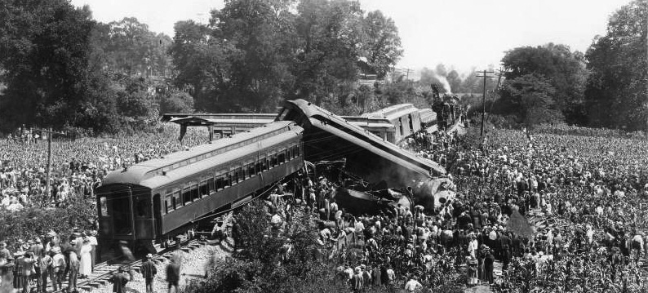
And then, January 2025 happened…
Notes:
Like the great trainwreck of 1918. So – how many of you have read the Finance Newsletter for February 2025? Raise your hands.

Slide 24

Federal Register, January 16, 2025
US Department Of Education updates all awardees’ Grant Award Notices (GANs) to apply the updated UGG:
Application of the Revised Version of the Uniform Guidance to Department Grants

Slide 25
Federal Register, February 10, 2025
US Department Of Education walks that back:
Retroactive Application of the Revised Version of the Guidance for Federal Financial Assistance
So – “Revised Version of the Uniform Guidance” is effective for new grants and amendments issued to SCDE from US ED on and after October 1, 2024.
What about your subawards?

Slide 26
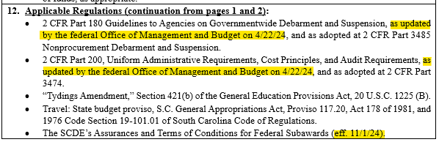
Check Your Subaward!
Currently (3/3/25) only Subaward Name:
25 Title I
25 Title I Distinguished Schools
25 Title I N&D (LEA)
Language to look for:
“…as updated by the federal Office of Management and Budget on 4/22/24…”
“…(eff. 11/1/24.” for the assurances, terms and conditions
Notes:
Header font 50pt
Content/body text font 26pt

Slide 27
Tips and Resources
We’re almost done, y‘all

Slide 28
Communicate Regularly
Within your District
Meet with offices and staff managing subgrants and grants
Talk with these staff regularly about compliance activities
Communicate with other offices that interact with program & activities
With SCDE Program Office(s)
Reports (meet all deadlines)
Participate in all technical assistance
Ask questions & request clarification
Notes:
As part of your routines, communicate regularly with others in your organization who are important to your grants management – like your finance office. And be sure you are communicating regularly with the SCDE program office for your subgrants, too.

Slide 29
Set routines to complete required tasks
Reconciling budget estimates to actual expenditures (reconciliation is in the regs now!)
Monitoring project and contract activities
Preparing and submitting reports
Reviewing and updating procedures/internal controls
Notes:
Back to tips – set routines for required tasks so that you’re sure they get done. Put things on your calendar, set reminders to prepare things like reports, and cross train others so they know how to complete such tasks, too.

Slide 30
Resources
US GAO’s Green Book:
https://www.gao.gov/greenbook
COSO Integrated Framework for Internal Control: https://www.coso.org/internal-control
COFFA (Counsel on Federal Financial Assistance): https://www.coffa.gov/uniform-guidance-coffa/2024/
Resources on 2024 Revisions to Title 2 CFR, including
Federal Register Notice
Redline Edits
2 CFR Crosswalk
FAQs
and more!
Notes:
Header font 50pt
Content/body text font 26pt

Slide 31
US Department of Education Items
US Department of Education FAQ on
2 CFR Part 200:
https://www.ed.gov/sites/ed/files/about/offices/list/ofo/oaga/uniformguidancefaqs.pdf
Keep these for your files:
US Department of Education actions:
January 16, 2025: Federal Register :: Application of the Revised Version of the Uniform Guidance to Department Grants.
February 10, 2025: Federal Register :: Retroactive Application of the Revised Version of the Guidance for Federal Financial Assistance.
Notes:
Header font 50pt
Content/body text font 26pt

Slide 32

Questions?
Notes:
Adjust yellow box outline as needed height wise, not width wise
Header font 50pt
Content left is 26pt

Slide 33
Contact Us
SCDE Office of Grant Services
Grants@ed.sc.gov (803) 734-5810
Audrey Shifflett, Director, ashiffle@ed.sc.gov
Lashaundra Dubose, Grants Coordinator, ldubose@ed.sc.gov

Slide 34
ed.sc.gov
Notes:
Slide title is hidden from display

