Slide 1
Assistant Principal Evaluation Webinar
September 2022
Office of Educator Effectiveness & Leadership Development
Lilla Toal Mandsager and Tom Smith
Welcome! As you arrive, please mute your microphone and
type your name, district/school, and role into the chat.
Notes:
Welcome, we are so thankful you are here. We will record this to share.
As we get started, I’ll introduce Tom Smith, he facilitates cohorts for APs and instructional leadership teams and has been invaluable in gathering feedback and drafting this version of the AP evaluation tool that includes suggested forms and processes. I’d also like to introduce Vicki Traufler, she is our PADEPP coordinator and was instrumental in drafting a version of this tool we released in 2018 that included extensive district input and provided the alignment with PADEPP that you will see in Appendix E of the AP evaluation guidance.
I’m Lilla Toal Mandsager, the director in the Office of EELD. As we get started today, we will remind you to keep your mics muted until we ask you to come on the mic. We will ask you for feedback throughout the webinar using the polls feature and the chat, so I encourage you to go ahead and click on the button that looks like a dialogue bubble so that you can have the chat at the ready for today’s webinar. Please feel free to ask questions as they come. Tom or I will either answer directly in the chat and on the mic, or we’ll loop back to your question at the end.
https://docs.google.com/presentation/d/1LQ20wizjuOoBg9nkRdDOWiqjUREsAU1hP_QkM039T_A/edit?usp=sharing

Slide 2
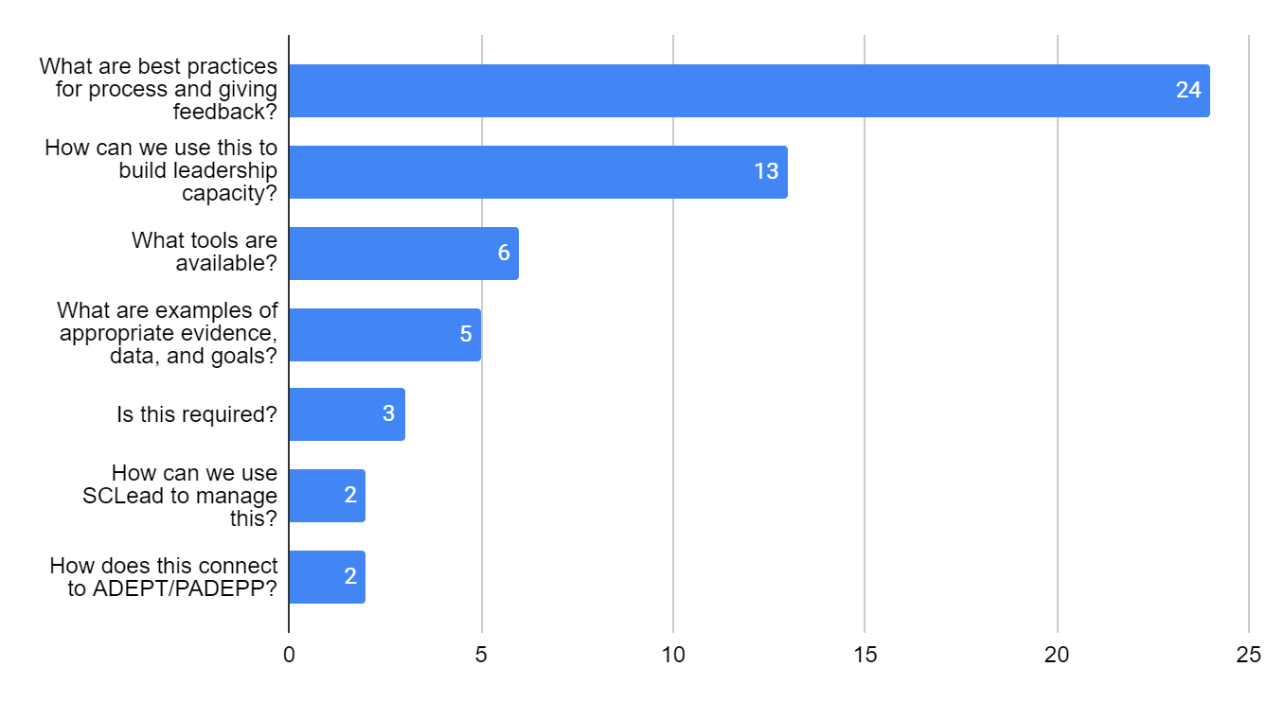
What you were hoping to discuss…
Notes:
When you registered, you gave us some feedback on what you hoped we would discuss today, with best practices and leadership capacity being the top two most frequently requested topics. Fortunately, we were able to incorporate these topics into our agenda.

Slide 3
Agenda
Why Assistant Principal (AP) Evaluations?
Resources for AP Evaluations
AP Evaluation Process
Examples: Setting Goals with APs
Examples: Tracking the Process
Questions and Discussion
Notes:
Our focus today is on AP evaluations. This tool is close to my heart, we know how essential assistant principals are to instructional leadership, creating an inclusive environment, communicating behavior expectations, and managing a safe, inviting school building. They do not have a required evaluation tool, but we've heard from induction principals and APs that one is needed.
Today we’ll start with …

Slide 4
SCDE Office of Educator Effectiveness and Leadership Development
SCDE
Office of Educator Effectiveness & Leadership Development
Professional learning
& coaching
  educator effectiveness,
  new teacher & principal induction,
  instructional leadership
WHAT WE DO
  Personalized Learning
  Collective Leadership
  Equitable access
HOW WE DO IT
OUR FOCUS
  Culture & Environment
  Instruction
Growing educators to lead schools where ALL students have equitable access to effective instruction.
  More effective teachers & leaders stay
  More students & educators grow
DESIRED RESULTS
Notes:
By way of introduction, our office’s mission is to grow educators to….
What we do is offer professional learning, coaching and resources focused on 3 things…
Our focus is on two things we know characterize great schools – leaders and teachers intentionally creating safe and inclusive learning environments, and leading systems to improve teaching and learning.
How we do it is by modeling personalizing learning for adults and students, collective leadership, and systems for ensuring equitable access to effective instruction, and
we hope that a focus on culture and instruction will result in retention, and student growth.

Slide 5
Why are AP evaluations needed?
Notes:
Q1: How does AP evaluation currently work in your district (Answer choices: District has a model and clear expectations, district has some expectations, Schools set up expectations, unsure or no consistent model
Q2: Who is responsible for evaluating APs right now (District alone, District+Principals, Principals, unsure or not consistent)
Q3: What would be the benefit for having a plan for conducting AP evaluations?
Q4: What are the obstacles to having a plan for conducting AP evaluations?
Format: USe the Pollz in Teams and test with an outside group.
Make the first two multiple choice, the second two word cloud.

Slide 6
Frequently Asked Question (FAQ) #1:
Will this become a standard expectation across the state as opposed to optional?
If so, when?
A: There is not a plan to pilot or to collect data on AP evaluation at this time. SCDE does want to partner with you to offer support and to listen to your feedback.
This is a “can do,” born out of feedback from school leaders, not a “have to do,” born out of mandates or legislation.
Notes:
This isn’t a trick, it’s really a response to an equity issue that we noticed. Some APs report having support and consistent feedback, others don’t.

Slide 7
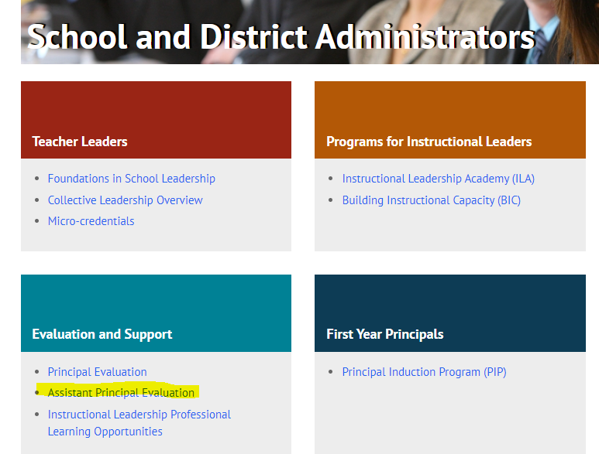

Assistant Principal Evaluation
Resources
Notes:
https://ed.sc.gov/educators/school-and-district-administrators/principal-evaluation/optional-assistant-principal-evaluation/
Go to ed.sc.gov>educators>school and district administrators, this resources is in the middle on the left side.

Slide 8
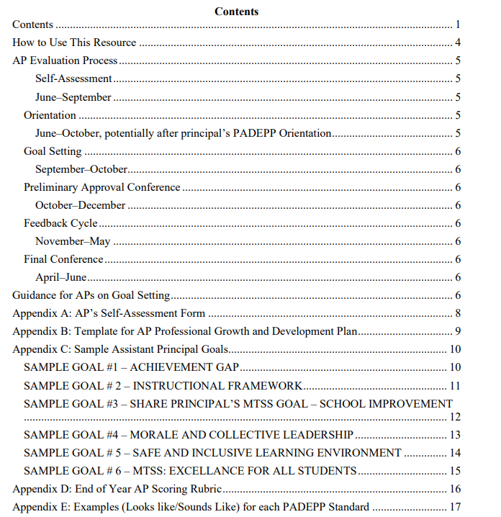
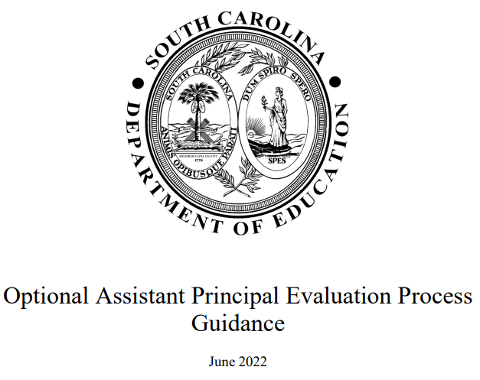
AP Evaluation Guidebook
Notes:
When you click there, the first resource you will see is the guidebook.
If you click on the image in the presentation, it will take you directly to the guidebook.

Slide 9
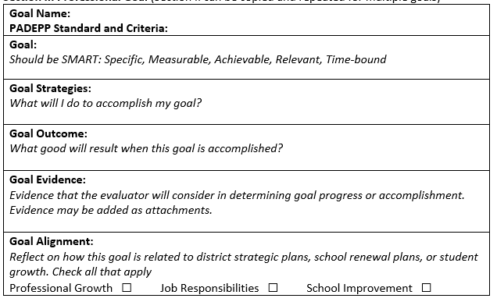
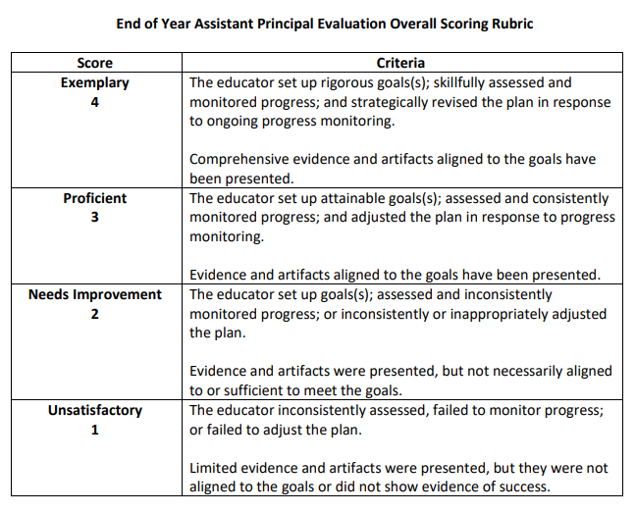
AP Evaluation Forms
Goal Setting Template
Rubric

Slide 10
AP Evaluation Process

Slide 11
AP Evaluation
Process
AP completes self-assessment on all 9 PADEPP Standards (Appendix A)
AP and Principal set expectations for number of goals and focus
Orientation Conference
AP creates 1-3 goals aligned to PADEPP criteria (Appendix C)
Principal approves goals and discusses appropriate evidence with AP
Preliminary Conference
Ongoing Feedback Cycle
AP provides evidence for each goal
Principal provides feedback on each goal: Met, In Progress, Not Met
Principal provides overall performance rating: Exemplary, Proficient, Needs Improvement, Unsatisfactory (Appendix D)
Final Conference
Notes:
The process will look familiar; it follows the same cycle as a regular professional growth and development plan or PGDP, with the exception that it's aligned to give the AP and principal an initial orientation before the goals are approved.
-Orientation
-Preliminary
-Final

Slide 12
AP Evaluation Timeline
June-
August
September- October
January-
February
March-
April
May-June
November-
December
Self-Assessment & Orientation
Goal Setting
Approval Conference
Feedback Cycle
Final Conference
Notes:
Self-Assessment -June-Sept.
Orientation, potentially after principal’s PADEPP Orientation, June-October
This meeting allows the principal and AP to get on the same page about the process, evaluation timeline and criteria for successfully completing the evaluation. If there are multiple APs, a single ­can be held for all APs at the same time.
Goal Setting, September–October
Sample goals can be found in Appendix C. Sample “looks like/sounds like” AP-level criteria aligned with the PADEPP standards can be found in Appendix E.
Preliminary Approval Conference, October–December
The conference confirms the APs professional growth and development goals and clarifies the PADEPP standard with which they will be aligned. Evidence and artifacts should be discussed at this time.
Feedback Cycle, November–May
The feedback cycle is not a singular event. Ongoing feedback on goals, dialogue, and professional learning opportunities will support clear expectations and the growth of the AP. These are times to engage in conversations about direction, process, and priorities such as personalized learning, collective leadership, or equitable access to effective instruction..
Final Conference, April–June
The principal and AP meet to evaluate goal attainment based on evidence collected by the AP and principal and the criteria determined during goal setting. The principal provides feedback on each goal (met, in progress, not met) and provides an overall performance rating based on a preponderance of evidence (Exemplary, Proficient, Needs Improvement, Unsatisfactory). The sample End of Year Rubric can be found in Appendix D.

Slide 13
AP Evaluation and Connections with PADEPP
AP Evaluation
Self-assessment beginning of year, all standards
3 optional goal areas, one goal suggested
Goal(s) tied to 1 PADEPP Standard
Evaluator provides feedback on goals, agreed upon criteria, and overall rating
Overall rating based on evidence of performance using holistic rubric
Principal Evaluation (PADEPP)
Self-assessment mid-year, assessed standards only
3 required goal areas
Goals don’t have to specify connection to standards
Evaluator provides written feedback and scores on assessed standards and overall rating
Overall rating based on portfolio of evidence for all assessed PADEPP Standards
Similarities
Focused on growth
Self-assessment on PADEPP standards
Job-embedded goals, evidence collection, and feedback cycle
Feedback from Evaluator on Goal attainment

Slide 14
Example: Setting Goals with APs

Slide 15
Goal Setting Template
Goal Name: PADEPP Standard and Criteria:
Goal: Should be SMART: Specific, Measurable, Achievable, Relevant, Time-bound
Goal Strategies: What will I do to accomplish my goal?
Goal Outcome: What good will result when this goal is accomplished?
Goal Evidence: Evidence that the evaluator will consider in determining goal progress or accomplishment. Evidence may be added as an attachment.
Goal Alignment: Reflect on how this goal is related to Professional Growth, Job Responsibilities, or School Improvement. Check all that apply Professional Growth ☐ Job Responsibilities ☐ School Improvement ☐
Notes:
This should look familiar, it's the same as the professional goal in SCLead with the exception of the last three categories.
Examples are available in the AP Evaluation Guidebook on our website.

Slide 16
Sample Goal #1 – Opportunity Gap – page 1
Goal Name: Targeting Opportunity Gaps (Equity) – Specifically, bring more students of color into the AP Program and build support systems (Collective Leadership). PADEPP Standards and Criteria Standard 3: Effective Management – Identifies resources, utilizes support services, and develops plans to assist in closing equity gaps and sets challenging goals. ___________________________________________________________________________________________Goal: Second semester (January 2023) enrollment by students of color in the AP Program will increase by 10%. ___________________________________________________________________________________________Goal Strategies In September, I will meet with AP teachers to gather suggestions for goal attainment. Additionally, I will meet with Student Government and ask for their support and ideas. We will also visit the Black Student Alliance, the Latin Students Unidos, and the Student Council to learn of the obstacles to enrollment. Once input is gathered, we will determine a course of action that could include the following. Address expectation, parental pressure and discomfort of not having classmates who look like them. Develop a shadowing program for AP potential students, recruiting stations at sporting events and performances, scholarships for AP test fees. Recruitment fair at middle school, more protocols for identifying AP potential students, and more intentional process for dropping AP classes if students struggle.

Slide 17
Sample Goal #1 – Opportunity Gap – page 2
Goal Outcome More AP potential students of color will have access to Advance Placement because of identification (looking at PSAT scores and class records) and recruitment efforts. _______________________________________________________________________________________Goal Evidence Were the goal strategies implemented Did enrollment in AP program by students of color improve by 10%? If so, specifically why did this happen (survey)? Were others (teachers, students, parents) involved in the process? (agendas) _______________________________________________________________________________________Goal Alignment Reflect on how this goal is related to Professional Growth, Job Responsibilities, or School Improvement. Check all that apply Professional Growth ☐ Job Responsibilities x School Improvement ☐

Slide 18
Sample Goal #3 – MTSS – Page 1
Goal Name: Teachers will develop standards-based assessments, use data to monitor progress and develop tier-two and tier-three supports aligned with the schools MTSS model. PADEPP Standards and Criteria: Standard 2: Instructional Leadership - Sets expectations for staff goals
Goal: By June 2023, 80% of K‐8 teachers will meet their SLO goals based on analysis of teacher-, district-, and school-created, standard‐based assessments.
Goal Strategies Call upon content/grade level teams to develop agreed upon processes for the following: 1. Curriculum Implementation a. Schedule grade level meetings, calendar PD and submission of data sheets b. Communicate dates for submission and provide feedback on student data 2. Assessment Data Meetings a. The leadership team sets dates for implementation of the date cycle. b. Present to staff and invite feedback and action plans c. Teachers will set learning goals for students based on standard based assessment d. Identify and model high stake strategies for instruction during data and grade level planning meetings. e. Monthly check-in with teachers around assessment data. 3. My part in supporting the Principal’s Student Growth Goal a. Content Data Monthly Meetings b. Create monthly and annual calendar c. Administrative review of teacher’s ideas for performance tasks, developing corrective instruction, assessment d. Ensure leadership team analyzes data and sets goals

Slide 19
Sample Goal #3 – MTSS – Page 2
Goal Outcome As a result of using data to monitor progress and using the tier two and tier three supports identified through MTSS, we will have improved student outcomes for all students. Utilizing collective leadership to support the process will improve teacher motivation and efficacy (and hopefully retention) because those closest to the work are involved in developing the process.
Goal Evidence 1. Monthly agenda for leadership team data analysis. 2. Following teacher participation in data meetings, teachers will recommend and implement strategies for corrective instruction within content team agendas. 3. Monthly and annual calendar for data meetings. 4. During admin meetings (set calendar), lead discussions on teacher-created, content-specific, action plans.
Goal Alignment Professional Growth ☐ Job Responsibilities ☐ School Improvement x Note, this goal aligns with the principal’s student growth goal.

Slide 20
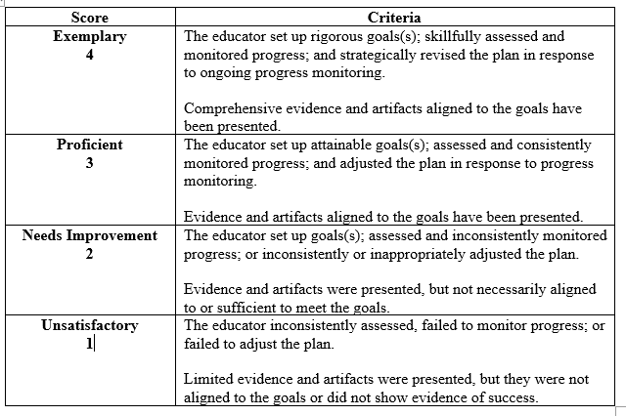
How to Score AP Evaluations?
First, Score Goal(s)
Then, Use Rubric
Section IV. Final Conference Review
(to be completed by the supervisor based on the evidence)
__x_ The educator has met the above goal.
___ The educator is making satisfactory progress toward achieving this goal.
___ The educator is not making satisfactory progress toward achieving this goal.

Slide 21
Example: Tracking Progress

Slide 22
Professional Goal
Goal Name: PADEPP Standard and Criteria:
Goal: Should be SMART: Specific, Measurable, Achievable, Relevant, Time-bound
Goal Strategies: What will I do to accomplish my goal?
Goal Outcome: What good will result when this goal is accomplished?
Goal Evidence: Evidence that the evaluator will consider in determining goal progress or accomplishment. Evidence may be added as an attachment.
Goal Alignment: Reflect on how this goal is related to Professional Growth, Job Responsibilities, or School Improvement. Check all that apply Professional Growth ☐ Job Responsibilities ☐ School Improvement ☐
Section II. Professional Goal
Section II can be copied and repeated for multiple goals.

Slide 23
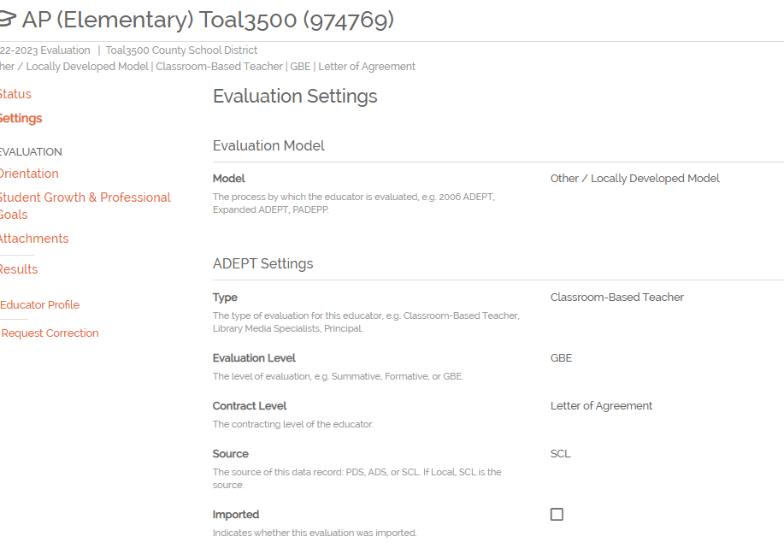
Using SCLead to Enter AP Evaluations
Evaluation Settings:
Locally Developed Model,
Classroom-
based Teacher,
GBE
LOA
Notes:
-Most APs who help out with the evaluation process are staffed as "School Staff" which is a non-evaluated role, but if you want to use SCLead to track AP evaluations there is a work around.
-When you add an evaluation for an AP, in the evaluation settings, please select (walk through each: Other/locally developed, classroom-based teacher, GBE, and LOA (because this will keep them out of the PADEPP statistics and doughnuts),

Slide 24
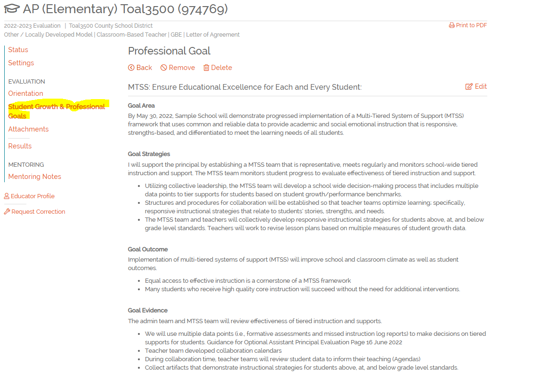
Add Attachment or Use Professional Goals

Slide 25
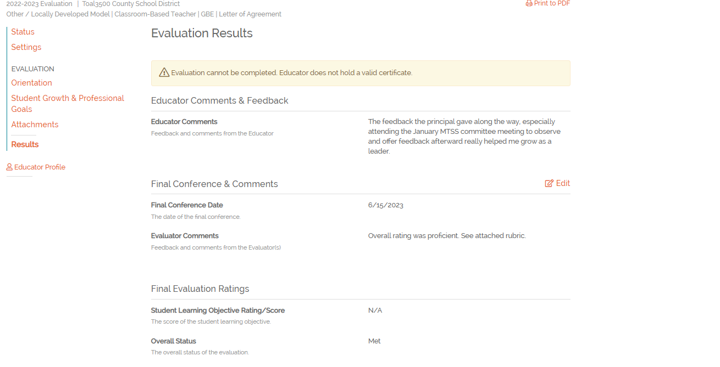
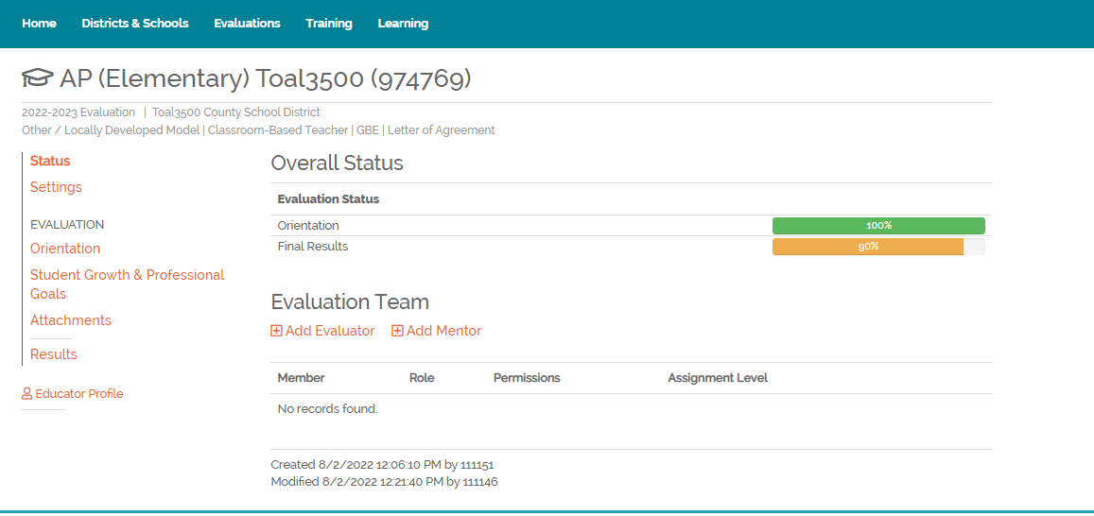
Results Page

Slide 26
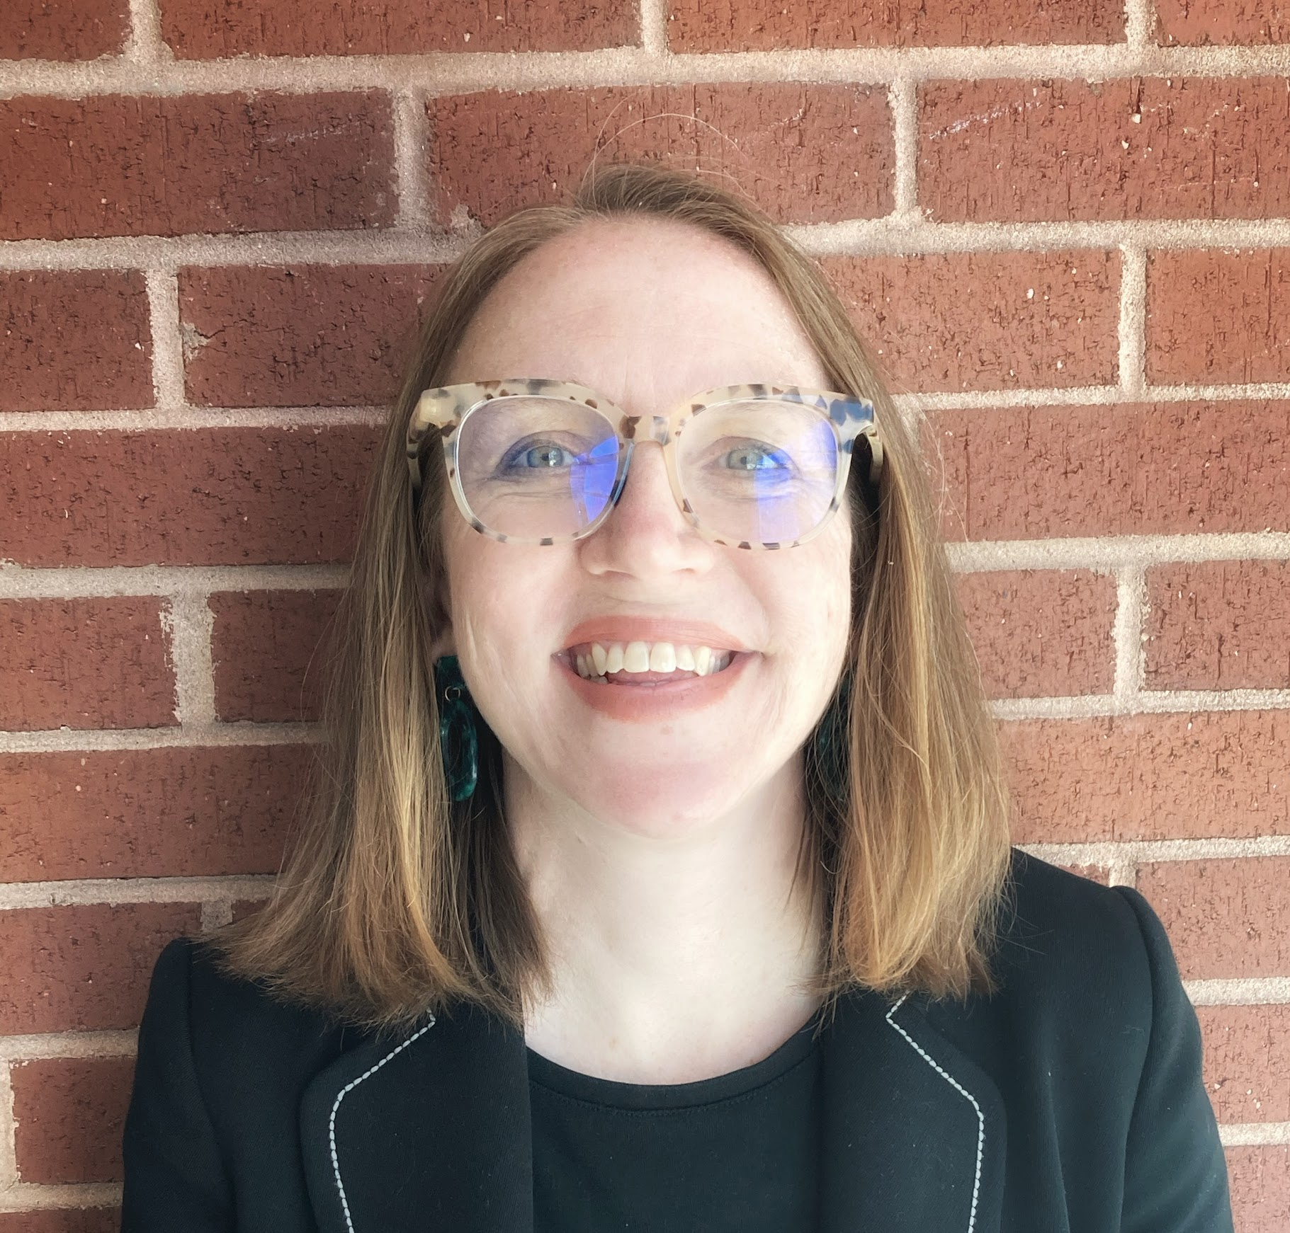
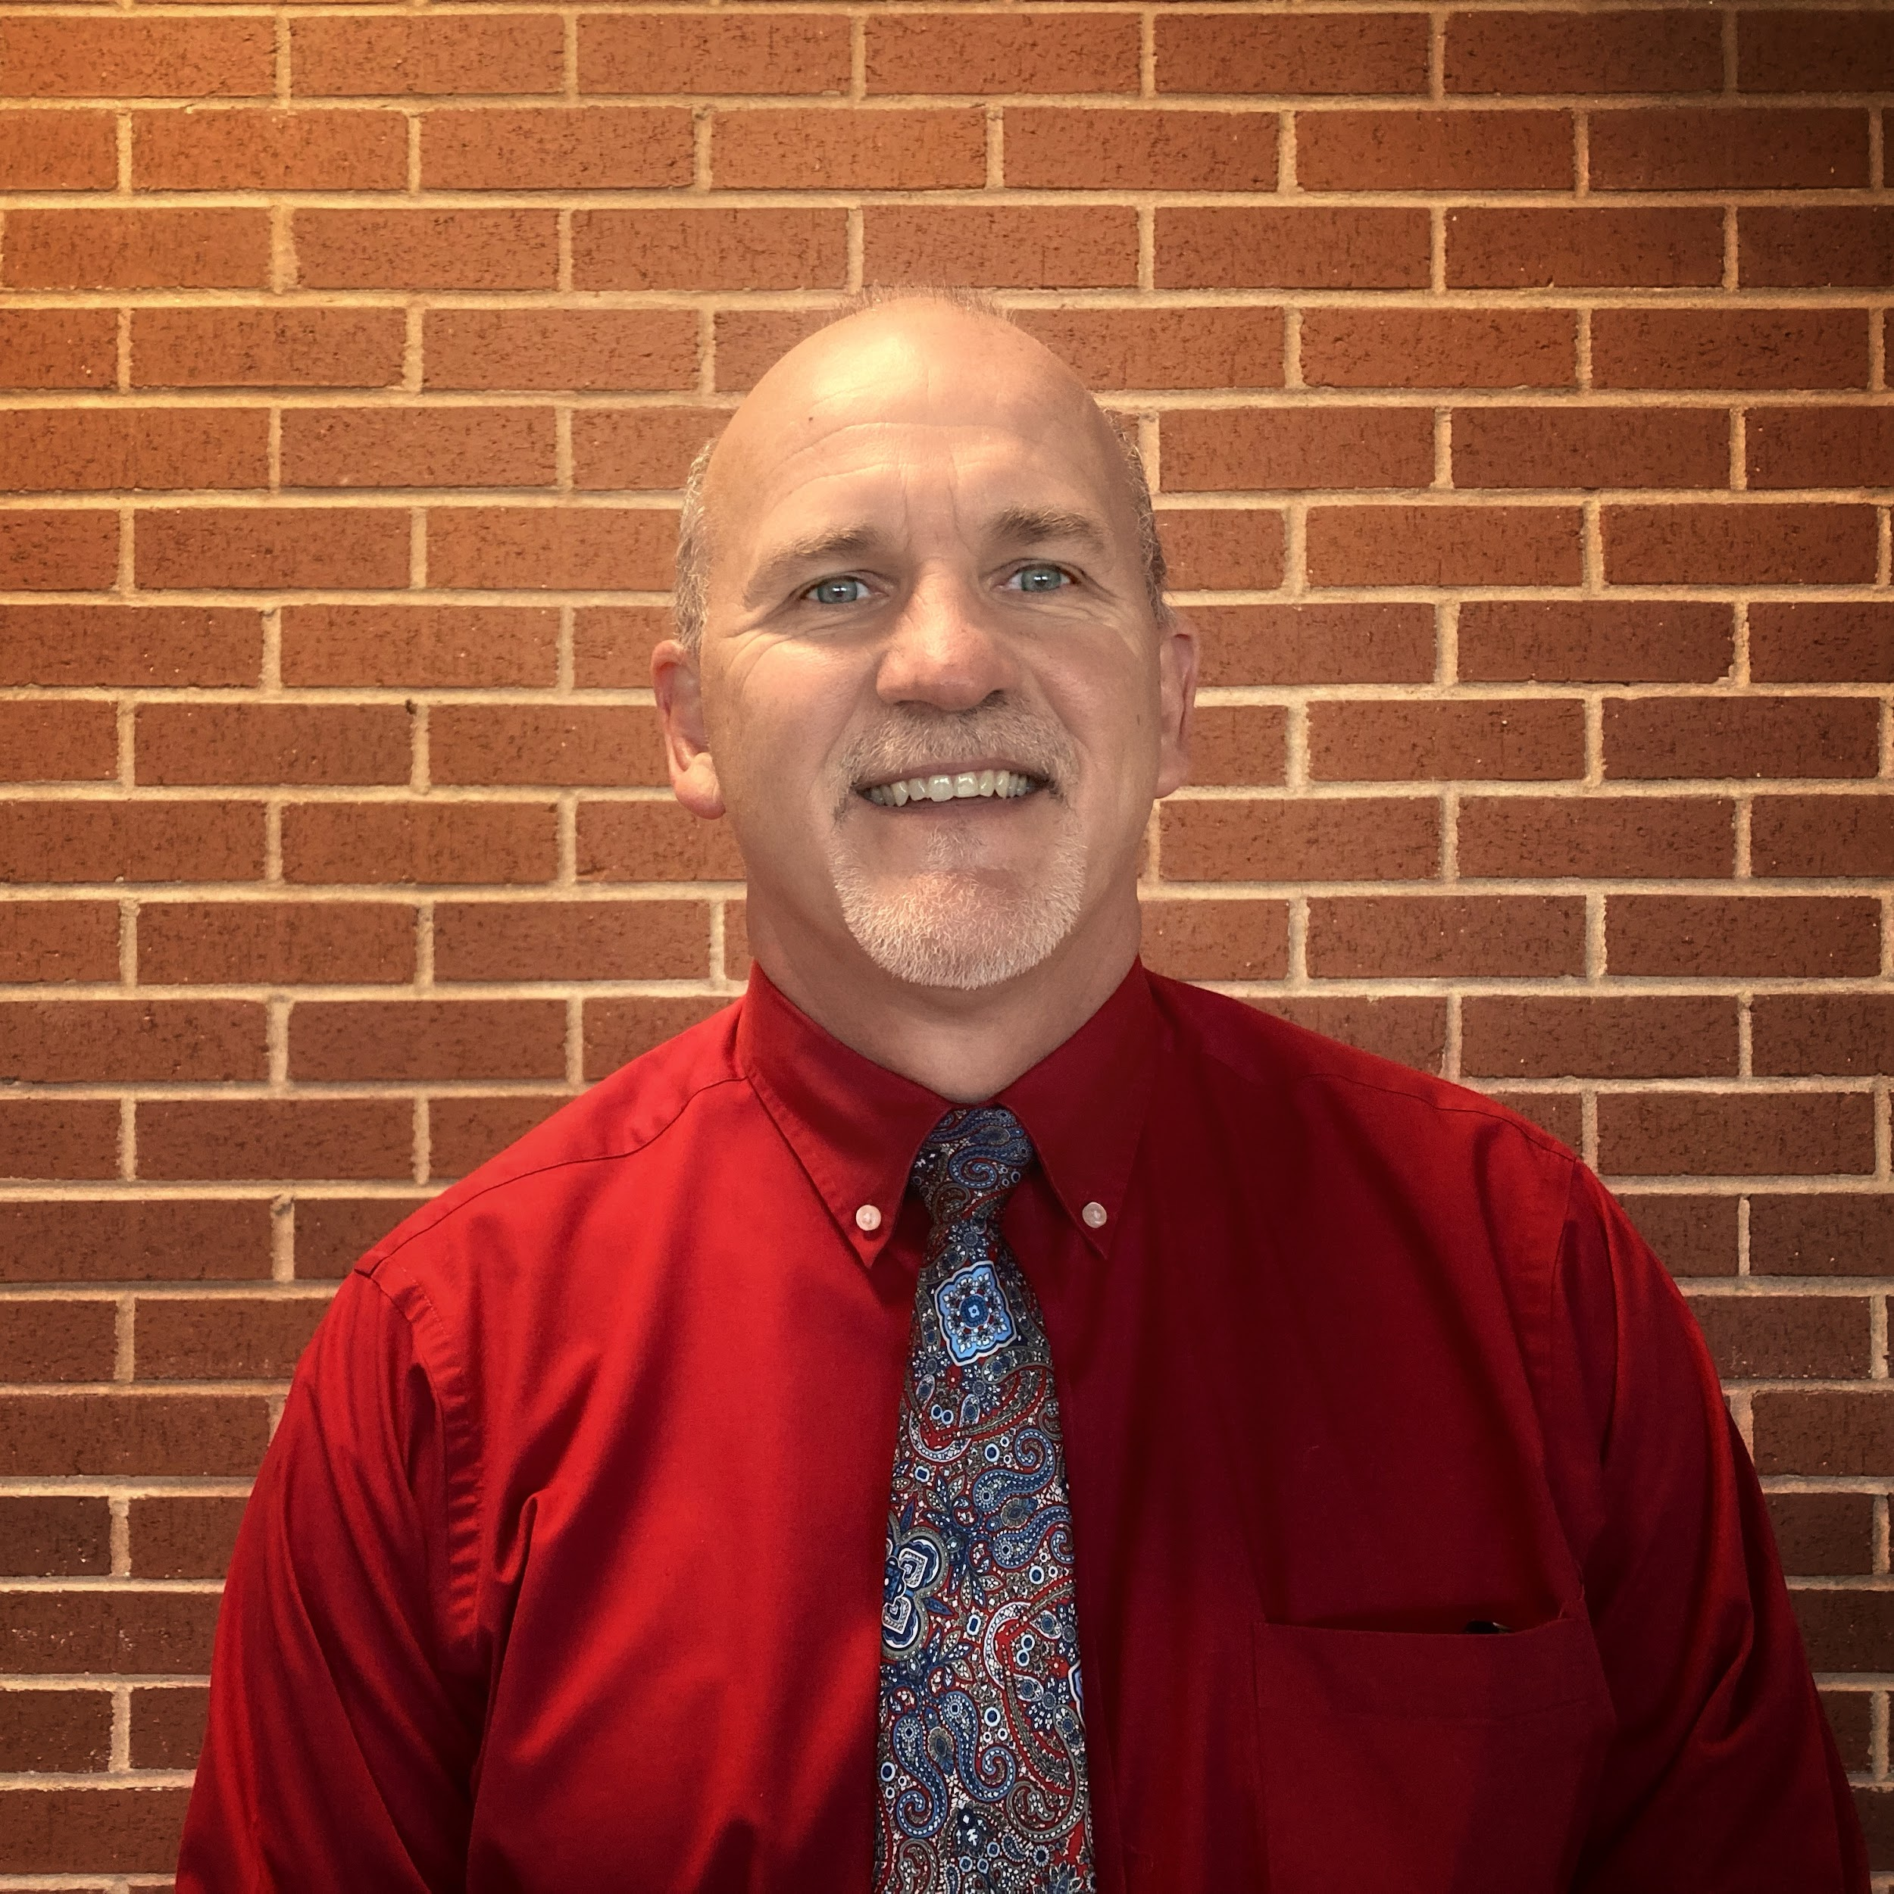
Questions?
Tom Smith,
tsmith@ed.sc.gov
Lilla Toal Mandsager, lmandsager@ed.sc.gov

