Slide 1
Welcome!
ADEPT 2020 for Special Areas Office Hours, School Librarians, January 17, 2024
in, you will nee
Office of Educator Effectiveness &
Leadership Development
2020 Guidelines for all 3 Areas
Rubrics for all 3 Areas
Notes:
Welcome to the spring installment of our Deep Dive into managing Special Areas evaluations in SCLead. Today our focus will be on finishing strong with your evaluations for School Librarians. As a matter of housekeeping before we get started, please mute your mics until you are ready to speak. Feel free to type any questions in the chat, or hop on the mic during our periodic breaks for questions. (Introduce self and team members assisting.)

Slide 2
Agenda
Status Check: Where should we be right now?
Planning: What’s next? Steps for Closing Out the Year
Lingering Questions
Notes:
Today we would like to take some time to do a midpoint check-in on your School Librarian evaluations. These sessions are recorded and will be posted to the Educator Effectiveness webpage once they have been through our accessibility process. Since our main target audience for today is evaluators, we will not spend a lot of time on contract levels or setting up the evaluations, since that was covered in our fall Office Hours for librarian evaluations. That recording can be found on our website at he link on the last slide of today’s deck. However, it is beneficial as an evaluator and an educator to be somewhat familiar with how the evaluation requirements vary based on contract level.

Slide 3
Evaluation components by contract level
Contract Level | # Required Observations? | Can spring observation(s) be waived? | School Librarian Plan? | SMART Professional Goal(s)/GBE? | Content Expert on team? | Assigned certified mentor?
Induction Formative | ≥ 1 per semester | No | Yes | Yes (embedded in Librarian Plan) | No | Yes
Annual or Continuing Summative | ≥ 2 per semester (1 from Administrator and 1 from Content Expert) | No | Yes | Yes (embedded in Librarian Plan) | Yes | No
Annual Formative (Diagnostic Assistance) | ≥ 2 per semester (1 from Administrator and 1 from Content Expert) | No | Yes | Yes ((embedded in Librarian Plan) | Yes | Yes
Continuing Formative (5th Year Recert) | ≥ 1 per semester* | Yes, if scoring all 3s and 4s in Preliminary | Yes | Yes (embedded in Librarian Plan) | No | No
Annual or Continuing GBE | None *But conferences are still required | N/A | No | Yes (This serves as the GBE.) *See Guidelines p. 19 (embedded in Librarian Plan) | No | No
Notes:
Evaluation requirements vary based on contract level as set by your district’s ADEPT Coordinator and factors in certification type and experience. You will notice that the main difference between evaluation levels is the number of required observations and the composition of the evaluation team. For instance, an Induction level librarian would require a certified mentor in addition to the ONE certified evaluator who may be the principal or their designee. The Summative librarian evaluation calls for no mentor, but a two member evaluation team consisting of the principal or their designee and a content expert, a certified librarian. The School Librarian Plan is required for all contract levels except Continuing GBE, when only the Professional Goal is required. The Professional Goal for GBE is embedded in the Librarian Plan section on SCLead. Please keep in mind that the agency sets the floor of requirements, but your district may require additional elements for evaluation, so consult your district ADEPT coordinator if you have specific questions concerning your district requirements.

Slide 4

Domain Weightings for School Librarians
Instruction 30%
Environment 20%
Library Services & Management 40%
Professionalism 10%
Notes:
Similar to the SC Teaching Standards Rubric, the School Librarian Rubric is comprised of four Domains. Librarian evaluations are also weighted based on the rubric. Here you will see the Domain weights for the School Librarian evaluation. The largest percentage weight is given to the Library Services and Management domain because this domain makes up the majority of the librarian’s day-to-day job functions.

Slide 5
Status Check: Where should we be now?
Notes:
SCLead provides several ways for you to check the status of your current school librarian evaluations. Let's look at one of those options now.

Slide 6
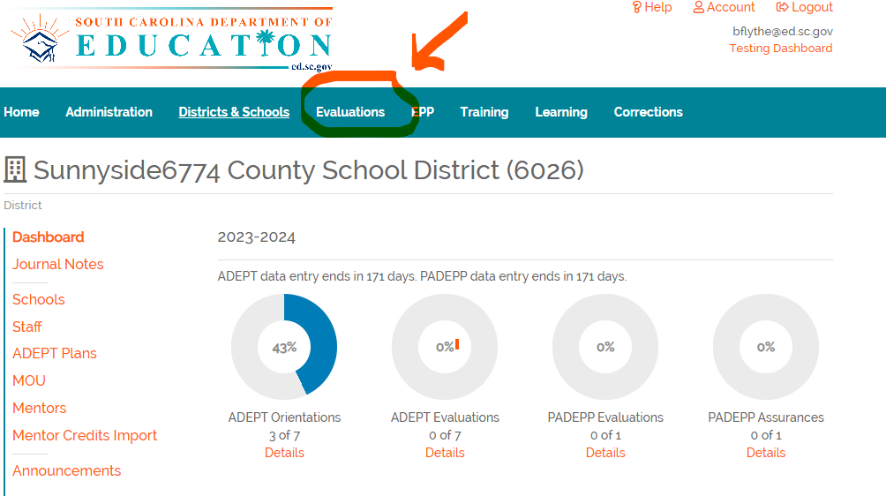
Where do I begin?
Notes:
From your district dashboard you will select the Evaluations tab from the teal bar. This tab will bring up all evaluations for your district.

Slide 7
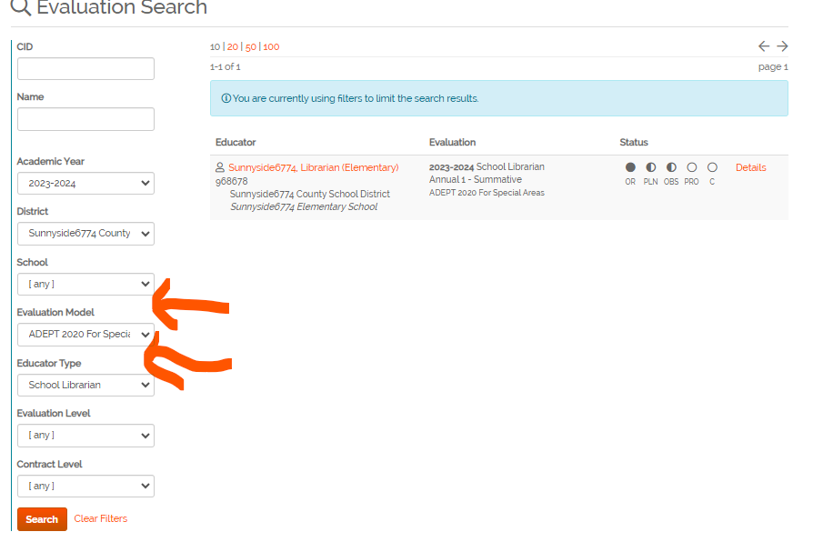
Then what?
Notes:
Once you have selected the Evaluations tab, then it is time to set the filters for your query. Be sure to clear any previous searches before selecting the ADEPT 2020 for Special Areas from the Evaluation Model drop down. Then select School Librarian from the Educator Type drop-down. Don’t forget to click on Search. This will show you an overview of the status of your librarian evaluation completion status, also known as the Bubbles page.

Slide 8
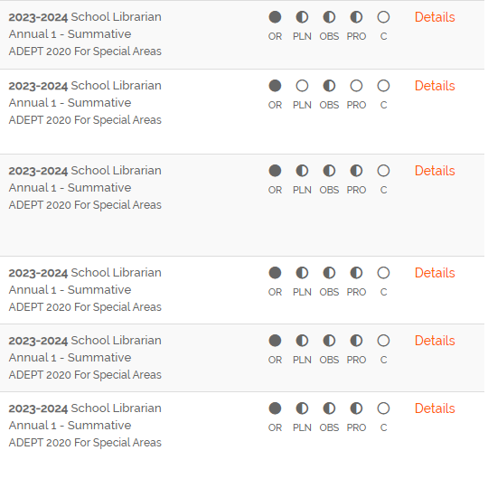
Bubbles
Notes:
You can check here for progress at any point in the evaluation year, but for the purposes of today’s webinar, we are performing a mid-year spot check. To better orient you to your Bubbles page, you see the academic year, librarian’s name, contract and evaluation level, and evaluation model. For school librarians, counselors, and SLPs, that must be ADEPT 2020 for Special Areas. On the right screen, you will see a series of bubbles. The number and type of bubbles varies based on the required elements of the educator’s contract level. You will see the same 5 bubbles for Formative and Summative evaluations. We’ll discuss the Continuing GBE librarian bubbles on the next slide.
Beginning from the left, the first bubble labeled OR is the Orientation bubble. This bubble is either fully shaded or blank, depending on the presence of the educator’s signature on their Orientation page. This signature unlocks their access to the rest of the components of their evaluation.
The second bubble is labeled PLN for the School Librarian Plan. At this point in the year, this bubble should be half filled indicating that the Preliminary Approval Conference and the Preliminary Evaluation Conference have been held and signed by the evaluation chair. Once the Final Evaluation Conference is held and the Plan signed, this bubble will fill completely.
The third bubble is the OBS button and it should be half filled at this point indicating that the required number of observations for the Preliminary Cycle have been completed using the worksheets and that those have been combined into the Preliminary Evaluation Conference form, conference held and signatures present. This bubble will fill completely once the same process is completed for the Final Cycle.
The next bubble is the PRO button for Professionalism. This bubble may fill partially if a Preliminary Review and Self Review are entered and signed during the Preliminary Cycle. Preliminary reviews are not required by the SCDE; however, the Final Professionalism Review is required. Once the Final Professionalism Review is entered by the evaluation chair or principal and the educator’s Professionalism Self-review are entered and both are signed, then the PRO bubble will fill completely.
The final bubble is the C for Complete. Once all components of the evaluation have been completed and all required signatures are present, the district ADEPT coordinator will enter the recommendations for next year, add their signature, and mark the evaluation Complete on the Results page. This will completely darken the C bubble.
As a checkpoint for January, empty bubbles other than the Completion bubble need a closer look. For a clearer picture of the completion level of these elements, click on Details which will take you directly to the evaluation. Since the School Librarian Plan should have at least Approval Conference signatures and Preliminary Cycle Conference signatures, those bubbles should be at least half filled. Since Preliminary Cycle observations should have been completed, this bubble should be at least half filled. Click on Details to dive deeper into the individual evaluation for more information and follow up with the Evaluation Chair.
Missing elements will warrant blue or yellow error messages depending on what is missing. These messages detail the missing element(s) that may be preventing completion

Slide 9
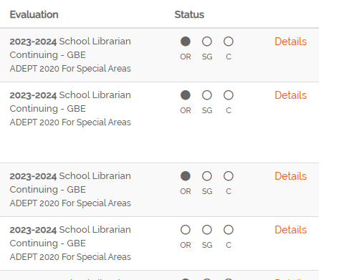
Continuing GBE Bubbles view
Notes:
Here you see the Evaluations tab view when filtered for the Continuing GBE librarians. You will see only three bubbles for these librarians. The First is the Orientation bubble, the middle bubble is the SG bubble which stands for SMART Goal. The SMART Goal is the professional goal embedded within the School Librarian Plan and serves as the Goal in Goals Based Evaluation or GBE. In order to fill this bubble partially, the librarian must enter the SMART goal, the Preliminary Approval conference must be held and signed, and the Preliminary Cycle Conference must be held and signed. This will shade the bubble halfway. Conducting and signing the Final Evaluation Cycle conference will complete the shading of the SG bubble. The last bubble is the C for complete and the same rules apply as discussed in the previous slide. As a side note, these are the same three bubbles that will populate for librarians on Letter of Agreement since those evaluations are suggested but not required in SCLead.

Slide 10
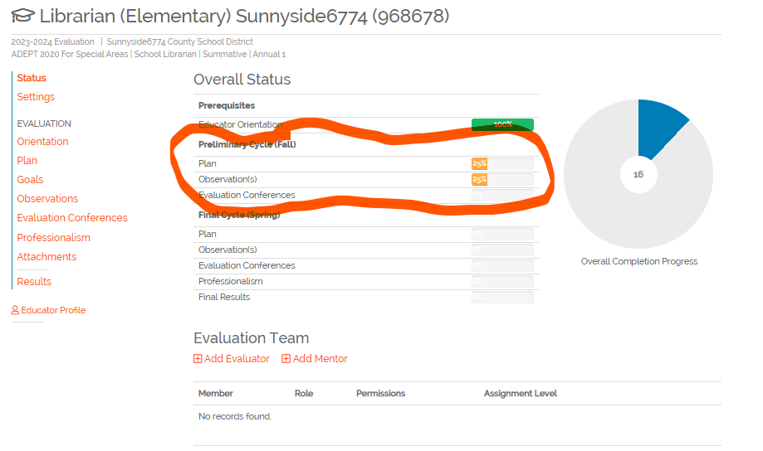
Overall Status Page
Notes:
When you click on Details to examine an individual evaluation, you are directed to the educator’s Overall Status page. This page reflects the percentage complete of the Prerequisites, the Orientation; the Preliminary Cycle, and the Final Cycle, as well as a list of the Evaluation team members and roles. Beside each of the required elements under each cycle you will see a bar graph containing the percentage complete of that element. This percentage is a more precise measure of the level of completion of required elements. For this mid-point check we want to focus on the Preliminary Cycle bars only. As you will see the Plan bar is reflecting only 25%. When we click into Plan on the left menu, you are taken to the School Librarian Plan where you would see only the Preliminary Approval Conference signed by the Principal. You would see that the Librarian had not signed the Preliminary Approval Conference which would increase the completion percentage to 50. Principal signature on the Preliminary Evaluation Conference would increase the percentage to 75% and the addition of the librarian’s signature on the Preliminary Evaluation conference would complete the bar at 100% for the Preliminary Cycle Plan bar. Similarly, you would investigate the 25% for Observations in much the same way. Remember that SCLead will give you the blue and yellow warning messages explaining what is missing for completion. You will also see the individual evaluation donut with the percentage complete for the entire evaluation.

Slide 11
What's Next?
What should we be doing to close out the year strong?
Notes:
Now that we have a better idea of where we stand as we begin the Final Cycle for 2023-24 with these Special Areas evaluations, let's talk about what we still need to accomplish before closing out the year. We discussed some of the is earlier when detailing the Bubbles page, but let’s take a look at a quick checklist.

Slide 12
Checklist for Closing Out the Year
Final Cycle Worksheets- Completed or Skipped
Final Cycle Evaluation Conference Held and Signatures
Professionalism Self-Score Entered
Final Professionalism Score entered
Revisit the School Librarian Plan and sign
Final Evaluation Conference Held and Signatures
Recommendations for Next Year completed and signed by district ADEPT coordinator
Notes:
Once you have verified that the Preliminary Cycle components have been completed it is time to move into the home stretch. Final Cycle Observations should be completed just like Preliminary Cycle Observations using the worksheets, unless the district allows the skip feature to be enabled for experienced librarians coming from out of state or for continuing formative librarians.
Once these observations are completed, the Final Cycle Observation Conference should be held and signed.
The librarian completes the Professionalism Self-Review and the Evaluation Chair completes the Final Professionalism Review and signatures are entered.
Once all of these required components including the Librarian Plan are completed, the Final Evaluation Conference is held and signed. Final Observation and Evaluation conferences may be combined as determined by your particular district's procedures. The District ADEPT administrator or their designee should complete the recommendations for Next Year and sign in order to complete the 2023-24 evaluation.

Slide 13
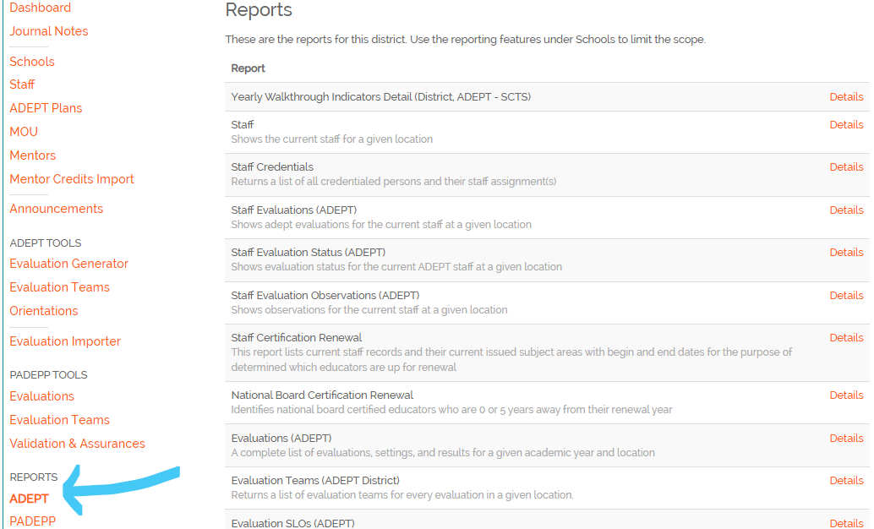
ADEPT Reports
Notes:
For a spreadsheet report drilling down even farther into the evaluation status for librarian evaluations, administrators can pull the Yearly Evaluation Results & Indicator Detail (District (School), ADEPT - SL) report from their ADEPT Reports tab indicated by the arrow on the left of the screen. This report lists all evaluation data and domain/indicator averages for each evaluated school librarian in a given school. The same report can be run by district administrators containing district data.

Slide 14
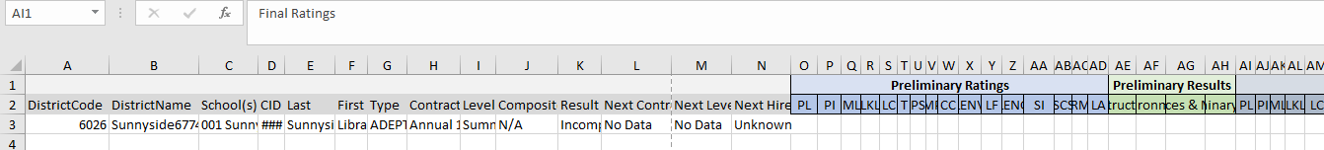
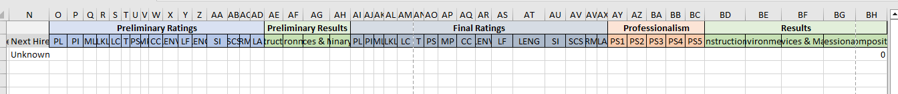
ADEPT Report for Evaluation Status
Notes:
In the screenshot of the column identifiers in the report, you can see that individual indicator scores and cycle results for each cycle, as well as the overall results and recommendations for next year are broken down in one spreadsheet.

Slide 15
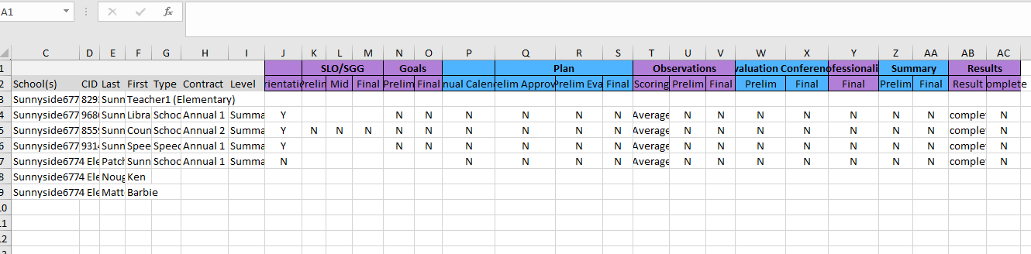
Evaluation Status Report
Notes:
Now for a much more aerial overview of the status without indicator detail, I would suggest the Evaluation Status report which shows you completion status with a simple Y or N for yes or no and doesn’t drill down to indicator level or scores.

Slide 16
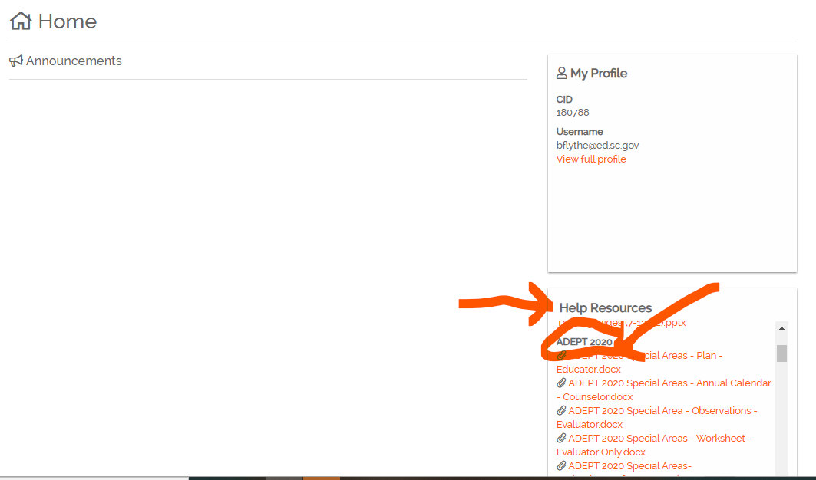
Help Guides
Notes:
We’d like to remind you of the helpful step by step guides we used in the Fall Virtual Office Hours for Special Areas where we used the guides to take us click by click through set-up and beginning evaluations for librarians in SCLead. Those click by click Help Guides can be found on your Home page in SCLead by scrolling down to the bottom of the page. Under the Help Resources box, you should be able to scroll to the ADEPT 2020 section where all of our Special Areas help guides are located. These help guides take you click by click through the steps and have screenshots and detailed descriptions for evaluators and educators to aide in navigating the data entry necessary for your evaluations. If you have confusion around the Worksheet or the Conferencing elements of the evaluations, those particular help guides may be of special assistance.

Slide 17
Stay Connected
ADEPT 2020 for Special Areas
https://ed.sc.gov/educators/educator-effectiveness/adept-for-special-areas-2020/
Beverly Hyatt Flythe, MSEd
803.896.0318
bflythe@ed.sc.gov
Notes:
Here are the links to the content located on our Educator Effectiveness webpage. Also, you will see my contact information, but you can also refer your questions to your ADEPT liaison on our team and they ill be happy to assist.

Slide 18

Wrap-Up and Questions
Notes:
That concludes all of the reminders and information that we have for you today. I’d like to thank my teammates for their assistance with these Office Hours. We are thankful for your participation and attention today. We know what a busy time this can be and we want to respect that time, so if you have no questions, feel free to log off or stick around with us.

Slide 19
Office of Educator Effectiveness
& Leadership Development
Educator Effectiveness Leads
Beverly Flythe, Educator Preparation Programs, bflythe@ed.sc.gov
Jenny Henke, Data & Reporting, vhenke@ed.sc.gov
Kimberly Howard, Mentoring & Induction, khoward@ed.sc.gov
Roshonda Frazier, SLO and Teacher Leadership, rfrazier@ed.sc.gov
Vicki Traufler, PADEPP, vtraufler@ed.sc.gov
  Visit our website: https://ed.sc.gov
  Who’s my ADEPT Contact?: Click here
Leadership Development Leads
  Gerard Edwards, Veteran Principals & District Leaders, gedwards@ed.sc.gov
  Crystal Halma, Collective Leadership, chalma@ed.sc.gov
  Frank Robinson, New Principals & Emerging Leaders, frobinson@ed.sc.gov
  Tom Smith, Instructional Leadership & Assistant Principals, tsmith@ed.sc.gov
  Keasha Grant, Certified Support & Emerging Leaders, ksgrant@ed.sc.gov
Office Support
  Lilla Toal Mandsager, Director, lmandsager@ed.sc.gov
  Marilyn Suber, Administrative Assistant, masuber@ed.sc.gov
Notes:
Please feel free to reach out to us if you have questions or feedback for us. Our email addresses are shown on the slide.

