Slide 1


Educator Effectiveness
Virtual Office Hours
September 10, 2025
Welcome!
What's the one thing that went better than expected at the start of school?
Notes:
Jenny - Welcome to our educator effectiveness virtual office hours. We’re so glad you could make it. Please type in the chat box your name and district. We have an open-response posted that we’d love for you to answer in the chat. We’ll get started right at 2 PM. ​
​
@ 2 PM: Welcome again everyone! (Introduce self and team: Dr. KH, Dr. RF, AC, TN, KB; from the OES: Sherry Schnieder (Assistant Director and Certification Team Lead), Alicia Gaither (Alternate Certification Team Lead), Tess Dawkins (Renewal credit Coordinator) If you haven’t done so, please type in the chat box your name and district. First, to orient you to the Microsoft Teams platform, the control icons will be on the upper right section of your screen for most users. If you haven’t yet, please click the mic icon to mute yourself. You will click the same mic icon to unmute yourself later when we are ready for conversation. We encourage you to utilize the chat throughout this session for any questions you may have during the presentation. Our team will be monitoring the chat and responding accordingly. We will also hold a time at the end for discussion.​ ​
The purpose of Office Hours is to hold time to ensure that we share timely reminders with districts, but even more importantly to create a space where you can share feedback, questions, ideas and best practices with your peers. If you are new, there is no question too small; if you are an effectiveness veteran, don’t be shy about letting us know what you need. Before we get started, let’s see what exciting events have happened recently in our chat. (summarize responses or ask 1-2 districts to elaborate….)

Slide 2
Agenda
ADEPT Reminders
    SLOs
ADEPT Q&A
Certification Updates
Certification Q&A
Notes:
Before we get to questions and open discussion, we have a few things to share with you (read agenda). As we go, please feel free to add questions in the chat. We will respond to all that we can as we go and will address any lingering questions and open up the room for discussion at the end.

Slide 3
ADEPT Reminders
Notes:
We want to start with a some ADEPT reminders that are important for this time of the year.

Slide 4
ADEPT Timeline Check-In
Orientation Signatures
Preliminary Conferences:
    SLO/SGG Approval
    Observation Pre-conferences
Observations
Observation Post Conferences
Use Staff Evaluation (ADEPT) Status Report to check progress
Notes:
Now that August is behind us and hopefully you have a moment to breathe, this is a great time to check the status of your educator's evaluations. Orientations should be getting signed to open the components of educators' evaluations. Preliminary conferences are taking place to include those SLO and SGG approvals along with observation pre-conferences. Some of you may already be in the midst of some observations and preparing for those post conferences. The easiest way to check evaluation progress is by downloading the Staff Evaluation (ADEPT) Status Report in SCLead.org. To locate your ADEPT report menu, simply look to the left menu on your district dashboard and select Reports under ADEPT. The Evaluation Status report is also a great way to make certain your educators are correctly identified and are assigned the correct contract and evaluation levels for the year.
If you notice an educator does not have an evaluation and no longer working for your district, you can make their role and evaluation type and "non-evaluated" until they are removed from compensation. This will ensure SCLead isn't looking for those evaluations to be completed which then skews your district dashboard data.

Slide 5
Student Learning Objectives (SLOs)
"NONE OF THE MEANINGFUL INSIGHTS FROM DATA OR EVALUATIONS CAN FULLY TRANSLATE INTO IMPROVED TEACHING AND LEARNING WITHOUT COACHING. COACHING BRIDGES THE GAP—HELPING EDUCATORS REFLECT ON EVIDENCE, REFINE THEIR PRACTICE, AND TAILOR STRATEGIES THAT MEET DIVERSE STUDENT NEEDS. IT IS THE ESSENTIAL CATALYST TURNING EVALUATION INTO GROWTH."

Slide 6
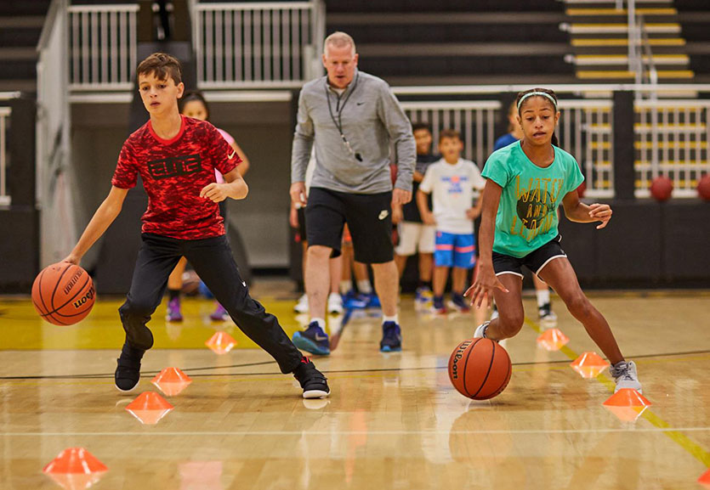
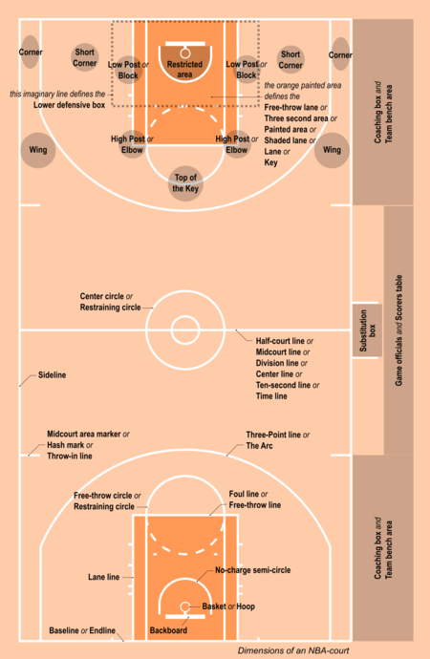
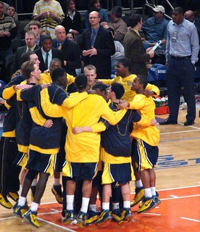
Creating SLO's
Student Outcomes
Clear Written Goals
Conferencing

Slide 7
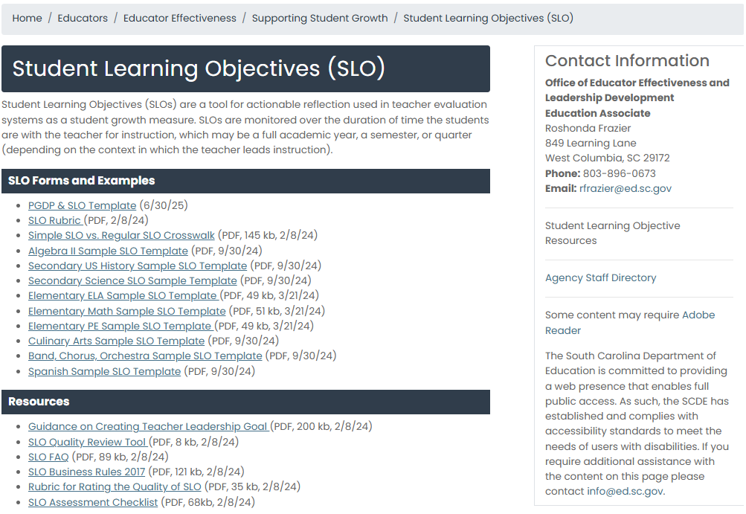
SLO Resources

Slide 8
ADEPT Q&A
Notes:
We are going to take a few minutes to answer submitted questions, then open the mic for any questions you may have.

Slide 9
ADEPT Q&A Responses
1.) If we’re already trained as Evaluator Train-the-Trainers, can we still attend the January 28–29, 2026 session in Columbia, or should we wait for the SCDE’s hybrid session details?
A: Since new information will be shared, you can attend either of the above sessions. Priority will be given to those who have not previously attended the training, but please know that we usually have plenty of room to accommodate participants.
2.) Any updates on when Special Areas will move from Moodle? We have a few administrators currently completing training, and we want to ensure their progress isn’t disrupted.
A: While there is no set date for the platform change, we will be sure to let you know well in advance. Your Administrators can go ahead and complete the training in Moodle.
Notes:
Present questions and answer. We will open the mic now for any questions you may have for the team. At end ask: If you think of questions along the way please place them in the chat. Now, I am going to turn it over to the Office of Educator Services.

Slide 10

Office of Educator Services
Office of Educator Services
September 10, 2025

Slide 11
Office of Educator Services Contacts
Staff Member | Contact Information | Responsibilities
Mary Hipp Director | mhipp@ed.sc.gov 803-896-0352 | All OES Teams Policy and Legislation Certification Assessments Required Credentials
Hannah Mathis Administrative Assistant | hmathis@ed.sc.gov 803-896-0401 | Administrative Support
Sherry Schneider Assistant Director Certification Team Lead | sschneider@ed.sc.gov 803-896-0384 | Educator Certification Required Credentials SC Educator System Access National Board
Becca Burg Education Associate | bfburg@ed.sc.gov 803-896-0434 | Professional Practices Certificate Sanctions
Michael Carothers Education Associate | mdcarothers@ed.sc.gov 803-896-2160 | Exchange Visitor Teachers Critical Needs
Robin Amick Education Associate | ramick@ed.sc.gov 803-896-0474 | CTE Work-based Teacher Certification

Slide 12
Office of Educator Services Contacts Cont.
Staff Member | Contact Information | Responsibilities
Keith Lauer District Certification Contact | rlauer@ed.sc.gov 803-896-0431 | Support to Designated Districts
Jamaica Allen District Certification Contact | jallen@ed.sc.gov 803-896-0311 | Support to Designated Districts
Coleen McLennon-Freeman District Certification Contact | cfreeman@ed.sc.gov 803-896-0440 | Support to Designated Districts
Keri Strauss District Certification Contact | kstrauss@ed.sc.gov 803-896-0341 | Support to Designated Districts
Tess Dawkins Certificate Renewal Coordinator | tdawkins@ed.sc.gov 803-896-0212 | Renewal Support for All Districts

Slide 13
Alternative Certification Contacts
Staff Member | Contact Information | Responsibilities
Alicia Gaither Alternative Certification Team Lead | agaither@ed.sc.gov 803-896-0332 | Alternative Route Programs Candidate Eligibility Participant Progress
Angela Faile PACE Program Coordinator | afaile@ed.sc.gov 803-896-0387 | PACE Participants PACE Training
Kimberly Kelso Alternative Certification Program Coordinator | kkelso@ed.sc.gov 803-896-0320 | American Board | Converse Art Teach for America | Teachers of Tomorrow
Brandon Hoover Alternative Certification Coordinator & District Contact | bhoover@ed.sc.gov 803-896-0370 | Support to Designated Districts APEC Coker | APEC Columbia College| Charter Inspire | TRUSA
Ryan Tavenner Alternative Certification Coordinator & District Contact Web Content Specialist | rtavenner@ed.sc.gov 803-896-9246 | Support to Designated Districts Carolina CAP | NetAPT | Teach AOP TeachFlorence1 Web Content Specialist
Jasmine Wactor Alternative Certification Coordinator & District Contact | jwactor@ed.sc.gov 803-896-0425 | Support to Designated Districts GATE | LEAP| TeachCharleston

Slide 14
Principal Certification
Amendments to Regulation 43-64

Slide 15
School Principal: PK–Grade 12
Principal Program Alignment. No later than September 1, 2026, South Carolina prep programs for school principals must align their courses, field experiences, and internships with the PK–12 grade span.
Internships. For most programs, the realignment will involve updates to the internship component to include the full PK–12 grade span.
Adding School Principal: PK–Grade 12. School leaders certified in Elementary or Secondary Principal may add the new field with a year of experience as an administrator in the complementary grade span or an internship course in the complementary span.
Permits. You may request a permit for an administrator to work in the complementary grade span.

Slide 16
The Educator Assistance Act
The Educator Assistance Act (Act 12 of the 2025-26 Legislative Session) became effective July 1, 2025, and includes provisions supporting educators in South Carolina. This omnibus legislation amends multiple sections of the South Carolina Code of Laws.

Slide 17
Educator Leave and the Educator Assistance Act
Leave Bank. The Educator Assistance Act requires school districts and charter schools to adopt a policy allowing all district or charter school employees to contribute any unused sick or annual leave in excess of 60 days to a sick leave bank. The policy must include eligibility criteria for use of the entity’s sick leave bank.
Unused Leave. Section 59-25-47 is further amended to authorize districts and charter schools to adopt a policy providing that all certified and noncertified teachers identified in the state’s Professional Staff Listing, certified school librarians, certified school counselors, and career specialists may be eligible to receive payment for earned leave in excess of 90 days at the end of a fiscal year. This provision only applies to sick and annual leave accrued after July 1, 2018.

Slide 18
Reemployment Notification Requirements
Reemployment Notification. Annually, before May 1, a district board of trustees, through the local superintendent, must notify a teacher employed by the district concerning the individual’s employment for the ensuing year.
Projected Compensation. The written notification of reemployment must include a projected minimum salary schedule for the district for the upcoming school year. The district is obligated to provide a finalized salary schedule as soon as practicable upon completion of the annual state and local budget approval processes.

Slide 19
Teacher Assignment Notification Requirements
Assignment. No later than 14 days before students are scheduled to return for the start of the new school year, the district must provide notice to a teacher of the assignment for the school year.
Reassignment. Once assigned to a school, the teacher shall not be reassigned to work at another location in the district unless the superintendent can demonstrate the need for the reassignment. The teacher must be afforded written notice at least five school days in advance of the change unless the superintendent can demonstrate that advance notice cannot be accomplished because of a critical student need or the teacher requested the reassignment. The local board of trustees must be notified in writing of all teacher reassignments.
Definition. For this purpose, a teacher is defined as an employee possessing a professional certificate issued by the SCDE who is hired to teach students in an academic setting, except an employee on a multi-year contract.

Slide 20
Teacher Professional Development and Staff Workdays
The Educator Assistance Act amends Section 59-1-425(A) concerning the 190-school calendar. Specifically, the ten staff workdays included in the 190-school calendar must include the following:
  Four days must be used for collegial professional development addressing, at a minimum, academic achievement standards including strengthening teachers’ knowledge of their content area, teaching techniques, and assessment.
  At least two days must be designated as staff workdays for the preparation of the opening of schools. On these days, teachers and instructional assistants must be afforded time that is self-directed and free from assigned meetings or trainings.
  The remaining four days may be used for teacher planning, academic plans, and parent conferences.

Slide 21
Just Cause Basis for Teacher Certificate Suspension or Revocation
The Educator Assistance Act amends the list of “just cause” for the suspension or revocation of an educator certificate to include breach of contract. Previously, unprofessional conduct for breach of contract has been cited as the reason for a related certificate suspension.
The Educator Assistance Act amends Section 29-25-530 concerning breach of contract to address district reporting requirements, certification sanctions, and exclusions

Slide 22
Breach of Contract
The Educator Assistance Act amends Section 29-25-530 concerning breach of contract to address district reporting requirements, certification sanctions, and exclusions
The State Board shall not hear a breach of contract complaint from a district unless it is received within 60 days of the breach.
Any suspension due to breach of contract must begin on the date of the breach of contract and run for a period determined by the Board, not to exceed six months.
Because any suspension for breach of contract must begin the date of the breach, some certificate sanctions will be retroactive.
The SCDE provides notification of all certificate disciplinary actions to South Carolina school districts and to other states through a national database.
An educator must apply for reinstatement of the certificate after the period of suspension.

Slide 23
Breach of Contract Exclusion
Noncontiguous County. A teacher that has a “bona fide” residence change to a noncontiguous county is not considered to be in Breach of Contract.
Burden of Proof. The educator has the burden of proof to demonstrate the residence change to a noncontiguous county.
  The statute provides a non-exhaustive list of documents that may be used to demonstrate the change in residence.

Slide 24
Lifetime Retired Educator Certificate
Certified Employment. The new version of the Retired Educator certificate allows retirees to return to certified employment and maintain a certificate without having to meet renewal requirements. The previous version could only be used for substituting.
Professional Development. Educators working on the Retired Educator certificate must still participate in their district’s required professional development.
Rate of Pay. An educator who works under the retired certificate must work under the agreement and rate of pay established for this purpose by the hiring district.

Slide 25
Lifetime Retired Educator Certificate Cont.
New Applicants. Educators with a valid Professional certificate should wait to apply until the expiration year of that credential to apply.
Educators with the Retired Educator (Substituting) Certificate. OES is in the process of updating these certificates to the new type, restoring the certification fields on the credential.
Every 5 years an educator must submit a request to Maintain the Retired Educator Certificate.

Slide 26
Read to Succeed (R2S) and Recent Changes
More information is available on our R2S webpage
Notes:
Pass the mic to Tess

Slide 27
R2S and Retired Educator Certificate
Qualifying for Retired Educator certificate. Educators are not required to earn a R2S endorsement as part of the qualification process for the Retired Educator certificate.
Renewal requirements. Educators with Retired Educator certificates do not need to meet renewal requirements; R2S is considered a renewal requirement and is not required for maintenance of the Retired Educator certificate.
Employment requirements. Educators with Retired Educator certificates must meet any employment requirements of their position, including LETRS training for educators working in grades K-3.

Slide 28
R2S Endorsements and Timelines
There are 2 R2S endorsements. Which one is needed depends on the certificate fields held:
R2S Literacy Administrator (1 course)
  Due by the conclusion of the first Professional renewal cycle beginning 2015 or later (unless educator has met other endorsement requirements).
  Required for educators certified and working as elementary administrators.
R2S Literacy Teacher (4 courses)
  Due by the conclusion of the second Professional renewal cycle; the first cycle must begin 2015 or later.
  Required for educators certified and working in Early Childhood, Elementary, Special Education (all fields), ESOL (if primary field of certification), and Montessori (PK-5K, Elementary I, Elementary II).

Slide 29
R2S for Elementary Administrators
The R2S Literacy Administrator endorsement may be earned through completion of one of the following approved trainings/courses:
  LETRS for Administrators
  R2S for Administrators
Administrators who earned the R2S Requirement endorsement prior to July 1, 2024 will not be required to complete an additional literacy endorsement.
Educators who have already earned the R2S Literacy Teacher endorsement do not need to earn the additional endorsement.

Slide 30
Methods for Adding R2S Literacy Teacher
The R2S Literacy Teacher endorsement may be added through the following methods:
Successful completion of the four approved R2S courses or equivalent professional development
Successful completion of LETRS Volume I and LETRS Volume II
Submission of an official qualifying score for one of the SBE-approved content area assessments in reading:
Praxis 5205 Teaching Reading: Elementary (Qualifying Score: 159) or
  Pearson Foundations of Reading 890/190 (Qualifying Score: 240)

Slide 31
Work Experience Credit
For Educators
Act 29 of 2025
Notes:
Pass the mic bacak to Sherry (or Alicia)

Slide 32
Implementation Timeline
Non-teaching occupational experience related to the educator’s certification field.
SCDE must have State Board approved guidelines and procedures completed by November 2025.
Changes in SC Educator are in development.

Slide 33
Noncertified Teacher Pilot
Act 30 of 2025
Notes:
Maybe Alicia?

Slide 34
Implementation Process
Act 30 authorizes SCDE to establish a noncertified teacher pilot program, allowing a participating school to hire noncertified teachers meeting eligibility requirements at a ratio up to 10% of the total number of teachers in the school.
Within three years of employment, these individuals must enroll in an approved teacher preparation program.
The SCDE has begun the development of the pilot implementation guidelines. These rules must establish requirements for:
  schools to participate in the pilot,
  eligible certification fields,
  eligibility requirements for noncertified teachers,
  criteria for the review of fingerprint-based background checks required by the statute, and
  procedures for issuing a registration to noncertified teachers in the pilot.

Slide 35
Implementation Process Cont.
The SCDE Office of Educator Services is working with SLED to complete all mandated steps before candidates may apply and complete the fingerprinting process under the new agency code recently issued by the FBI for the sole purpose of the noncertified teacher pilot.
To prepare, superintendents may consider which schools should be eligible for the pilot and how many positions would be eligible given the ratio of up to ten percent of a school’s staff.
Districts and principals should be aware that eligible noncertified teachers must possess a suitable baccalaureate or graduate degree for the position and must have at least five years of relevant workplace experience.
Due to limitations in the federal Individuals with Disabilities Education Act (IDEA), special education fields will not be included in the pilot.

Slide 36
Certification Q&A
Notes:
We would now like to open the mic for any questions you may have for OES.

Slide 37
Certification Q&A Responses
1.) There are many new pathways to certification beyond those first introduced in mentor training. There are also different licenses like provisional license, intern license... Is there a one pager or a chart that breaks down the differences, especially related to evaluation? If not, can there be one made?
2.) We've gotten lots of questions about the Retired Educator certificate. Is there a one-pager or FAQs for that topic that we can give to teachers? Some have received various bits of information that don't completely mesh with my understanding of what is involved in that certificate.
3.) Guidelines for the Non-certified pilot program.
Notes:
From our questions documents...

Slide 38
Links to Resources
ADEPT 101
Deep Dive into Contract Levels 2025
OES: Certification and ADEPT
Notes:
Add to chat:
ADEPT 101
Deep Dive into Contract Levels 2025
OES: Certification and ADEPT

Slide 39
Open Discussion

Slide 40
Office of Leadership Effectiveness
Effectiveness Leads
Leadership Development Leads
Kate Berresford, EPPs, skberresford@ed.sc.gov
Ashley Cohoon, Communications, ascohoon@ed.sc.gov
Dr. Roshonda Frazier, SLO and Teacher Leadership, rfrazier@ed.sc.gov
Jenny Henke, Induction & Mentoring, vhenke@ed.sc.gov
Dr. Kimberly Howard, PADEPP, khoward@ed.sc.gov
Torian Nunn, Data & Reporting, tmnunn@ed.sc.gov
  Visit our website: https://ed.sc.gov
  Dr. Gerard Edwards, Veteran Principals & District Leaders, gedwards@ed.sc.gov
  Keasha Grant, Certified Support & Emerging Leaders, ksgrant@ed.sc.gov
  Crystal Halma, Collective Leadership, chalma@ed.sc.gov
  Dr. Frank Robinson, New Principals & Emerging Leaders, frobinson@ed.sc.gov
Office Support
  Kimberly Mack, Director, kemack@ed.sc.gov
  Marilyn Suber, Administrative Assistant, masuber@ed.sc.gov

Slide 41
SCDE SEAL LOGO

