Slide 1



Educator Effectiveness
Virtual Office Hours
October 13, 2026
Welcome!
What helpful habits or new hobbies are you "falling"
into this season?
Notes:
Jenny-Welcome to our educator effectiveness virtual office hours. We’re so glad you could make it. Please type in the chat box your name and district. We have two opening questions posted that we’d love for you to answer in the chat. We’ll get started right at 2 PM. ​
​
@ 2 PM: Welcome again everyone! If you haven’t done so, please type in the chat box your name and district along with your response to our opening question. I am ____ and I am joined by my colleagues from the Office of Leadership Effectiveness, Kate Berresford, Ashley Cohoon, Dr. Roshonda Frazier, Dr. Kimberly Howard, and Torian Nunn.) First, to orient you to the Microsoft Teams platform, the control icons will be on the upper right section of your screen for most users. If you haven’t yet, please click the mic icon to mute yourself. You will click the same mic icon to unmute yourself later when we are ready for conversation. We encourage you to utilize the chat throughout this session for any questions you may have during the presentation. Our team will be monitoring the chat and responding accordingly. We will also hold a time at the end for discussion.​ ​
The purpose of Office Hours is to hold time to ensure that we share timely reminders with districts, but even more importantly to create a space where you can share feedback, questions, ideas and best practices with your peers. If you are new, there is no question too small; if you are an effectiveness veteran, don’t be shy about letting us know what you need. Before we get started, let’s consider our opening question (summarize responses or ask 1-2 districts to elaborate….)

Slide 2
Agenda
ADEPT Reminders
District Spotlights: Sharing ADEPT Success Strategies
    Williamsburg
    Richland 1
    Lexington 1
Induction and Mentoring
Foundations in School Leadership
FAQs
Questions and Discussion
Notes:
We are so glad to have you here with us today. We have a few things to share with you as seen on our Agenda (read items). As we go, please feel free to add questions in the chat. We will respond to all that we can as we go and we address any lingering questions and open up the room for discussion at the end.
Pass the mic to Kate.

Slide 3
ADEPT Reminders
Notes:
Kate
We have a few ADEPT reminders for you today.

Slide 4
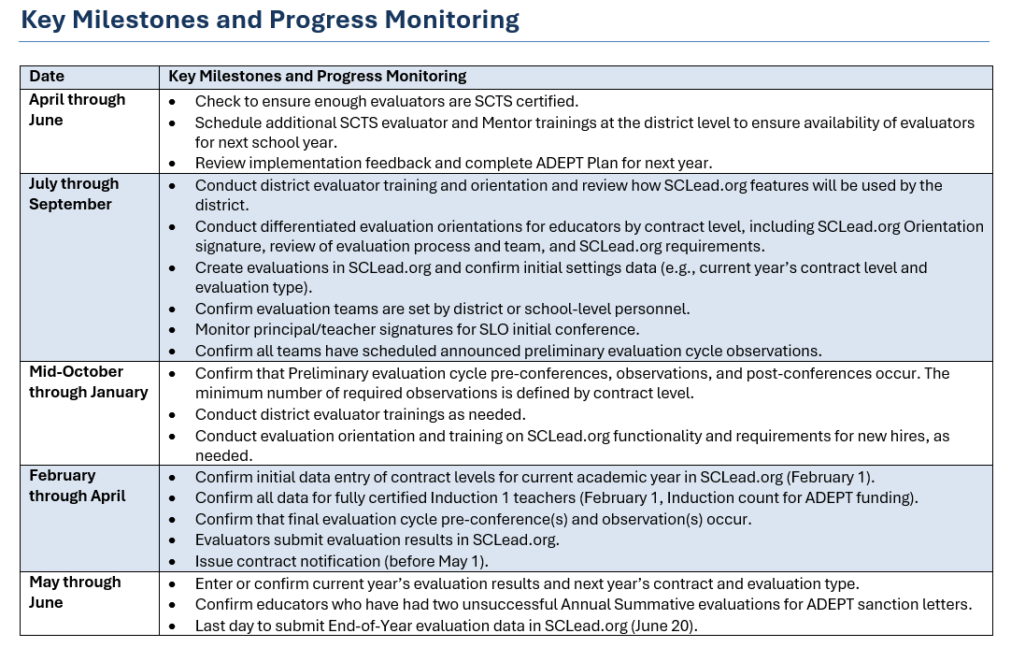


ADEPT Calendar
Notes:
Between now and January, please make sure you confirm that Preliminary evaluation cycle pre-conferences, observations, and post-conferences have occurred. Remember, the minimum number of required observations is defined by the educator's contract level. Conduct district evaluator trainings as needed; and conduct evaluation orientation and training on SCLead functionality and requirements for new hires, as needed.

Slide 5
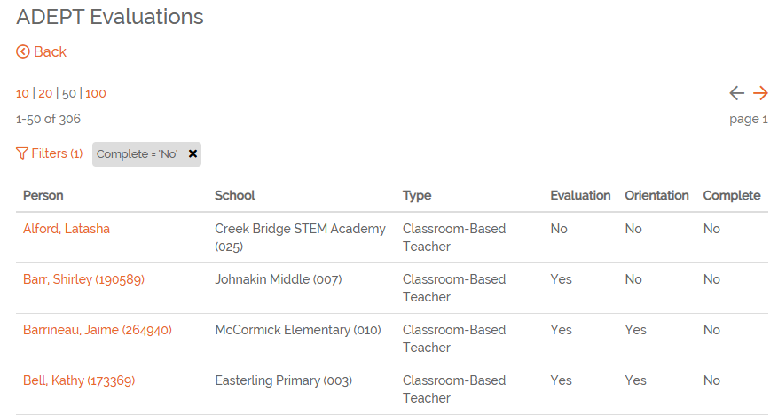
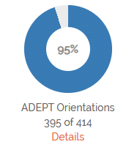

Orientations
Orientation Donut
Filtering Staff
3
1
2
Notes:
Orientations must be signed by the educator in order for the components in the evaluation to open up. In SCLEAD, on your district's dashboard, you will find your Orientation Donut. By the end of September this should have been at 100%. If it is not, then you can click details under the donut and filter "No" in the orientation column to see which educator's still need to sign their orientation. If you see "no" under evaluation, double check that the educator is still employed in the district. If so and the educator is in a position that requires it, create an evaluation. If the educator is in a position that does not require an evaluation, mark the role as "school staff" and evaluation type as "not evaluated." If this educator is no longer employed in your district, mark both the role and evaluation types as "not evaluated" and notify your district's finance department to add a termination date in the compensation system.

Slide 6
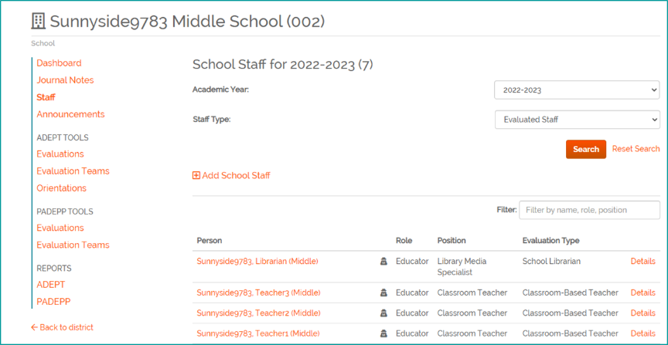
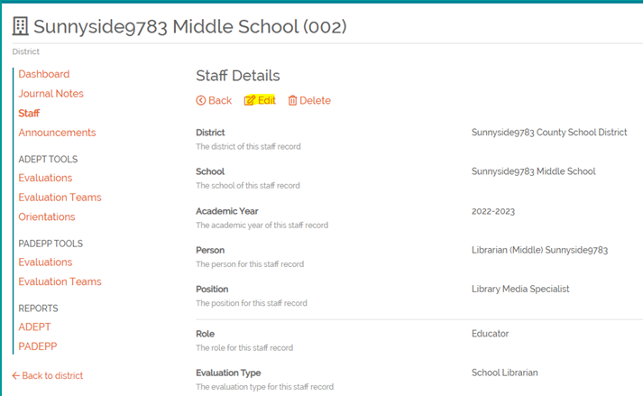
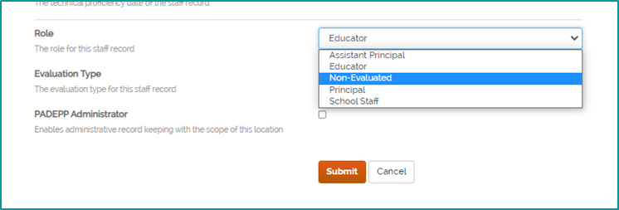
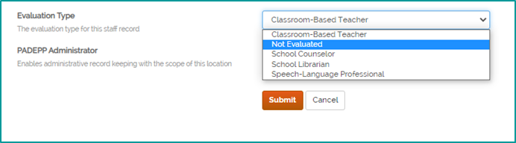
Cleaning up Staff Lists
2
1
3
4
Notes:
Finally, cleaning up staff lists. Since you will need to be checking and cleaning up your staff lists as the school year progresses, we wanted to give you a quick reminder on how to do this. Looking at a School Staff list in SCLead, you will see filters for the Academic Year, Evaluated Staff and Non-evaluated Staff as shown on the left. You will see a list of educators pulled from SCEducator and their corresponding roles and positions, as well as evaluation types. On the right-most column you will see "details". To go about "cleaning-up" your staff lists: for educators no longer working in your district, notify your finance department to add a termination date in their compensation system so the educator will be removed from SCLead. In the meantime, mark the educator's role and evaluation type as "not evaluated" so it removes the educator from the orientation and evaluation donuts. I'm going to pass it back to Jenny now for District Spotlights.
Pass the mic back to Jenny

Slide 7
District Spotlights:
Sharing ADEPT Success Strategies
Notes:
Jenny
Whether it’s submitting signed orientation forms on time, ensuring observations are completed with all required signatures, or keeping principals and school leaders actively engaged in classroom observations, we appreciate your commitment to ensuring ADEPT responsibilities are completed within the timelines outlined in your districts' ADEPT plans. We've asked several districts to share sharing practical tips, tools, or communication practices that help keep everyone informed during the evaluation process.

Slide 8

Dr. Latetia Staggers – Williamsburg County School District
Tips for Helping Evaluators Enter Data into SCLead.org in a Timely Manner:
  1. Build Supportive Relationships
    Develop strong, supportive relationships with evaluators, team chairs, teachers, and district personnel.
      Provide one-on-one assistance and in-person technical support, particularly for new evaluators and teachers.
      Send weekly or biweekly reminders regarding upcoming responsibilities and deadlines.
      Maintain open communication and create a welcoming environment in which staff members feel comfortable asking questions.
  2. Monitor Progress in SCLead.org
    Establish checkpoints or “temperature checks” to monitor completion rates and identify areas requiring additional support.
      Log in to SCLead.org weekly to review district and school-level progress.
      Share progress updates with evaluators and team chairs.
      Identify incomplete requirements and follow up with the appropriate staff members.
      Celebrate accomplishments while encouraging continued progress.
  3. Use a Collaborative Team Approach
    Dr. Staggers, Mrs. Brunson, Jenny Henke, and Dr. Kimberly Howard work as “Partners in Progress.”
    The team communicates regularly to:
      Troubleshoot concerns and resolve technical issues.
      Develop appropriate plans of action.
      Monitor completion data.
      Provide targeted assistance.
      Plan professional learning opportunities based on identified needs.
Notes:
I'd like to welcome Dr. Latetia Staggers from Williamsburg County School District to share herADEPT Evaluation Success strategies.

Slide 9
Dr. Latetia Staggers – Williamsburg County School District Continued
4. Adhere to ADEPT and PADEPP Timelines
  Conduct ADEPT and PADEPP orientations and refresher sessions at the school and district levels during the summer and fall.
  Train new evaluators and team chairs as soon as possible.
  Provide evaluators with ADEPT and PADEPP timelines well in advance.
  Create resource binders outlining expectations, applicable legislation, procedures, and SCDE guidance.
  Establish an internal completion deadline at least five business days before the official deadline. This provides a buffer for unexpected circumstances or needed corrections.
  Use read receipts for emails involving firm deadlines or time-sensitive requirements.
  Follow up directly with evaluators who may require additional assistance.
  Document communications, support provided, and progress toward completion.
Keys to Success
  Timely SCLead.org data entry requires consistent communication, proactive monitoring, accessible technical support, clear expectations, and a collaborative approach. When evaluators receive the resources and support they need, the district is better positioned to meet all ADEPT and PADEPP requirements on time.

Slide 10

Daniel Oddo – Richland School District 1
Know the Policy Manuals:
  Flow Chart: ADEPT Contract Levels and Evaluations
  ADEPT Evaluation System Guidelines for Classroom-based Teachers
  SCTS Process Manual
  ADEPT for Special Areas 2020
3-Phase Check-in:
  "SCLead Assurance" - checking all Teams and Initial Conferences
  Mid-Year (end of preliminary cycle) conferences with each site
  Final conferences with each site
Quality Coaching within the POP-Cycle
4. "Above and Beyond" the ADEPT Minimum (part of our ADEPT Plan)
Notes:
We would now like to welcome Daniel Oddo, from Richland School District One, to share about his tips for ADEPT success including his 3-Phase Check-in.
Drop Links in Chat:
Flow Chart: ADEPT Contract Levels and Evaluations
ADEPT Evaluation System Guidelines for Classroom-based Teachers
SCTS Process Manual
ADEPT for Special Areas 2020

Slide 11
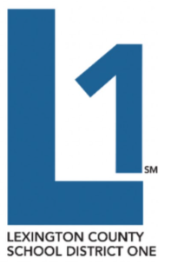
Will Moody - Lexington School District 1
Each school has an evaluation spreadsheet that is shared with me and the school’s administrators
  Lists all Induction, Annual Summative and Continuing Comprehensive educators
  I regularly add feedback to each spreadsheet to keep the administrators on track with the ADEPT timeline (via the mid-cycle evaluation audit mentioned below)
Developed a Standard Operating Procedure (SOP) called the Fall and Spring Mid-Cycle Evaluation Audit
  During each audit, I provide detailed feedback about every single Induction, Annual Summative and Continuing Comprehensive evaluation in Lexington One
General ADEPT timeline reminders are provided in a weekly memo to all Lexington One administrators (along with reminders from other departments)
Notes:
We will conclude our strategies for ADEPT success with Will Moody, from Lexington School District One, to share his Standard Operating Procedure for evaluations.
Drop Link in Chat: https://docs.google.com/document/d/1UOQjBxWFmtBIlDdApnARlNhHLDbMNxC7FMvcwBEOi10/edit?usp=sharing

Slide 12
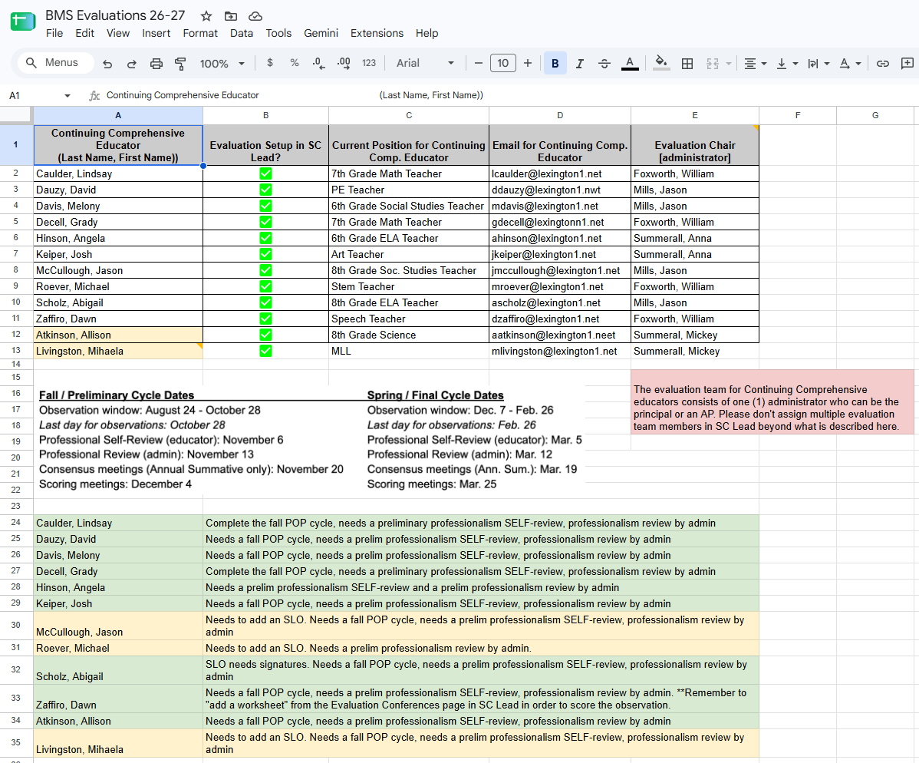
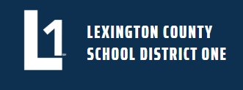
Snippet of a School’s Evaluation Spreadsheet
Active evaluations are listed here
ADEPT timeline reminders are included here
My feedback is provided here via the mid-cycle evaluation audit
Notes:
Thank you to our ADEPT Coordinators for sharing your time, expertise, and encouragement. Your contributions help strengthen our collective efforts to support educators across the state and in turn positively impact student learning outcomes.
Pass the mic to Ashley

Slide 13
Induction & Mentoring
Notes:
Ashley

Slide 14

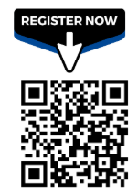



Mentor & Induction Virtual Support Sessions
M & I _ Virtual Support Session Registration Links (13).pdf - Google Drive
Sponsored by:
*Mentors who attend the live session will receive 1 PD hour that can be applied to the18 required credits to maintain their mentor credential.
Notes:
At our September Mentor and Induction Virtual Support session, we had 30 educators join us! We had great conversations about lesson, structure and pacing as well as giving sample templates for lesson presentation and organization. These monthly sessions are designed for educators to explore evaluation best practices, strengthen effective instruction through rubric support, discover useful resources, and connect with others across the state.
Please pass this along to your Induction 1 educators, other early career educators, mentors, or whoever else could benefit from this resource. Registration is through the QR code or the link in the chat.
Drop Link in the Chat:
Flyer with Registration Links to All M&I Virtual Support Session Dates: https://drive.google.com/file/d/1EWzvBgDs1E9Usyz9URLEWJwCbsBz1Ise/view?usp=sharing
Pass the mic to Roshonda

Slide 15
Foundations in School Leadership
Dr. Keasha Grant & Dr. Roshonda Frazier
Notes:
Roshonda

Slide 16
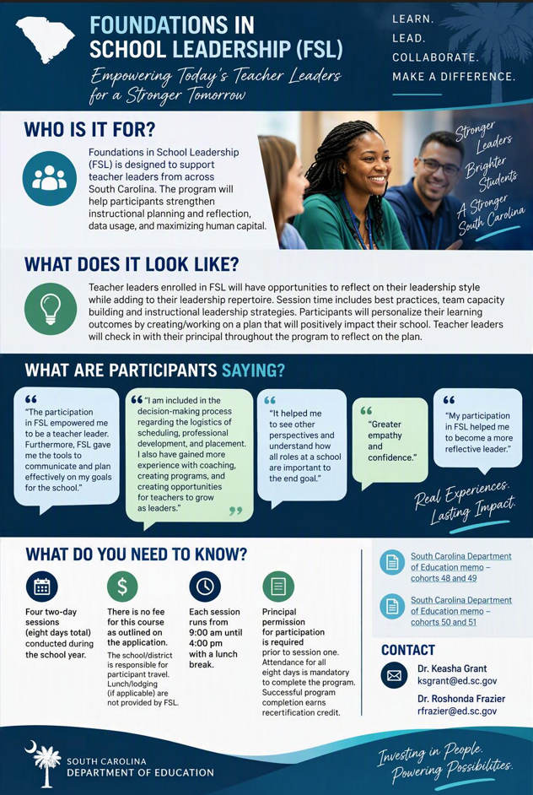
Foundations in School Leadership
Notes:
Links to Drop in Chat:
Teacher Leadership Professional Learning Opportunity: FSL Memo: Cohorts 48 & 49
Teacher Leadership Professional Learning Opportunity: FSL Memo: Cohorts 50 & 51
Pass the mic to Torian

Slide 17
Frequently Asked Questions
Notes:
Torian

Slide 18
FAQs
Q: How do other districts evaluate the following:
    Dean (school level)
    Testing Coordinator (school level)
    Program Coordinator (school level/high school)
    Career Specialists (district, school level)
    Literacy Coaches, Instructional Coaches (school level)
A: Options to evaluate educators who are not "classroom-based":
  Option A: Professional Goals (use template to align to a leadership growth plan)
  Option B: Teacher Leadership Goals (click "Skip SLO" and select "Teacher Leadership Goal"
    South Carolina Department of Education Teacher Leadership Goal Guidance
  Option C: Several districts are in the process of creating a district-developed model to evaluate
  their non-classroom-based educators
  Option D: Mark educator as "School Staff" and "Not Evaluated" and keep hard copy records
Notes:
We had two questions that we wanted to share. (read slide)
Would any other district coordinators be willing to share how you evaluate educators who are not classroom-based? (open for discussion)
Link to drop in chat: South Carolina Department of Education Teacher Leadership Goal Guidance

Slide 19
FAQs 2
Q: Do you know of any SCTS 4.0 Evaluator Training options being offered by the SCDE or other districts?
A: Upcoming Trainings offered by SCDE:
SCTS 4.0 EVALUATOR Training
January 12–14, 2027
9:00 a.m.– 4:30 p.m.
Location: Marcia O'Brien Conference Center
200 Stadium Circle
Summerville, SC 29483
Registration Link
SCTS 4.0 TRAIN THE TRAINER Training
November 4-5, 2026
9:00 a.m.–4:30 p.m.
South Carolina Department of Education
849 Learning Lane
West Columbia, SC 29172
Registration Link
Are any districts hosting SCTS 4.0 training and willing to let others join?
Notes:
(read slide)
Links to Drop in Chat:
Train the Trainer Training: SCTS 4.0 Teacher Evaluator Training: January 12 - 14, 2027
SCTS 4.0 Evaluator Training: SCTS Train-the-Trainer Training: November 4 - 5, 2026
Pass the mic back to Jenny

Slide 20
Questions and Discussion
Notes:
Jenny
We appreciate everyone joining us today for our October Virtual Office Hours. If anyone has any questions or has something up for discussion, we welcome you to turn on your mic or drop it in the chat.

Slide 21
Office of Leadership Effectiveness
Educator Effectiveness Leads
Leadership Development Leads
Kate Berresford, EPPs, skberresford@ed.sc.gov
Ashley Cohoon, Communications, ascohoon@ed.sc.gov
Dr. Roshonda Frazier, SLO and Teacher Leadership, rfrazier@ed.sc.gov
Jenny Henke, Induction and Mentoring, vhenke@ed.sc.gov
Dr. Kimberly Howard, PADEPP, khoward@ed.sc.gov
Torian Nunn, Data and Reporting, tmnunn@ed.sc.gov
Visit our website: https://ed.sc.gov
  Dr. Gerard Edwards, Veteran Principals & District Leaders, gedwards@ed.sc.gov
  Dr. Keasha Grant, Certified Support & Emerging Leaders, ksgrant@ed.sc.gov
  Crystal Halma, Collective Leadership, chalma@ed.sc.gov
  Dr. Frank Robinson, New Principals & Emerging Leaders, frobinson@ed.sc.gov
  Dr. Adrienne Davenport, Instructional Leadership & Assistant Principals, adavenport@ed.sc.gov
  Kimberly Mack, Director, kemack@ed.sc.gov
  Marilyn Suber, Administrative Assistant, masuber@ed.sc.gov
Office Support
Notes:
Jenny
We thank you for your time today. We will stay for a few extra minutes if anyone has any additional questions.
Feel free to reach out to us if you have questions that arise. Our email addresses are shown on the slide.
Have a great rest of your day!

Slide 22
SCDE SEAL LOGO

