Slide 1


Educator Effectiveness
Virtual Office Hours
November 12, 2025
Welcome!
What song gets you pumped up and ready for your day?
Notes:
Welcome to our educator effectiveness virtual office hours. We’re so glad you could make it. Please type in the chat box your name and district. We have an open-response posted that we’d love for you to answer in the chat. We’ll get started right at 2 PM. ​
​
@ 2 PM: Welcome again everyone! (Introduce self and team) If you haven’t done so, please type in the chat box your name and district. First, to orient you to the Microsoft Teams platform, the control icons will be on the upper right section of your screen for most users. If you haven’t yet, please click the mic icon to mute yourself. You will click the same mic icon to unmute yourself later when we are ready for conversation. We encourage you to utilize the chat throughout this session for any questions you may have during the presentation. Our team will be monitoring the chat and responding accordingly. We will also hold a time at the end for discussion.​ ​
The purpose of Office Hours is to hold time to ensure that we share timely reminders with districts, but even more importantly to create a space where you can share feedback, questions, ideas and best practices with your peers. If you are new, there is no question too small; if you are an effectiveness veteran, don’t be shy about letting us know what you need. Before we get started, let’s see what exciting events have happened recently in our chat. (summarize responses or ask 1-2 districts to elaborate….)

Slide 2
Agenda
ADEPT Reminders
SCLead Reminders
Mentoring & Induction
Leadership Highlight- F.S.L.
Q & A
Notes:
We are so glad to have you here with us today. Before we get to questions and open discussion, we have a few things to share with you (state them). As we go, please feel free to add questions in the chat. We will respond to all that we can as we go and will address any lingering questions and open up the room for discussion at the end.

Slide 3
ADEPT Reminders
Notes:
We want to start with a some ADEPT reminders that are important for this time of the year.

Slide 4
ADEPT Timeline Check-in
Observation
Observation Post Conferences/Consensus Meetings
Preliminary Conferences and Mid-Year SLO/GBE Conferences
Follow-up with schools that do not have SG or OBS bubbles at least partially filled on the Evaluation Tab

Slide 5
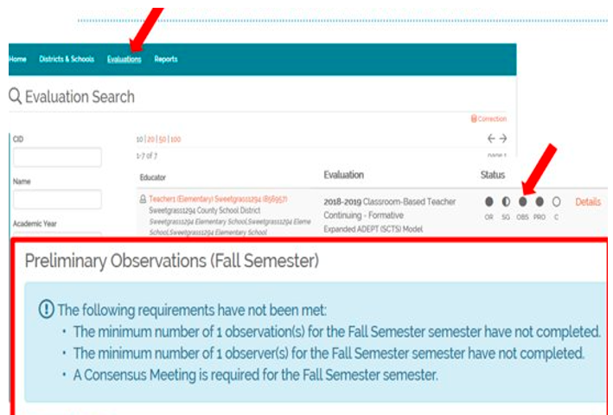
Wrapping up Preliminary Cycles and Beginning Final Cycle Evaluations
• The Observation status bubble denotes that the Evaluator has signed the Post-Conference form.
• A filled-in observation bubble DOES NOT indicate that the correct number of observations are loaded, nor does it indicate that the teacher has signed the post conference form.
• Teacher signatures are needed but will not prevent the evaluation from being completed or closed.
Notes:
A helpful tool for monitoring the progress of evaluations is using the Status Bubbles on the Evaluation Tab.
A filled bubble denotes that the evaluator has completed and signed appropriately. Partially filled bubbles denote that parts of that component have been completed.
Please note that a filled in observation bubble DOES NOT indicate that the correct number of observations are loaded, nor does it indicate that the teacher has signed the post conference form.
Teacher signatures are needed but will not prevent the evaluation from being completed or closed.
Remind evaluators to get teacher signatures during the post conference prior to closing/completing the evaluation.

Slide 6
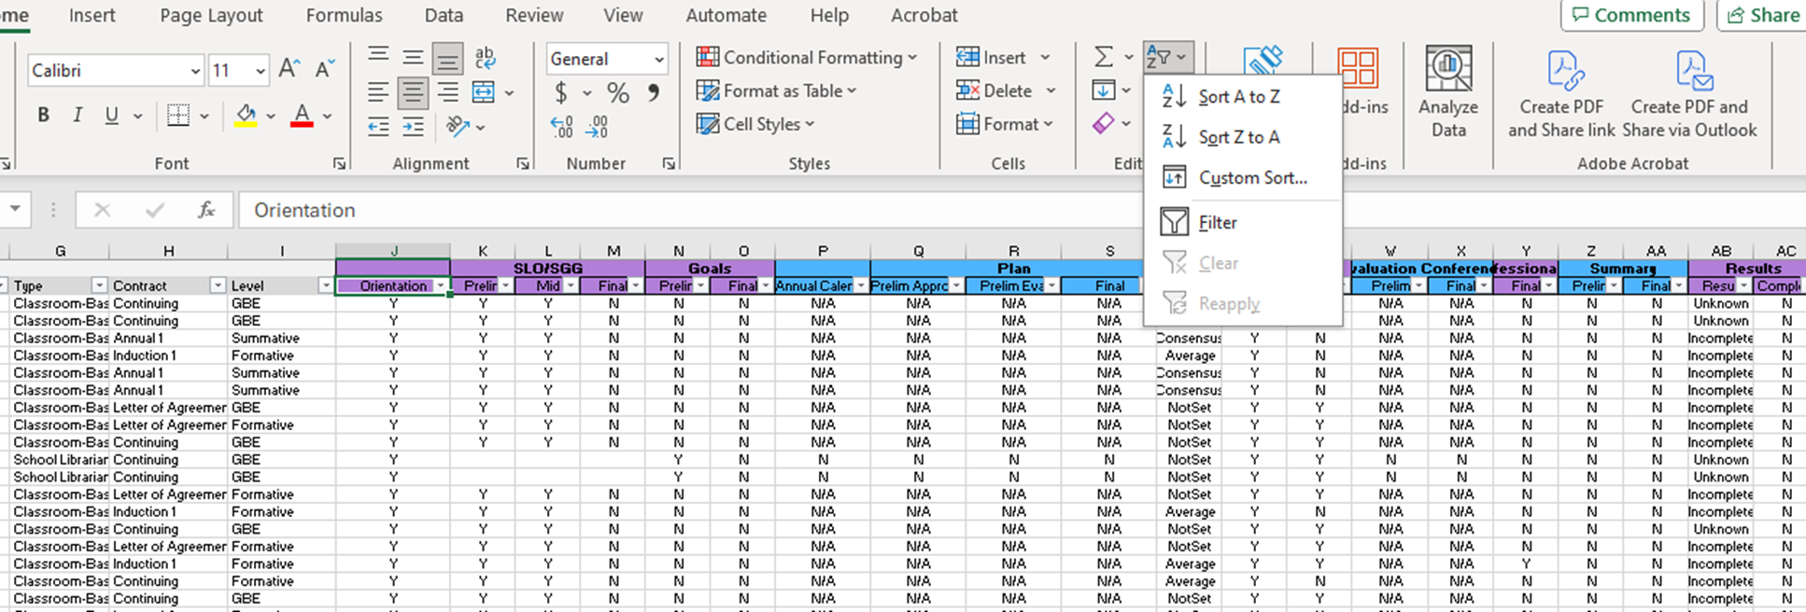
Evaluation Status (ADEPT, District) Report
Notes:
The easiest way to check evaluation progress is by downloading the Evaluation Status (ADEPT, District) Report in SCLead.org. To locate your ADEPT report menu, look to the left side on your district dashboard and select Reports under ADEPT. The Evaluation Status report is also a great way to make certain your educators are correctly identified and are assigned the correct contract and evaluation levels for the year. You can use the sort and filter tool to drill down to specifics for your district evaluations.
As you can see, I filtered the "orientation" column specifically for the YES to remove any educators who have "no" or blank. I want to see those educators who require evaluations and have signed the orientation. I can scan across the spreadsheet to see if other components of the evaluation have been completed. While this filter is in place, I can sort another column from "A to Z" or "Z to A" to see how many have completed that component as denoted with a "y" or how many have not, as denoted with an "n." This allows me to get a quick glance of completed and missing components.

Slide 7
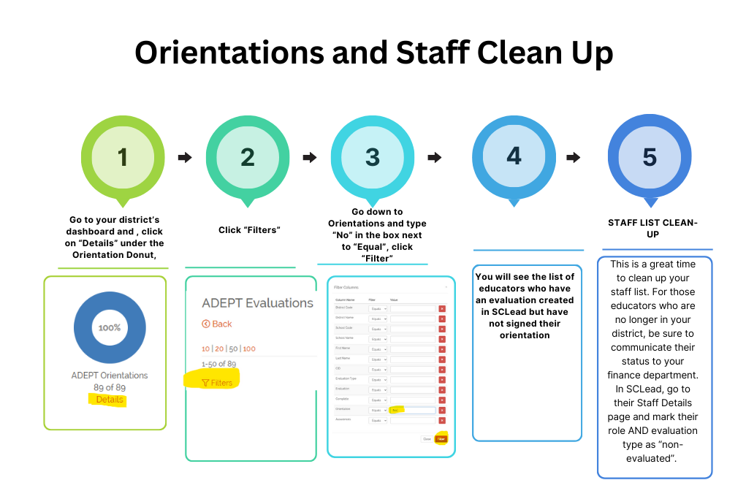
SCLead Assistance

Slide 8
SCLead Reminders
Notes:
We want to start with a some ADEPT reminders that are important for this time of the year.

Slide 9
SCLead Support
If a district administrator has a technical question:
  Email support@sclead.org
  Allow 24 hours for a response
  Check your email chain/spam folder
  Send a follow up email and copy your ADEPT contact
If a user forgets his/her password, email the following:
  Email support@sclead.org
  Name, Current Email Address, CID
  Update secondary email to personal email address

Slide 10
Mentoring & Induction
Notes:
Good afternoon everyone! I have exciting updates to share with you all about our first Mentor and Induction Virtual Support Session!

Slide 11
October's M&I Virtual Support Session By The Numbers...
51 educators in attendance
60 minutes of support and encouragement
6 Areas of Focus that included:
  The Professional Communication Pathway
  ADEPT Evaluation Support
  Expectations for new teachers and their mentors
  Monthly Resource Spotlight
  Answers to submitted questions
  Encouragement
October's M&I Virtual Support Session Resource Document
Notes:
Our first launch of the Mentor and Induction Virtual Support Session was a success! You can see the numbers on the slide...We had 51 participants in who each received a certificate of attendance to reflect an earned hour of professional development that included... (READ SLIDE)
I am dropping the October session's resource document by clicking the link in the chat. The document includes links to all resources used in the session including the full presentation, all the ADEPT rubrics, system guidelines for each of the evaluations, and links to the SC Premiere Educator's Guide to Year 1 and the Mentor's At-A-Glance Guide booklets.
DROP IN CHAT:
Link to October's M&I Virtual Support Session Resource Document: https://docs.google.com/document/d/1oZQe3Vb85X7p6OGS3Y1pRR98eBc5vG7Lw13dQYpXaEM/edit?usp=sharing

Slide 12
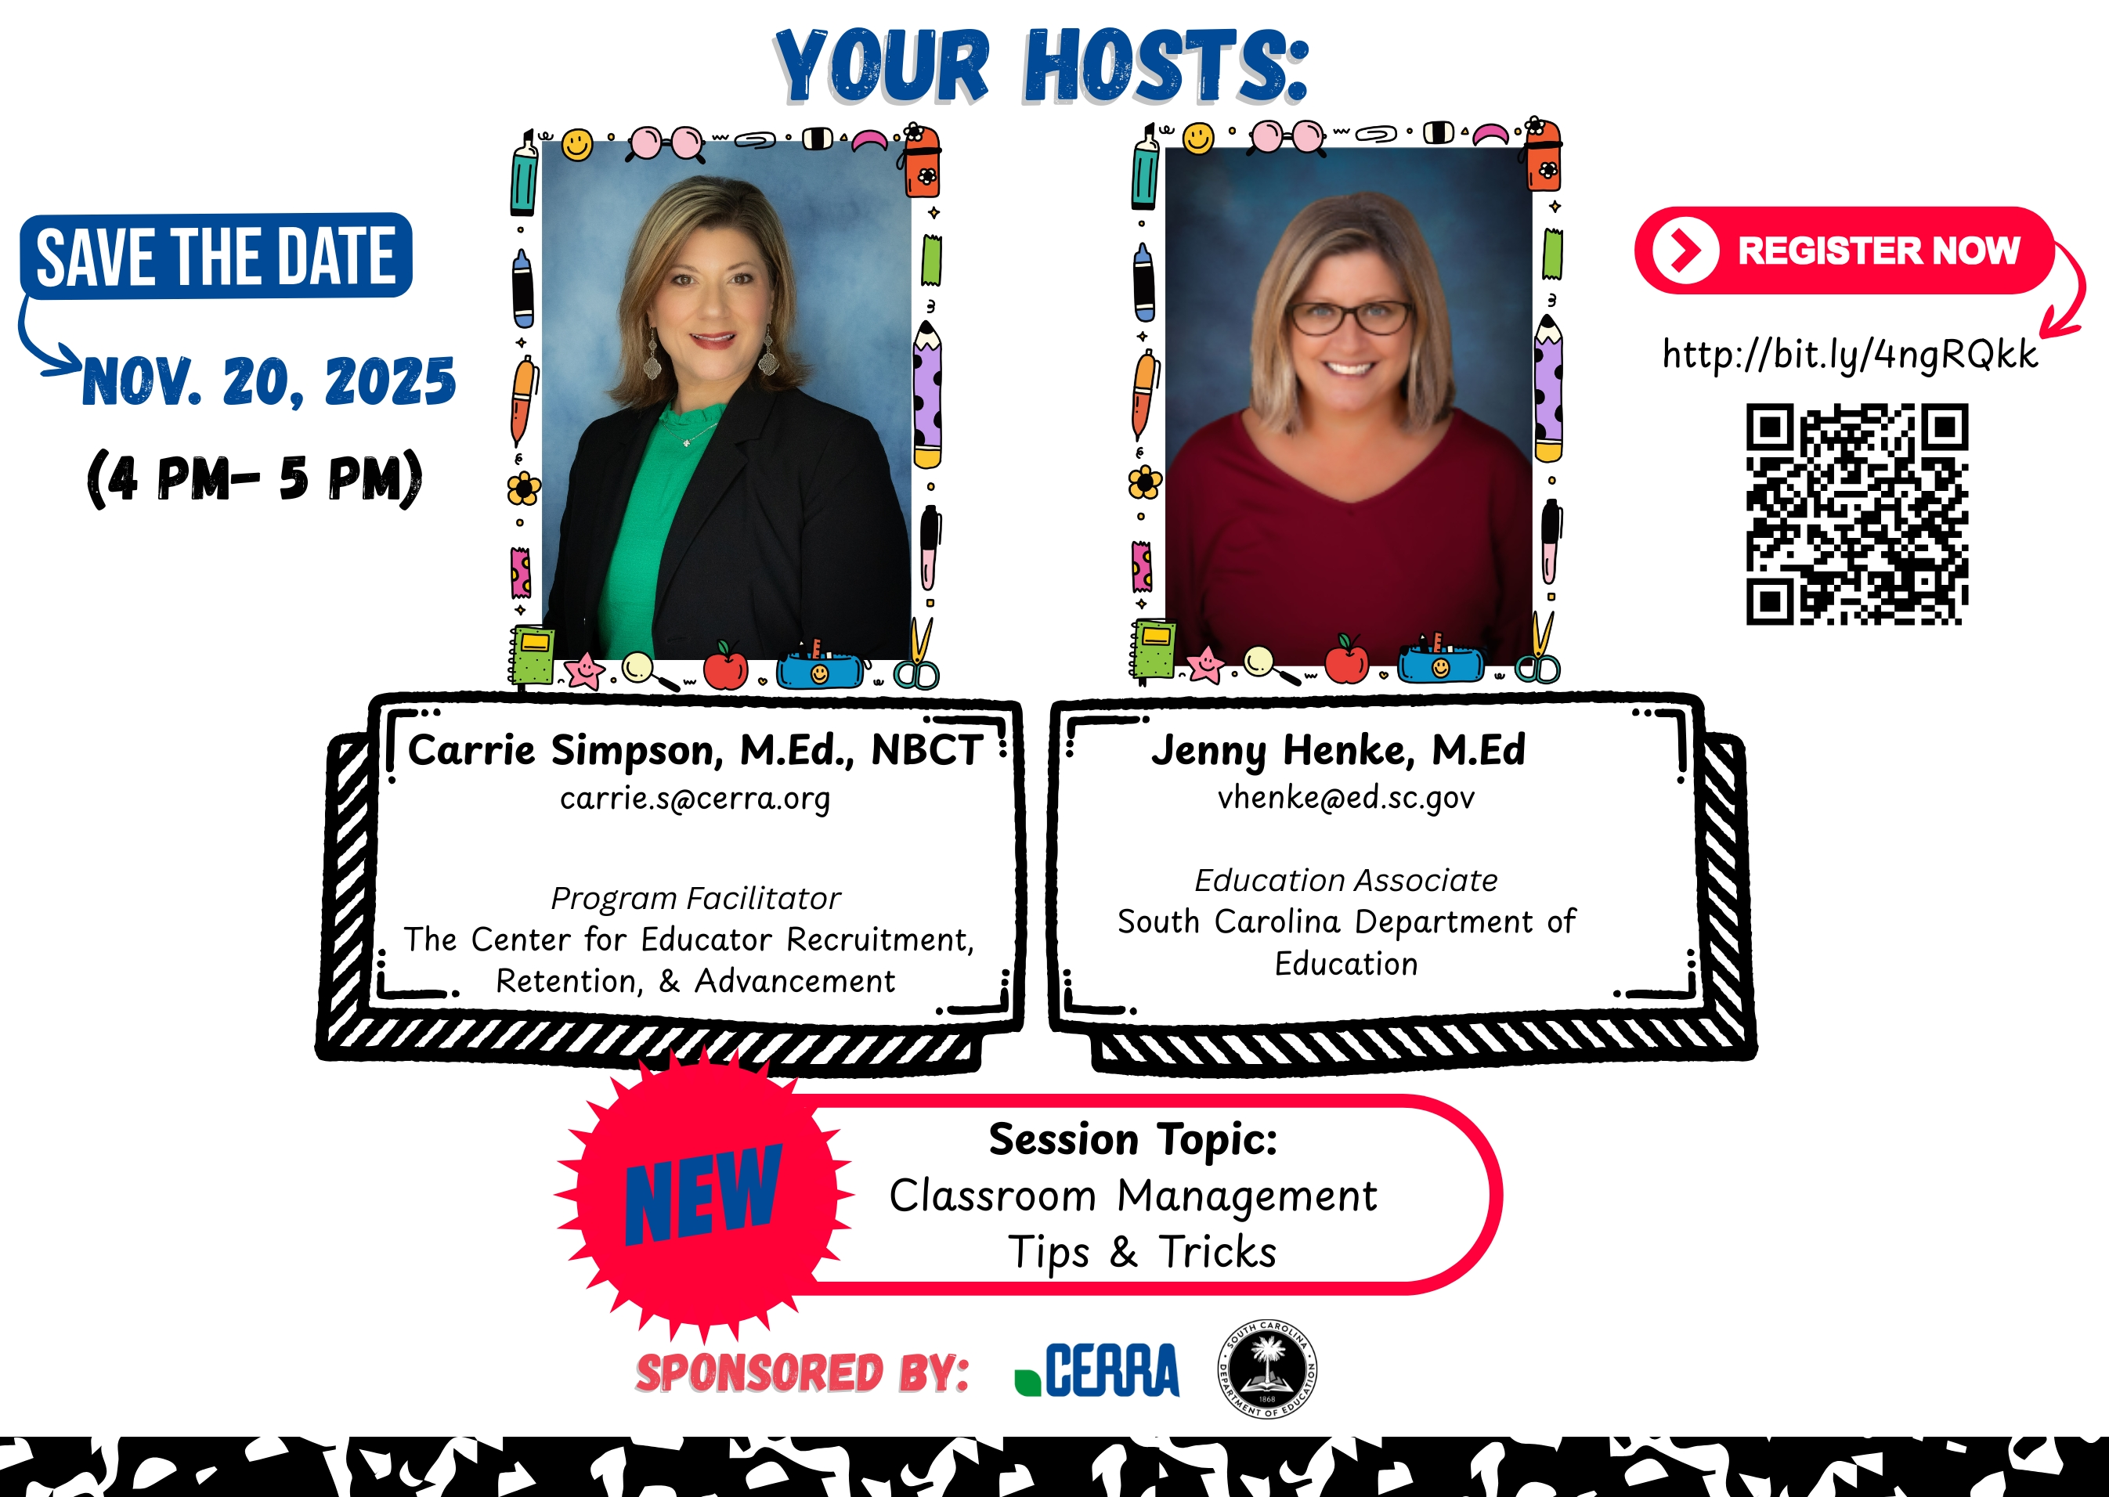
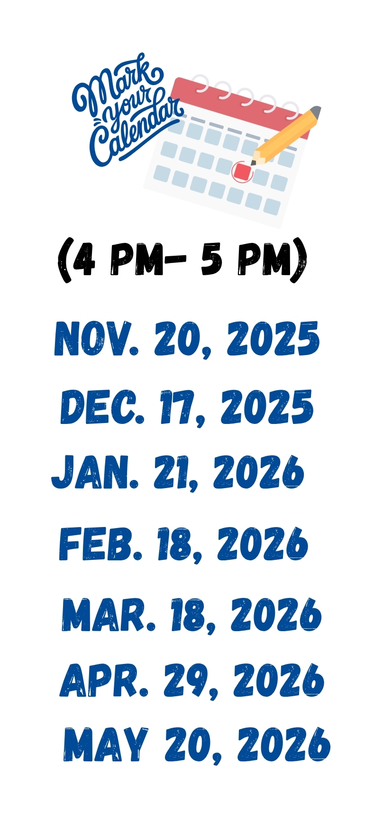
Upcoming M&I Virtual Support Sessions
Notes:
We are now preparing for our November Virtual Support session that will take place on Thursday, November 20th from 4-5 pm. As of now, we have 65 educators registered! Based on questions we received from the registration forms and during our session, our topic for November is Classroom Management Tips and Tricks. I will be diving into several rubric indicators that support classroom management and student engagement. Carrie will be sharing some valuable resources that educators can take and use immediately in their classrooms.
Ahsley will email a shareable flyer at the end of this session for you to share with your induction teachers and current mentors. The QR code can be scanned to access the registration form. I will also drop the registration link in the chat. Please share this information with your Mentor and Induction Coordinators or anyone else who could benefit from this session.
DROP IN CHAT:
Link to Register for Nov. M&I Virtual Support Session: https://cerra.wufoo.com/forms/z14htt1v1m2jaxn/

Slide 13
Foundations In School Leadership
Keasha Grant
Dr. Roshonda Frazier

Slide 14
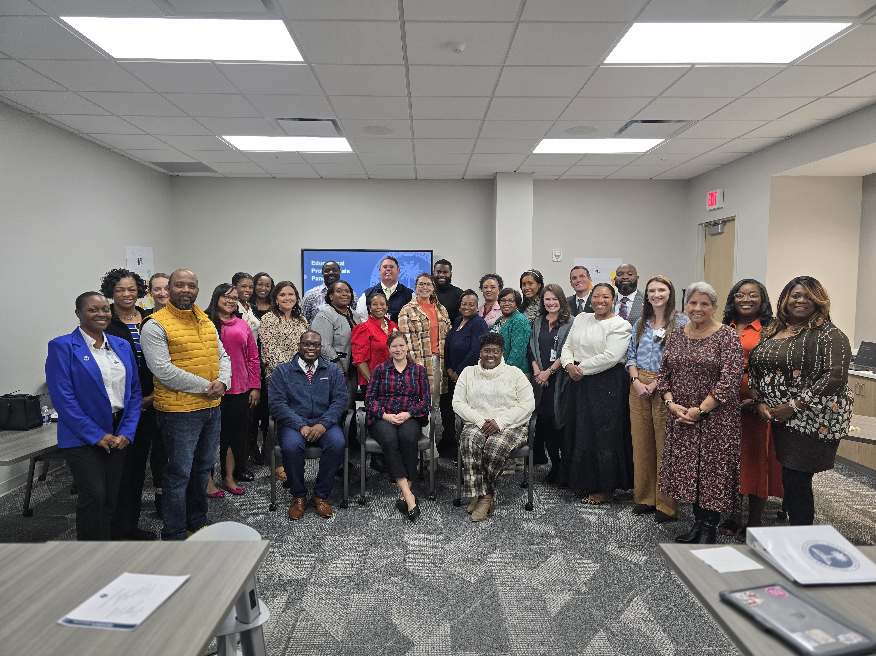
Foundations in School Leadership Cohort

Slide 15
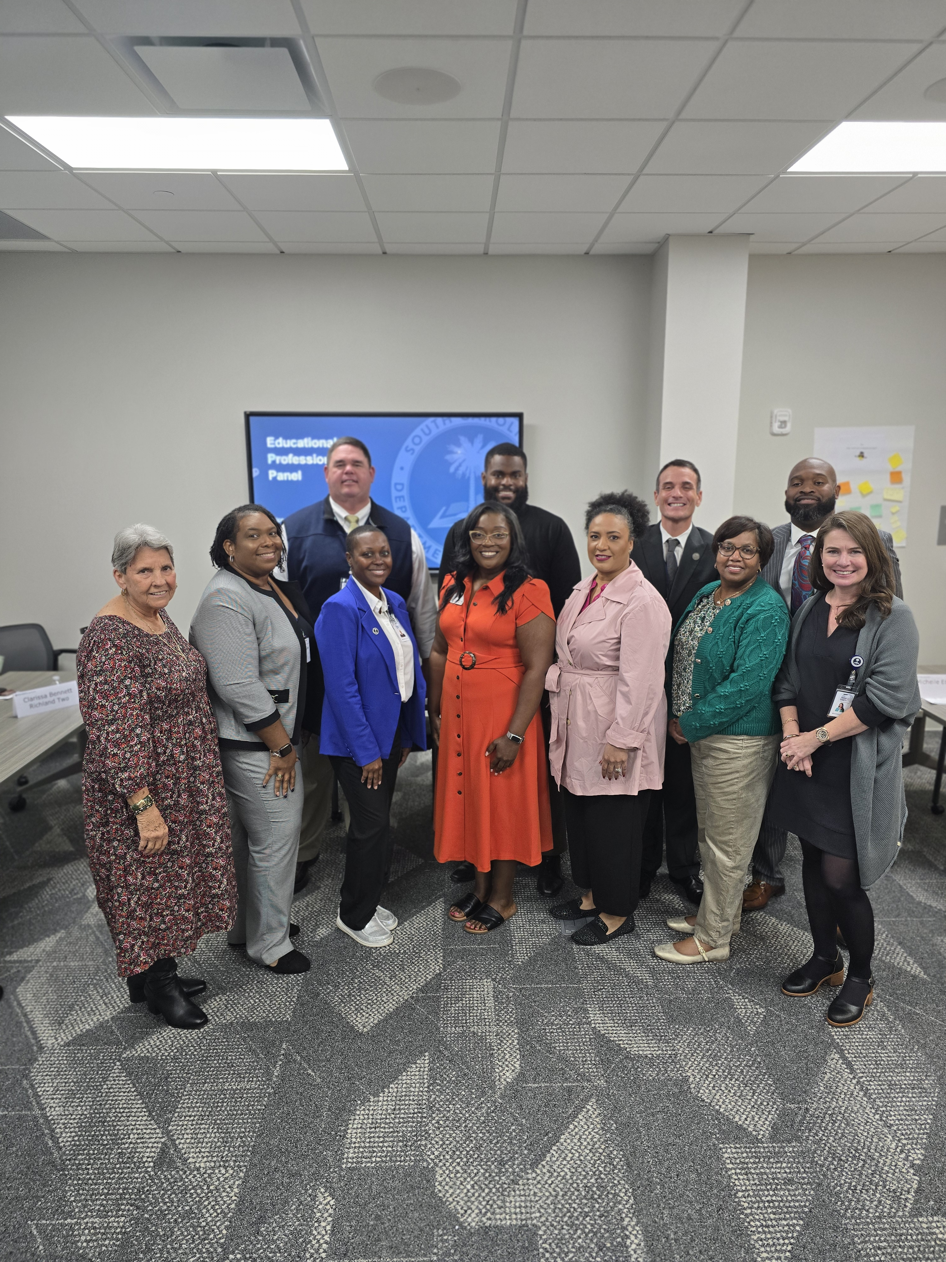
Human Capital
Educational Professional Panel

Slide 16
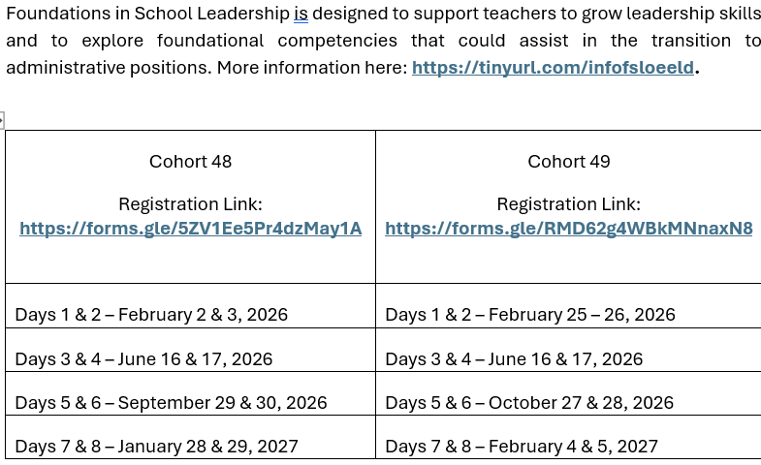
Foundations in School Leadership Cohort Information

Slide 17
Q & A
Notes:
We would like to go over some frequently asked questions we've received over the last couple weeks.

Slide 18
Office of Leadership Effectiveness
Effectiveness Leads
Leadership Development Leads
  Dr. Adrienne Davenport, Instructional Leadership & Assistant Principals adavenport@ed.sc.gov
  Dr. Gerard Edwards, Veteran Principals & District Leaders, gedwards@ed.sc.gov
  Keasha Grant, Certified Support & Emerging Leaders, ksgrant@ed.sc.gov
  Crystal Halma, Collective Leadership, chalma@ed.sc.gov
  Dr. Frank Robinson, New Principals & Emerging Leaders, frobinson@ed.sc.gov
Office Support
  Kimberly Mack, Director, kemack@ed.sc.gov
  Marilyn Suber, Administrative Assistant, masuber@ed.sc.gov
Kate Berresford, EPPs, skberresford@ed.sc.gov
Ashley Cohoon, Communications, ascohoon@ed.sc.gov
Dr. Roshonda Frazier, SLO and Teacher Leadership, rfrazier@ed.sc.gov
Jenny Henke, Mentoring & Induction, vhenke@ed.sc.gov
Dr. Kimberly Howard, PADEPP, khoward@ed.sc.gov
Torian Nunn, Data & Reporting, tmnunn@ed.sc.gov
  Visit our website: https://ed.sc.gov

Slide 19
SCDE SEAL LOGO

