Slide 1
Educator Effectiveness
Virtual Office Hours
May 1, 2024
Welcome!
Name a song that represents how you are feeling about wrapping up the school year.
Notes:
Welcome to our educator effectiveness virtual office hours. We’re so glad you could make it. Please type in the chat box your name and district. We have our opening questions posted that we’d love for you to answer in the chat. We’ll get started right at 2 PM. ​
RECORD
@ 2 PM: Welcome again everyone. If you haven’t done so, please type in the chat box your name and district. First, to orient you to the Microsoft Teams platform, the control icons will be on the upper right section of your screen for most users. If you haven’t yet, please click the mic icon to mute yourself. You will click the same mic icon to unmute yourself later when we are ready for conversation. We encourage you to utilize the chat throughout this session for any questions you may have during the presentation. Our team will be monitoring the chat and responding accordingly. We will also hold a time at the end for discussion.
Welcome to OEELD April 2023 virtual office hours. We’re so glad you could be here with us. I am Ashley Cohoon and I am joined today by our Effectiveness Director, Lilla Toal Mandsager and Team Members: Dr. Vicki Traufler, Dr. Kim Howard, Beverly Flythe, Roshonda Frazier, and Jenny Henke.
​ ​
The purpose of Office Hours is to hold time to ensure that we share timely reminders with districts, but even more importantly, to create a space where you can share feedback, questions, ideas and best practices with your peers. If you are new, there is no question too small; if you are an effectiveness veteran, don’t be shy about letting us know what you need. Before we get started, let’s consider our opening questions (summarize responses or ask 1-2 districts to elaborate….)

Slide 2
Agenda
Welcome
ADEPT Reminders
Human Capital Planning Reminders
2024-25 Professional Learning Opportunities

Slide 3
ADEPT Reminders
Notes:
Jenny

Slide 4
ADEPT Reminders and Information
ADEPT Plans are due June 1, 2024, in SCLead.org
Refer to the 2022-23 Effectiveness Human Capital (Schools) ADEPT Report in SCLead to respond to the questions in the Addendum
Complete all parts of the plan to avoid multiple resubmissions
    Only complete the District Choice Measures page if it applies to your district
Your district's ADEPT contact will provide feedback/approval
Completed ADEPT Evaluations due June 20, 2024
Notes:
Jenny - READ SLIDE

Slide 5
Auto-Completion Feature for GBE Evaluations
What does this feature do?
    Completes all eligible open evaluations for the current academic year for Classroom-Based Teachers, School Counselors, Librarians, and Speech Language Professionals who are on a GBE evaluation with a continuing contract.
When will auto-completion start?
    Auto-completion will begin on Friday, May 17th and continue every Friday thereafter until June 20th.
Why is this feature important?
    This feature allows ADEPT Coordinators to focus on educators who are Not Met and may not be rehired the next school year
What about educators without SLO scores?
    Classroom-based teacher evaluations missing a Student Learning Objective Rating/Score will not be updated or closed during the Auto-completion feature.
Notes:
Jenny - READ SLIDE

Slide 6
Human Capital: End of Year/Summer Planning
Notes:
Kim – As you start planning for next year, there are a few things we want you to keep in mind considering those key stakeholders in your districts

Slide 7
Key Activities
Ensure proper processes are in place for transitioning and exiting staff
Analyze existing data to target critical shortage areas/schools when hiring
Notes:
Exit surveys, checklists
As you start the hiring process this summer - Most immediate hiring for those schools/subject areas that are most in need

Slide 8
Key Activities 1
Review evaluation data for teachers receiving "Needs Improvement" and "Unsatisfactory" ratings. Ensure plans are in place for targeted professional learning.
Ensure that school and district administrators have tools and resources to match mentors/coaches to new teachers
Notes:
PLL
Evaluators and mentors trained and ready to go for next year

Slide 9
2024-25 Professional Learning Opportunities
Notes:
Kim

Slide 10
2024-25 Educator Effectiveness Professional
Learning Opportunities
2024-25 Training opportunities have been released through the SCDE's Communications Office!
Attach memo here (released Tuesday, 4/30/24)
Remember, if someone in your district has been successfully trained through Train-the-Trainer training, they can host an Evaluator training as seats are limited in the SCDE training sessions
More to come regarding inter-rater reliability, coaching conversations, and the PLL.

Slide 11
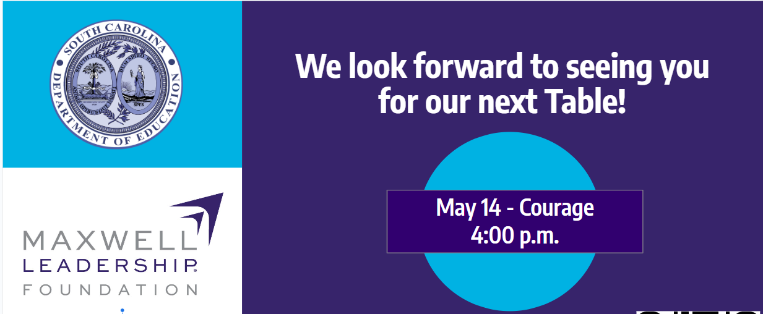
Other OEELD Professional Learning
Principal Induction Memo for 2024-25
LEAD leadership cohort for librarians and counselors
Maxwell iLead Student Leadership Curriculum
Notes:
*The Principal Induction Memo for 2024-25 is out. We’ll share the link in the chat. The earlier you can register new principals, the easier it is for them to get their first choice of orientation date: https://ed.sc.gov/newsroom/school-district-memoranda-archive/principal-induction-program-pip-registration-202425/principal-induction-program-pip-registration-202425-memo/.
*The LEAD leadership cohort for librarians and counselors is accepting applicants. More information is available at the link in the chat: https://ed.sc.gov/newsroom/school-district-memoranda-archive/emerging-leaders-and-support-staff-opportunity-2024-25/emerging-leaders-and-support-staff-opportunity-2024-25-memo/
*Our office is also supporting schools that are interested in the free Maxwell Leadership Foundation’s iLead student curriculum. Learn more at the link in the chat: https://ed.sc.gov/newsroom/school-district-memoranda-archive/maxwell-leadership-foundation-ilead-student-curriculum-interest-meeting/maxwell-leadership-foundation-ilead-student-curriculum-interest-meeting-memo/
*Finally, you can click on the picture to register for our final adult leadership transformation table of the year. It will be on May 14 and will focus on the value of Courage. The registration link is also in the chat: https://docs.google.com/forms/d/e/1FAIpQLSdun30uf-JyDQwPqCloxPphJYtxC4AdnsfbNgrnsBvJjXAo4g/viewform

Slide 12
Questions?
Notes:
Here are some great questions from the chat…
Please feel free to hop on the mic or drop your questions in the chat.

Slide 13
Office of Educator Effectiveness & Leadership Development
Educator Effectiveness Leads
Ashley Cohoon, Communications, ascohoon@ed.sc.gov
Beverly Flythe, Ed. Prep. Programs & Special Areas, bflythe@ed.sc.gov
Dr. Roshonda Frazier, SLOs, rfrazier@ed.sc.gov
Jenny Henke, Data & Reporting, vhenke@ed.sc.gov
Dr. Kimberly Howard, Mentoring & Induction, khoward@ed.sc.gov
Dr. Vicki Traufler, PADEPP, vtraufler@ed.sc.gov
Visit our website: https://ed.sc.gov
Who’s my ADEPT Contact?: Click here
Leadership Development Leads
  Dr. Gerard Edwards, Experienced Leaders, gedwards@ed.sc.gov
  Crystal Halma, Collective Leadership, chalma@ed.sc.gov
  Dr. Frank Robinson, New Principals & Emerging Leaders, frobinson@ed.sc.gov
  Tom Smith, Instructional Leadership & Assistant Principals, tsmith@ed.sc.gov
  Keasha Grant, Certified Support & Emerging Leaders, ksgrant@ed.sc.gov
Office Support
  Lilla Toal Mandsager, Director, lmandsager@ed.sc.gov
  Marilyn Suber, Administrative Assistant, masuber@ed.sc.gov
Notes:
Please feel free to reach out to us if you have questions or feedback for us. Our email addresses are shown on the slide.

