Slide 1


Educator Effectiveness
Virtual Office Hours
April 9, 2025
Welcome!
Spring symbolizes a time for renewal. What are you doing personally and/or professionally to renew your spirit?
Notes:
Welcome to our Educator Effectiveness virtual office hours. We’re so glad you could make it. Please type in the chat box your name and district. We have an open-response posted that we’d love for you to answer in the chat. We’ll get started right at 2 PM. ​
​
@ 2 PM: Welcome again everyone! (Introduce self and team) If you haven’t done so, please type in the chat box your name and district. First, to orient you to the Microsoft Teams platform, the control icons will be on the upper right section of your screen for most users. If you haven’t yet, please click the mic icon to mute yourself. You will click the same mic icon to unmute yourself later when we are ready for conversation. We encourage you to utilize the chat throughout this session for any questions you may have during the presentation. Our team will be monitoring the chat and responding accordingly. We will also hold a time at the end for discussion.​ ​
The purpose of Office Hours is to hold time to ensure that we share timely reminders with districts, but even more importantly to create a space where you can share feedback, questions, ideas and best practices with your peers. If you are new, there is no question too small; if you are an effectiveness veteran, don’t be shy about letting us know what you need. Before we get started, let’s see what exciting events have happened recently in our chat. (summarize responses or ask 1-2 districts to elaborate….)

Slide 2
Agenda
Welcome
ADEPT Reminders
    Auto-Completion
    ADEPT Plans
Professional Learning & Support
Questions
Notes:
We are so glad to have you here with us today. Before we get to questions and open discussion, we have a few things to share with you (state them). As we go, please feel free to add questions in the chat. We will respond to all that we can as we go and will address any lingering questions and open up the room for discussion at the end.

Slide 3
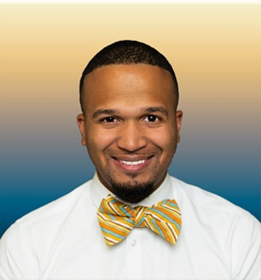
Welcome to the Team!
Torian Nunn
Notes:
We want to welcome Torian Nunn to our team! He is taking over the Data and Reporting Role and we are excited to have his expertise.

Slide 4
ADEPT Reminders

Slide 5
ADEPT Reminders and Information
Final evaluation cycles and SLO post-conferences should be in process/completed
​
April 30 – Final evaluation conference meetings completed​
May 16 – Auto Complete begins
June 1 – ADEPT Plans due​
June 20 – All Evaluations completed in SCLead
Notes:
Here is a quick glance at some ADEPT reminders. Please do not hesitate to email us if you have any questions or concerns during the close-out process.

Slide 6
Auto-Completion Feature for GBE Evaluations
What does this feature do?
    Completes all eligible open evaluations for the current academic year for Classroom-Based Teachers, School Counselors, Librarians, and Speech Language Professionals who are on a GBE evaluation with a continuing contract.
    It will place these educators on Continuing GBE for Next Year's Recommendation
When will auto-completion start?
    Auto-completion will begin on Friday, May 16th and continue every Friday thereafter until June 20th.
Why is this feature important?
    This feature allows ADEPT Coordinators to focus on educators who are Not Met and may not be rehired the next school year.
What about educators without SLO scores?
    Classroom-based teacher evaluations missing a Student Learning Objective Rating/Score will not be updated or closed during the Auto-completion feature.
Notes:
Auto Complete will begin in mid-May and will be upon us sooner than later. I want to take a moment to explain this feature in SCLead.
(READ SLIDE)

Slide 7
ADEPT Plans
The ADEPT Plan for the 2025-26 school year is available in SCLead.
Completed ADEPT plans are due June 1, 2025, in SCLead.org.
Complete ALL parts of the plan to avoid multiple resubmissions.
Your district's ADEPT contact will provide feedback/approval.
Notes:
ADEPT Plan

Slide 8
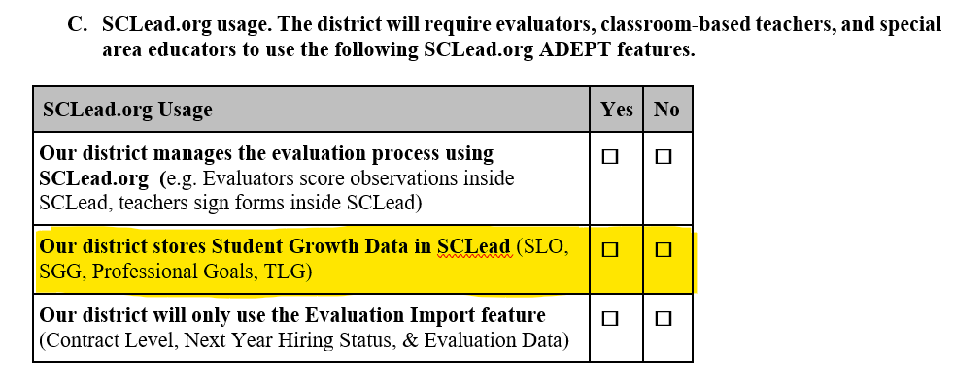
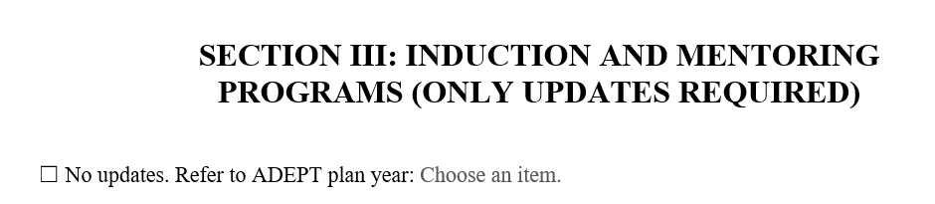
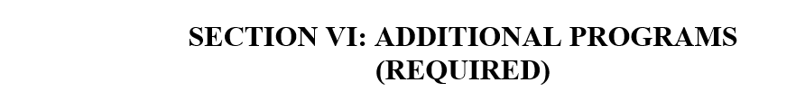
ADEPT Plan Updates
SECTION I: C. SCLead Usage:
If your district stores Student Growth Data in SCLead, mark "Yes."
If your district stores Student Growth Data outside SCLead, mark "No."
Import districts mark "No" for the first two responses and "Yes" for the last response.
SECTION III: Induction and Mentoring Programs:
Only updates required; Click box to Refer to the ADEPT plan year "2024-2025"
SECTION VI: Additional Programs (REQUIRED)
Update your district's charter school participation
Update your district's CTE centers
Mark the response "No" if your district has no charter schools or CTE centers

Slide 9
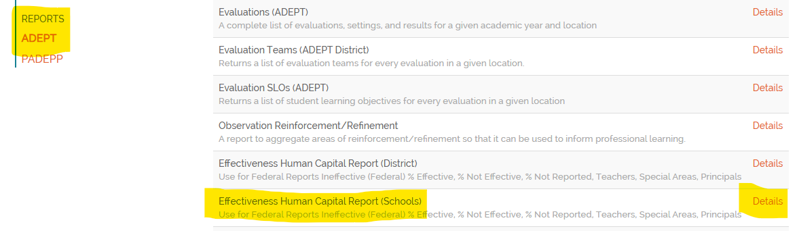
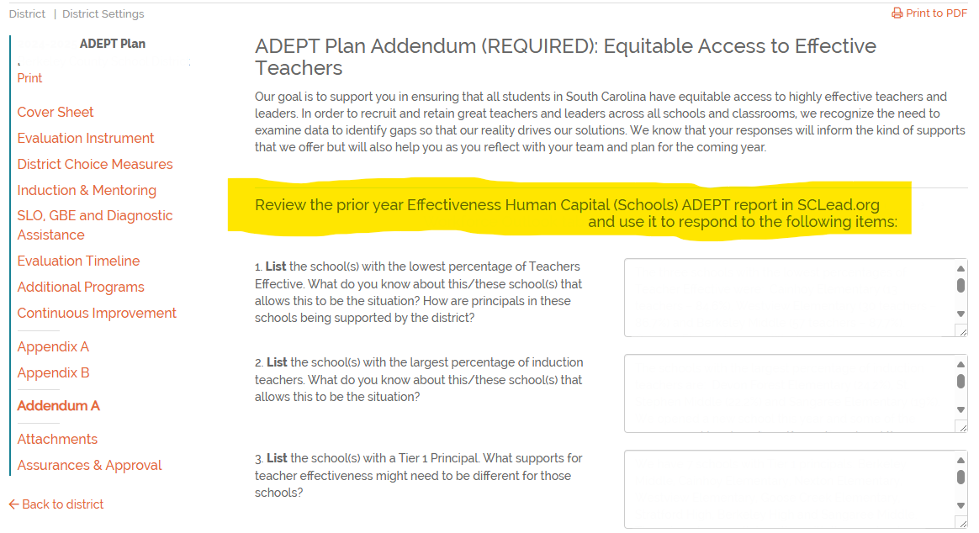
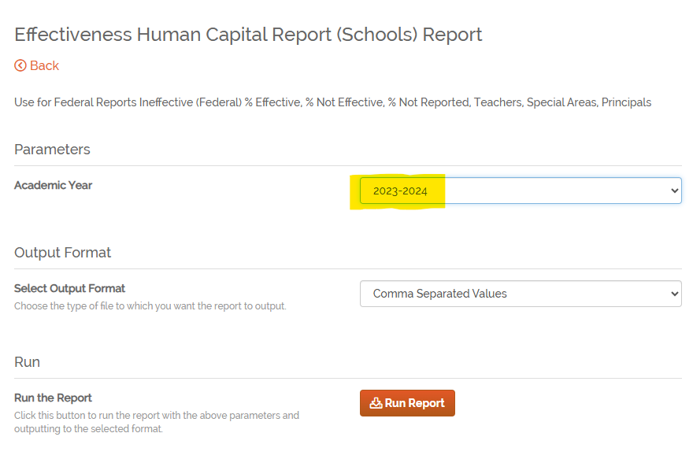
ADEPT Plan: Addendum
Review the 2023-24 Effectiveness Human Capital (Schools) ADEPT report in SCLead to respond to the questions.
Notes:
Drop link to the ADEPT plan template and Addendum Support Document in the chat

Slide 10
Professional Learning and Support

Slide 11
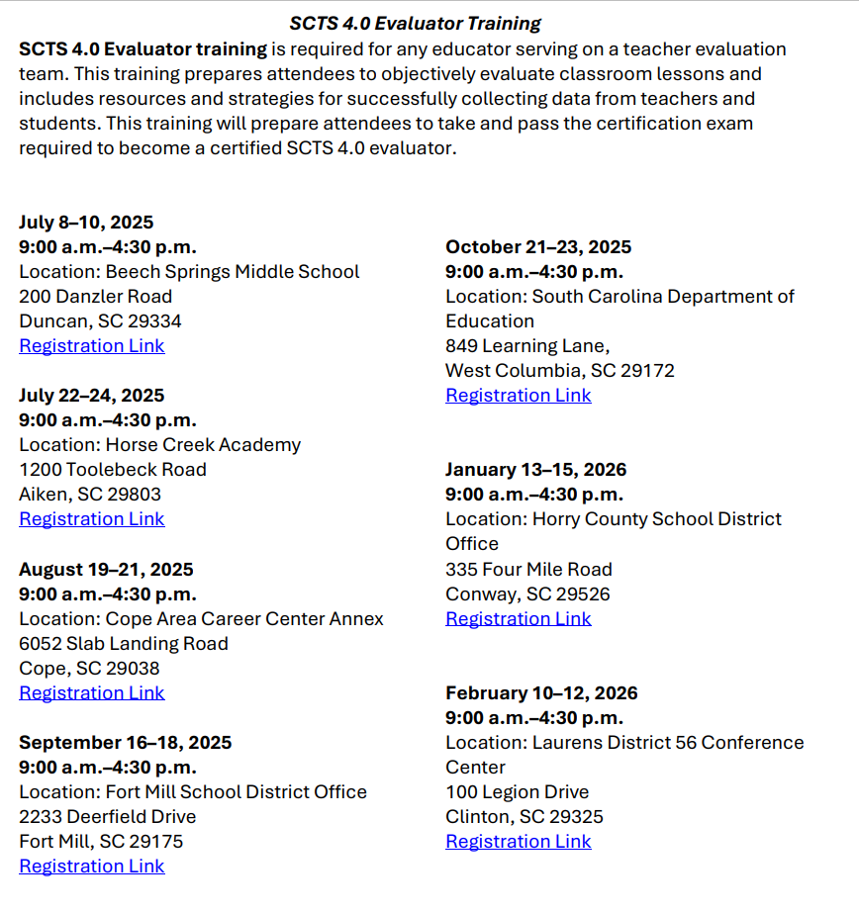
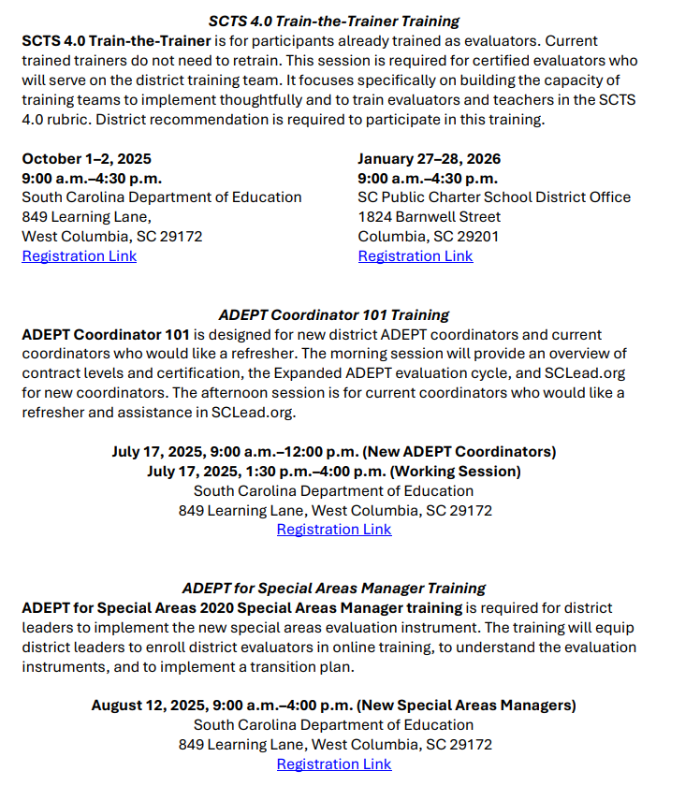
2025-26 Professional Learning Opportunities
Notes:
Educator Effectiveness Professional Learning Opportunites 2025-26 Memo

Slide 12

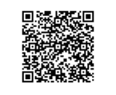
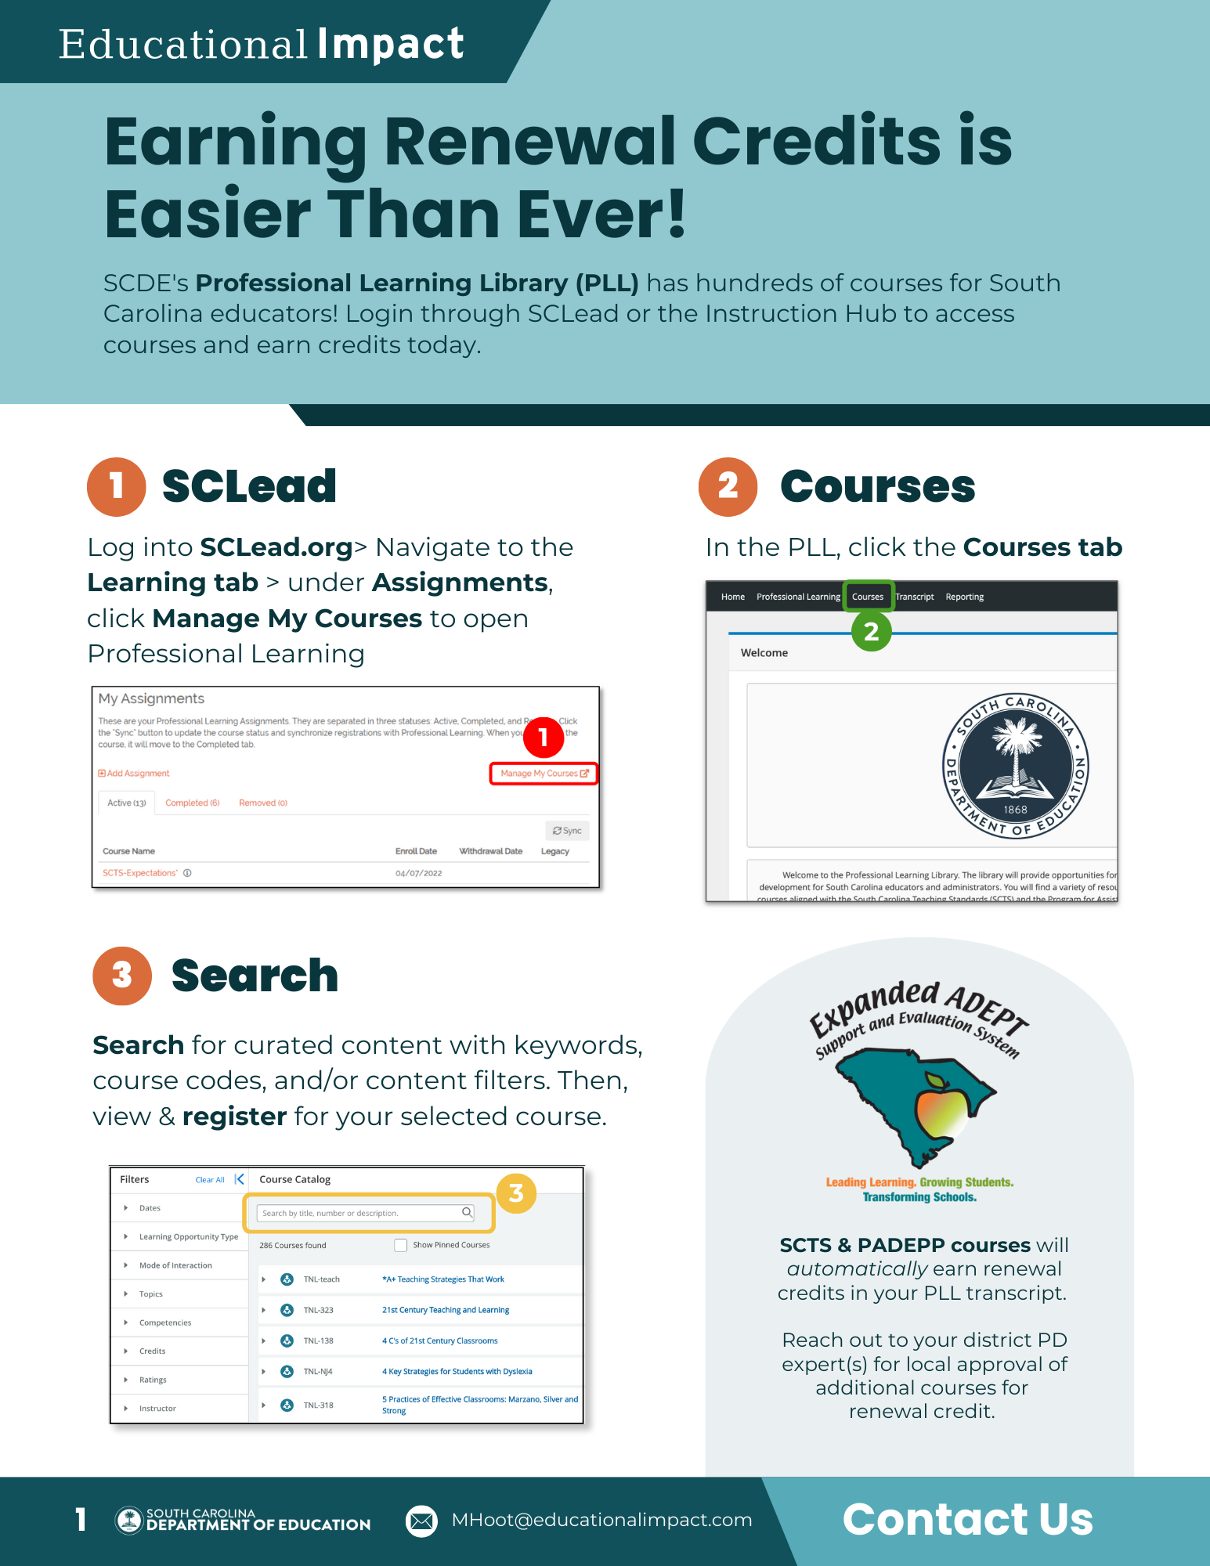
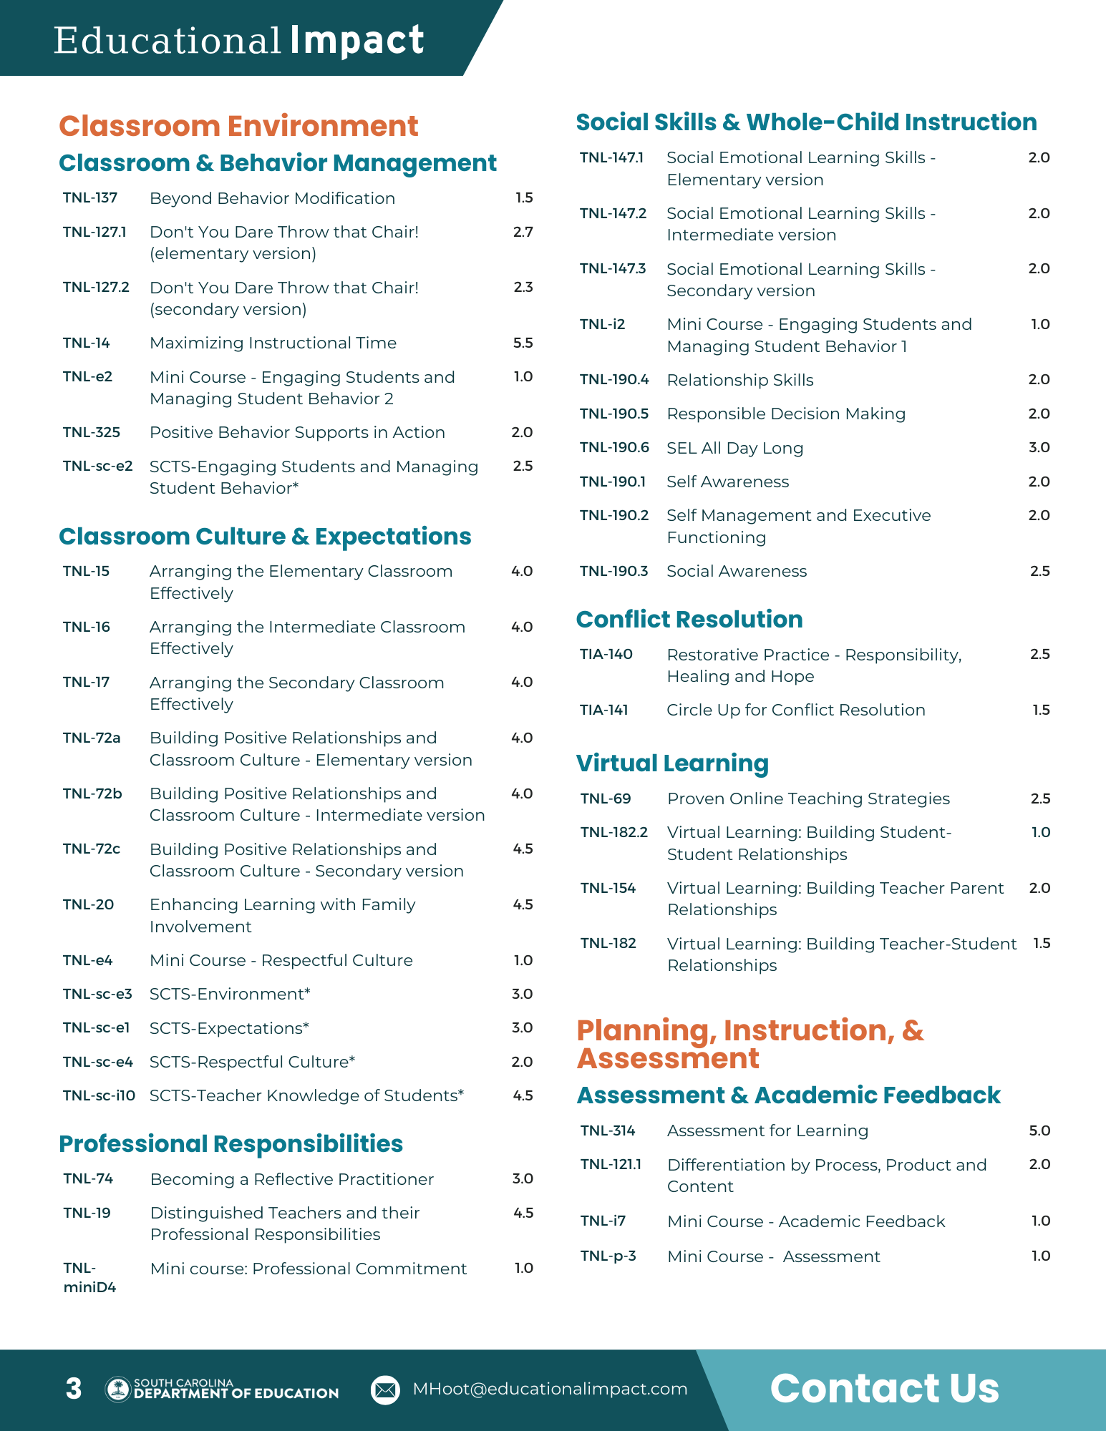
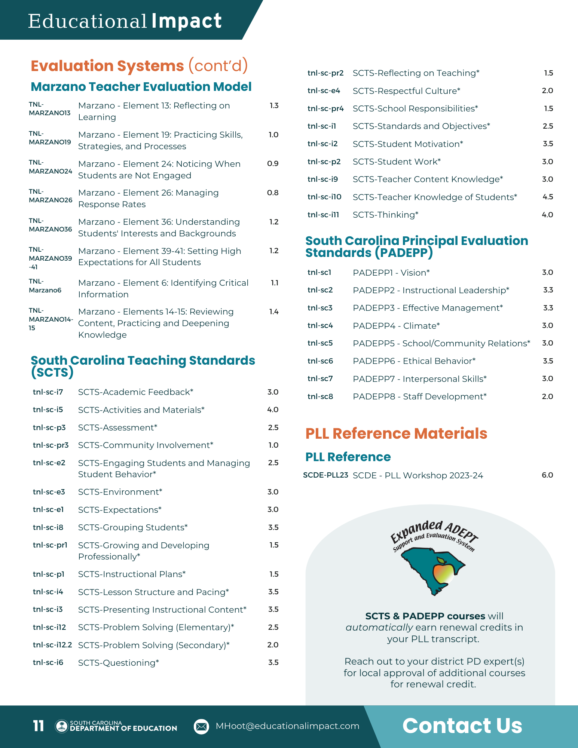
Hundreds of Courses at the Click of a Button!
Scan for the
2024-25
Course Catalog
https://www.educationalimpact.com/pdfs/SCDECourseCatalog.pdf
Notes:
EI takes all of these amazing resources to create vast and customizable learning libraries, such as the one we’ll explore today.
Link to SCDE course catalog booklet: https://www.educationalimpact.com/pdfs/SCDECourseCatalog.pdf

Slide 13
Professional Learning Library Credits Renewal Hours vs.
PD Hours
Courses aligned with SCTS and PADEPP indicators provide recertification renewal hours. The certificate generated for these courses will show the number of hours earned for renewal credits.
PLL mini-courses aligned to SCTS indicators and other, non-SCTS courses will reflect the number of PD hours earned.
Districts are encouraged to use the SCDE Renewal Credit Matrix to provide renewal credit for any PLL courses that do not automatically have SCDE renewal credits attached.
Reach out to your district's renewal coordinator for more information.
Notes:
SCDE Renewal Credit Matrix
And flyer
Earn Renewal Credits Anytime, Anywhere.pdf - Google Drive

Slide 14
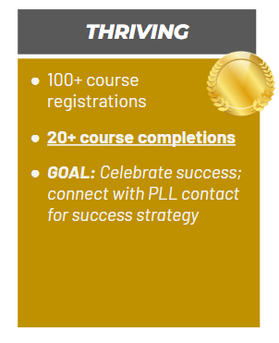
District Highlights with the PLL
Dorchester School District Two (208, 66)
Richland School District Two (148, 84)
Clover School District (York 2) (143, 44)
Charleston County School District (138, 20) New from Silver
Laurens County School District 55 (130, 29)
Spartanburg School District 7 (114, 28)
Sumter School District (100, 29) New from Silver

Slide 15
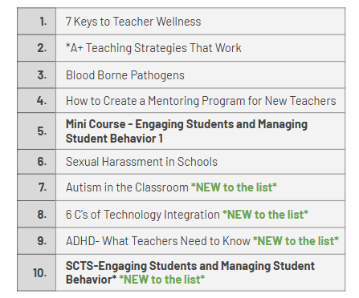
Top Completion Records by Course Title

Slide 16

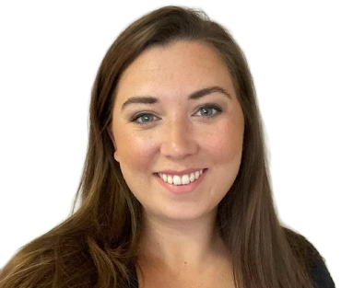
Need Course Suggestions and Implementation Support?
Contact: Melissa Hoot
South Carolina’s Implementation Specialist
Mhoot@educationalimpact.com
Notes:
Provided personalized support for:
Charleston County School District
Rock Hill Schools
Charter Institute at Erskine
Learning Pathway suggestions

Slide 17
FAQs

Slide 18
What if an educator needs a different evaluation type than Continuing GBE after Auto-complete?
You can manually change the "Next Year's Recommendation" any time prior to June 20, 2025.
  To do this, you will need to re-open the evaluation, change the evaluation type, and close the evaluation.
​
Notes:
This is particularly important for educators who have resigned and are going to a different district for the next school year.

Slide 19
Do I need to submit a correction for "Recommendations for Next Year" if they were incorrect in a previous year's evaluation?
You do not need to submit a correction for recommendations from a previous school year.
When entering the recommendations for the 2025-26 school year, refer to the ADEPT Contract Levels and Evaluations flow chart, the educator's ADEPT history, and current certification status to ensure you enter the appropriate information.
​
Notes:
Drop Link in Chat: ADEPT Contract Levels and Evaluations

Slide 20
What mentoring requirements are needed?
Mentors are required to have 18 hours of renewal credits that support their mentoring work every 5 years.
  First cycle requirement: Attend SCTS 4.0 Evaluator Training
  Additional Mentor Cycles:
    courses from the Professional Learning Library
    other hours earned from district/school PD or trainings, graduate courses
Although we do not require districts to document those hours in SCLead, a message was sent to those whose mentoring renewal credits are not documented there (and are at the end of a 5-year cycle).
    There is nothing to do on your end except ensure that the folks listed have met the 18-hour requirement so that they can continue to serve as mentors.
    Upload the "Staff Credentials" Report to see educators who have the mentor credential and the begin/end dates of their mentoring cycles

Slide 21
Questions

Slide 22
Office of Leadership Effectiveness
Effectiveness Leads
Leadership Development Leads
  Dr. Frank Robinson, Team Lead, New Principals & Emerging Leaders, frobinson@ed.sc.gov
  Dr. Gerard Edwards, Veteran Principals & District Leaders, gedwards@ed.sc.gov
  Keasha Grant, Certified Support & Emerging Leaders, ksgrant@ed.sc.gov
  Crystal Halma, Collective Leadership, chalma@ed.sc.gov
  Tom Smith, Instructional Leadership & Assistant Principals, tsmith@ed.sc.gov
  Visit our website: https://ed.sc.gov
Dr. Kimberly Howard, Team Lead, PADEPP, khoward@ed.sc.gov
Ashley Cohoon, Communications, ascohoon@ed.sc.gov
Dr. Roshonda Frazier, SLO and Teacher Leadership, rfrazier@ed.sc.gov
Jenny Henke, Induction and Mentoring, vhenke@ed.sc.gov
Torian Nunn, Data and Reporting, tmnunn@ed.sc.gov
Kimberly Mack, Director, kemack@ed.sc.gov
Marilyn Suber, Administrative Assistant, masuber@ed.sc.gov
Office Support
Notes:
We thank you for your time today. We will stay for a few extra minutes if anyone has any additional questions.
Feel free to reach out to us if you have questions or feedback for us. Our email addresses are shown on the slide.
Have a great rest of your day!

Slide 23
SCDE SEAL LOGO

