Slide 1

Retaining Effective Educators
Welcome and Reflection
As you arrive, please write…
White Index Card
When you reflect on your own role in supporting teacher and principal effectiveness …
One celebration from the past year
One priority you’re personally focused on for next year
One challenge you anticipate when you execute that priority
Colorful Index Card
Questions you want answered about ADEPT (Teacher Evaluation), PADEPP (Principal Evaluation), and SCLead
Notes:
Welcome and Reflection
Image credit: Pixabay

Slide 2
ADEPT, PADEPP, & Retaining Effective Educators
Lilla Toal Mandsager
SCASA i3 Conference, June 2018
Notes:
ADEPT, PADEPP and Retaining Effective Educators,
Monday June 18, 11:00am -- 12:00pm Palladium B
Session Description
Join this session for system updates, transition planning tips, and communication resources for creating a reflective instructional culture in your school or district with a focus on growth. Learn about using coaching to improve principal and teacher practice.

Slide 3
Guiding Questions
Agenda
  Context: Why Retention?
  Strategy: Building a Culture of Feedback
  Updates: Effectiveness Support Systems
    Principal Support
    Teacher Support
    SCLead.org
  Taking Action: Questions, Strategies, and Next Steps
How can we all build educator capacity with the transition to the SC Teaching Standards 4.0, SLOs and PADEPP?
How are these coaching and effectiveness tools linked to retention of top performers?
Notes:
Four parts of our time together
Context
Share a quick strategy
Updates on Effectiveness – PADEPP, ADEPT, SCLead
Next Steps
We hope today will be a conversation about two questions (read them)

Slide 4
Retaining Effective Educators
Nationwide: 2/3 of superintendents believe the quantity of new teacher candidates is decreasing (Gallup, 2017).
South Carolina : 550 teacher vacancies and 15 principal and assistant principal vacancies in August (CERRA , 2018).
Notes:
Picture is stark
The quantity of new teacher candidates is decreasing, 67% of superintendents agree (quality 39%)
The quantity of new principal candidates is decreasing, 43% of superintendents agree (quality 32%) (Gallup)
550 teacher vacancies in August in SC in 2017.
15 principal and AP vacancies (CERRA)

Slide 5
Retaining Effective Educators
“…shortages of teachers of color are generally caused less by recruitment shortfalls than by retention problems”
(Ingersoll & May cited in Carver-Thomas , 2017).
“…teacher turnover has a significant and negative effect on student achievement in both math and ELA…. turnover is particularly harmful to the achievement of students in schools with large populations of low-performing and black students.”(Ronfeldt, Loeb, & Wycoff, 2012).
Notes:
Ingersoll and May find, “…shortages of teachers of color are generally caused less by recruitment shortfalls than by retention problems (cited in Carver-Thomas (2017)).
Results demonstrate that teacher turnover has a significant and negative effect 22 on student achievement in both math and ELA. Moreover, teacher turnover is particularly harmful to the achievement of students in schools with large populations of low-performing and black students. (Ronfeldt, Loeb, Wycoff)

Slide 6
What do highly effective teachers want?
Feedback, Recognition, and Opportunities to Lead
“Positive, effective communication between teachers and administration is lacking. Performance feedback is missing. For example, my principal never once visited my classroom during the entire school year to see how effective I really am with my students.”
(The New Teacher Project, 2012).

Slide 7

Strategy: Building a Culture of Feedback
Person A: Share what you wrote about
One celebration from the past year
One priority you’re personally focused on for next year
One challenge you anticipate when you execute that priority
Person B: Give Feedback
What I heard…
What I wonder…
Notes:
Image credit: Otto Fokus, https://www.flickr.com/photos/jbmac/4737231422

Slide 8
Effectiveness System Feedback
  Effectiveness Experts
    District and IHE ADEPT Plans 2017
    Effectiveness Office Hours
    Effectiveness Advisory Teams (District, Higher Ed., Principals, Teachers)
  Trainings and Roundtables
    SC Teaching Standards, PADEPP, and Leadership Continuum trainings
    Personnel, Instructional Leaders, HR, SCEDA Roundtables, SCATE Conference
    Induction and Mentoring Coordinators
  Independent Reviews
    University of South Carolina Research, Evaluation, & Measurement Center
    Southern Regional Education Board Focus Groups
        American Institutes for Research Statewide Surveys (2016 and 2018)
Notes:
Sought extensive feedback.
Most consistent theme was that teachers wanted more and more meaningful feedback on their practice.
This year, we really dug in to ask about induction requirements and if they needed to change. Consensus was system is well set-up to support induction teachers’ needs, but the SCDE should emphasize current flexibility districts have to make the process easy for new teachers.
Feedback from stakeholders in this first year of partial implementation is that they love the intention, giving that feedback to teachers is more rigorous, but ultimately worth it

Slide 9
PADEPP: Supporting Principal Growth

Slide 10
PADEPP Guidelines Changes
Create Alignment
National Standards (PSEL) and ESSA’s Equity Plan
Embedding growth in Principal’s Professional Development Plan Reflection
Signed Assurances
Establish Emphasis on Growth
Principal’s Self-Assessment
High-Quality School Visits by Evaluator
Link to guidelines, February 2017

Slide 11
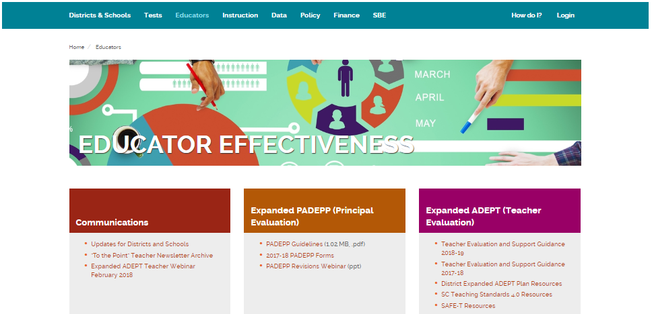
PADEPP Tips and Key Resources
PADEPP is a growth model – constructive formative and summative feedback is essential
New principals need multiple types of support – in context, tactical, and strategic
PADEPP resources https://ed.sc.gov/educators/educator-effectiveness/

Slide 12
Expanded ADEPT: Supporting Teacher Growth

Slide 13
ADEPT Guidelines Changes
Establish Scoring Ranges
Met – 2.26 – 3.00 (Proficient, Exemplary)
Not Met – 1.00 – 2.25 (Unsatisfactory, Needs Improvement) (p. 30)
Clarify
When is a Professional Growth and Development Plan (PGDP) Required in addition to the SLO? (p. 13, 17)
Link to guidelines, April 2018
Notes:
Two primary revisions were made in the guidelines. The first was to establish a range for “Met” and “Not Met”
The line is between proficient and needs improvement.
HR directors in districts that used Unsatisfactory as the cuttoff this year said it was almost impossible for a teacher to be “Not Met” and that they were concerned such a low bar would get in the way of necessary difficult hiring decisions.
The ADEPT advisory group said that keeping the system simple in the first few years of implementation and having one range for all groups (induction, annual, continuing) and gathering data was a better approach. Based on the over 750 observation records collected and analyzed in the USC Study this fall, less than 2% of educators would be classified as “Not Met” using this range.
PGDP
A professional growth and development plan is required at every level (induction, annual, and continuing), but there was confusion about the competency-building plans created during SAFE-T vs. the SCTS process. This change simplifies the decision making process for districts

Slide 14
Expanded ADEPT Process for 2018-2019
Contract Level | Observations | Student Growth
Induction (Formative) | >1 – Full Classroom Observation per semester, with conferences* | Complete 1 SLO, may cover 2nd semester only
Annual and Continuing (Summative) | >2 – Full Classroom Observations per semester, with conferences* | Complete 1 SLO
Continuing (Formative) Comprehensive 5th year recertification | >1 – Full Classroom Observation per semester, with conferences* | Complete 1 SLO
Continuing and Annual (GBE) | Informal | Complete 1 SLO
Notes:
Differentiated: Induction/Annual/Continuing Contract, Our office sets the floor, your district may choose to do more
Observers
Induction: Principal or SCTS certified administrative designee, teacher also has a mentor
Annual: Principal or trained administrative designee AND person with knowledge of teachers content area
Highly Consequential: Three person team
Continuing Contract Comprehensive: Principal or SCTS certified administrative designee

Slide 15
ADEPT Guidelines 2018-19
Areas of Flexibility
Scoring Approach: By contract level
SLOs: SLO scoring rubric, Combining conference meetings/ Integrating SLOs with data teams
Evaluation Teams: “Administrative Designee” for observations does not have to be an administrator
Induction: Suggest coordinating induction areas of focus (classes, mentoring plans) with areas of reinforcement/refinement; provide support for SLOs

Slide 16
ADEPT Tips and Key Resources
ADEPT is a growth model – constructive feedback is essential
SLOs + SCTS = Data-informed reflection on teacher effectiveness
Communication with and feedback from teachers about the process is essential
ADEPT resources https://ed.sc.gov/educators/educator-effectiveness/

Slide 17
Tracking and Supporting Effectiveness – SCLead.org

Slide 18
Effectiveness Data Management and Support System, SCLead.org
  Pilot: March – April
  Training: May, June, July
  Frontline Professional Development Resources: August
Notes:
Partner with RANDA solutios, have the contract for Ohio, Tennessee, and Colorado
RANDA has partnered with Frontline to provide a Professional Development Library that will be available in August and will include PD resources aligned to SCTS and PADEPP standards that are available to every educator.

Slide 19
What’s Required in SCLead.org?
Required State-level reporting for classroom-based teachers
overall effectiveness ratings (Met/Not Met),
next year contract level and hiring status
observation results at the indicator level, if applicable, and
student learning objective scores
Required state-level reporting for PADEPP (2018-19)*
        Conferences and signatures
        Principal’s professional development plan * (not required for 2017-18)
        Principal’s self-assessment
        Principal’s summative evaluation form
Notes:
Required State-level reporting for classroom-based teachers
overall effectiveness ratings (Met/Not Met),
next year contract level and hiring status
observation results at the indicator level (Summative and Formative), if applicable, and
student learning objective scores (All, Summative, Formative, and GBE)
Required state-level reporting for PADEPP (2018-19)
Conferences and signatures (orientation, Mid-year, end-of-year)
Principal’s professional development plan
Principal’s self-assessment
Principal’s summative evaluation form (comments needed for all standards for induction principals, comments needed for all unsatisfactory and needs improvement for all other evaluations)

Slide 20
District Decisions
Teacher Evaluation Set Up (All in ADEPT Plan due June 1)
  Scoring Approach: By contract level, consensus or average
  SLO Scoring rubric, district choice measures
  Evaluator training, certification, and evaluation team assignment
  Mentoring and Induction Support
  Communication (orientation, evaluation timelines, and ongoing feedback)
SCLead.org Set up
  What features will you use at the district level (observation process, self-reflections, SLO process, etc.)
  How do you want to train? (consider roles, evaluation timeline, gathering
  feedback)
Notes:
Teacher Evaluation Set Up
There are some structural choices to be made with teacher evaluation and some logistical ones. You’ve already made most of the structural ones in your ADEPT plans.
2. SCLead Set up, you should be thinking today about which features you will use at the district level and how you want to train.
First, there are three main options for how you might use SCLead. At one end of the spectrum, using all of the SCLead functionality as designed to support the process including observations, conferences, the SLO, and professionalism. At the other end of the spectrum we have a few districts who have worked with other technology vendors to build systems to manage the evaluation process that they are very committed to. These districts might only report the required elements for all teachers. In the middle, there may be some districts who decide to manage a piece of the process offline, for example, they may have teachers store SLOs on google drive but manage the observation and conferencing process, as well as the final evaluation reporting through SCLead.

Slide 21
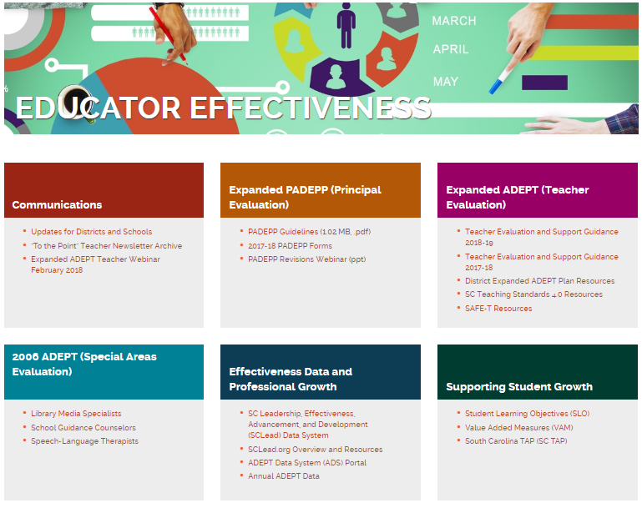
SCLead Tips and Key Resources
SCLead is a resource to track the process and support you with actionable data
Districts will need to set expectations with teachers, evaluators, and principals
SCLead resources https://ed.sc.gov/educators/educator-effectiveness/

Slide 22
Questions?

Slide 23
Training and Professional Learning
SCTS and SCLead.org training links:
https://ed.sc.gov/
educators/educator-effectiveness/professional-learning/professional-learning-opportunities/
Instructional Leadership Professional Learning
https://ed.sc.gov/
educators/
school-and-district-administrators/

Slide 24
Office of Educator Effectiveness & Leadership Development
Educator Effectiveness Liaisons
Faye Colley, Professional Learning and Communications, fcolley@ed.sc.gov
Dr. Julie Hartwell, Data and Reporting, jhartwell@ed.sc.gov
Dr. Kimberly Howard, Mentoring and Induction, khoward@ed.sc.gov
Dr. Vicki Traufler, PADEPP, vtraufler@ed.sc.gov
Leadership Program Managers
Walter Clark, Experienced Leaders, wclark@ed.sc.gov
Olivia Ortmann, Collective Leadership, oortmann@ed.sc.gov
Dr. Frank Robinson, Principal Induction, Emerging Leaders frobinson@ed.sc.gov
Tom Smith, Assistant Principals and Instructional Leaders, tsmith@ed.sc.gov
Regina Thurmond, Emerging Leaders, Special Areas, rthurmond@ed.sc.gov
Office Support
Lilla Toal-Mandsager, Director, lmandsager@ed.sc.gov,
Marilyn Suber, Administrative Assistant, masuber@ed.sc.gov
Online https://ed.sc.gov/educators
Leadership: /school-and-district-administrators/
Effectiveness: /educator-effectiveness/

Slide 25
Strategy Sharing and Next Steps
Communications
Strategic Planning
Culture of Coaching
ADEPT
PADEPP
SCLead

Slide 26
Retention and Development Resources
Retaining and Recognizing Teachers Playlist and Research
https://docs.google.com/document/d/1rhrb05FnNwTTNbKh__faGB9wFMT5coUzaytM6txJmtg/edit?usp=sharing

Slide 27
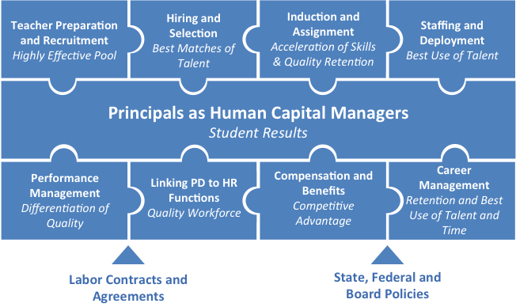
District Visioning Tool:
USHCA Teacher Puzzle Pieces
Notes:
USHCA: https://www.humanresourcesineducation.org/resource/teacher-puzzle-pieces/?cat=14

Slide 28
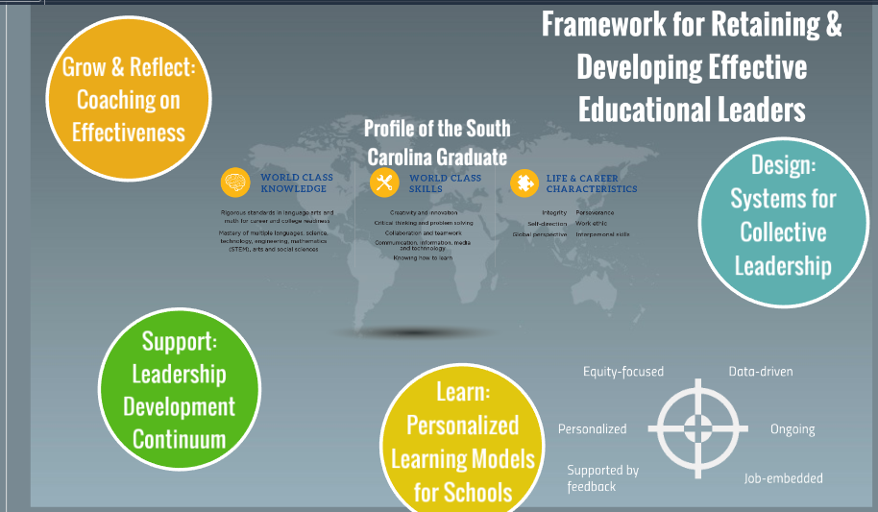

Slide 29
References
Carver-Thomas, D. and Darling-Hammond, L. (2017) Why Black Women Teachers Leave and What Can Be Done About It. Black Female Teachers: Diversifying the United States’ Teacher Workforce Advances in Race and Ethnicity in Education, Volume 6. Emerald Publishing Limited. Retrieved from https://learningpolicyinstitute.org/sites/default/files/product-files/Why_Black_Women_Teachers_Leave_CHAPTER.pdf.
Center for Educator Recruitment, Retention, and Advancement. (2018). South Carolina Annual Educator Supply and Demand Report. Retrieved from https://www.cerra.org/uploads/1/7/6/8/17684955/2017-18_supply_demand_report.pdf
Gallup. (2017). Leadership Perspectives on Public Education: The Gallup 2017 Survey of K-12 School District Superintendents. Retrieved from https://news.gallup.com/reports/217103/gallup-k-12-superintendent-report-201708.aspx
Ronfeldt, M., Loeb, S., & Wyckoff, J. (2012). How Teacher Turnover Harms Student Achievement. National Center for Analysis of Longitudinal Data in Education Research. Retrieved from https://caldercenter.org/sites/default/files/Ronfeldt-et-al.pdf
The New Teacher Project. (2012) The Irreplacables: Understanding the Real Retention Crisis in America’s Urban Schools. New York, NY: TNTP.https://tntp.org/assets/documents/TNTP_Irreplaceables_2012.pdf
USHCA. (2014). Teacher Puzzle Pieces. Retrieved from https://www.humanresourcesineducation.org/resource/teacher-puzzle-pieces/?cat=14.

Slide 30
SCLead.org Permissions
User | Permissions
State-level PADEPP/ADEPT | All historical teacher and principal evaluation summaries, observation indicator scores, SLO Scores, evaluation progress by school, and PD Resources
Superintendent/District ADEPT and PADEPP Administrators | All district historical teacher and/or principal evaluation summaries, all teacher and principal process documents, evaluation progress by school and evaluator, PD Resources
Principals | School historical teacher evaluation summaries for the past 5 years, all teacher and principal process documents, evaluation progress by evaluator, PD Resources, his/her own evaluation process documents and historical data
Evaluators | Current year evaluation process documents for educators you are evaluating, PD Resources, his/her own evaluation process documents and historical data
Teacher Mentors | Current year SLO document for mentees, PD Resources, his/her own evaluation process documents and historical data
Educators | Current year evaluation process documents, PD Resources, his/her own historical evaluation data
Notes:
Go through Permission levels
State-level
District-level
Principal (has access to last five years)
Evaluator / Mentors / Educators – only those you support, only yourself.

Slide 31
ADEPT Plans
ADEPT Plans Due June 1
ADEPT Plan addendum for use of SAFE-T with highly consequential evaluations in 2018-19
Email your ADEPT Contact for the form
  Or follow this link.
Notes:
adept-addendum-district-safe-t-request-2017-18

