Slide 1
Teacher Evaluation Flexibility 2020–21
August 2020
Office of Educator Effectiveness & Leadership Development
Notes:
NOTE: Teacher Evaluation Flexibility for 2020-21 may vary in your district. Update this PPT to reflect your district’s plan for implementation. All changes included in this PPT will be built into SCLead.

Slide 2

Shaping the Path
Council of Chief State School Officers (CCSSO) recommendations for Observation & Feedback
Based on Clear Expectations
Aligned with Priorities
Connected to Coaching
Target: SC teacher and principal evaluation policy
supports educator growth and advancement,
prioritizes feedback, and
provides flexibility for educators to focus on addressing the challenges of teaching and learning during the COVID-19 pandemic.
Notes:
South Carolina’s decision to continue with teacher evaluations, yet offer flexibility for districts was based on feedback from instructional and HR leaders, educator preparation providers, teacher organizations, and discussions with leaders in other states.
During the COVID-19 pandemic, teachers, school leaders, and districts have needed to shift to new practices that prioritize school safety, student and staff social emotional health, and different modes of teaching and learning. Recognizing that these adjustments take time and feedback, the Office of Educator Effectiveness and Leadership Development (OEELD) offers these flexibility provisions for educator evaluations in the 2020–21 school year.
In their guide to reopening, the Chief Council of State School Officers recommends that for 2020-21, schools should implement a system of observation, feedback, and coaching anchored by clear expectations. They encourage alignment of observations to broader system priorities and a coaching methods that can function in remote or in-person settings. The recommendation emphasizes frequent observations to support continuous improvement over traditional evaluations.
In South Carolina, ADEPT teacher and PADEPP principal evaluations are our traditional evaluation system, and because of the close relationship between evaluation and certificate advancement, SC decided not forgo evaluations altogether for 2020-21. The goal of this flexibility is to support educator growth and certificate advancement, prioritize meaningful feedback, and provide flexibility for educators to focus on the unique challenges of teaching and learning during the COVID-19 pandemic.

Slide 3
Teacher Evaluation: Observation Flexibility
All Observations:
Observations may take place in virtual or face-to-face settings
Conferencing may take place virtually or in person
For observations in a virtual setting: teacher should make student work and other asynchronous supports available to the observer
Video observations may be used for evaluation if video can capture both teacher and student voices
Timelines for days between steps in the observation cycle (pre-conference, observation, and post-conference) are best practices, but districts have flexibility to extend as needed given the many different scheduling concerns for school reopening.
Resources
The NIET Virtual Companion describes the SC Teaching Standards in a virtual setting.
All ADEPT forms and guidelines available here.
Notes:
The OEELD recognizes the need for flexibility to conduct observations and conferences in ways that prioritize safety and the quality of feedback. Observations and conferences may take place in virtual or face-to-face settings. For observation cycles, the suggested timelines between pre-conferences, observation, and post-conferences are still recommended; districts and schools have the ability to extend those timelines as needed. Video observations of instruction may be used for evaluation purposes if the video can capture both teacher and student voices. For observations in virtual and face-to-face settings, the teacher should continue to make student work, lesson plans, and other asynchronous support resources available to the observer. For Annual and Continuing contract teachers, OEELD encourages districts and schools to continue the practice of unannounced observations in the final evaluation cycle, but offers districts the flexibility to conduct announced observations where necessary due to teacher schedule. There are no proposed changes to the composition of evaluation teams.

Slide 4
Teacher Evaluation:
Observation Flexibility
SUMMATIVE (Annual and Continuing)
All required observations in the preliminary evaluation cycle
At least one required observation in the final evaluation cycle
Maintain two person teams
FORMATIVE (Annual)
All required observations in the preliminary cycle
At least one required observation in the final evaluation cycle
Maintain two person teams
Maintain mentor requirement
Notes:
For Annual and Continuing Summative and Annual Formative evaluations, observers will conduct all required preliminary evaluation cycle observations. SCDE encourages districts to conduct all required final evaluation cycle observations, but the flexibility provided allows districts to mark evaluations “Met” or “Not Met” even if only one observation is conducted in the final evaluation cycle.

Slide 5
Teacher Evaluation:
Observation Flexibility
Teacher Evaluation:
Observation Flexibility 1
FORMATIVE (Induction)
Option to replace required preliminary cycle observation with a required walkthrough
  Walkthrough should be focused on specific SC Teaching Standards indicators
  Teachers should be aware which SCTS indicators will be the focus of the walkthrough
  Walkthrough for this purpose should include at least 20 mins of instruction
At least one required observation in the final evaluation cycle
Full observations will be used for scoring
FORMATIVE (Continuing)
At least one required observation in the preliminary cycle
No required observation in the final cycle
Notes:
For Induction Formative evaluations, districts must either conduct a preliminary cycle observation OR a walkthrough and post-conference focused on specific SC Teaching Standards indicators. This flexibility will allow districts to support new teachers with specific practices, especially if they will be teaching in a virtual or hybrid environment for the first time. Any full observations will be used for scoring.
For Continuing Formative evaluations, districts are still required to conduct one observation in the preliminary cycle. The final cycle may be waived for all teachers.

Slide 6
Teacher Evaluations:
Student Learning Objectives
All teachers complete the simplified SLO
The simplified SLO focuses on 1-2 high priority standards and 1 instructional strategy.
SLO creation, monitoring, and mid-year check can be folded into data team structures or PLCs
Changes with Simplified SLO (Crosswalk here)
  Simpler questions throughout with a focus on existing teacher knowledge vs. additional research or paperwork
  What was cut?
    Demographics: SLO Evaluator Position/Role, SLO Type (individual or team), SLO Approach (Class or Course), Assessment Dates,
    IV. Post Assessment,
    V. Progress Monitoring Plan, and
    VII. Growth Targets A. Type and C. Rationale
Notes:
Over the course of this spring and summer, it has been clear that teachers have gone above and beyond to grow their practice to meet the ever-changing needs of students and the complex circumstances of sustaining learning during a pandemic. Teachers are growing in ways they could not have imagined The goal of this SLO flexibility is to re-focus the SLO on its original purpose, to facilitate job-embedded reflection on how students are growing and how teaching practice is connected to that growth.
The Student Learning Objective (SLO) functions as the individual professional growth plan for all classroom-based teachers. For 2020-21, all classroom-based teachers are required to complete the simplified SLO that focuses on a teacher-created goal, 1-2 high priority standards, and 1 instructional strategy related to the SCTS 4.0 indicators. Beginning-of-year and end-of-year conferences with the SLO approver are still required, but the mid-course conference may be folded into existing data team, PLC, department, grade-level, or other collaborative meetings.
Similar to the flexibility for induction teachers, districts are highly encouraged to use this flexibility to prioritize individualized professional growth and development over extensive documentation or uniform mandates. A crosswalk is hyperlinked here to show the differences between the traditional and simplified SLOs. It makes sense that with the later start dates in many districts, initial SLO meetings may also happen later than they would in a more regular year.

Slide 7
Simplified SLO Template
Simplified SLO Template 1
Demographics Teacher name, School, SLO Evaluator Name, Grade Level, SLO Content Area, SLO Interval
I. Student Population and Baseline What do I already know about the students in my focus class? Information could include the number of students, a description of students with exceptionalities (e.g., learning disability, gifted and talented, and/or language learner status), easily accessible reports of last year’s performance, information from the Rally Analytics platform, etc. This should not require reflection, not extensive research on the part of the teacher. b. What do I know about the support my students will need to be successful in this class/content area? Response could include information from LEAP pre-assessments or summer academic recovery camps.
Notes:
At a glance, the Simplified SLO Template asks teachers to focus on what they already know about students and their needs. Teachers do not have to choose a class or course, team or individual approach. Instead, all teachers will focus on one section or one content area. Related arts teachers in an elementary setting can just focus on one class section as would a secondary teacher in any content area. Elementary and primary teachers could focus on one content area for their class.
In Section I. SCDE encourages short, bulleted responses and welcomes teachers to focus on easily accessible data gathered in the spring, summer, or at the beginning of the school year.

Slide 8
Simplified SLO Template 2
Simplified SLO Template Page 2
Simplified SLO Template
II. Priority Standard and Learning Objective a. Identify one to two high priority content standard(s) and indicators or SC Profile of a Graduate Competencies that will provide the basis of the SLO learning objective. If focused on ELA or Math, consider using one of the SCDE priority standards to be released in early September. Other content areas may consider a skill- or practice-based standard that spirals back multiple times. b. Related to that priority standard or competency, what should students be able to do at the end of the SLO interval? The goal should be broad enough to capture essential skills but focused enough to be measurable. Alternatively, educators may set a growth goal using the or existing data team structures or the Rally platform. c. What evidence will tell me that a student has met this learning objective? Consider what formative and summative assessment data is already collected as part of your course that can be used to measure this objective. Multiple measures and incorporation of existing assessments are encouraged. This evidence can be connected to existing data team/PLC structures or work with the Rally platform.
Notes:
Section II. Asks teachers to streamline by focusing on one to two high priority content standards or one SC profile of the graduate competency. The competencies are appropriate for any subject and grade-level.
Teachers should select a target for section b. that is rigorous and achievable. Teacher may alternatively set a goal using the growth projections in the Rally platform
In section c, the evidence should be established by the teacher and could come from multiple sources. Teachers should ideally select assessments that are already a part of the planned curriculum. Nothing new need be created for the purpose of the SLO; the SLO should reflect the work teachers are already planning for students. If teachers already examine a set of specific data in PLC’s or data teams, that can be used as evidence for the SLO.

Slide 9
Simplified SLO Template 3
Simplified SLO Template
III. Instructional Strategies a. When I consider my professional practice and growth, what is one instructional practice that will be my focus connected to this professional goal? Why? b. Which SCTS 4.0 Rubric Indicator(s) is most connected to this instructional practice? Choose one indicator.
Notes:
Finally, Section IIII. Asks teachers to connect their student learning objective to the teaching practices the teacher believes will best support student learning. Part b. asks teachers to connect those instructional practices to one of the SC Teaching Standards indicators.

Slide 10
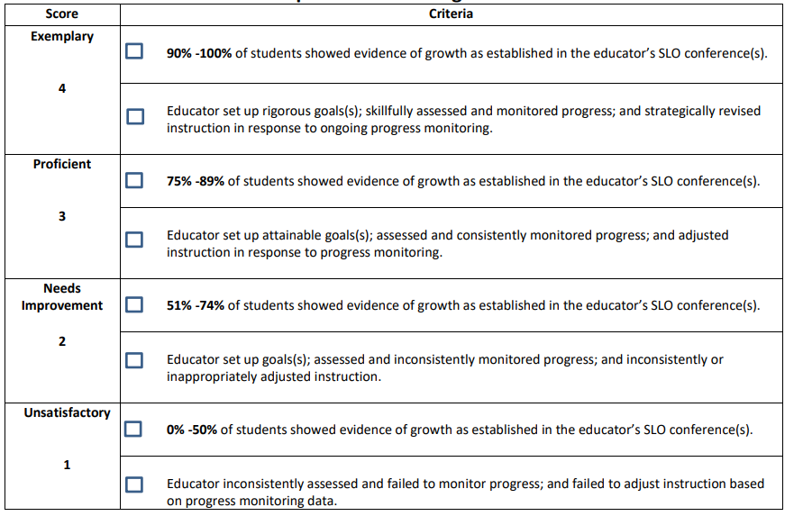
Simple SLO Rubric
Notes:
The SLO rubric has also been updated to focus on the evidence of growth that teachers establish in the SLO conference and monitor throughout the SLO interval.
Districts are encouraged to use this flexibility to prioritize feedback on individualized professional growth and development.

