Slide 1

Educator Effectiveness & Leadership Development Teacher Webinar
October 4, 2022
As you are waiting for us to get started, please type in your name, school, and your answers to these questions in the chat box.
Toot your own horn…how are you supporting your colleagues or students this week?
What questions do you have for us?
Notes:
Welcome to our Educator Effectiveness and Leadership Development annual teacher webinar. We’re so glad you could make it. For now, please introduce yourself to the room by typing in your name and district and respond to our opening questions. If there are multiple people in your room, let us know. To orient you to your controls, there is a chat window on the far right-hand side. On the top gray menu on the right, there is a person with a hand raised, you can use the options below to update your status, to give the speaker feedback on volume, pace, or content.
Throughout the webinar, please use the chat to share your reactions and to pose questions to your colleagues in the virtual room. For now, we’ve muted your mikes, but when it’s time for questions, you may raise your hand or type questions into the chat box. As we’re waiting for responses to roll in, I’ll go ahead and introduce our team. Joining us today are Faye Colley, Beverly Flythe, Kimberly Howard, and Vicki Traufler. My name is Lilla Toal Mandsager and I’m the director in the office of educator effectiveness and leadership development. I’m really thankful to work with this talented team and I can tell you honestly that they model growth mindset. In our profession, you don’t survive for very long trying to be perfect. The best teachers and leaders realize that reflection and feedback are keys to staying motivated and best serving our students. I’m very thankful these talented and reflective educators are leading our work in educator evaluation.

Slide 2
SCDE Office of Educator Effectiveness and Leadership Development
Professional learning
& coaching
  educator effectiveness,
  new teacher & principal induction,
  instructional leadership
SCDE
Office of Educator Effectiveness & Leadership Development
WHAT WE DO
  Personalized Learning
  Collective Leadership
  Equitable access
HOW WE DO IT
OUR FOCUS
  Culture & Environment
  Instruction
Growing educators to lead schools where ALL students have equitable access to effective instruction.
  More effective teachers & leaders stay
  More students & educators grow
DESIRED RESULTS
#SCTSRubric
#CollectiveLeadership
@PIPLeaders
@EducationSC
Notes:
To introduce you to our office, the Office of Educator Effectiveness and Leadership Development is focused on (Mission)
When we’ve examined the commonalities in schools that excel in supporting the growth of all students, we find that they have two things in common, one, the culture and environment are one where students, families, and teachers feel supported and included. Moreover, they are places where there is a clear vision for prioritizing learning and teaching. With those two areas of focus, Culture and Instruction, What our office does is to
Provide Professional learning and coaching to support our educator effectiveness systems, new teacher and principal induction, and to deepen instructional leadership. This looks like working directly with contacts in your districts to make sure that evaluators are trained and evaluation systems are working or facilitating cohorts for the growth and development of principals and other leaders.
All of the professional learning we offer models our priorities of personalization, collective leadership, and attention to equitable access to effective instruction.
It’s our deep hope that by supporting leaders to focus on creating strong school cultures and systems that support instruction, we’ll get to the desired results (read them)

Slide 3
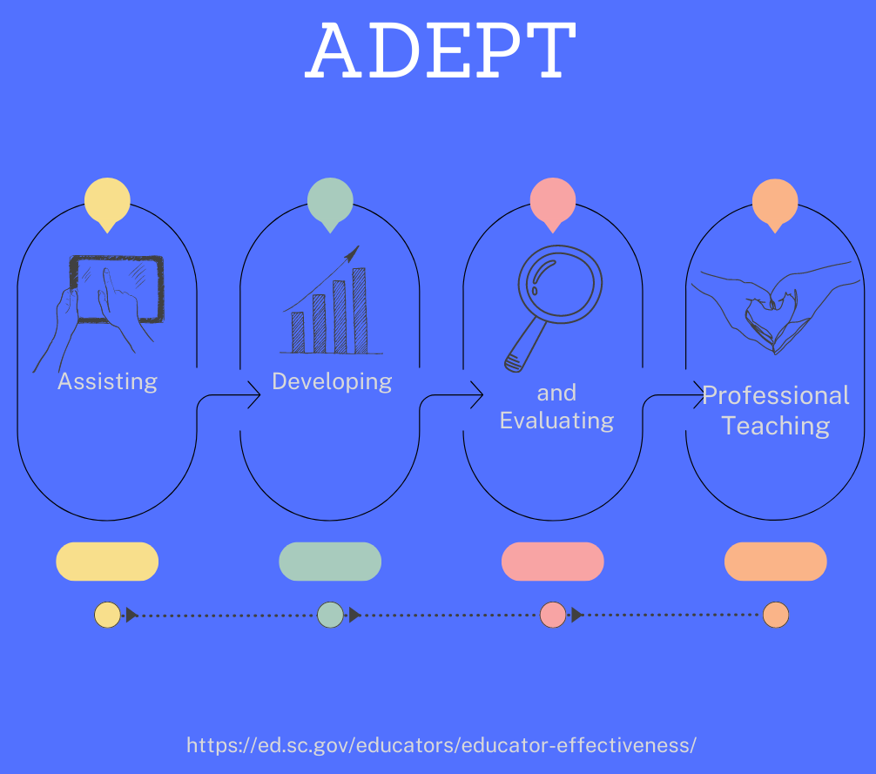
Agenda
Assisting: Zooming in on SCTS 4.0
Developing: Personalizing Your Professional Learning
Resources for Professional Teachers
Feedback & Staying Connected
Notes:
The SCDE believes that educator evaluation is all about growth and development. ADEPT stands for Assisting, Developing, and Evaluating Professional Teaching. We didn’t pick those words just because they make a nice acronym. Giving assistance and feedback on development are necessary parts of the evaluation process. It’s also necessary to call out that teaching is a profession, in our opinion one with an amazing opportunity for growth, fulfillment, and impact in your communities and in our state.
Today’s agenda marks a big moment for us because if we take those parts of ADEPT, starting in 2016, our office started working with stakeholder groups, giving surveys, and hitting the road to update teacher and special areas evaluations in the state. Many of you were a part of those efforts, and you are deeply appreciated for your contribution to those changes and the shift to a growth-focused system.
Today’s agenda feels different because we won’t focus as deeply on the evaluation systems and SCLead. Instead we’ll look at (click) the assisting part of ADEPT by Zooming in on the SC Teaching Standards, (Click) then looking at resources for personalizing your professional learning, and (click) sharing resources that may help you or help you as you support your colleagues, and finally (click) to invite you to share feedback with us on how we can best serve teachers in South Carolina. Throughout the webinar, we’ll be posing questions and fielding questions from you in the chat. Please add them as we go.

Slide 4
ADEPT Evaluation Results
Notes:
Before we move on from our introduction, we do want to share some evaluation data with you.
When we look at evaluation data from 2020-21 (click), there were still some COVID flexibilities in place, but we saw a return to a more normal distribution of evaluation data, including less than 1% unsatisfactory and not reported, 70% of all evaluations proficient, and 28% overall Exemplary.
(click) The overall statewide percentages in 2021-22 were exactly consistent.
(click) When we look just at SLO ratings, in 2021, 41% of SLOs were scored Exemplary with 55% proficient.
(Click) The percentages for 2021-22 were nearly identical.

Slide 5
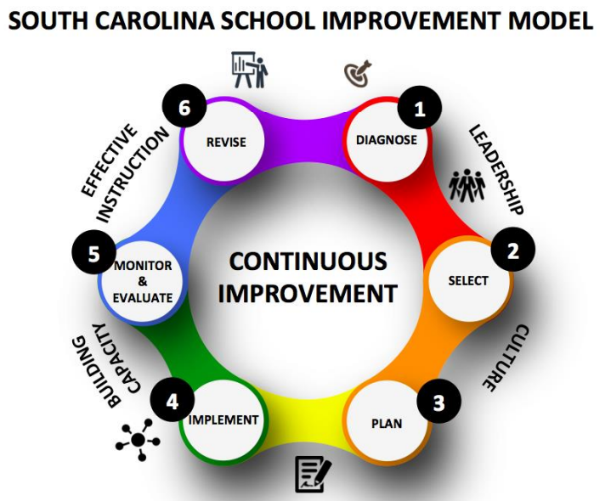
Assisting: Zooming in on the SC Teaching Standards
How can common language support your school improvement journey?
Notes:
Our first section will focus on the tool at the heart of educator evaluations in South Carolina, the South Carolina Teaching Standards (as well as the SC School Librarian, School Counselor, and Speech Language Professional Standards.
Before we head to the rubric, it’s worth saying that when we think about South Carolina’s school improvement framework, from diagnosing needs, to making a plan, to implementing, monitoring, and reflecting on that plan, it’s really important to remember than any improvement cycle (whether it’s for an individual student with an academic need, an individual teacher with a professional goal, or a school with a set of priorities) happens in a specific context. Making a plan that fits that context is essential to success.
The next factor that is essential to continuous improvement is a common language….the SCTS rubric is one way to provide that common understanding of what excellent teaching and learning look like and sound like.
Finally, consistency is essential. When we’re looking to improve (student performance, our own professional practices, or school performance), staying focused on the plan enables us to really look at the success of our plans and interventions. The SCTS can provide that common language for improvement, but…(click)

Slide 6
South Carolina Teaching Standards 4.0
Planning
Environment
Instruction
Professionalism
Instructional Plans
Student Work
Assessment
Engaging & Managing Student Behavior
Expectations
Environment
Respectful Culture
Standards & Objectives
Motivating Students
Presenting Instructional Content
Lesson Structure & Pacing
Activities & Materials
Questioning
Academic Feedback
Grouping Students
Teacher Content Knowledge
Teacher Knowledge of Students
Thinking
Problem Solving
Growing & Developing Professionally
Reflecting on Teaching
Community Involvement
School Responsibilities
Notes:
The SC Teaching Standards Rubric (with 4 domains and 23 indicators) is a little overwhelming when you look at it as a whole document, but fortunately, we’re not asking you to look at every bullet at once.
When we train evaluators for how to rate lessons using the rubric, we emphasize how one strong piece of evidence can count under multiple different indicators. The rubric is holistic and interconnected.
We also train evaluators and coaches to zoom in on a specific indicator when giving feedback. The post conference is designed to have just one area of reinforcement and one area of refinement.
Now that evaluators and teachers are familiar with the rubric, we’re hoping it’s used as much for the assisting and developing part of ADEPT as it is for the evaluating

Slide 7
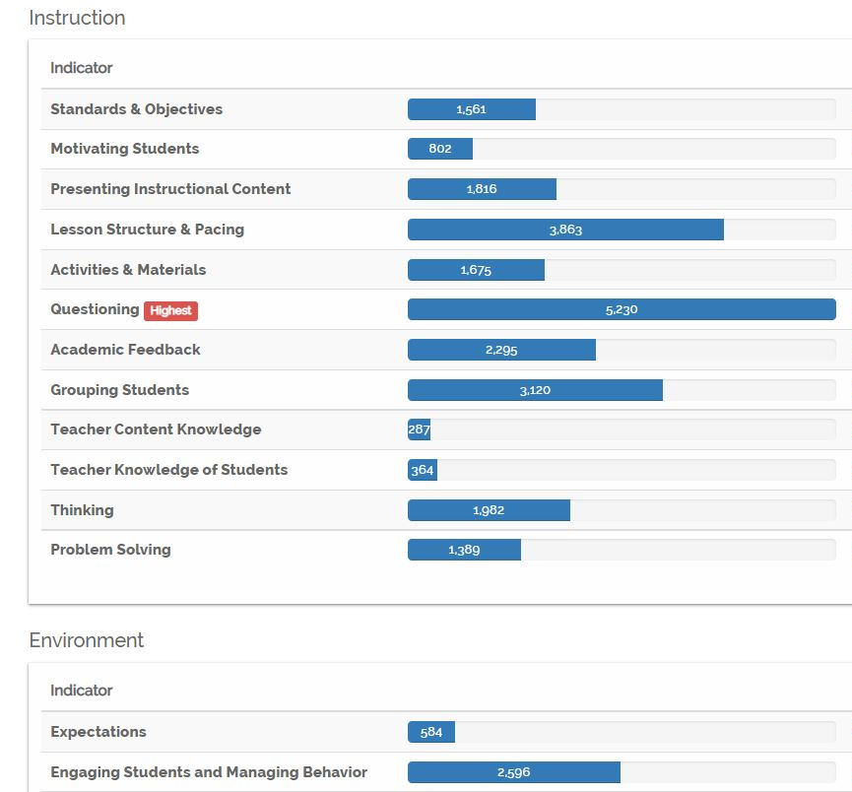
Teacher Performance
South Carolina Teaching Standards Observation Refinement
South Carolina Teaching Standards Indicator Averages
Strengths
Respectful Culture
Environment
Content Knowledge
Areas of Growth
Thinking
Assessment
Questioning
Grouping
Notes:
Over on the left is some more specific data about indicators in the rubric and the highest and lowest scoring indicators on average in the teaching rubric
First off, it’s important to know that overall, teachers average at least a 3 or proficient on most indicators. The difference between the highest and lowest scoring on average is not that great.
It also makes sense that with a growth model there are always places to grow.
Strengths
Areas of growth (note Grouping and assessment) it makes sense that some teachers need more support on those..some students need more support on those right now.
On the right, this shows the indicators that observers most often pick as the area of growth or refinement for teachers, questioning is the highest with lesson structure and pacing and grouping coming in next.
Our office looks at this data to target our support, but we also teach your districts how to pull it for districts and schools and we are partnering with other offices to think about these areas strategically

Slide 8
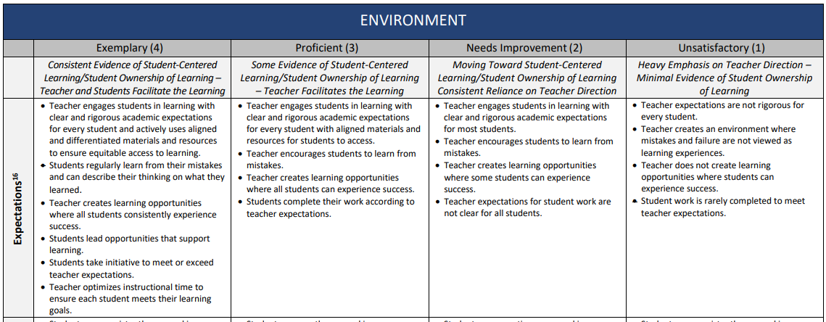
South Carolina Teaching Standards
Notes:
Your teaching standards are like an index…
In SC, we have 4 domains and 23 indicators with four levels of performance.
When we work with coaches and principals to understand the rubric, we often think about the individual bullet points or descriptors as the unit of change for coaching individual teachers (e.g. working with a teacher to move from a level 3, having clear and rigorous expectations for every student vs. having those expectations, but adding in the active use of aligned and differentiated materials at a level four.

Slide 9
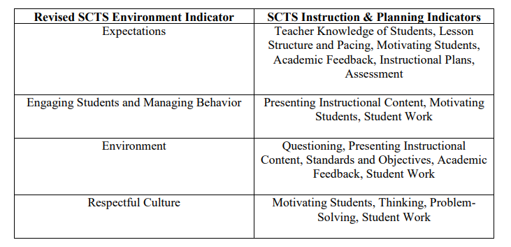
Rubric Crosswalk
Notes:
When we zoom in on an individual indicator like expectations of environment, we can see that it has an impact on so many other areas, like TKS, LSP, Assessment, etc.
Focusing on one tiny piece can have a huge impact.
According to Change management guru, John Kotter quote, “Wins are the molecules of results. They must be recognized, collected and communicated–early and often–to track progress and energize volunteers to persist.”
Transition, Poll…When you think about creating a strong culture in your classroom, what do you think is most important…expectations, Engaging students and managing behavior, Environment, or respectful culture, or Creating a Safe Space for Learning
Knowing & Communicating with Students
Building Relationships
Designing with High Expectations for Cognitive Rigor
Pick your top two….

Slide 10
Responsive and Inclusive Practices
Creating a Safe Space for Learning
Knowing & Communicating with Students
Building Relationships
Designing with High Expectations for Cognitive Rigor
Notes:
The next resource for having common language with your colleagues is the responsive and inclusive practices. Because we heard so much from schools, especially through the toughest parts of COVID that connecting with students and families was really important, our office came together to highlight four key responsive and inclusive practices that align to the SCTS rubric and describe teaching practice that promotes learning experiences that are rigorous, relevant, engaging, and accessible for all students. Those four practices are
Creating a Safe Space for Learning
Knowing & Communicating with Students
Building Relationships
Designing with High Expectations for Cognitive Rigor
These research-based practices link directly to creating an environment that is optimal for learning.
When we look at the poll we see…

Slide 11
Responsive and Inclusive Strategies
Responsive & Inclusive Practice | What the Research Says | What the Rubric Says | Looks Like/Sounds Like | Possible Conference Questions
Creating a Safe Space for Learning | An emotionally stable and responsive environment goes beyond the decorations on the walls; teachers that create a safe space for learning set the social and emotional tone of confidence and caring. (Hammond, 2015). | The classroom displays current student work that promotes a positive and inclusive classroom environment. (Environment) The teacher uses a variety of techniques to maintain student engagement and promote a positive classroom environment. (Engaging Students & Managing Behavior) Instructional plans include activities, materials, and assessments that build on prior student knowledge, are relevant to students’ lives, and integrate other disciplines. (Instructional Plans) Students regularly learn from their mistakes and can describe their thinking on what they learned. (Expectations) Teacher engages students in giving feedback to one another.(Academic Feedback) Students generate higher order questions that lead to further inquiry and self-directed learning. (Questioning) | Resources, images, and student work in the classroom depict people from a variety of backgrounds. Lesson plans connect to previous learning . Students make connections between classroom activities and their experiences or real-life scenarios. Students take academic risks, including giving and receiving feedback, asking questions, and recognizing mistakes as a part of the learning process. | How do you create a safe space for learning where every student feels valued and respected? How does this lesson connect with your students’ life experiences? How do your students take ownership of their learning? In this lesson, where are there opportunities for students to raise questions or offer feedback?
Notes:
We’re sharing in the chat a link to a document we created that outlines each of those four practices in detail.
We were intentional about showing the alignment between research and the rubric and providing you with examples of what you might see and hear in a classroom environment that is responsive and inclusive. We’ve also identified some questions that could be asked in a pre- or post- conference that would allow one to gauge how the environment is responsive to and inclusive of the needs of every learner. You can find the completed document for all 4 responsive and inclusive practices by clicking the link in the chat.
Share link: https://ed.sc.gov/educators/educator-effectiveness/expanded-adept-resources/https-ed-sc-gov-educators-educator-effectiveness-expanded-adept-resources-educator-evaluation-guidance-2018-19/responsive-and-inclusive-practices-and-the-south-carolina-teaching-standards/

Slide 12
Teacher Leadership Goal
Option: Use Section II of PGDP/SLO as a Teacher Leadership Goal
South Carolina Teaching Standard Indicator(s):
Goal: Could include working toward National Board Certification, a goal around mentoring new teachers, or serving as a cooperating teacher for teacher candidates.
Goal Strategies:
Goal Outcome:
Goal Evidence:
Goal Alignment Reflect on how these goals are related to district strategic plans, school renewal plans, or student growth.
Notes:
There has also been an update to the SLO/PGDP template to include an optional Teacher Leadership Goal. This update is in section II, which is on page 3 of the SLO/PGDP template or the professional goals section of SCLead. It’s a district decision
What is a Teacher Leadership Goal?
The SCDE got feedback from the field that some teacher leaders neglect their growth as leaders when they are focused only on student centered SLO goals. We recommend for districts and school leaders to allow teachers to substitute the Teacher Leadership Goal (TLG) for the Student Learning Objective (SLO) for teachers who are seeking recognition for specialized teaching expertise or for coaching teachers. Districts also have the flexibility to allow educators to use a Teacher Leadership Goal as an additional PGDP goal.
Why might your district consider letting some teachers set a Teacher Leadership Goal instead of an SLO?
The SCDE wants to give teachers an opportunity to grow in areas of leading other teachers and growing their expertise. Examples of Teacher types that might complete a TLG in the place of an SLO could be an interventionist, instructional coach, cooperating teacher, mentor teacher, hybrid teacher leader, and those educators working on certification or recognition that grows their expertise.
Although SLO Business Rules require a minimum of six students, a Teacher Leadership Goal is more flexible and does not require a certain number of students or coachees. The TLG is flexible and based on the needs of the teacher leader. We have developed a one pager on our Effectiveness website that explains the TLG more in detail. We will drop the link in the chat-box for you. South Carolina Department of Education Teacher Leadership Goal Guidance (sc.gov)
Please type into the chat if you have set a leadership goal as part of your evaluation or if you know that your district is testing it out. We’d love your honest feedback on how and if it’s working.

Slide 13

Developing: Personalizing Your Professional Learning
Notes:
Now we’re shifting to the Developing part of our webinar and some different ways you can personalize your own professional learning journey. The first is through our brand new, free professional learning library. It’s accessible in SCLead and it offers engaging, online courses you can use for professional development and as a free resource.
As we take you through more details, we invite you to answer this poll…
Have you had the chance to explore the PLL?
If you did, what works about it?
What courses or topics would be most useful for you or your colleagues?

Slide 14
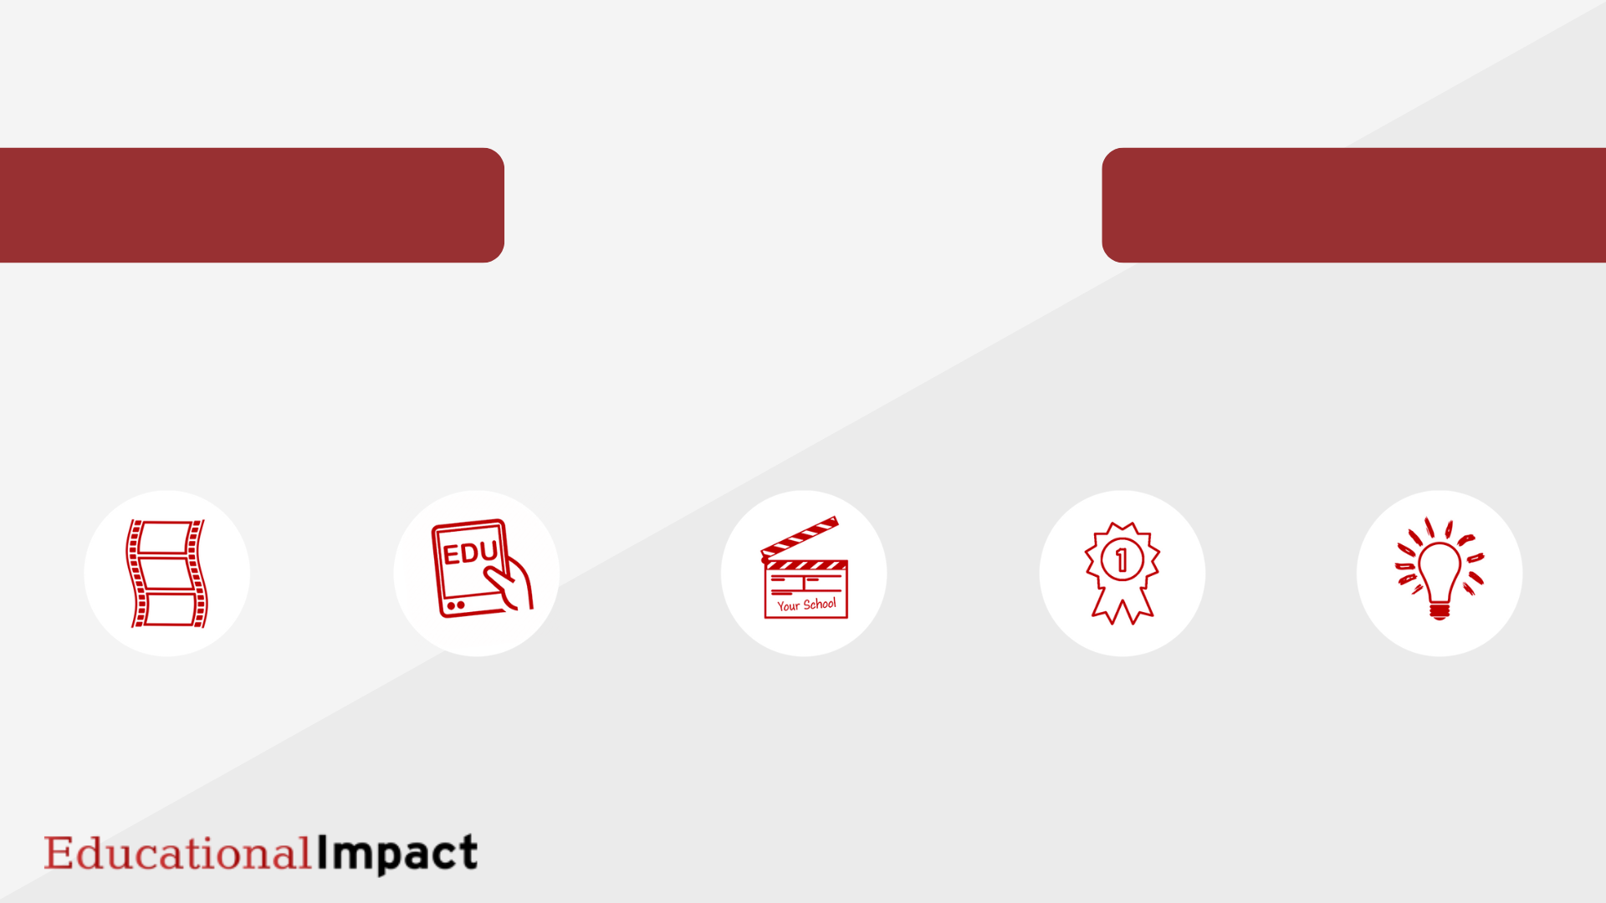

CONTENT PARTNER
Since 1999, Educational Impact has provided schools with unsurpassed course content that inspires them to watch and model best practices.
“Bringing you inside great classrooms”
7,184
unique videos
359
diverse courses
726
hours of videos
57
state Teachers
of the Year
114
educational experts
Notes:
We are really thankful to partner with EI and PS to provide access to…

Slide 15
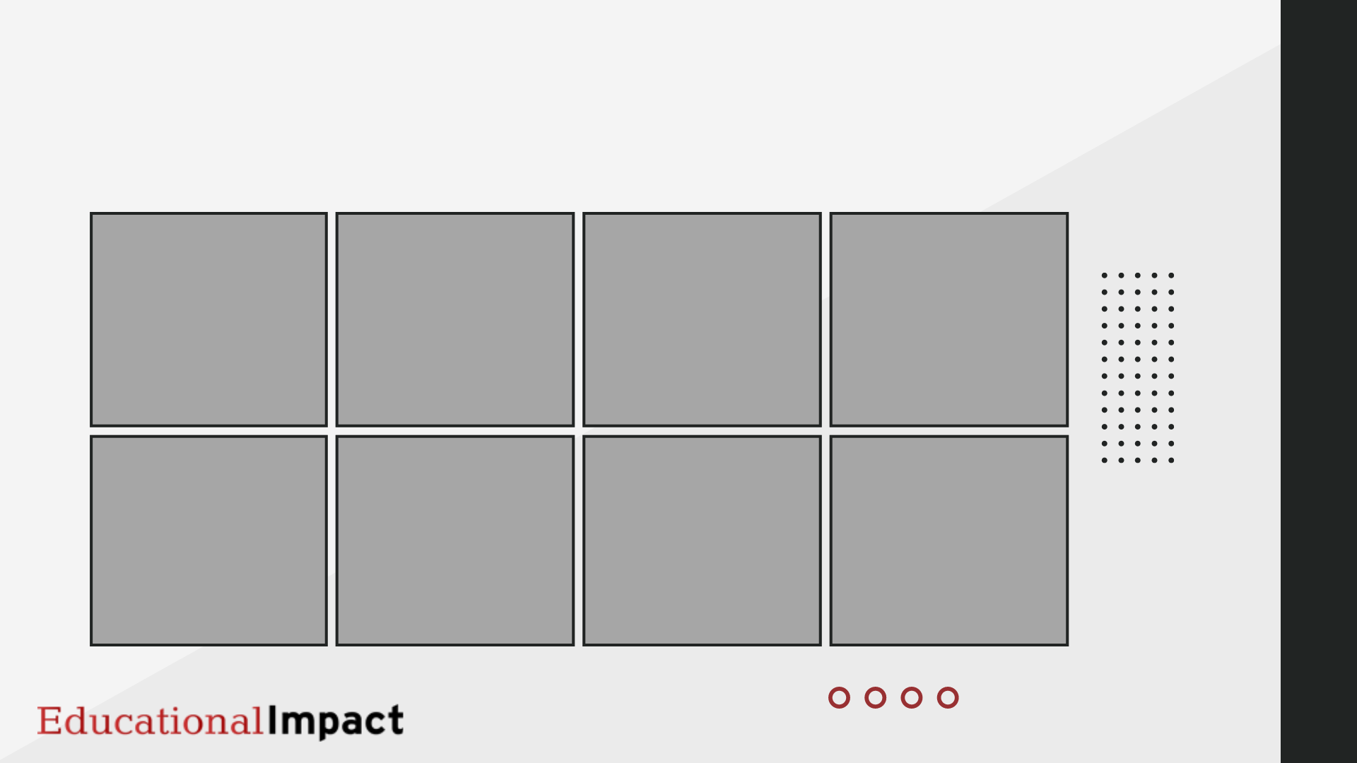
POPULAR TOPICS
ALIGNED TO STATE/DISTRICT INITIATIVES
ACES, Trauma, & SEL
Rethinking Discipline
SCTS 4.0
Technology
ESE & Diverse Learning Needs
New Teacher Training
PADEPP
Reading
Notes:
Emphasize induction, safe environment/social/emotional.

Slide 16
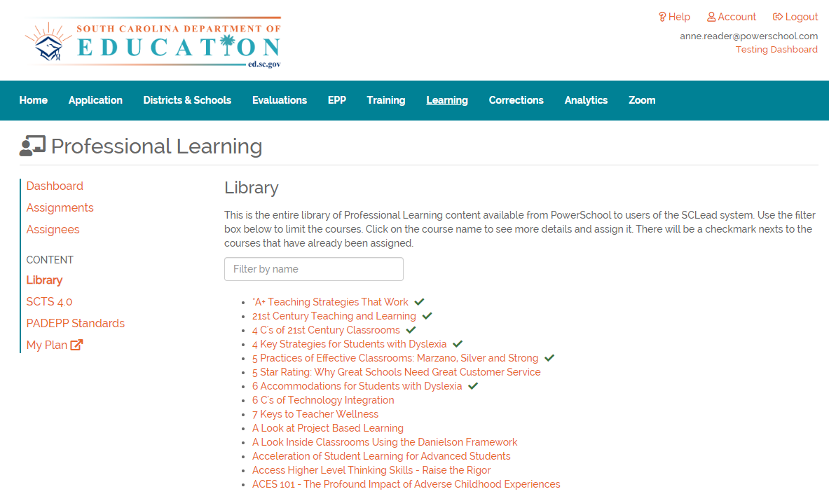
Using the Professional Learning Library in SCLead.org
Go to SCLead.org
Click Learning
Click Library, SCTS 4.0, or PADEPP Standards
Click the Course Title to view
Notes:
We mentioned some areas that might need additional support, here’s where you can find it and get renewal credits that count toward the 120 needed every five years. To get to the PLL…(read directions) The courses with SCTS and PADEPP in the title are automatically eligible to earn renewal credits, while

Slide 17
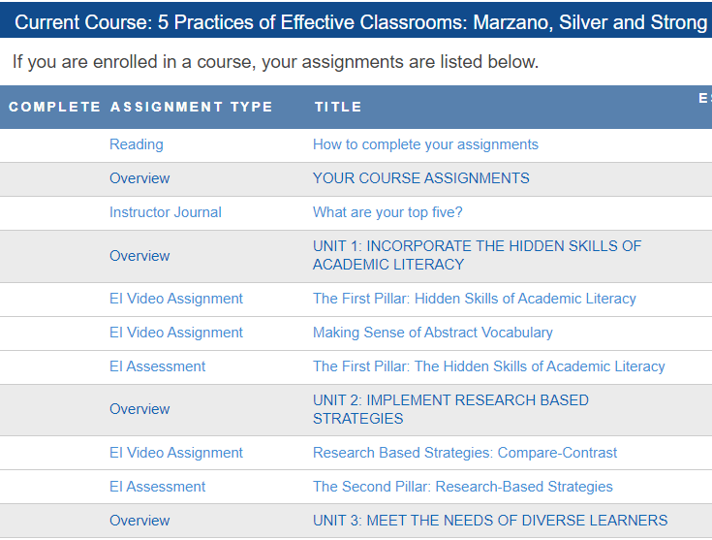
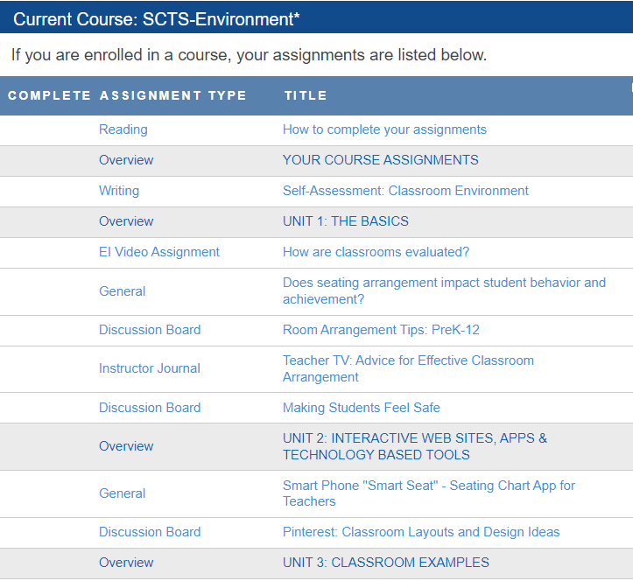
Personalizing PD
Using the Professional Learning Library
ELEOT A. 2.
ELEOT A. 1.
October 13, PLL Educator Training Registration Link
October 27, PLL District Training Registration Link
Notes:
Here’s an example of how the PLL could work in practice. Going back to the two teachers we discussed before.
You could use different courses in the PLL to supplement teacher’s learning and discussions of specific instructional moves connected to the ELEOT strand or SCTS indicator they are working on. For example (click, show the course for A2), and (click, show the different course for A1).
Click, if you want to know more, we have two upcoming trainings.
Follow this link to register for October 13 PLL Educator Training Registration Link
And this link to register for October 27PLL District Training Registration Link

Slide 18
Renewal Credit for Job-embedded professional learning
SCDE Renewal Matrix, Option 6 (Professional Training) or Option 9 (Educational Project)
Type | Renewal Credits | Proof Required
Professional Training (Option 6) | 1 hour of direct participation = 1 renewal credit | Training objectives and/or outline A certificate or other official documentation
Educational Project, Collaboration, Grant, or Research (Option 9) | 1 hour of direct participation = 1 renewal credit | A synopsis (one page or less) of the project, collaboration, grant, or research Official documentation from the educational entity verifying participation
Micro-credential (recommendation) | 1 earned micro-credential = or > 12 renewal credits | Key components or competencies Verification of awarded badge from issuer
Notes:
The PLL fits into professional training, where as a MC could fit in either…speaking of micro-credentials…

Slide 19
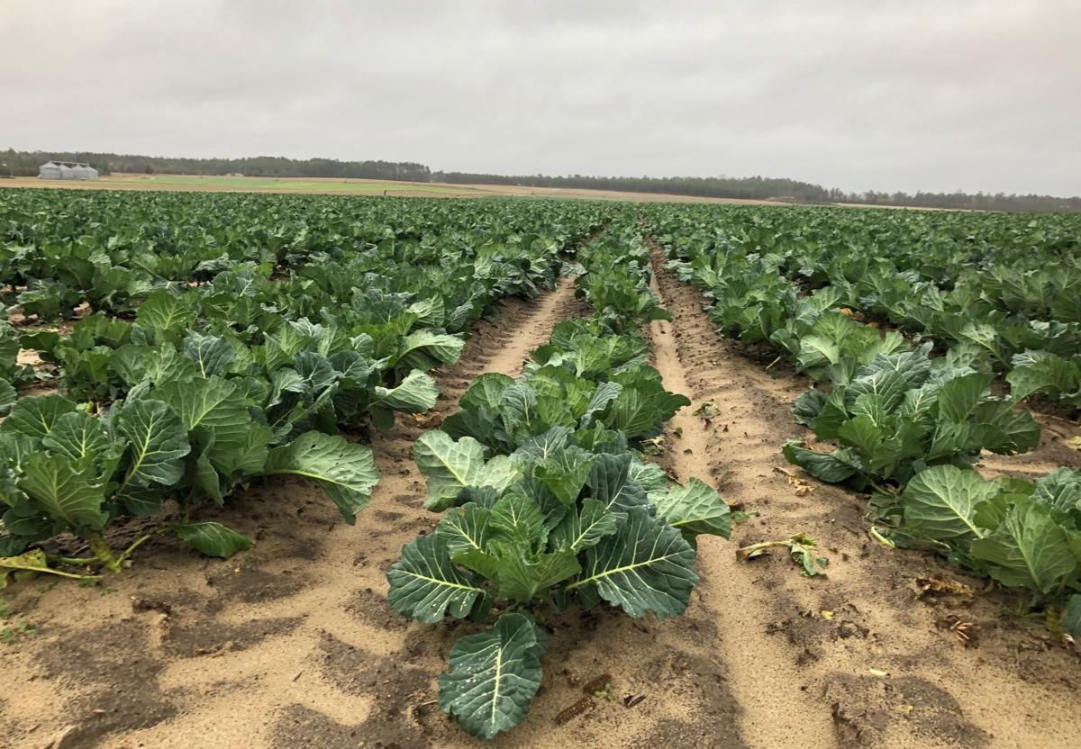
What is a Micro-credential?
A micro-credential is a competency-based, personalized, self-directed assessment that recognizes a discrete skill related to educator practice. The evidence collected demonstrates the educators’ competency.
The SCDE Micro-credential Academy Starts in November
Notes:
Another way to personalize your professional learning and earn renewal credits using options 6 or 9 is…earning a micro-credential.
Emphasizing the words that make MCs unique: competency-based, personalized, & self directed. It’s not the whole row!
The MCA is free….

Slide 20



Professional Learning
Micro-credential Academy
Micro-credential Platforms
Orientation
November 9, 9:00-10:00 a.m. or 4:00-5:00 p.m.
SCTS 4.0 Rubric-Environment, Professionalism & Instruction
Collective Leadership
Cultivating Leadership
Social Emotional Learning
Diversity, Equity, & Inclusion
Notes:
MCA kicks off in November
We have multiple topics available
Other low cost options…
Link to share for registration
https://docs.google.com/forms/d/e/1FAIpQLSfMV_Q8U7ta12HTU3RvTFWpcYDbeNAihPwtN1gN3vH0PPbZJg/viewform

Slide 21
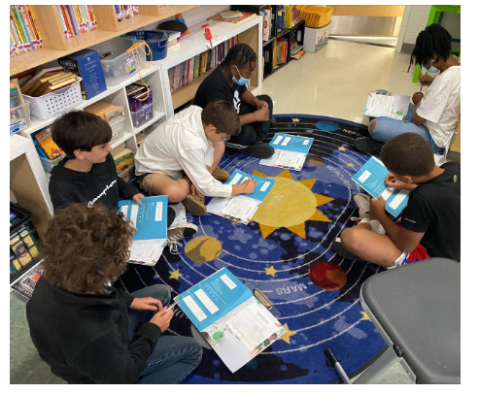
Leadership Development Opportunities
Foundations in School Leadership
Year-long cohort experience
Register Here for February 1 start
or Here for February 28 start
Maxwell iLead Student Leadership Curriculum Info Session
Free for Schools
Info sessions: November 30, 10 am or 4pm
Notes:
Transition: Moving to those last two letters in ADEPT, the professional teaching part, we want to ahrea a few resources that might be a good reference for you.

Slide 22
Resources for Professional Teachers

Slide 23
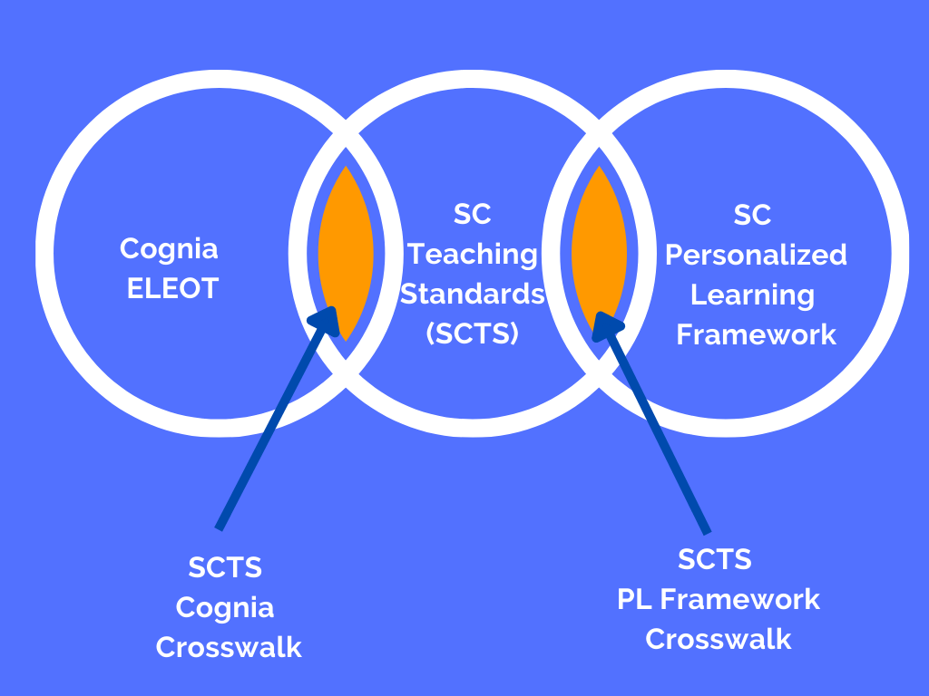
What frameworks can support your improvement journey?
Notes:
We want to acknowledge that the SC Teaching standards aren't the only language for describing strong teaching practices.
-If you're going through accrediation, the ELEOT tool might be more top of mind and if you're focusing on designing your classroom or school to be more personalized, the SC personalized learning framework might be more up your alley.
-Although the SCTS is language every instructional leader and teacher has access to, we know that the entire rubric can be overwhelming. We highly suggest when you're thinking about improving instruction that we zoom in on very specific language related to the changes you are making.
-With these crosswalks, you can zoom into the ELEOT to focus on engaging practices and consider where your school’s areas of instructional need and strength are and you can connect them to the language of the SCTS. Or
-You can zoom in to PL Framework to really focus on how to design classroom instruction (or even instruction across a school) to ensure all learners are engaged and getting what they need. The crosswalk helps you connect back to the SCTS.
In the chat, we'll share these links for your reference. First the SCTS/Cognia/ELEOT Crosswalk: https://ed.sc.gov/sites/scdoe/assets/File/educators/teacher-evaluations/AdvancED_SCTS_Crosswalk_Detailed_06_05_17.pdf
And the SCTS Personalized Learning Framework Crosswalk: https://docs.google.com/document/d/18-nWpUxTHf5Fh11aPRScg5H-x5rcfpg44-3lq67NZHw/edit

Slide 24
ADEPT 2020 for Special Areas Guidelines
ADEPT 2020 for School Counselors Guidelines
  Student Growth Goal
  School Counselor Plan and Annual Calendar
ADEPT 2020 for School Librarians
  School Library Plan
  Professional Goal/GBE
ADEPT 2020 for Speech-Language Professionals
    Observations of IEP and Therapy Sessions with Conferences
Notes:
This past year was the first full year of implementation for our school counselors, librarians and speech-language professionals.
Share Link: https://ed.sc.gov/educators/educator-effectiveness/adept-for-special-areas-2020/

Slide 25
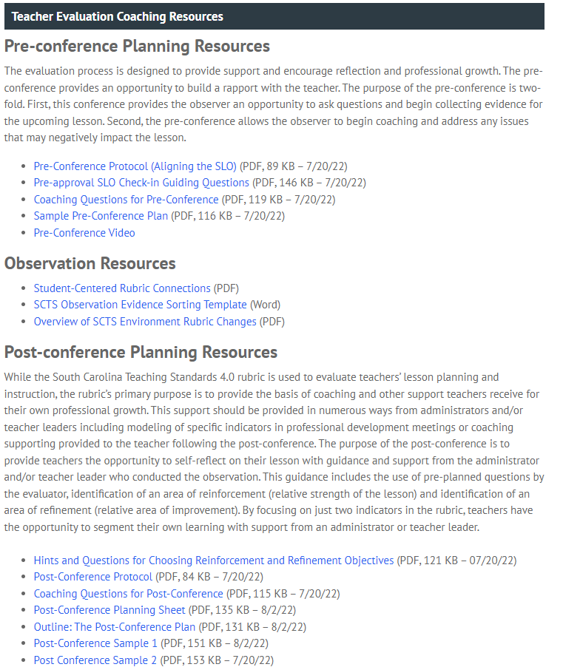
Coaching Resources
Notes:
Walk through coaching resources, Pre-conference alignment with the SLO, looks like sounds like for Students, Reinforcement/Refinement, Videos
Share link: https://ed.sc.gov/educators/educator-effectiveness/expanded-adept-resources/https-ed-sc-gov-educators-educator-effectiveness-expanded-adept-resources-educator-evaluation-guidance/

Slide 26
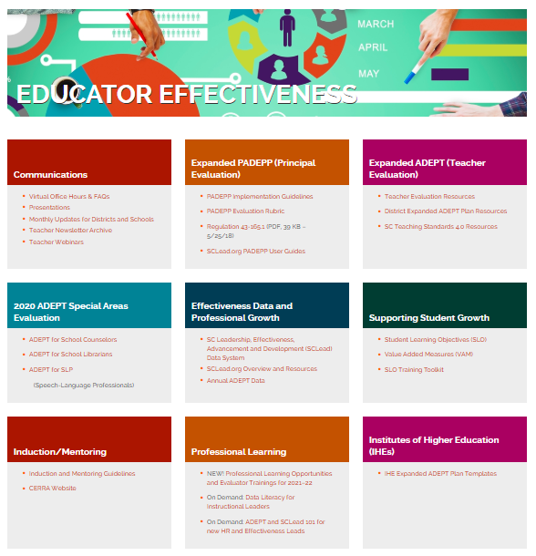
Stay Connected
ed.sc.gov/educators/
educator-effectiveness
And
ed.sc.gov/educators/
school-and-district-administrators/
Notes:
We are so happy that so many of you joined us for this afternoon’s webinar and we want to encourage you to stay connected. You deserve to know what’s going on with teacher evaluation and support, so we want to take a moment to show you that you have access to the same documents we share with districts. Here is the web address for the Office of Educator Effectiveness and Leadership Development.
ed.sc.gov/educators/
educator-effectiveness
We believe the site is a one-stop shop for all things related to educator evaluations and upcoming professional development.
Stop share and share website live…
When you enter the department’s webpage, click on educators at the top of the page and educator effectiveness from the dropdown menu. Show teacher/special are evaluation resources, professional learning, and communications

Slide 27
Feedback and Staying Connected
Type into the chat: Now that you've seen some of the resources from our office, what other information, resources, or professional learning opportunities should we be offering?
Notes:
We’re moving into a section where we’ll ask you to type some information into the chat and we'll invite you to keep those questions coming as well.
First, we’re curious about content, what types of information or professional learning would help you most?

Slide 28
Your input is valued...
  SCTS 4.0/SLO perception study of Early Adoption and TAP schools (2016-18, USC)
  Educator feedback SCTS 4.0 implementation (January 2017, SREB)
  Educator perception study on ADEPT, PADEPP and SLOs (July 2016 and April 2018 AIR)
  Stakeholder feedback was integral in several system enhancements:
  Offering training to support SLOs,
  Providing coaching training for evaluators and principals,
  Creating growth-focused special areas evaluation models, and
  Including timely feedback in the form of Pre- and Post-conferences as a part of the observation cycle
August 12, 2021 ADEPT Teacher Webinar Survey
Notes:
As you type in your responses in the chat, I want to reiterate that a big part of what we do in the office is listen to feedback from educators. Whether its through informal feedback during trainings, webinars, or structured studies on the state’s evaluation model, we care about what you think and your thoughts about how the evaluation system is meeting your needs and how it could be improved.
Here you’ll see 3 of the more formal studies conducted on the state’s evaluation system, of which the July 2016 study gave us data from 10,000 of colleagues. That data helped select the SCTS 4.0 rubric and helped keep the focus on providing immediate feedback after the observation, which we now know as the post-conference.
Stakeholder feedback also informed the need for SLO trainings, coaching training for evaluators and principals, and a continued focus on Pre- and Post-conferences as a part of the observation cycle. Before we part or soon after we part, kindly fill in this survey link: https://forms.gle/AeRyZZLt2EgyWwsy9
It should only take about 5 minutes to complete.

Slide 29
Recruitment and Retention Task Force Feedback
Proviso 1.114
(E)Recommendations from the task force shall include:
  (1) increasing recruitment to the teaching profession;
  (2) improving teacher preparation;
  (3) transforming compensation for teachers;
  (4) enhancing the effectiveness of teacher evaluation;
  (5) improving working conditions for all teachers; and
  (6) identifying best practices from other jurisdictions and designing them for South Carolina.
Notes:
Note: Don't need link in chat
For larger context, part of what we’d like your feedback on is recruitment and retention
This topic has been a focus for all educators we work with
We created a talent matters webinar series last year and are holding two human capital networks currently. . .
We want to know from you…
What are the most pressing issues related to recruitment, retention, compensation, and working conditions?
From your perspective, what information should the task force should consider?
What recommendations do you have about recruitment, retention, compensation, and working conditions?
We’ll collect that information in our survey, but also feel free to share your ideas in the chat.

Slide 30
Questions?
Teacher Webinar Survey: https://forms.gle/AeRyZZLt2EgyWwsy9
Notes:
Now, as we near the end of our time together, please use this opportunity to type questions in the chat box. If we don’t share your question in the webinar, know that we will read and discuss each question as a team. The team has gathered a few questions that have popped up along the way, so we will start with those.
As we get started on questions, we want to share our survey…..https://forms.gle/AeRyZZLt2EgyWwsy9
Finally, Our office has been working on making transparent, clear communications out to teachers. In the past, we have tried contributing to the SCEA and PSTA quarterly newsletters, sending information to district coordinators, providing information on our website, coming to district teacher forums, and holding this annual webinar. We want to know what works for you as far as content and method of outreach, those questions are also in the survey, but if you have ideas about how we could best reach teachers, please share them here.

Slide 31
Office of Educator Effectiveness & Leadership Development
Educator Effectiveness Leads
Faye Colley, Communications, fcolley@ed.sc.gov
Beverly Flythe, Educator Preparation & Special Areas, bflythe@ed.sc.gov
Dr. Kimberly Howard, Mentoring & Induction, khoward@ed.sc.gov
Dr. Vicki Traufler, PADEPP, Team Leader vtraufler@ed.sc.gov
Office Support
Lilla Toal Mandsager, Director,
lmandsager@ed.sc.gov
Marilyn Suber, Administrative Assistant,
masuber@ed.sc.gov
Leadership Development Leads
  Olivia Ortmann, Collective Leadership, oortmann@ed.sc.gov
  Dr. Frank Robinson, New Principals & Emerging Leaders, frobinson@ed.sc.gov
  Tom Smith, Instructional Leadership & Assistant Principals, tsmith@ed.sc.gov
  Keasha Grant, Certified Support & Emerging Leaders, ksgrant@ed.sc.gov
Visit our website: https://ed.sc.gov
Notes:
Thanks again to all who joined us for this webinar. Here is a staff listing for the office and our email addresses. Please reach out if we can be of assistance.

