Slide 1



Office of Educator Effectiveness
& Leadership Development
EPP Reports in SCLead.org
Beverly Hyatt Flythe, MSEd.
Office of Educator Effectiveness and
Leadership Development
Notes:
Welcome to the Quick Guide for EPP Reports in SCLead.org presented to you by the Office of Educator Effectiveness and Leadership Development. My name is Beverly Flythe and I am your EPP ADEPT liaison. You may reach me at bflythe@ed.sc.gov or at 803.896.0318 for more information.

Slide 2
Reports in SCLead.org
Notes:
We know that in order to support your continuous improvement and accreditation efforts, you must have access to pertinent data. We have attempted to tailor these reports to meet your needs as best we can based on your feedback. Here is what is readily available to you in SCLead.org.

Slide 3
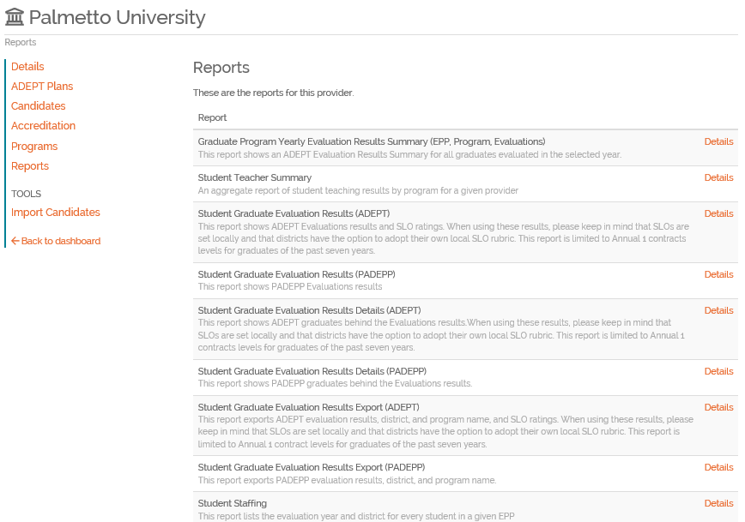
Generating Reports
Notes:
On your EPP dashboard page, select Reports from the menu on the left. This will bring up the list of reports available to you. The names of these reports have been changed from ADEPT reports to evaluation reports since you have access to ADEPT and PADEPP evaluation results. We have been hard at work with our partner RANDA Solutions in continuous efforts to fine-tune these reports into exactly what you need for your accreditation reviews and reporting.

Slide 4
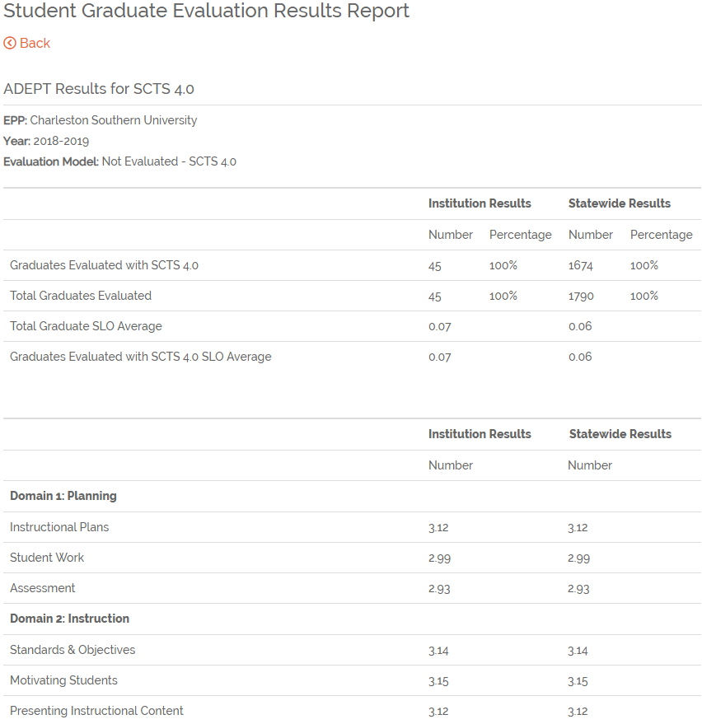
Summary Reports
Notes:
After you select Reports. This will bring up a drop down menu where you are able to select from several reports including the Graduate Program Yearly Evaluation Results Summary (EPP, Program, Evaluations), Student Teacher Summary, Student Graduate ADEPT Results, and Student Graduate ADEPT Results Export. This summary report compares graduates of your institution with statewide averages. The data consists of ADEPT Evaluations results and SLO ratings. When using these results, please keep in mind that SLOs are set locally and that districts have the option to adopt their own local SLO rubric. This report is limited to Annual 1 contract levels for graduates of the past seven years. It is also important to remember that SCDE issued flexibility to support districts finishing reporting of teacher evaluations in 2019-20 and 2020-2021 due to the Covid-19 pandemic, so there may be fewer SLO results for those years.

Slide 5
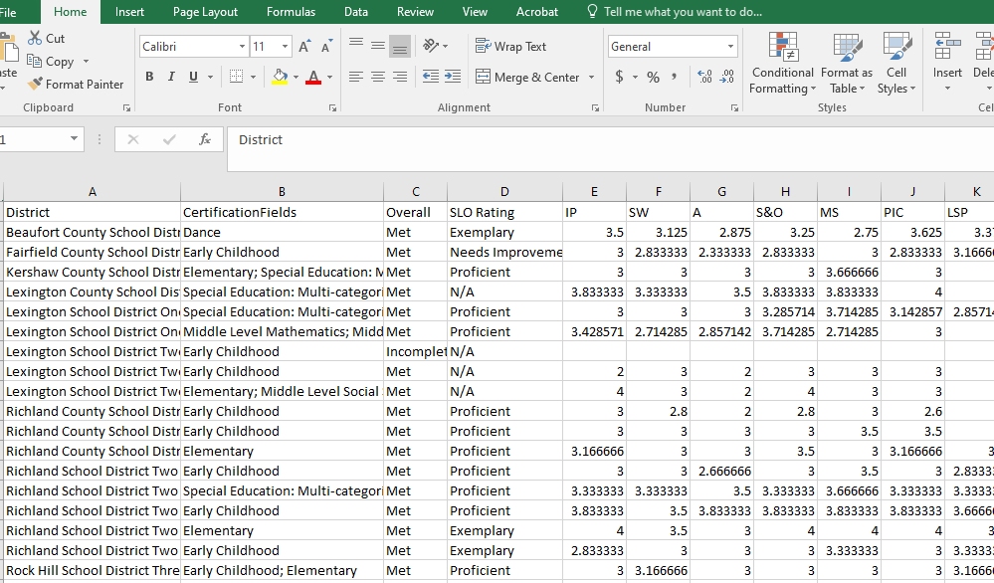
Student Graduate Evaluation Results Export
Notes:
This is the Student Graduate Evaluation Results report which gives you access to:
SCTS 4.0 Indicator scores and Domain Averages
SLO scores – no longer just the +/- .25 or 0, but the actual ratings
Overall Met/Not Met Ratings
Program data (going forward from 2020)
You will be able to pull results by program and year. Based on your feedback, we have removed the Limit of 10 qualifier for you, which should greatly benefit our smaller institutions and programs.

Slide 6
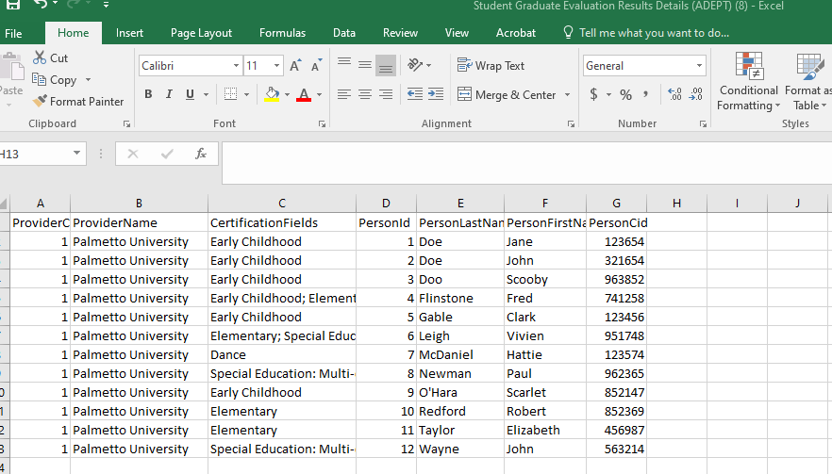
Student Graduate Evaluations Results Details
Notes:
In order to know which of your graduates are represented in this report, we have created the Student Graduate Evaluation Results Details report which identifies the educators represented in the Export.

Slide 7
Student Staffing Report
Notes:
We have created a Staffing report which identifies which of your graduates are found in which districts by evaluation year. You can also run this as an Export report which can then be disaggregated and filtered to better suit your reporting needs.
This report lists the evaluation year and district for every student reported by a given EPP. This report contains the name of the EPP, the name of the graduate and what year they were reported by the EPP as well as the semester and results. Then columns move into year evaluated using a Summative evaluation and the district that evaluated them that year. This is a tool you can use to see what districts are employing your graduates in which years. Graduates listed in columns A through J with blank information for the rest indicate educators who were not employed in a South Carolina public school district after graduation.

Slide 8
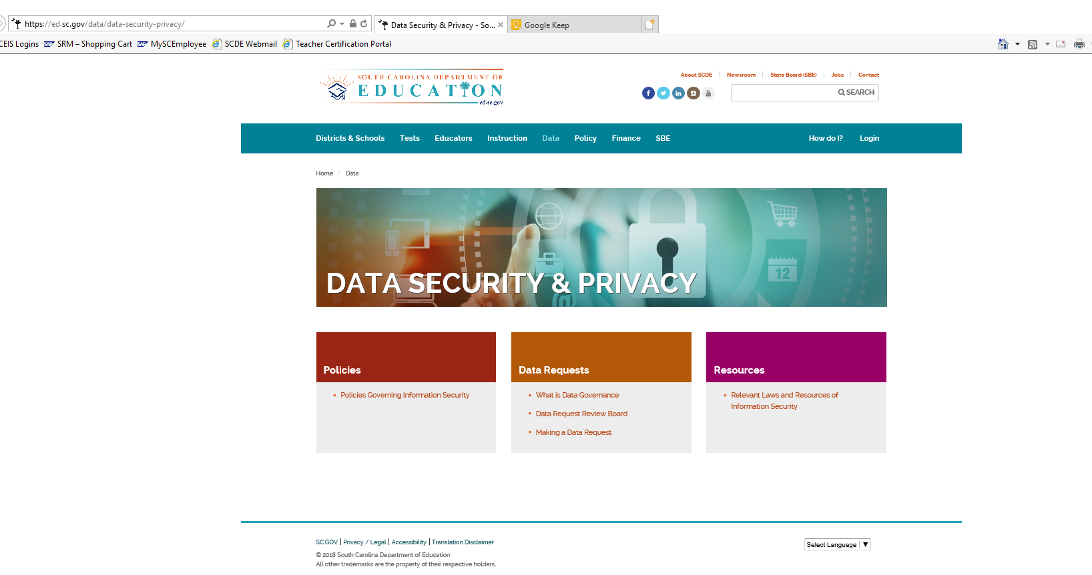
Other Data Requests
ORDA request webpage link
Notes:
As in the past, if you want additional data, you can go through the agency data request process which requires a data sharing MOU with the agency. This process for requesting data should be reserved for information that you do not already have access to in SCLead.org. Please check the reports you do have access to prior to submitting an ORDA request, as requesting reports through ORDA that you already have access to slows down the process and clogs the system. If you have any questions about data available, feel free to reach out to me. If you do not currently have an MOU on file, you will need to process one with ORDA. These are usually compiled without a charge to the institution, but if the request requires extensive pulling together of information that isn’t readily available, there may be a fee associated.

Slide 9
EPP Reports in SCLead.org
Beverly Hyatt Flythe, MSEd.
Office of Educator Effectiveness and
Leadership Development
Notes:
Thank you for your attention to the Quick Guide for EPP Reports in SCLead.org presented to you by the Office of Educator Effectiveness and Leadership Development. My name is Beverly Flythe and I am your EPP ADEPT liaison. You may reach me at bflythe@ed.sc.gov or at 803.896.0318 for more information or support.

