Slide 1

2018-2019 EPP Expanded ADEPT Guidance Presentation
Office of Educator Effectiveness and Leadership Development
May 18, 2018
Notes:
Welcome participants
Introduce myself and others in the room
Orient participants to Adobe classroom
Chat feature up to check sound
Poll – which EPP are you located
Q and A box for questions
Will respond to as many questions as we can at the end of the presentation (questions we cannot respond to today, we will email responses)
Raise hand if need me to slow down or speak louder
Presentation will be 1 hour or less
Acknowledge skill diversity in room (new EPP ADEPT coordinators and veterans)
Review each page of the Expanded ADEPT plan (spend more time on the updated information and move a little quicker through pages with little to no changes)
OEELD is available to assist you as you complete the EPP ADEPT plans

Slide 2
Agenda
Introductions
ADEPT Guidelines Updates
ADEPT Plan Reminders
ADEPT Plan Step-by-Step
Transition
Q and A

Slide 3
ADEPT Guidelines Stakeholder Feedback
  Effectiveness Experts
    ADEPT Plans 2017
    Effectiveness Office Hours
    Effectiveness Advisory Team (District, Higher Ed., Principals, Teachers)
  Trainings and SCASA Roundtables
    SC Teaching Standards, PADEPP, and Leadership continuum trainings
    Personnel, Instructional Leaders, and HR Roundtables
    Induction and Mentoring Coordinators
    SCEDA
  Independent Reviews
    University of South Carolina Research, Evaluation, & Measurement Center
    Southern Regional Education Board Focus Groups
    American Institutes for Research Statewide Surveys (2016 and 2018)
Notes:
FYIs about implementation in districts for EPPs to note:
Sought extensive feedback.
Most consistent theme was that teachers wanted more and more meaningful feedback on their practice.
This year, we really dug in to ask about induction requirements and if they needed to change. Consensus was system is well set-up to support induction teachers’ needs, but the SCDE should emphasize current flexibility districts have to make the process easy for new teachers.
Feedback from stakeholders in this first year of partial implementation is that they love the intention, giving that feedback to teachers is more rigorous, but ultimately worth it
2018-2019 ADEPT Guidelines can be found at ed.sc.gov->Educator Effectiveness->Expanded ADEPT (Teacher Evaluation)->Teacher Evaluation and Support Guidance->Expanded ADEPT and Support Guidance->Expanded ADEPT System Guidelines April 2018

Slide 4
ADEPT Plan Deadline
July 2nd deadline for 2018. Submit via Google Drive link you are sent.
Will be placed in the EPP portal in SCLead.org in 2019.
Will gather data on implementation.

Slide 5
ADEPT Plan Reminders
  OEELD required to report ADEPT Plan feedback to the State Board of Education
Submission Process
  Ensure reports are complete before submission
  Submit via the Google Drive link that is sent to your dean/chair/designee
  Expect follow-up questions/feedback on plan
  When SCLead.org is released, you will be expected to become familiar with the
  EPP portal within the platform (data entry, reports, etc.). Webinars will follow
  in July and August
Notes:
OEELD will present an ADEPT Plan summary to the state board in the fall. This summary will identify some of the trends and processes as reported in these plans. Thus, it is critical that we meet deadlines in getting plans submitted.
Read from slide

Slide 6
EPP ADEPT Plan
Page by Page

Slide 7
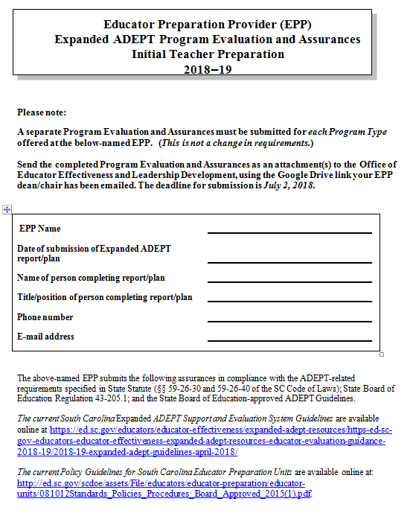
Page 1
Notes:
Page 1 is the same for all EPP ADEPT plan types. It requires the basic EPP information: EPP name, date of submission, person completing the plan, the title of the person submitting the plan, the EPP phone number and email of the person to be contacted if there are questions about the plan. Support Guidelines are available on the page via the link at the bottom of the page.

Slide 8
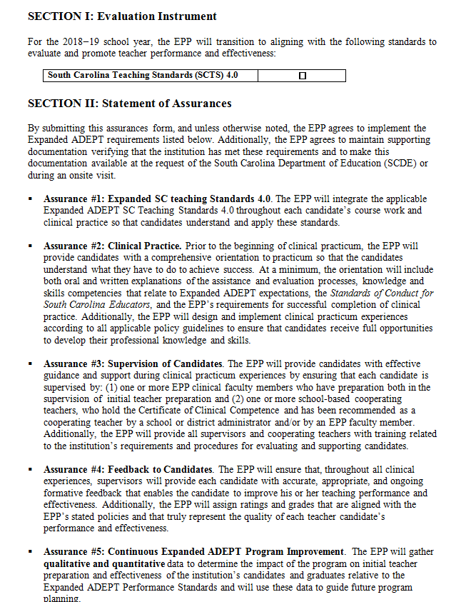
Page 2
Notes:
Page 2 of the plan includes the Evaluation Instrument (Initial Teacher Preparation plan only) and Statement of Assurances. In Section I of the plan for Initial Teacher Preparation, the Evaluation Instrument section at the top of the page asks the EPP to note that they are completing, or have completed their transition to alignment with SCTS 4.0., however EPP catalogs and institutional documents may still be in the transition phase. EPP ADEPT Plans for Speech Language, Guidance Counselor, and Library Media Specialist will not have the Evaluation Instrument section that you see on this screen. The Section I in other plans is the Statement of Assurances.

Slide 9
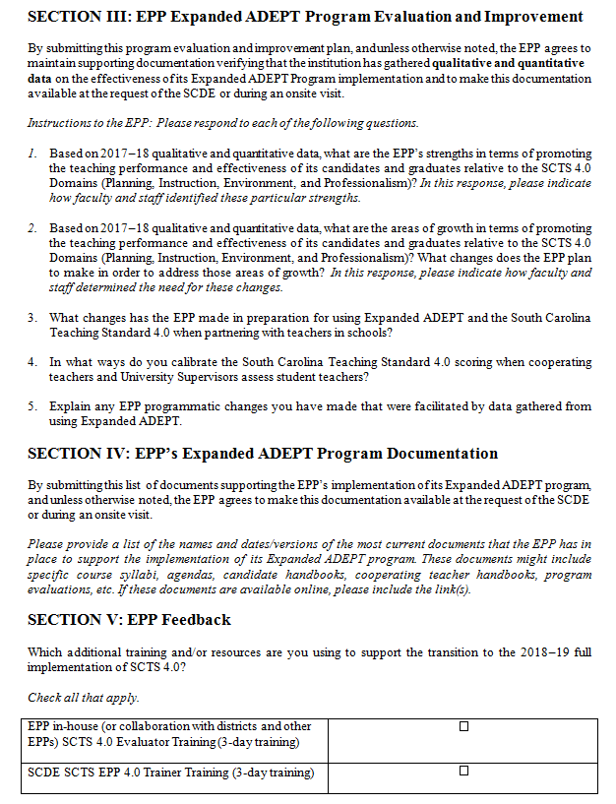
Page 3
Notes:
On page 3 of the document EPPs will be asked to: (i) respond to question about program improvement as related to Expanded ADEPT implementation, and (ii) provide documentation to support implementation (document location or web link), and (iii) offer feedback about the training methods that will be used to sustain and expand capacity for full implementation. In this slide you can see the Sections III-IV from the Initial Teacher EPP ADEPT Plan. There are three additional questions (#s 3-5) in Section III that differ from from the 2017-2018 IHE ADEPT plan. EPP ADEPT Plan questions for Speech Language, Guidance Counselor, and Library Media Specialist have not changed.

Slide 10
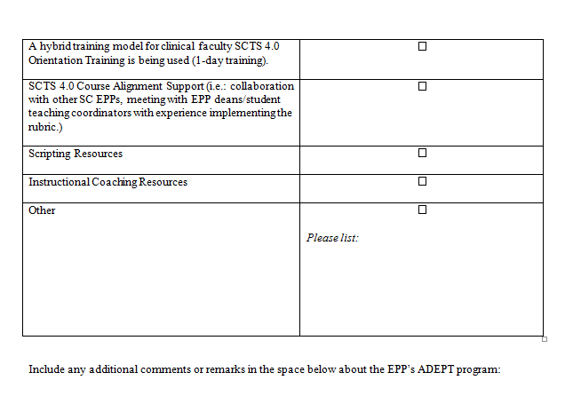
Page 3
Notes:
The last page of the Initial Teacher ADEPT Plan poses an additional question about training using the hybrid training model for clinical faculty for the 1-day training. In addition, please take time at the end of the plan to offer comments or remarks about your EPP ADEPT plan to offer a more detailed description or explanation about your plan(s).

Slide 11
NEW Website Resources
At www.ed.sc.gov > Educator Effectiveness > Expanded ADEPT Evaluation Guidance
2018-19
Notes:
The Office of Educator Effectiveness is in the process of publishing new website resources. “Coming Soon” resources are scheduled to be published in May.

Slide 12
SCLead.org Webinars for EPPs
SCLead.org is the new data management system for educators and EPPs combining SC Department of Education data management systems (to include the IHE Portal).
SCLead.org will offer current and additional reports for EPPs to help with data collection.
This site will be where EPPs enter student teaching results after this semester.
If you have not sent in your EPP credentials for SCLead.org, then please do this using the following link: https://scde.formstack.com/forms/sclead_org_credentials_check_epp
SCLead.org Webinars
Dates | Times
July 25, 2018 | 10:00AM-11:00AM
August 15, 2018 | 2:00PM-3:00PM
Notes:
The Department of Education has been developing a new data management system for educators and EPPs in South Carolina.
The new data system, SCLead.org, is currently in the design phase, and will be implemented in August 2018.
EPPs will be part of SCLead.org to access the new EPP Portal (the successor of the IHE Portal).
It is our hope that as part of SCLead.org, EPPs will be able to get the same reports that they can currently run in the IHE portal and more to help with their own data collection.
EPPs will continue to enter student teaching results this spring into the IHE portal that can be accessed on the Educator Effectiveness website.
We have two webinars planned for EPPs in July and August that will offer further guidance on SCLead.org.
Please use the link above that was sent to your EPP dean/chair to enter credentials for administrative users’ access to SCLead.org when it comes online-- if you have not done this already.

Slide 13
Posted Trainings
SCLead
  Berkeley/Charleston (Goose Creek)- May 30, 2018
  Greenville/Spartanburg (Greenville)- June 6, 2018
  Lexington/Richland (Chapin)- June 13, 2018
  Lexington/Richland (Columbia)- June 14, 2018
  Pee Dee (Florence)- July 11, 2018
SCTS 4.0 Evaluator Trainings
  Midlands (Lexington and Richland), June 26–28, 2018
  Spartanburg/Greenville, July 10–12, 2018
  Pee Dee (Florence), August 7–9, 2018
  Midlands (Lexington and Richland), February 4–6, 2019
SCTS 4.0 Train the Trainer
  Midlands- Morris College, (IHE Focus), June 12–14, 2018
  Savannah River- Newberry College, September 18–20, 2018
  Low Country- Beaufort, October 10–12, 2018
SCTS One-Day Refresher Trainings
  Midlands (Columbia)
-August 2, 2018
-October 4, 2018
-March 6, 2019
Complete training calendar can be found at: https://ed.sc.gov/educators/educator-effectiveness/professional-learning/professional-learning-opportunities/
Notes:
In this slide you can see the trainings that are currently posted for participant registration. Each training has a maximum capacity, so please register as soon as you know you will be able to attend. The registration link is at the bottom of this slide. Or, you may go to www.ed.sc.gov, then go to Educators->Educator Effectiveness->Professional Learning Opportunities and Resources.

Slide 14
James-Transition
In efforts to better serve EPPs in program approval I will be transitioning to the Office of Educator Services collaborating with Jacki Walsh. I have experience in program approval from Georgia.
Good news! I will be an Educator Effectiveness resource in Educator Preparation.
As part of the transition I will help facilitate the Morris College SCTS training event (EPP Focus) this summer.
I will collaborate with Educator Effectiveness as it relates to EPP ADEPT Plans and other areas, as requested.
I look forward to continuing to work with EPPs in the future as part of Educator Preparation!
Notes:
Read from Slide

Slide 15

Questions?
Notes:
Please take a moment to consider any questions you may have about the EPP ADEPT Plans.

Slide 16


Stay Connected ed.sc.gov/educators/ educator-effectiveness
OEELD Contact Information
Lilla Toal-Mandsager
OEELD Director, lmandsager@ed.sc.gov
Dr. Julie Anna Hartwell
Data and Accountability, jhartwell@ed.sc.gov
Dr. Kim Howard
Mentoring & Induction, khoward@ed.sc.gov
Dr. James Ritter
Higher Education/EPP, jritter@ed.sc.gov
Dr. Vicki Traufler
PADEPP Coordinator, vtraufler@ed.sc.gov
Notes:
http://ed.sc.gov/educators/educator-effectiveness
Please note the deadline for submission of Expanded ADEPT plans is July 2nd. Please return the completed plans at the Google Drive link your dean/chair or his/her designee is emailed.
Q and A portion of the presentation will begin now.

