Slide 1



Office of Educator Effectiveness
& Leadership Development
EPP ADEPT Plan Guide
Beverly Hyatt Flythe, MSEd.
Office of Educator Effectiveness and
Leadership Development
Notes:
Hello and welcome to the Quick Guide to uploading your EPP ADEPT Plans. My name is Beverly Flythe and I am your ADEPT liaison in the Office of Educator Effectiveness and Leadership Development.

Slide 2
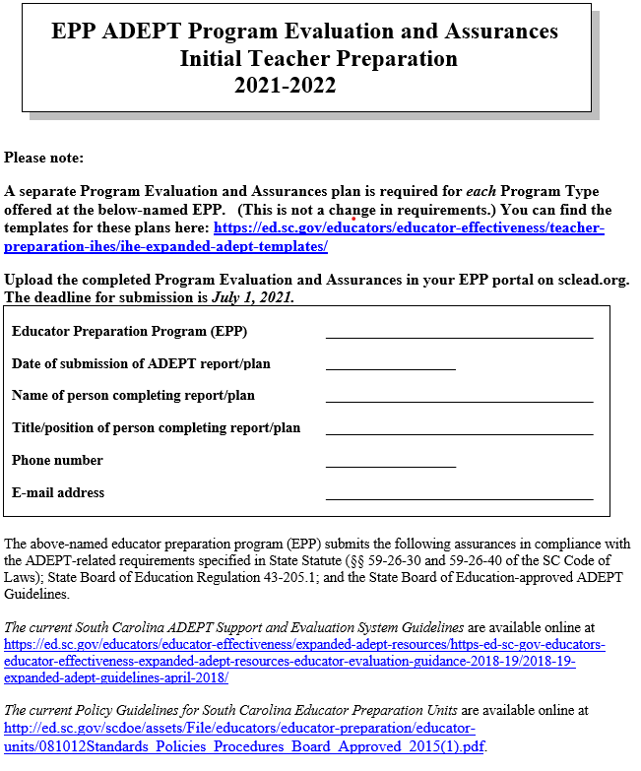
ADEPT Plan Template Page 1
Notes:
Let’s look at your EPP ADEPT Plan template. Page 1 is the same for all EPP ADEPT plan types. It requires the basic EPP information: EPP name, date of submission, person completing the plan, the title of the person submitting the plan, the EPP phone number and email of the person to be contacted if there are questions about the plan. Support Guidelines are available via the link at the bottom of the page.

Slide 3
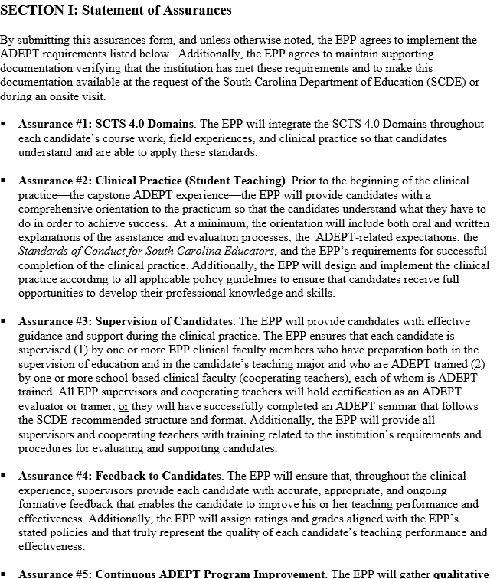
ADEPT Plan Template Page 2
Notes:
Page 2 of the plan includes the Evaluation Instrument (Initial Teacher Preparation plan only) and Statement of Assurances.

Slide 4
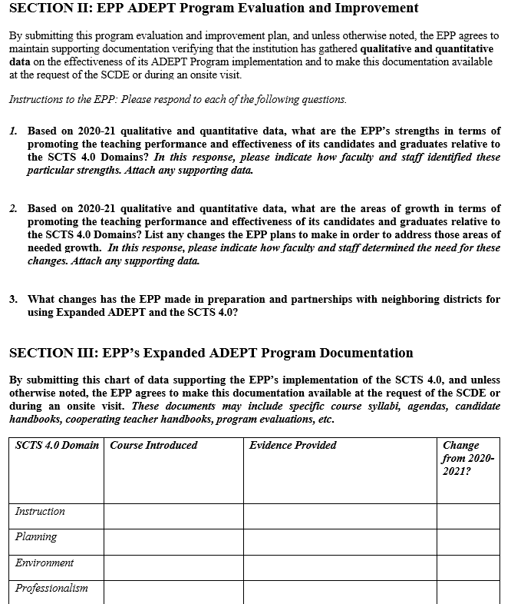
ADEPT Plan Template Page 3
Notes:
On page 3 of the document, EPPs will be asked to: (i) respond to questions about program improvement as related to Expanded ADEPT implementation, and (ii) provide documentation to support implementation (document location or web link). EPP ADEPT Plan questions for Speech Language, School Counselor, and School Library reflect the implementation of the 2020 ADEPT for Special Areas evaluation models.

Slide 5
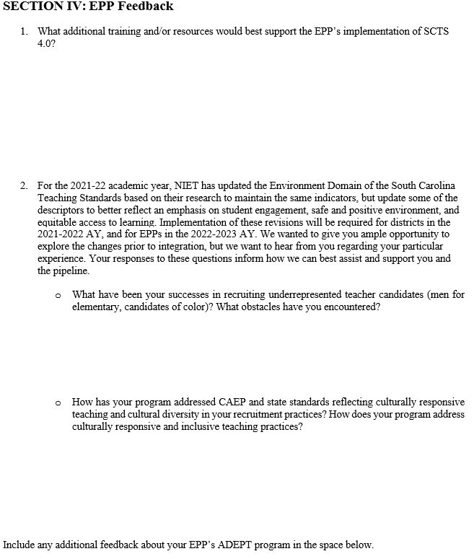
ADEPT Plan Template Page 4
Notes:
The last page of the Initial Teacher ADEPT Plan poses additional questions about training and any other support your EPP may require in order to better implement and integrate the SCTS 4.0. In addition, please take time at the end of the plan to offer further comments or remarks about your EPP ADEPT plan to offer a more detailed description or explanation about your plan(s). New for 2021 reporting will be the inclusion of ways in which the EPP approaches diversity and includes issues of cultural sensitivity and anti-racism into the coursework and expectations for students.

Slide 6
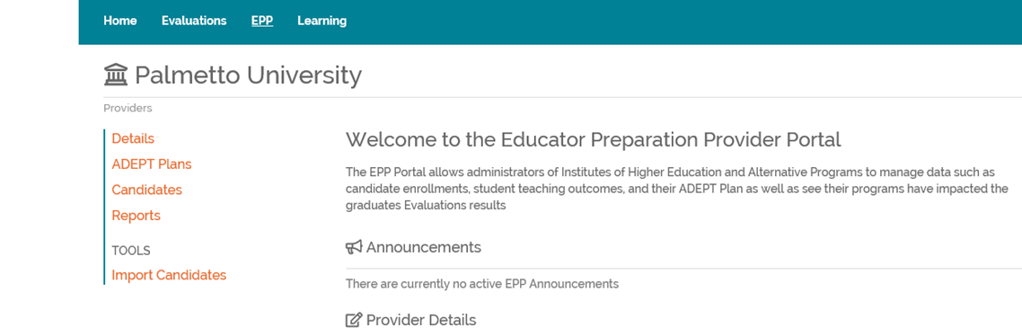
Uploading your ADEPT plan: Step 1
Notes:
Please upload your ADEPT Plan using these steps.
1. On your homepage, select ADEPT Plans.

Slide 7
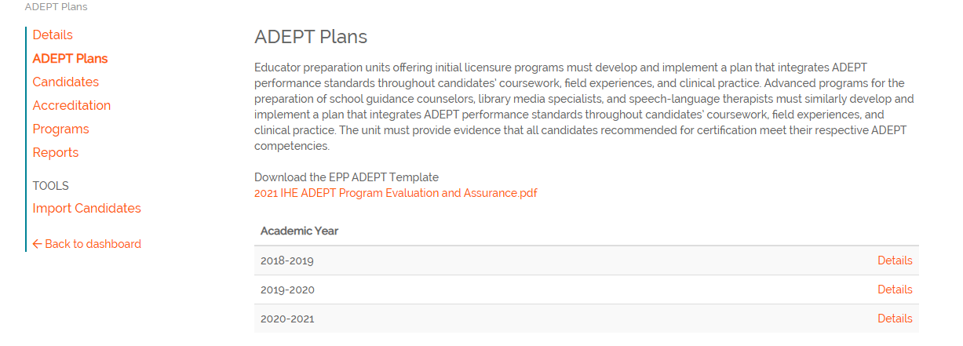
Uploading your ADEPT plan: Step 2
Notes:
When the ADEPT Plans screen pops up, select the correct year and click Details.

Slide 8
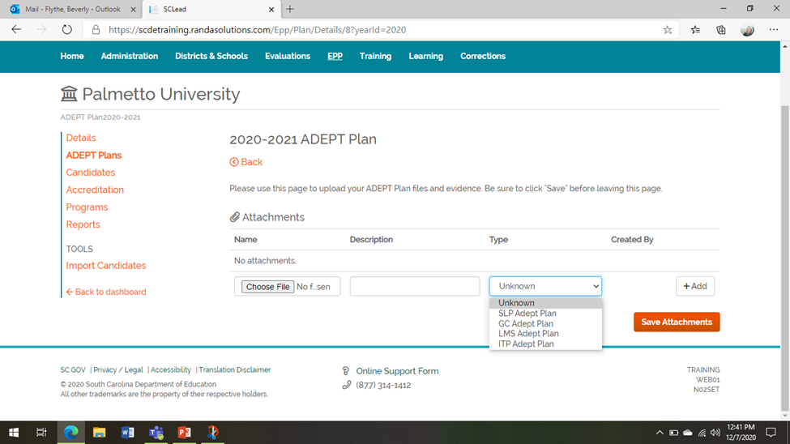
Uploading your ADEPT plan: Step 3
Notes:
Here you will click Browse to locate the correct version of your ADEPT plan from your computer, type in a brief description, and be sure to SAVE. In the drop down menu, you have the option to identify which type of ADEPT plan this is, School Counselor, SLP, School Library, or Initial Teacher Prep plan.

Slide 9
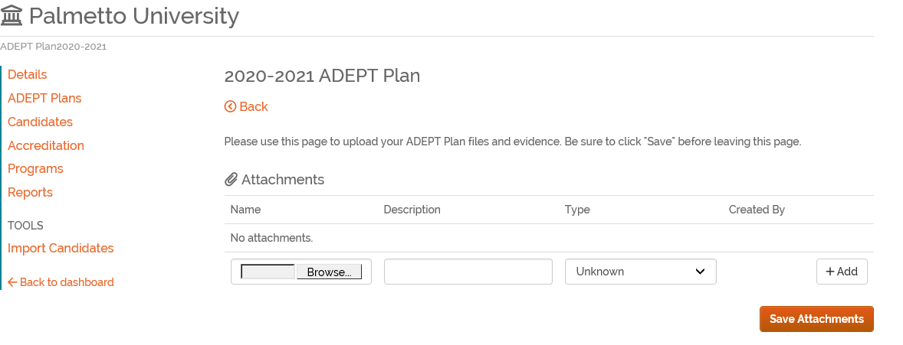

Uploading your ADEPT plan: Step 4
Notes:
If you enter something in error, you have the bright red trash can to delete your mistake and repeat the process correctly. Once your ADEPT Plan shows up here, you have successfully uploaded your ADEPT Plan.

Slide 10
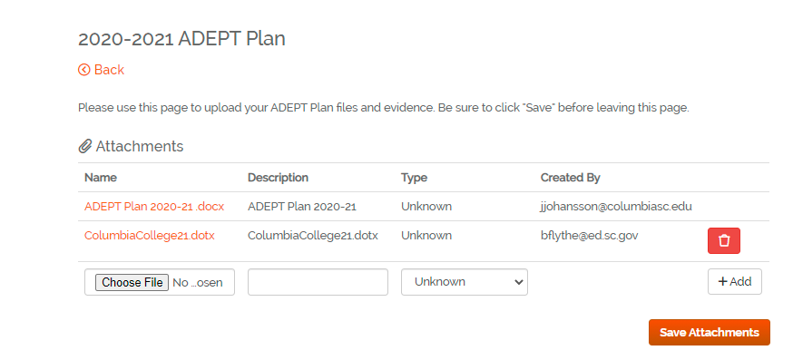
Pulling your ADEPT Plan for later reference
Notes:
For accreditation reviews and many other reasons, you may need to access your submitted and approved ADEPT Plans from the past couple years. This is where you are able to do that. Simply click on the ADEPT Plan link on the left screen menu and click on the year you need. You are then able to save or print the pdf you submitted to us, as well as our SCDE feedback. Our office reviews and makes revisions to the ADEPT plan template each spring, making it available for download by late April on the website and in SCLead. I will also send out an email reminder once the link is available on the SCDE website.

Slide 11


Stay Connected ed.sc.gov/educators/ educator-effectiveness
OEELD Contact Information
Lilla Toal-Mandsager
OEEL Director, lmandsager@ed.sc.gov
Beverly Hyatt Flythe
Higher Education/EPP, bflythe@ed.sc.gov
Notes:
http://ed.sc.gov/educators/educator-effectiveness
Please note the deadline for submission of Expanded ADEPT plans is July 1st. Please submit the completed plans in SCLead.org. Feel free to reach out to me if you have any questions or concerns.
.

