Slide 1



Office of Educator Effectiveness
& Leadership Development
Guide to Validity and Reliability Studies for Expanded ADEPT
Beverly Hyatt Flythe, MSEd.
Office of Educator Effectiveness and
Leadership Development
Notes:
Welcome to the Quick Guide for Validity and Reliability of the SCTS 4.0 Rubric for accreditation review purposes. My Name is Beverly Flythe and I am your EPP ADEPT liaison from the Office of Educator Effectiveness and Leadership Development.

Slide 2
Validity & Reliability
Notes:
One of the questions we receive a lot is regarding the validity and reliability of the rubric. Allow me to share some insight from our partners at NIET.

Slide 3
Do EPPs have direct access to the validity and reliability studies for this instrument?
Yes. In the past, these documents were available upon request. OEELD and OES are currently in the process of updating our webpages in order to make these resources available to the EPP “on demand”.
Further research is also available to the EPP by contacting Josh Barnett or Tanee Hudgens and the research team at NIET.
Notes:
Read slide.

Slide 4
NIET Rubric Outperforms Other Observation Rubrics
OBSERVATION INSTRUMENT | CORRELATION WITH VALUE-ADDED MEASURE | SIGNIFICANCE OF CORRELATION | SAMPLE SIZE
Framework for Teaching (FfT) (Polikoff, 2014) | 0.18 math 0.07 ELA | p < .05 | 805 math teachers 864 ELA teachers
Research-based Inclusive System of Evaluation (RISE) (Chaplin et al., 2014) | 0.24 | p < .05 | 269 teachers in one district
Classroom Assessment Scoring System (CLASS) (Polikoff, 2014) | 0.15 math 0.09 ELA | p < .05 | 804 math teachers 864 ELA teachers
Protocol for Language Arts Teaching Observation (PLATO) (Grossman et al., 2014) | 0.16 SAT-9 0.09 state tests | Not reported | 893 teachers
Mathematical Quality of Instruction (MQI) (Polikoff, 2014) | 0.03 | p > .05 | 794 teachers
TAP Observation Score | 0.24 | p < .001 | 4,248 teachers in 82 districts across 11 states
Source: Barnett & Wills, 2016a
Notes:
Internal research on the validity and reliability of the instrument from NIET looks across 11 states and 4000 teachers and resulted in finding the highest correlation in large scale research on rubrics. That internal correlation is .24. This internal data was also validated externally in Texas by AIR to have an even stronger correlation coeffecient of .27.

Slide 5
NIET Teacher Evaluation System is Capable of Distinguishing Variations in Teacher Performance
80%
80%
60%
60%
Percentage of Teachers
40%
Percentage _{40%}
of Teachers
20%
20%
0%
0%
Lowest
Ratings
Middle
Ratings
Highest
Ratings
1.0
1.5
2.0
2.5 3.0 3.5 4.0
NIET Teacher Evaluation Scores
4.5
5.0
Traditional Teacher Evaluation Ratings
Source: Barnett, Hudgens, & Logis, 2018
Notes:
In the graph on the left you will see the ratings for traditional teacher ratings as compared to the NIET teacher scoring. You can easily see the trend traditionally has been to score in the highest rating bracket. This skewed scoring has been attributed to evaluation models which are either not well-designed or are not implemented well. This lopsided trend in teacher evaluation is called the Widget Effect. This chart clearly examines how the NIET rubric challenges the Widget Effect by showing a more normal curve and distribution of scores, rather than a skewed positive trend in teacher evaluation results. NIET created their rubric to help combat this issue which can be and has been detrimental to public education in our country.

Slide 6
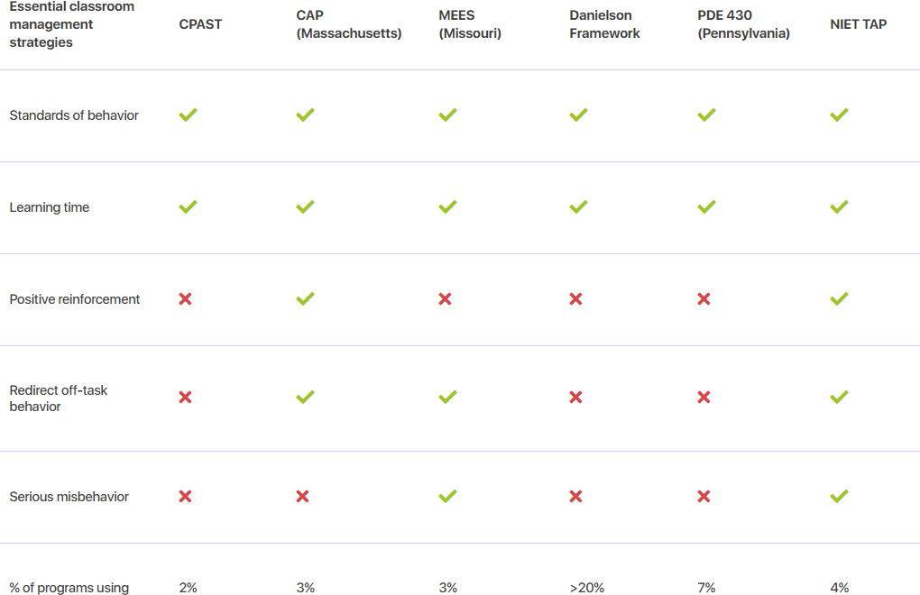
National Council on Teacher Quality rates NIET
Rubric as “most comprehensive” (2020)
“In spite of progress, many observation instruments popular with programs do not incorporate key evidence-based classroom management strategies. Only one, the National Institute for Excellence in Teaching (NIET) TAP instrument, is comprehensive and up-to-date.”
-NCTQ (2020) Teacher Prep Review
Source: Pomerance & Walsh, 2020
Notes:
NCTQ provided a 3rd party review looking at national k-12 studies and IHE’s using k-12 rubrics. Our rubric was rated the highest and the only rubric that covered all the core elements they deemed important.

Slide 7
If the EPPs choose to “tweak” the rubrics, are they required to resubmit to the state to ensure the revised rubrics are valid and reliable?
We have not required this, but we do approve EPP ADEPT plans annually. As an example, some EPPs ask to use different performance level titles (e.g. emerging vs. needs improvement) or to supplement the language in professionalism with teacher candidate specific details. Neither of these alter the validity and reliability. In particular, the professionalism domain is tailored to each state that uses NIET's tools.
Should the EPP choose to alter the rubric in a manner that voids the validity and reliability, it is acceptable for the EPP to conduct and submit its own validity and reliability findings to SCDE and CAEP.
Notes:
Keep in mind that changes do alter the validity, and some changes do indeed make it null and void. Also keep in mind that the ADEPT model is one of consistent components and ideals. Altering the rubric to fit your EPP also impacts our K-12 partners since they do not alter the rubric. Your candidates will be much better prepared for their first teaching assignments if they are well-versed in the rubric and scoring as they will face it in a district setting. Also, as a state we do not want to have a wide variation. We want to be consistent across IHE and K-12. Our feedback from districts is that they prefer hiring from those EPPs that do not deviate from the NIET rubric as they find those teachers to be the most well-prepared.

Slide 8
Validity & Reliability
For further information on the validity and reliability of the NIET rubric, here are two more resources.
NIET Teaching Standards Rubric Research pdf
NIET’s Research and Policy page
Notes:
For more information on the validity and reliability of the SCTS 4.0 rubric, please check out the resources available to you on the Research and Policy page of the NIET website. I am also in the process of updating the information on our EPP webpage and will post the links there also.

Slide 9


OEELD Contacts
Lilla Toal-Mandsager
OEELD Director, lmandsager@ed.sc.gov
Beverly Hyatt Flythe
EPP ADEPT Liaison, bflythe@ed.sc.gov
Notes:
http://ed.sc.gov/educators/educator-effectiveness
Feel free to reach out to me if you have any questions or concerns.
.

