Slide 1
The IHE Portal
Looking at the Success of Your Graduates
January 2016

Slide 2
What is the IHE Portal

Slide 3

Entering the IHE Portal
http://ed.sc.gov/

Slide 4

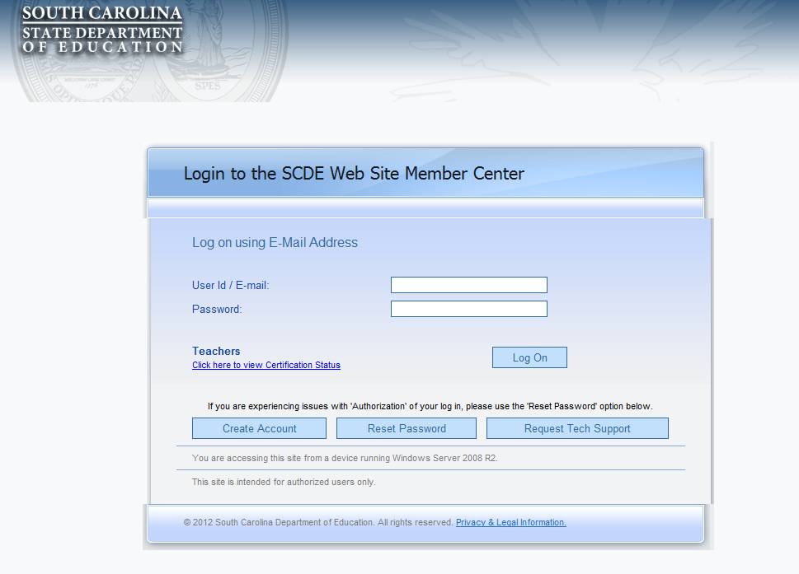
Entering the IHE Portal
Once on the SCDE Website (http://ed.sc.gov), click the login button to enter the SCDE Member Center Account Information Screen and fill in in your username and password.
SCDE Homepage
Account Information Screen

Slide 5
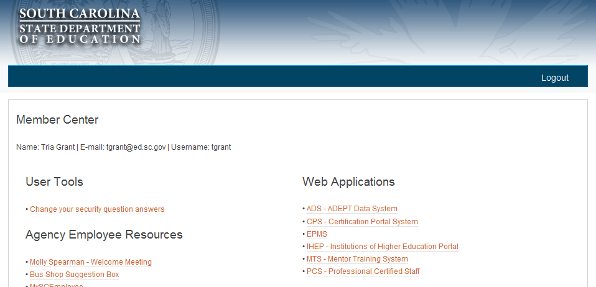

Entering the IHE Portal
In the Web Applications section of the SCDE Member Center, choose IHEP – Institutions of Higher Education Portal to take you to the IHE Portal Welcome Page.
SCDE Member Center
IHE Portal Welcome Page

