Slide 1

SCLead.org 101
South Carolina Department of Education
Office of Educator Effectiveness and Leadership Development

Slide 2
AGENDA
9:00 – 9:15 AM Welcome – Overview
9:15 – 10:45 AM Classroom-based teacher evaluation process
and Q&A
10:45 – 12:00 PM Special Areas evaluation process and Q&A
Notes:
Let’s review the agenda.
The purpose of the Overview is to provide a level of understanding of SCLead.org system functions and system rules or safeguards we have embedded in the system.
We will then shift our focus on understanding how Classroom-based teacher evaluators use SCLead.org, followed by understanding how Special Area evaluators use SCLead.org
We will stop at the end of each section for questions you may have. If you will not be serving as Special Areas evaluator, you may excuse yourself or you may choose to listen in.

Slide 3
SCLead.org 101 Training Norms
Don’t multi-task.
While in the Training Room, please stay engaged.
Be prompt.
Please return to the Training Room on time after lunch and enter your name in the chat. This is how we will take attendance.
Please work along with the training team and enter questions or requested responses in the chat box.
We’re in this together.
Have your camera on when in the Training Room and unmute your mic to speak.
Notes:
Read the norms.

Slide 4
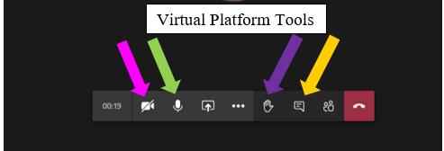
Using the Virtual Platform
Notes:
As a quick intro to the TEAMS tools, point out the camera (pink), microphone (green), raised hand (purple) and chat (gold) option on the TEAMS page.

Slide 5
SCLead.org 101
Overview

Slide 6
Does SCLead impact my duties?
SCLead.org impacts ALL South Carolina
Superintendents,
ADEPT and PADEPP staff at the District-level,
Principals, and
Educators (classroom-based teacher and special area educators)
Notes:
One FAQ we routinely get is – Does it involve me?
The answer is yes if you evaluate classroom-based teachers, special area educators or manage ADEPT or PADEPP evaluations – you will enter some if not all of your district’s evaluation data in SCLead.org. Today, we’ll just review the process for ADEPT evaluations.

Slide 7
What’s my role?
Primary Roles in SCLEad.org
ADEPT Administrator
  District-Level Administrator (view all evaluation data, manage staff, manage & complete evaluations)
  School-level Administrator (view current & past 5-years of evaluation data, manage evaluation process (add school staff, create evaluations, complete evaluations)
PADEPP District Administrator, District User
Notes:
For the purposes of this training, there are three administrative roles outside of the state and Superintendent level that will have access to evaluation data in SCLead.org.
First the ADEPT Administrator. ADEPT district-level administrators are most often also the ADEPT contact in the district. Please make sure you know who your district ADEPT contact is and direct any specific questions you have about how to execute ADEPT evaluations to your district ADEPT contact. District-level administrators will be able to access all educator evaluation data (all years) for any educator staffed, through PCS, in your district. If you’ve hired an educator, and they are not showing up in SCLead, check with your district ADEPT contact OR your district PCS contact first. Educators will not show up in SCLead under your district or school rosters, until they are officially staffed in your district through PCS. District administrators can also manage evaluations (including using bulk tools, adding staff records, creating orientation records, and completing/closing evaluations at the end of the year). They will also have access to SCLead district-level reports, which we will go through later.
Now let’s talk about school-level administrator access in SCLead.org. ADEPT school-level administrators may be assigned by district or school SCLead.org administrators. If you are a principal, you have school-level administrator access to evaluation records for educators assigned to your school by default. Principals also have the option to grant the same school-level access they have to an Assstant Principal or support staff to assist them in managing the evaluation process. This is done by checking the ADEPT box next to the staffers name on the school roster. BUT –Please be careful whom you assign this role to. School-level ADEPT administrators will be able to see what the principal sees for their assigned school. They will be able to (1) view current and 5-years of historical evaluation data, (2) manage the evaluation process and (3) view an educator’s evaluation scores and overall status. So be careful to whom you assign this role, if you decide to use this option. Principals can reserve this access for themselves, assigning another school-level ADEPT administrator is optional. You’ll notice that I’ve italicized complete evaluations. The district level administrator may also assign rights for a principal to complete educator evaluations at the school-level. This would cut down on the number of formative and summative evaluations that have to be individually completed at the district level, but it also means that the principal assigned this right, must be knowledgeable of which contract level to advance an educator to the following year and be able to address any error messages that appear on the results page. This option can only be assigned at the District level.
You will learn more about PADEPP DAs or DUs during the synchronous training, but feel free to contact Dr. Vicki Traufler if you have questions about PADEPP.

Slide 8
SCLead.org Permissions
User | Permissions
Evaluators | Current evaluation process documents for educator(s) they are evaluating, access to PD Resources, his/her own evaluation process documents and historical data
Certified Mentors | Current year SLO document for mentees, PD Resources, his/her own evaluation process documents and historical data
Educators | Current year evaluation process documents, PD Resources, his/her own historical evaluation data
Notes:
Outside of administrator roles, there are 3 main user roles.
As an Evaluator, you only have access to current year’s evaluation data for TEACHERS you ARE ASSIGNED TO EVALUATE and your own current and historical evaluation data.
Mentors will be able to access their mentee’s SLO documentation - if the district is using SCLead to capture SLO progress monitorign data – and of course, they will be able to see their own current or historical evaluation records
Educators – can only view their own records (both current and historical).

Slide 9

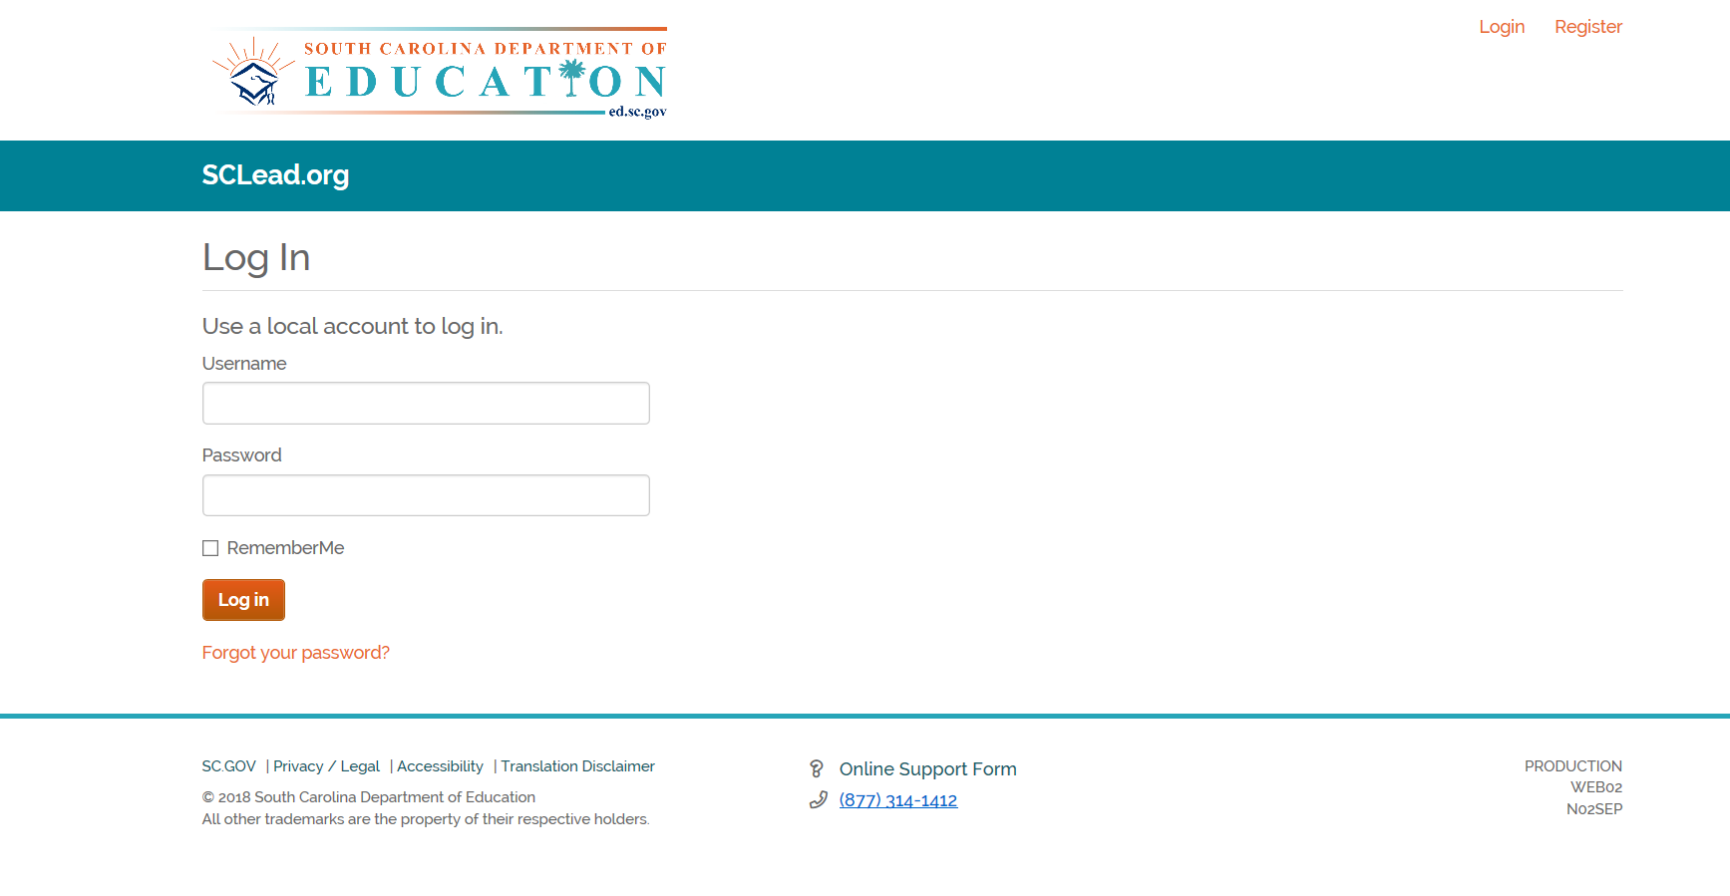
When am I required to use SCLead.org?
Classroom-based Teacher Evaluation
Overall effectiveness ratings (Met/Not Met)
Next year contract level and hiring status (district-level decision)
Observation results at the indicator
level for Induction, Annual Summative and
Formative, Continuing Summative and
Formative)
Student learning objective scores
Notes:
Perhaps one of your questions is when am I required to use SCLead.org?
Required State-level reporting for classroom-based teacher evaluation has not changed.
District’s are required to report
overall effectiveness ratings (Met/Not Met) for Induction, Annual and Continuing contract educators,
Next year contract level and hiring status for all educators, and
observation results at the indicator level for educators on Induction, Annual Summative and Formative, Continuing Summative and Formative contracts .
Remember all classroom-based teachers are required to report student learning objective scores – this includes Summative, Formative, and GBE contract educators

Slide 10
When do I login?
End of Summer/Fall
  Create evaluation records and orientation records (district)
  Teachers sign orientation records
  Conduct Observations/POP cycle (varies by contract level)
  Conduct SLO conferences
  Evaluation Team consensus meeting (if applicable)
  Consensus conference (if applicable)
Notes:
Another FAQ: When do I login?
First, let me establish that everyone has 24-7 access to SCLead.org.
But here we have listed important SCLead.org benchmarks and when they should occur.
The one caveat is that you must check with your district to determine where evaluation PROCESS data will be housed. This could vary by district. All districts are required to report final evaluation data in SCLead.org, but are NOT required to use all the system functions and capabilities to manage the process. Some districts house observation scores in SCLead, but house SLO and observation scripting documentation in another system. System use is noted in each district’s ADEPT plan and all evaluators and principals must be aware of how their district has decided to utilize SCLead.org beyond required reporting.
So during the Summer/Fall, the district ADEPT liaison will (read bullet 1), teachers will (read bullet 2), and evaluators will be responsible for (read remaining bullets)

Slide 11
When do I login for evaluation?
Winter/Spring
  Conduct observations (check district calendar for preliminary and final cycle dates to determine if POP or OP cycle is required )
  Professionalism Scoring (self-score and administrator rating)
  Consensus meeting (if applicable)
  Results conference
Notes:
So during the Winter/Spring, as evaluators you will (read remaining bullets)

Slide 12
Terms in SCLead.org
Orientation - format varies by contract level, but required for all; teacher signature triggers teacher/evaluator access to all forms
Status Bubbles – on Evaluations page, indicates when process is finished
Status Bars – on Overall Status page inside an evaluation record, indicates when signatures are present and process progress
Completed record – all required data and school-level signatures, next year recommendations and district signatures are present
Closed record – on Settings page inside an evaluation record, Incomplete record, rationale indicated, district signature
Notes:
Finally, I would like to review a few terms you’ll hear in training and see in the system once you begin working in SCLead.org.

Slide 13
SCLead.org 101
Quick Quiz
Notes:
Let’s take a quick quiz to check for understanding

Slide 14
Question 1:
Which permission(s) are granted to Evaluators in SCLead.org?
Current year’s evaluation of those they are evaluating
Access to PD Resources
His/her own current evaluation documents and historical data
All above the above
Answer: D

Slide 15
Question 2:
If an educator I am assigned to evaluate does not show up on my Evaluations page, I should…..
Take that as a “sign” that I don’t have to evaluate them.
Evaluate them using last year’s forms and submit hard copy.
Contact my principal.
Add forms in another educator’s record for them and include their name and date of observation in the comment section.
Answer: C
Notes:
Your principal may be able to trouble-shoot for you and ensure that you are added on the educator’s evaluation team.
If your principal is unsure of what to do, they should reach the district SCLead.org Administrator, who is usually the District ADEPT Coordinator, for assistance on how to add an evaluator to an educator’s evaluation team.

Slide 16
Question 3:
When should evaluators log-in SCLead.org to enter evaluation data?
Fall
Winter
Spring
All of the above
Answer: D
Notes:
We highly recommend entering evaluation data throughout the year as you do each step of the process.

Slide 17
SCLead.org 101
Website Tour
Notes:
Now let’s get familiar with the layout of SCLead.org

Slide 18
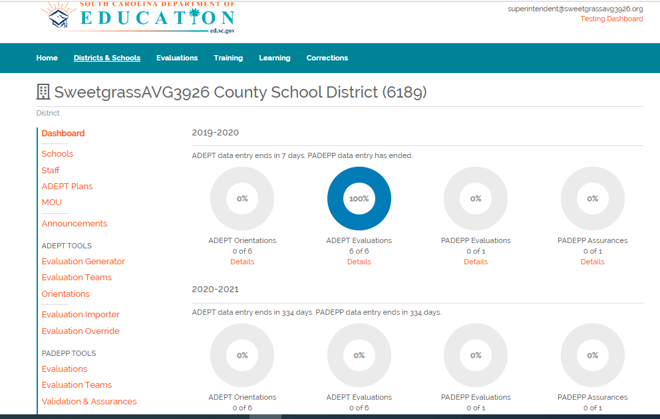
Website Tour
Notes:
There is a District Dashboard visible to District SCLead.org Administrators. It gives a quick view of the progress of ADEPT Orientations, ADEPT Evaluations, PADEPP Evaluations and PADEPP Assurances for the entire district.
The School-Level SCLead.org Administrator can see a similar dashboard that shows information for their specific school.

Slide 19
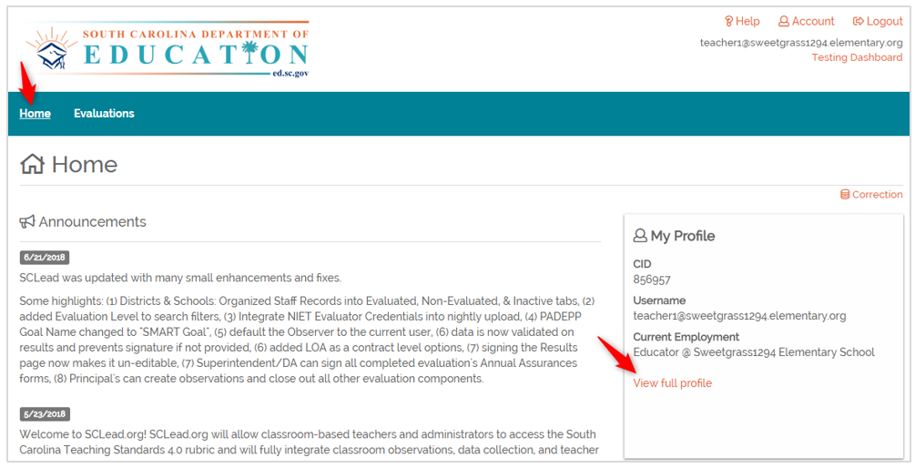
What data is included in SCLead.org?
Notes:
All users have a “Home” tab, where they can find own educator profile, which includes their CID, username and current employment. Clicking “View full profile” will show additional information data.

Slide 20
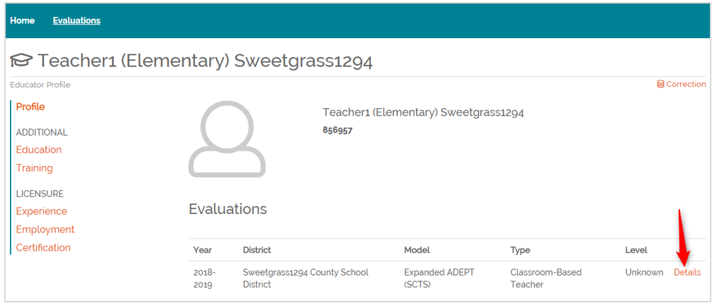
Profile Page
Notes:
Additional information includes Employment, Experience and Certification. Please note that you should contact the Office of Educator Services for a more accurate accounting of years of experience. SCLead.org is mainly created to support the evaluation process and not for certification experience

Slide 21
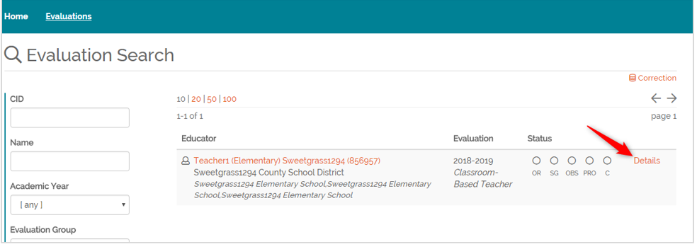

Evaluation Search Page
Notes:
When looking at the evaluation search page, you will see the Academic Year with the assigned Evaluation Level, Contract Level and Evaluation Model. You will see the “Bubbles” that indicate progress, and a button to get more details or enter details on the evaluation.

Slide 22
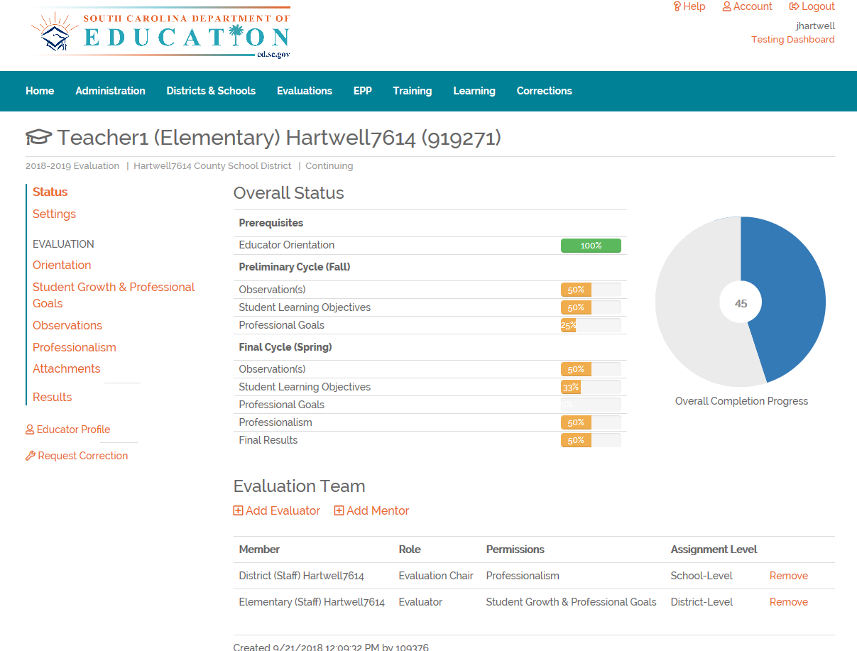
Educator Status Page
Educator Status Page
Notes:
Shown on the educator’s evaluation record “Overall Status” page are the following:
The different components of the evaluation are on the left vertical menu
The Evaluation Team, where in you can add the Mentor and/or Evaluator
The Status Bars reflecting completion for the entered evaluation component
Doughnut for educator’s evaluation record’s overall completion
Note: On the left vertical menu, the attachments are not required. Anything attached in this section is visible to both educator, evaluator and district SCLead.org ADEPT Administrator

Slide 23
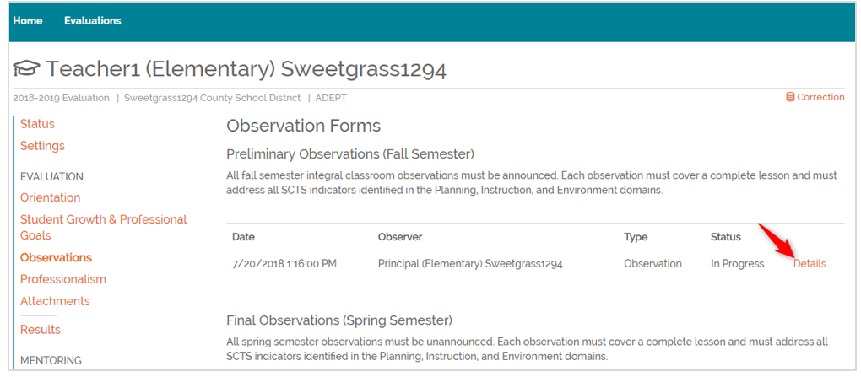
Observations
Notes:
You will continue to see the vertical menu on each page that you are on. When on a page, it will be in bold to indicate that is the component or page you are working on.
Observations is where evaluators can:
Add observation
Add Walkthrough
Delete/Restore observation or walkthrough
Review and complete details of an entered observation or walkthrough
Click Details to get the details of an entered observation or walkthrough

Slide 24
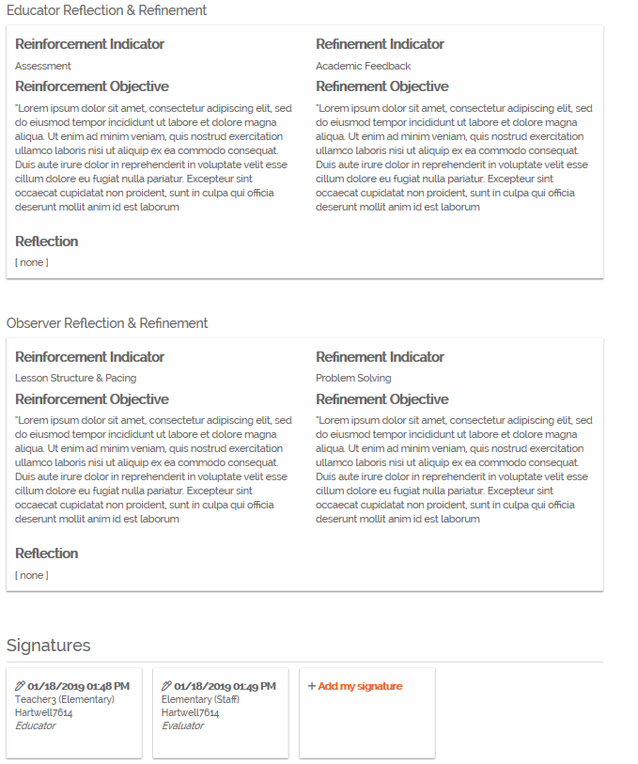
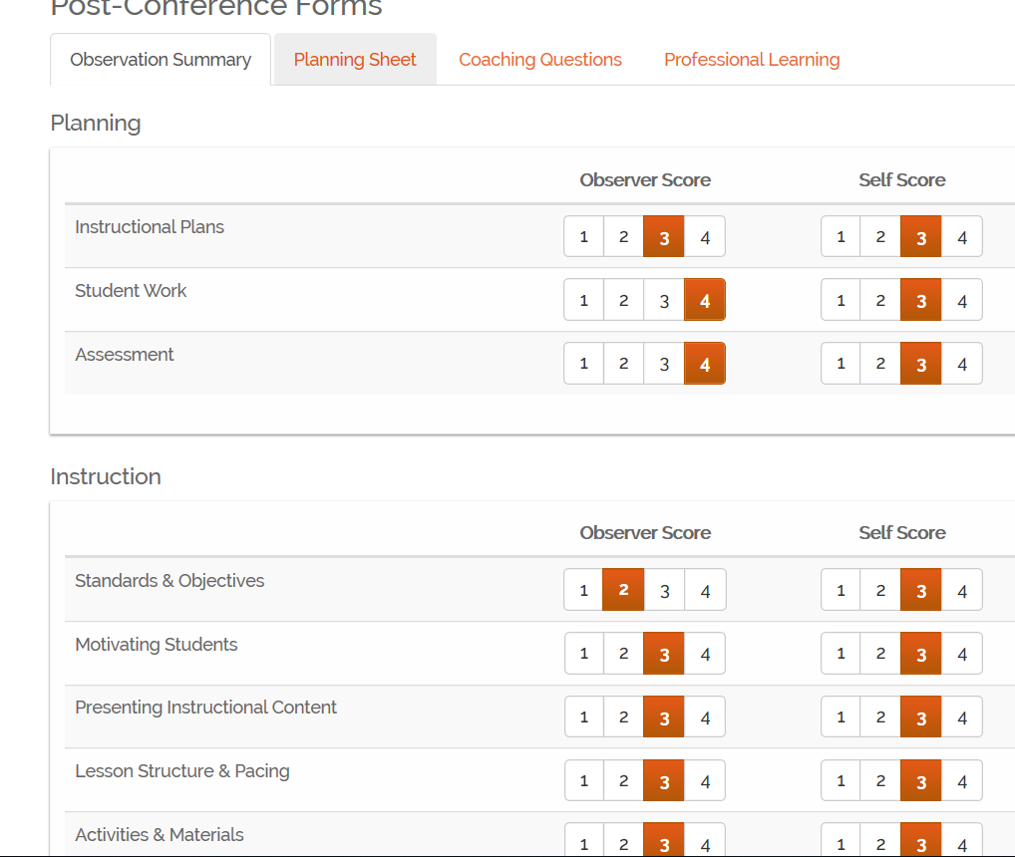
Sample
Post-Conference Page
Notes:
This is a sample of a completed post-conference form inside the Observation page. The scores, reinforcement and refinement entered by the evaluator under “Scripting and Scoring” will show here, as well as the Self-Score, reinforcement and refinement of the educator once the educator enters them. This is the page where Signatures are added

Slide 25
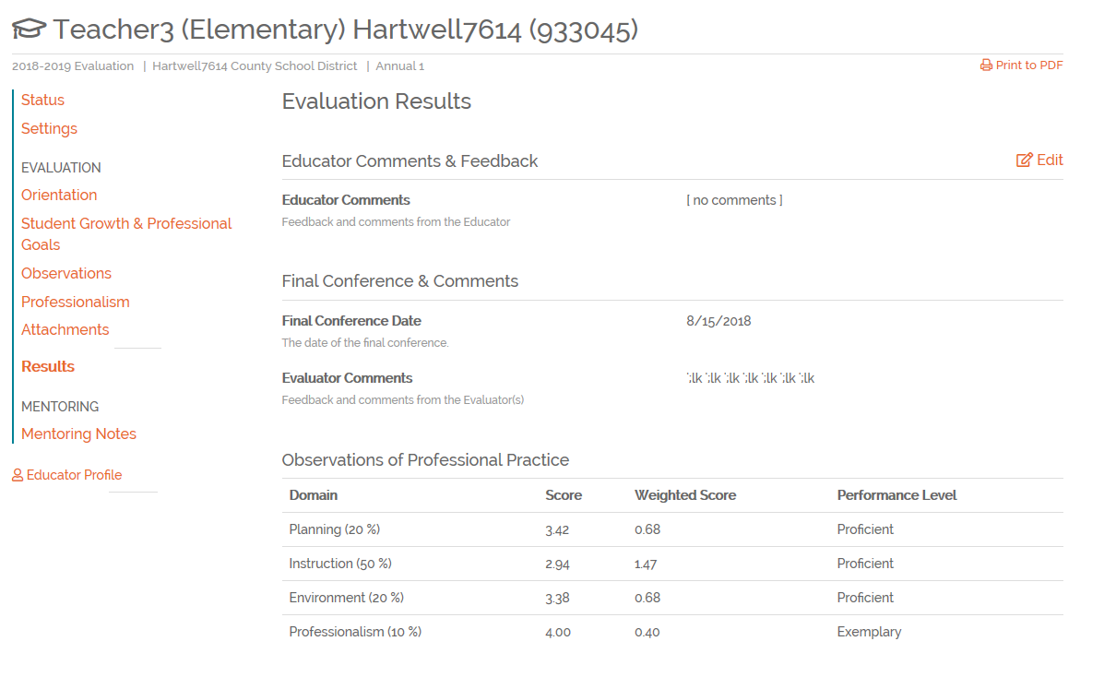
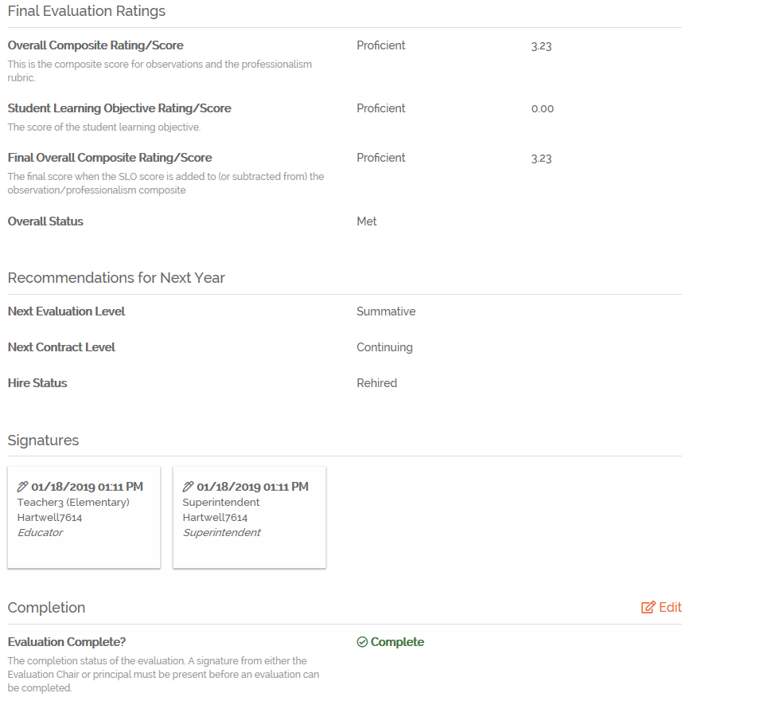
Sample
Results Page
Sample Results Page
Notes:
This is a sample results page. This page auto-calculates the weighted scores for required evaluation components entered in Preliminary and Final Evaluation Cycles.
The Recommendations for Next Year can be entered by the school-level or district administrator. Signatures from School level and District Level ADEPT Administrators are required before the evaluation record can be completed by the district level ADEPT Coordinator or by the Auto-Complete Feature if the evaluation is for an educator on Continuing GBE with SLO score entered.

Slide 26
Sample Results Page Update
NOTE: The results page has been updated to clarify how the weighted scores are calculated in the Preliminary Cycle.
Notes:
The results page will have an update to clarify how the weighted scores are calculated in the Preliminary Cycle.

Slide 27
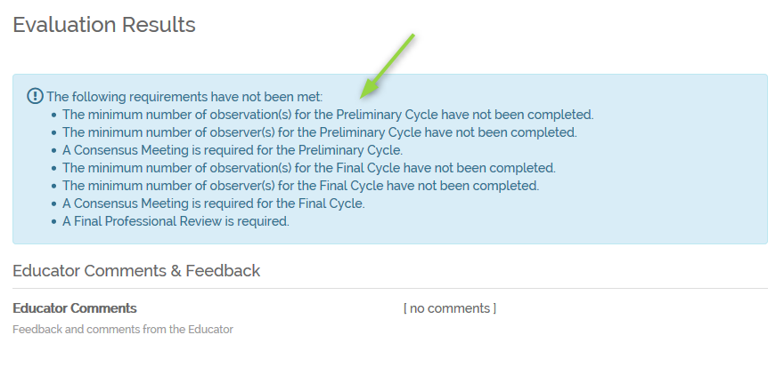
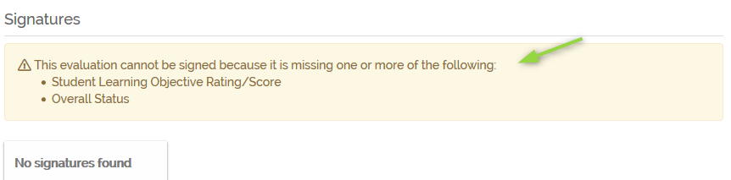
Information Messages: help the user know what is required before results can be entered or evaluation completed.
Notes:
Information messages are a helpful tool. If items are missing before the next step can be completed, the information messages will let you know what those missing pieces are. The messages could be in a blue or yellow box.
In the screenshots here, this educator is missing the required number of observations, the required number of observations completed by different evaluators and the consensus for both spring and fall.
In addition, the yellow message lets the user know the page cannot be signed until the SLO rating and overall status has been entered.

Slide 28
At the beginning of the school year, it may be a good practice to review the evaluation requirements at a glance by going to the “Results Page” and checking the message to see what is needed for completion.
Tip

Slide 29

Part 1
Questions?
Notes:
Now, please hop on the mic or type in the chat if you have any questions on how to add staff manually on your staff list.

Slide 30
5 Minute
Stretch Break
Notes:
Thanks for your responses!
Now, please hop on the mic or type in the chat if you have any questions on how to add staff manually on your staff list.

Slide 31
Signing Orientations
Purpose:
To ensure the educator has a
clear understanding of his/her
evaluation process and to allow entries to be made to his/her SCLead.org evaluation record
Resources Needed:
Attendance for each orientation, Date orientation was conducted
Notes:
This section applies to educators but would be helpful to evaluators so that you understand why you are unable to see the full vertical menu on the educator’s evaluation record. It is not the evaluators’ job to conduct the orientation but as an evaluator, you would hopefully be able to help your evaluated educators understand why they need to sign their orientation and how to go about it.

Slide 32
Signing Orientation Records
In the chat box, type which user(s) need to sign their orientations? Select all that apply.
Educators who are undergoing ADEPT Evaluations
Evaluators
Mentors
Assistant Principals
Answer: A
Notes:
Let’s start with a quick review on which users in SCLead.org need to sign an orientation.
Answers: a
If you picked a give yourself a pat on the back. You are correct!
When would B be applicable? Please hop on the mic to respond
*B and C would apply if the evaluator o mentor are also being evaluated

Slide 33
Why sign an Orientation record?
Educators are required to have appropriate evaluations under ADEPT.
Educators must have an orientation regarding their evaluation prior to beginning the evaluation.
In order to utilize SCLead.org to document evaluations, the educator must confirm through his or her signature on the SCLead.org orientation page that he/she received an orientation.
Notes:
As a reminder, here are reasons for evaluated educators to sign their orientation in SCLead.org.
Read Bullet 1
Every educator being evaluated under ADEPT has to have some type of orientation to introduce them to what they will encounter during the evaluation. If a teacher has never had the full SCTS one-day training, in your district or their prior district, they need to have the one-day SCTS training. Teachers on summative evaluation are also required to have a structured overview of the evaluation process. Those on formative contracts must also be informed, and the district may determine the best format to accomplish that.
Read Bullet 3

Slide 34
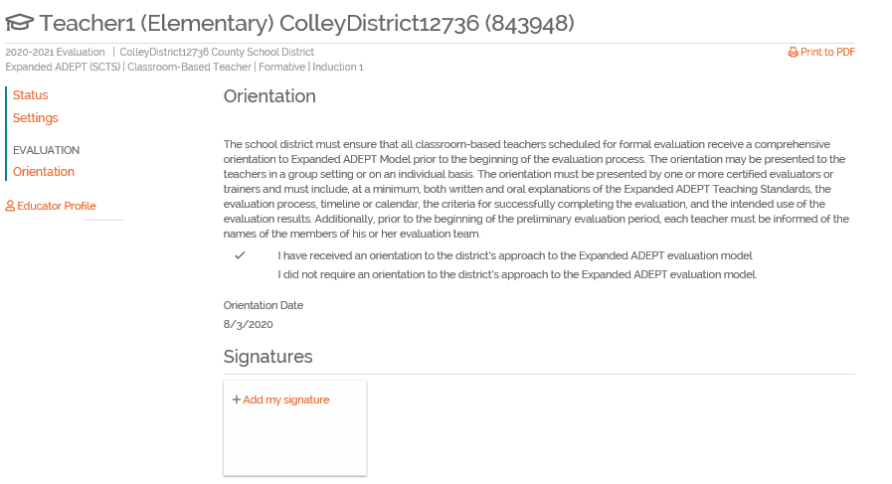
Signing Orientation Page
Notes:
If your school or district SCLead.org ADEPT Administrator successfully created an orientation for an evaluation, your educator should see this screen.

Slide 35
Signing Orientations - Scenario
If you have an educator that says they do not see the Orientation link at all, what should you do?
Answer: Contact the District SCLead.org administrator or Principal to ensure an evaluation record and orientation record was created for the educator.
Notes:
Make sure you created the evaluation record and the orientation. Create if you have not created any of these.

Slide 36
Signing Orientation in a Nutshell
The orientation will not be visible to the educator if an orientation has not been created.
Evaluation forms will not be visible to the educator unless they sign their orientation.
If an educator was unable to attend a scheduled orientation, the school or district level SCLead.org ADEPT Administrator can edit the orientation date.
Notes:
Read slide.

Slide 37
Questions?
Notes:
Now, please hop on the mic or type in the chat if you have any questions on how to add staff manually on your staff list.

Slide 38
Classroom-based teacher evaluation process
Purpose:
To manage and document the evaluation process
Resources Needed:
Access to SCLead.org
Notes:
SCLead.org is a data management system based on the evaluation requirements as stated in the Expanded ADEPT Guidelines. We will have an overview of the process and requirements for classroom-based teachers in this section.

Slide 39
Required Observations
Induction
>1 – Full Classroom Observation in Final cycle with conferences; may conduct a walkthrough for the Preliminary cycle
Annual and Continuing Summative
>2 – Full Classroom Observations per semester, conducted separately by at least two observers (4 observations total)
Annual Diagnostic (Formative
>2 – Full Classroom Observations per semester, conducted separately by at least two observers (4 observations total)
Continuing Comprehensive (Continuing Formative, 5th year recertification)
>1 – Full Comprehensive Classroom Observation per semester with conferences.
(However, if more than one observation is completed in a semester, the second observation must come from a different observer.)
Continuing GBE (Continuing GBE Years 1-4)
PDGP (SLO/TLG + Professional Goal if required)
Preliminary/Fall Cycle -(Announced observations) Final/Spring Cycle - (Unannounced observations)
Notes:
The system will require the correct number of observations be completed to include observations by more than one observer when applicable.
In addition, a mentor is required for Induction Formative and Annual Formative. Results cannot be entered if the required number of observations are not completed as well as the presence of a mentor on the team, if required.
As a reminder, if the average scoring approach is selected by the district, all observations (excluding walkthroughs) will be averaged together to determine the final domain scores. If consensus is used, the fall and spring consensus observation scores only would be averaged together to determine the final domain scores.

Slide 40
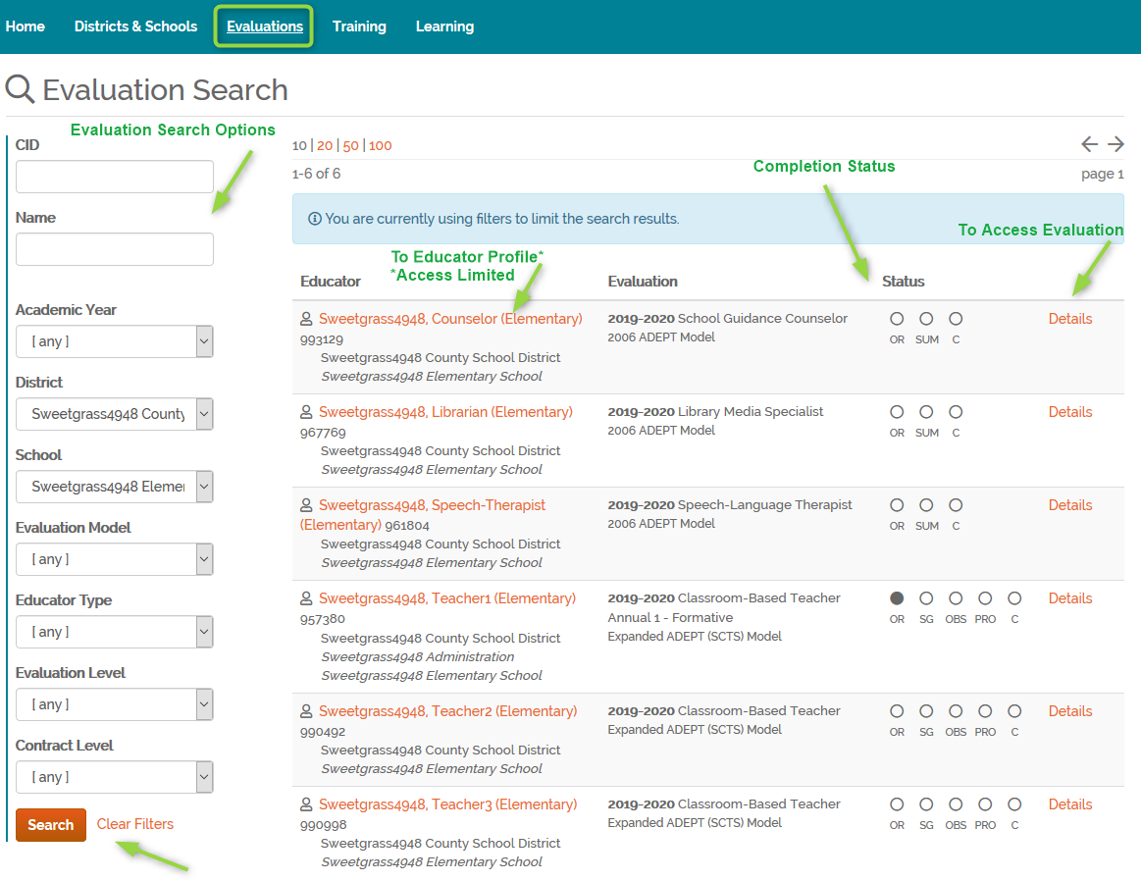
Evaluations
Tab
Notes:
Now let’s go over how you will access the evaluations assigned to you. The evaluations tab will have a search feature to help quickly find an evaluation. The search criteria entered will be retained, even if you leave the page, until you either change the search options and click search or until you click Clear Filters.
Access to click on the person’s name is limited to principals and ADEPT administrator’s as this takes you to a teacher’s profile which includes historical evaluation data. To access the evaluation for the teacher, click details.

Slide 41
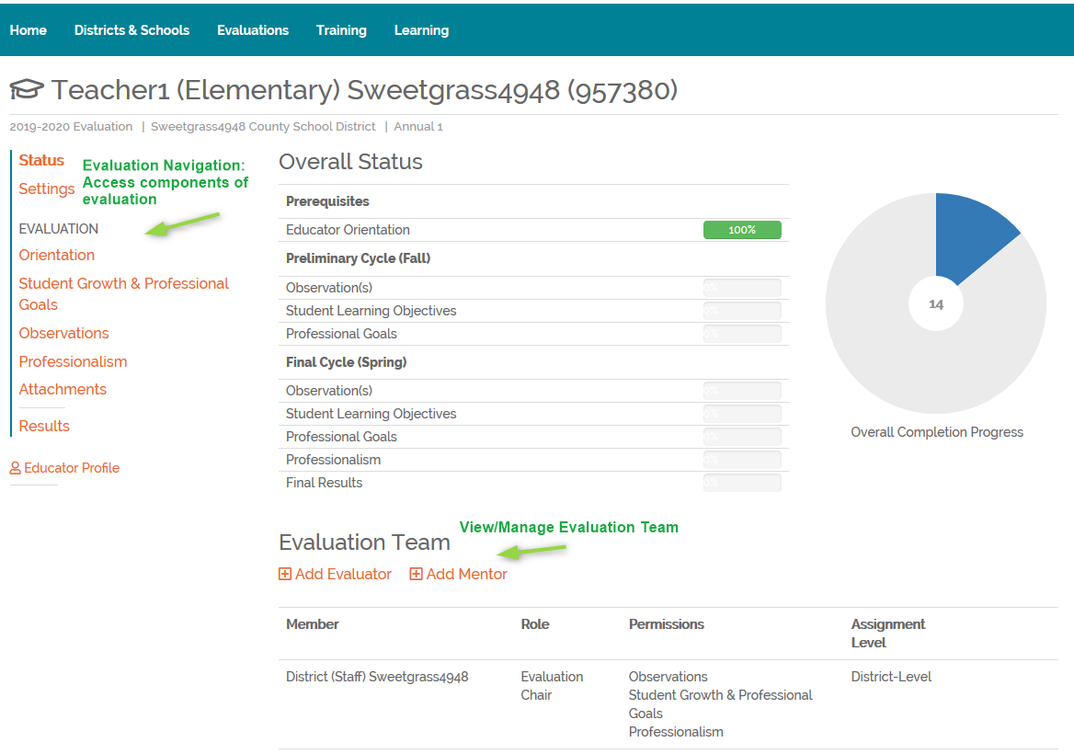
Educator Evaluation
Notes:
Once the evaluation is opened, the components of the evaluation can be accessed by the links in the navigation selections to the left. We’ll review the components of the evaluation in detail from our training website. The navigational items will always display to the left of the page.

Slide 42
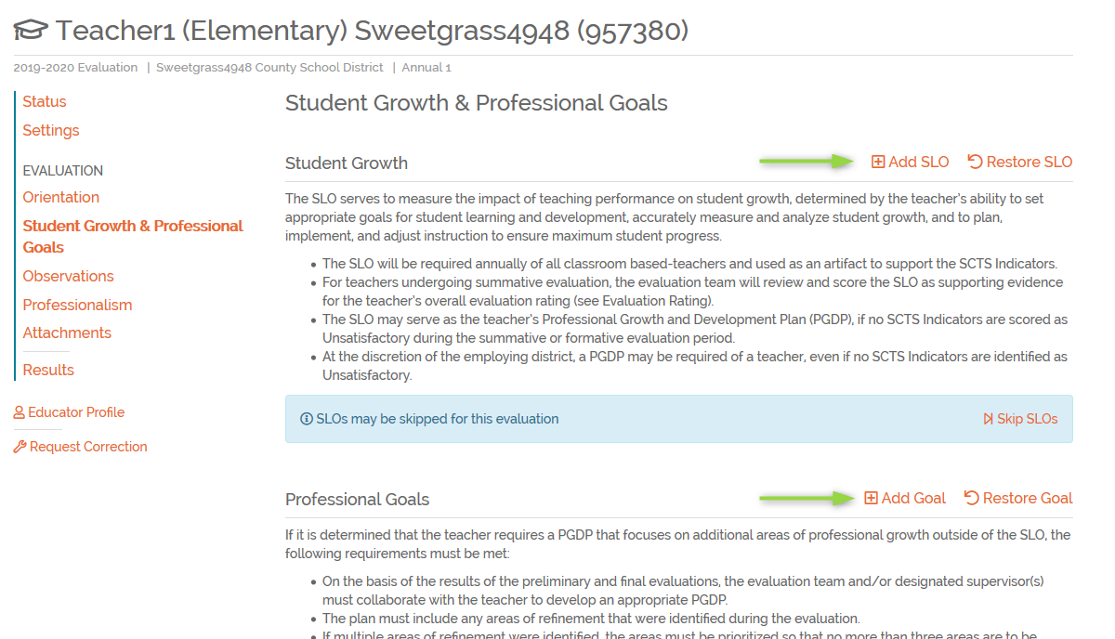
Student Growth
Notes:
The educator or evaluator can create SLO’s, Teacher Leadership Goals, and professional goals with the Student growth section. This is an optional function within SCLead but districts are encouraged to have educator’s record goals within the system. Check with your districts if they reported on their ADEPT Plan whether or not your educators need to enter SLO, TLG and/or Professional Goals in SCLead.org. If your district will utilize this feature and you are assigned to approve, progress monitor and rate the SLO, TLG and/or Professional Goals, you will go to the Student Growth & Professional Goals Page. Remind the educator to enter their SLO, TLG, and/or Professional Goals here by clicking the appropriate button(s).
As a reminder, evaluators will enter the final SLO rating in the results section.

Slide 43
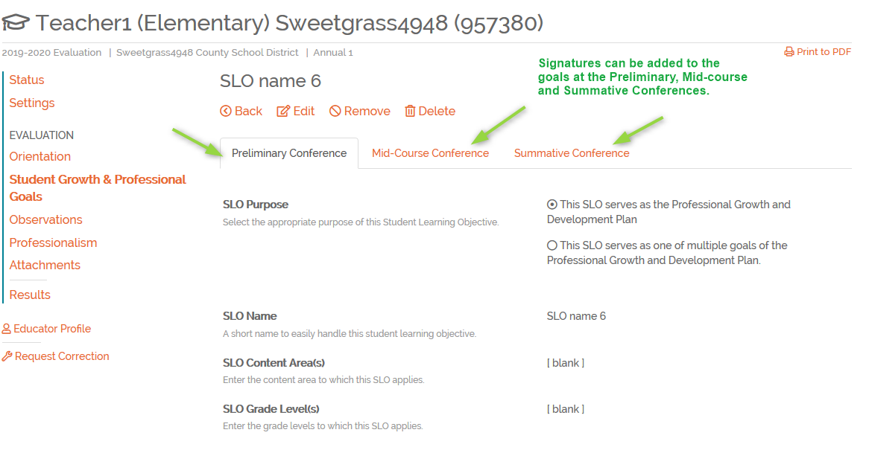
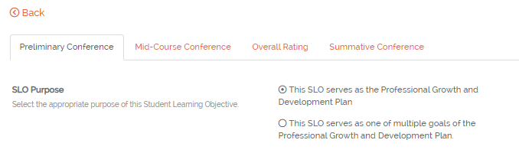
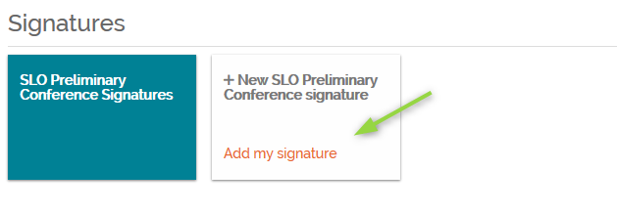
Student Learning Objective – Professional Goal
Notes:
Once a goal is created, there will be a tab for all three conferences to add signatures. A signature should be added by the evaluator and educator. Once signatures have been added, edits cannot be made. If edits are needed, the signatures would need to be removed from that conference form.

Slide 44
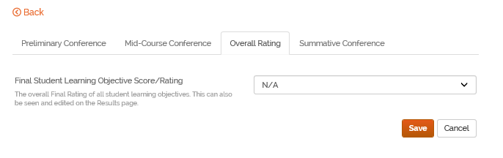
Pay attention to the flow of the SLO Process as indicated by the left to right order of the tabs. Enter the SLO Overall Rating BEFORE signing the Summative Conference page.
Tip

Slide 45
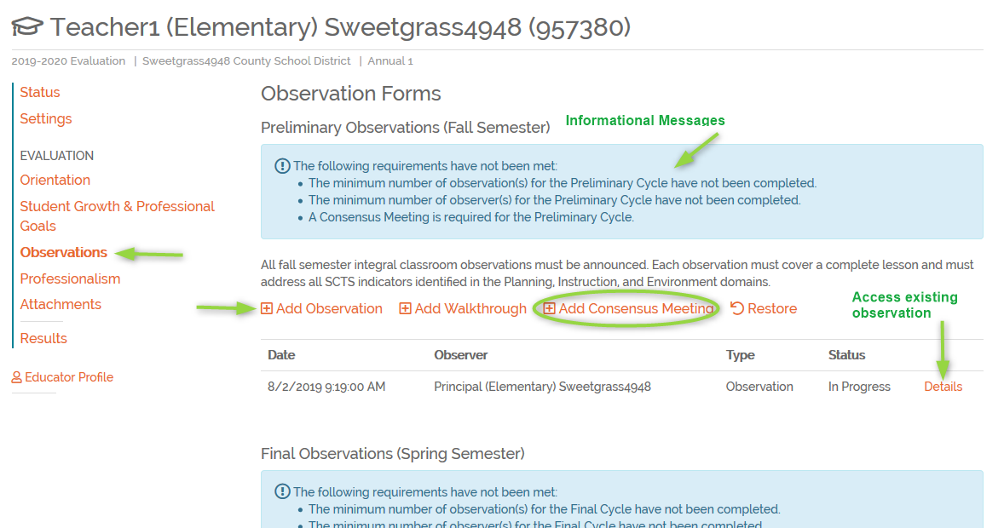
Observations
Notes:
Now let’s look at the Observations Page. The observations tab will be divided into two sections, Preliminary or Fall and Final or Spring.
If there are specific observation requirements that have not yet been met, a blue informational box will display letting the evaluators know what is needed.
This example is using the consensus scoring approach so a consensus form would be required.
Other observers on the team, can view, but not edit, observations completed by others on the team.

Slide 46
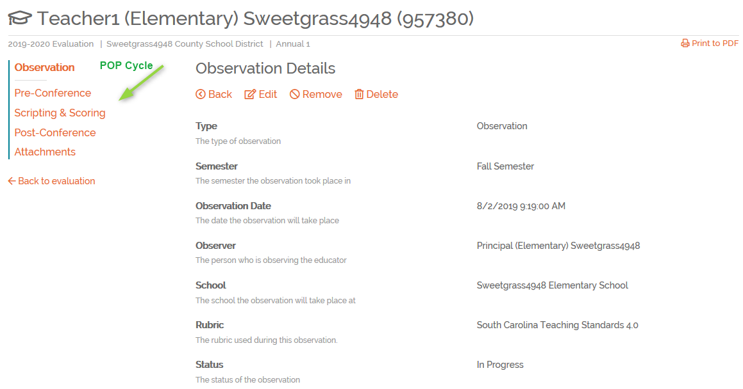
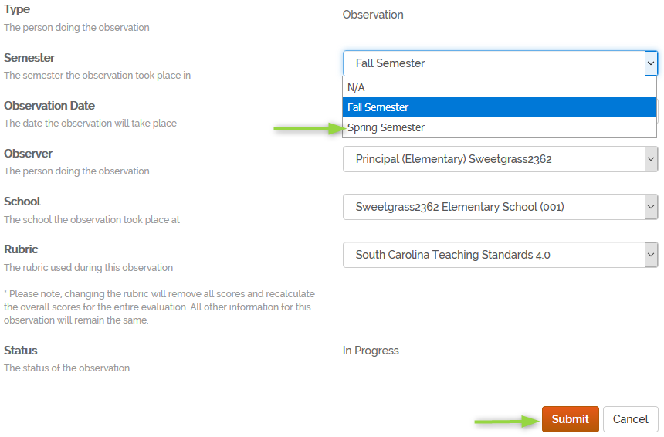
Observation
Set-up
Notes:
Once the Observation has been created, the elements of the observation will be generated.
Another frequently asked question/problem was how do you move an observation that was started in the wrong cycle. This caused an issue with observation completion requirements. SCLead has been enhanced to add a semester dropdown which allows the observer to move the observation to the correct cycle. Click Edit for the observation, change the semester to Spring (or Fall if applicable) and click Submit.
I’d also like to point out two options that show in the top screenshot, Remove and Delete. If you click Remove, you are removing the observation. The system is retaining the observation; however, it is no longer visible and is not part of the evaluation. However, the observation could be restored, if removed in error. If you click Delete, the system will delete the observation and it cannot be restored. This would apply anywhere you see the option to Remove or Delete.

Slide 47
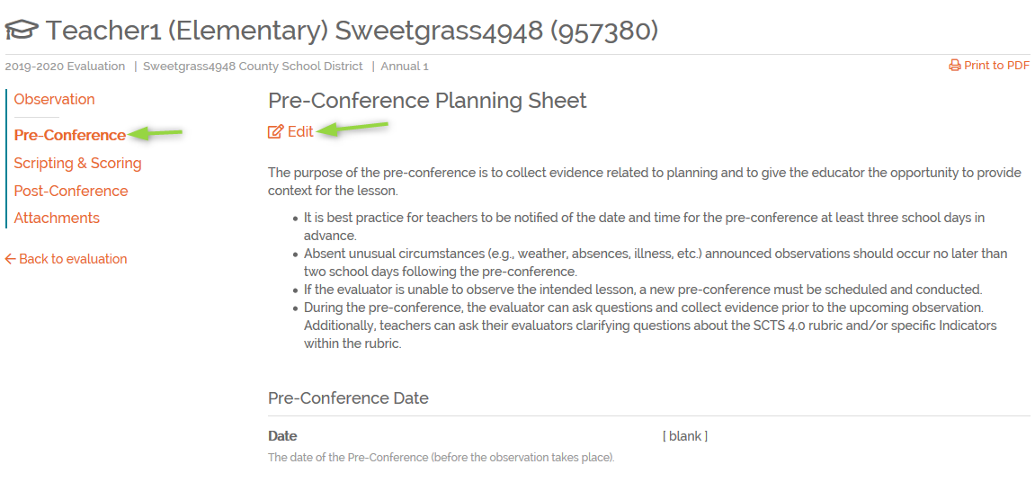
Pre-Conference
Notes:
Pre-Conference is straight forward. Click Edit to enter details of pre-conference.
This Pre-Conference Planning Sheet is not required to be entered in SCLead.org. Use this at your convenience to help you plan for your conference.

Slide 48
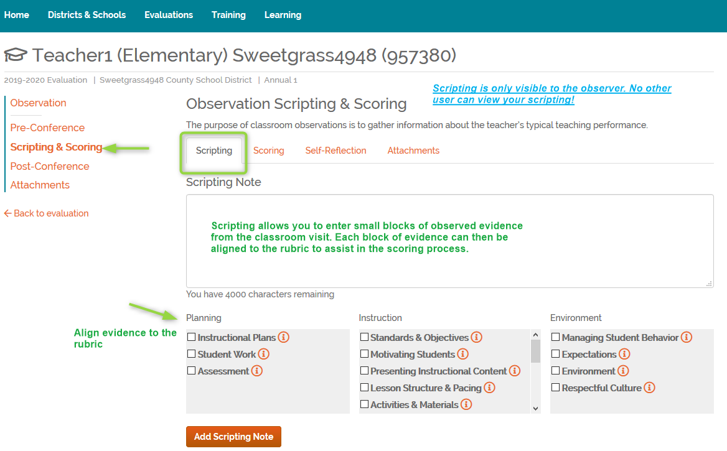
Observation: Scripting & Scoring
Notes:
The Scripting & Scoring tab is only visible to the observer.
Scripting notes are an optional feature in SCLead. Check with your District ADEPT Coordinator if business rules have ben set-up and if you are expected to utilize this feature. Some districts set-up a minimum number of evidence entered in this section. Scripting can be entered in SCLead and then each section of notes, or evidence, can be aligned to the rubric indicators. Each block of evidence can be aligned to as many indicators as applicable.
Let’s say you are in the classroom and recording scripting in SCLead. You’re focused on what is occurring in the classroom and creating blocks of notes/evidence and saving as you go. You’re not thinking about how this evidence aligns .. Just focused on everything you are observing. Once the observation is complete, you can then go back and edit each section of notes and align them to the rubric.
Some users may want to record all the notes in Word or even on paper and then later add them to SCLead and that is okay too. My only caution is that if you are copy/pasting from Word or similar program, copy into SCLead as plain text to avoid hidden characters. Please remember, the blocks are intended to be smaller sections of notes and there are character limits to each section.
When you go to the scoring tab, you’ll see the number of scripting notes associated with each indicator. If you click on the number, the system will return the scripting page and filter/show only the notes that apply to that indicator. This allows you to view those notes to help with the scoring process.
Scripting notes will only be visible to the observer. The teacher, other administrators or observers will NOT be able to access the scripting notes at any time.

Slide 49
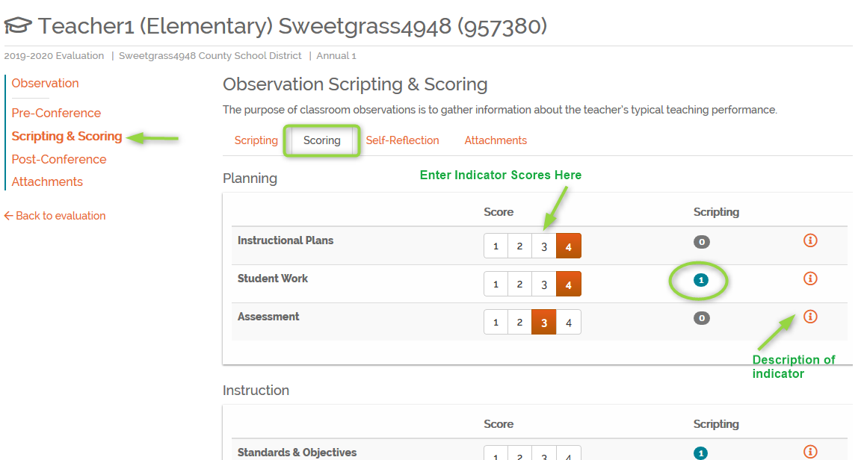
Observation: Scripting & Scoring (Slide 1)
Notes:
Each indicator will be scored on the Scoring tab. All indicators are required to be scored. If a score needs to be changed, the observer will go back to the Scoring tab to adjust scores.
Note the scripting column that has an indication of evidence collected for indicators.
Also note that you have to be certain of the scores you enter based on the evidence you gathered. If you missed something in your notes and need to make changes, make sure that you do so before conducting a post conference with the educator.

Slide 50
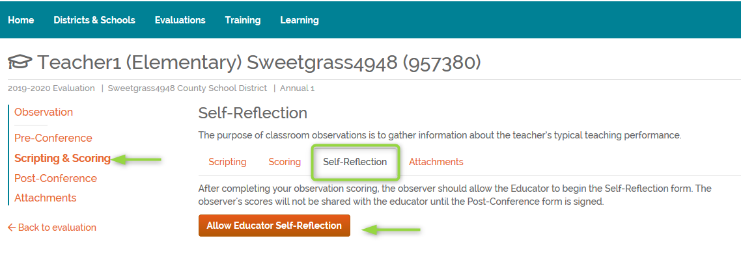
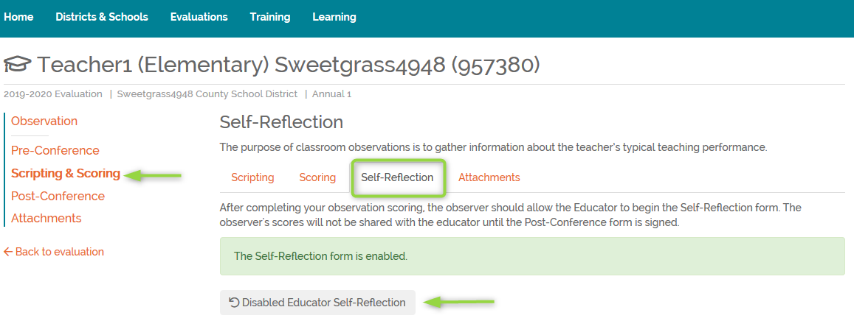
Observation: Scripting & Scoring (Slide 2)
Notes:
Teacher Self-scoring can be enabled/disabled on the Self-Reflection tab. This button determines if the teacher can see the observation record.
If enabled, the teacher will see the observation and can enter self-reflection (provided the post conference has not been signed).
If disabled, the teacher will not be able to see the observation, even if the post conference has been signed.

Slide 51
Note
Many educators encounter the problem of not being able to sign their observation observation because it is not visible to them. When this happens, remember to enable to self-reflection in the details of the observation.

Slide 52
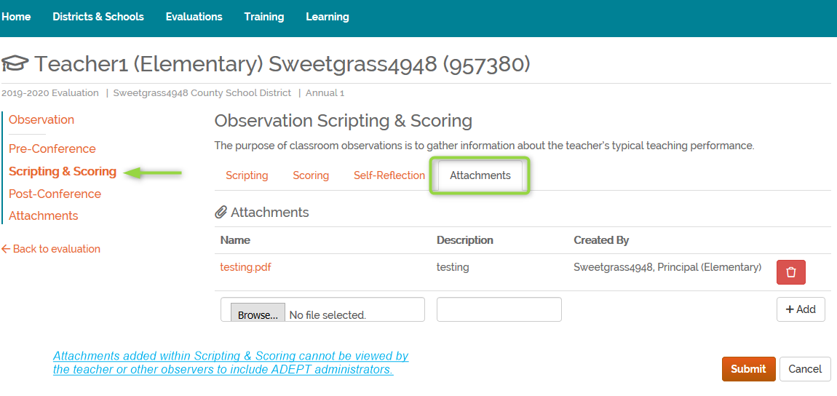
Observation: Scripting & Scoring (Slide 3)
Attachments under Scripting & Scoring tab
can only be viewed by the observer.
Notes:
You can use the attachments section for evidence or perhaps scripting documents. These attachments are not visible to the educator or other observers.
The use of this feature is optional.

Slide 53
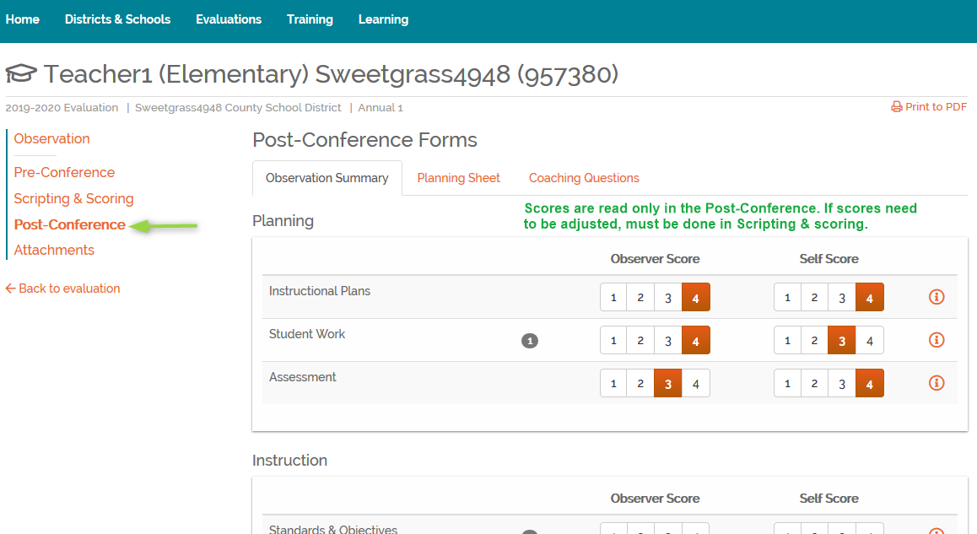
Observation: Post-Conference
Notes:
The post-conference form will display the observer scores and teacher self scores. Please note, the scores on this page are read only. If observer scoring changes are needed, the change would need to be made in the Scripting and Scoring tab.
Below the scoring section, this page will have a place for the reinforcement/refinement, reflection. Once post-conference has occurred, the observer and teacher would sign the observation. The observer must sign first. If consensus, all observers on the team would need to sign.
As we shared earlier, pleas note that the post-conference form will not be visible to the educator unless 1. self-reflection is enabled and 2. all required evaluators have signed.

Slide 54
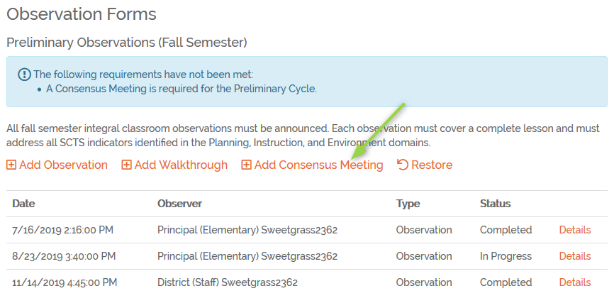
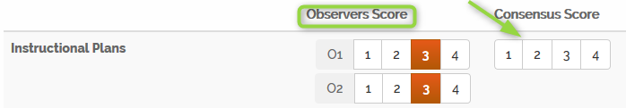
Observation: Consensus Form
Consensus meeting is
added by the Evaluation Chair.
Observation scores from completed observations will show in the scoring tab.
Evaluation chair will enter a score for each indicator.
All evaluators will sign the consensus post conference before the teacher will view/sign.
Notes:
Now let’s talk about the Consensus Form under Observations Page. This will not apply to all of you. The district determines the scoring approach for each evaluation/contract level in the ADEPT Plan each year. Some districts chose to have a consensus for every level, even if that level only requires one observation per semester. In those cases, an observation and consensus form would be required.
The evaluation chair will need to add and complete the consensus form. Once the evaluation chair has added the scores, he/she will need to sign the post-conference. Next, all evaluators listed on the team will be required to sign the post conference form and will need to do so before the teacher can. Once all team members have signed, the teacher will then be able to view and sign the post conference form.
What if the team changes during the year? The members currently listed on the team would need to sign. As a reminder, the consensus form must be signed by an evaluation chair.

Slide 55
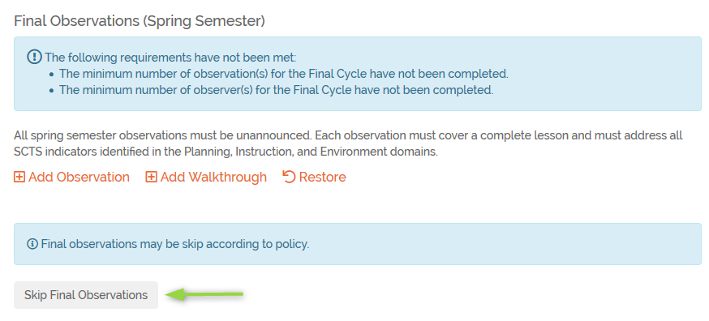
Observations: Skip/Waive
Spring/Final Cycle Observation
Continuing Formative contract
Or
AND
All indicator scores are proficient or higher.
Notes:
Another feature that you may see that is not applicable to all your evaluated educators is the Final Cycle Observation Skip option. An evaluator can skip the Spring/Final observation cycle provided the requirements are met. It is important for evaluators to review this for educators early in the Spring semester, or even as soon as fall observations are complete, to ensure educators are eligible for Spring cycle skip or if additional observations must be completed. The skip option will only show if the requirements are met.
Another – rare scenario where spring observations can be skipped…..Summative - Annual with a Professional Certificate

Slide 56
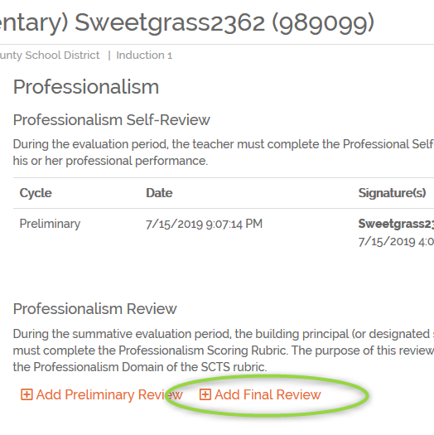
Professionalism Rubric
Evaluator must complete a Professionalism Final Cycle Review.
Evaluator has the option to complete a Preliminary Review. – Preliminary reviews are not included in scoring.
Teacher has the option to complete both a preliminary and final self-review.
Notes:
The Professionalism review is required for class-room based teachers, unless on GBE/LOA. A preliminary review is optional, and the scores do not count. A final review must be completed and once signed by the evaluator; the scores will be included in results. The teacher is not required to sign the professionalism review; however, the progress indicators will not show as complete unless the teacher signs.
The teacher professionalism self-reviews must be entered in the system. According to the Expanded ADEPT Support and System Guidelines, “The teacher must submit their Professionalism Self-Review no later than five school days after their final observation of the final evaluation cycle.”

Slide 57
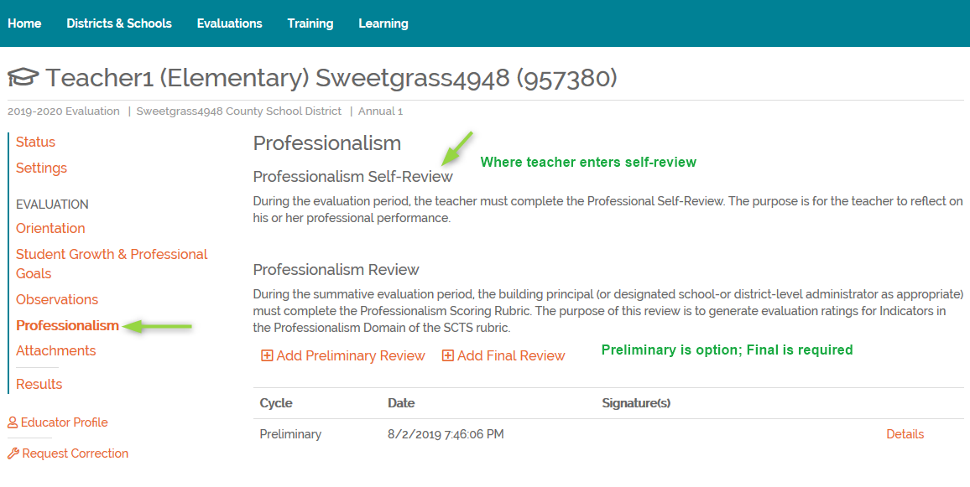
Observation: Post-Conference (Self-Review)
Notes:
This is a screenshot of where to enter Professionalism

Slide 58
Notes
If multiple Final Professionalism Review are entered, the last entered Final Professionalism Review will be calculated on the Results page for the Professionalism Domain.
If multiple Final Professionalism Reviews are entered and one set has been signed by both evaluator and educator but others are not signed or are only signed by either the evaluator/educator, the Professionalism status bar will not be at 100%

Slide 59
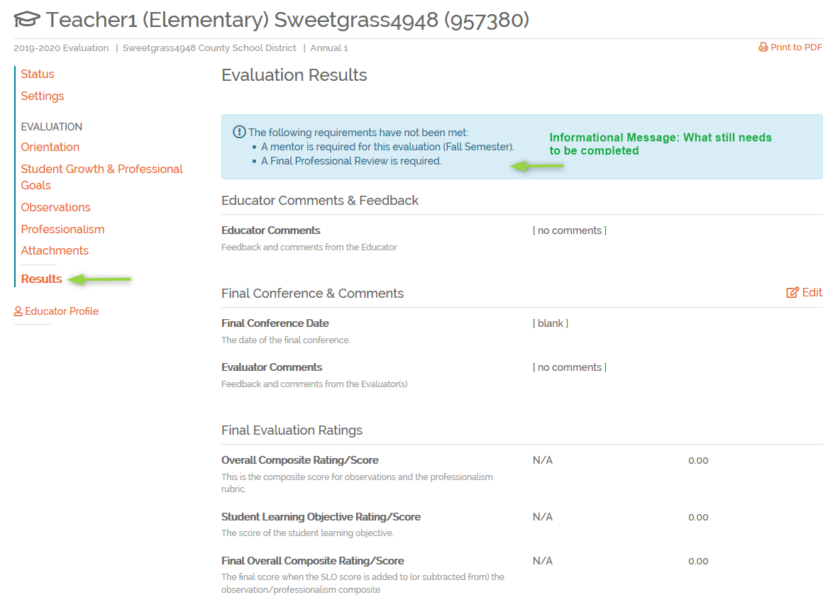
Results
Notes:
Now let’s look at the Results Page. In the results section, the evaluator will need to enter the final SLO rating and Overall Status, if they haven’t entered that yet under the Overall Rating Tab inside the Student Growth & Professional Goals Page. In order to enter the SLO Rating under the Results Page, the system need all required elements of the evaluation completed first. Look to the blue information bar for any missing elements.
Once SLO rating and Overall Status have been entered, and evaluator will need to sign the results page. The teacher can sign next.
The district ADEPT administrator will then enter recommendations for next year, sign the results and mark the evaluation as complete.

Slide 60
Results Page
The principal, evaluation chair or evaluator can enter results once all required elements have been entered.
Once results have been entered, the District ADEPT administrator will enter recommendations for the following year and must sign the results page.
Once district Administrator’s signature has been added, the evaluation can be marked as complete.
**Report:
Staff Evaluation Status
Notes:
Results can be entered by an evaluator or principal. For class-room based teachers, results will include domain scores, calculations dependent on ADEPT Plan, professionalism score, SLO rating and overall met/not met. For special areas, the overall met/not met should be entered; however, a summary form is required to be completed before the results can be entered. *See Informational messages if results page cannot be edited.
Once the results have been entered and signatures are present, the evaluation can no longer be edited. If edits are needed, the signatures will need to be removed.
I’ll show you an example of information messages on the next slide.
As a reminder, you can use the Staff Evaluation Status report to see who has/hasn’t completed the evaluation. I use the same process to determine who isn’t complete as Orientation completion.

Slide 61
Part 2
Questions?
Notes:
Now, please hop on the mic or type in the chat if you have any questions

Slide 62

SCLead.org Help Desk
Online Help Desk:
Click the Help Desk link on any SCLead.org webpage
Email:
Email support@sclead.org (preferred method)
OR
Phone:
1-877-314-1412 (leave a message with full name,
school district and contact information
Notes:
If you are also serving as an evaluator for SLP, School Counselors and/or School Librarian, please feel free to stay for our next section of training. Otherwise, you are dismissed and we ask that you complete our survey that is shared with you in the chat box.
As a reminder we will also have PADEPP evaluator session this afternoon at 1:00 PM. IF that is part of your role, please come back at 1 PM and complete the survey after attending PADEPP session.

Slide 63
Special Areas
Purpose:
To ensure the evaluators of each
Special Area can utilize SCLead.org
to document evaluation
Resources Needed:
Access to SCLead.org

Slide 64

Overview of Special Areas Evaluations in SCLead.org
Notes:
This afternoon I’d like to walk you through the new ADEPT 2020 evaluations for Special Areas in SCLead.org.
The Evaluation creation, teams and orientation process has not changed for the new special area evaluations. The same tools will be used.
The system will require an evaluator credential in order to be added as an observer, this now includes Special Area evaluations.
A principal or school admin can use the tools for his/her school and the district ADEPT administrator can use the tools for all schools. It’s up to the district who should manage the initial evaluations set up.
If you have questions regarding the evaluation tools, I’m happy to answer those questions at the end of the presentation.

Slide 65
School Librarians
Orientation
Plan
Goals (Professional-Optional)
Observations
Evaluation Conferences
  Worksheets
  Evaluation Conference Scoring
Professionalism
Attachments
Results
Notes:
The components will be included in a school librarian evaluation. However, if a librarian is GBE, only professional goals would be included.

Slide 66
School Counselors
Orientation
Plan
Annual Calendar
Goals
Observations
Evaluation Conferences
  Worksheets
  Evaluation Conference Scoring
Professionalism
Attachments
Results
Notes:
The components are included on the school counselor evaluation.
If a school counselor is on a GBE, only Student Growth Goal(s) under Goals would be included.

Slide 67
Speech-Language Professionals
Orientation
Goals (Professional – optional)
Observations
Evaluation Conferences
  Worksheets
  Evaluation Conference Scoring
Professionalism
Attachments
Results
Notes:
If a speech-language professional is on a GBE, professionalism would not be included, and professional goals would be added to the evaluation.

Slide 68
School Counselor and Librarian Plan
Notes:
The School Librarian and School Counselor evaluation will include a plan. While each plan is different based on the educator type, the completion process is the same for both roles.

Slide 69
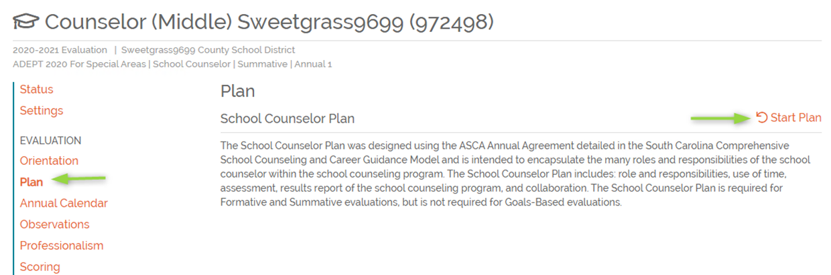
Creating the Plan
Notes:
Educators will click Plan in the navigation selections and then click Start Plan.

Slide 70
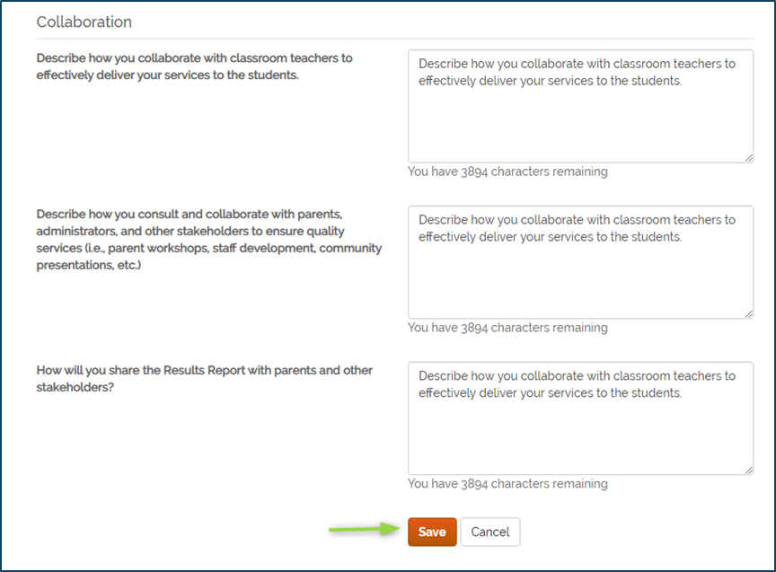
Saving the Plan
Notes:
The educator will enter data for each of the items for the plan. The educator must click Save at the bottom of the page in order to save their work. If he/she leaves the page without saving, any changes will be lost. This form doesn’t have to be completed at one time; however, it does have to be saved when changes are made.
My personal recommendation working with support is to have educators save often as they are working, especially when typing for long periods of time. We do have warning messages for system time-outs so it should not be an issue, but I would still recommend saving often.

Slide 71
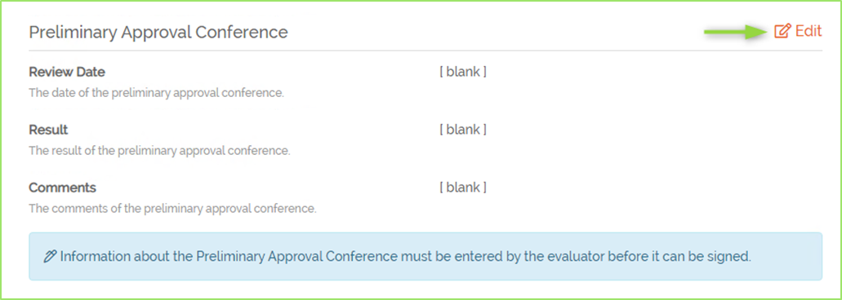
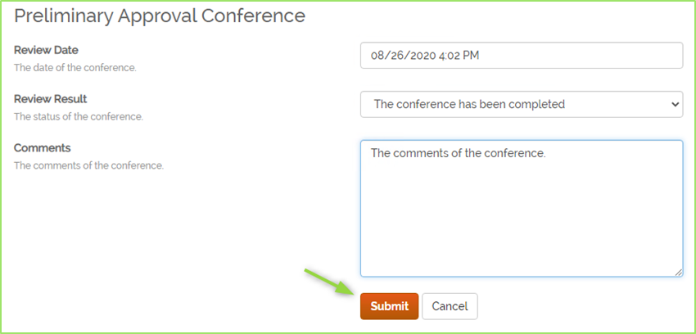
School Librarian Plan
Notes:
Once the plan has been entered and conferences occur, the evaluator will enter the conference information for the plan and click submit. Once the evaluator has signed the conference information, then the educator will sign.
The completion order here is important. You can think of it like the evaluator is indicating that he/she had the conference with the educator, the date it occurred any notes that should be shared. Then educator confirms with his/her signature.

Slide 72
School Counselor Annual Calendar
Notes:
The School Counselor evaluation will include an annual calendar.

Slide 73
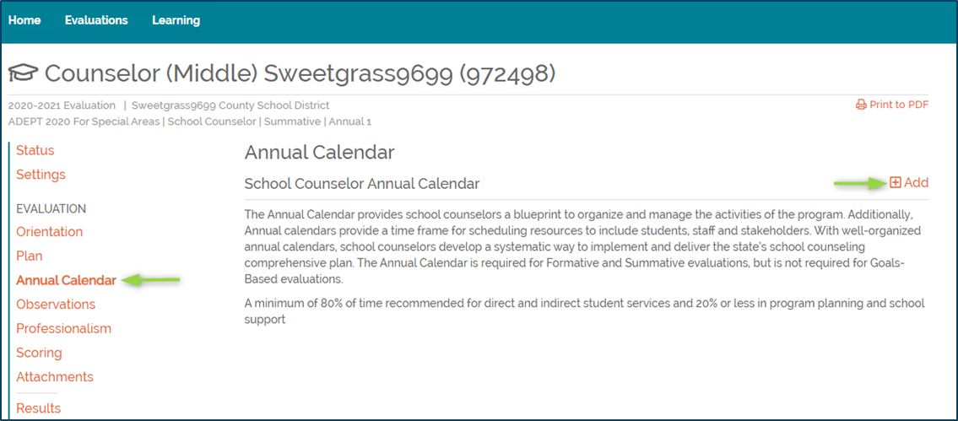
Annual Calendar
Notes:
Counselors will click Annual Calendar in the navigation selections and then click Add.

Slide 74
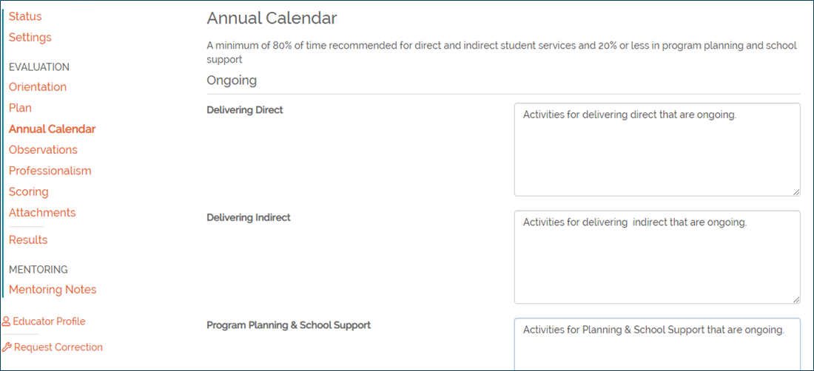
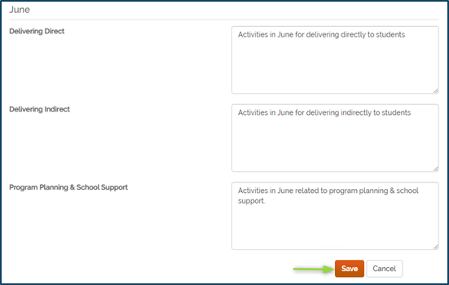
Completing the Annual Calendar
Notes:
The counselor will enter the activities that are ongoing as well as by month. As the counselor enters the calendar details, he/she will need to click Save in order to save progress. The calendar does not have to be completed at one time, but the counselor must save when changes are made.

Slide 75
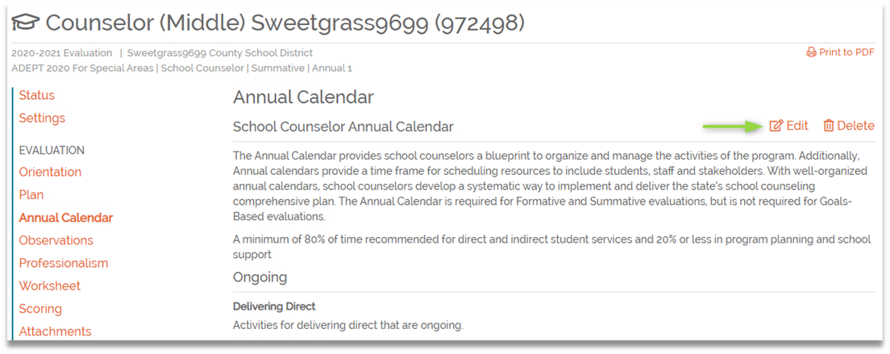
Editing the Annual Calendar
Notes:
The annual calendar will remain open throughout the year and the counselor can adjust as needed. There are not signatures on this form as it’s a working document.

Slide 76
Observations
Notes:
Let's look at the observation process. Observations will be created the same way for the new special area evaluations as they are for educators.
There are a few difference with what’s included for Observations. The biggest difference between special area observations and classroom teacher observations, is that special areas will not include scoring directly in the observation. The evaluator will score the rubric in a separate worksheet. I’ll show that worksheet in just a bit.

Slide 77
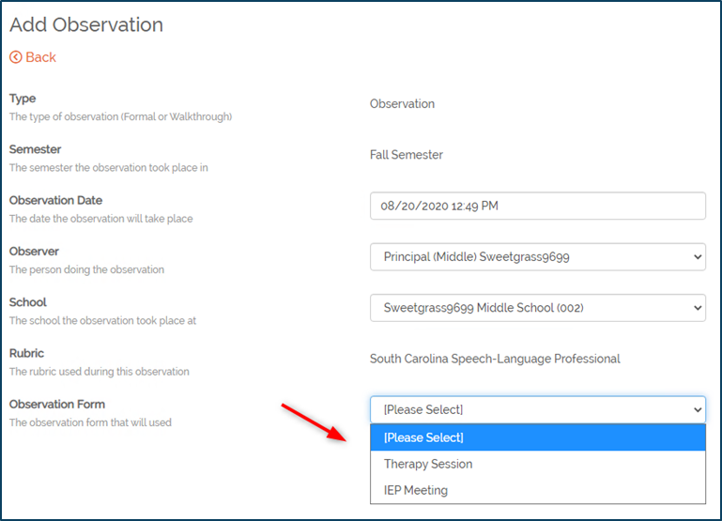
Speech-Language Professionals
The evaluator will need to select the observation type when creating the observation.
Therapy Session
IEP Meeting
Notes:
One thing to note for speech-language observations, when the evaluator creates the observation, he/she will need to indicate what type of observation they are completing, therapy session or IEP meeting. That selection will drive the indicators included for scripting purposes and the indicators the educator sees for self-reflection.

Slide 78
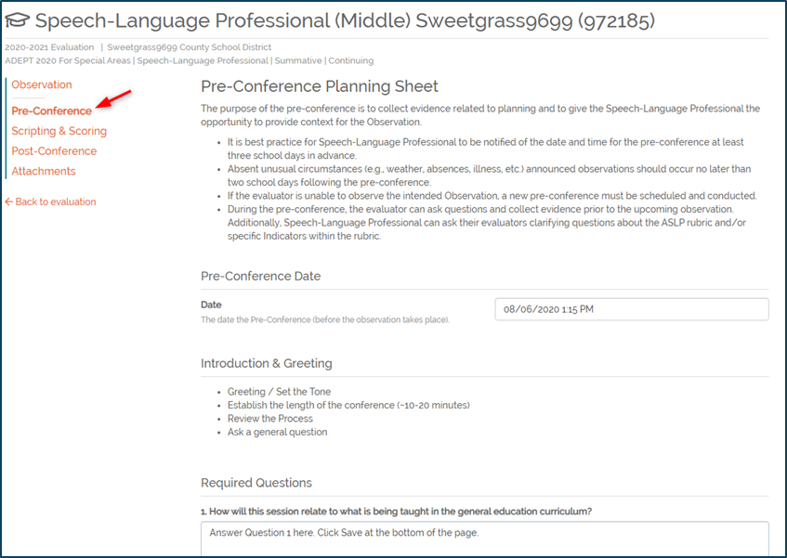
Pre-Conference Form
Each observation will have a pre-conference form to be completed by the evaluator.
Notes:
Each of the three areas will have its own pre-conference form. The questions will be asked by the evaluator during the pre-conference and the educator’s answers will be noted in the form.

Slide 79
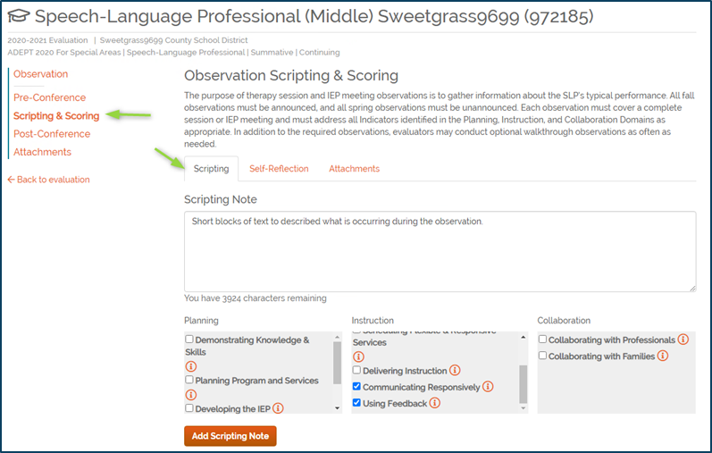
Observations: Scripting
Short blocks of evidence
Aligned to each indicator
Intended to facilitate scoring
Notes are not visible to anyone except the observer
Notes:
Scripting notes are an optional feature in SCLead.org. Scripting can be entered in SCLead.org and then each section of notes, or evidence, can be aligned to the rubric indicators. Each block of evidence can be aligned to as many indicators as applicable.
The idea is that each script block is a small description of what occurred during the observation. For example, you create one script block to describe what the educator just said to a group of students and how the students responded. Then you enter a new block to describe what happened next. Each of those small blocks of scripting can be aligned to each indictor to help inform scoring. The alignment can occur at any time, but it may be easiest to enter all scripting and then after the visit portion of the observation has concluded, go back and complete the alignment.
Some users may want to record all the notes in Word or even on paper and then later add them to SCLead.org and that is okay too. My only caution is that if you are copy/pasting from Word or similar program, copy into SCLead.org as plain text to avoid hidden characters. Please remember, the blocks are intended to be smaller sections of notes and there are character limits to each section. You could also just save the document and add it as an attachment. Attachments in this section are not viewable anyone else.
Scripting notes will only be visible to the observer. The educator, administrators or other observers will not be able to access the scripting notes at any time.

Slide 80
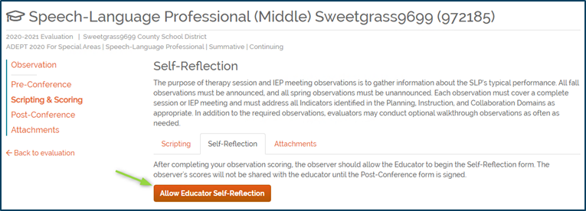
Observations: Self-Reflection
If the observation date has passed, self-reflection will be enabled.
If observation in the future, select when you are ready for the educator to see the observation in SCLead.org.
If not enabled, educator will not see the record of the observation.
If the observer has signed the post-conference, self-reflection can no longer be entered.
Notes:
We have added a feature that will automatically enable self-reflection if the date of the observation has passed. If the date has not passed, self-reflection will need to be enabled by the observer.
Once the observer clicks “allow educator self-reflection”, the educator can see the observation and enter self-scores provided the post conference form has not been signed.
If the observer disables self-reflection, the observation is no longer visible to the educator, even if the observer has signed the post-conference form. It’s important to remember “Allow Educator Self-Reflection” is required for an educator to see the observation. If you want to disable the self-reflection after the three-day window, you can; however, you must enable again once you are ready to sign the post conference form (AND before you sign the post conference form), thus allowing the educator to sign yet still controlling the window for self-reflection.

Slide 81

Observations: Post-Conference
The Post-Conference form for special areas will include
  An observation summary tab
    Only has Reflection and Refinement
  Planning sheet
Notes:
The Post-conference form will have the Observation Summary and the planning sheet. Again, the scoring will not be included directly in the observation.
The Planning sheet will be completed by the evaluator.
The evaluator will also complete the Observation Summary. If the educator has completed the self-reflection and shared it with the evaluator, his/her reflection selections will be displayed. The evaluator will select a reinforcement and refinement and can enter reflections notes. The educator will not see the post-conference form until the evaluator has entered his/her signature.

Slide 82
Worksheets
Notes:
We understand for special areas, there are many sources of evidence to consider when scoring the rubric. Some indicators may not have any relation to an observation. With that, we have created worksheets as a space for evaluators to collect evidence, add notes and score the rubric.
The worksheets are not visible to the educator and are a tool solely for the evaluator.
Once the worksheets are complete, the scores will be displayed in the Preliminary and Final Conference forms. We’ll discuss the scoring section in just a moment.

Slide 83


Worksheet
Notes:
To add a worksheet, click Evaluation Conferences in the left navigation menu. Then click Add Worksheet.
Each evaluator on the team will need to complete a worksheet for the preliminary and final cycles. The system will indicate if final cycles can be skipped based on scoring and contract levels.

Slide 84

SLP Worksheet
Next select IEP Meeting or Therapy Session for Speech-Language Professionals
Notes:
Once you click add worksheet, you’ll go to the details page.
When creating worksheet for Speech-Language Professionals, the evaluator will select the type of observation he/she completed and are responsible for scoring.

Slide 85


Worksheet, Cont.
Notes:
Next, select the domain you’d like to work with. Then enter supporting evidence in the form of notes and attachments. Each indicator will need a score selected. Before you leave the page, click Save at the bottom to save your work.
I know I’ve said this but as a reminder, the worksheet is not shared with the educator.
Once the evaluator has completed the worksheet and scored all indicators, the evaluator will add his/her signature to indicate the scores are complete.
Both evaluators on the team would need to complete a worksheet.

Slide 86
Scoring (Evaluation Conference)
Notes:
.
The scoring section will have the Preliminary and Final Evaluation Conference forms. These are the forms where consensus scores will be selected, and the scores shared with the educator. The final evaluation conference form will carry forward to the results section unless the final cycle can be skipped in which case preliminary scores would be used. It could be a combination of preliminary and final scores for Speech-Language Professionals in a situation where the spring IEP meeting is eligible to be skipped.

Slide 87

Scoring
The Evaluation chair will need to Start the conference forms
The consensus tab will not be shared with educators
Once scores have been selected and the conference occurs, the evaluation chair will sign, then evaluator and educator.
Notes:
The evaluation chair will need to start the evaluation conference forms. The evaluator (without chair role) cannot start form.

Slide 88


Entering Scores
Notes:
The evaluation conference form will open to the Consensus scoring page. Again, this page will not be shared with the educator.
The evaluation chair will select the consensus score for each indicator.

Slide 89


Summary Tab - Scoring
Notes:
The scores selected will display on the Summary tab. The evaluation chair and then evaluator will enter his/her signature. At that point, the conference form will be visible to the educator and the educator can enter his/her signature.
So the only action for the summary tab is to add signatures.

Slide 90
Overall Process Review
Evaluators collect evidence such as
  Plans submitted by educator
  Annual Calendar
  IEP reports
  Observations
Evaluators complete a scoring worksheet
Evaluators have consensus meeting to determine final score.
Share evaluation feedback with educator.
Notes:
As an overview: The evaluators will collect evidence. This may be from an observation, the counselor submitting their annual calendars, reviewing communication regarding IEPs, etc.
As the evaluator is reviewing evidence, he/she will complete the worksheet. Scoring does not really make sense in an observation since many of the indicators are not observable in a student setting, so the worksheet allows the evaluator to consider all evidence.
Once the evaluators have finalized individual scoring, they will meet to discuss scores and reach a consensus. Those consensus scores are shared with the educator in the Preliminary and Final Evaluation Conferences. The professionalism scores may be shared at this time as well, but those scores are recorded separately.

Slide 91

Professionalism Rubric (Final Review)
Evaluator must complete a Final Review.
Evaluator has the option to complete a Preliminary Review. – Preliminary reviews are not included in scoring.
Educator is required to complete a final self-review.
Notes:
As I just mentioned, special areas will also complete the professionalism rubric.
The Professionalism review is required unless on GBE/LOA. A preliminary review is optional, and the scores do not count. A final review must be completed and once signed by the evaluator; the scores will be included in results. The educator is not required to sign the professionalism review; however, the progress indicators will not show as complete unless the educator signs.
For special areas, educators ARE required to complete a final self-review. The preliminary self-review is optional.

Slide 92
Results Page
Results are calculated based on scored elements by the system.
Scores will be based on Spring scores unless the Spring cycle has been skipped based on eligibility.
The educator can sign but is not required to do so.
Once results are complete, the District ADEPT administrator will enter recommendations for the following year and must sign the results page.
Once district Administrator’s signature has been added, the evaluation can be marked as complete.
*See Informational messages if results page cannot be edited.
Notes:
The evaluation overall rating will be calculated by the system.
Once the results have been entered and signatures are present, the evaluation can no longer be edited. If edits are needed, the signatures will need to be removed.
I’ll show you an example of information messages on the next slide.
As a reminder, you can use the Staff Evaluation Status report to see who has/hasn’t completed the evaluation

Slide 93


Information Messages: Where is the Edit button?
Information messages help the user know what is required before results can be entered or completed.
Notes:
Information messages are a helpful tool. If items are missing before the next step can be completed, the information messages will let you know what those missing pieces are. The messages could be in a blue or yellow box.
In the screenshots here, this educator is missing the required number of observations, the required number of observations completed by different evaluators and the consensus for both spring and fall.
In addition, the yellow message lets the user know what is preventing the evaluation from being signed.

Slide 94
SCLead.org Help Desk Information
Online Help Desk:
Click the Help Desk link on any SCLead.org webpage
Email:
Email support@sclead.org (preferred method)
Phone:
1-877-314-1412 (leave a message with full name,
school district and contact information

Slide 95

SCDE OEELD

