Slide 1
Technical Support Enablement
South Carolina Department of Education
Last updated: 6-30-22

Slide 2


Zoom Communication Tools
Q&A will be our primary method of communication today.
We may use a poll in this webinar. Please participate if/when you see one appear on your screen.
The chat will be disabled during the webinar today. Please use the Q&A instead.
Notes:
Deanna

Slide 3
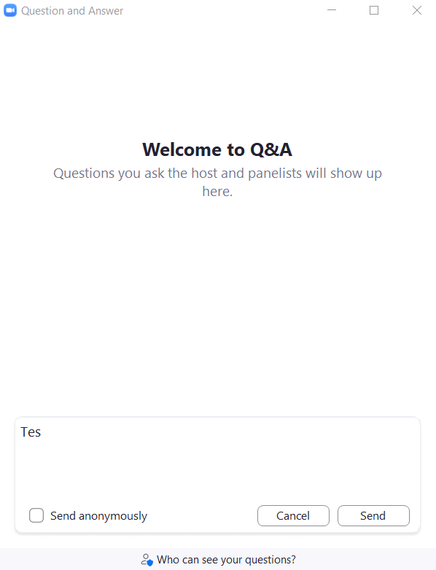
Anatomy of the Zoom Q&A
Check the box to send anonymously, if desired.
Type your question in the box. Click Send when ready.
How do I access the PLL?

Slide 4
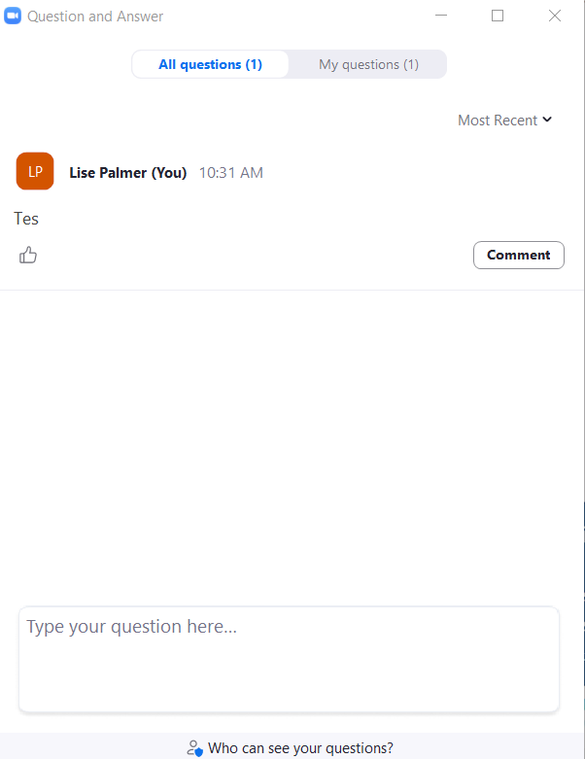
Review Submitted Questions
Click the tabs to move between Question types.
If you have the same question as another participant, upvote it!
How do I access the PLL?
Comment on others’ questions, if desired.
Notes:
Deanna

Slide 5

Agenda
The Technical Contact Responsibilities
PowerSchool Community
  Overview of PowerSchool Community
  How to enter support tickets in the PowerSchool Community
  What are the key pieces of information to include?
  Where can you find Professional Learning support materials within the Community?
Professional Learning Support
  How to access user accounts
  Trouble-shooting user accounts
  Whitelisting no-reply email

Slide 6
Technical Contact Responsibilities

Slide 7
Technical Contact Role & Responsibilities
Assist educators having trouble logging into the PLL or accessing PLL courses, mini-courses, or videos
Confirm Profile settings for users as needed
Utilize Educational Impact Troubleshooting guides
Utilize PowerSchool Support for issues you cannot solve at https://help.powerschool.com

Slide 8
PowerSchool Community

Slide 9

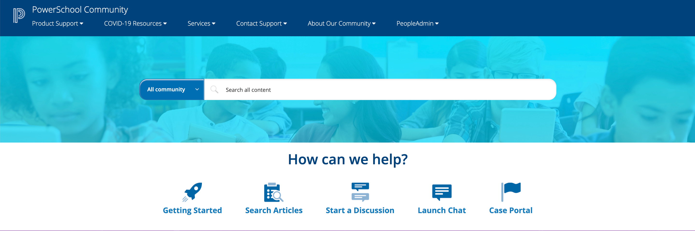
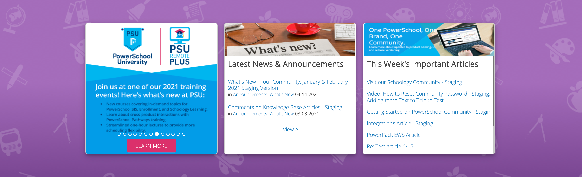



Award-Winning
Community
The entry point for all your support needs is at help.powerschool.com:
Growing number of support articles and product updates​
A great place to interact with peers, our team, and contact support​
Events Hub for Office Hours, Webinars, and PowerUps
Ideas Portal for enhancement requests
We recognize and celebrate our most active members: PowerSchool Mentors

Slide 10
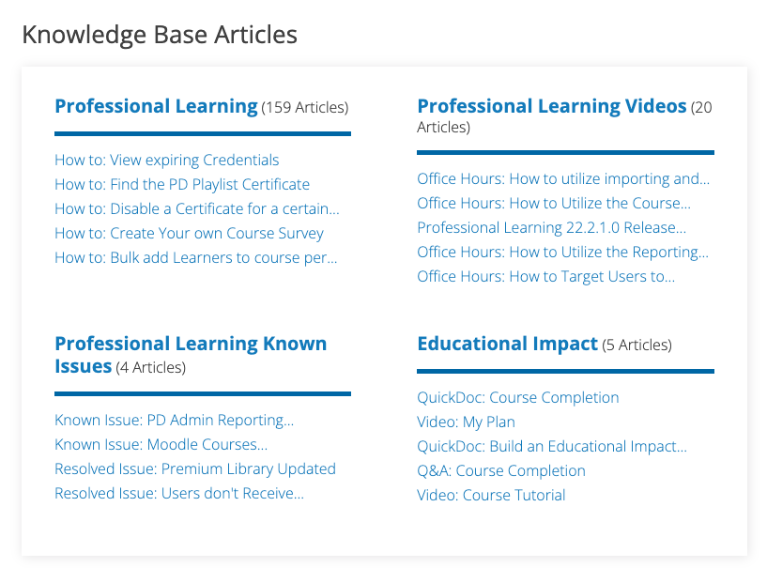


Forums & Knowledge Base
Get the most out of our PowerSchool Community by:
  Searching through our Knowledge Bases
  Posting questions and replying to others in our Forums
  Subscribing to receive timely updates

Slide 11
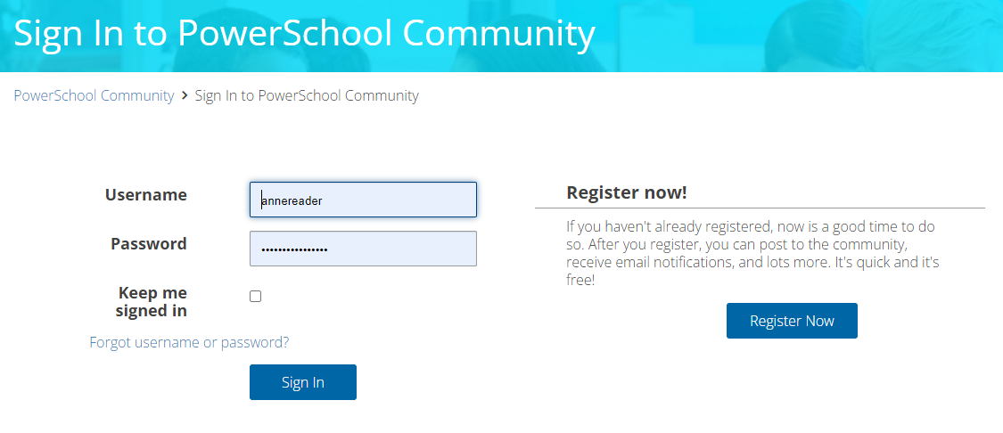
PowerSchool Community Account
Follow these steps to create an account in PowerSchool Community:
  Open https://help.powerschool.com
  On the top-right corner of the page, click Sign In
  Click Register Now
  Create a Username and Password
    Note: Username should not be your email address
  Click Register
  Please give us 24 hours to update your access
  For any access questions, email businessoperations@powerschool.com
  Video: How to Create a Community Account

Slide 12
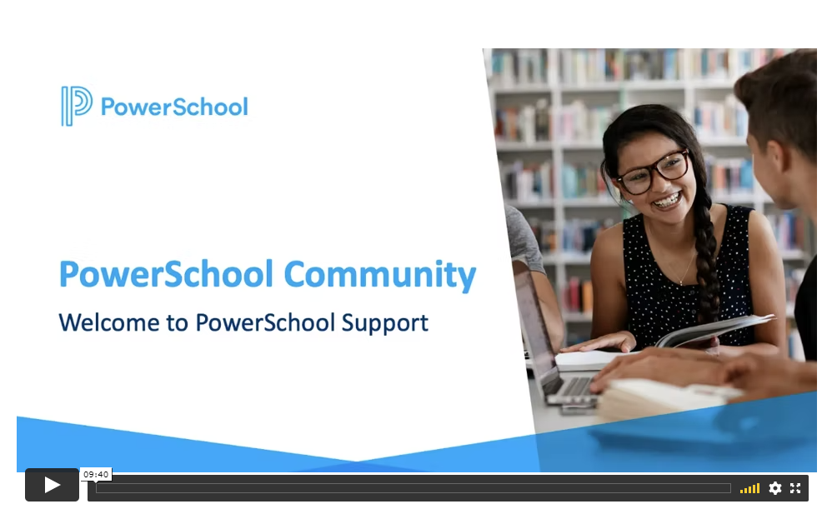
Resources for Getting Started
Please visit these links to help you navigate the PowerSchool Community:
  Welcome to PowerSchool Community
  Getting Started in PowerSchool Community
  How to Create a New Support Case
  How to Manage Your Cases
  How to Subscribe to Product Updates

Slide 13
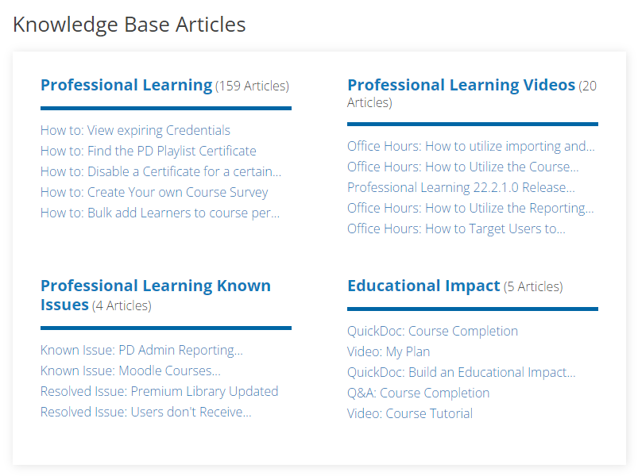
South Carolina Resources
QuickDoc: Course Completion
Q&A: Course Completion
Video: My Plan
QuickDoc: Build an Educational Impact My Plan
Video: Course Tutorial

Slide 14
Creating a Support Case
Create a case via PowerSchool Community
Contact Support Tab > Create a Case through Case Portal or Launch Chat Support
Phone: (866) 434-6276
Press 1 for “Support”
Select 1 for “New case” or 2 for “Existing case”
Select 8 for “Talent”
Select 3 for “Professional Learning”
Direct Phone for Unified Talent Products: (855) 955-0946
Select 3 for Professional Learning

Slide 15

Support CHECKLIST
Know the Support phone number: 1-866-434-6276
Sign up and bookmark the Community at help.powerschool.com
  Review tips on Getting Started
  Engage in our Community Forums
  Subscribe to Product Updates in the Community
  Sign up to be a PowerSchool Reference or Mentor

Slide 16
Professional Learning Support

Slide 17




Please Login
Take a moment to login to Professional Learning so that you can follow along today
Let me know you’re ready to begin by typing “Ready”
Your Turn

Slide 18

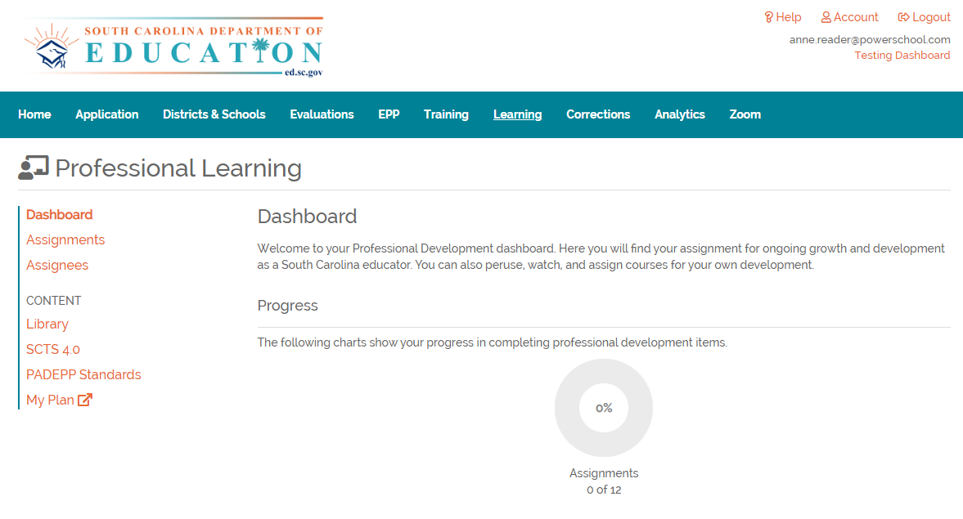
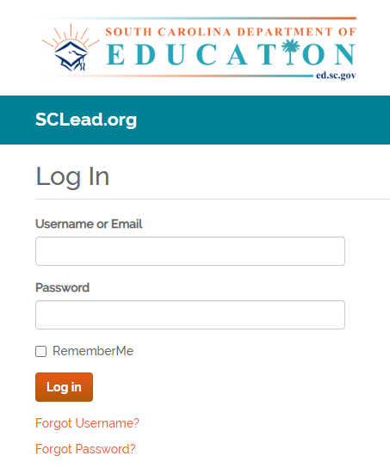
Login to SCLead.org
SCLead.org
Login to SCLead.org
Click the Learning tab
Click Assignments
1
2
2
3
3
1

Slide 19


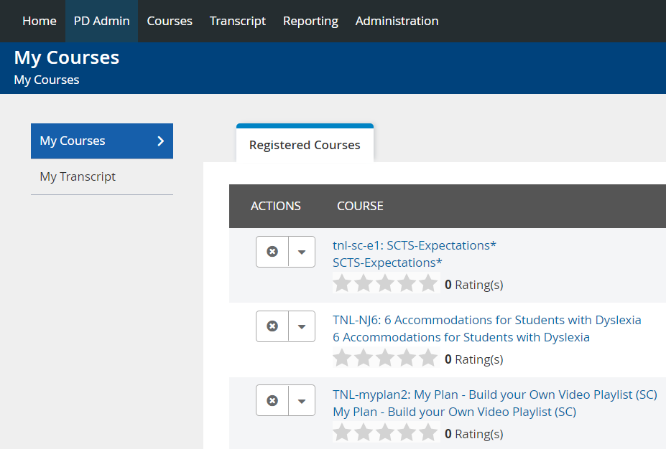
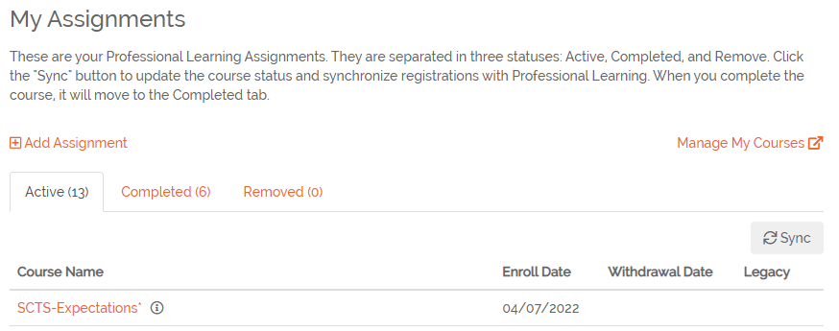

Travel to Professional Learning
Professional Learning
In SCLead.org click Manage My Courses to open Professional Learning
In Professional Learning, click the Administration tab
4
5
5
4
Notes:
Deanna turn over to Anne for live demo after this

Slide 20
How do I access the PLL?
Login to SCLead.org
Do you have an SCLead.org account?
yes
yes
Do you have a CID?
Register for an SCLead.org account
no
Reach out to your District Effectiveness Contact to request an SCLead.org account
no

Slide 21
Understanding User Accounts

Slide 22

Why Access User Accounts?
To confirm account exists
To check that their username and demographic information is accurate and up-to-date
To confirm email address is correct
To view their Course Completions
To view their Transcript
To determine their System Rights

Slide 23
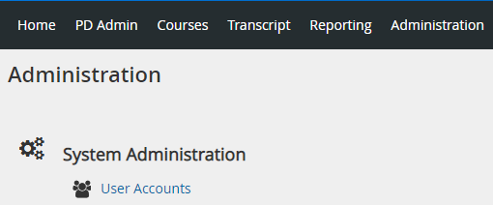
Accessing User Accounts
Click Administration
Click User Accounts

Slide 24
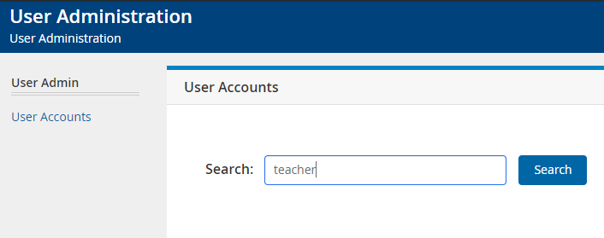
Search for User Account
Search for the user

Slide 25
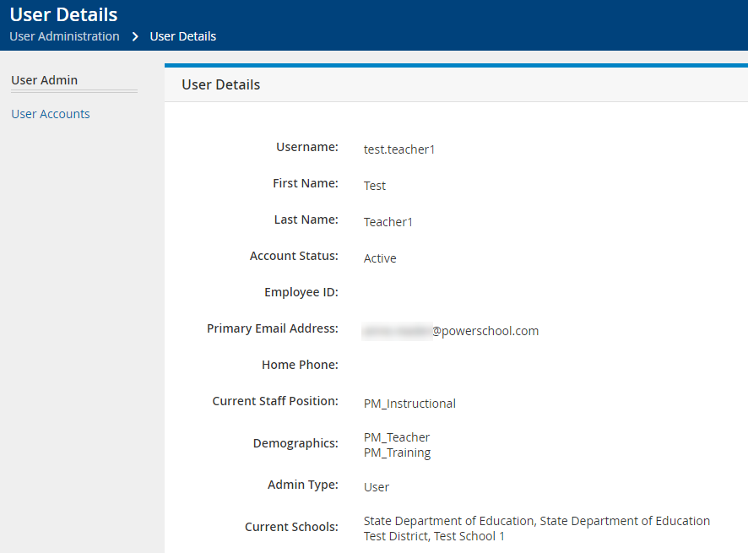
View User Profile
Click their name to view their Profile
Click User Accounts when done

Slide 26
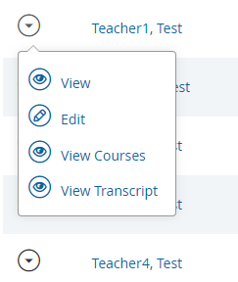
View Courses
Administration > User Accounts > Menu > View Courses
View all courses a user has registered for or completed

Slide 27
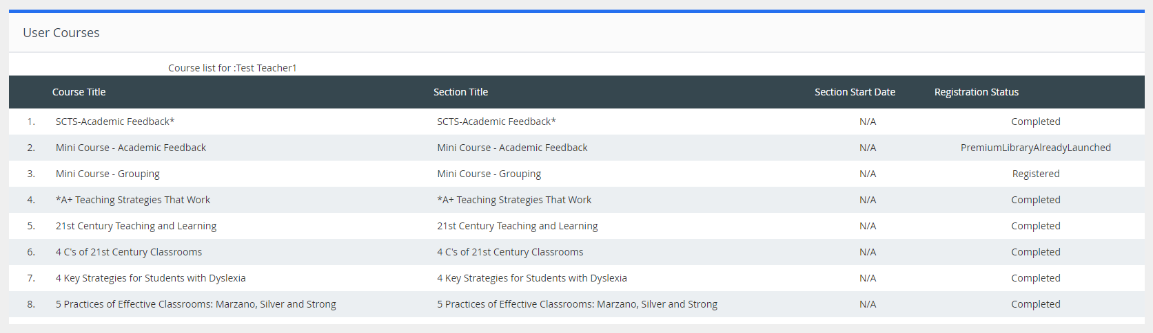
User Courses

Slide 28
View Transcripts
Administration > User Accounts > Menu > View Transcript
View the user’s transcript

Slide 29
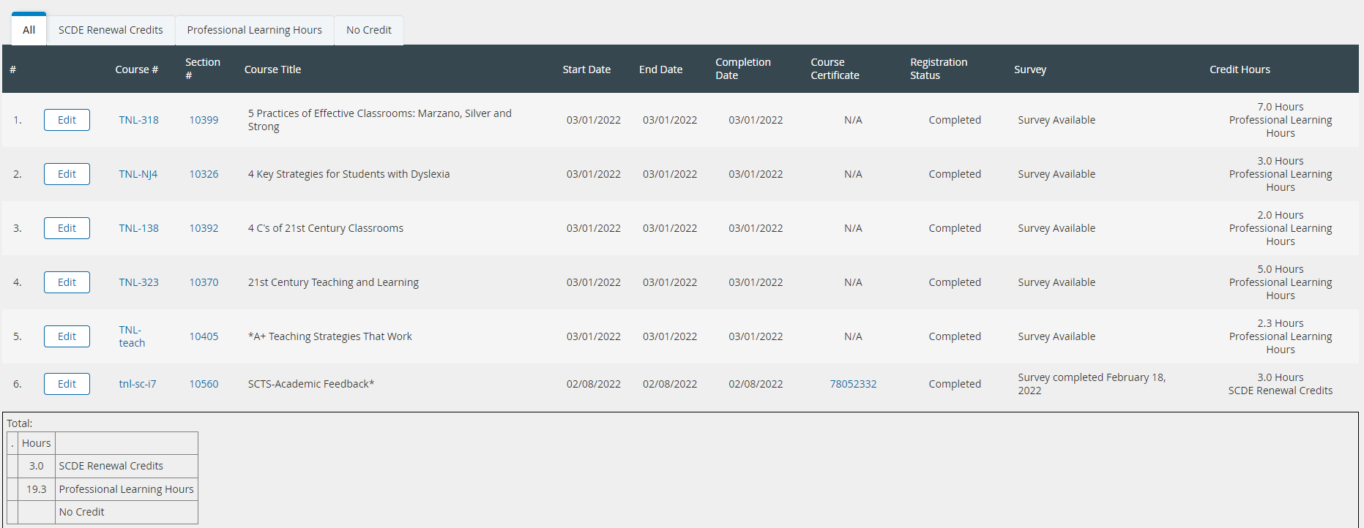
User Transcripts

Slide 30
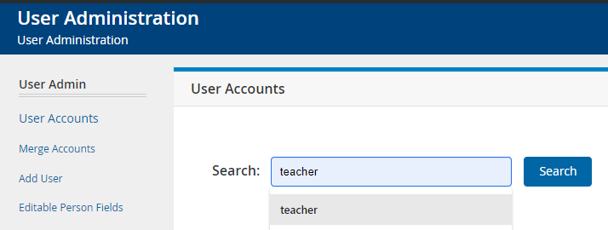
Reset Search
To reset the user list:
  Delete the search query and click Search

Slide 31
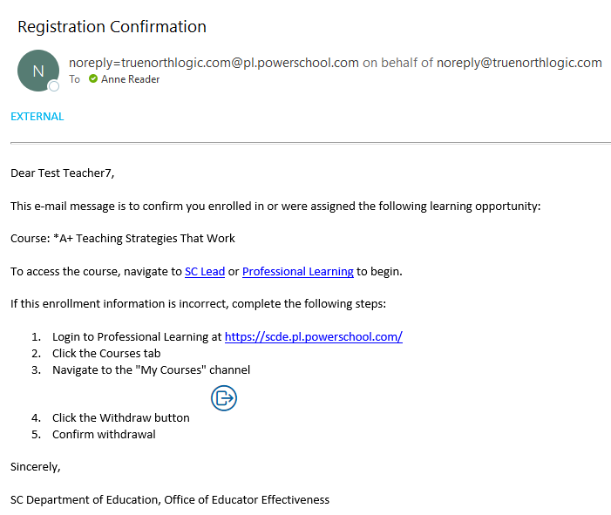
Please Whitelist No-Reply Email
The email notifications within Professional Learning come from noreply=truenorthlogic.com@powerschool.com
Please ensure this email address is whitelisted for your district so that the notifications are not sent to Spam/Junk

Slide 32
Common Troubleshooting
User cannot access Professional Learning (PL)
  Verify user exists in User Accounts
  Confirm PL Username matches expected SCLead Username
  Reach out to SCLead Contact for Account Creation
  https://sclead.org/Account/Register
Issues with SCLead Username/Email
  Update Username or Email under Profile Settings
  Video Support Password: sclead
Issues accessing the PowerSchool Community
  Email: businessoperations@powerschool.com

Slide 33
Common Troubleshooting cont’d
Issues with Educational Impact Content
  View Resources and Troubleshooting Guide in Community
  Contact support@educationalimpact.com
User Transcript Does not Reflect Completion
  Verify the user is Registered for the course in Professional Learning
  The learner has not correctly checked something off as complete
  The learner has not mastered the assessment – it will be marked complete automatically when 80% mastery is achieved
  The learner has not watched an “EI Video Clip” all the way to the end

Slide 34
Questions?

