Slide 1

Recruiting, Retaining, & Supporting Excellent Educators:
Leveraging Expanded ADEPT and PADEPP to Grow Teachers & Principals
As you enter, write your answer to each of these questions on a different sticky note. When you think about how teacher evaluation or principal evaluation have gone this year....
1. What's working with building a culture of growth?
2. What was challenging?
Notes:
ADEPT, PADEPP and Retaining Effective Educators,
Monday June 18, 11:00am -- 12:00pm Palladium B
Session Description
Join this session for system updates, transition planning tips, and communication resources for creating a reflective instructional culture in your school or district with a focus on growth. Learn about using coaching to improve principal and teacher practice.

Slide 2
Recruiting, Retaining, & Supporting Excellent Educators:
Leveraging Expanded ADEPT and PADEPP to Grow Teachers & Principals
Lilla Toal-Mandsager, Kim Howard, and Beverly Flythe
SCASA i3 Conference, June 2019
Notes:
ADEPT, PADEPP and Retaining Effective Educators,
Monday June 18, 11:00am -- 12:00pm Palladium B
Session Description
Join this session for system updates, transition planning tips, and communication resources for creating a reflective instructional culture in your school or district with a focus on growth. Learn about using coaching to improve principal and teacher practice.

Slide 3
Bright Spots and Challenges

Slide 4


What's Hot? What's Not?
When thinking about building a culture of growth with ADEPT and PADEPP, what is working?
What is challenging?
Notes:
Beverly
Image credit: Otto Fokus, https://www.flickr.com/photos/jbmac/4737231422

Slide 5
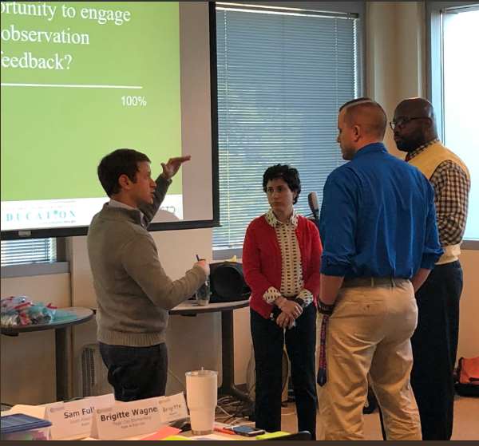

From the trenches...
Through this experience I was able to identify my own strengths and weaknesses as a leader. Being able to collaborate with other assistant principals provided me with opportunities to learn from others." Assistant Principal, Instructional Leadership Academy
"I like that SCLead is accessible to teachers and administrators. There should never be a question about someone's area of reinforcement or refinement since everything is at your fingertips! " District ADEPT Coordinator
The answers are in our buildings...
Notes:
Lilla

Slide 6
Outcomes
Identify what’s already working and not to build a culture of reflection in your context
Practice strategies for giving feedback through the lens of building relationships
Establish a next step you’ll take to retain effective teachers
Connect to key resources and how PADEPP and ADEPT align with other state priorities
Notes:
Premise: The culture in your building will keep strong teachers. The culture in your building will retain strong teachers.
If we are intentional and transparent about building culture AND we embed feedback as part of that culture, then we will push each other to improve instruction AND we will improve capability.
Agenda
Bright Spots & Challenges
Building Culture and Building Relationships
Giving Effective Feedback
Taking Action: Next Steps
ADEPT/PADEPP resources and questions

Slide 7
Building Culture and Building Relationships: Scenario-based Activities
Notes:
Kim

Slide 8
Establishing Culture
Your goal is to build a culture that values feedback and reflection while ensuring that positive relationships are developed. In your group, read your assigned scenario. Consider how you would address the situation and brainstorm potential solutions. One group with each scenario will be asked to share.

Slide 9
What Would You Do?
Scenario 1
Scenario 2
School A has a faculty that consists of 35 teachers, the majority being veterans that have been in the school for at least 9 years. These teachers are all fully aware of the changes in the evaluation system with the SCTS rubric, but do not all welcome the idea of the evaluation process, including being observed and engaging in conferences about their instruction. Because they haven’t been observed in years, they resent the idea of someone coming into their classrooms to tell them what they need to do better. New to the staff this year are 6 first-year teachers who are excited about the idea of working in their own classrooms for the first time. They have become familiar with the SCTS rubric throughout their college career but after hearing the reactions of their colleagues, they are hesitant about experiencing the process. Also new to the building is the principal, Mr. Bell, who is not only new to the school but also to the state. In his previous role, conferences were not a part of the evaluation system and are therefore not something he is accustomed to doing.
Your district has recently experienced a mass amount of teacher turnover. Accordingly, approximately 30% of the current district staff consists of educators new to the district. Much of this turnover has occurred in three schools in particular. Within the last 5 years, each of the 3 schools has had at least 3 different principals. In addition, in one of these schools the newly hired assistant principal was formerly a teacher in the school who is now in the position of coaching her peers as an evaluator. As expected, morale is low in these schools as staff members don’t know what to expect from year to year.

Slide 10
Giving Effective Feedback
Notes:
Kim

Slide 11
Coaching Preparation
In your group, read your assigned scenario. Identify what is critical about the challenging conversation that must occur.
What questions are essential?
What evidence is necessary to share?
What specific next steps should take place?
Notes:
Kim

Slide 12
Reflections
•Keep doing or start: What good ideas or strategies emerged?
•Stop doing: What red flags/reminders/reflections came up?
•What questions do we have for each other?
Notes:
Kim

Slide 13
Taking Action: Next Steps
Notes:
Beverly

Slide 14
One small step...
Think of an immediate need in your district or school that connects to retaining and supporting educators. What is one small action step you could take based on the conversations we've had today?
Jot it down on the colorful notecard you received earlier.
Notes:
Beverly

Slide 15

Step to the beat...
Remember musical chairs? As the music plays, make your way around the room. When the music stops, swap action steps with the person standing closest to you. When we finish, you should have several bright ideas to carry you forward.

Slide 16

Feedback vs. Advice
"We too often jump right to advice without first ensuring that the learner has sought, grasped, and tentatively accepted the feedback on which the advice is based," Wiggins (2012).
Feedback vs. Evaluation
Evaluation without feedback "serves no useful function."
Notes:
Lilla

Slide 17
ADEPT and PADEPP Resources
And Questions...

Slide 18
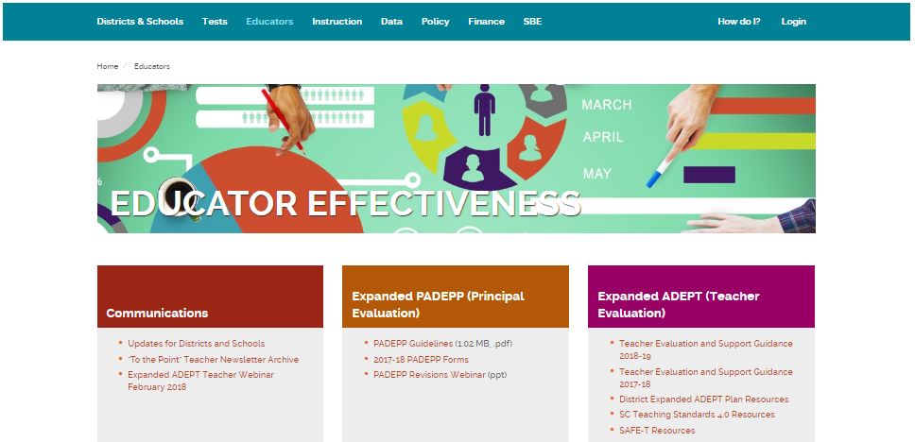
PADEPP: Supporting Principal Growth
PADEPP is a growth model – reflection and actionable, timely feedback are essential
Principals need multiple types of support – in context, tactical, and strategic
PADEPP resources *https://ed.sc.gov/educators/educator-effectiveness/
*PADEPP guidelines (2017)

Slide 19
ADEPT Tips and Key Resources
ADEPT is a growth model – reflection and actionable, timely feedback is essential
SLOs + SCTS = Data-informed reflection on teacher effectiveness
Communication with and feedback from teachers about the process is essential
ADEPT resources *https://ed.sc.gov/educators/educator-effectiveness/
*ADEPT guidelines (2018)
*SLO resources

Slide 20
Expanded ADEPT Process for 2018-2019
Contract Level | Observations | Student Growth
Induction (Formative) | >1 – Full Classroom Observation per semester, with conferences | Complete 1 SLO, may cover 2nd semester only
Annual and Continuing (Summative) | >2 – Full Classroom Observations per semester, with conferences | Complete 1 SLO
Continuing (Formative) Comprehensive 5th year recertification | >1 – Full Classroom Observation per semester, with conferences | Complete 1 SLO
Continuing and Annual (GBE) | Informal | Complete 1 SLO
Notes:
Differentiated: Induction/Annual/Continuing Contract, Our office sets the floor, your district may choose to do more
Observers
Induction: Principal or SCTS certified administrative designee, teacher also has a mentor
Annual: Principal or trained administrative designee AND person with knowledge of teachers content area
Highly Consequential: Three person team
Continuing Contract Comprehensive: Principal or SCTS certified administrative designee

Slide 21
Important Educator Effectiveness Dates
ADEPT Plans Due, June 1st
ADEPT Teacher Evaluations Due in SCLead, June 20th
PADEPP Principal Evaluations Due in SCLead, Sept. 1st , Conferences for 19-20 completed by Sept. 15th
April 30th, Teacher Contract Date, All Teacher Evaluation Conferences must be completed.
New Principal Induction Program, email masuber@ed.sc.gov to register new Principals.

Slide 22
Training and Professional Learning
SCTS and SCLead.org training links:
https://ed.sc.gov/
educators/educator-effectiveness/professional-learning/professional-learning-opportunities/
Leadership Development Professional Learning
https://ed.sc.gov/
educators/
school-and-district-administrators/
Notes:
Update links

Slide 23
Tracking and Supporting Effectiveness – SCLead.org

Slide 24
What’s Required in SCLead.org?
Required State-level reporting for classroom-based teachers
overall effectiveness ratings (Met/Not Met),
next year contract level and hiring status
observation results at the indicator level, if applicable, and
student learning objective scores
Required state-level reporting for PADEPP
Conferences and signatures
        Principal’s professional development
        Principal’s self-assessment
        Principal’s summative evaluation form
Notes:
Required State-level reporting for classroom-based teachers
overall effectiveness ratings (Met/Not Met),
next year contract level and hiring status
observation results at the indicator level (Summative and Formative), if applicable, and
student learning objective scores (All, Summative, Formative, and GBE)
Required state-level reporting for PADEPP (2018-19)
Conferences and signatures (orientation, Mid-year, end-of-year)
Principal’s professional development plan
Principal’s self-assessment
Principal’s summative evaluation form (comments needed for all standards for induction principals, comments needed for all unsatisfactory and needs improvement for all other evaluations)

Slide 25
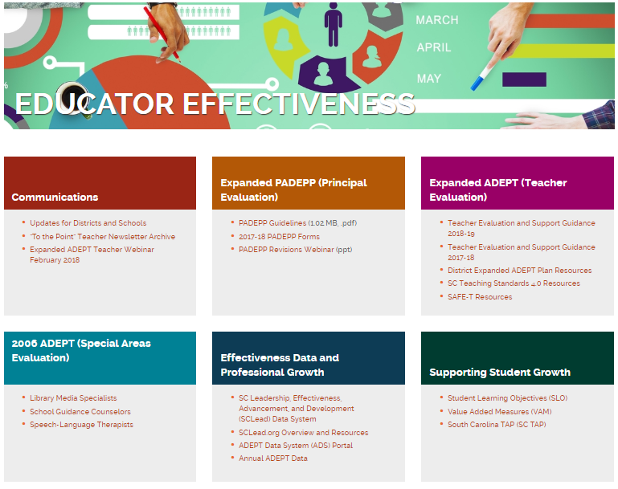
SCLead Tips and Key Resources
SCLead.org is a resource to track the process and support you with actionable data
Districts will need to set expectations with teachers, evaluators, and principals
SCLead resources https://ed.sc.gov/educators/educator-effectiveness/

Slide 26
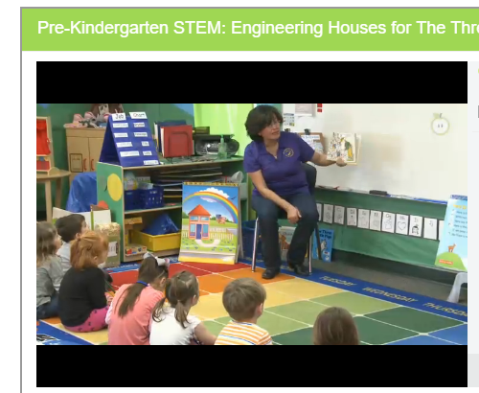
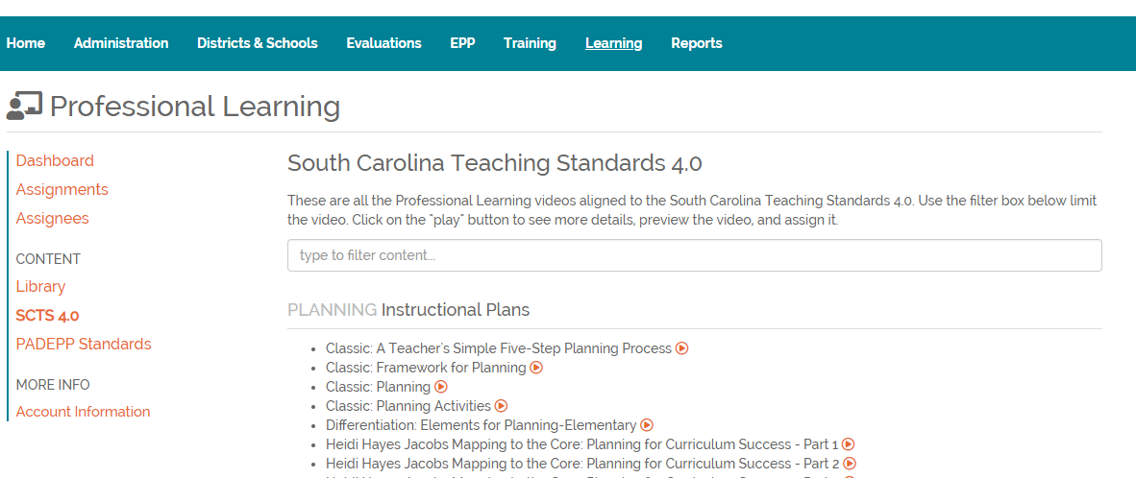
Growing Teachers and Principals:
SCTS 4.0 and PADEPP Video Library

Slide 27
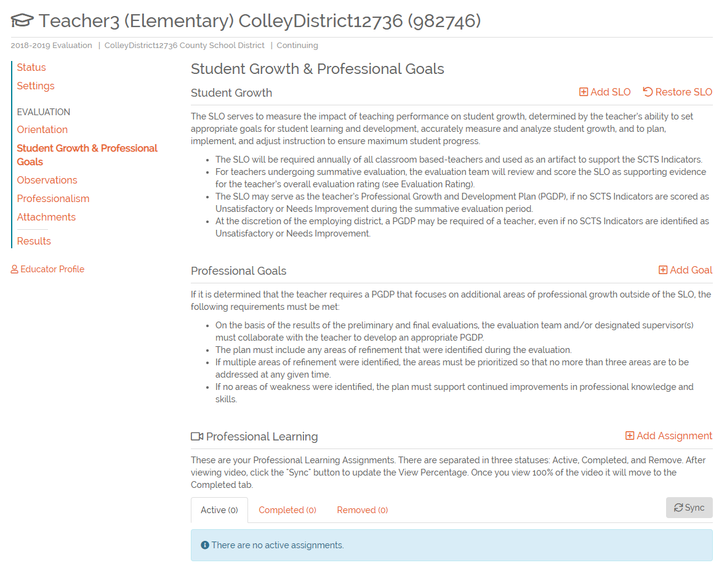
Professional Learning Videos
Notes:
Once you are in the Educator’s Evaluation, click on Student Growth & Professional Goals and Professional Learning will populate at the bottom of the screen. Click Add Assignment and the Library will Pop-up.

Slide 28
Questions?

Slide 29
Office of Educator Effectiveness & Leadership Development
Educator Effectiveness Leads
Beverly Flythe, Educator Preparation, bflythe@ed.sc.gov
Dr. Kimberly Howard, Mentoring and Induction, khoward@ed.sc.gov
Faye Colley, Professional Learning and Communications, fcolley@ed.sc.gov
Rodney Evans, SLOs, revans@ed.sc.gov
Dr. Julie Hartwell, Data and Reporting, jhartwell@ed.sc.gov
Dr. Vicki Traufler, PADEPP, vtraufler@ed.sc.gov
Leadership Program Leads
Walter Clark, Experienced Leaders, wclark@ed.sc.gov
Olivia Ortmann, Collective Leadership, oortmann@ed.sc.gov
Dr. Frank Robinson, Principal Induction, Emerging Leaders frobinson@ed.sc.gov
Tom Smith, Assistant Principals and Instructional Leaders, tsmith@ed.sc.gov
Regina Thurmond, Emerging Leaders, Special Areas, rthurmond@ed.sc.gov
Office Support
Lilla Toal Mandsager, Director, lmandsager@ed.sc.gov,
Marilyn Suber, Administrative Assistant, masuber@ed.sc.gov
Online https://ed.sc.gov/educators
Leadership: /school-and-district-administrators/
Effectiveness: /educator-effectiveness/

Slide 30
Research and References
Playlist for Retaining and Recognizing Teachers:
https://docs.google.com/document/d/1rhrb05FnNwTTNbKh__faGB9wFMT5coUzaytM6txJmtg/edit
CERRA Supply and Demand Report (2019) Center for Educator Recruitment, Retention, and Advancement. South Carolina Annual Educator Supply and Demand Report.
https://www.cerra.org/uploads/1/7/6/8/17684955/2018-19_supply_demand_report_update_jan_16.pdf
  Covey, Franklin. Summary of Speed of Trust: https://www.cu.edu/sites/default/files/ExecSummaries-The_Speed_of_Trust.pdf
  Wiggins, Grant. (2012). SEven Keys to Effective Feedback. ASCD. http://www.ascd.org/publications/educational-leadership/sept12/vol70/num01/Seven-Keys-to-Effective-Feedback.aspx
Notes:
5,300 teachers left their positions during or at the end of the 2017-18 school year and are no longer teaching in any SC public school.
When retirements are considered, 35% were new teachers and 13% in their first year.
First-year teachers, in particular, are leaving at an alarming rate. According to district surveys from the past two school years, 25% of the first-year teachers hired for 2017-18 are no longer teaching in any SC public school.

