Slide 1
Grant Applications
Shanna Graham-Garrett
sgraham@ed.sc.gov

Slide 2

What’s New?
The GAN’s new look
Project Numbers to Project Names
From FY16 CG 004 to FY16 Preschool Orangeburg 4
Less Paper
Grants Narrative has been reduced to 3 pages due to GAPS activities description.

Slide 3
FY 16 Grant Applications
Submit in Paper Form
CEIS
Assurances
GAPS
Budgets
PPPSC
Fiscal
Lobbying Certification
GAN
Activities Description
Must detail how the funds will be spent
Evidence of Meaningful Consultation (PPPSC)
Notes:
As you are developing a budget, make sure that your District can provide FAPE.

Slide 4
Three Roles Assigned
(Grant Title Specific) Coordinator – Enters Budget/Budget Amendments
(Grant Title Specific) Finance – Approves Budget/Enters Expenditures
Grants Accounting Finance Approver- Approves Expenditures
Must be at least one different person assigned to each role for a total of three people – In other words, one person can not have more than one role on the same grant.
Assigned by Web Access Coordinator within the District - please don’t forward to SCDE

Slide 5
Allocation/Budget
Allocation
(SCDE)
Enter Budget (LEAs Grant Coordinator)
Sub-recipient level
Budget Approval
(LEAs Finance Official)
LEAs’ Budget Approval
(SCDE)
GAPS system available for entry of expenditures

Slide 6
The application approval process has three components:
Part I. Assurances and lobbying certification are used to determine if your agency is eligible for IDEA funds.
Part II. Narrative information is used to determine if the proposed services/activities are allowable IDEA expenditures.
Part III. Fiscal information, which includes the Budget Report, Excess Cost and Maintenance of Effort, is necessary to determine if the agency has met all fiscal requirements for reimbursement

Slide 7
CEIS
Districts planning to voluntarily spend funds on Coordinated Early Intervening Services (CEIS) must submit a CEIS plan with their application.

Slide 8
Working in GAPS

Slide 9
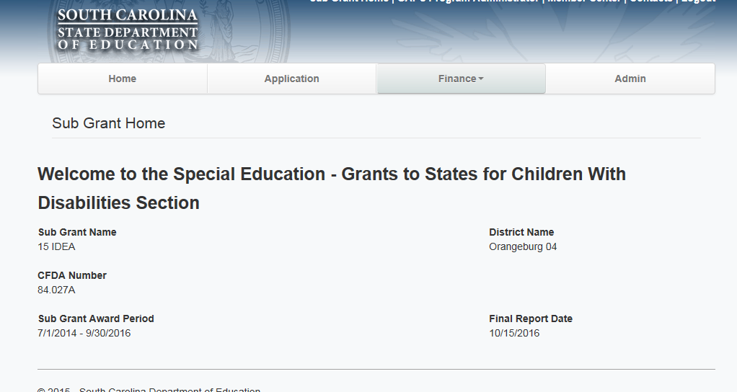
Master Data for Sub Grant
Important Dates Displayed:
1) Award Period – From and To Dates for Grant Award
2) Final Report Date – Final Date for Expenditure Report to be submitted

Slide 10
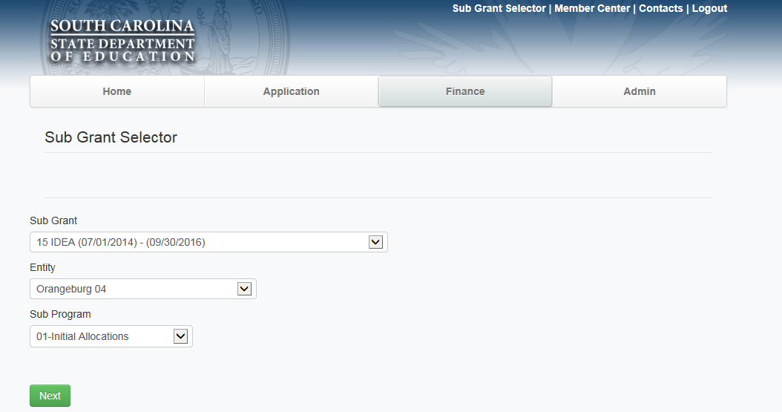
Selecting a Grant to work on
Sub recipients will see only their information – SCDE Program Offices will have a dropdown to select sub recipient and award. Select the “16 IDEA” or “16 IDEA Preschool” sub-grant. Select “next”.

Slide 11
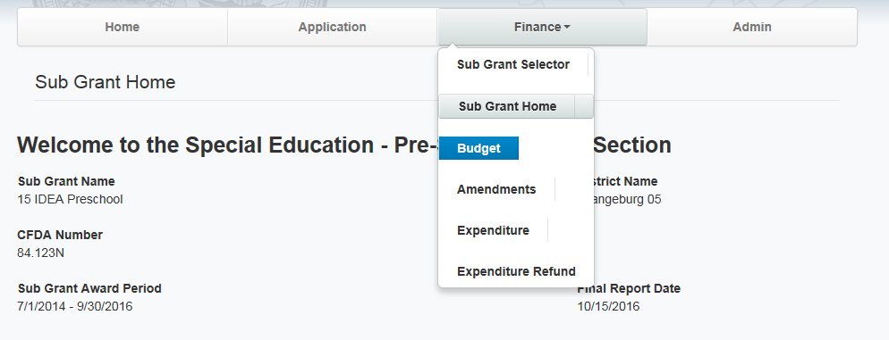
Entering Your Budget
Select “Budget” under the Finance tab and the “Add New”.

Slide 12
Activities Description

Slide 13
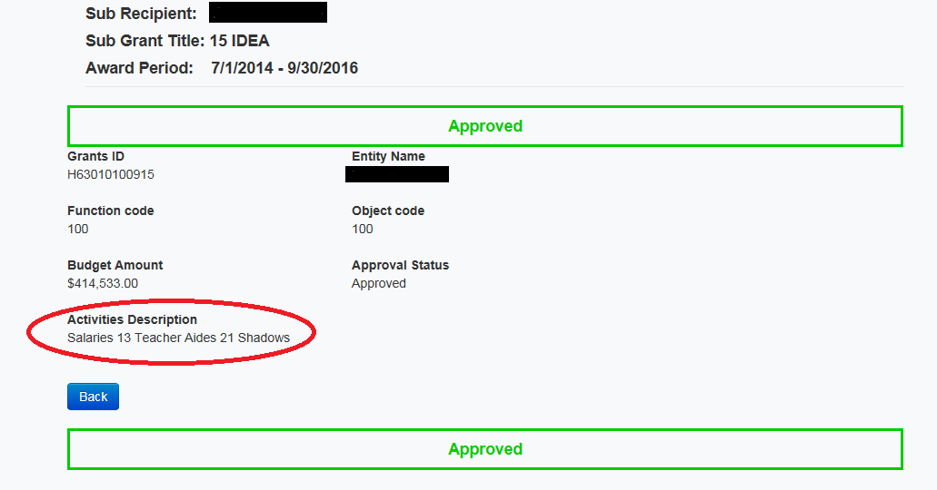
The Importance of a description

Slide 14
Activities Description
We are moving from the paper version of grant applications.
Please use the “Activities Description” in GAPS to provide a detailed explanation of how the funds will be used.
Blank or vague Activities Descriptions will be returned for further explanation.
A good “Activities Description” describes in detail how many teachers will be hired, at what rate, what instructional Materials and supplies will be used for, etc…
Ensure that all items are reasonable and necessary.

Slide 15
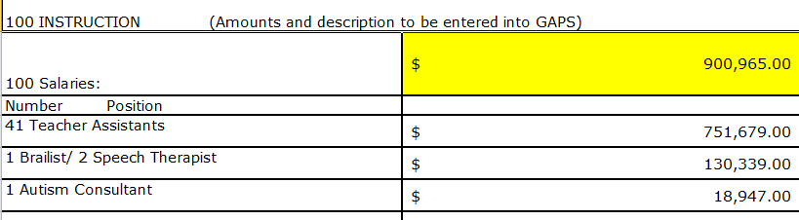
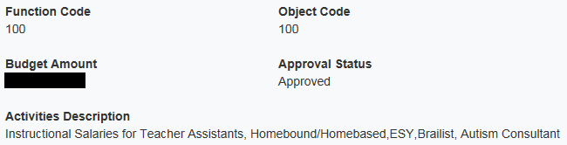
Activities Description
Old (Paper)
New (GAPS)
Ensure that your budget items have the same level of description as when Districts were required to submit paper applications.
Please use the “Activities Description” area to enter a detailed description.
Under 100; 100: Activities Description should detail that it will cost $900,965.00 to fund “41 Teacher Assistants, 1 Brailist, 2 Speech Therapists, and 1 Autism Consultant”.

Slide 16
Next Steps
After you’ve entered your budget into GAPS, your budget will be sent to your finance office, and then to SCDE.
Please remember to log in to GAPS to see the status of your budget.
  Ensure that your budget has been processed through your finance office.

Slide 17
Checklist

Slide 18
Please make sure that your application is complete.
GAN signed and returned
Assurances signed and returned
Terms and Conditions signed and returned
Lobbying Certification signed and returned
Evidence of meaningful consultation
Grant application cover page signed by all
PPPSC calculation has been completed without errors
  Minimum required amount (or more) has been added to budget in GAPS
CEIS plan included (required if you budget CEIS funds)
Fiscal is signed and has been completed without errors or missing items
  MOE is equal or larger than previous year
  Excess cost is correctly calculated
  Last page is correctly calculated
GAPS budget has been entered
  A detailed Activities Description has been completed for each budgeted item

Slide 19
Movement of PPPSC Funds
FY 16 – Your districts required amount of PPPSC funds cannot be moved until August 1, 2017.
  If your District has budgeted more than the required amount, the District may move the overage.
“Under 34 CFR §300.133(a), each LEA is required to spend a minimum amount of its subgrant under Part B of the IDEA on children with disabilities placed by their parents in private elementary and secondary schools. As provided in 34 CFR §300.133(a)(3), if an LEA has not expended all of the proportionate share of its Part B subgrant by the end of the fiscal year for which Congress appropriated the funds, the LEA must obligate the remaining funds for special education and related services to children with disabilities placed by their parents in private schools during a carry-over period of one additional year. A reduction in the number of children, for example, when a school closes after the start of the school year, does not excuse the LEA from spending its proportionate share to provide equitable services to children with disabilities placed by their parents in private schools.”

Slide 20
GAPS Training
Online Video presentations can be viewed at any time at:
http://www.ed.sc.gov/agency/cfo/finance/Grants-Accounting/

