Slide 1

District Consolidation: Office of Career and Technical Education
#FUTUREREADYCTE

Slide 2
CTE in SC & Perkins V

Slide 3
What Does Perkins V Do?
Perkins is a federal education program that invests in secondary and postsecondary CTE programs in all 50 states and the territories
Perkins is dedicated to increasing learner access to high-quality CTE programs of study
Perkins is critical to ensuring programs meet the ever-changing needs of learners and employers

Slide 4
What do Perkins funds support?
A variety of activities, including:
  CTE Programs
  Programs of Study
  Career exploration, guidance and advisement
  Professional development
  Technical assistance
  Data collection and analysis, including program and plan evaluation and monitoring

Slide 5
Perkins V Federal Funding

Slide 6
Flow
Federal Allocation Formula
30% Based on 5 – 17 Title I (census) population data
70% based on age 5 – 17 Title I (census) poverty data
Funding may increase or decrease as a result of consolidation.
Notes:
SC Department of Education is the eligible fiscal agency managing both secondary and community college CTE.
Local eligible agencies (independent school districts, multi-district career centers, and community colleges receive 85% of the allocation, shared secondary 68% and post-secondary 32%.
The remaining 15% is being retained for state leadership and administration
There are a total of 100+ eligible secondary recipients (school districts and multi-district career centers) and 16 post- secondary recipients (community colleges)

Slide 7
Federal Perkins Allocations - Subfund 207
Budget built in GAPS to support State Approved CTE Courses
15 month grant ends on September 30th
Reimbursement only
Federal funds do not carry forward

Slide 8
Legacy District Claiming
The individual (i.e., legacy) district can make claims for the open FY22 grants for any expenditures that occurred before June 30, 2022.
The individual district can make claims in GAPS through August 15, 2022; however, these are only for expenditures that occurred through June 30, 2022.

Slide 9
Deobligation and Re-Issue
Pre-consolidation claims can be filed in GAPS through August 15, 2022, deobligation will typically occur shortly after.
Any unclaimed funds left by the individual district(s) will be issued to the newly consolidated district.
Legacy districts are encouraged to spend and claim as much as possible from FY22 prior to June 30!

Slide 10
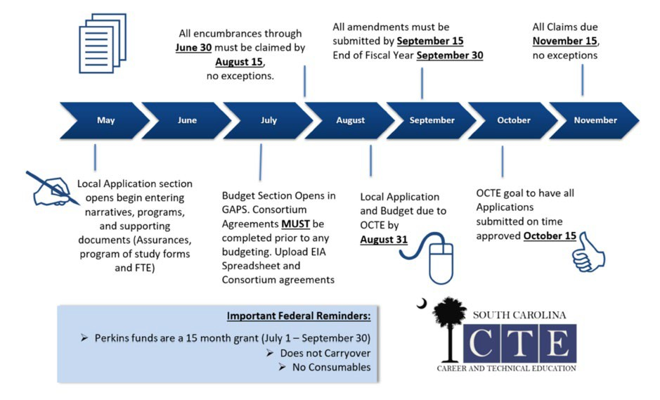
Perkins V Workflow and Timeline
#FUTUREREADYCTE

Slide 11
State CTE Funding

Slide 12
Education Improvement Act (EIA) - Subfund 329
State EIA Career and Technical Equipment Funding Technology Education is listed as Proviso 1A.60. (SDE-EIA: Career and Technology Education).
Funds distributed to school districts and multi-district career centers based on the prior year student enrollment for career and technical education courses
No district or multi-district career center receiving less than $50,000
Budget not entered into GAPS

Slide 13
State Education Improvement Act (EIA)
Subfund 329 - Use of Funds:
  The purchase of career and technical equipment
  The up-fitting of facilities and the purchase of consumables
  Regional career specialists
  Evidence-based initiatives - High Schools that Work and Project Lead the Way
  State funds Carryover for an additional 12 months

Slide 14
Industry Certifications & Credentials
State EIA Industry Certifications & Credentials Funding is listed as Proviso 1A.63.
Subfund 328 - Allocation Formula:
The funds appropriated for Industry Certifications/Credentials must be allocated to school districts based upon the number of national industry exams administered in the prior school year.
Consolidated district will receive $10,000 base in October
Additional allocation based on Proviso dispersed in February
State funds Carryover for an additional 12 months

Slide 15
Industry Certifications & Credentials
State EIA Industry Certifications & Credentials Funding is listed as Proviso 1A.63. (Certifications Administered to Completers entered into PowerSchool) – (Subfund 328)
All certifications and credentials listed in the Student Reporting Procedures Guide are allowable uses of funds
The Student Reporting Procedures Guide is available online

Slide 16
Consolidation Considerations

Slide 17
Planning for Consolidation
Consolidating districts need to determine point(s) of contact for all CTE administration, programming and data (i.e. PowerSchool)
Each consolidating district should have obtained a DUNS number through SAM.gov
Consolidating districts need to spend and claim remaining funds prior to consolidation

Slide 18
Technical Assistance
Technical Assistance is available for all LEAs.
Technical Assistance purpose is to ensure that the LEA has the tools to ensure all State and Federal CTE guidelines are met.
We encourage the consolidating districts to reach out and let us support you through the transition

Slide 19

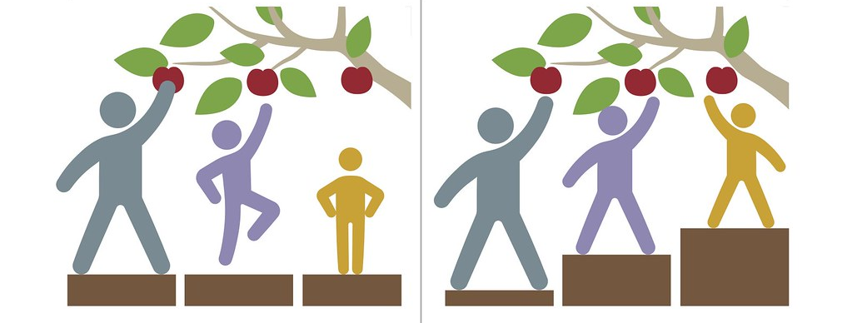
CTE - Supporting Access and Success
All students graduate prepared for success in college, careers, and citizenship.

Slide 20

Q & A

Slide 21
Contact Information
Office of Career and Technical Education
Maria Swygert, Team Lead
nmswyger@ed.sc.gov
803-734-8456

Slide 22

Thank you

