Slide 1
Incident Management Training 101
Aveene Coleman, Student Intervention Services Kimberly Smith, Student Intervention Services
Carolyn Bostick, Special Education Services
Tameka Legrant, Office of Research and Data Analysis

Slide 2
Incident Management System
All discipline and truancy data must be reported in Incident Management System for the 2018-19 school year.
Security is set by groups
Discipline and Truancy
Data from Incident Management will be used to compile the state and federal reports listed above, it is critical that all data entered be reviewed and verified for accuracy.
It is important that all discipline and truancy data are coded in Incident Management and not log entries.
Do not add additional codes to Incident Management. To request a new code please send an email to acoleman@ed.sc.gov.

Slide 3
Required Fields for Coding
Incident Management Required Fields
Participants
Offender
Victims- Bullying-Level Physical Injury
Behavior Codes
Action Codes
Removal Type
Action Date Range
Duration Code
Object Codes
Subcodes dropdown
Incident Elements

Slide 4
Required Fields for Coding
Actions
Record the Type of Removals
Record Subcodes for Type of Removal
Provide the Duration of the Removal
Must be Associated with the Behavior

Slide 5
Incident Management Coding 101
Reminder: Behavior Code must be dragged and dropped on the top of the participant’s name. The Action Code must be dragged and dropped on the top of the behavior.
Offender Name Behavior (must be dragged and dropped on Participants name) Action (must be dragged and dropped on the behavior)
Additional Behavior (must be dragged and dropped on Participants name) Action(must be dragged and dropped on the behavior.
The incident below was coded using Chrome.

Slide 6
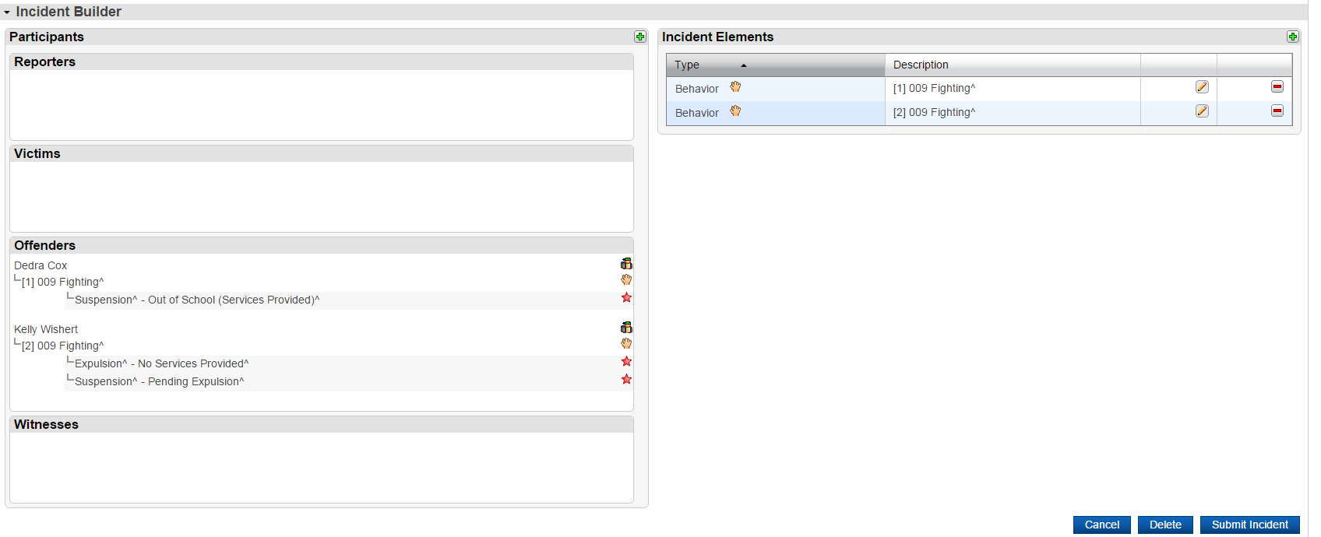

Properly Coded Incident

Slide 7
Incident Management 101
School grounds
School Events
School Transportation

Slide 8
Federal Reporting Requirements
Every Student Succeed Act (ESSA) Discipline Reporting will be based on Office of Civil Rights (OCR) Reporting:
All Suspensions and Expulsions (all offenses)
School-related arrests
Arrested (ARR)
Referrals to law enforcement
Call to Law Enforcement (CTL)
In-School Suspension (all offenses)
Incidences of violence including bullying and harassment

Slide 9
Federal Reporting Requirements
Office of Civil Rights Definitions
Referral to law enforcement is an action by which a student is reported to any law enforcement agency or official, including a school police unit, for an incident that occurs on school grounds, during school-related events, or while taking school transportation.
School-related arrest refers to an arrest of a student for any activity conducted on school grounds, during off-campus school activities (including while taking school transportation), or due to a referral by any school official. All arrests are considered referrals to law enforcement

Slide 10
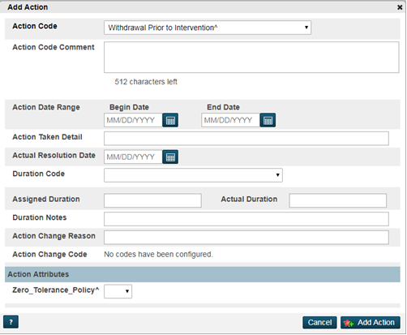

What’s new in IM for 2018-19?
New Action Code
Withdrawal Prior to Intervention-WPI

Slide 11
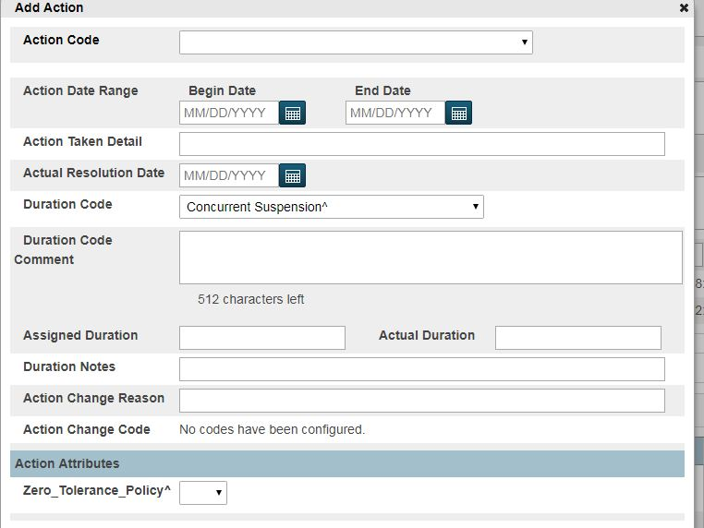
What’s new in IM for 2018-19?
New Duration Code
Concurrent Suspension should be used when using the Concurrent Action Code

Slide 12
Federal Discipline Reports
EDFacts File | Data | Reporting Format
FS005 | Children with Disabilities (IDEA) Removal to Interim Alternative Educational Setting | Table 5
FS006 | Children with Disabilities (IDEA) Suspensions/Expulsions | Table 5
FS007 | Children with Disabilities (IDEA) Reasons for Unilateral Removal) | Table 5
FS088 | Children with Disabilities (IDEA) Disciplinary Removals | Table 5
FS143 | Children with Disabilities (IDEA) Total Disciplinary Removals | Table 5
FS144 | Educational Services During Expulsion | Table 5
FS086 | Students Involved with Firearms | PowerSchool
FS163 | Discipline Data | PowerSchool
Notes:
New slide

Slide 13
Federal Reporting Requirements
Uniform Management Information Reporting System (UMIRS) is a data collection system required by ESSA
510- Aggravated Assault
610- Forcible Sex Offense
640- Homicide
570- Drug Distribution
575- Drug Usage
580- Drug Possession
660 Kidnapping/abduction
730- Robbery
All three codes will be reported in federal and state reports.

Slide 14
Federal Reporting Requirements
789 Weapons (Specify in Objects)
Subcodes for Weapons
780- Other Weapons
781- Handguns
782- Rifles/Shotguns
783- Other Firearms
784-Knife Blade> 2 inches (State)
785- Knife Blade>2.5 inches (Federal)
Object Subcodes for Weapons must be coded.
Action Taken must be coded

Slide 15
Federal Reporting Requirements
650-Intimidation
651- Bullying
652- Cyberbullying
151-Truant
152- Habitual Truant
153- Chronic Truant
Intervention Plan
Family Court Referral
Violation of Court Order
009 Fighting
012 Harassment*
260 Bomb Threat
An incident number should be assigned to the student who is truant. No student should have the same incident number as it relates to truancy.

Slide 16
South Carolina’s Model Policy Harassment, Intimidation or Bullying
Purpose The Model Policy Prohibiting Harassment, Intimidation or Bullying has been developed in compliance with 2006 S.C. Act 353 (to be codified at S.C. Code Ann. 59-63-110, et.seq.). This act requires each local school district to adopt a policy prohibiting harassment, intimidation, or bullying at school. This model policy is provided for use by school districts as a possible guide for the development of policies for the prevention of harassment, intimidation or bullying that are applicable to grades kindergarten through twelve. The local school board should ensure that the school district’s policy is included in the school district’s publication of the comprehensive rules, procedures, and standards of conduct for schools and in the student’s handbook.

Slide 17
South Carolina’s Model Policy Harassment, Intimidation or Bullying
The school district shall involve parents and guardians, school employees, volunteers, students, administrators, and community representatives in the process of creating the policy
Statutory Requirement The policy must include a definition of harassment, intimidation or bullying no less inclusive than the definition in Section 59-63-120 (see below). Model Policy Language The district board of trustees establishes that "harassment, intimidation or bullying" means a gesture, an electronic communication, or a written, verbal, physical, or sexual act that takes place on school property, at any school-sponsored function where the school is responsible for the child or on a school bus or other school-related vehicle, at an official school bus stop and that: a) a reasonable person should know, under the circumstances, that the act(s) will have the effect of harming a student, physically or emotionally, or damaging the student’s property, or placing a student in reasonable fear of harm to his person or damage to his property; or b) has the effect of insulting or demeaning any student or group of students in such a way as to cause substantial disruption in, or substantial interference with, the orderly operation of the school.

Slide 18
South Carolina’s Definitions Harassment, Intimidation or Bullying
SECTION 59-63-120. Definitions. As used in this article: (1) "Harassment, intimidation, or bullying" means a gesture, an electronic communication, or a written, verbal, physical, or sexual act that is reasonably perceived to have the effect of: (a) harming a student physically or emotionally or damaging a student's property, or placing a student in reasonable fear of personal harm or property damage; or (b) insulting or demeaning a student or group of students causing substantial disruption in, or substantial interference with, the orderly operation of the school. (2) "School" means in a classroom, on school premises, on a school bus or other school-related vehicle, at an official school bus stop, at a school-sponsored activity or event whether or not it is held on school premises, or at another program or function where the school is responsible for the child.

Slide 19
Federal Reporting Requirements
South Carolina public school or charter school will be considered "persistently dangerous“ if its conditions expose students to injury from violent criminal offenses for a period of three consecutive years. The Unsafe School Choice Option—which is mandated by Section 9532 of the Elementary and Secondary Education Act (ESEA) of 1965, as amended by the ESSA(Incidences of Violence)
Required Fields
640- homicide,
610- forcible sex offenses,
660- kidnapping/abduction,
510- aggravated assault,
570- drug distribution,
575- drug usage
580- drug possession
730- robbery
780, 781, 782, 783, 784, 785 weapons offenses

Slide 20
Federal Reporting Requirements
Guns Free Act
Number of Incidents
781-Handguns
782-Rifles
783-Other Firearms
Indicate the total Number of Incidents involving students who brought firearms to or possessed firearms at school and the type of weapon involved.
Indicate the Number of Students Expelled from school for possessing a firearm
Indicate the number of Expulsions by Elementary, Middle and High School by Types of Firearm

Slide 21
Federal Reporting Requirements
Total number of District Expulsions, how many were shortened to less than one year
How many of the Total Number of District Expulsions were not modified (Less than 365 days)
Number of Modified Expulsions reported above, how many resulted in a referral of the student to an alternative school or program
Number of Non-Modified Expulsions reported above, how many resulted in a referral of the student to an alternative school or program

Slide 22
Federal Reporting Requirements
Number of Modified expulsions reported above, how many were students with Disabilities as defined in Section 602(3)(A)
Number of Modified expulsions reported above, how many were students without disabilities as defined in Section 602(3)(A)
How many of the District Expulsions were with and without services for all students with and without disabilities

Slide 23
Federal Reporting Requirements
Table 5: Report of Children with Disabilities Subject to Disciplinary Removal
PowerSchool IM Fields
Incident Date
Participant Role
Last, First, Middle Names
Action
Action Subcodes
Duration
Behavior Codes (IAES Actions)
Behavior Subcodes (IAES Actions)
Object Code (Behavior = Weapons)
Object Subcode (Behavior = Weapons)
PowerSchool SC Specific Fields
(Include in IM Query)
Gender
English as a Second Language (ESL)
Ethnicity/Race
Special Education Status
Instructional Setting
Enrich Fields
Primary Disability
State ID
Last, First, Middle Names
Initial Placement Date
Exit Date
Matching PS + Enrich Data
Link Primary Disability
Compare Active Dates to Incident Date
Notes:
edited

Slide 24
Federal Reporting Requirements
Table 5 Reporting Components:
Unilateral Removals to an Interim Alternative Educational Setting by School Personnel by disability, race/ethnicity, Gender, ESL (Action: Removal Type = IAES + Removal subcode = Unilateral)
Number of Children
Number of Removals for Drugs (Behavior)
Number of Removals for Weapons (Behavior + Object)
Number of Removals for Serious Bodily Injury (Behavior)
Removals to an Interim Alternative Educational Setting Based on a Hearing Officer Determination Regarding Likely Injury by disability, race/ethnicity, Gender, ESL
Number of Children (Action: Removal Type = IAES + Removal Subcode = HRO)

Slide 25
Federal Reporting Requirements
Out-of-School Suspensions or Expulsions by disability, race/ethnicity, Gender, ESL (Action: Removal Type + Removal Sub-Code)
Number of Children with Out-of-School Suspension/Expulsions Totaling 10 Days or Less (DurationDayValue)
Number of Children with Out-of-School Suspension/Expulsions Totaling >10 Days (DurationDayValue)
In-School Suspensions by disability, race/ethnicity, Gender, ESL (Action: Removal Type + Removal Sub-code)
Number of Children with In-School Suspensions Totaling 10 Days or Less (DurationDayValue)
Number of Children with In-School Suspensions Totaling >10 Days (DurationDayValue)

Slide 26
Federal Reporting Requirements
Disciplinary Removals (Action: Removal Type + Removal Sub-Code)
Total Disciplinary Removals by disability, race/ethnicity, Gender, ESL (Student ID + Incident ID)
Number of Children with Disciplinary Removals Totaling 1 Day
Number of Children with Disciplinary Removals Totaling 2-10 days
Number of Children with Disciplinary Removals Totaling >10 Days
(DurationDayValue)
Children Subject to Expulsion by Children with Disabilities Ages 3-21 and Children without Disabilities, Grades K-12
(Instructional Setting + Incident Date + Removal Type)
Received Educational Services During Expulsion
Did Not Receive Educational Services During Expulsion
(Removal Sub-Code)

Slide 27
Incident Management Coding
All incidents coded must have an offender associated with the incident.
All incidents coded must have a behavior associated with the offender.
All incidents coded must have an action associated with the behavior.
All removals must be coded with removal type, subcode if applicable, and duration.
All IAES removals must have behavior and/or object codes with any corresponding subcodes to indicate if the removal was for drugs, weapons, serious bodily injury, or by a hearing officer for likely injury to self or others.

Slide 28
Federal Reporting Requirements Reminders
An incident involving more than one school district, for example, at a sporting event between two districts.
If the incident resulted in the removal of one or more students in each school district, the incident would be reported by both district.
If only one district remove a student(s) as a result of the incident, only that district would report the incident. (Federal Reporting guidance)
An incident involving more than one student in the same district in different schools, the incident will be reported where the incident occurred as one incident.
An incident involving more than one student in the same school, the incident is reported as one incident where the incident occurred.

Slide 29
Incident Management Coding
How should I code incident for the following scenario?
Two students involved in a fight at one high school, but one student attends another high school in the district.
Code as one incident at the high school in which the incident occurred
Code all participants under the one incident
Make sure you assign the role offender(s) and victim(s) for each participant
Make sure you code the behavior for each participant
Make sure you code the action taken by associating it to the behavior for each participant
Make sure in the attributes you code the school for each student.

Slide 30
Incident Management Coding 101
Reminder: Behavior Code must be dragged and dropped on the top of the participant’s name. The Action Code must be dragged and dropped on the top of the behavior.
Offender Name Behavior (must be dragged and dropped on Participants name) Action (must be dragged and dropped on the behavior)
Additional Behavior (must be dragged and dropped on Participants name) Action(must be dragged and dropped on the behavior.
The incident below was coded using Chrome.

Slide 31
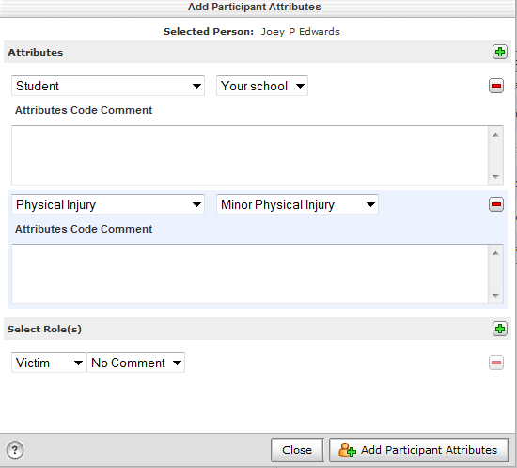
Federal Reporting Requirements Reminders
An incident involving more than one student in a different school in the same district, each student’s school should be selected in the attribute section.

Slide 32
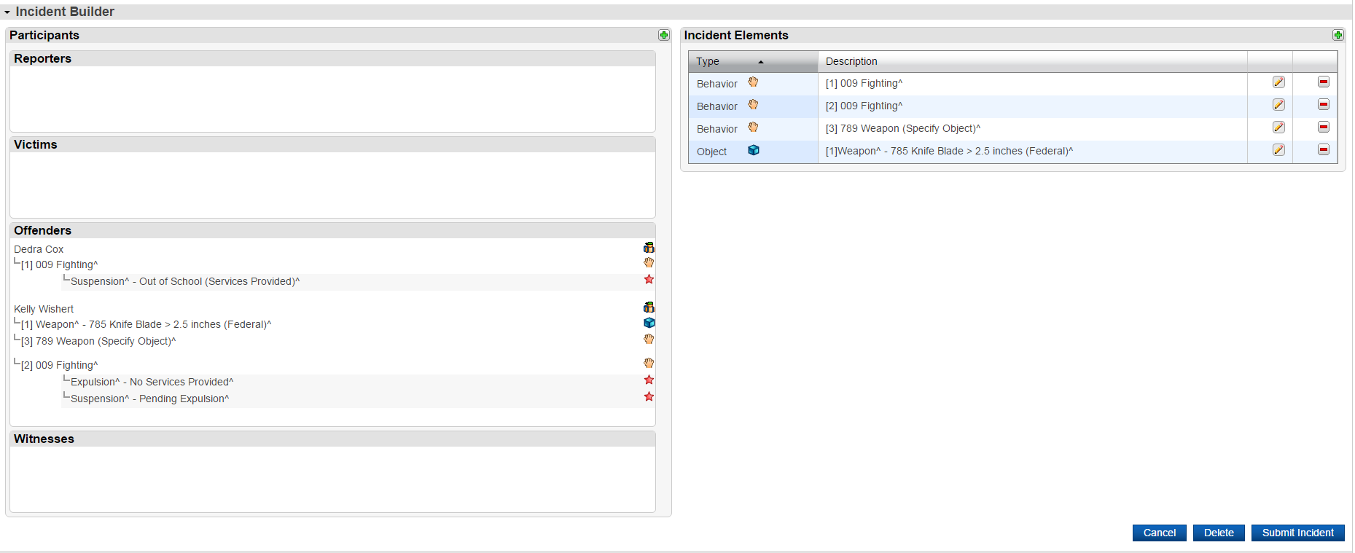
Incident Management Coding

Slide 33
Incident Management Coding
How should I code incident for the following scenario.
Three Students are involved in a fight at one high school.
Code as one incident
Code all Three participants under the one incident
Make sure you assign the role offender(s) and/or victim(s) for each participant
Make sure you code the behavior for each participant
Make sure you code the action taken by associating it to the behavior for each participant

Slide 34
Incident Management Coding
If there is more than one discipline reason for removal of students from their regular education program for discipline (Suspension and Expulsion). How will the state count the incident? The state will use the federal hierarchy:
Violence with physical injury
Violence without physical injury
Weapons possession
Drugs
Alcohol
Note: To code physical injury make sure you select the participant attributes then code the subcode to indicate the level of injury.

Slide 35
Incident Management Coding
All SUX-Pending Expulsion should be resolved before the 180th day reporting.
All SPC-Pending Parent Conference should be resolved and updated before the 180th day reporting.
When coding 789 Weapons you must coded a sub code and action taken. (Subcodes 780,781, 782, 783, 784, 785, & 786)

Slide 36
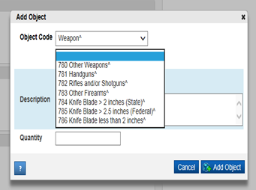
Incident Management Coding
Weapon Coding-Adding Object

Slide 37
Federal Reporting Requirements Reminders
All weapons incidents must have a final action. All of the following are weapons incident:
781-Handguns
782-Rifles
783-Other Firearms
Please note that a call to parent is not a final action for the incidents listed above.
Summer Incidents occurring after July 1st that results in a school removal for the 2018-19 school year, will be reported in the 2018-19 school year data collection.

Slide 38
Incident Management Coding
Do not use students names in the title or Suns ID.
Toy bullets, toy guns, toy cap guns, toy pellet guns should be coded as 789 Weapons-OBJ Misc. Objects. Do not code as 781,782, & 783.
BB Guns should be coded as 789 as Other Weapons-sub code Other Weapon-sub code 780-Other Weapons.
783-Other Firearms – examples- devices designed to expel a projectile, grenade, explosive
Fireworks should be coded as 010 Fireworks.(page 40 IM Guide)
780-Other Weapons- examples- razor blade, ice pick, Chinese star, chain, brass knuckle, billy club, stun gun, mace, tear gas, hatchet, Taser, pepper spray

Slide 39
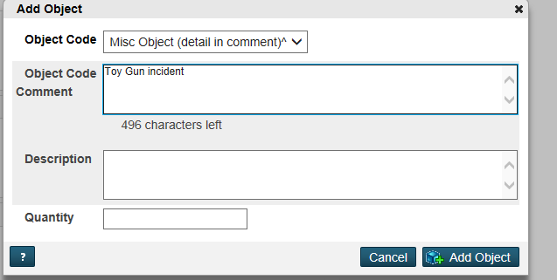
Weapon Coding-Misc. Object
Adding Misc. Object

Slide 40
Incident Management Coding
Do not add additional codes to Incident Management System. Align your district's codes to the available codes in the system.
No student should have 12 incidents in one day coded.
Incidents must be coded with attributes for each student.
Tardies are not considered Truancy. The tardy code of 180 should be used for excessive tardies.

Slide 41
Incident Management Coding Definitions
Fighting- Federal Spec. Definition
Mutual participation in an incident involving physical violence where there is no major injury.
Aggravated Assault
Victim suffers
Broken bones, loss of teeth, possible internal injury, severe laceration, loss of consciousness.
Full definition can be found on page 37 of IM manual.

Slide 42
Incident Management Coding Definitions
Physical Injury-Federal Spec. Definition
Incidents with injury include those in which one or more students, school personnel or other persons on school grounds required professional medical attention.
Examples: concussion, fractured or broken bones, cuts requiring stitches, stab or bullet wounds

Slide 43
Federal Reporting Requirements Reminders
An incident that is coded as an Aggravated Assault should have a physical injury coded.

Slide 44
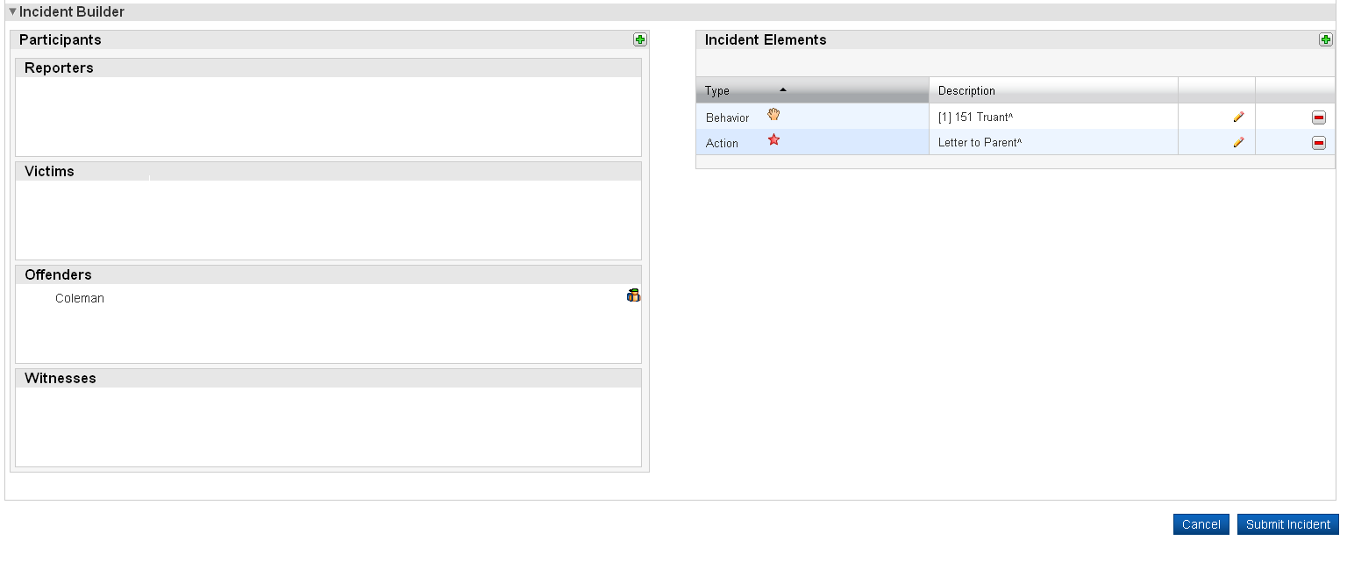

Incident Management Coding
If the incident does not have an element under the offender the incident is improperly coded

Slide 45
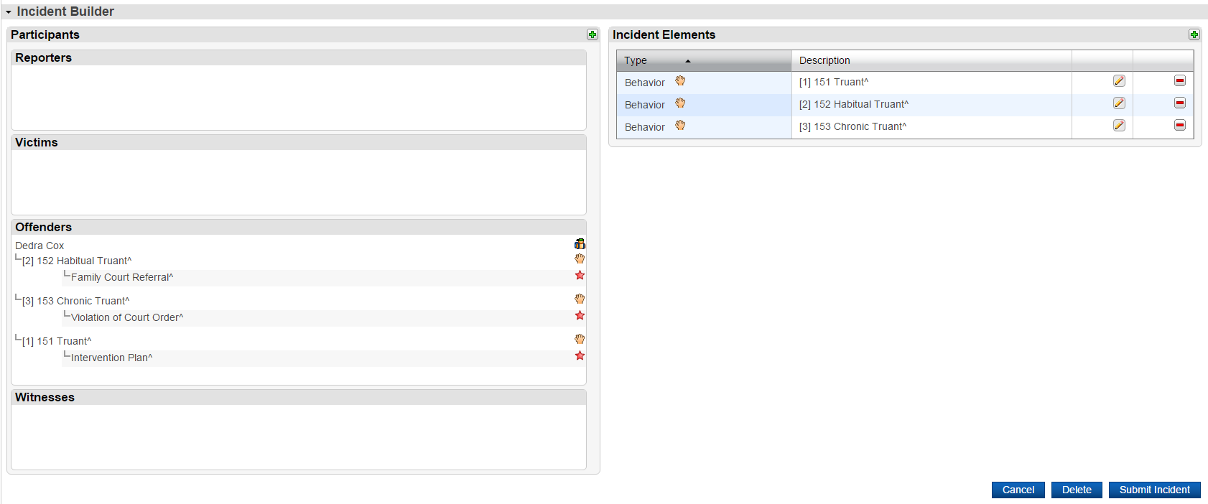
Action Association
Actions must be associated with the Behavior for the removal and duration to generate on reports and the IM Query.

Slide 46

Reviewing Incident Data and Reports
During the 2018-2019 school year the Incident Reports will be posted in ADT or Secure SFTP Server at 45th day, 90th day, 135th day and 180th day.
District should review data at the end of each quarter to ensure that the totals match the reports in Incident Management.
Districts should review the IM Query data to ensure no incident components are missing, invalid, or require updating or level data reports.
ADT reports will provide the total count of incidents reported by your districts.
ADT reports will provide an overall count of incidents reported by all school in the district based on the quarterly reports submitted to SCDE.

Slide 47
Reviewing Incident Reports in ADT
ADT reports will be updated to include-ARR, CTL, and In-School Suspension information
Districts should review all incidents reported as Homicides and Kidnapping to ensure this information is coded correctly.
Reports are available in Incident Management:
Staff Referral Report
Discipline By Behavior
Discipline Frequency Report

Slide 48
IM Data Review Tools
Level Data Validation
ADT-Advance Data Transfer

Slide 49

IM Data Validation
Error Reports delivered in PowerSchool directly to the school
Instant feedback with error corrections
Direct link to the incident
Review the Level Data Validation

Slide 50
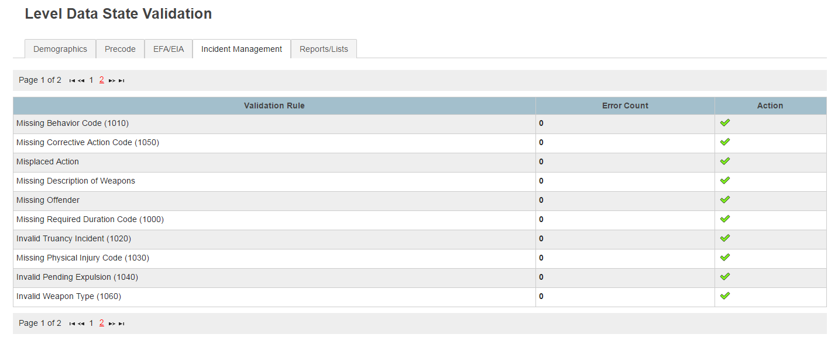
Level Data State Validation

Slide 51
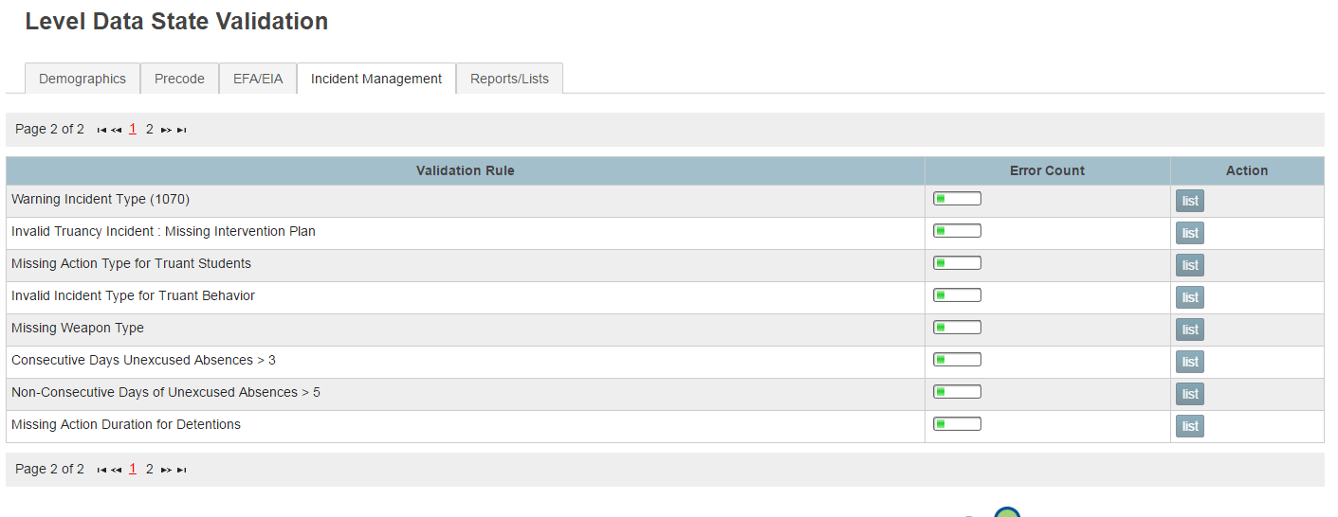
Level Data State Validation

Slide 52
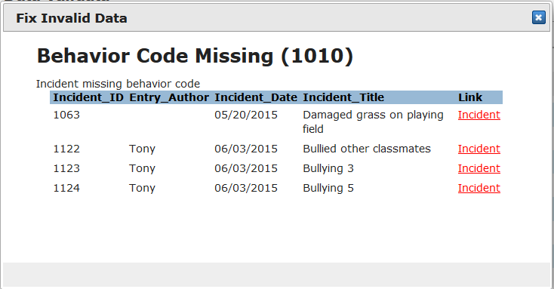
Level Data Validation Reports

Slide 53
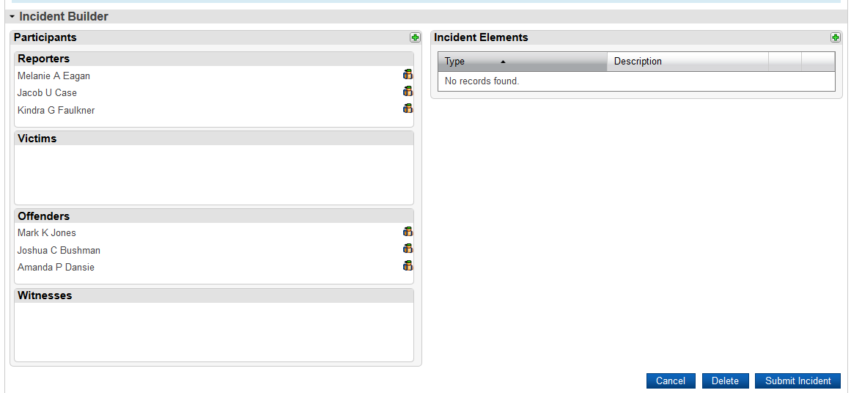
Level Data Validation Reports

Slide 54
Level Data Validation Tips
Make sure you click on the incident link to make updates
Review the incident for additional errors such as:
Missing Action Codes
Missing Object Codes
Missing Duration Code
Pending Expulsion (no final outcome)
Make sure you click the submit button to update changes made to the incident
Make sure you reload the tab once corrections are made to update the totals

Slide 55
Discipline Data for Reporting
Reports should be reviewed for the following errors:
Error Code | Error Message
1000 | Duration code missing. All expulsions require a duration code (Refer to IM Guide page 21).
1010 | Behavior code missing. All incidents require at least one behavior code. (Note: Make sure that you dragged and dropped the behavior code on top of the participant) (Refer to IM Guide page 8).
1020 | More than one student per Truancy incident. Create a separate incident for each truant student.
1030 | Physical Injury code missing. Participant Attributes is missing (Refer to IM Guide page 15).
1040 | All pending expulsions should be updated to the final outcome (e.g., Expulsion, Alternative School, OSS, Overturn Expulsion or other outcome (Refer to IM Guide page 28-30).
1050 | All incidents require some type of action.
1060 | Missing Weapon Object from a '789' Weapon incident (Refer to IM Guide page 22).
1070 | Warning - Please confirm Homicide and Kidnapping incidents. Double check the coding to ensure for accuracy.

Slide 56
IM Reports ADT-ISS Report
Please review the new reports:
School ID | School Name | Students w/ISS | Total Suspensions | Students ISS % | Total Students
 | ABC Middle | 31 | 48 | 3.3% | 945
 | ABC High | 310 | 546 | 18.4% | 1689
 | ABC Middle | 90 | 178 | 13.7% | 656
 | ABC High | 196 | 478 | 15.6% | 1259
 | ABC Elem | 12 | 15 | 2.0% | 613
 | ABC High | 278 | 670 | 14.6% | 1900

Slide 57
IM Reports ADT
Please review the new reports:
Total numbers of Arrest, Call to Law Enforcement
School Code | School | ARR Count | CTL Count | Total
 | ABC High | 37 | 0 | 37
 | ABC Middle | 0 | 2 | 2
 | ABC High | 0 | 2 | 2
 | ABC High | 10 | 2 | 12
 | ABC Elem | 0 | 2 | 2
 | ABC Middle | 0 | 3 | 3

Slide 58
IM Reports ADT
Please review the Suspensions report:
School ID | School Name | Students w/OSS | Total Suspensions | Students OSS % | Total Students
 | ABC Middle | 37 | 62 | 3.9% | 945
 | ABC High | 173 | 275 | 10.2% | 1689
 | ABC Middle | 68 | 119 | 10.4% | 656
 | ABC High | 175 | 521 | 13.9% | 1259
 | ABC Elem | 9 | 11 | 1.5% | 613
 | ABC Elem | 13 | 17 | 2.2% | 584
 | ABC Elem |  |  | 0.0% | 645

Slide 59

IM Reports in ADT for Table 5 Reporting
Click on Behavior Actions Tab in excel:
Reports can be filtered by:
Schools
Behaviors
Action Codes
Action Code Descriptions
Primary EFA code
Instructional Setting

Slide 60

IM Reports in ADT for Table 5 Reporting
Excel Report (Suspensions):

Slide 61

IM Reports in ADT for Table 5 Reporting
Excel Report (Expelled):

Slide 62

IM Reports in ADT for Table 5 Reporting
Excel Filter on Missing Duration Code:

Slide 63
IM Reports in ADT for Table 5 Reporting
Excel Filter on Race and Gender:
Gender | Race_H | Race_A | Race_B | Race_I | Race_P | Race_W | Grade
F | 0 | 0 | 1 | 0 | 0 | 0 | 7
F | 0 | 0 | 1 | 0 | 0 | 0 | 7
F | 0 | 0 | 1 | 0 | 0 | 0 | 7
F | 0 | 0 | 1 | 0 | 0 | 0 | 7
F | 0 | 0 | 1 | 0 | 0 | 0 | 7
F | 0 | 0 | 1 | 0 | 0 | 0 | 7
F | 0 | 0 | 1 | 0 | 0 | 0 | 7
F | 0 | 0 | 1 | 0 | 0 | 0 | 7
F | 0 | 0 | 1 | 0 | 0 | 0 | 7
F | 0 | 0 | 1 | 0 | 0 | 0 | 7
F | 0 | 0 | 1 | 0 | 0 | 0 | 7
F | 0 | 0 | 1 | 0 | 0 | 0 | 7
F | 0 | 0 | 1 | 0 | 0 | 0 | 7
F | 0 | 0 | 1 | 0 | 0 | 0 | 7

Slide 64
Incident Management Frequent Errors from 2017-18
At the 180th day the following errors were unresolved:
Missing Behavior Code
Missing Physical Injury Code
Invalid Pending Expulsion
Missing Corrective Action

Slide 65
Incident Management Frequent Errors from 2017-18 & 2016-17
2016-17
2017-18
Error Codes | Number of Districts/Special Schools | Total Number of Errors
1000 Missing Duration Code | 2 | 3
1010 Missing Behavior Code | 15 | 1716
1020 Invalid Truancy Incident | 0 | 0
1030 Missing Phys Injury Code | 3 | 17
1040 Invalid Pending Expulsion | 13 | 85
1050 Missing Corrective Action | 8 | 54
1060 Invalid Weapon Type | 4 | 7
1070 Warning Incident Type | 0 | 0
Error Codes | Number of Districts/Special Schools | Total Number of Errors
1000 Missing Duration Code | 10 | 30
1010 Missing Behavior Code | 17 | 249
1020 Invalid Truancy Incident | 1 | 2
1030 Missing Phys Injury Code | 6 | 65
1040 Invalid Pending Expulsion | 18 | 246
1050 Missing Corrective Action | 31 | 880
1060 Invalid Weapon Type | 11 | 44
1070 Warning Incident Type | 0 | 0

Slide 66
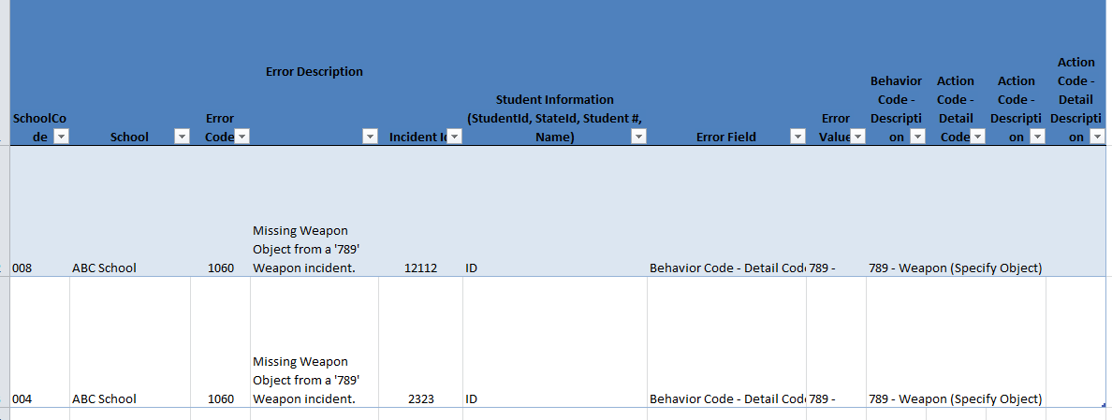
Reviewing Incident Data Reports- Report with Errors

Slide 67
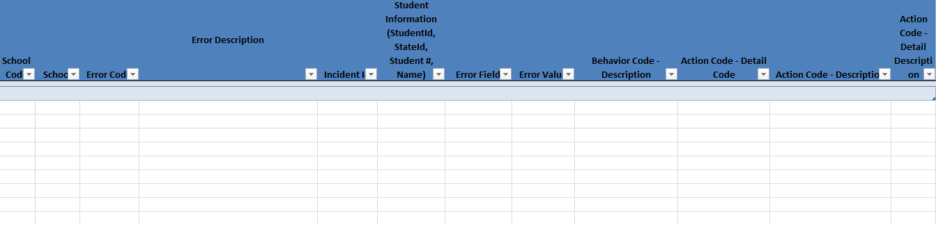
Reviewing Incident Data Reports Report without Errors

Slide 68
IM Resources
PowerSchool Incident Management User Training and Reference Guide
Incident Management Frequently Asked Questions
Truancy Coding Guide
Behavior Coding Guide

Slide 69

Questions/Break

Slide 70
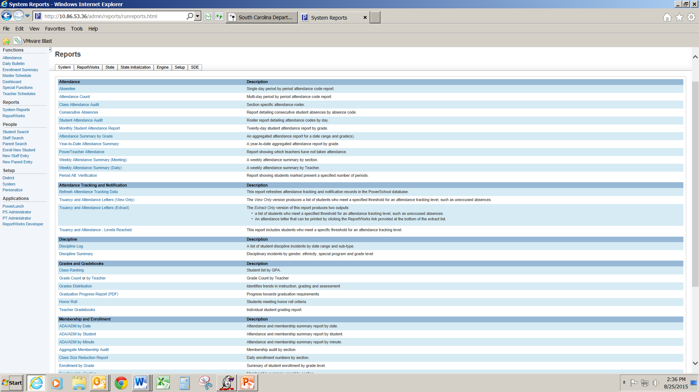
Incident Management Report Tab
SDE Tab

Slide 71
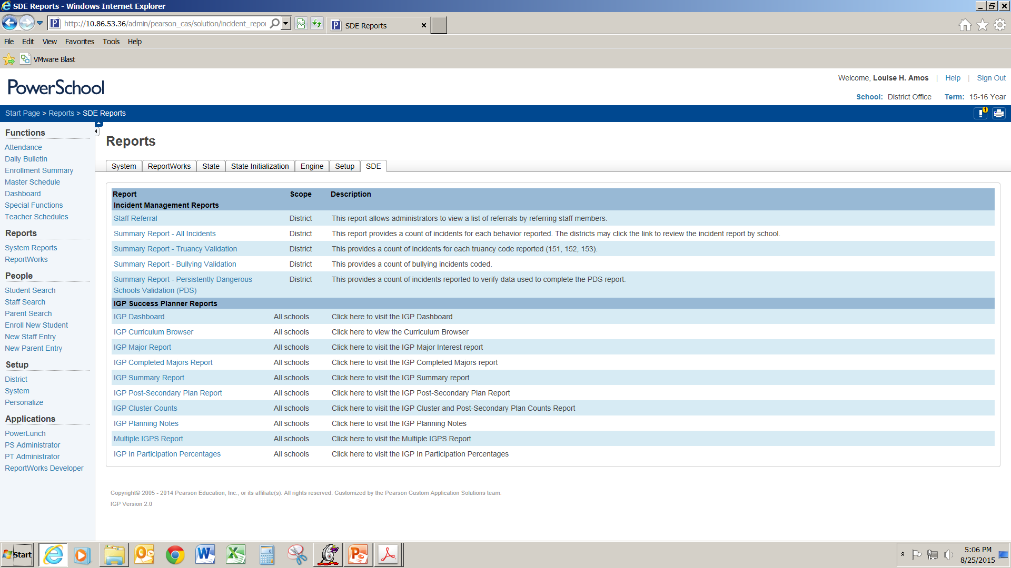
Incident Management SDE Reports Tab

Slide 72
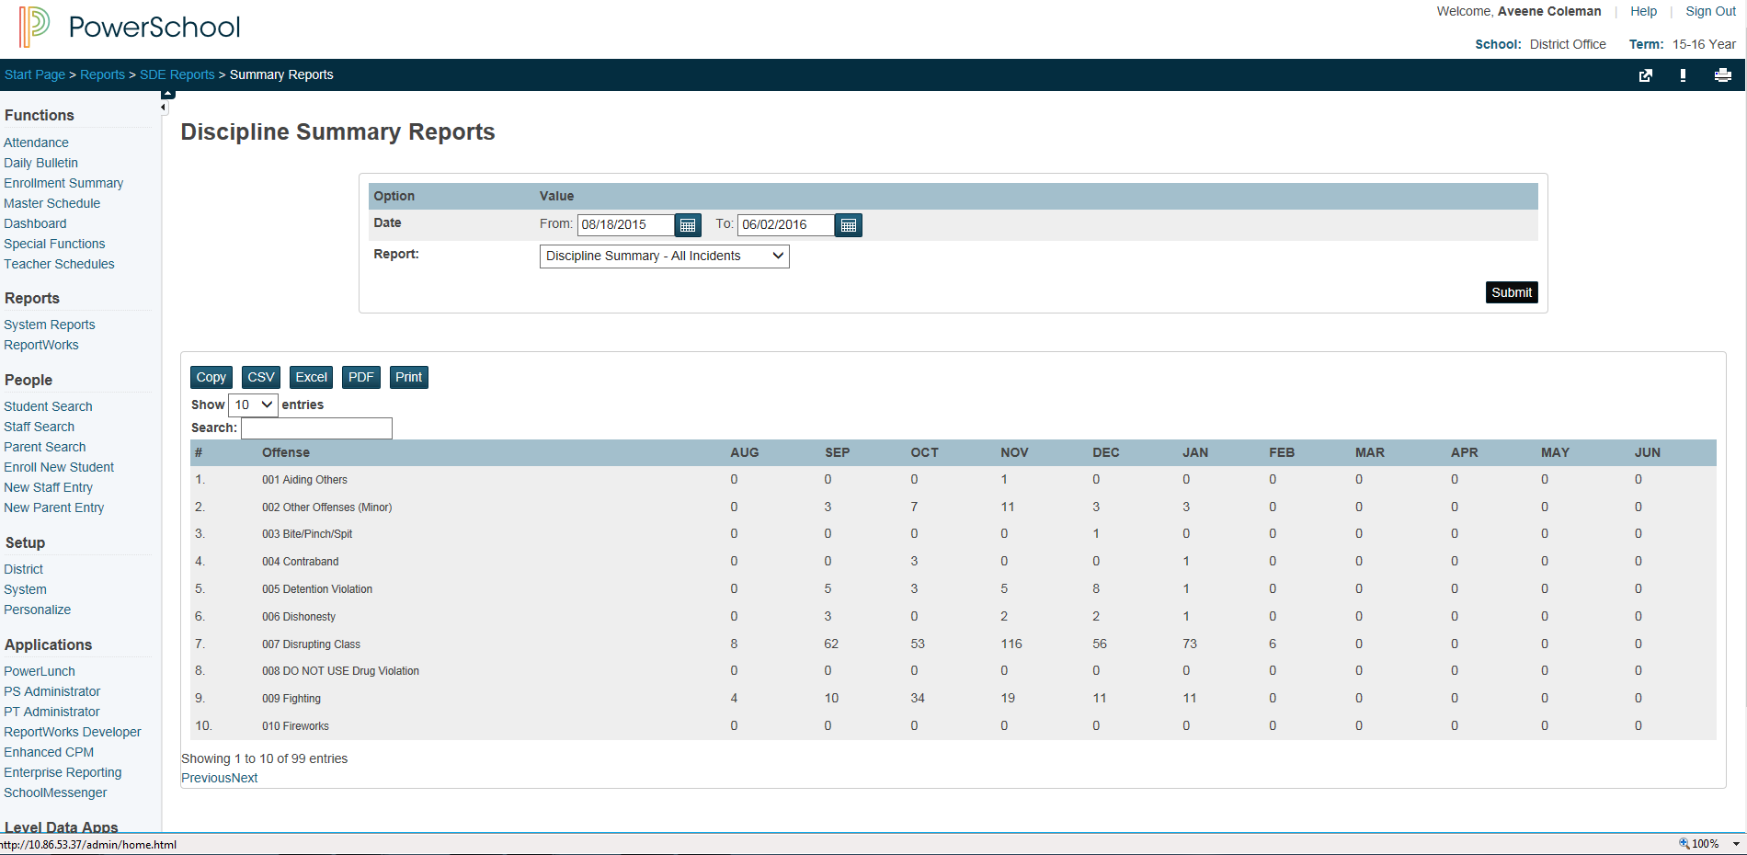
IM-Discipline Summary Report

Slide 73
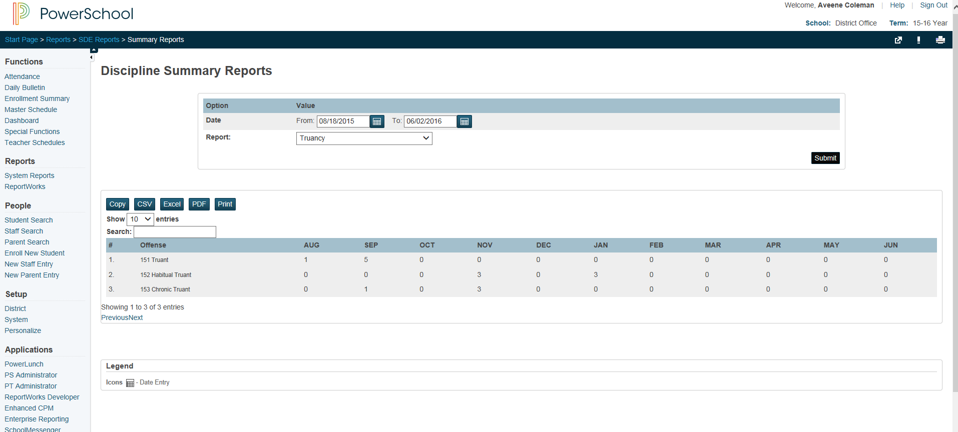
IM-Truancy Report

Slide 74
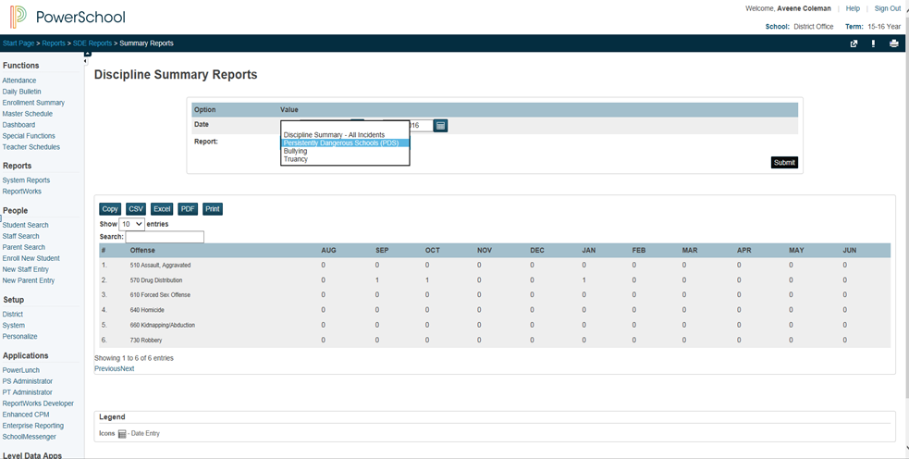
IM-PDS Report

Slide 75
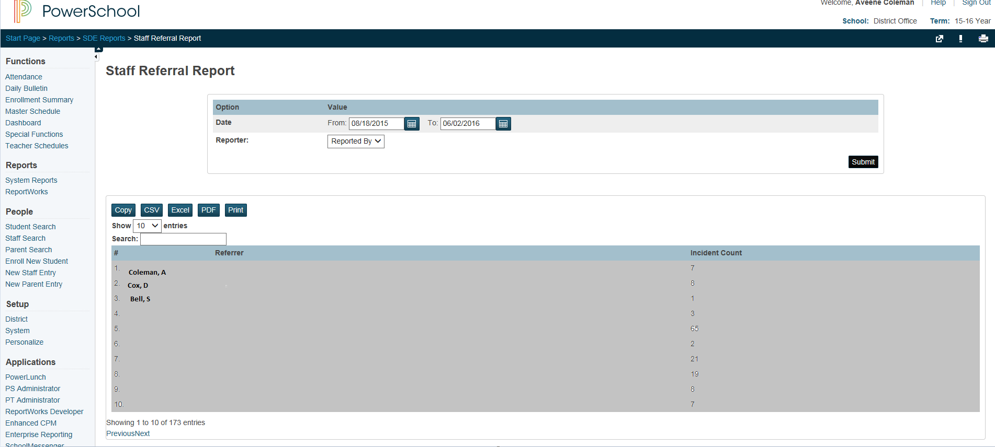
IM-Staff Referral Report

Slide 76
Discipline Data for Reporting
State Reports can be found:
https://ed.sc.gov/districts-schools/school-safety/discipline-related-reports/truancy-suspension-and-expulsion-data/

Slide 77
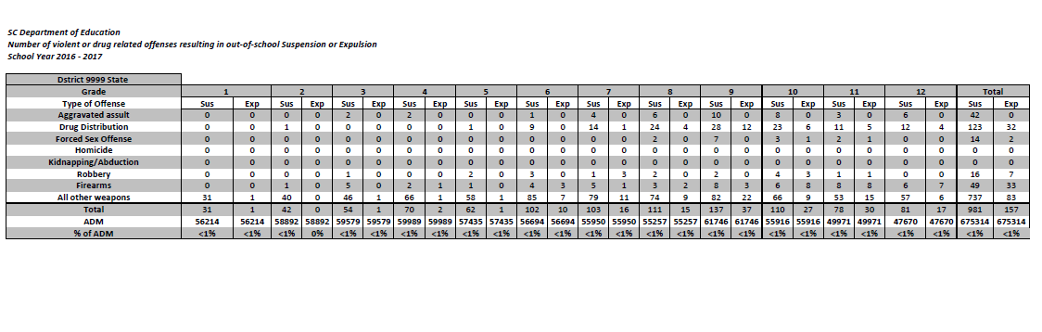
Suspension-Expulsion Data Information

Slide 78
IM Resources
http://ed.sc.gov/agency/ac/Student-Intervention-Services/
PowerSchool Incident Management User Training and Reference Guide
Incident Management Frequently Asked Questions
Truancy Coding Guide
Behavior Coding Guide

Slide 79
Live Tour of Incident Management System in PowerSchool

Slide 80
Questions??????

Slide 81
Incident Management Contact Information
Student Intervention Services
Sabrina Moore, Director, 803-734-8433 or smoore@ed.sc.gov
Aveene Coleman, Education Associate, 803-734-3057 or acoleman@ed.sc.gov
Kim Smith, Education Associate, 803-734-8113 or kwsmith@ed.sc.gov
Special Education Services
Carolyn Bostick, Education Associate, 803-734-1263 or cbostick@ed.sc.gov Internal Technology Services LEA IT Support Staff may submit an IT Support Request: https://eservices.ed.sc.gov

