Slide 1


Update: Division of College, Career & Military Readiness
Abbey Duggins, PhD
Deputy Superintendent
October 2, 2025

Slide 2
SCDE Mission & Vision
SCDE’S Mission:
We will accomplish our Mission and Vision by:
The mission of the South Carolina Department of Education is to serve students, support teachers, empower parents, and engage the community so that every student graduates prepared to reach their full potential.
Increasing student achievement (at least 75% or more of students at or above grade level in reading and math by 2030).
Recruiting and retaining the highest quality teachers in the profession and investing in teacher knowledge.
Ensuring a safe learning environment in all classrooms and campuses across our state.
Preparing students with the leadership and life skills that will build productive citizens who are workforce and/or military ready.
Engaging the community in creative, sustainable partnerships to serve and support our state’s public schools.
SCDE’S Vision:
Every South Carolina student graduates college-, career-, or military-ready. By 2030, at least 75% of students perform at or above grade level.
SCDE’S Tagline:
An excellent education for every child.

Slide 3
Policy Updates

Slide 4
Proviso 1.118 - Assessments for Final Grade Determination
This proviso prohibits districts from using any student's score on any district-selected benchmark assessment in calculating the student’s final grade. District-selected benchmark assessments, defined as required formative assessments, may only be used as formative assessments for informing instructional purposes unless the assessment is developed or directly approved by the course instructor and exclusively measures content that has previously been taught in the course.
2025-26 Formative Assessment FAQs
Q: If my district developed a common assessment using a question bank, can that assessment be calculated into students’ final grades?
A: Districts may use ungraded common assessments and benchmarks to inform instruction. If the district wishes to use a common assessment across schools and include the common assessment in student grades, the South Carolina Department of Education recommends the following practices to ensure alignment with Proviso 1.118.
Classroom teachers should be made aware of the assessment content and format well in advance of the expected administration of the assessment.
The district should clearly communicate the expectation that teachers have taught the content and adjust any common curriculum and pacing guides accordingly to align with the assessment content.
The district should clearly communicate the expectations for assessment implementation with enough time for teachers to incorporate the assessment into course planning.
Notes:
S78 to State Board (tenative) in September/October
S79 to State Board (tentative) in August/September depending on SLED/FBI Approval.

Slide 5
SC Ready Administration Days
In June, the SCDE notified districts that grades 3-5 SC Ready Math would be administered over two days for spring 2026 to conduct field testing. The two sections of the SC READY 3–5 math test must be administered in the same school week.
A vast majority of districts requested that we continue offering SC Ready ELA (grades 3-5) over two days (with a third day for writing)
The 3-day test format includes each of the following sections given on separate days: Writing, Reading Part A, and Reading Part B. The reading sections must be administered during the same school week.
The SC READY ELA test in grades 6–8 will revert to the original 2-day test format in spring 2026.
Resources
June 24 Memo: SC Ready and EOCEP Updates
August 26 Memo: SC Ready ELA and Math Update

Slide 6
Budget Update
1.107 (Strategic Compensation Pilot) - Continues with the original 2024-25 pilot schools; the SCDE will notify districts later this fall if we are able to add new schools to the pilot.
1A.74 (CERDEP Foundational Literacy Skill Training): This proviso requires school districts with CERDEP classrooms to participate in the implementation of foundational literacy skills training, currently defined as Early Childhood LETRS. Training will be provided and paid for by the Department and educators who successfully complete the training will receive a stipend will have satisfied the requirements of the literacy teacher endorsement (2025-26 school year only).
Notes:
If needed:
Strategic comp: If asked, we anticipate sending out 2024-25 award allocations to districts in the next few weeks (likely beginning with interim assessment-model schools and followed by SC Ready or EOC-model schools)
CERDEP: Assistants are not currently included in the allocation.

Slide 7
ICYMI: District Memos
Beginning of the Year Pro Tips
Regularly check the SCDE Archived Memos site: School District Memoranda Archive - South Carolina Department of Education - 09/16/2025 3:17 PM
Work with your district Web Access Coordinator (WAC) to ensure your District and Entity Information Management System (DEIMS) is updated and accurate
Link to School District Memoranda

Slide 8

Office of Instructional Materials

Slide 9



Vision for Implementing High-Quality Materials
For students to achieve the vision, they need to receive different instruction from their teachers.
For teachers to use different instructional practices, they need support from their principals, coaches, and vendors.
For principals to support strong instruction, their district needs to have a clear plan for instruction and support.
For districts to understand and plan for strong literacy and math instruction, the state needs to set a vision and define best practices.
Key Teacher Action Key Principal/Coach Action Key District Action Key State Action
Use HQIM planning Implement structures for Clarify roles and Provide aligned tools,
to prep for using HQIM collaboration expectations for HQIM coaching, and guidance
HQIM implementation on leadership of HQIM
implementation
Notes:
How do we help districts and schools align their actions? We need an implementation chain.
(Let them read graphic, then click on actions to emphasize)

Slide 10

Resources for Implementing HQIM
Instruction Partners Professional Learning
April 28, Session 1: Intro to HQIM Leadership (PPT)
April 28 Session 1: Video (MOV)
May 16, Session 2: Unit Internalization Slides
May 16, Session 2: Unit Internalization Video.
May 16: Curriculum Support Guide
May 16: Professional Learning Conditions
Additional HQIM Research
Research: “Building Better PL: How to Strengthen Teacher Learning,” (Hill and Papay, RPPL, 2022)
Research: “What Works, Q&A with Heather Hill” (Learning Forward, 2020)
Research: “Does Studying Student Data Really Raise Test Scores” (Hill, EdWeek, 2020)
Research: “The Opportunity Myth,” (TNTP, 2018)
Notes:
Last spring we held online sessions about key moves for leading the implementation of HQIM from the district perspective. We also held a preview for one of the first key steps a teaching team can take to do the intellectual preparation needed to use new materials well—unit internalization.
The resources from those sessions are here.

Slide 11

Save the Date: HQIM PD for District Instructional Leaders
Chief Academic Officer HQIM Professional Learning Series
90-minute virtual sessions, will include how to use resources from the HQIM Leadership Toolkit.
Dates
October 21
December 9
February 12
April 1
Interested? Register here by October 16 for more information.
Coming this fall: Applications for school team HQIM Leadership Academy
Notes:
SCDE is excited to partner with Instruction Partners to offer a virtual training series for district Chief Academic Officers/Instructional Leaders on the dates listed on this slide. Each session will last no more than 90 minutes.

Slide 12

Office of Instructional Supports

Slide 13
Summer Reading Camp | 1st Grade Requirement
Beginning in the 2025–26 school year, first grade students not exhibiting grade-level reading proficiency must be invited to attend Summer Reading Camp (SRC), per Act 114 of 2024, Section 59‑155‑160 (H).
This expansion of SRC eligibility ensures earlier intervention for struggling readers.
The next two slides present the current cut scores for approved assessments, based on the most recent available linking studies (EA report, May 2024).
⚠️Please note: New linking studies are either in progress or being planned for the updated ELA assessment. Updated cut scores will be released once those studies are complete. Until then, districts should use the current cut scores to identify first grade students who require intensive reading intervention.
Notes:
Alisha

Slide 14
Summer Reading Camp & First Grade Intervention Planning
Grade 1 students scoring at or below the remediation level (24.7%) on the spring formative assessment must be invited to attend Summer Reading Camp (SRC).
While spring scores will determine SRC eligibility, winter scores may be used for early planning to:
Support timely district planning and staffing needs for SRC
Enable the Office of Finance to allocate funding based on projected per-pupil costs
Notes:
Alisha

Slide 15
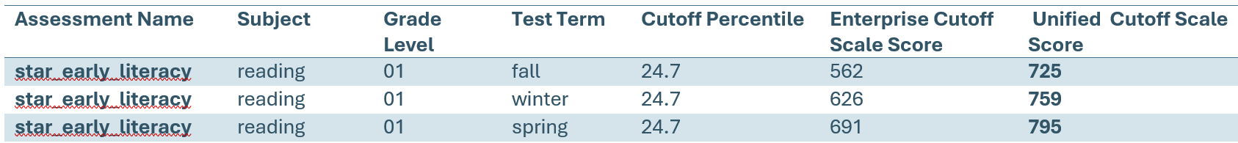
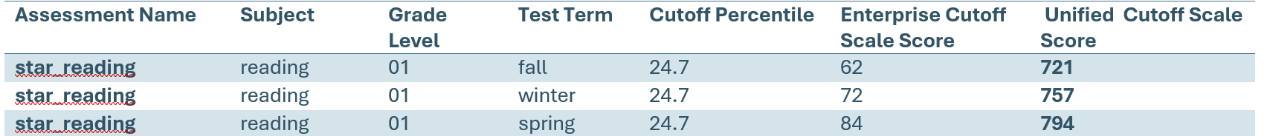
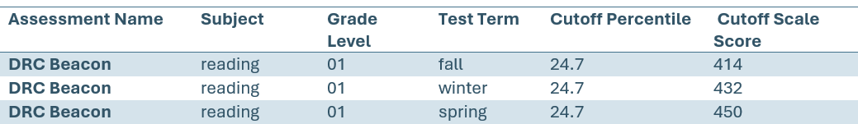
Current First Grade Cut Scores – SRC 2026
Notes:
Alisha

Slide 16
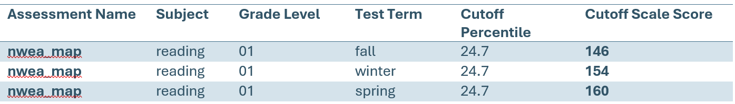
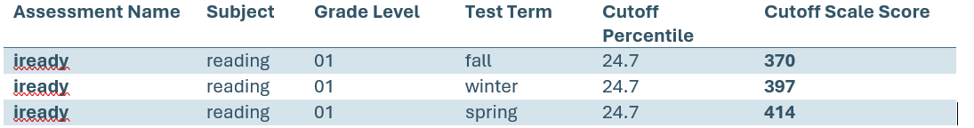
Current First Grade Cut Scores – SRC 2026
Note: MVPA was unable to provide first grade cut scores. SCDE will work with MVPA districts to determine the best identification metric.
Notes:
Alisha

Slide 17
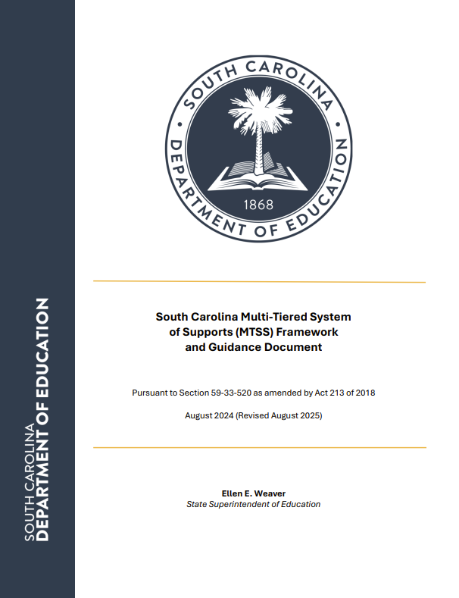
MTSS | Framework and Guidance Document Update
The MTSS Framework and Guidance Document has been updated and is available here.
Appendix D includes a new, simplified self-assessment tool. Other changes in wording throughout the document are minor. Broken links have also been repaired.
Please reach out to cgleaton@ed.sc.gov if you have any questions.

Slide 18
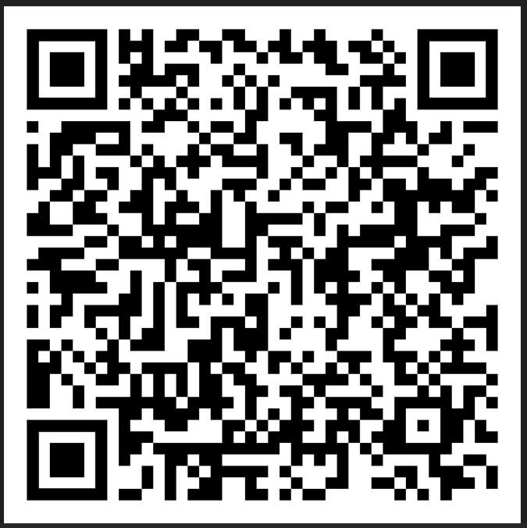
MTSS | Gather and Grow Collaboratives
Dates/Guest Speakers:
September 11, 2025 - Dr. Stephanie Stollar
VIDEO RECORDING
October 23, 2025 - Zearn
November 13, 2025 - Dr. Pam Kastner
January 8, 2026 - Dr. Paul Riccomini
February 12, 2026 - Dr. Judy Elliott
March 12, 2026 - TBD
Registration:
School and district MTSS leadership teams are invited to join these virtual collaboratives from 9:00–11:00 a.m. for opportunities to engage with colleagues from across the state. Interested participants should register using the link in the SCDE memo (9/3/25).

Slide 19

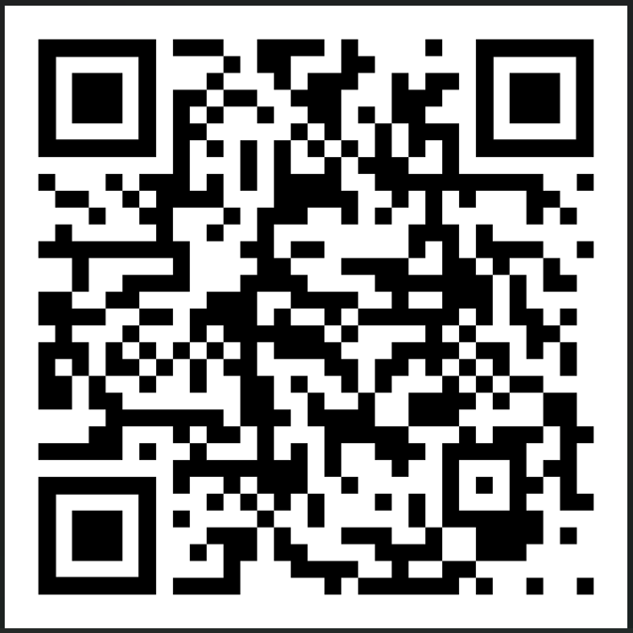
MTSS | Academic Alliance of SC MTSS PD Opportunities
September 10, 2025 Piecing it Together: Universal Design for Learning, Evidence-Based Instruction, and Specially Designed Instruction Presenter: Dr. Alisa Lowery Session Description/Registration | High Quality Instructional Techniques for Math October 14, 2025 - Elementary Session Description/Registration October 15, 2025 - Secondary Session Description/Registration Presenter: Dr. Paul Riccomini
November 19, 2025 Do We Have it Yet? Data-Based Decision Making: Progress Monitoring for Success Presenter: Dr. Judy Elliott Session Description/Registration | Reading Comprehension Instruction: Theory and Best Practices January 26, 2026 - Elementary January 27, 2026 - Secondary Presenter: Dr. Devin Kearns
Instructional and Intervention Strategies for Writing February 17, 2026 - Elementary February 18, 2026 - Secondary Presenter: Dr. Michael Herbert | March 18, 2026 Strategies to Intensify Intervention in the RtI Process Presenter: Dr. Jason Harlacher
Don’t miss the MTSS Summit Series hosted by the Academic Alliance of South Carolina (AASC)!

Slide 20
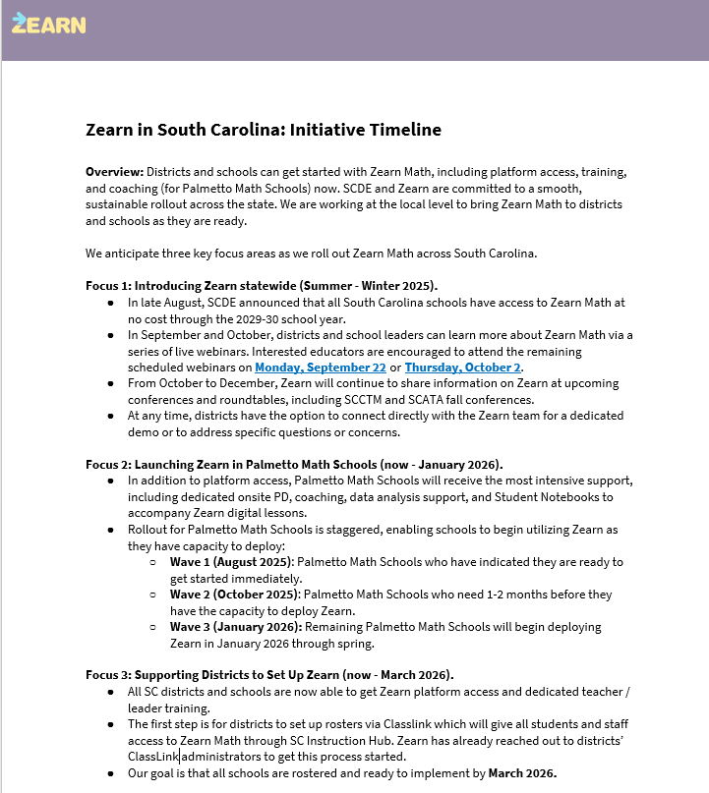
Zearn Math
What is Zearn Math?
Zearn Math is a top-rated K–8 math platform that offers a library of over 1,000 digital lessons aligned to South Carolina’s College-and Career-Ready Standards for Mathematics and can be used flexibly across instruction, intervention, tutoring, and summer learning.
Is Zearn Math effective?
Zearn Math has earned a “Strong” (Tier 1) rating — the highest possible designation — from Evidence for ESSA.
Districts and school leaders can learn more about Zearn Math and the timeline for implementation: Zearn Math Timeline

Slide 21
Modern Classrooms Project (MCP)
What's available?
As of August 2025, the following resources are available:
Standard Overview Guides for Algebra 1 and Geometry and Statistics, including:
Student-facing learning goals
Sample assessment questions
Sentence starters for instruction
Connections to related standards
Curriculum alignment highlights
The guides include short Video Modules that walk through each standard and indicator with examples drawn from the state’s approved instructional materials: enVision, Illustrative Math, Math Nation, and BW Walch.
Also included are Curriculum Maps for Algebra 1 and Geometry with Statistics that provide a crosswalk between each standard and specific lessons in the adopted curricula.
MCP can be accessed using your link to the SC Instruction Hub. To access start with South Carolina Department of Education

Slide 22
Modern Classroom Project (MCP)
What’s coming next?
Fall 2025 | Spring 2026 | School Year 2026 – 2027
Statistical Modeling | Discrete Mathematics | Grades K – 2
Reasoning in Mathematics | Grades 7 and 8 compact courses | Pre-Calculus
Grade 8 | Grades 6 – 7 | Calculus
Grade 5 | Grades 3 – 4
Applications and Modeling
Algebra 2 with Probability

Slide 23
Palmetto Math Project
Tier 2 Palmetto Math Regional Professional Learning
The first quarterly regional professional learning opportunity for Tier 2 Palmetto Math Project Schools are as follows:
Upstate – October 22, Greenwood 50 hosting
Midlands – October 22, Lexington 1 hosting
Pee Dee – October 24, Marion hosting
Lowcountry – October 24, Beaufort hosting
Registration and more details are forthcoming. Palmetto Math Specialists will contact Tier 2 principals via email with the specifics on who should attend, how to register, address, and time for each regional PLO.

Slide 24
R2S Recent Memos
Reading Plan Memo– due October 14, 2025
District Reading Plan
Primary & Elementary Reading Plan
Middle School Reading Plan
Reading Plan Directions
Memorandum of Agreement Memo
MOA – due September 8, 2025
Reading Coach Institute Memo
Registration

Slide 25
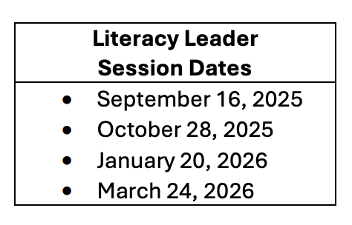
2025-26 Reading Coach Quarterly Support Sessions
As indicated in the Reading Coach Memorandum of Agreement, all R2S Reading Coaches must attend the quarterly support sessions.
First Quarterly Sessions for Reading Coaches
Upstate - September 30, 2025
Midlands – October 2, 2025
Pee Dee -September 29, 2025
Lowcountry -September 29, 2025
Memo – Reading Coach & Literacy Leader Sessions
Registration Reading Coaches
Registration District/School Leaders
Notes:
The reading coach quarterly support sessions offers valuable learning, resources, and networking opportunities to elevate literacy knowledge and coaching practice.
The sessions will focus on explicit instruction and how to coach into that while aligning the standards with the new curriculums.

Slide 26

LETRS Volume II Facilitator Training
Sept. 29 – Oct. 2, 2025 | Ten Oaks Elementary 2287 Carolina Forest Blvd Myrtle Beach, SC
Sept. 29 – Oct. 2, 2025 | Greenville County District Office 301 E Camperdown Way Greenville, SC
October 27-30, 2025 | Woolard Technology Center 70 Innovation Way Camden, SC
June 8-11, 2026 | Men Riv 1 Men Riv Drive Goose Creek, SC
There are still openings.
Participants must be Volume I LCF certified.
Additional Volume I cohorts will be offered next semester.
Contact mgibbons@ed.sc.gov if you have someone you would like to register for the Volume II training.

Slide 27
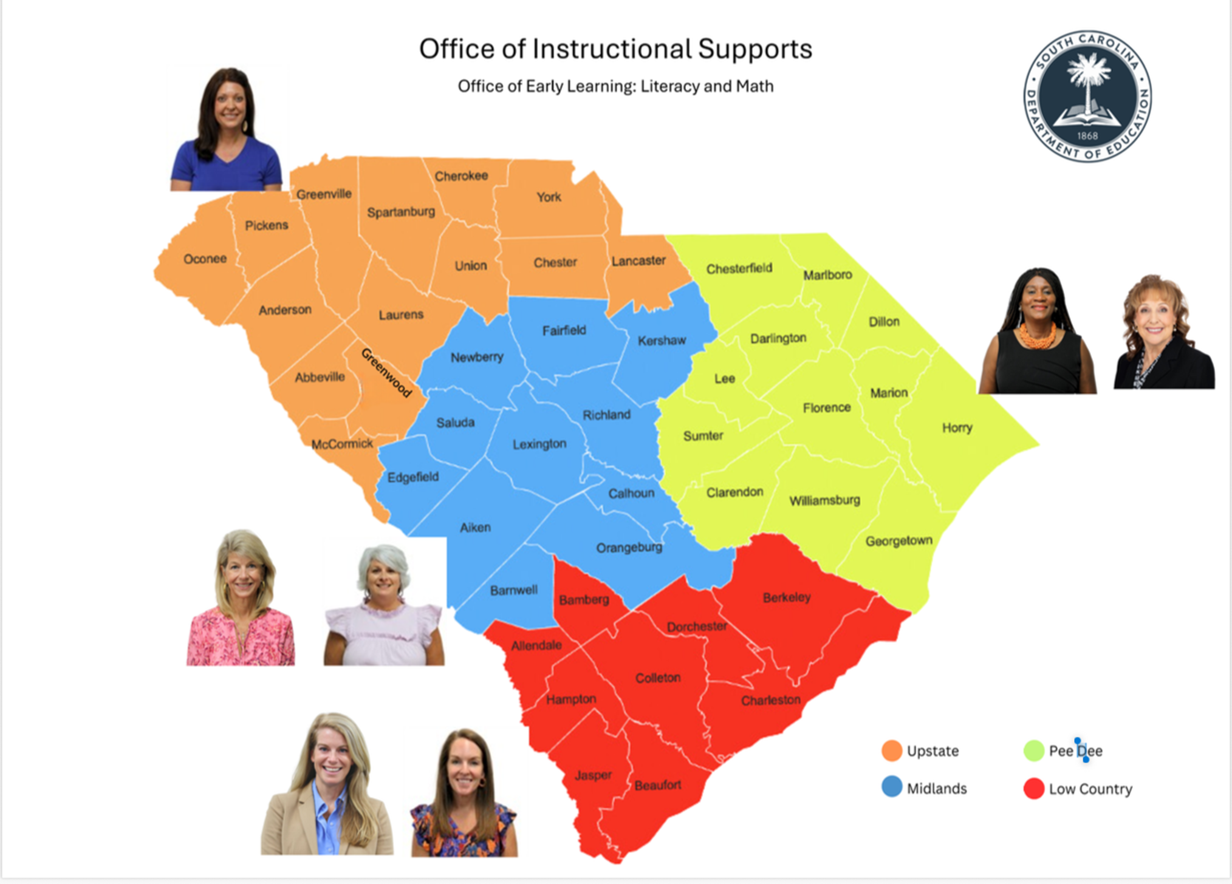
CERDEP Expansion Updates
Estimated 15,000+ CERDEP students will be served across the state
130 CERDEP classrooms were added across 12 districts for 2025-26
3 new CERDEP districts added (Beaufort, York 2, and Horry)
CERDEP participation is determined at the district level

Slide 28
CERDEP Funding
CERDEP Funding is based on appropriate student coding in PowerSchool. Please review the Funding Manual for CERDEP allowable expenditures.
Continuing CERDEP districts are highly encouraged to use any carryover funds from the previous school year into the current school year for supplies and materials.
New classrooms supply funds will be released with district monthly payments on September 22.
New districts to CERDEP will receive supply funds only in September and will receive their first CERDEP program payment with the 45th Day update.
New CERDEP districts will see their first CERDEP payment in January 2026. You will continue to receive monthly payments after that.
Initial CERDEP allocations use prior year 135-day data for the 2024-25 school year. CERDEP allocations will be updated in December or January using current FY25 student data.

Slide 29
Office of Assessment and Standards

Slide 30
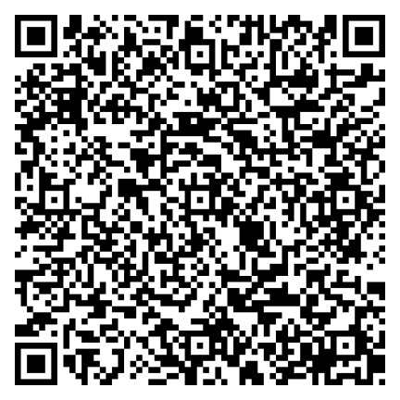
English Language Arts
Office of Assessment and Standards
ELA Standards App
Registration for
September webinars
and Office Hours
is open!
All SCDE ELA Standards Professional Learning Modules are now
available as Canvas courses! Educators can begin using the Canvas
courses immediately. Renewal credit is offered for each completed course.
As we begin the second
year of the 2024 SC CCR ELA Standards, we’ve created one-page briefs to help
new or transitioning educators quickly build a foundation for the year.
K-2 / 3-5 / 6-8 / E1-E4
Printable QR Code Sign
To receive information on future professional learning opportunities, subscribe to the OAS Distribution List and the ELA Standards Email Distribution List.

Slide 31
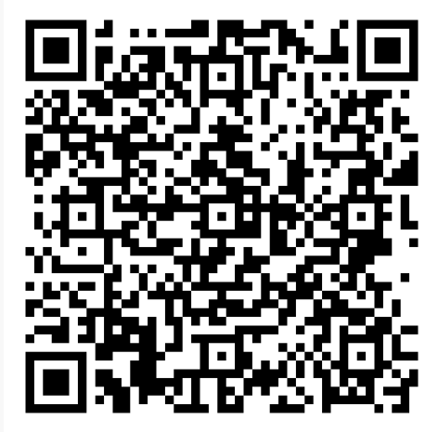
Math Standards Updates
Resources:
New! Printable Algebra 1 Standards (required for EOCEP course)
Updated! Frequently Asked Questions (FAQ) for Implementation Document
Coming Soon:
Frequently Asked Questions (FAQ) document for content
https://ed.sc.gov/instruction/standards/mathematics/instructional-resources/

Slide 32
Math Standards Fall Webinars: September & October
Navigating the 2025 Standards Document Session Time: 3:45-4:45 Audience: All educators Description: This session will show participants how to locate and navigate through the 2025 standards document. It will highlight important sections of the document and the key features. Date: September 23, 2025 Registration Link | We Are Family! Fact Families and Other Strategies to Support Fact Fluency Session Time: 3:00-4:00 pm Audience: K-5 math teachers Description: This session will dive into fluency and the key stages that pave the way for student mastery of basic math facts. Participants will learn strategies for effectively teaching these facts, as well as useful methods for assessing students' understanding of them. Date: October 16, 2025 Registration Link
Compacting 8th Grade and Geometry with Statistics: Where do the indicators fit? Session Time: 3:45-4:45 Audience: Compacted 8th grade Math and Geometry with Statistics teachers Description: This session will explore the compacted course indicators and help teachers determine which indicators can be taught together to maximize classroom instruction time. Date: October 16, 2025 Registration Link | Mathematical Proofs: Beyond the Formal Two-Column Proof Format Session Time: 4:00-5:00 Audience: Geometry with Statistics teachers Description: This session will explore proving mathematical theorems using alternative approaches. Date: October 21, 2025 Registration link
Notes:
Header font 50pt
Content/body text font 28pt

Slide 33
Math Standards Fall Webinars: November
No More Running in Circles Session Time: 4:00-5:00 Audience: Geometry with Statistics teachers Description: This session will explore and investigate the relationships between radii, secants, and chords, angles (inscribed, central, and circumscribed), and radii and tangents. Date: November 4, 2025 Registration link | Rebuilding After the Breakdown: Composing and Decomposing Numbers Session Time: 3:00-4:00 Audience: K-5 teachers Description: This session will explore composing and decomposing numbers in grades Kindergarten through fifth grade, equipping teachers with a comprehensive understanding of grade level expectations and instructional strategies to enhance student understanding. Date: November 13, 2025 Registration Link
Notes:
Header font 50pt
Content/body text font 28pt

Slide 34
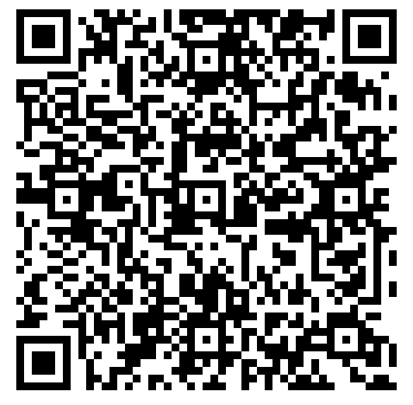
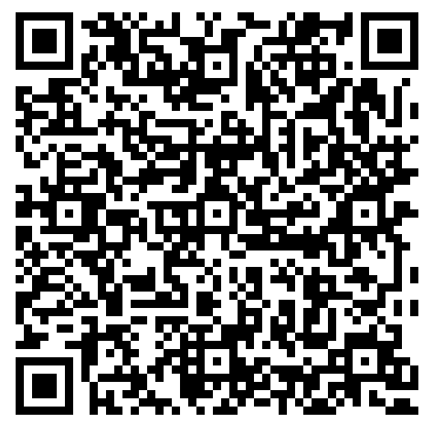
Science Standards and Instruction Updates
Science Instructional Resources Webpage Updates:
Updated! Performance Targets for the Science Standards
New! Using the SEPs and CCCs
Updated! Graphic Organizers for the SEPs and CCCs
Updated! Science Assessment Resources
Professional Learning Updates:
2025-2026 School Year Webinar Series
2025-2026 PLO Menu Options
Science Instructional Resources
https://ed.sc.gov/instruction/standards/science/instructional-resources/
Science Professional Learning
https://ed.sc.gov/instruction/standards/science/professional-learning-opportunities/
Notes:
Header font 50pt
Content/body text font 28pt

Slide 35
Visual and Performing Arts
Visual and Performing Arts Standards
Second Reading by SBE (and Anticipated Approval) in November
Regional PLOs in the Spring (Look for a Memo Coming Soon)
Full Implementation Beginning in 2026-2027 School Year
Visual and Performing Arts Professional Learning is Available!
Contact Roger Simpson, Education Associate for the Visual and Performing Arts, rsimpson@ed.sc.gov

Slide 36
World Languages
An updated version of South Carolina Seal of Biliteracy Overview and Guidelines has been published with updated requirements and new resources.
Updated Requirements:
To meet Qualification II (English Proficiency) the ACCESS composite score for ML students is now a 4.4 flat for all three tiers. There are no longer different ACCESS scores per tier.
To meet Qualification II (English Proficiency), d/Deaf students have now the option of demonstrating their English proficiency by earning intermediate mid or higher in reading and writing on an approved proficiency based assessment.

Slide 37
World Languages
Anderson University becomes the 6th university to recognize the SC Seal of Biliteracy as a placement tool and for credit. Students can earn 6 to 12 credits based on the tier earned.
SCDE is now offering a pathway for Endorsement to Dual Language Immersion Teachers, Coaches and Instructional leaders. For more information, visit this page

Slide 38
Health and Physical Education
Upcoming Professional Learning
Regional PLOs in the spring (Memo with more details coming soon)
Information sessions on health education requirements for each grade band (Dates TBD for early 2026)
Students Health and Fitness Act (SHFA)
SHFA Compliance Survey achieved a 98% response rate for the 2024-25 school year, with only 14 schools not completing the survey—an increase of 133 schools from the year prior. Thank you all for getting this task completed during testing and end of the year activities!
Questions
Ben Miedema, PhD Education Associate – Health and Physical Education
bjmiedema@ed.sc.gov
Notes:
Header font 50pt
Content/body text font 28pt

Slide 39
Advanced Programs
Training is being held for the existing GIFT software and Overview of Requirements of a Gifted and Talented program on September 24, 2025.
Memo with all approved assessments for Dimension A and Dimension B along with Identification Criteria was sent September 9, 2025.
Ordering deadline for all AP Assessments (Fall and Full Year Courses):
October 3, 2025- Preferred Ordering Date
November 14, 2025- Final Ordering Date

Slide 40

SC American Revolution 250th Anniversary
Statewide events are ongoing to commemorate the 250th anniversary of the American Revolution
The SC 250 website has extensive resources for educators and a list of key sites and events over the next year
Each county has a dedicated County 250 Committee who assist with local events. You can find your county's committee contact here.

Slide 41
Office of Career Readiness

Slide 42
Office of Educator Services

Slide 43
Office of Virtual Education

Slide 44
Office of Federal and State Accountability

Slide 45
Office of Leadership Effectiveness

Slide 46

What questions can we answer?

Slide 47

THANK
YOU

