Slide 1

Office of Leadership Effectiveness
Yvonne Cranford, Progress Monitoring Team Lead
Denise Covert-Wilson, School Improvement Manager Team Lead
SCASA Roundtable
September 26, 2025

Slide 2
Today’s Objectives
We hope all participants walk away with:
An understanding of School Improvement Designations in South Carolina
Information on exit criteria for designated schools
Updates on the Continuous Improvement Plans
Upcoming events

Slide 3
Agenda
School Improvement Designations
Consolidated Continuous Improvement Plan and District ATSI Plan
Upcoming Events

Slide 4
School Improvement Designations

Slide 5
1. Comprehensive Support and Improvement (CSI)
Identification: Title I school performing in the bottom 5%.
Exit Criteria: A final summative score on weighted point index that is above the bottom 5% of Title I schools in the most recent subsequent identification year AND the % of Meets/Exceeds in ELA or math.
Designation Length: 3 Year Designation
Next Identification: Fall 2025 (November?)
Notes:
The bottom 5% established by Elementary, Middle, and High.
Thresholds originally set in 21-22.
New thresholds will be set
Notes:
CSI schools are identified 3 different ways. CSI Low Performing Title I Schools
CSI Exit – In order to exit, schools must not be identified AND they must go above the 21-22 threshold. The new threshold will hopefully be higher meaning schools will need to be higher than the new threshold as well.

Slide 6
2. Comprehensive Support and Improvement (CSI)
Identification: All schools (Title I and non-Title I) with a graduation rate of less than 70%.
Exit Criteria: Graduation rate is 70% or higher.
Designation Length: 3 Year Designation
Next Identification: Fall 2025 (November?)
Notes:
CSI Low Graduation Rate

Slide 7
3. Comprehensive Support and Improvement (CSI)
Identification: Title I schools identified for Additional Targeted Support and Improvement (ATSI) due to low performing subgroups who have not satisfied the statewide exit criteria for such schools after six years (2 cycles)
Exit Criteria: The identified subgroup(s) performance moves above the performance of ALL students in the highest performing Title I CSI school in the most recent subsequent identification year after initial identification AND the % of the identified subgroup(s) who meets or exceeds in ELA or math over the percentage observed in that subgroup in the original identification year.
Designation Length: 3 Year Designation
Next Identification: Fall 2025 (November?)
Notes:
Title I schools that have been designated as ATSI that have not exited ATSI after a second consecutive cycle for the same identified subgroup will be identified as CSI for the next identification cycle.
Notes:
This identification cycle (2025-2026) will be the first time identifying schools using this criteria.

Slide 8
Additional Targeted Support and Improvement (ATSI)
Identification: All schools will be identified for ATSI if the overall weighted point index for one or more subgroups of students on its own is at or below the fifth percentile of Title I schools in the identification year.
Exit Criteria: (Elementary and Middle)
The identified subgroup(s) performance moves above the performance of ALL students in the highest performing Title I CSI school in the most recent identification year after initial identification year AND the % of Meets/Exceeds in ELA or math.
(High School)
The identified subgroup(s) performance moves above the performance of ALL students in the highest performing Title I CSI school in the most recent identification year after initial identification year AND the % of the identified subgroup(s) who meet or exceeds in English 2 or Algebra 1 increased over the percentage observed for that subgroup in the original year of identification.
Notes:
ATSI – take the subgroup and create its own report card using the data.

Slide 9
Additional Targeted Support and Improvement (ATSI) continued
Designation Length: 3 Year Designation
Next Identification: Fall 2025 (November-December?)
Notes:
The bottom 5% established by Elementary, Middle, and High.
Thresholds originally set in 21-22.
Thresholds will be set with report cards.
Concurrent with the state’s interim targets, schools are expected to meet the criteria within six years of being identified for ATSI.
  Title I schools that have been designated as ATSI that have not exited after 2 consecutive cycles in the same subgroup will be identified as CSI the next identification cycle.
  Non-Title I schools that have been designated ATSI that have not exited after 2 consecutive cycles in the same subgroup will remain ATSI.
Notes:
This will be the first time identifying schools as 3rd cycle or moving to CSI.

Slide 10
Targeted Support and Improvement Consistently Underperforming Subgroup
Identification: Schools with one or more subgroup performance at or below the 10th percentile for 3 consecutive years.
Exit Criteria: Districts determine if the school has successfully improved the identified subgroup.
Designation Length: Annual Designation
Next Identification: Fall 2025 (November-December?)
Notes:
The bottom 10% established by Elementary, Middle, and High
Thresholds are set annually
2025-2026 Thresholds
Notes:
This typically is where the confusion begins.

Slide 11

Targeted Support and Improvement
Identification: Schools with one or more subgroup performance at or below the 10th percentile
Exit Criteria: Districts determine if the school has successfully improved the identified subgroup.
Designation Length: Annual Designation
Next Identification: Fall 2025 (November-December?)
Notes:
TSI identifications are proactive (.
The bottom 10% established by Elementary, Middle, and High
Thresholds are set annually
Notes:
Red flag or warning

Slide 12
Federal Support Categories (ESSA)
Category | Entry Criteria | Exit Criteria | Cycle
Comprehensive Support and Improvement (CSI) | Title I school performing in the bottom 5% | A final summative score on weighted point index that is above the bottom 5% of Title I schools in the most recent subsequent identification year AND the % of Meets/Exceeds in ELA or math | 3 Year Designation Next cycle: 2028
Comprehensive Support and Improvement (CSI) | High School graduation rate below 70% | Graduation rate is 70% or higher | 3 Year Designation Next cycle: 2028
Comprehensive Support and Improvement (CSI) | Title I ATSI school that doesn’t exit after 2 cycles | The identified subgroup(s) performance moves above the performance of ALL students in the highest performing Title I CSI school in the most recent subsequent identification year after initial identification AND the % of the identified subgroup(s) who meets or exceeds in ELA or math over the percentage observed in that subgroup in the original identification year | 3 Year Designation Next cycle: 2028

Slide 13

Federal Support Categories (ESSA) continued
Category | Entry Criteria | Exit Criteria | Cycle
Additional Targeted Support and Improvement (ATSI) | Subgroup performance is at or below the 5th percentile | The identified subgroup(s) performance moves above the performance of ALL students in the highest performing Title I CSI school in the most recent subsequent identification year after initial identification AND the % of the identified subgroup(s) who meets or exceeds in ELA or math over the percentage observed in that subgroup in the original identification year | 3 Year Designation Next cycle: 2028
Targeted Support and Improvement Consistently Underperforming Subgroup (TSI_CUS) | Subgroup performance is at or below the 10th percentile for 3 consecutive years | District determines if the school has successfully improved the identified subgroup | Annual
Targeted Support and Improvement (TSI) Warning Only | Subgroup performance is at or below the 10th percentile | District determines if the school has successfully improved the identified subgroup | Annual

Slide 14
Threshold Scores
Year | Elementary | Middle | High
2018 | 28.86 | 24.8 | 30.92
2022 | 30.79 | 27.48 | 15.4
2024* 5% | 33.14 | 29.19 | 11.19
2024* 10% | 38.11 | 32.7 | 41.45
2025 5% | TBD | TBD | TBD
2024 is not an identification year – included to show how scores are tracking
2025 is an identification year = new threshold
Subgroup performance is compared to lowest 5% of Title I schools (elem, middle, and high)
Notes:
Schools must NOT be identified AND must exit. If the threshold is higher than 21-22, then do NOT get identified. If the threshold is lower than 21-22, then must not be identified and must exit. For example, If I am a high school with an overall weighted score of 13, I would have not been identified in 2024, but I would have not exited.

Slide 15
Underperforming Schools
Identification: Any school that receives an overall rating of unsatisfactory or below average on its annual school report card.
Exit Criteria: Schools improve the overall rating to average or higher on its annual school report card.
Designation Length: Annual Designation
Next Identification: Fall 2025 (October)
Notes:
In the absence of the annual school report card, the Department of Education shall apply the same metrics as established in the state and federal combined accountability model, as defined in the Every Student Succeeds Act to identify “underperforming schools”.
Underperforming Schools can receive a federal designation of CSI, ATSI, or TSI CUS as well as the underperforming designation.

Slide 16
Chronically Underperforming Schools
Identification: Any school that receives an overall rating of unsatisfactory on its annual school report card for three consecutive years.
Exit Criteria: Schools improve the overall rating to average or higher on its annual school report card.
Designation Length: Annual Designation
Next Identification: Fall 2025 (October)
Notes:
Chronically Underperforming Schools may trigger emergency management.
Chronically Underperforming Schools can receive a federal designation of CSI, ATSI, or TSI CUS as well as the underperforming designation.

Slide 17
Underperforming Districts
Identification: Any district that has 65% or more of its schools with an overall rating of unsatisfactory or below average on its annual school report card. (Section 59-18-900)
Exit Criteria: Districts have less than 65% of their schools with an overall rating of unsatisfactory or below average on its annual school report card.
Designation Length: Annual Designation
Next Identification: Fall 2025 (October)
Notes:
Districts identified as underperforming for three consecutive years may trigger emergency management.

Slide 18
State School Support Categories (59-18-1615)
Category | Entry Criteria | Exit Criteria | Cycle
Underperforming School | Any school with below average or unsatisfactory report card rating | Improve school’s overall rating to average or higher on school report card | Annual
Chronically Underperforming School | Any school with 3 consecutive years of unsatisfactory report card ratings | Improve school’s overall rating to average or higher on school report card | Annual
Underperforming District | Any district that has 65% or more of its schools (with report card ratings) with below average and/or unsatisfactory report card ratings | More than 35% of schools in the district have an overall rating of average or higher on the school report card | Annual
Emergency Managed | The district is identified as underperforming for 3 consecutive years; or The district’s accreditation is denied; or The district’s turnaround plan results are insufficient; or the district is classified as being in a fiscal emergency status | A district meets annual targets identified in the district’s revised strategic plan for sustained improvement for a minimum of three consecutive years | Annual

Slide 19
Support Designation Timeline October-December
October
Final district and state report cards published
Underperforming notification letters sent to districts from SCDE
November
Notify parents of underperforming status
Underperforming schools hold public meeting
December
Local school boards approve the turnaround plan for underperforming schools and districts
Create the turnaround plan component for underperforming schools and districts
*Notification of federal designations
Continue working on the turnaround plan component
Continue working on the turnaround plan component

Slide 20
Support Designation Timeline January-March
January
February
Office of Leadership Effectiveness Roadshow
March
Turnaround plan components published on websites
Local school board approved Turnaround Plans submitted to the Office of Leadership Effectiveness
Office of Leadership Effectiveness Roadshow
CIPS for federal designations submitted to OLE
Turnaround Plans reviewed and approved by OLE
CALL sessions will begin for CSI schools and districts
Subgroup support sessions will begin for schools and districts

Slide 21
Support Designation Timeline April-June
April
May
CIPs reviewed and approved by OLE
June
FY’25 funds expire
CIPS reviewed and approved by OLE

Slide 22

Underperforming Requirements
Requirement | Below Average | Unsatisfactory | Due Date
Notify parents |  | Electronically AND in Writing | November 13, 2025
Hold a public meeting |  |  | November 13, 2025
Local School Board approval |  |  | January 30, 2026
Submit to OLE Revise Strategic Plan, including Turnaround component |  |  | January 30, 2026
Post approved plans to websites |  |  | March 6, 2026
Update District Board of Progress Monitoring |  |  | Quarterly
Update OLE of Progress Monitoring |  |  | Quarterly

Slide 23
Updates to Continuous Improvement Plan and District ATSI Plan

Slide 24
Consolidated Continuous Improvement Plan Updates
Stakeholders page
Overall rating and all report card indicators for all subgroups
Two concise sentences to explain the connection between the goals and the SC Report Card and Comprehensive Needs Assessment
District support for Implementation

Slide 25
Consolidated Continuous Improvement Plan Updates
Timeline for implementations, persons responsible, annual review status
Plans for professional development
Explanation of how the selected activities align to meet the goal
Progress Monitoring will have its own tab allowing schools to monitor on the 45th, 90th, and 135th day of implementation
Quarterly funding claim reminders

Slide 26
District ATSI Continuous Improvement Plan Updates
Stakeholders page
Overall rating and all report card indicators for all subgroups
Tier Level ( Identified by SCDE)
Submission of identified school CIP (Yes/No)
Plans for professional development
Explanation of how the selected activities align to meet the goal

Slide 27
District ATSI Continuous Improvement Plan Updates
Each subgroup will have individual tabs (6)
District support for implementation
Evidence Based Interventions including which schools will be participating
Timeline for implementations, persons responsible, annual review status
Progress Monitoring will have its own tab allowing schools to monitor on the 45th, 90th, and 135th day of implementation

Slide 28
Upcoming Events

Slide 29
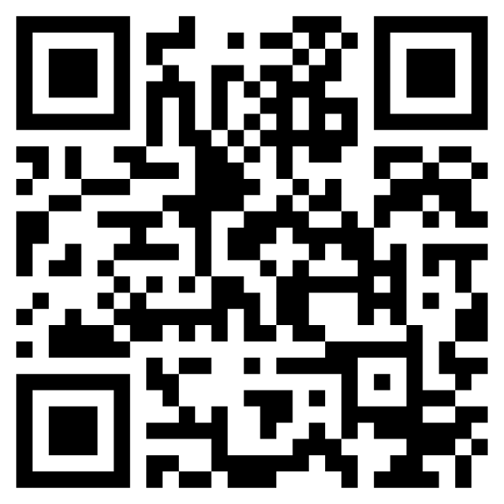
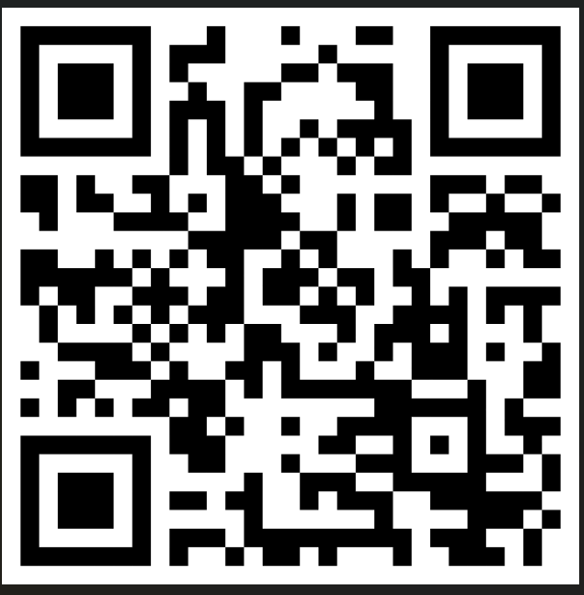
Virtual Walk-Through of the Consolidated Continuous Improvement Plan and District ATSI Continuous Improvement Plan​
Google Users
Microsoft Users

Slide 30
SCATA Conference
School Improvement Unlocked: Navigating the New Identification Cycle with Confidence
Presenters: Kimberly Mack and Yvonne Cranford
Strengthening School Improvement through Updated Guidance
Presenters: Denise Covert-Wilson and Yvonne Cranford
Fostering Partnerships in School Improvement – Office Hours
School Improvement Managers and Progress Monitoring Team Members
How to Make a Bigger Impact on Student Groups in Your Role
  Presenters: Joey Greene, Dr. LeConte Middleton, Andrea Niesse, and Deirdre Howard

Slide 31
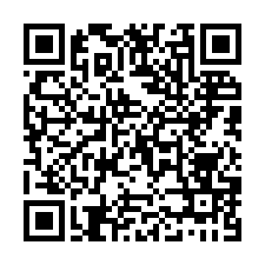
Fall 2025 Regional Subgroup Support Sessions
Preview the AGENDA
Register for October and November Regional Sessions HERE
Work Session Topics:
MTSS Tools and Structures
Conditions for Collaborative Planning
Effective and Collaborative Efforts to Improve Student Outcomes for Students with Disabilities
Protocol Pivots: When Data Calls the Shots (SLOs)

Slide 32
Denise Covert-Wilson
Yvonne Cranford
yacranford@ed.sc.gov
dcovertwilson@ed.sc.gov

Slide 33
ed.sc.gov
Notes:
Slide title is hidden from display

