Slide 1

Graduation Rate and the High School Student Success Indicator (HSSSI)
Accountability Coordinators, District Testing Coordinators, Assessment Proxies, and PowerSchool Administrators
Vann Holden, PhD, Era Roberts, EdD, and Wendy Stephens
February 2026
Notes:
Slide title should be Aptos Bold font, left-aligned, not smaller than 44pt
Audience – To whom/group you are presenting to
Speaker – Who is giving the presentation (may be by name or by department)
Date – Date of presentation

Slide 2
Agenda
What are the accountability rules for graduation rate and HSSSI?
What are the coding requirements?
How can we verify our data?
What should we do if data looks inaccurate?
Planning Time
Next Steps
Notes:
Left aligned
Title font is 88pt
Numbered line item 66 pt
Detail/slide item 36 pt

Slide 3
Cohorts
Notes:
Agenda is 88 pt
Line item is 66 pt

Slide 4

What is a Cohort?
In the accountability context, a cohort is generally a group of students who entered a high school in the United States for the first time on or prior to the 45th day of a given school year.
The 9GR is the student’s 9th grade code. This tells us which high school cohort the student is in for accountability purposes.
Notes:
Header font 50pt
Content/body text font 28pt

Slide 5
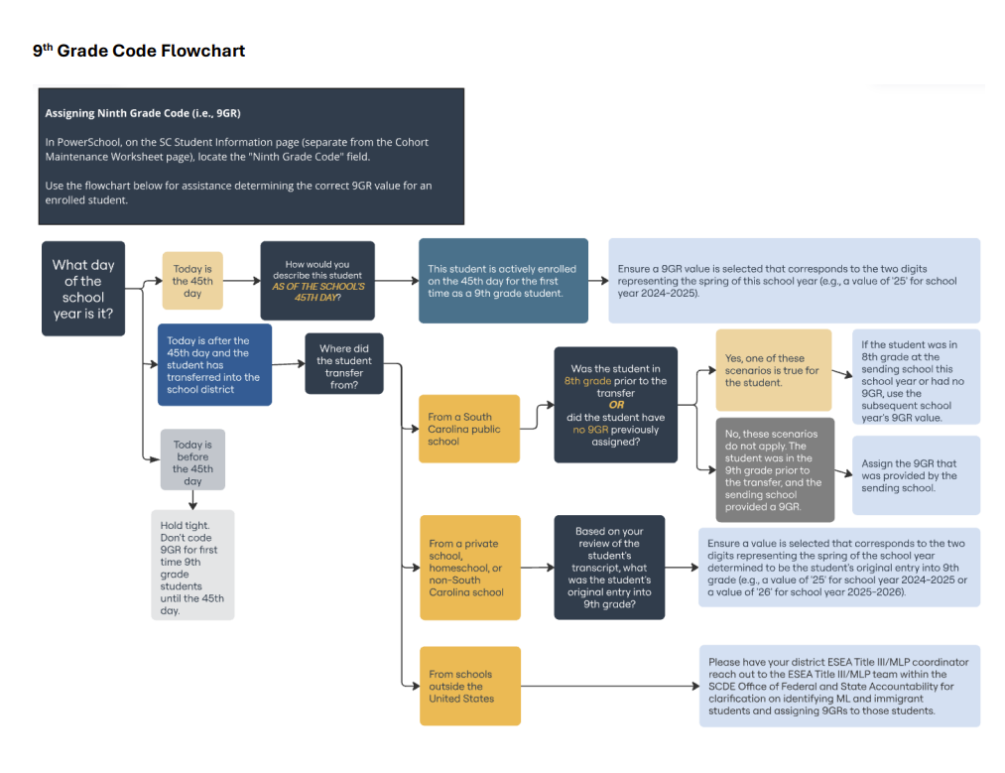
9th Grade Code Flowchart
https://ed.sc.gov/data/cohort-maintenance-information-and-resources/ninth-grade-code-flowchart/
Notes:
Header font 50pt
Content/body text font 28pt

Slide 6
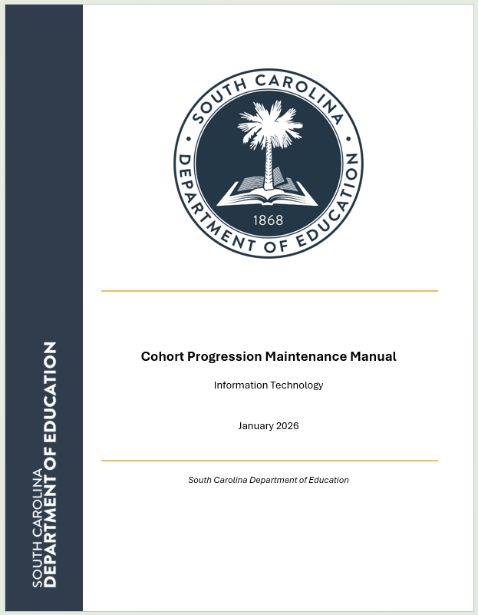
Cohort Progression Maintenance
Please see the Cohort Progression Maintenance Manual for documentation requirements.
https://ed.sc.gov/data/cohort-maintenance-information-and-resources/cohort-progression-maintenance-manual/
Notes:
Header font 50pt
Content/body text font 28pt

Slide 7
High School Ratings
Notes:
Agenda is 88 pt
Line item is 66 pt

Slide 8
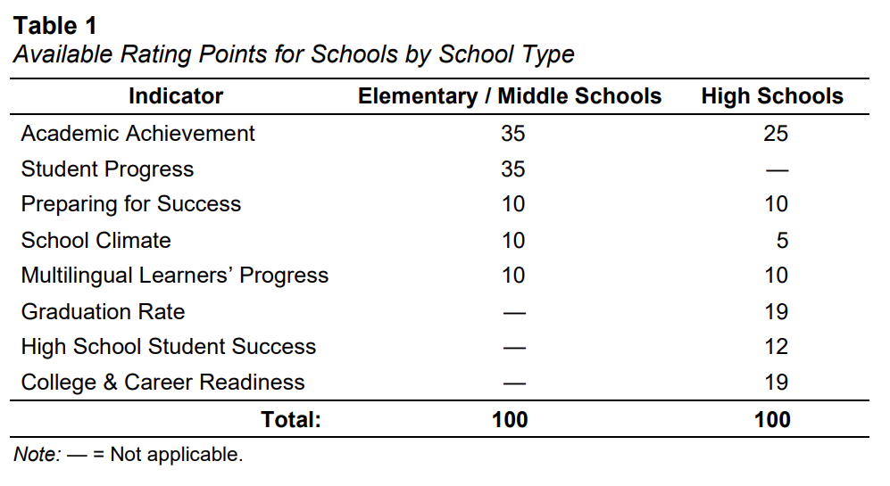
High School Ratings: Indicator
Graduation Rate is worth 19% of a high school’s overall rating.
  This increases to 24% of the rating if the school has fewer than 20 students included in the Multilingual Learners’ Progress indicator.
High School Student Success is worth 12% of a high school’s overall rating.
Combined, these two metrics account for 31% to 36% of a high school’s overall rating.
https://www.eoc.sc.gov/accountability-manuals

Slide 9
Graduation Rate
Notes:
Agenda is 88 pt
Line item is 66 pt

Slide 10
Graduation Rate: Indicator
This indicator reports the percent of students who graduate from high school within four full school years of their initial enrollment unless the student meets one of the approved reasons for removal from the cohort (documentation of transfer to another diploma-granting high school, emigration to another country, transfer to prison or juvenile facility following adjudication, or death).
The Graduation Rate shall be calculated based on the number of students who earned a regular high school diploma divided by the total number of students in the four-year graduation cohort for the school.
https://www.eoc.sc.gov/accountability-manuals
Notes:
Header font 50pt
Content/body text font 28pt

Slide 11
Graduation Rate: Cohort
For the 2025-26 school year, students with a 9GR of 23 are included in the four-year graduation cohort.
  These students entered high school in the United States for the first time during the 2022-23 school year.
All students in the graduation cohort for the current year as defined by their ninth-grade code (9GR) are included, as assigned to the school of their enrollment on the 180th day.
  A student who is no longer enrolled and does not have an approved reason for removal from the cohort is still included in the cohort of their last school of enrollment.
https://www.eoc.sc.gov/accountability-manuals
Notes:
Header font 50pt
Content/body text font 28pt

Slide 12
Graduation Rate Calculations
Calculate the number of Rating Points earned according to the equation using the following steps:
  Determine the four-year graduation cohort for the school (as described in the What Students are Included in the Indicator section above).
  Determine the number of students in the four-year graduation cohort who earned a regular high school diploma.
  Divide the number obtained in step 2 by the number obtained in step 1.
  Multiply the quotient by 100.
  Subtract 50 from the product. If the difference is less than zero, set it to zero.
  Divide the product obtained in step 5 by 50.
  Multiply the quotient obtained in step 6 by 19 and round to the nearest hundredth (e.g., 16.65) to obtain the number of Rating Points out of 19.
  Finally, total Rating Points earned are converted to Ratings using Table 17. Per this table, any high school with a graduation rate of less than 70% is deemed Unsatisfactory and any high school which exceeds the state goal of 90% graduation rate is deemed Excellent.
https://www.eoc.sc.gov/accountability-manuals
Notes:
Header font 50pt
Content/body text font 28pt

Slide 13
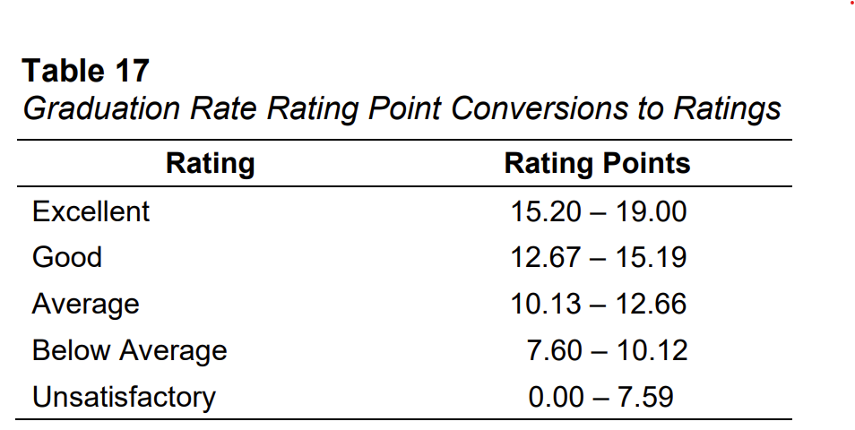
Graduation Rate Calculation Rating Points
https://www.eoc.sc.gov/accountability-manuals
Notes:
Header font 50pt
Content/body text font 28pt

Slide 14
HSSSI
On-Track to Graduate

Slide 15
HSSSI: On-Track
The High School Student Success Indicator (HSSSI) has two components.
The first is the percent of students who are in their first three years at a high school and are on track to graduate within four years.
https://www.eoc.sc.gov/accountability-manuals
Notes:
Header font 50pt
Content/body text font 28pt

Slide 16
On-Track: Overview
Since 24 High School credits are required to earn a regular diploma in South Carolina, at least four of which must be English credits and at least four of which must be math credits, a student is considered on track to graduate within four years if:
  they have earned six or more High School credits, at least one of which must be an English credit and at least one of which must be a math credit by the end of each successive year in High School.
 | First Year | Second Year | Third Year
9GR for 2025-26 | 26 | 25 | 24
Math Credits | 1 | 2 | 3
English Credits | 1 | 2 | 3
Total Credits | 6 | 12 | 18
https://www.eoc.sc.gov/accountability-manuals
Notes:
Header font 50pt
Content/body text font 28pt

Slide 17
On-Track: Annually
By the end of their first year in High School, a student is considered on track if they have earned at least 6 credits, with at least 1 English credit and 1 math credit.
By the end of their second year in High School, a student is considered on track if they have earned at least 12 credits, with at least 2 English credits and 2 math credits.
By the end of their third year in High School, a student is considered on track if they have earned at least 18 credits, with at least 3 English credits and 3 math credits.
 | First Year | Second Year | Third Year
9GR for 2025-26 | 26 | 25 | 24
Math Credits | 1 | 2 | 3
English Credits | 1 | 2 | 3
Total Credits | 6 | 12 | 18
https://www.eoc.sc.gov/accountability-manuals
Notes:
Header font 50pt
Content/body text font 28pt

Slide 18
On-Track: Credits
Any valid high school credit listed in the SCDE Course Code Database (linked from the Student Information Systems page on the SCDE website) that has been earned by the student at any time in the past can contribute to the 6, 12, or 18 HS credits required to be considered on track.
Because On-Track to Graduate measures whether students are on track to graduate with a regular high school diploma within four years of starting high school, only courses listed as satisfying an English graduation credit can contribute to the required English credit(s) and only courses listed as satisfying a mathematics graduation credit can contribute to the required math credit(s).
https://www.eoc.sc.gov/accountability-manuals
Notes:
Header font 50pt
Content/body text font 28pt

Slide 19
HSSSI
5th Year Student Success

Slide 20
HSSSI: 5th Year Student Success
The second HSSSI component is the percent of students who achieve a successful high school outcome within five years of starting High School.
This component reports the percent of students who have either earned a regular High School diploma, earned a GED, or earned the SC High School Employability Credential (see https://ed.sc.gov/districts-schools/special-education-services/postsecondary-outcomes/ employability-credential-south-carolina-high-school-credential/) within five years of starting High School.
https://www.eoc.sc.gov/accountability-manuals
Notes:
Header font 50pt
Content/body text font 28pt

Slide 21
5th Year Student Success
Students who were reported in the Graduation Rate indicator for the prior year Report Cards shall be included in the 5YSSR of the High School for which they were included in the four year on time graduation cohort that year.
Students shall be removed from the cohort for student death, emigration, or transfer to prison or juvenile facility following adjudication but shall not be removed from the cohort for properly documented transfer during the fifth year.
Students shall not be added to the cohort during the fifth year.
https://www.eoc.sc.gov/accountability-manuals
Notes:
Header font 50pt
Content/body text font 28pt

Slide 22
HSSSI
Calculations

Slide 23
How does the HSSSI calculation work? Steps 1-4
Determine the number of students assigned to the high school’s First-Year Cohort (1YCohort) according to the guidelines and procedures described in the Graduation Rate section.
Determine the number of students included in Step 1 who are considered on track to graduate (i.e., who have accumulated at least 6 high school credits, at least 1 of which is in English and at least 1 of which is in math; ∑ 1𝑌𝑂𝑇𝐺𝑖 𝑛1 𝑖=1 ).
Determine the number of students assigned to the high school’s Second-Year Cohort (2Y-Cohort) according to the guidelines and procedures described in the Graduation Rate section.
Determine the number of students included in Step 3 who are considered on track to graduate (i.e., who have accumulated at least 12 high school credits, at least 2 of which are in English and at least 2 of which are in math; ∑ 2𝑌𝑂𝑇𝐺𝑖 𝑛2 𝑖=1 ).
https://www.eoc.sc.gov/accountability-manuals
Notes:
Header font 50pt
Content/body text font 28pt

Slide 24
How does the HSSSI calculation work? Steps 5-9
Determine the number of students assigned to the high school’s Third-Year Cohort (3YCohort) according to the guidelines and procedures described in the Graduation Rate section.
Determine the number of students included in Step 5 who are considered on track to graduate (i.e., who have accumulated at least 18 high school credits, at least 3 of which are in English and at least 3 of which are in math; ∑ 3𝑌𝑂𝑇𝐺𝑖 𝑛3 𝑖=1 ).
Determine the number of students who were included in the Graduation Rate for the High School on the prior year Report Cards (𝑛5; the fifth year cohort; i.e., 9GR = 22 for 2026 Report Cards).
Determine the number of students included in Step 7 who obtained a successful High School outcome (i.e., a regular High School diploma, a GED, or the SC HS Employability Credential) within five years of their first year in US High School (∑ 5𝑌𝑆𝑆𝑅𝑖 𝑛5 𝑖=1 ).
Total the numbers found in the even-numbered steps above (i.e., Step 2, Step 4, Step 6, and Step 8).
https://www.eoc.sc.gov/accountability-manuals
Notes:
Header font 50pt
Content/body text font 28pt

Slide 25
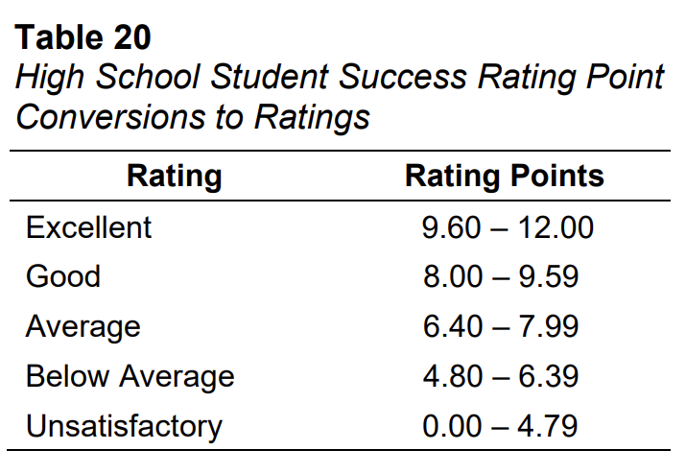
How does the HSSSI calculation work? Steps 10-14
Divide by the sum of the numbers found in the odd-numbered steps above (i.e., Step 1, Step 3, Step 5, and Step 7).
Subtract 0.5 from the quotient found in Step 10. If the difference is less than zero, set it to zero.
Multiply 24 by the difference found in Step 11.
The product obtained in Step 12, rounded to the nearest hundredth (e.g., 10.65), is the number of Rating Points
Finally, total Rating Points earned are converted to Ratings using Table 20. Per this table, any High School with a percent of students on track or obtaining successful outcomes of less than 70% is deemed Unsatisfactory and any High School with rates exceeding 90% is deemed Excellent.
https://www.eoc.sc.gov/accountability-manuals
Notes:
Header font 50pt
Content/body text font 28pt

Slide 26
Coding Requirements
Notes:
Agenda is 88 pt
Line item is 66 pt

Slide 27

Coding requirements: PowerSchool
Critical fields in PowerSchool
Graduation Rate
Diploma Earned
(for diplomas earned by the expected "on-time" graduation date)
Graduation Date
High School Student Success Indicator (HSSSI) - On-Track to Graduate
Course Codes:
https://sc-satchel.commongoodlt.com/
Seeking Diploma Type
High School Student Success Indicator (HSSSI) - 5th Year Success
Employability Credential-related fields
Adult Ed and GED (or "high school equivalency-related") fields
Notes:
Header font 50pt
Content/body text font 28pt

Slide 28
Graduation Rate:
How does the PowerSchool coding apply?
Students who graduate are identified as follows:
  PowerSchool values coded for the Diploma Earned field (value of ‘F’ or ‘Z’)
  and
  Graduation Date field (for students coded ‘F’) or values coded for the Adult Education Graduation Date field (for students coded ‘Z’)
Remember: The on-time graduation cohort for a given school year consists of students who received their 9GR values three school years before (for example, for school year 2025-2026, the on time 9GR cohort would be 23, representing the students first in enrolled in 9th grade during the 2022-2023 school year).
Remember:
The "denominator" field we discussed during the last training comes into play.
The graduation cohort is adjusted by subtracting students who are coded with a value of NO in the field labeled Student Should Remain in Cohort (denominator)? on the Cohort Maintenance Worksheet page in PowerSchool; remember that values of YES or (blank) in that field indicate cohort inclusion.

Slide 29
Graduation Rate:
Adult Education - How does the PowerSchool coding apply?
Note:
If the student earns a high school diploma (not a GED or “high school equivalency diploma”) from the Adult Education program by the expected on-time graduation date of their original school’s cohort, the student is counted positively in their previous school’s graduation rate.

Slide 30
High School Student Success Indicator (HSSSI) :
How does the PowerSchool coding apply?
Remember:
HSSSI reports the percent of students who have either earned
  a regular High School diploma,
  SC High School Employability Credential, or
  a GED
Remember:
The "denominator" field we discussed during the last training still comes into play.
Students who were reported in the Graduation Rate indicator for the prior year Report Cards shall be included in the 5YSSR of the High School for which theywere included in the four year on time graduation cohort that year.

Slide 31
Coding requirements: Graduation Rate
Required PowerSchool fields
(all on the
SC Student Information page):
Seeking Diploma Type
  Field label: Seeking Diploma Type (for Transcript)
  Table.field: s_sc_stu_x.diploma_type
Diploma Earned
  Field label: Diploma Earned
  Table.field: S_SC_STU_X.DiplomaEarnCode
Graduation Date
  Field label: Graduation Date
  Table.field: S_SC_STU_X.GradDate
Diploma Ordered
  Field label: Diploma Ordered
  Table.field: s_sc_stu_x.diplomaordcode
Must be correct before the 180-day data submission deadline for final metrics.
Critical for ordering paper diplomas.
Notes:
Header font 50pt
Content/body text font 28pt

Slide 32

Coding requirements: HSSSI – On-Track to Graduate
Required PowerSchool fields
Course Codes
  PowerSchool pages: Courses / New Course
  Field label: Number
  Table.field: Courses.Course_Number
  IMPORTANT:
  Use Satchel, the SCDE Course Code database, to ensure accurate course codes:
  https://sc-satchel.commongoodlt.com/
Seeking Diploma Type
  PowerSchool page: SC Student Information Page
  Field label: Seeking Diploma Type (for Transcript)
  Table.field: s_sc_stu_x.diploma_type
Notes:
Header font 50pt
Content/body text font 28pt

Slide 33
Coding requirements: HSSSI – 5th Year Success
Employability Credential
Required PowerSchool fields
(all on the
SC Student Information page):
Seeking Employability Credential
  Field label: Seeking Employability Credential
  Table.field: s_sc_stu_x.seeking_emp_credential
Employability Credential Date
  Field label: Employability Credential Date
  Table.field: s_sc_stu_x.emp_credential_date
Employability Credential Earned
  Field label: Employability Credential Earned
  Table.field: s_sc_stu_x.emp_credential_earned
Unique Student Email Identifier for Orders
  Field label: Postgraduate Student Email
  Table.field: u_scde_stu_x.postgrad_stu_email
Must be correct before the 180-day data submission deadline for final metrics.
Critical for ordering paper credentials, as well as for issuing digital credentials.
Notes:
Header font 50pt
Content/body text font 28pt

Slide 34
Coding requirements: HSSSI – 5th Year Success
Adult ed and GED
Required PowerSchool fields
(all on the
SC Student Information page):
Adult Ed Entry Date
  Field label: Adult Ed Entry Date
  Table.field: S_SC_STU_X.AdultEd_EntryDate
Adult Ed Exit Date
  Field label: Adult Ed Exit Date
  Table.field: S_SC_STU_X.AdultEd_ExitDate
GED Earned
  Field label: GED Earned
  Table.field: s_sc_stu_x.yrgedearned
Adult Ed Graduation Date
  Field label: Adult Ed Graduation Date
  Table.field: s_sc_stu_x.adulted_graddate
Notes:
Header font 50pt
Content/body text font 28pt

Slide 35
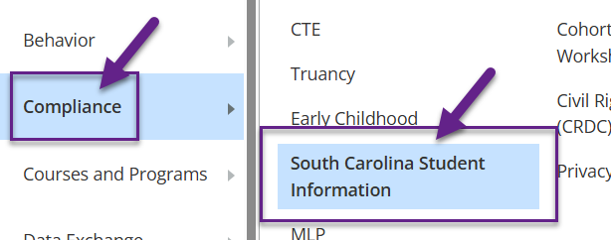
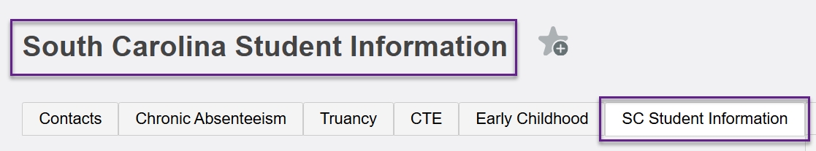
Coding requirements: PowerSchool
Where in PowerSchool to code ALL of these fields (except course numbers):
the SC Student Information Page
Notes:
Header font 50pt
Content/body text font 28pt

Slide 36
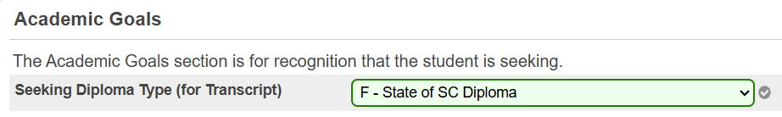
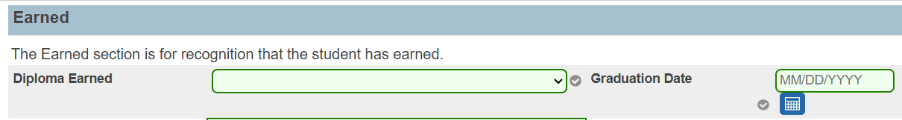
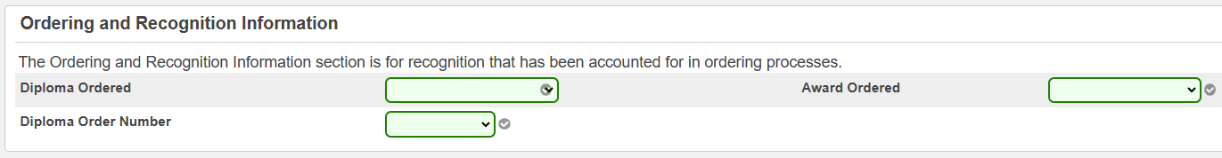
Coding requirements: Graduation Rate (earned) AND
HSSSI – On-Track to Graduate (seeking)
Notes:
Header font 50pt
Content/body text font 28pt

Slide 37

Coding requirements: HSSSI – 5th Year Success
Employability Credential
Notes:
Header font 50pt
Content/body text font 28pt

Slide 38
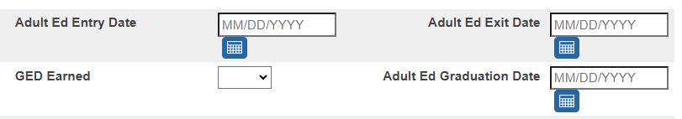
Coding requirements: HSSSI – 5th Year Success
Adult ed and GED
Notes:
Header font 50pt
Content/body text font 28pt

Slide 39
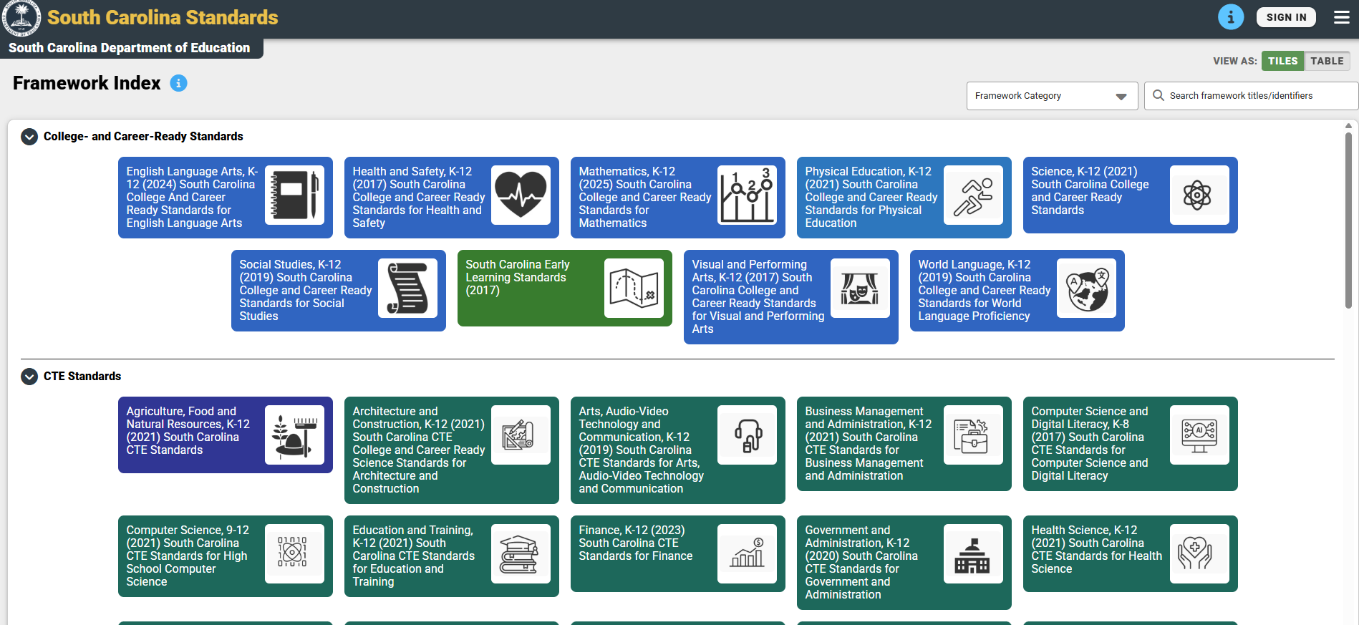
Coding requirements – Courses (check Satchel)
https://sc-satchel.commongoodlt.com/
Notes:
Header font 50pt
Content/body text font 28pt

Slide 40

Coding requirements
When to code?
When to code data
(adjust as needed before day 180 deadline)
Graduation Rate
Diploma fields – when seeking (for "Seeking") or once earned (for "earned")
Graduation Date – once determined
High School Student Success Indicator (HSSSI) - On-Track to Graduate
Course Codes: verify when setting up for a new year
Seeking Diploma Type: when seeking
Notes:
Header font 50pt
Content/body text font 28pt

Slide 41
Coding requirements
5YSSR: When to code?
When to code data
(adjust as needed before day 180 deadline)
High School Student Success Indicator (HSSSI) - 5th Year Success
Employability Credential-related fields – date should be coded right away once student is seeking; otherwise, code "seeking" data when seeking and "earned" data once earned
Adult Ed and GED (or "high school equivalency-related") fields – once earned
Notes:
Header font 50pt
Content/body text font 28pt

Slide 42
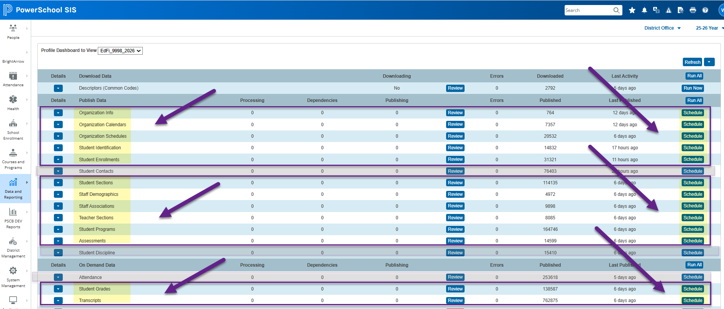
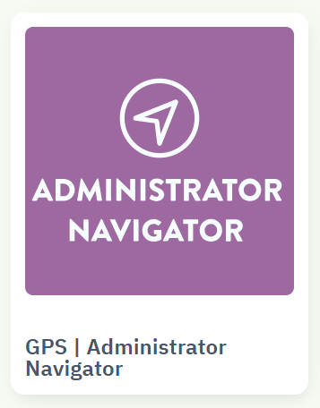
How does data make it to SCDE?
Once data is entered in PowerSchool and published to Ed-Fi by 7:00 p.m., you can verify data in Administrator Navigator the next day!
Notes:
Header font 50pt
Content/body text font 28pt

Slide 43

How does the data make it to SCDE?
Spot Checking Steps
1 - Select a student whose data values you wish to verify as "published"/"submitted."
2 - Go to the student's "publishing" page in PowerSchool (Data Exchange > Publishing).
3 - Click the green check mark next to the desired category.
4 - Look for the Ed-Fi element and associated value. The mapping document that Data Management will soon make available will help you identify the Ed-Fi elements in the json that you are looking for.
JSON examples:
"diplomaTypeDescriptor" : "uri://ed.sc.gov/DiplomaTypeDescriptor#DiplomaEarned_Pending",
"diplomaAwardDate" : "2026-06-01"
"diplomaTypeDescriptor" : "uri://ed.sc.gov/DiplomaTypeDescriptor#F",
"diplomaAwardDate" : "2026-05-28"
Notes:
Header font 50pt
Content/body text font 28pt

Slide 44
How does the data make it to SCDE?
Spot Checking
Look for these subcategories on the student's publishing page in PowerSchool:
  Student Demographics
  Student Academic Records
  Student Course Transcript
Notes:
Header font 50pt
Content/body text font 28pt

Slide 45


How does the data make it to SCDE?
Using the Mapping Doc
Example Mapping Doc Search Results
Notes:
Header font 50pt
Content/body text font 28pt

Slide 46
Verifying Your Data
Notes:
Agenda is 88 pt
Line item is 66 pt

Slide 47
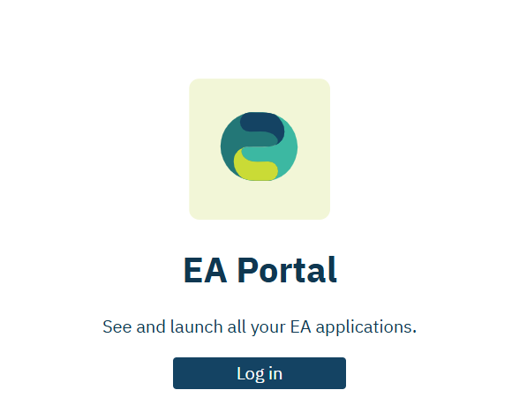
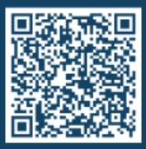
Verifying Data: Admin Navigator
Please go to Admin Navigator.
  https://portal.edanalytics.app/
If you do not have access to Admin Navigator, please scan the QR code below to find out who in your district can provide you with access.
Notes:
Header font 50pt
Content/body text font 28pt

Slide 48
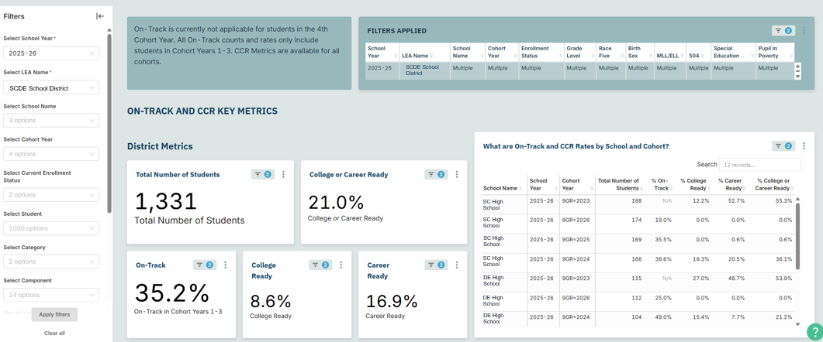
Verifying Data: Dashboard
In Admin Navigator, go to the On-Track and College & Career Readiness Dashboard.
Notes:
Header font 50pt
Content/body text font 28pt

Slide 49
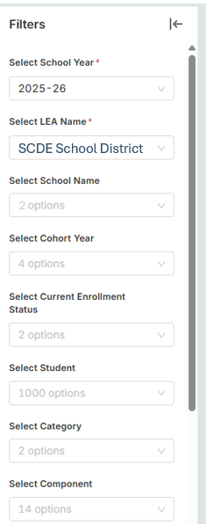
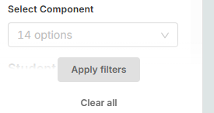
Verifying Data: Filters
In Admin Navigator, go to the On-Track and College & Career Readiness Dashboard.
  Select School Year – 2025-26
  Select LEA Name – Your district
  Select School Name – If needed
  Select Cohort Year – If needed
  Apply filters
Notes:
Header font 50pt
Content/body text font 28pt

Slide 50
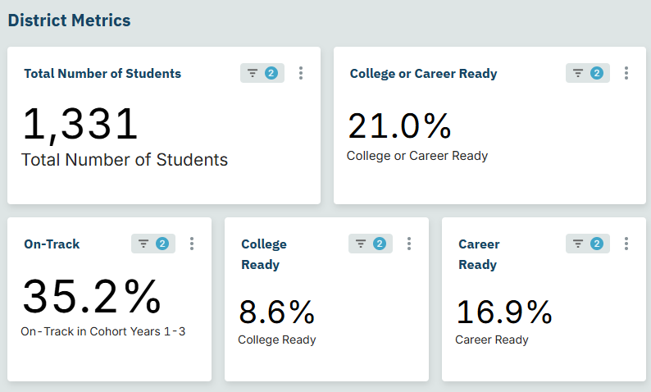
Verifying Data: District Metrics
Notes:
Header font 50pt
Content/body text font 28pt

Slide 51
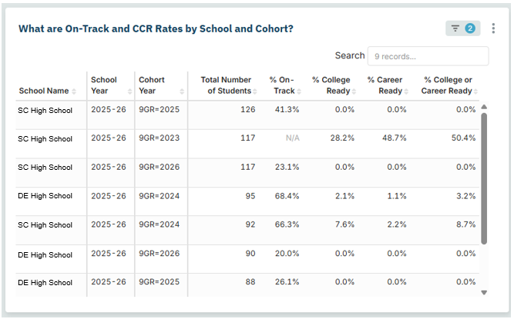
Verifying Data: School and Cohort
Notes:
Header font 50pt
Content/body text font 28pt

Slide 52
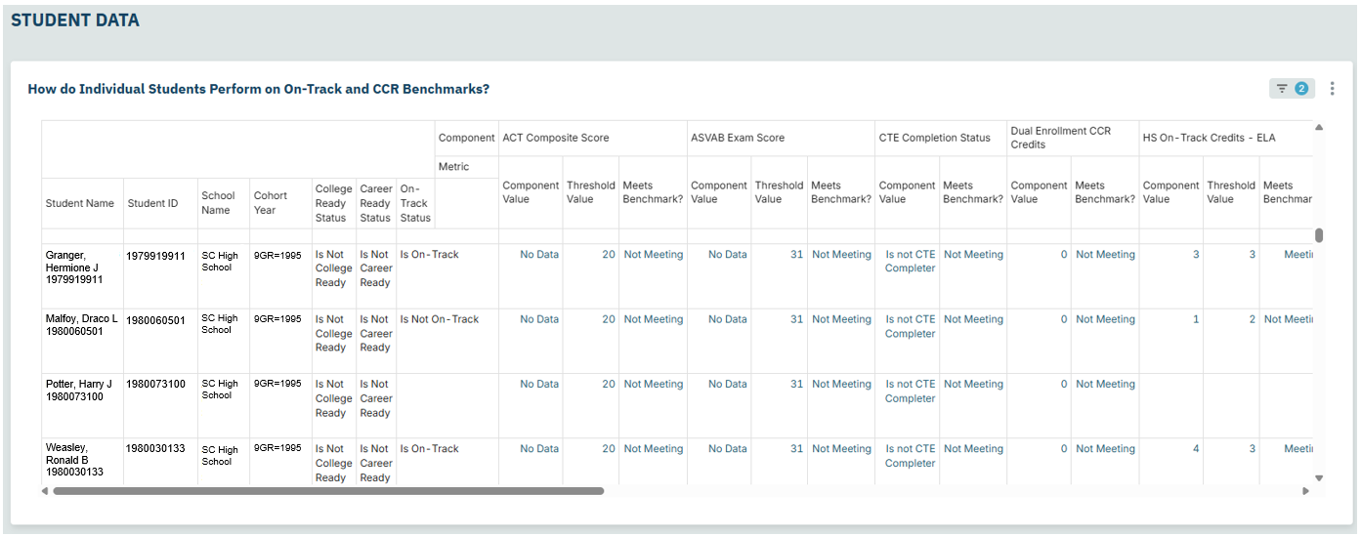
Verifying Data: By Student
Notes:
Header font 50pt
Content/body text font 28pt

Slide 53
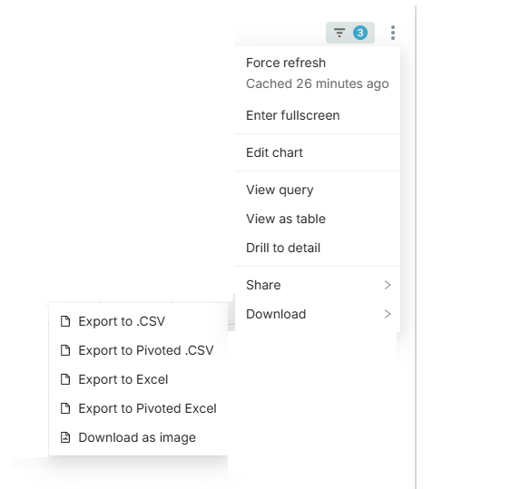
Verifying Data: Export
Interested in exporting the data in that table?
  Click the three dots.
  Select “Download.”
  There are a variety of options.
  You should choose the one that works best for you and your data systems.
Notes:
Header font 50pt
Content/body text font 28pt

Slide 54
Verifying Data: Export Options
Download Option | Headers | Rows per Student
Export to .CSV | Component, Student Name, Student ID, School Name, Cohort Year, College Ready Status, Career Ready Status, On-Track Status, Component Value, Threshold Value, Meets Benchmark? | Multiple per student
Export to Pivoted .CSV | 43 columns – Score/Value, Threshold Value, Meets Benchmark | One row per student
Export to Excel | Component, Student Name, Student ID, School Name, Cohort Year, College Ready Status, Career Ready Status, On-Track Status, Component Value, Threshold Value, Meets Benchmark? | Multiple per student
Export to Pivoted Excel – Most closely resembles the Admin Navigator Dashboard | 46 columns – Score/Value, Threshold Value, Meets Benchmark | One row per student
Notes:
Header font 50pt
Content/body text font 28pt

Slide 55
Verifying Data: Issues
One possible issue is caused by differences in the way that districts define how a specific dual enrollment course counts toward high school graduation.
We are working to determine the best way to accurately represent that data for on-track purposes given that challenge.
This issue exists for both the school report card itself and the Admin Navigator tables.
Any coding requirements will be communicated by the Office of Information Technology by Friday, February 27.
Notes:
Header font 50pt
Content/body text font 28pt

Slide 56
Verifying Data: Who’s Included
That dashboard only looks at who is included in the cohort and whether or not the student is on-track (Years 1-3).
What if we want to understand our Graduation Rate or 5th Year Student Success Rate data?
Notes:
Header font 50pt
Content/body text font 28pt

Slide 57
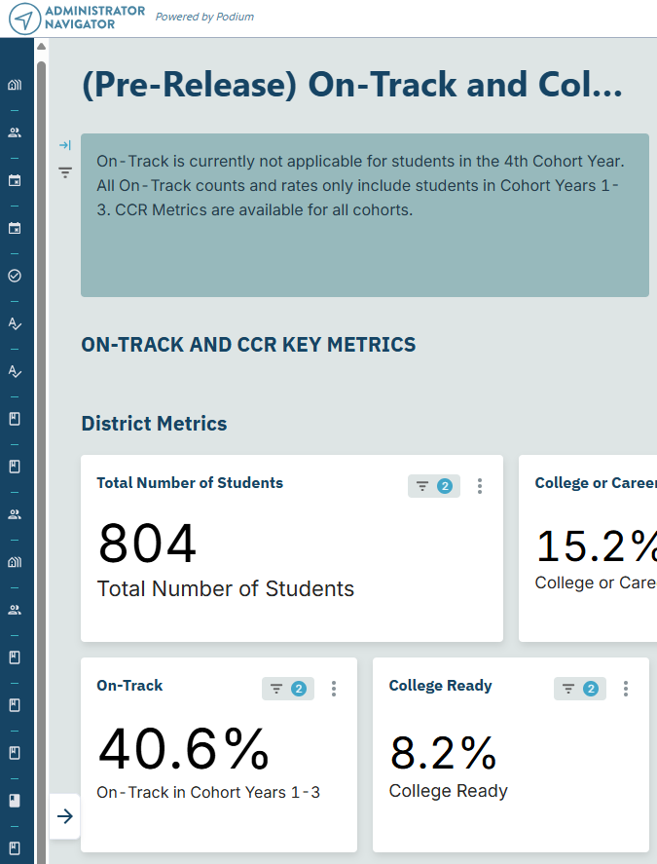
Verifying Data: Metrics
In Admin Navigator, go to the Metrics Dashboard.
If you minimized the filter panes, we will need to bring those back onto the screen.
Notes:
Header font 50pt
Content/body text font 28pt

Slide 58
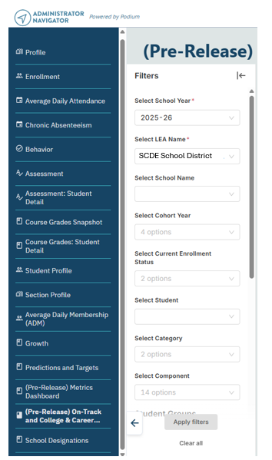
Verifying Data: Metrics Filters
In Admin Navigator, go to the Metrics Dashboard.
If you minimized the filter panes, we will need to bring those back onto the screen.
Notes:
Header font 50pt
Content/body text font 28pt

Slide 59
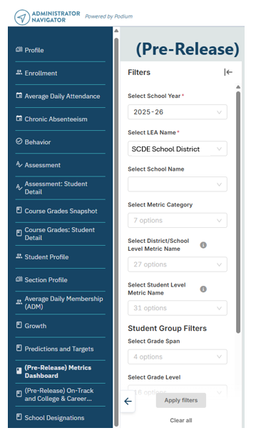
Verifying Data: Metrics Dashboard
In Admin Navigator, go to the Metrics Dashboard.
Notes:
Header font 50pt
Content/body text font 28pt

Slide 60
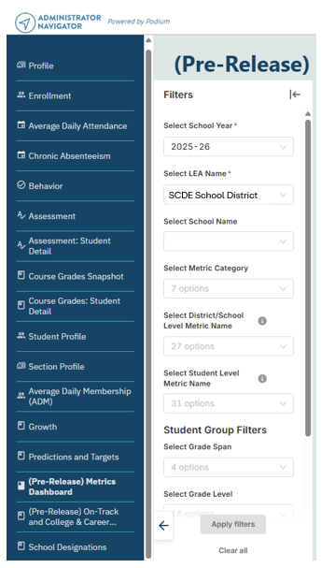
Verifying Data: Apply Filters
In Admin Navigator, go to the Metrics Dashboard.
  Select School Year – 2025-26
  Select LEA Name – Your district
  Select School Name – If needed
  Select Metric Category – Graduation Rate, High School Student Success
  Apply filters
Notes:
Header font 50pt
Content/body text font 28pt

Slide 61
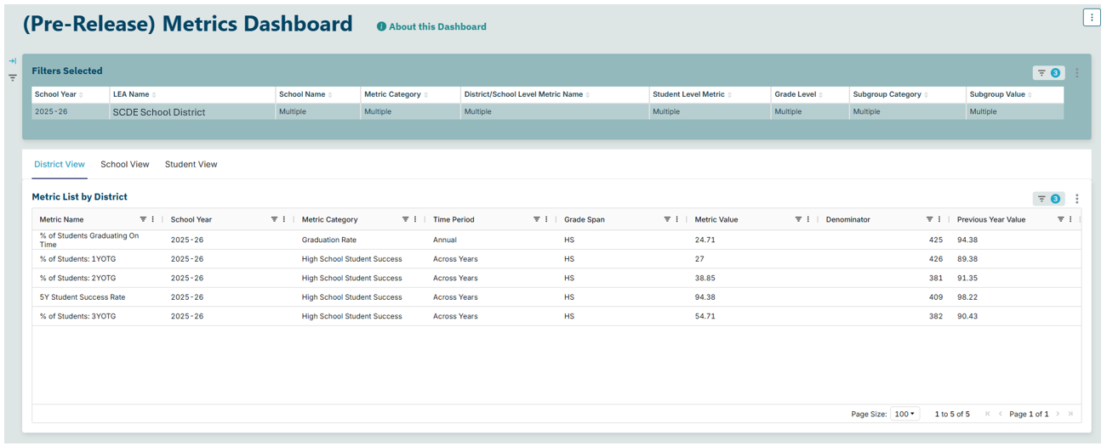
Verifying Data: Views
Notes:
Header font 50pt
Content/body text font 28pt

Slide 62
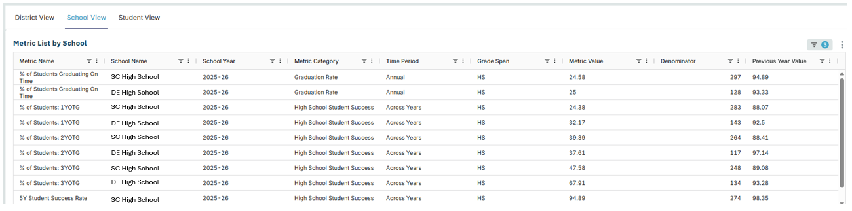
Verifying Data: Filter Options
Notes:
Header font 50pt
Content/body text font 28pt

Slide 63
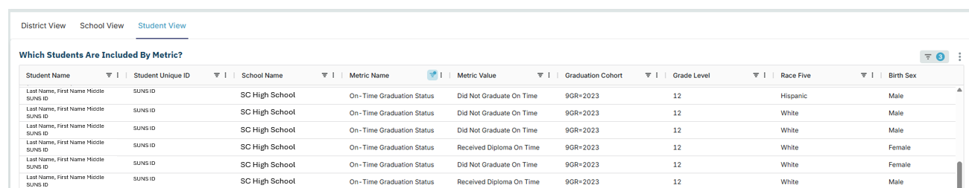
Verifying Data: Student List
Notes:
Header font 50pt
Content/body text font 28pt

Slide 64
Verifying Data: Publishing
These reports update nightly as your data updates, but note that depending on when publishing completes. There could be a 1- to 2-day lag between the coding of the data and it showing up in the reports. To minimize the possibility of lag, aim to schedule publishing such that it is completed by 7:00 p.m.
SCDE is running parallel tests to ensure EA and SCDE business rules are aligned.
Data remains dynamic until you begin PowerSchool rollover or June 15 (whichever happens first).
Notes:
Header font 50pt
Content/body text font 28pt

Slide 65
Verifying Data: Basefiles
Previously, SCDE provided cohort and basefiles via ADT to communicate which students districts should expect to be included in the four-year graduation cohorts.
For 2025-26, SCDE is using Admin Navigator to communicate this information.
Notes:
Header font 50pt
Content/body text font 28pt

Slide 66
Verifying Data: Functionality
In past years, you could see the students who were included in the cohort as well as the students who were no longer included in your cohort.
In the current version of our dashboard, you can only see the students who are included in your cohort.
We are aware of requests to bring back the prior functionality, but that is not available at this time.
Notes:
Header font 50pt
Content/body text font 28pt

Slide 67
Resolving Potential Issues
Notes:
Agenda is 88 pt
Line item is 66 pt

Slide 68
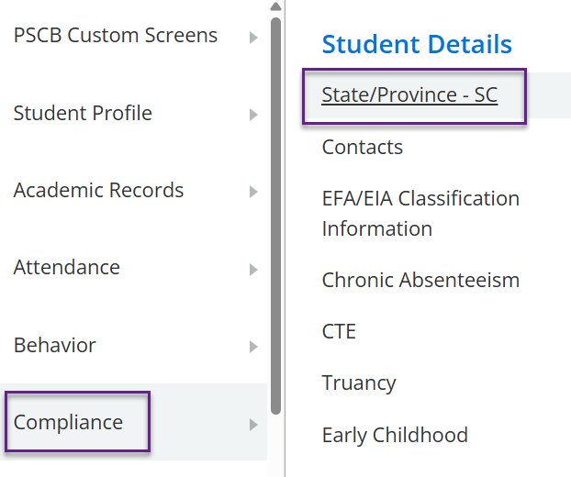
Resolving Potential Issues: PowerSchool
Work with a district PowerSchool administrator to
check to make sure the data have been correctly coded for each field/data point for the students in question.
check to make sure the correct data for the students has published to Ed-Fi (see the slide on spot checking).
If the students don't seem to be publishing, ensure that they are included in Ed-Fi publishing.
Notes:
Header font 50pt
Content/body text font 28pt

Slide 69
Resolving Potential Issues: Who to Contact
Who to contact when all that fails?
Publishing issues: PowerSchool Support case
https://help.powerschool.com/t5/Case-Portal/ct-p/Support-CasePortal
Questions about Administrator Navigator: submit a ticket to Education Analytics
https://edanalytics.atlassian.net/helpcenter/products-and-services/user/login
SCDE Data Management Team
PowerSchool@ed.sc.gov
Notes:
Header font 50pt
Content/body text font 28pt

Slide 70
Resolving Potential Issues: Validations
Level Data validations (see our team's "Validation Prioritization" resource!):
  Within your Level Data Validations, go to "Informational Lists" and find the rule called "Excluded from Ed-Fi Publishing." This provides a list of active students with ‘Exclude this student from Ed-Fi Publishing’ set to Yes.
Satchel
  https://sc-satchel.commongoodlt.com/
Notes:
Header font 50pt
Content/body text font 28pt

Slide 71
Planning Time
Notes:
Agenda is 88 pt
Line item is 66 pt

Slide 72
Planning Time Purpose
We have covered a lot of information today:
  Basic definitions
  What to code, when, and where
  How to check your data
  How to resolve potential errors
This means you have a lot of information to act on and communicate.
Notes:
Header font 50pt
Content/body text font 28pt

Slide 73
Planning Time: Questions
Questions | Priority 1 | Priority 2 | Priority 3
What needs to be communicated?
Who is the audience?
How does it need to be communicated?
When does it need to be communicated?
How do you plan to follow up to ensure implementation is occurring?
Notes:
Header font 50pt
Content/body text font 28pt

Slide 74
Next Steps
In the coming months, we will have more professional development on related topics.
We plan to distribute event links about one week prior to the sessions.
  Topic 3: College and Career Readiness
    Dates: March 18 (1 PM) and March 19 (9 AM)
  Topic 4: Students not Tested
    Dates: April 22 (1 PM) and April 23 (9 AM)
  Topic 5: TBD
    Dates: May 20 (1 PM) and May 21 (9 AM)
  Topic 6: General assistance
    Date: Before June 15
Notes:
Header font 50pt
Content/body text font 28pt

Slide 75
Key Documents
Accountability Manuals
SIS Data Entry Manual
Data flow diagram – see slide deck
9th Grade Code Flowchart
Level Data validations
Cohort Maintenance Information and Resources web page
  Cohort Progression Maintenance Manual
  SCDE Memo (July 25, 2023) - Student Enrollment, Age-Appropriate Placement, Ninth Grade Cohort, and International Transcript Guidance
Mapping document – updates in progress (will be posted, and link will be shared)
Accountability-oriented mapping doc – in progress (will be posted, and link will be shared)
Notes:
Header font 50pt
Content/body text font 28pt

Slide 76
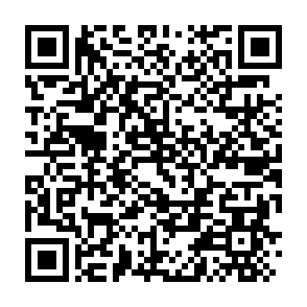
Session Evaluation
Please complete an evaluation of the session using the QR Code.
Notes:
Header font 50pt
Content/body text font 28pt

Slide 77
Key Takeaways
The Graduation Rate and High School Student Success Indicators use cohort data to establish which students are included in the metric.
The two indicators count for 31% to 36% of a high school’s overall rating.
Districts and schools should use Admin Navigator to check school and student-level data related to the Graduation Rate and High School Student Success Indicators.
As potential errors are identified, districts should lead schools through the processes outlined today to ensure accurate data is reported to SCDE for the 2026 school report cards.

Slide 78

Vann Holden
Era Roberts
Wendy Stephens
cvholden@ed.sc.gov
Chief Research Officer
earoberts@ed.sc.gov
Accountability Program Manager
wstephens@ed.sc.gov
Team Lead, Data Management
Notes:
Insert your picture within the yellow circle (replace the SCDE logo inside circle)
Speaker/person photo should be in a circle frame
Should have a yellow outline
Should be 6 x 6 inches
Firstname/Lastname is font 80pt
Title, Copmany is 36pt (italic)

Slide 79
ed.sc.gov
Notes:
Slide title is hidden from display

